Slide 1
Extending ArcGIS using programming
David Tarboton

Slide 2
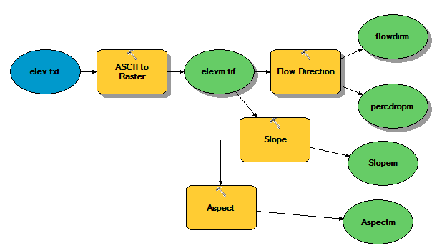
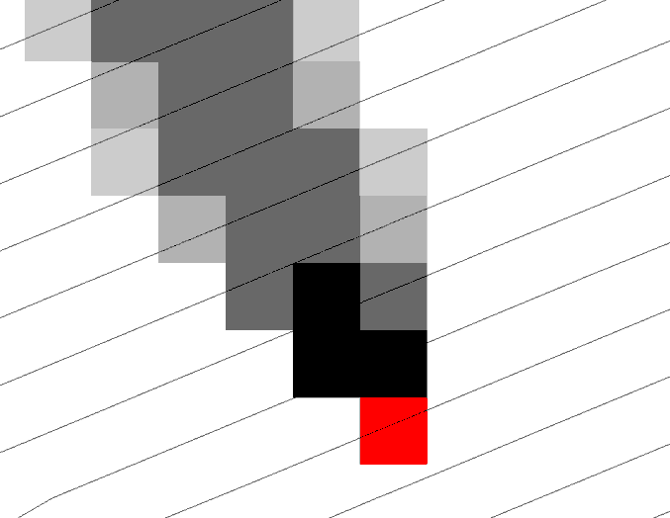
Why Programming
Automation of repetitive tasks (workflows)
Implementation of functionality not available (programming new behavior)

Slide 3
ArcGIS programming entry points
Model builder
Python scripting environment
ArcObjects library (for system language like C++, .Net)
Open standard data formats that anyone can use in programs (e.g. shapefiles, geoTIFF, netCDF)

Slide 4
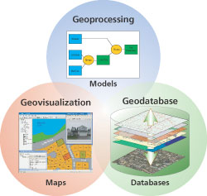
Three Views of GIS
Geodatabase view: Structured data sets that represent geographic information in terms of a generic GIS data model.
Geovisualization view: A GIS is a set of intelligent maps and other views that shows features and feature relationships on the earth's surface. "Windows into the database" to support queries, analysis, and editing of the information.
Geoprocessing view: Information transformation tools that derive new geographic data sets from existing data sets.
adapted from www.esri.com

Slide 5
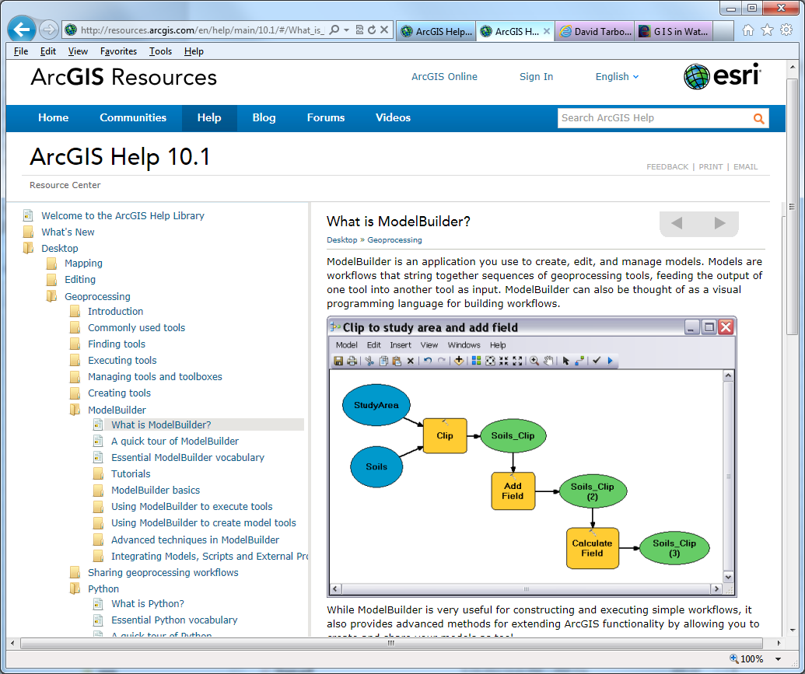
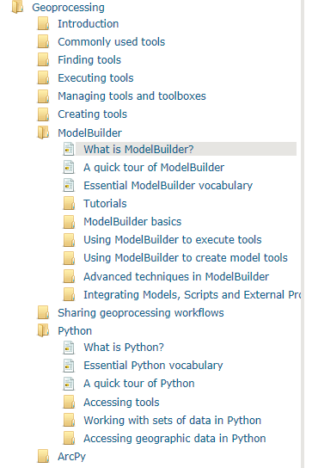
http://resources.arcgis.com/en/help/main/10.1/002w/002w00000001000000.htm

Slide 6
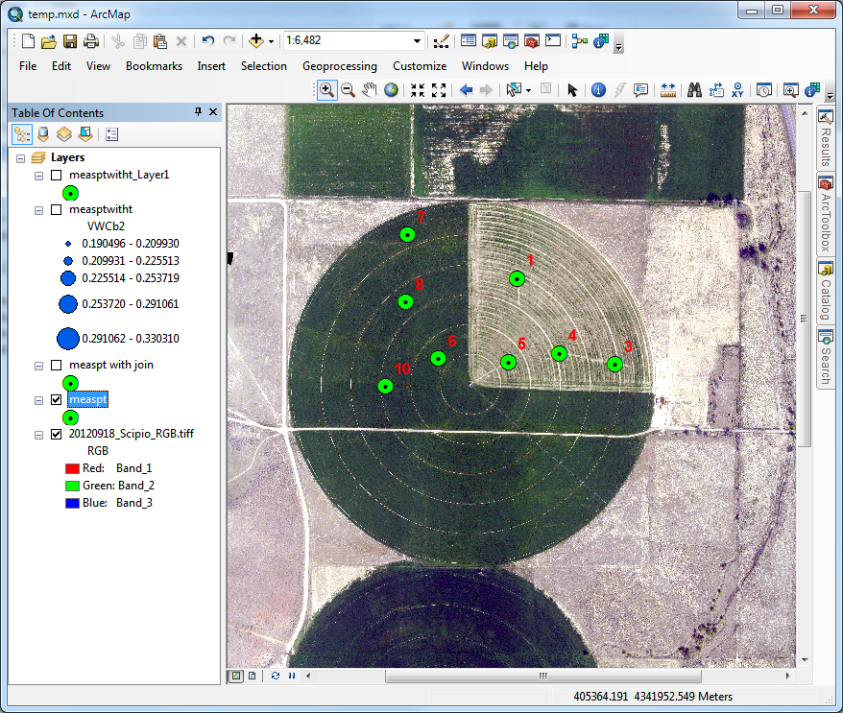
An example – time series interpolation
Soil moisture at 8 sites in field
Hourly for a month
~ 720 time steps
What is the spatial pattern over time
Data from Manal Elarab

Slide 7
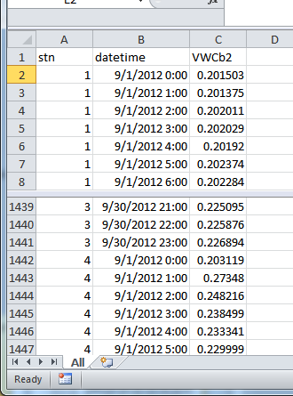
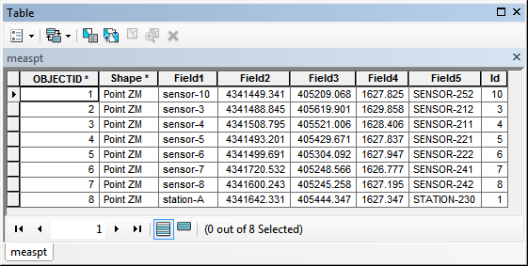
How to use in ArcGIS
Time series in Excel imported to Object class in ArcGIS
Joined to Feature Class (one to many)

Slide 8
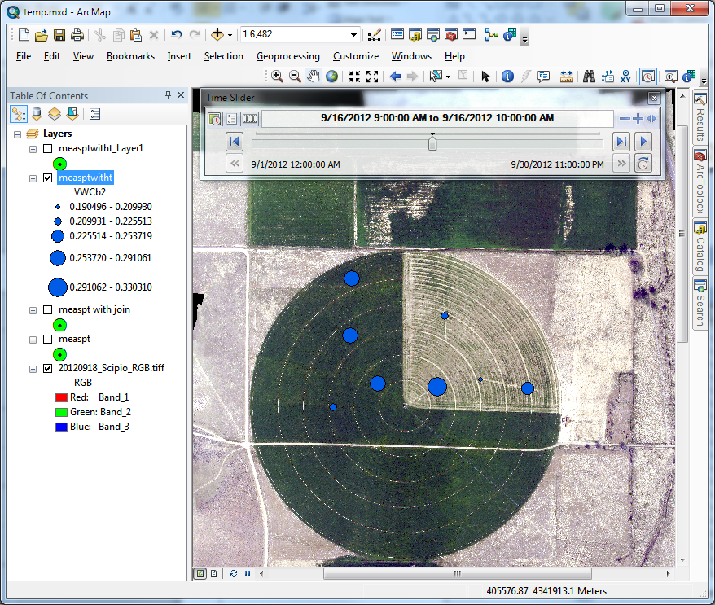
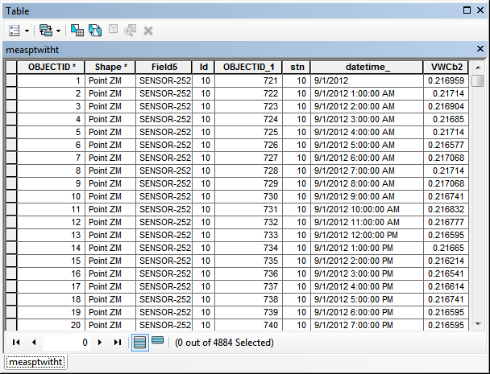
Time enabled layer with 4884 records that can be visualized using time slider

Slide 9
But what if you want spatial fields
Interpolate using spline or inverse distance weight at each time step
Analyze resulting rasters
30 days – 720 hours ???
A job for programming

Slide 10
The program workflow
Set up inputs
Get time extents from the time layer
Create a raster catalog (container for raster layers)
For each time step
  Query and create layer with data only for that time step
  Create raster using inverse distance weight
  Add raster to raster catalog
Add date time field and populate with time values

Slide 11
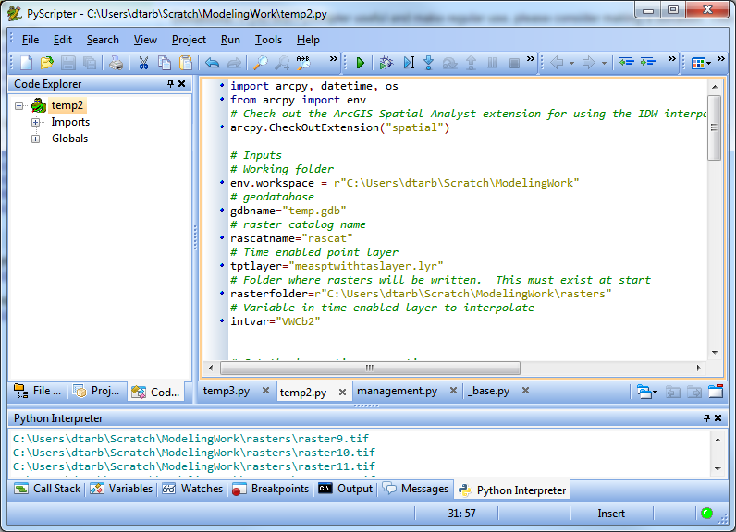
I used PyScripter
(as suggested by an ESRI programmer http://blogs.esri.com/esri/arcgis/2011/06/17/pyscripter-free-python-ide/)
http://code.google.com/p/pyscripter/

Slide 12
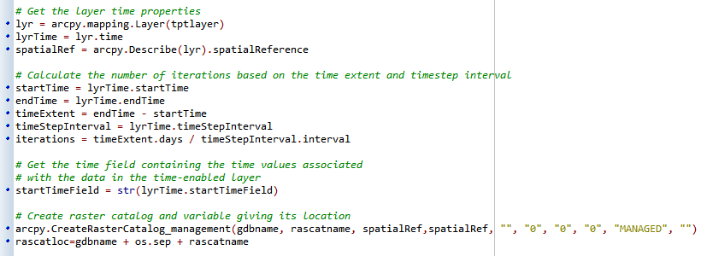
This shows the reading of time parameters and creation of raster catalog

Slide 13
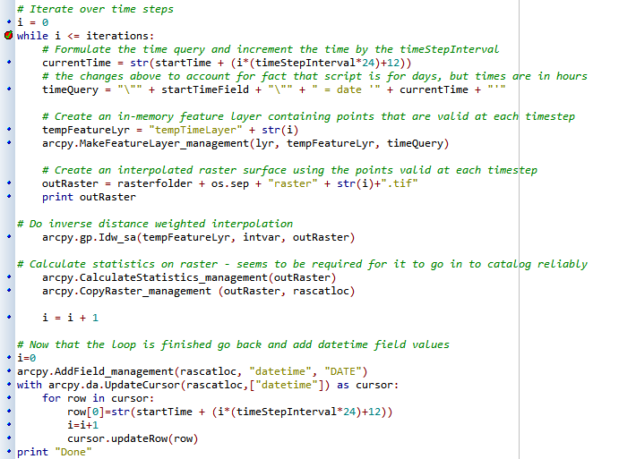
This shows the iterative part

Slide 14
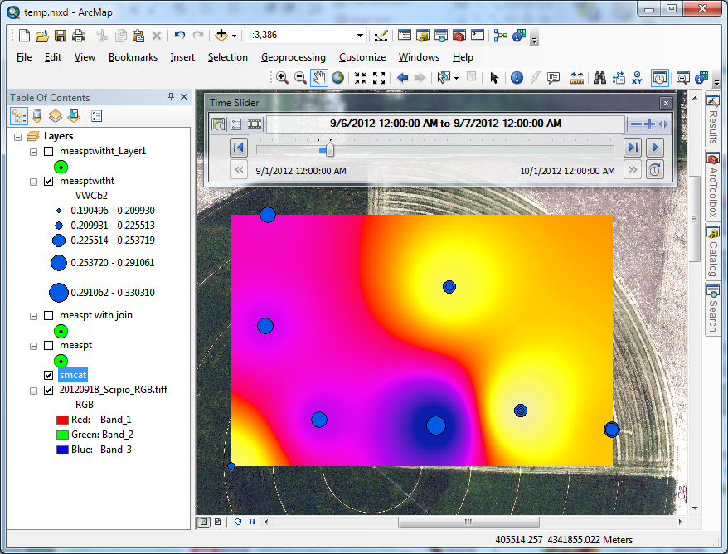
The result

Slide 15


Terrain Analysis Using Digital Elevation Models (TauDEM)
David Tarboton¹, Dan Watson², Rob Wallace³
¹Utah Water Research Laboratory, Utah State University, Logan, Utah
²Computer Science, Utah State University, Logan, Utah
³US Army Engineer Research and Development Center, Information Technology Lab, Vicksburg, Mississippi
http://hydrology.usu.edu/taudem dtarb@usu.edu
This research was funded by the US Army Research and Development Center under contracts number W9124Z-08-P-0420 and W912HZ-09-P-0338

Slide 16
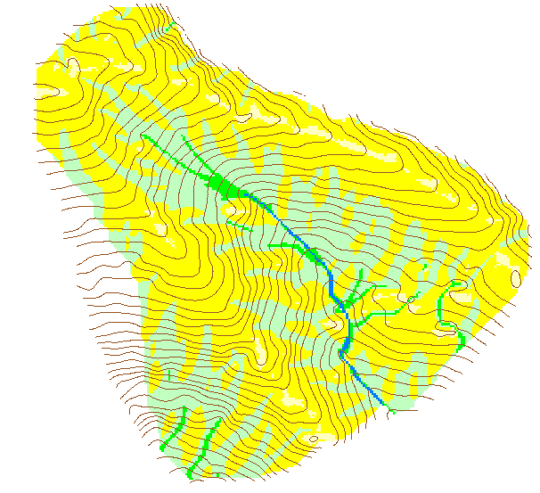
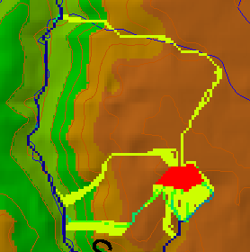
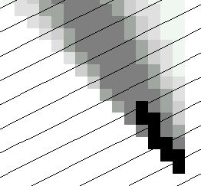
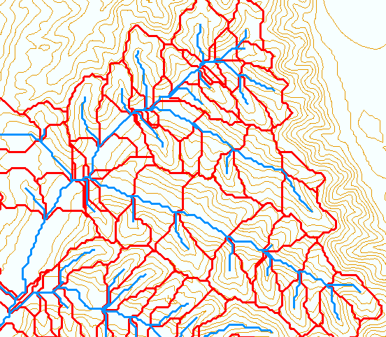
TauDEM - Channel Network and Watershed Delineation Software
Pit removal (standard flooding approach)
Flow directions and slope
  D8 (standard)
  D∞ (Tarboton, 1997, WRR 33(2):309)
  Flat routing (Garbrecht and Martz, 1997, JOH 193:204)
Drainage area (D8 and D∞)
Network and watershed delineation
  Support area threshold/channel maintenance coefficient (Standard)
  Combined area-slope threshold (Montgomery and Dietrich, 1992, Science, 255:826)
  Local curvature based (using Peuker and Douglas, 1975, Comput. Graphics Image Proc. 4:375)
Threshold/drainage density selection by stream drop analysis (Tarboton et al., 1991, Hyd. Proc. 5(1):81)
Other Functions: Downslope Influence, Upslope Dependence, Wetness index, distance to streams, Transport limited accumulation
Developed as C++ command line executable functions
MPICH2 used for parallelization (single program multiple data)
Relies on other software for visualization (ArcGIS Toolbox GUI)

Slide 17
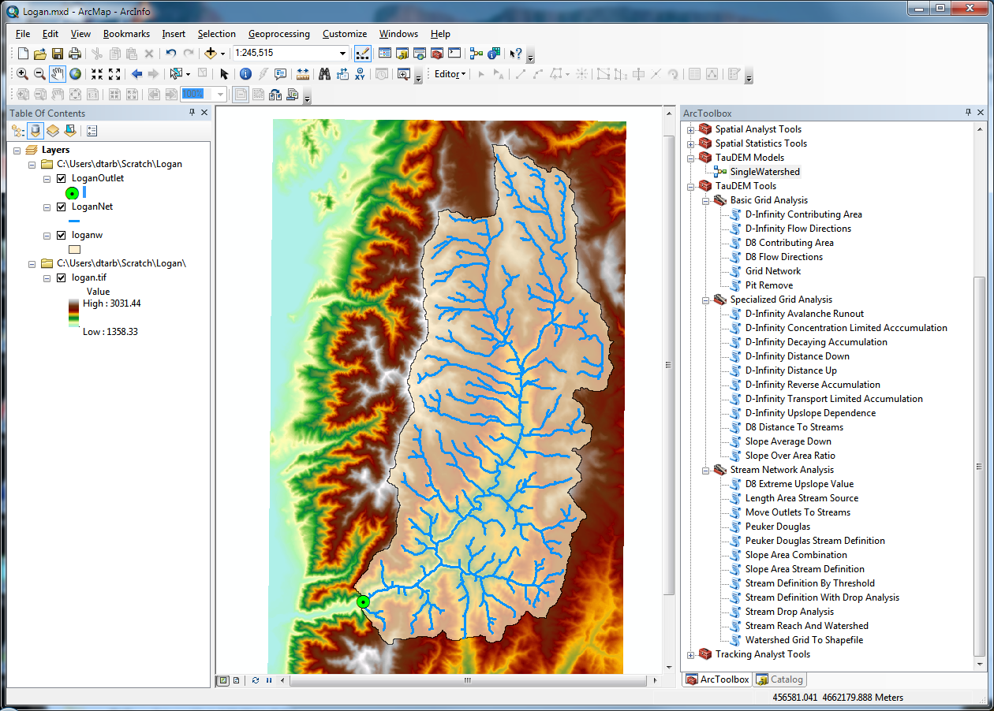
Website and Demo
http://hydrology.usu.edu/taudem

Slide 18
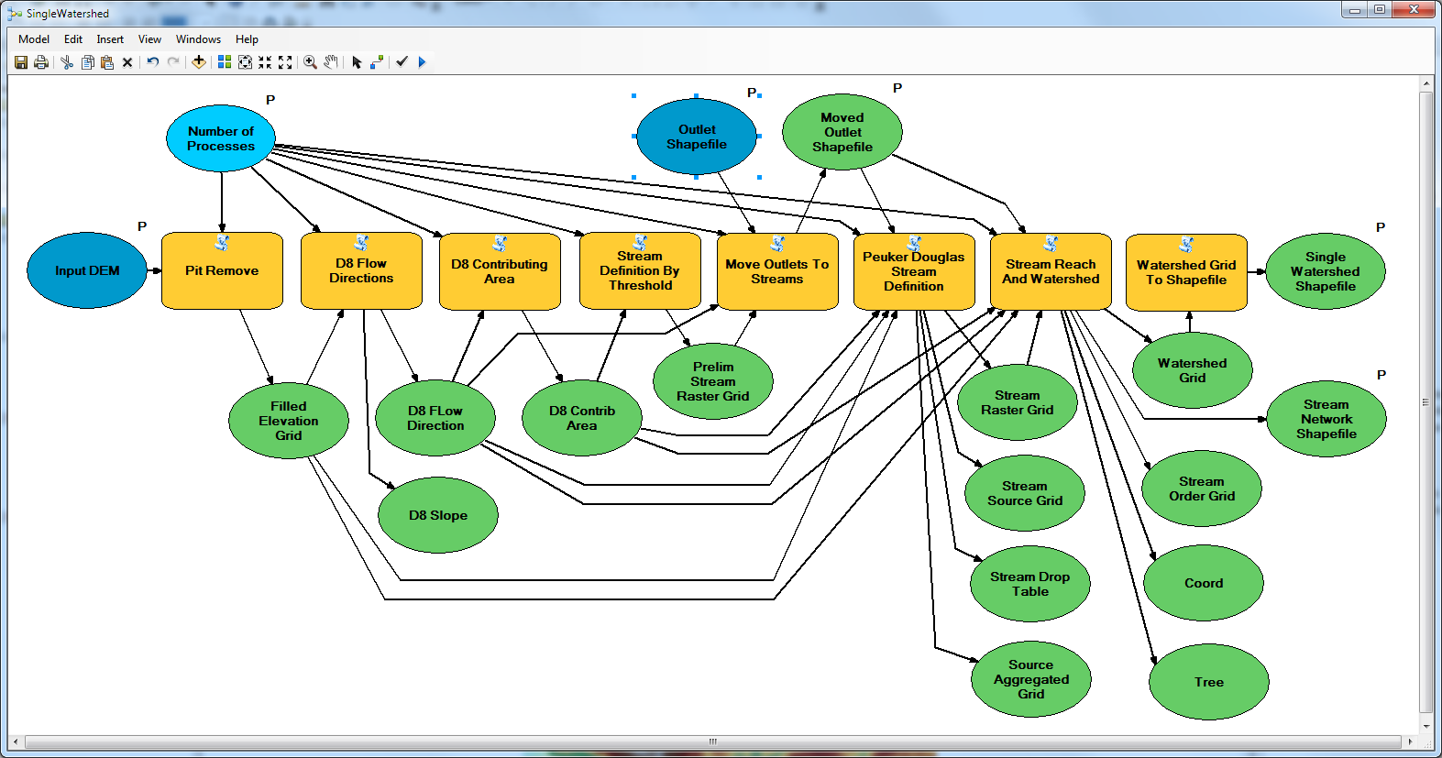
Model Builder Model to Delineate Watershed using TauDEM tools

Slide 19
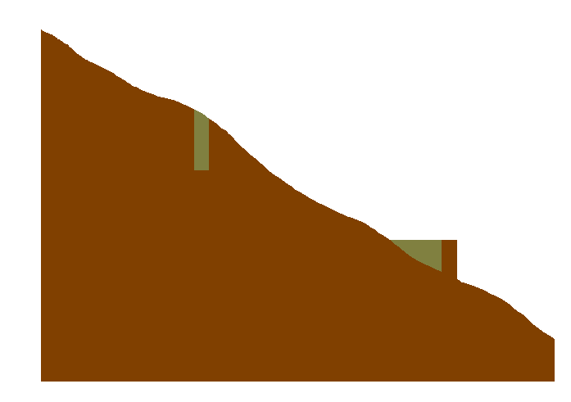
Pit Filling
Original DEM
Pits Filled
Notes:
Elevations are filled to that of the pools pour point

Slide 20
Some Algorithm Details
Pit Removal: Planchon Fill Algorithm
Initialization
1st Pass
2nd Pass
Planchon, O., and F. Darboux (2001), A fast, simple and versatile algorithm to fill the depressions of digital elevation models, Catena(46), 159-176.

Slide 21
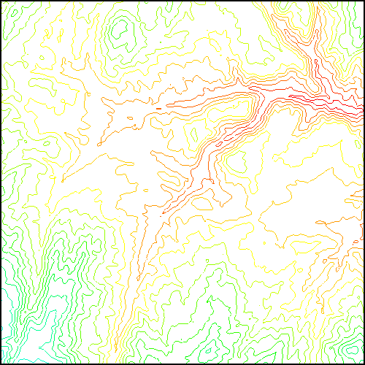
Parallel Approach
MPI, distributed memory paradigm
Row oriented slices
Each process includes one buffer row on either side
Each process does not change buffer row

Slide 22
Parallel Scheme
Communicate
Initialize( Z,F) Do for all grid cells i if Z(i) > n F(i) ← Z(i) Else F(i) ← n i on stack for next pass endfor Send( topRow, rank-1 ) Send( bottomRow, rank+1 ) Recv( rowBelow, rank+1 ) Recv( rowAbove, rank-1 ) Until F is not modified
Z denotes the original elevation.
F denotes the pit filled elevation.
n denotes lowest neighboring elevation
i denotes the cell being evaluated
Iterate only over stack of changeable cells

Slide 23
Contributing Area (Flow Accumulation)
1
1
1
1
1
1
1
1
1
1
1
3
3
3
1
1
3
3
3
1
1
1
11
1
2
1
1
1
2
11
2
1
1
15
1
2
1
1
1
15
1
5
2
20
2
1
5
2
2
20
The area draining each grid cell includes the grid cell itself.

Slide 24
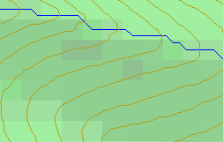
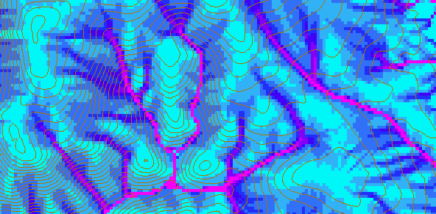
D-Infinity Contributing Area
D8
D∞
Tarboton, D. G., (1997), "A New Method for the Determination of Flow Directions and Contributing Areas in Grid Digital Elevation Models," Water Resources Research, 33(2): 309-319.)
Notes:
This slide shows how the terrain flow field is represented. Early DEM work used a single flow direction model, D8. In 1997 I published the Dinfinity method that proportions flow from each grid cell among downslope neighbors. This, at the expense of some dispersion, allows a better approximation of flow across surfaces.

Slide 25
Pseudocode for Recursive Flow Accumulation
Global P, w, A, Δ FlowAccumulation(i) for all k neighbors of i if P_{ki}>0 FlowAccumulation(k) next k return
P_{ki}

Slide 26
General Pseudocode Upstream Flow Algebra Evaluation
Global P, γ, θ FlowAlgebra(i) for all k neighbors of i if P_{ki}>0 FlowAlgebra(k) next k θ_{i} = FA(γ_{i}, P_{ki}, θ_{k}, γ_{k}) return
P_{ki}

Slide 27
Example: Retention limited runoff generation with run-on
Global P, (r,c), q FlowAlgebra(i) for all k neighbors of i if P_{ki}>0 FlowAlgebra(k) next k return
q_{k}
r
q_{i}
c

Slide 28
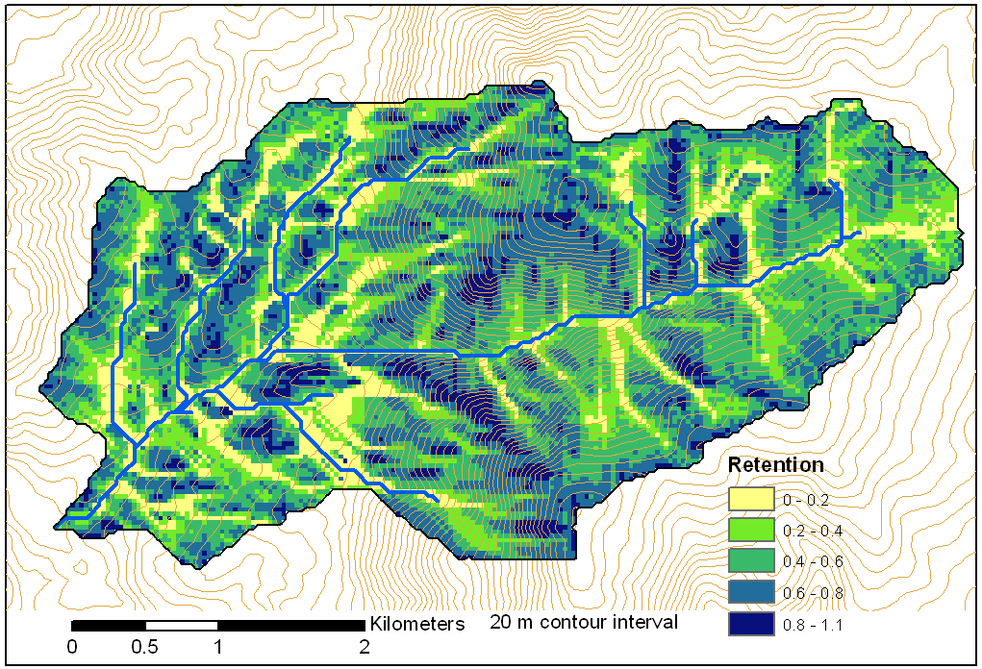
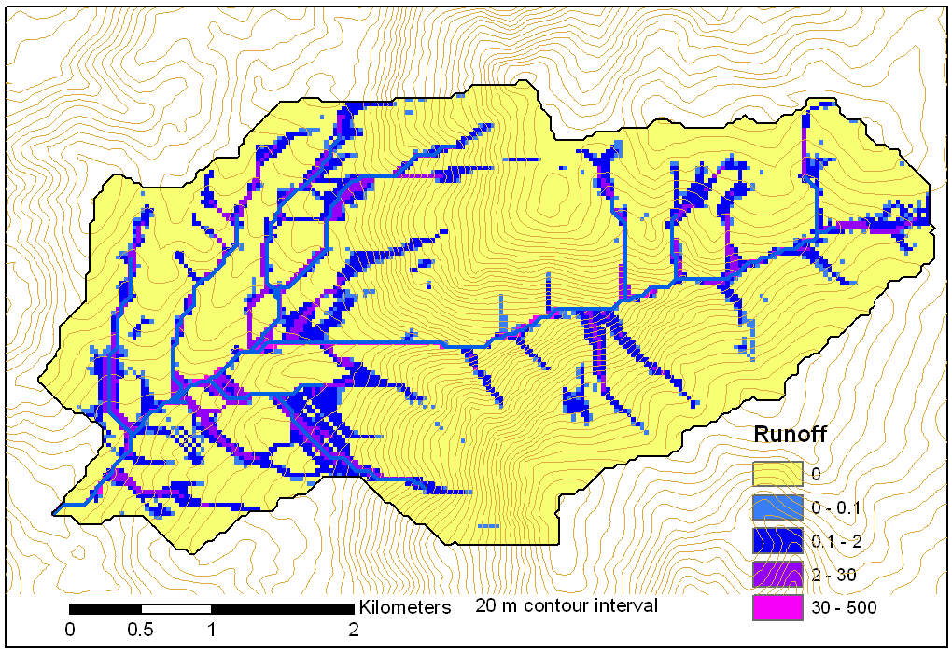
Retention limited runoff with run-on
Retention Capacity
A
C
r=5
c=6
q_{in}=1.8
q=0.8
r=7
c=4
q=3
0.6
1
Runoff from uniform input of 0.25
r=4
c=6
q=0
0.4
r=4
c=5
q_{in}=2
q=1
1
B
D
Notes:
Figure 2 illustrates the evaluation of infiltration capacity limited runoff generation with run on according to (5). Inputs are the r and c values indicated, with the proportional flow directions indicated by the arrows. Grid cells A and B on the left have no dependencies so may be immediately evaluated and using min(r-c,0) result in q=3 and 0 for grid cells A and B respectively. With these evaluated, the unevaluated dependencies of grid cell C become 0, so equation (5) can be evaluated for grid cell C. The inflow is q_{in}=0.6 x 3 = 1.8 from grid cell B. Then q=min(5-6+1.8,0)=0.8. Now all dependencies of D have been evaluated. Inflows from cells A, B, and C, accounting for the proportions are 3 x 0.4 + 0.8 = 2, so the runoff from D is q=min(4-5+2,0)=2.

Slide 29
Parallelization of Contributing Area/Flow Algebra
1. Dependency grid
and so on until completion
resulting in new D=0 cells on queue
Queue’s empty so exchange border info.
Decrease cross partition dependency
Executed by every process with grid flow field P, grid dependencies D initialized to 0 and an empty queue Q. FindDependencies(P,Q,D) for all i for all k neighbors of i if P_{ki}>0 D(i)=D(i)+1 if D(i)=0 add i to Q next
A=1
A=1
A=1
A=1
A=1
A=1
A=1
A=1
D=0
A=1
A=1
A=1
A=1
D=0
D=0
A=1
A=1
A=1
D=0
D=0
A=1
D=0
A=1
A=1
A=1
A=1
A=1
A=1.5
A=1.5
A=3
D=0
A=1.5
A=1.5
D=1
D=0
D=1
D=0
D=0
A=3
D=0
D=3
D=2
D=1
D=0
D=0
D=1
D=1
A=1.5
D=1
A=1.5
A=3
A=3
A=1.5
A=1.5
2. Flow algebra function
B=-2
B=-1
Executed by every process with D and Q initialized from FindDependencies. FlowAlgebra(P,Q,D,θ,γ) while Q isn’t empty get i from Q θ_{i} = FA(γ_{i}, P_{ki}, θ_{k}, γ_{k}) for each downslope neighbor n of i if P_{in}>0 D(n)=D(n)-1 if D(n)=0 add n to Q next n end while swap process buffers and repeat
B=-2
B=-1
A=1
A=1
D=2
D=2
D=1
A=1
D=1
A=1
D=0
A=1
A=1
D=2
D=2
D=2
D=2
D=2
D=1
D=1
D=1
D=1
A=1
D=1
A=1
A=5.5
D=0
A=2.5
D=0
A=1
A=1
D=1
D=1
D=1
A=1
D=1
A=1
D=0
D=0
A=1
D=1
D=1
D=3
D=2
D=1
D=1
D=1
D=1
D=1
A=1
D=1
A=1
D=1
A=6
A=3.5
D=1

Slide 30
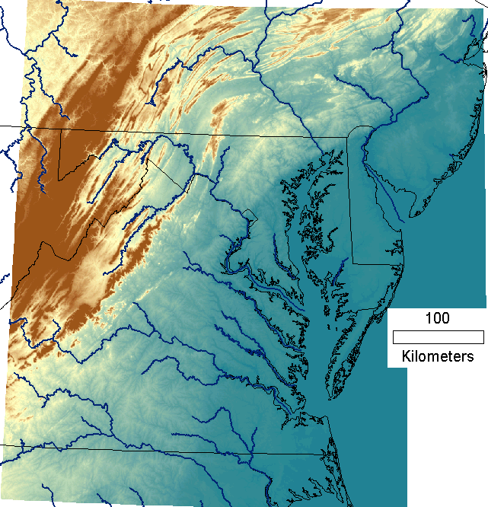
Capabilities Summary
Capability to run larger problems
 |  | Processors used | Grid size
 |  |  | Theoretcal limit | Largest run
2008 | TauDEM 4 | 1 | 0.22 GB | 0.22 GB
Sept 2009 | Partial implement-ation | 8 | 4 GB | 1.6 GB
June 2010 | TauDEM 5 | 8 | 4 GB | 4 GB
Sept 2010 | Multifile on 48 GB RAM PC | 4 | Hardware limits | 6 GB
Sept 2010 | Multifile on cluster with 128 GB RAM | 128 | Hardware limits | 11 GB
11 GB
6 GB
4 GB
1.6 GB
0.22 GB
Single file size limit 4GB
At 10 m grid cell size

Slide 31
Improved runtime efficiency
Parallel Pit Remove timing for NEDB test dataset (14849 x 27174 cells ≈ 1.6 GB).
8 processor PC
Dual quad-core Xeon E5405 2.0GHz PC with 16GB RAM
128 processor cluster
16 diskless Dell SC1435 compute nodes, each with 2.0GHz dual quad-core AMD Opteron 2350 processors with 8GB RAM

Slide 32
Improved runtime efficiency
Parallel D-Infinity Contributing Area Timing for Boise River dataset (24856 x 24000 cells ~ 2.4 GB)
8 processor PC
Dual quad-core Xeon E5405 2.0GHz PC with 16GB RAM
128 processor cluster
16 diskless Dell SC1435 compute nodes, each with 2.0GHz dual quad-core AMD Opteron 2350 processors with 8GB RAM

Slide 33
Scaling of run times to large grids
Dataset | Size | Hardware | Number of Processors | PitRemove (run time seconds) |  | D8FlowDir (run time seconds)
 | (GB) |  |  | Compute | Total | Compute | Total
GSL100 | 0.12 | Owl (PC) | 8 | 10 | 12 | 356 | 358
GSL100 | 0.12 | Rex (Cluster) | 8 | 28 | 360 | 1075 | 1323
GSL100 | 0.12 | Rex (Cluster) | 64 | 10 | 256 | 198 | 430
GSL100 | 0.12 | Mac | 8 | 20 | 20 | 803 | 806
YellowStone | 2.14 | Owl (PC) | 8 | 529 | 681 | 4363 | 4571
YellowStone | 2.14 | Rex (Cluster) | 64 | 140 | 3759 | 2855 | 11385
Boise River | 4 | Owl (PC) | 8 | 4818 | 6225 | 10558 | 11599
Boise River | 4 | Virtual (PC) | 4 | 1502 | 2120 | 10658 | 11191
Bear/Jordan/Weber | 6 | Virtual (PC) | 4 | 4780 | 5695 | 36569 | 37098
Chesapeake | 11.3 | Rex (Cluster) | 64 | 702 | 24045
Owl is an 8 core PC (Dual quad-core Xeon E5405 2.0GHz) with 16GB RAM
Rex is a 128 core cluster of 16 diskless Dell SC1435 compute nodes, each with 2.0GHz dual quad-core AMD Opteron 2350 processors with 8GB RAM
Virtual is a virtual PC resourced with 48 GB RAM and 4 Intel Xeon E5450 3 GHz processors
Mac is an 8 core (Dual quad-core Intel Xeon E5620 2.26 GHz) with 16GB RAM

Slide 34
Scaling of run times to large grids
Owl is an 8 core PC (Dual quad-core Xeon E5405 2.0GHz) with 16GB RAM
Rex is a 128 core cluster of 16 diskless Dell SC1435 compute nodes, each with 2.0GHz dual quad-core AMD Opteron 2350 processors with 8GB RAM
Virtual is a virtual PC resourced with 48 GB RAM and 4 Intel Xeon E5450 3 GHz processors

Slide 35
Programming
C++ Command Line Executables that use MPICH2
ArcGIS Python Script Tools
Python validation code to provide file name defaults
Shared as ArcGIS Toolbox

Slide 36
Q based block of code to evaluate any “flow algebra expression”
while(!que.empty())
{
//Takes next node with no contributing neighbors
temp = que.front(); que.pop();
i = temp.x; j = temp.y;
// FLOW ALGEBRA EXPRESSION EVALUATION
if(flowData->isInPartition(i,j)){
float areares=0.; // initialize the result
for(k=1; k<=8; k++) { // For each neighbor
in = i+d1[k]; jn = j+d2[k]; flowData->getData(in,jn, angle);
p = prop(angle, (k+4)%8);
if(p>0.){
if(areadinf->isNodata(in,jn))con=true;
else{
areares=areares+p*areadinf->getData(in,jn,tempFloat);
}
}
}
}
// Local inputs
areares=areares+dx;
if(con && contcheck==1)
areadinf->setToNodata(i,j);
else
areadinf->setData(i,j,areares);
// END FLOW ALGEBRA EXPRESSION EVALUATION
}

Slide 37
Maintaining to do Q and partition sharing
while(!finished) { //Loop within partition
while(!que.empty())
{ .... // FLOW ALGEBRA EXPRESSION EVALUATION
}
// Decrement neighbor dependence of downslope cell
flowData->getData(i, j, angle);
for(k=1; k<=8; k++) {
p = prop(angle, k);
if(p>0.0) {
in = i+d1[k]; jn = j+d2[k];
//Decrement the number of contributing neighbors in neighbor
neighbor->addToData(in,jn,(short)-1);
//Check if neighbor needs to be added to que
if(flowData->isInPartition(in,jn) && neighbor->getData(in, jn, tempShort) == 0 ){
temp.x=in; temp.y=jn;
que.push(temp);
}
}
}
}
//Pass information across partitions
areadinf->share();
neighbor->addBorders();

Slide 38
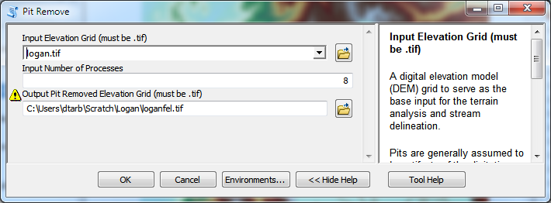
Python Script to Call Command Line
mpiexec –n 8 pitremove –z Logan.tif –fel Loganfel.tif

Slide 39
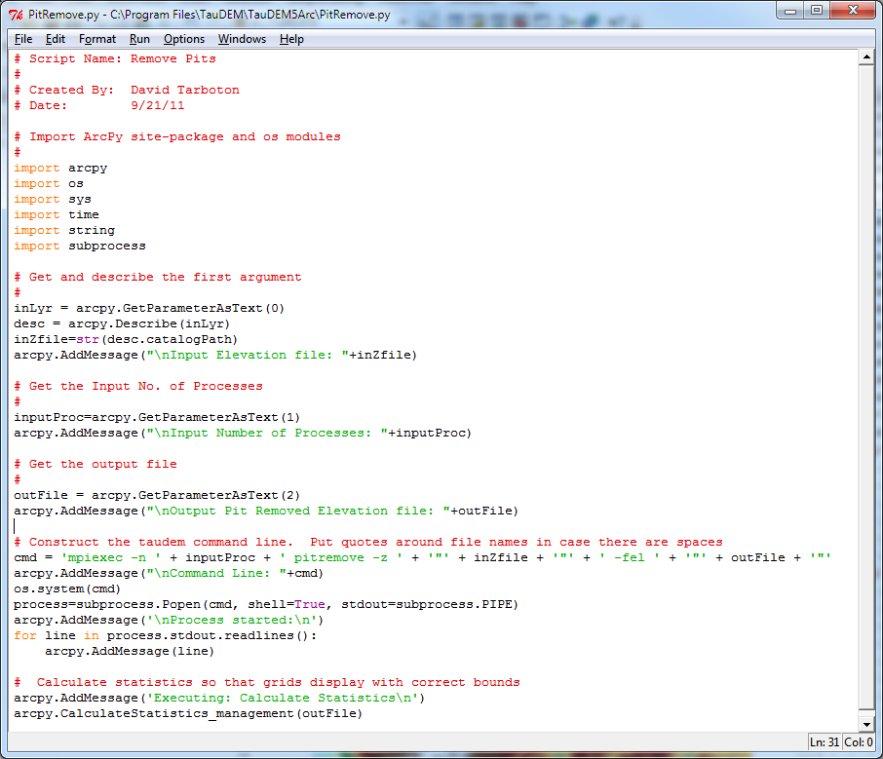
PitRemove

Slide 40
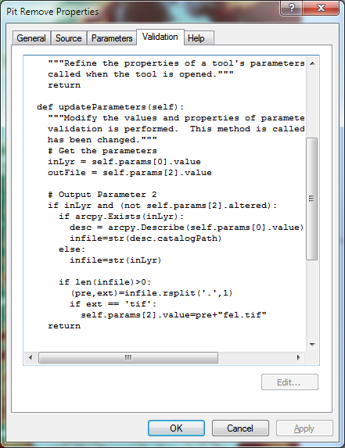
Validation code to add default file names

Slide 41
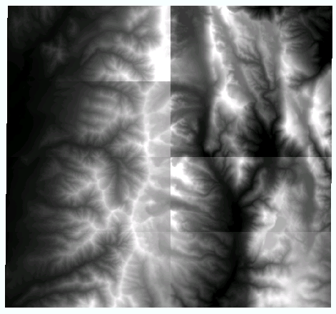
Multi-File approach
To overcome 4 GB file size limit
To avoid bottleneck of parallel reads to network files
What was a file input to TauDEM is now a folder input
All files in the folder tiled together to form large logical grid

Slide 42
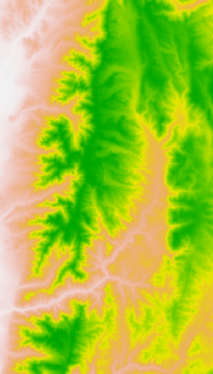
Multi-File Input Model
No data values are returned where there is no file
Number of processes
mpiexec –n 5 pitremove ...
results in the domain being partitioned into 5 horizontal stripes
5
On input files (red rectangles) may be arbitrarily positioned and may overlap or not fill domain completely. All files in the folder are taken to comprise the domain.
Only limit is that no one file is larger than 4 GB.
Maximum GeoTIFF file size 4 GB = about 32000 x 32000 rows and columns

Slide 43
Multi-File Output Model
Option to align output with processor partitions to avoid output files spanning processors so that local disks can be used
3 columns of files per stripe
Number of processes
mpiexec –n 5 pitremove ...
results in the domain being partitioned into 5 horizontal stripes
5
2 rows of files per stripe
Multifile option
-mf 3 2
results in each stripe being output as a tiling of 3 columns and 2 rows of files
Maximum GeoTIFF file size 4 GB = about 32000 x 32000 rows and columns

Slide 44
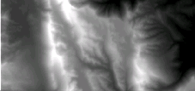
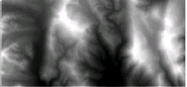
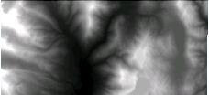
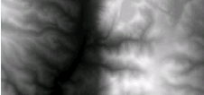
Processor Specific Multi-File Strategy
Input
Output
Shared file store
Node 1 local disk
Node 1 local disk
Shared file store
Core 1
Core 2
Node 2 local disk
Node 2 local disk
Core 1
Scatter all input files to all nodes
Gather partial output from each node to form complete output on shared store
Core 2

Slide 45
Open Topography
A Portal to High-Resolution Topography Data and Tools (http://www.opentopography.org)
TauDEM tools for Open Topography under development
Open Topography provides capability to derive DEM in GeoTIFF format from Lidar Data that can serve as input to Hydrologic Analysis using TauDEM

Slide 46
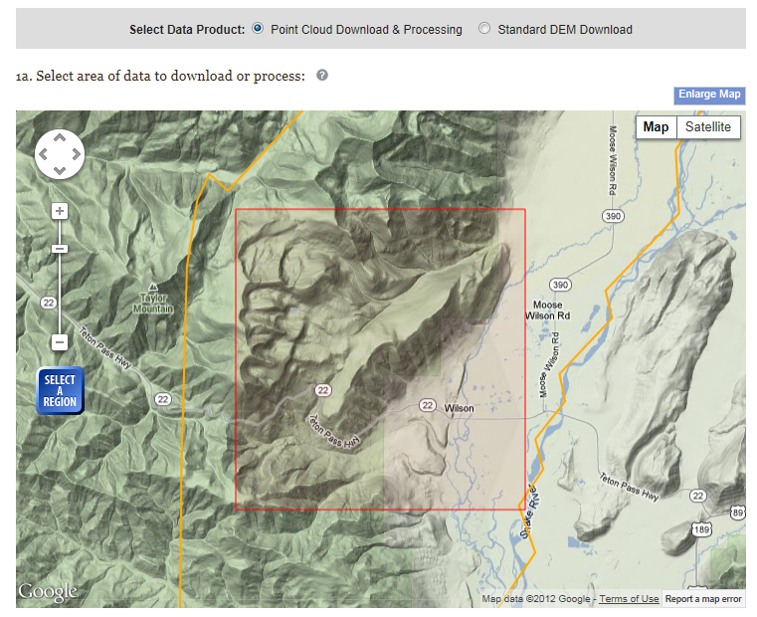
Teton Conservation District, Wyoming LIDAR Example

Slide 47
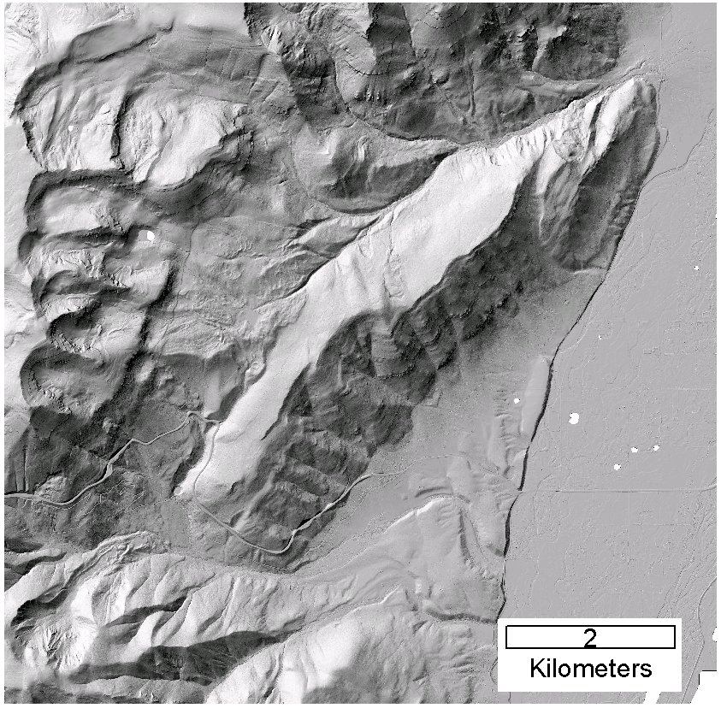
DEM derived from point cloud using TIN DEM Generation and output as GeoTIFF

Slide 48
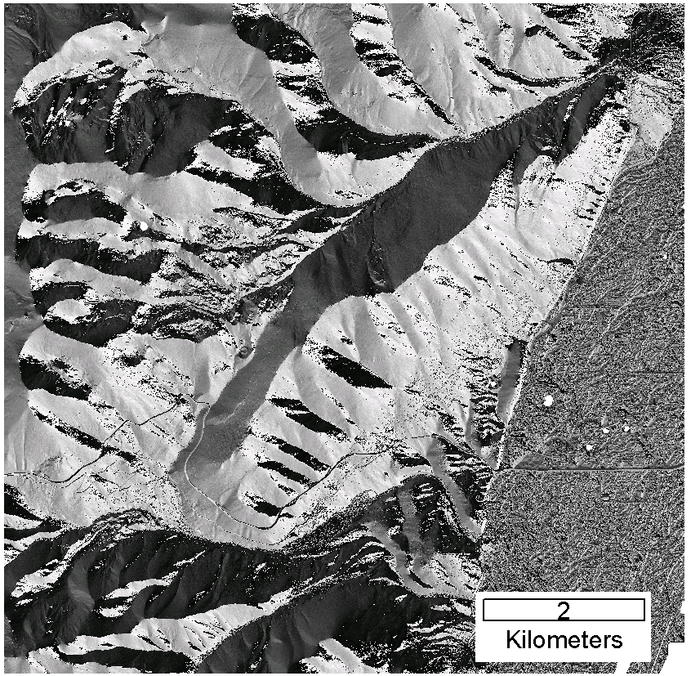

TauDEM Steps
Pit Remove (Fill Pits)
D-Infinity Slope and Flow Direction
D-Infinity Contributing area
Tarboton, D. G., (1997), "A New Method for the Determination of Flow Directions and Contributing Areas in Grid Digital Elevation Models," Water Resources Research, 33(2): 309-319.)
Notes:
After filling pits flow direction and slope are evaluated. This slide shows flow direction encoded as an angle counter clockwise from East in radians

Slide 49
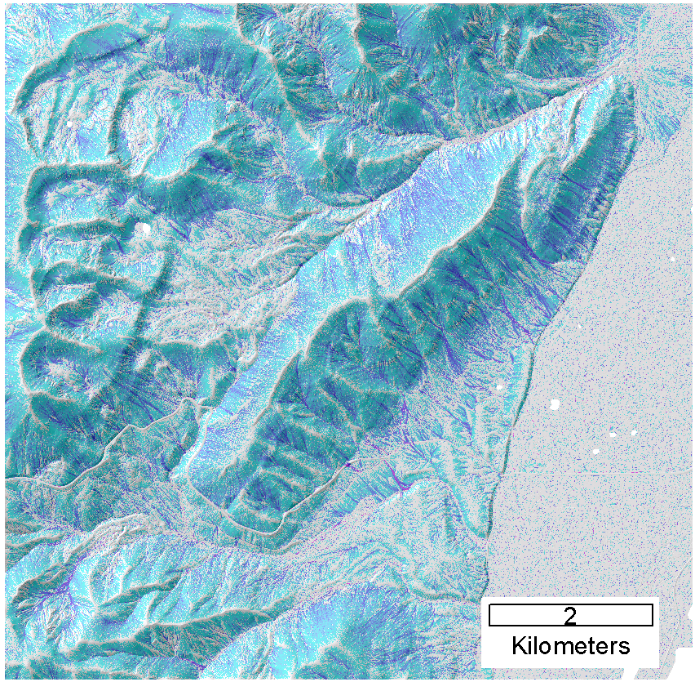
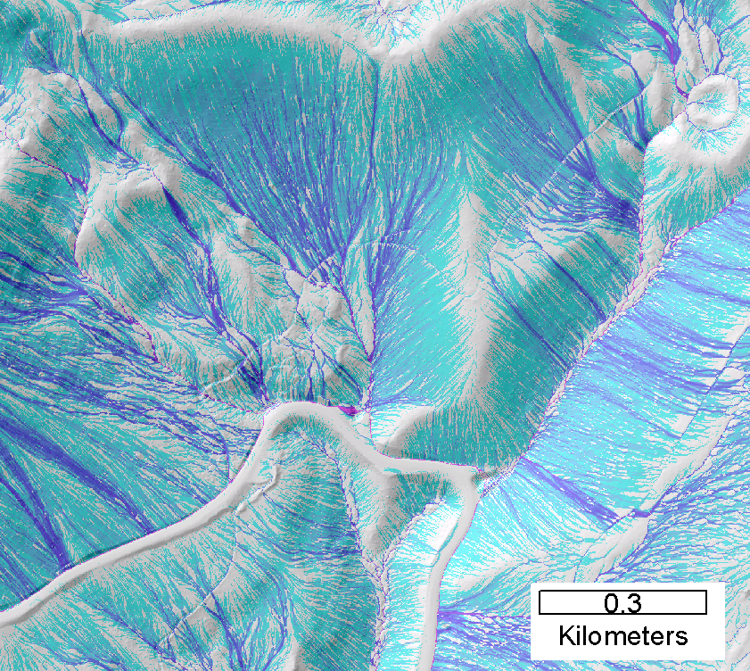
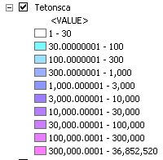
Contributing area from D-Infinity
Notes:
Note the detail in the representation of flow paths at features such as roads

Slide 50
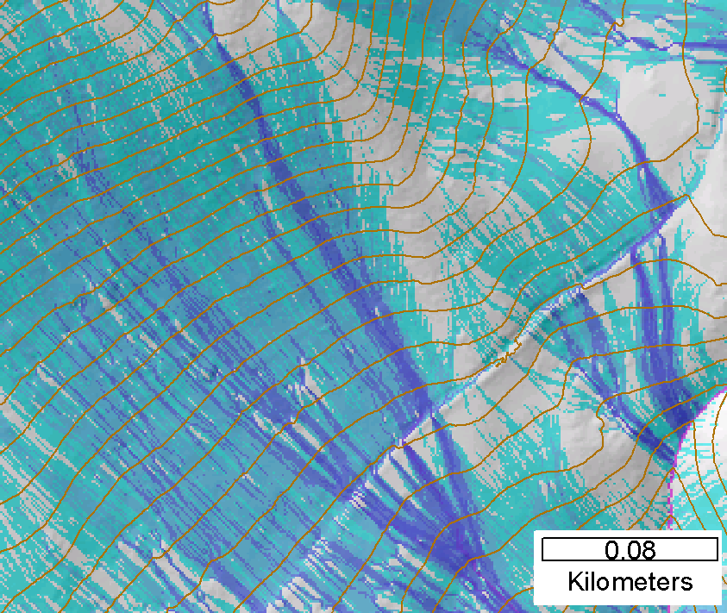
Contributing area from D-Infinity
Notes:
Note the detail in the representation of flow paths at features such as roads

Slide 51
Summary and Conclusions
Parallelization speeds up processing and partitioned processing reduces size limitations
Parallel logic developed for general recursive flow accumulation methodology (flow algebra)
Documented ArcGIS Toolbox Graphical User Interface
32 and 64 bit versions (but 32 bit version limited by inherent 32 bit operating system memory limitations)
PC, Mac and Linux/Unix capability
Capability to process large grids efficiently increased from 0.22 GB upper limit pre-project to where < 4GB grids can be processed in the ArcGIS Toolbox version on a PC within a day and up to 11 GB has been processed on a distributed cluster (a 50 fold size increase)

Slide 52
Limitations and Dependencies
Uses MPICH2 library from Argonne National Laboratory http://www.mcs.anl.gov/research/projects/mpich2/
TIFF (GeoTIFF) 4 GB file size (for single file version)
Run multifile version from command line for > 4 GB datasets
Processor memory

