Slide 1
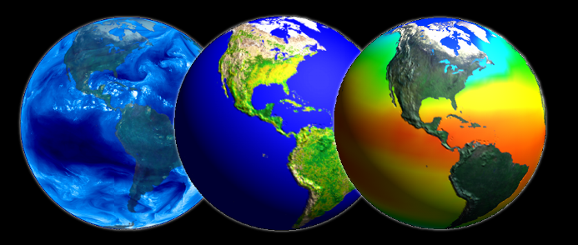
An Introduction to Remote Sensing
Ayse Kilic
Some slides are from:
John Jensen, 2000. Remote Sensing of the Environment: An Earth Resource Perspective
Bradley A. Shellito, Introduction to Geospatial Technologies
3. Dr. Arthur I. Zygielbaum at CALMIT, UNL

Slide 2

Field trip of Cavett Elementary School to Roca Berry Farm (NE) on Oct 4, 2012. An JPG image taken with an Iphone

Slide 3
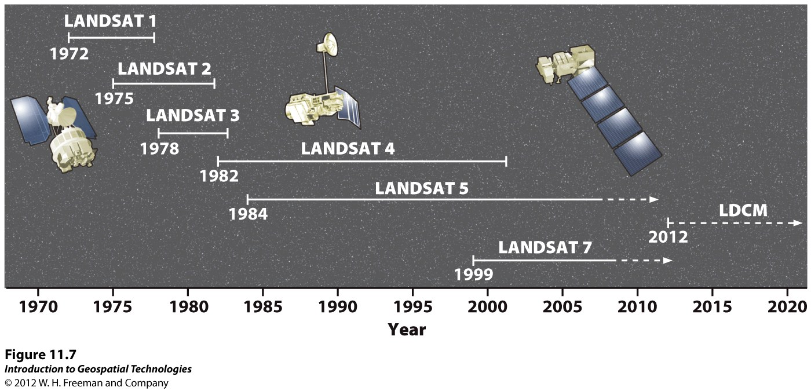
http://www.youtube.com/watch?v=BPbHDKgBBxA

Slide 4
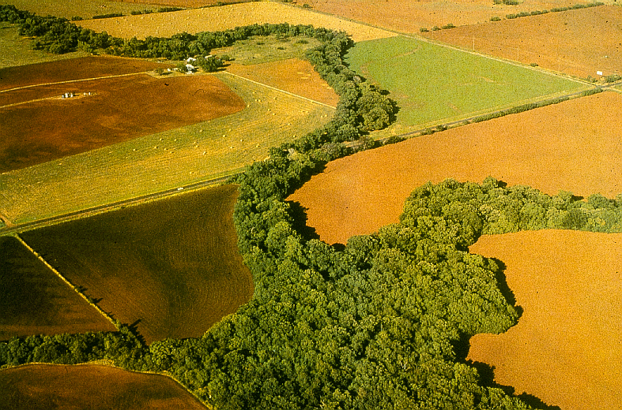
Remote Sensing: A Definition
The art and science of acquiring information about the earth and its environment using sensors mounted in aircraft and spacecraft

Slide 5
Remote Sensing in the context of GIS
Aerial images taken from aircraft using film or digital cameras
Satellite images recorded with satellite scanners
Under most conditions, aerial images contain geometric distortion
  Imperfections in the camera, lens or film systems,
  Camera tilt or terrain variation
Satellite scanners may also contain errors due to imaging equipment or satellite platform

Slide 6
Remotely sensed images have a number of features which make them ideal GIS data sources
Remote sensing provides a regional view
Remote sensing provides repetitive looks at the same area
Remote sensors "see" over a broader portion of the electromagnetic spectrum than the human eye

Slide 7
Remote Sensing and GIS
Sensors can focus in on a very specific bandwidth in an image
They can also look at a number of bandwidths simultaneously
Remote sensors often record signals electronically and provide geo-referenced, digital data (i.e. aerial images)
Some remote sensors operate in all seasons, at night, and in bad weather
Permanent record (Image is fixed in time). Therefore, it is an accurate source of historical information

Slide 8
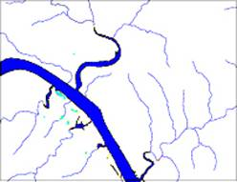
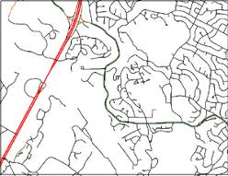
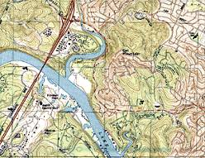
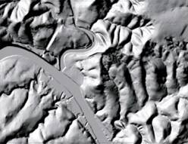
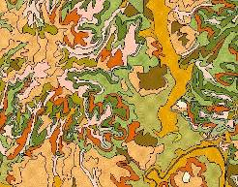
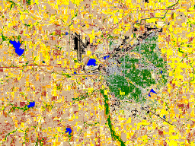
Geospatial Data
Hydrography
Transportation
Digitized Quads
Elevation
Soils
Land Use
Aerial and satellite images are valuable source of spatial data in GIS!
Notes:
Aerial images are used as a basis for surveying and topographic mapping to measure and identify horizontal and vertical locations of objects.
1:24,000 –scale quadrangle maps by USGS
Digital orthophotographs

Slide 9
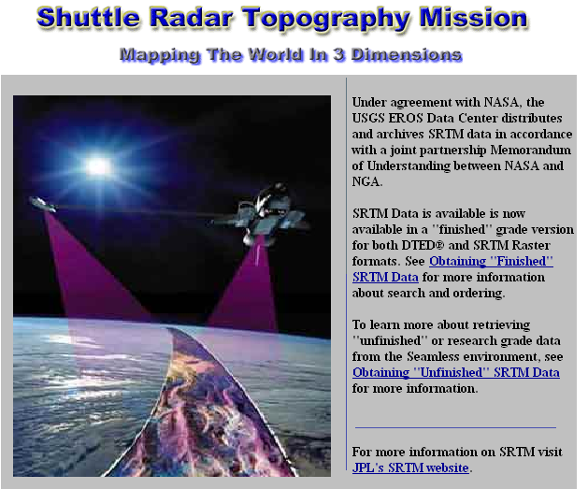
http://srtm.usgs.gov/

Slide 10
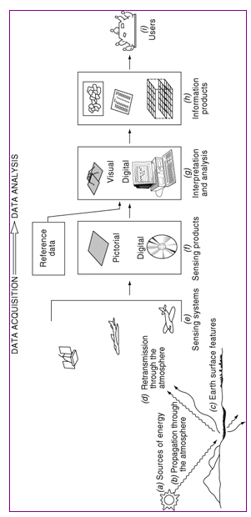
Processes involved in electromagnetic remote sensing of earth features
Notes:
Camera tilt and terrain variations may cause large errors in aerial photos – stereophogtoraphic determination of elevations removes terrain caused image displacement.

Slide 11
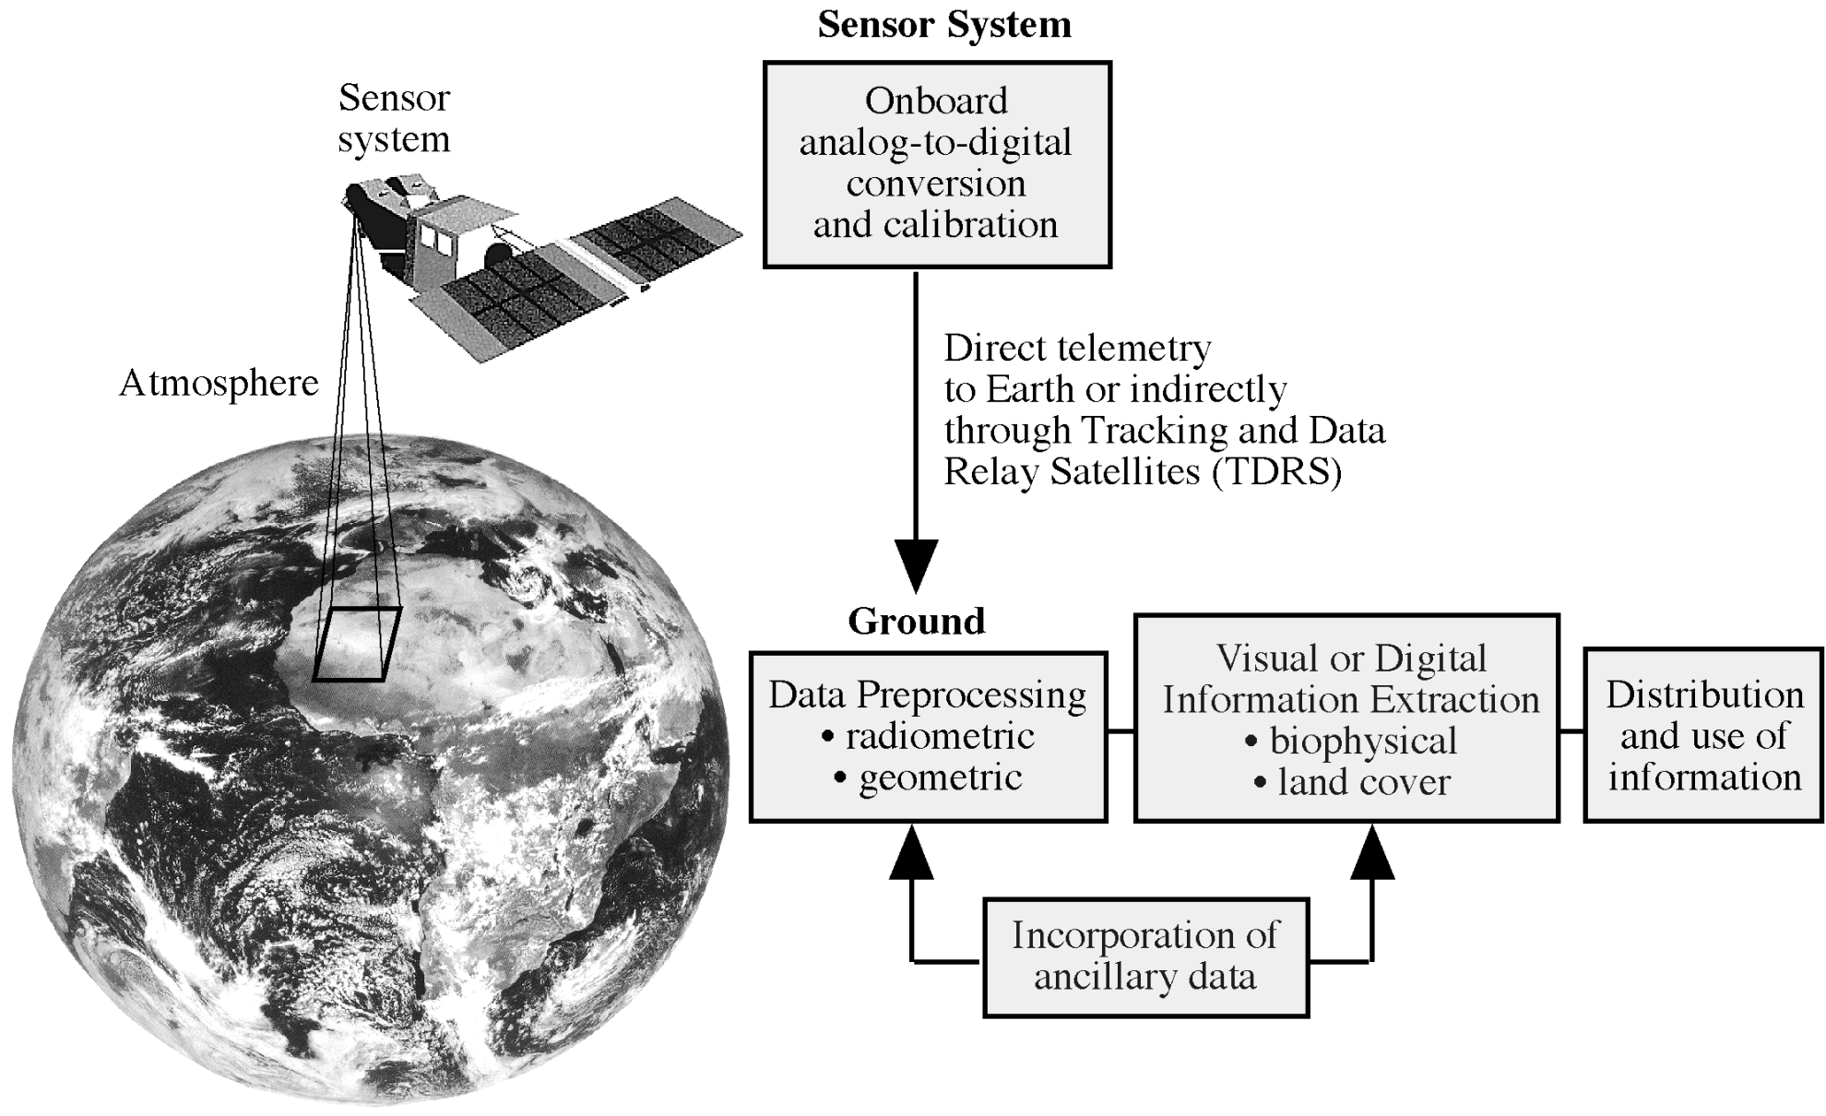
Overview of data acquisition by satellites
Source John R. Jensen
Notes:
Overview of data acquisition
Data recorded by the sensor system are converted from an analog electrical signal to a digital values. It takes places on-board. Sensor system creates pixels with a brightness value of 8 bit to 12 bits
Data is transmitted to ground control stations
Radiometric correction: for sensor performance. Some sensor is not performing well over time
Geometric correction. Satellite is not always going up and down. There might be some tilting.
Ground processing removes geometric and radiometric distortions.
The data are then ready for visual or digital analysis to extract information on biophysical and landcove

Slide 12
Remote Sensing Raster (Matrix) Data Format
Jensen 2000
Notes:
Digital remote sensor data are stored as matrix of numbers
Each digital value is located at a specific row and column in that matrix
Sensor systems creates pixels with a brightness value (BV) range of 8 to 12 bits. This is called “Quantization” level of remote sensor data.
8 bits have BV that range from 0 to 255
Data quantized to 12 bits range from 0 to 1023
The greater the range of values, the more precise we may able to measure the amount of radiance recorded by the sensor

Slide 13
Digital Image
25 | 22 | 19 | 47 | 44
22 | 18 | 25 | 22 | 44
19 | 21 | 22 | 23 | 42
21 | 116 | 121 | 125 | 134
118 | 125 | 123 | 135 | 126
125 | 133 | 136 | 221 | 234
244 | 243 | 212 | 232 | 178
Pixel (picture element)

Slide 14
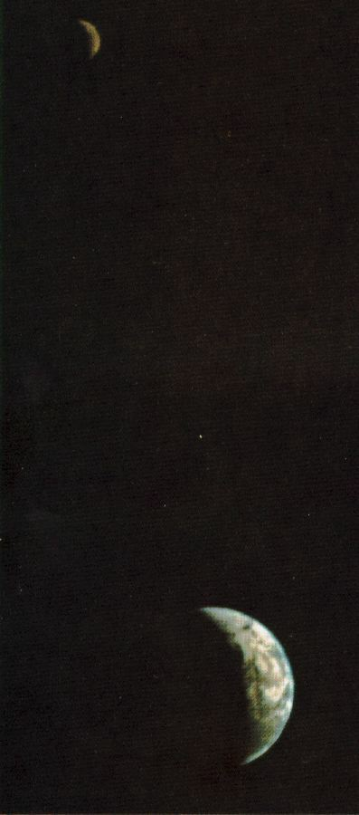
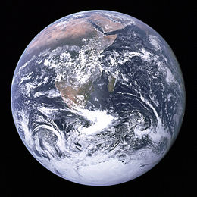
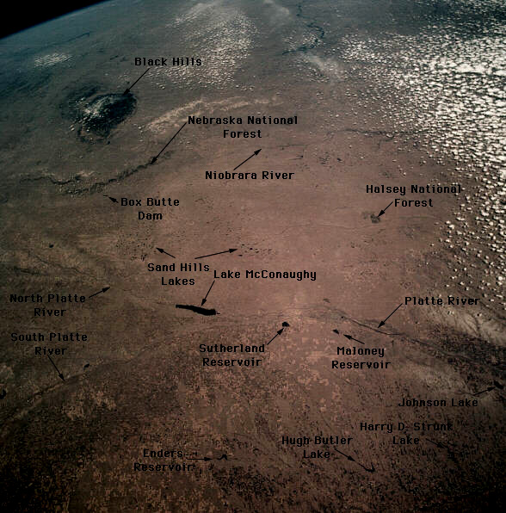
Passive Remote Sensing
Illumination typically by the sun
Passive – no energy provided by the remote sensing system to the object
Examples…
Notes:
Passive - we don’t hold a light that illuminates the target – or broadcast radiowaves like in RADAR

Slide 15
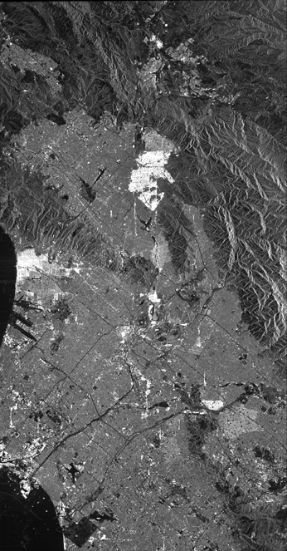
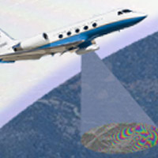
Active Remote Sensing
Illumination provided by the sensor system (light or radiowaves)
Emits energy in order to scan objects whereupon a sensor then detects and measures the radiation that is reflected or backscattered from the target
Radar (Radio Detection and Ranging)
  Synthetic Aperture Radar (SAR)
Notes:
Active – we illuminate the target with light or radiowaves

Slide 16
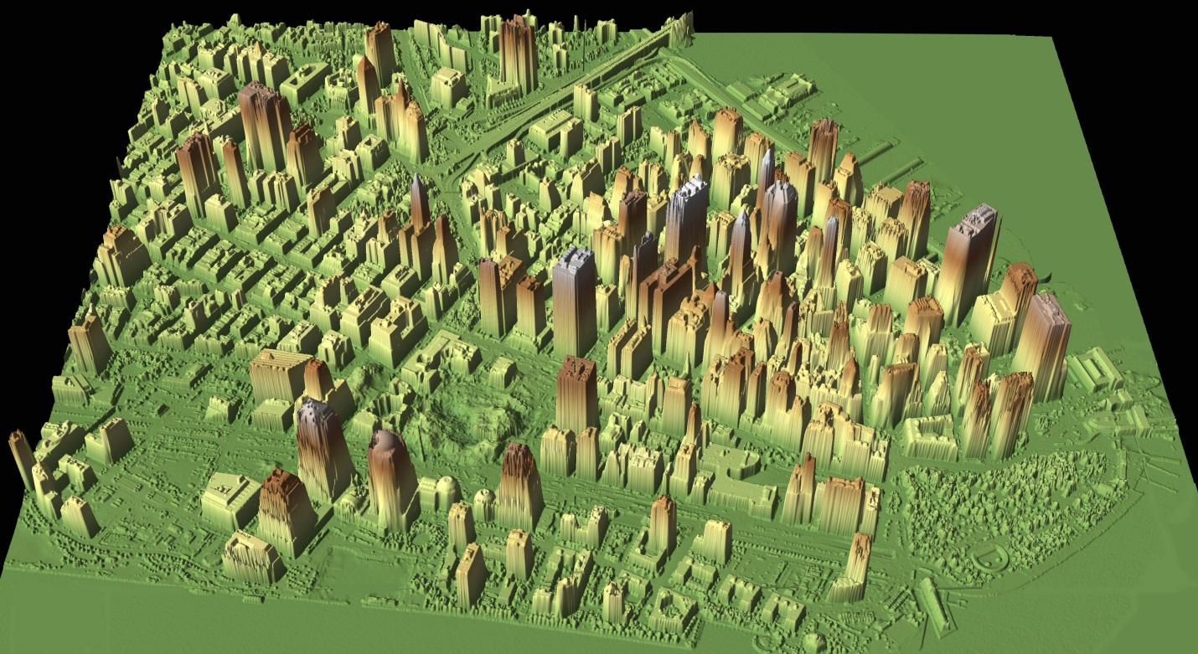
Active Remote Sensing
Illumination provided by the sensor system
LIDAR (Light Detection and Ranging)
Notes:
Active – we illuminate the target with light or radiowaves

Slide 17
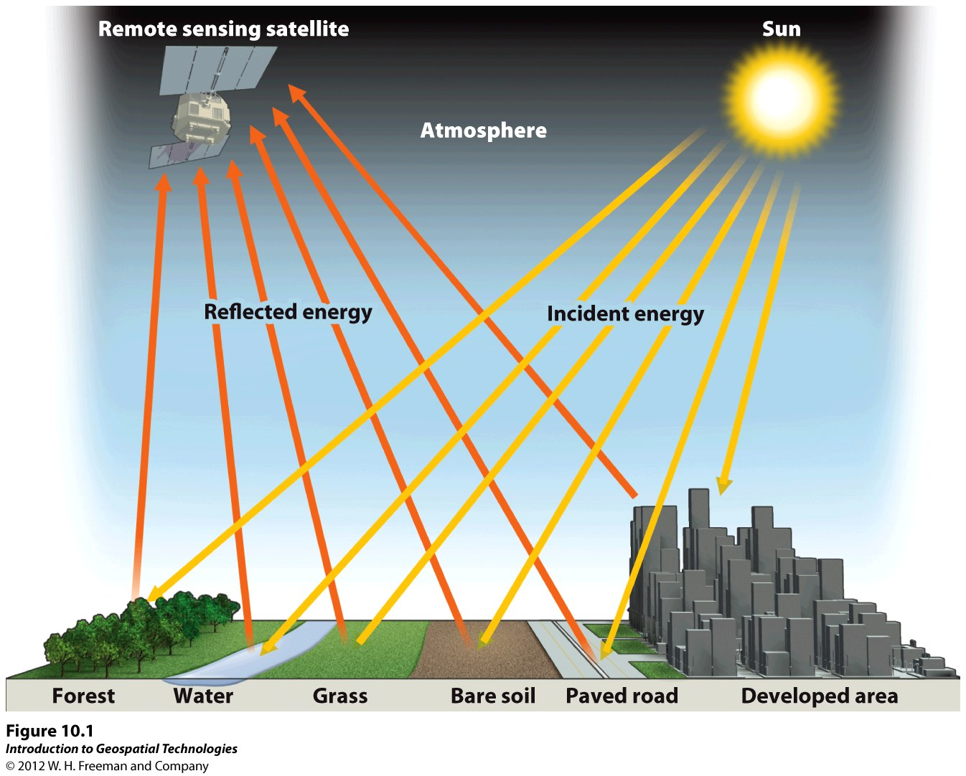
Notes:
Light energy is the principal form detected
Common forms of RS is based on reflected electromagnetic energy. i.e. Sensing Electromagnetic Radiation
Light energy is characterized by its wavelengths
Different materials reflect different amounts of incoming energy. This differential reflectance gives objects a distinct appearance
Light reflected from the surface and transmitted to the sensor is used to create an image
Light energy may be absorbed, transmitted or reflected, by the atmosphere
Light reflected from the surface and transmitted to the sensor is used to create an image
The image may be degraded by atmospheric scattering due to water vapor, dust, smoke, ant others
Absorbed energy may be re-radiated at longer wavelenghts, forming the basis for thermal remote sensing.

Slide 18
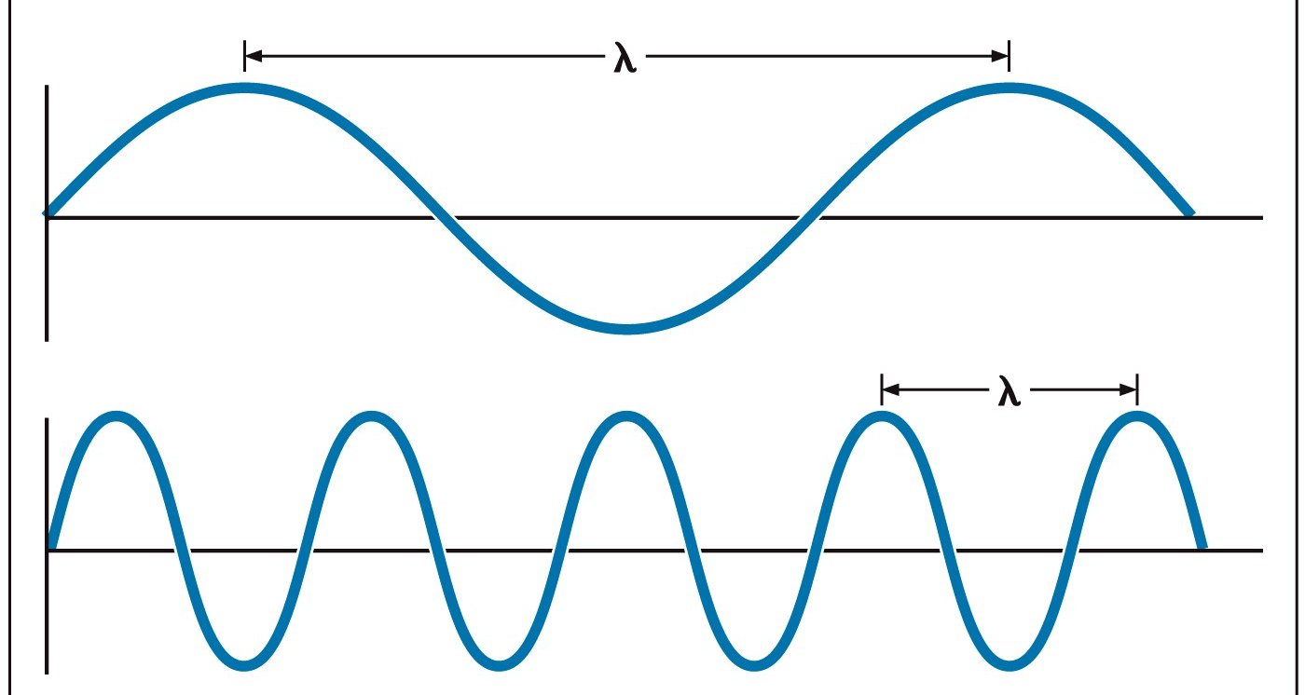
When sun radiates energy, it radiates in the form of waves at the speed of light
The distance between the crest of two waves in the electromagnetic stream is called “Wavelength”
Each color of light has a distinctive wavelengths
Notes:
Speed of light. 300 million meter/second

Slide 19
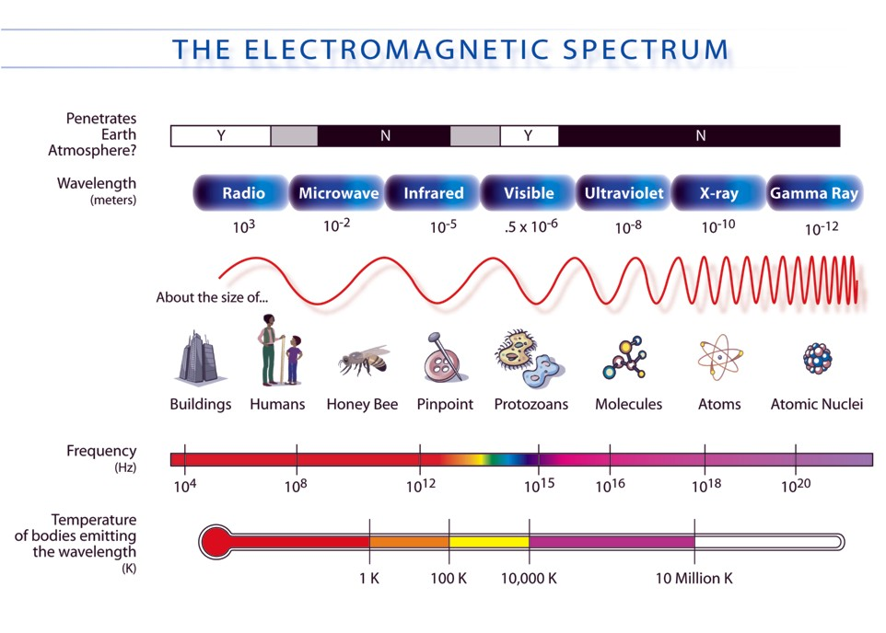
Electromagnetic Spectrum
Remote Sensing
Humans
Notes:
Different wavelengths have different characteristics stretching from radio waves to gamma rays
Examples of the approximate wavelength
Objects at certain temperatures emit EM radiation at different wavelengths
>Humans emit infrared radiation
>Remote sensing uses >optical – infrared through ultraviolet
> And Radio waves

Slide 20
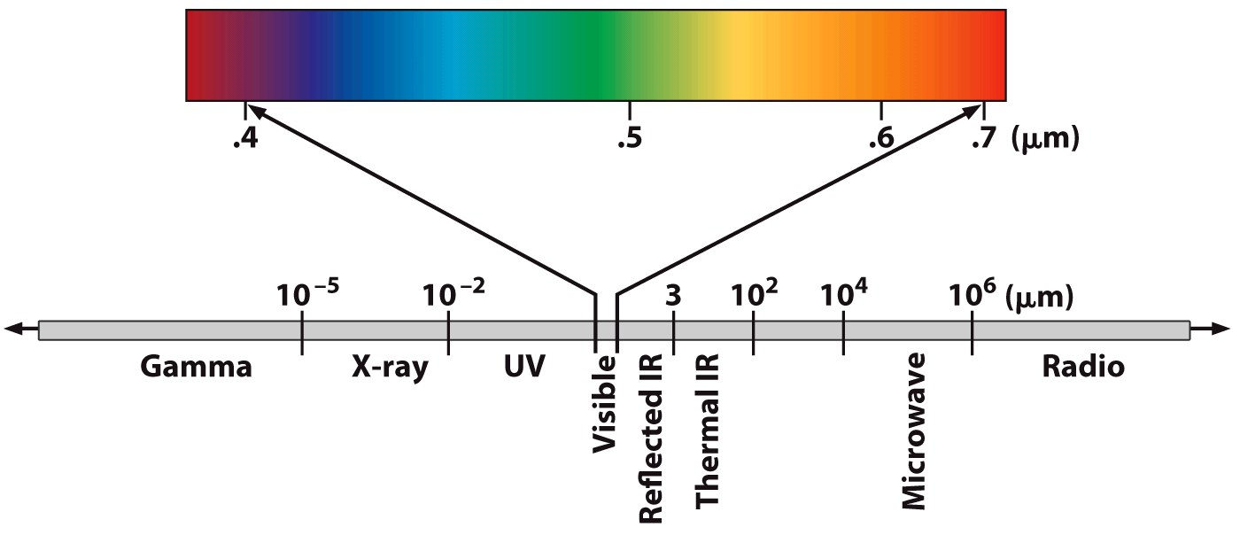
Looking more closely: Visible” spectrum
Micrometers (one million of meter) or Nanometers (one billionth of a meter
Our eyes perceive light in the visible portion of spectrum
Satellites can operationally measure multi-spectral imagery (the simultaneous sensing of two or more wavebands).
Notes:
We can see only a small portion of the spectrum
But we have instruments that tell us there is radiation at other wavelengths
Our radios and televisions, for example, use invisible radio frequency electromagnetic radiation
We have infrared cameras that can take pictures in those invisible wavelengths
One reason that birds of prey can spot a mouse hundreds of feet away is that their eyes allow them to see ultraviolet radiation. Shorter wavelength means that their lenses can resolve the image better than our eyes can.

Slide 21
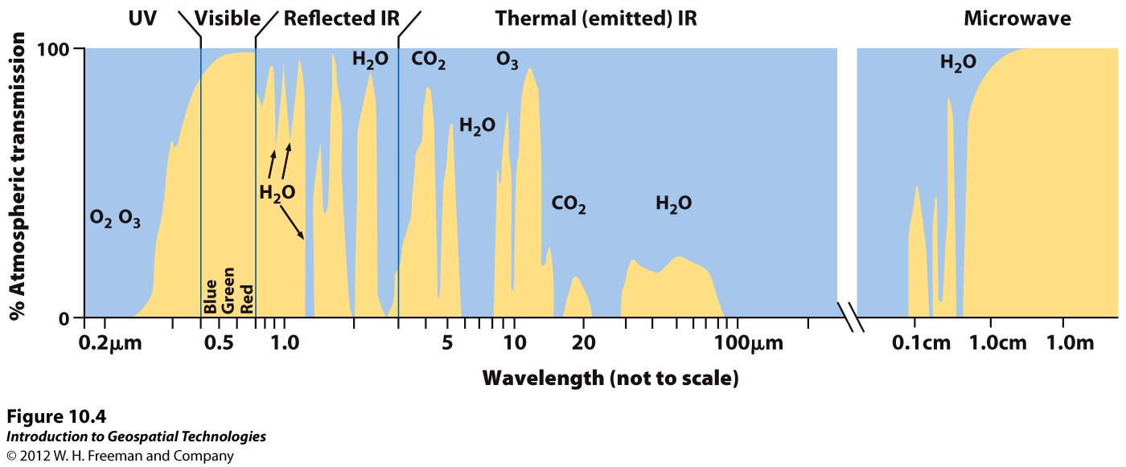
Passive Remote Sensing Spectrum
Solar Illumination
  Visible: Blue, Green, Red
  Near IR
  Middle IR
Earth emission
  Thermal IR
  Microwave
Near IR
Middle IR
Notes:
This is the spectrum we are concerned with – the light from the sun that hit’s the ground.
Solar illumination --- light directly reflected
Visible: blue, green, red
Infrared: Near IR and middle IR
Earth emission
Thermal IR
Microwave

Slide 22
Thermal Radiation Principles
Thermal infrared radiation refers to electromagnetic waves with a wavelength of between 3.5 and 20 micrometers
Most remote sensing applications make use of the 8 to 13 micrometer range
Thermal infrared is emitted energy, whereas the near infrared (photographic infrared) is reflected energy
Notes:
Thermal energy
Heat is a form of energy. Heat energy is stored in matter just like electrical energy is stored in a battery. An object that contains no heat energy is very cold, and is said to be at absolute zero (-460 F or -273 C). As heat is added to the object, its temperature rises. The more heat energy an object contains the hotter the object becomes. infrared energy is emitted as a result of atomic and molecular vibration.
The total amount of infrared energy emitted by an object is proportional to temperature to the fourth power.
Stefan-Boltzmann Law
P/A = emissivity of the object X stefan bolzman constant (5.6703 10⁻⁸ watt/m2/K⁴). X T⁴
P= new radiated power; A =radiating area

Slide 23
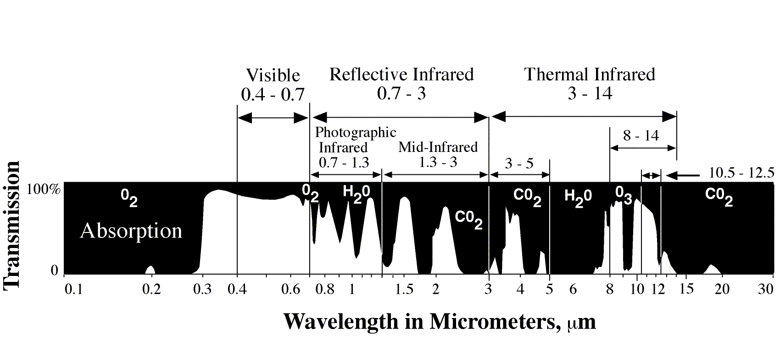
Atmospheric Windows (AW) in the Electromagnetic Spectrum
Jensen 2000
AW are caused when atmospheric gases/particles do not absorb the radiation
Only light in certain wavelength regions can penetrate the atmosphere well
Satellite are designed to operate on certain AW
Black if sensor is designed to operate on absorption bands
Notes:
Absorption results in the effective loss of energy to the atmosphere
AW are caused when atmospheric gases/particles do not absorb the radiation
Only light in certain wavelength regions can penetrate the atmosphere well
Satellite are designed to operate on certain AW
Black if sensor is designed to operate on absorption bands

Slide 24
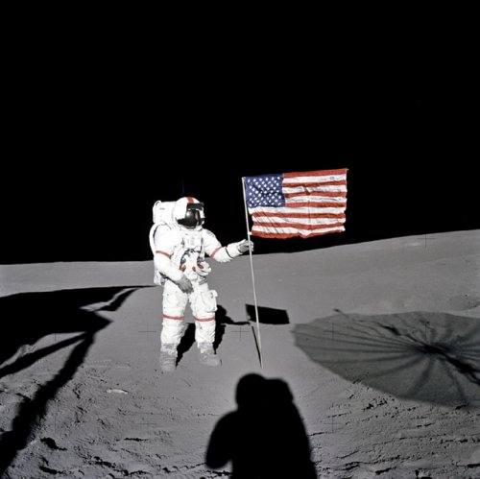
Light in the atmosphere
Two main atmospheric effects on light
  Absorption – we just looked at that
  Scattering
No atmosphere: the sky is black
Scattering
  Makes the sky blue
  Makes the clouds white
  Makes the sunsets red

Slide 25
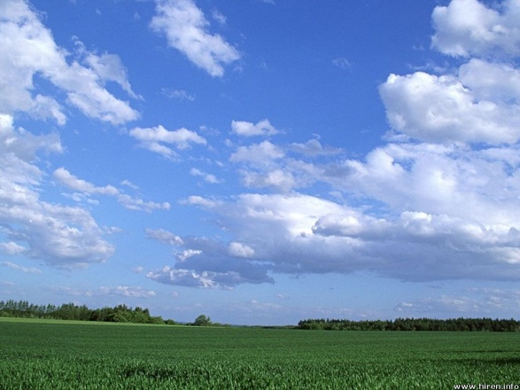
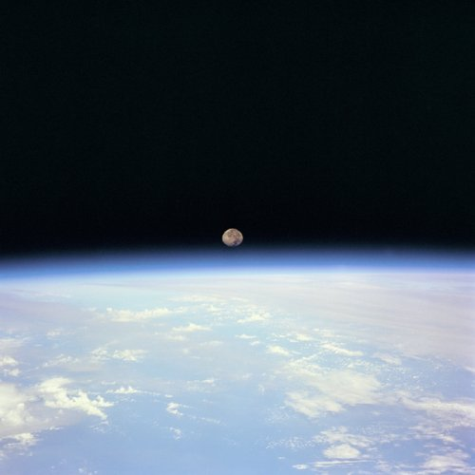
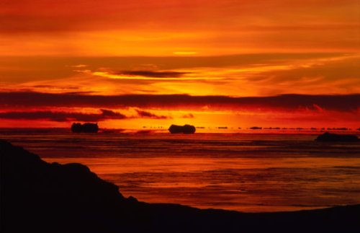
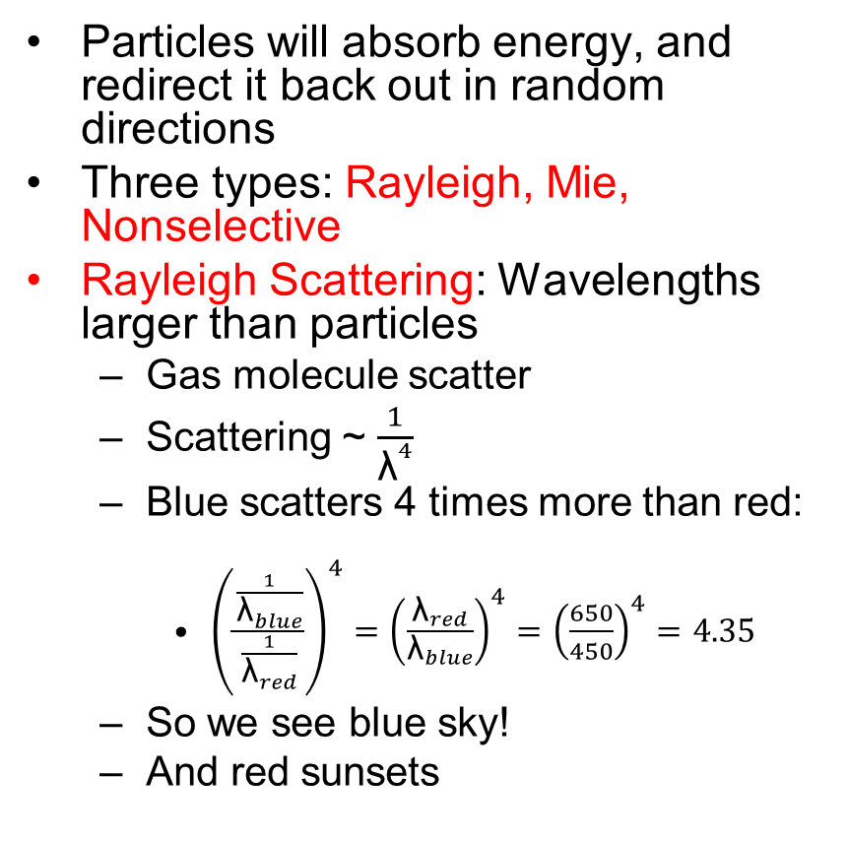
Scattering (due to particles in the atmosphere).
Particles will absorb energy, and redirect it back out in random directions
Three types: Rayleigh, Mie, Nonselective
Rayleigh Scattering: Wavelengths larger than particles
  Gas molecule scatter
  Scattering ~ $\frac{1}{{\text{λ}}^{4}}$
  Blue scatters 4 times more than red:
    ${\left(\frac{\frac{1}{{\text{λ}}_{blue}}}{\frac{1}{{\text{λ}}_{red}}}\right)}^{4}={\left(\frac{{\text{λ}}_{red}}{{\text{λ}}_{blue}}\right)}^{4}={\left(\frac{650}{450}\right)}^{4}=4.35$
  So we see blue sky!
  And red sunsets

Slide 26
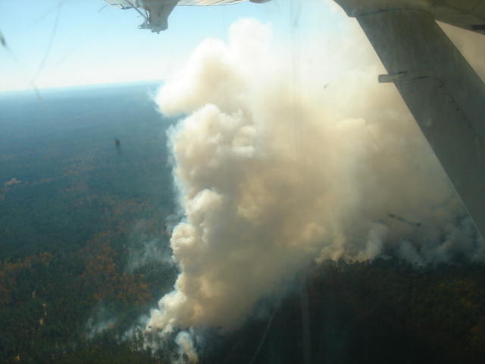
Scattering
Mie Scattering: Wavelength and particles about the same size
  Smoke and dust particles
  Wavelength dependent
  Blue scatters more than red

Slide 27

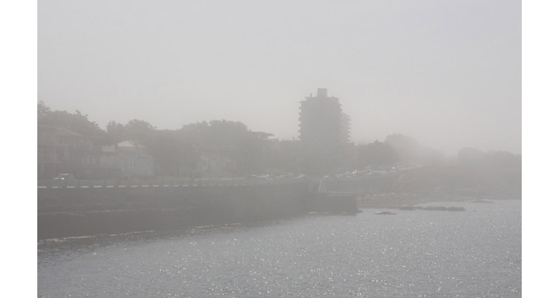
Scattering
Nonselective Scattering: Wavelengths smaller than particles
  Water droplets and ice crystals
  All wavelengths scattered equally
  Clouds - fog
    White – all wavelengths, RGB scattered the same.

Slide 28

When light “hits” an object
Reflected
I=R+A+T
Incident Light
Absorbed
Transmitted
Notes:
When light hits a target, three things can happen.
The light can be reflected, transmitted or absorbed.
This is embodied in the equation I=R+A+T. Incident light equals reflected, absorbed and transmitted light.

Slide 29
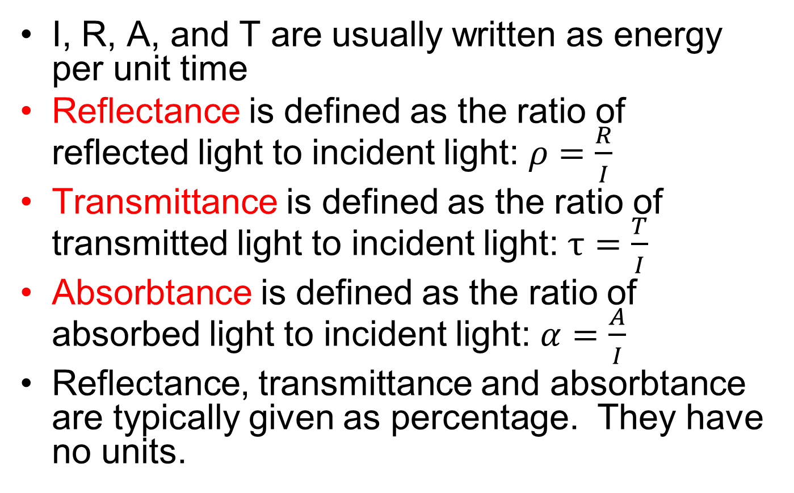
I = R + A + T
I, R, A, and T are usually written as energy per unit time
Reflectance is defined as the ratio of reflected light to incident light: $ρ=\frac{R}{I}$
Transmittance is defined as the ratio of transmitted light to incident light: $τ=\frac{T}{I}$
Absorbtance is defined as the ratio of absorbed light to incident light: $α=\frac{A}{I}$
Reflectance, transmittance and absorbtance are typically given as percentage. They have no units.

Slide 30
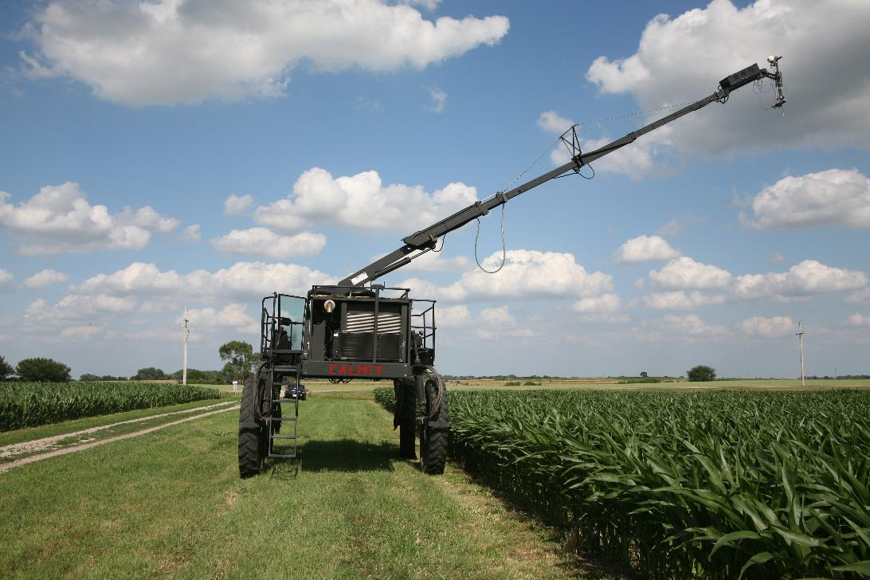
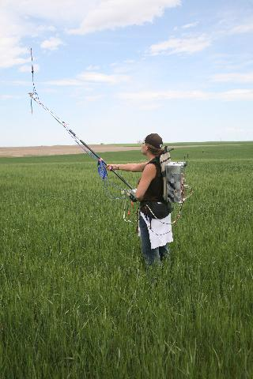
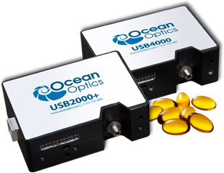
Measuring Spectral Reflectance
Optical Spectrometer
Non-imaging
  Just spectrum
Ground-based, aircraft, or satellite
Example: Ocean Optics Spectrometer
  350 to 1,000 nm

Slide 31
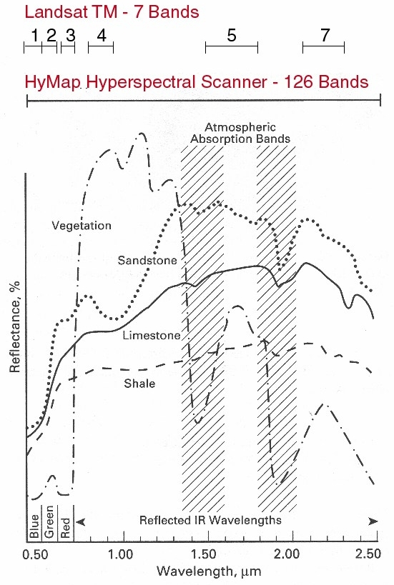
Multispectral - Hyperspectral
Multispectral – measure several wavelength bands
  Average reflectance in the bands
  Landsat TM-7 had 7 bands
  NDVI: bands 3 (red) and 4 (NIR)
Hyperspectral – measure hundreds of wavelength bands
  “HyMap” airplane sensor has 126 bands
  Ocean Optics has thousands of bands
Notes:
Multi and Hyperspectral
Satellites are very expensive. Limited number of bands are used to keep the cost down.
Reflectance is the total reflectance within the band of wavelengths
Gives a crude spectrum. But good enough for NDVI
To look at the details of the spectrum, you need more bands.
Hyperspectral: 100’s to 1000’s of bands

Slide 32
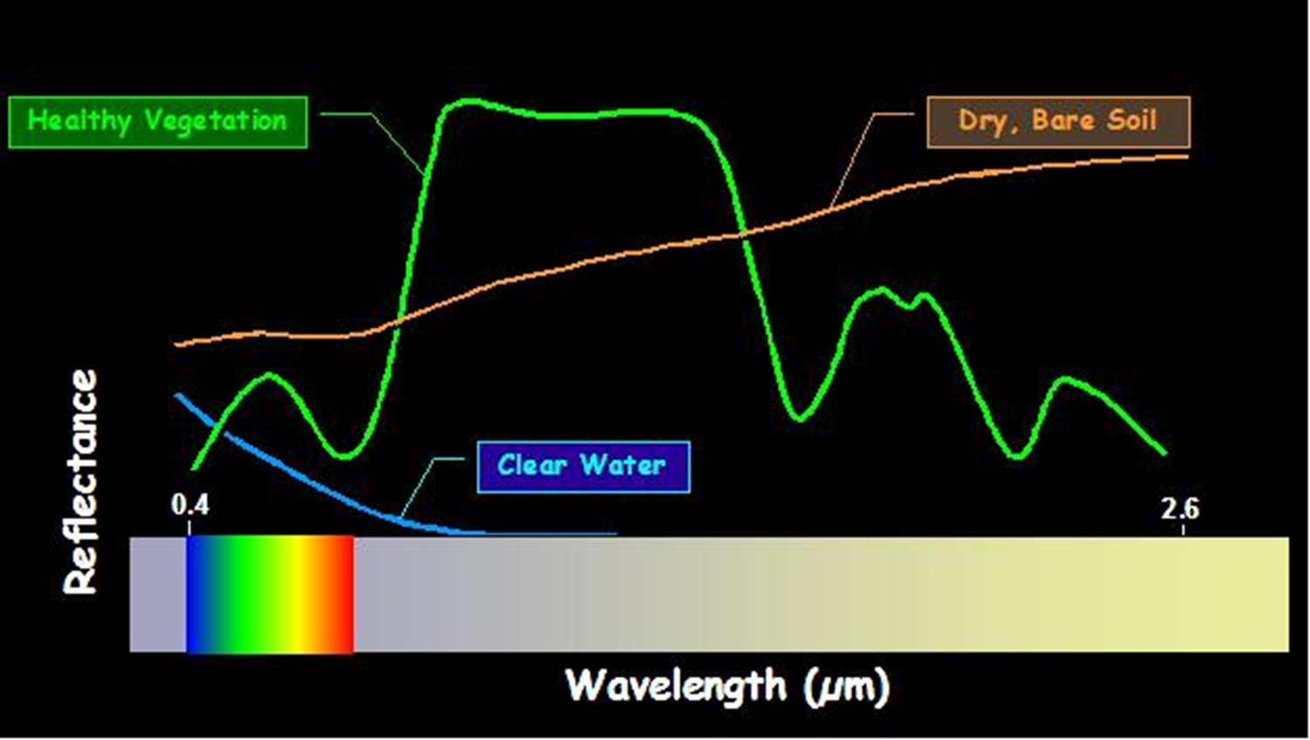
Reflectance
Typical reflectance signatures
Notes:
Here are three typical reflectance spectra
Bare soil. Higher reflectance in the infrared
Water. Hi absorption as the wavelength getes longer
Vegetation. More on this later
Key feature: absorption in blue and red. Some reflectance in green.

Slide 33
Reflectance Spectrum
If corn leaves had no water and no pigments (like chlorophyll)
  Note: Visible light = Photosynthetically Active Radiation (PAR)
Structural light scatter
and water absorption
PAR
NIR
MIR
Pigment absorption and
structural light scatter
Structural light scatter

Slide 34

Reflectance Spectrum
Now Add Water to the Corn Leaves
Water Absorption

Slide 35

Reflectance Spectrum
Now Add Pigments – Chlorophyll and Carotenoids
No change in Absorption
Lots of Absorption!

Slide 36
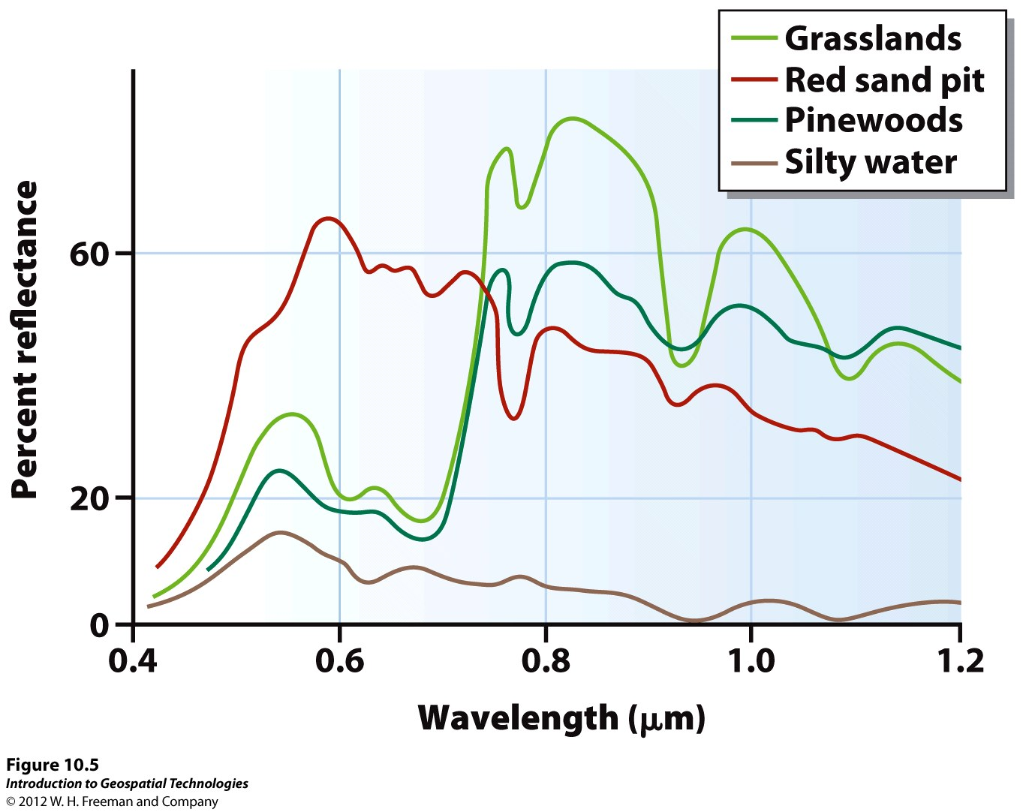

Slide 37
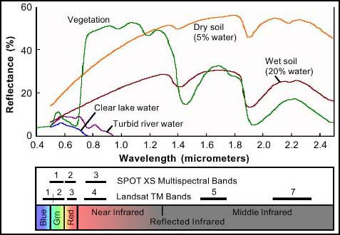
Spectral Response Curve (“signature”)
Natural objects appear to be the color they most reflect!
Notes:
Healthy green vegetation always manifest “peak and valley”
The valleys in the visible portion of spectrum are dictated by the pigments in the leaves. Chlorophyll absorbs energy centered at 0.45 and 0.67
That means high absorption of blue and red energy by plants
0.7 1.3, plant reflects as much as 50% of energy incident upon it
Dips (valleys) occur at 1.4, 1.9, and 2.7 because water in the leaves absorbs
Water: most distinctive characteristics. Absorption at near—IR and beyond
Soil shows less peak and valley because factors (moisture, texture, organic matter, surface roughness) affecting soil reflectance act less specific spectral bands

Slide 38
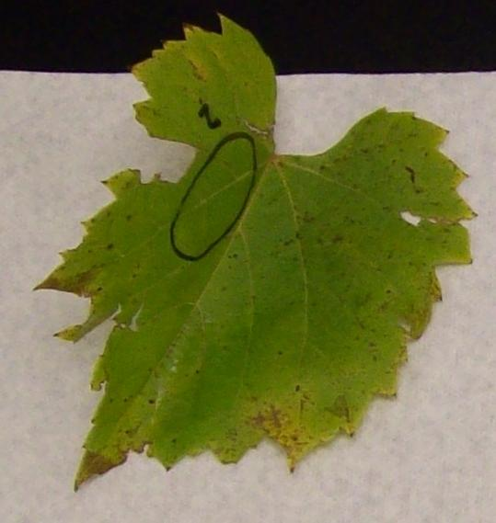
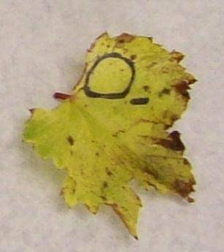
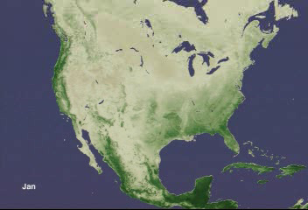

How do you get useful information out of the reflectance spectrum?
Start with the spectrum of a leaf and play part of the spectrum off against another
An example of a mathematical transform or index based on reflectance:
  Normalized Difference Vegetation Index or “Greenness” Index
  Pick, for instance, 670 nm for red and 800 nm for NIR
  Relatively green leaf
  Not so green leaf
NDVI used globally
Calibrations performed to convert an “index value” into an estimate of a biophysical parameter like chlorophyll content
670
800
NDVI=0.87
NDVI=0.18
Notes:
NDVI is related to the amount of chlorophyll in the vegetation

Slide 39
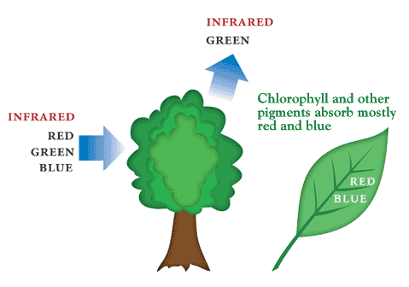
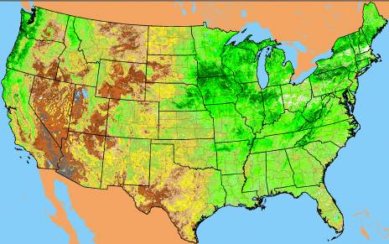

Vegetation Index
As plants grow, canopy and biomass increase
Green leaves absorb more red and blue light –
Increase in NIR reflectance
Vegetation indices express the difference between NIR and red reflectance
“Greenness” - associated with plant photosynthetic activity, biomass, fractional cover of vegetation
Normalized vegetation index (-1, 1)

Slide 40
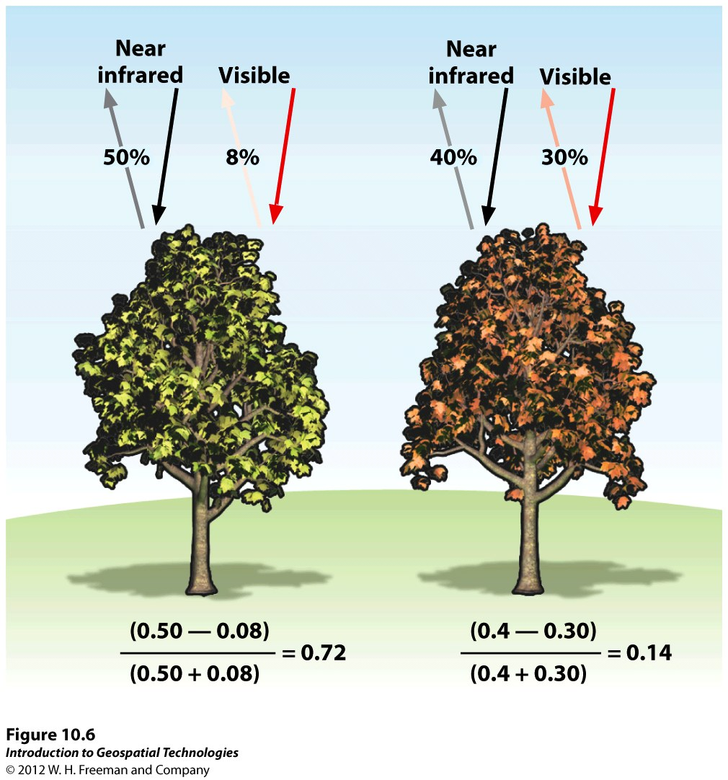

Slide 41
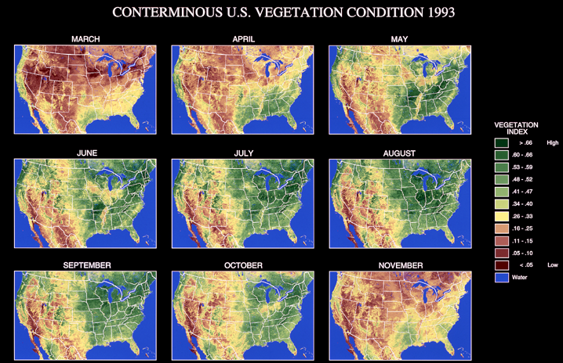

Slide 42

Imaging
Digital images are made up of picture elements (pixels)
1957-- Soviets launch Sputnik I
Explorer-I, Satellite 1958 Alpha, the first US earth satellite

Slide 43
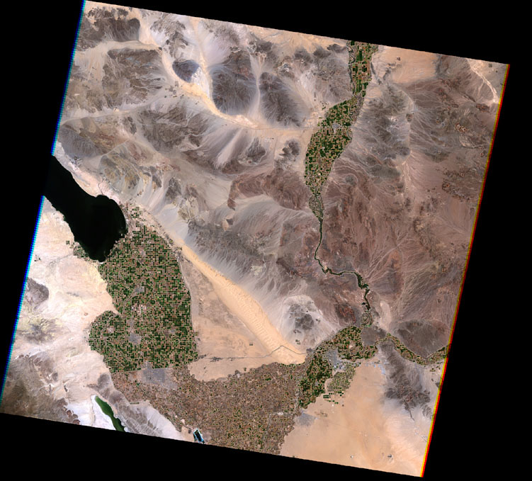
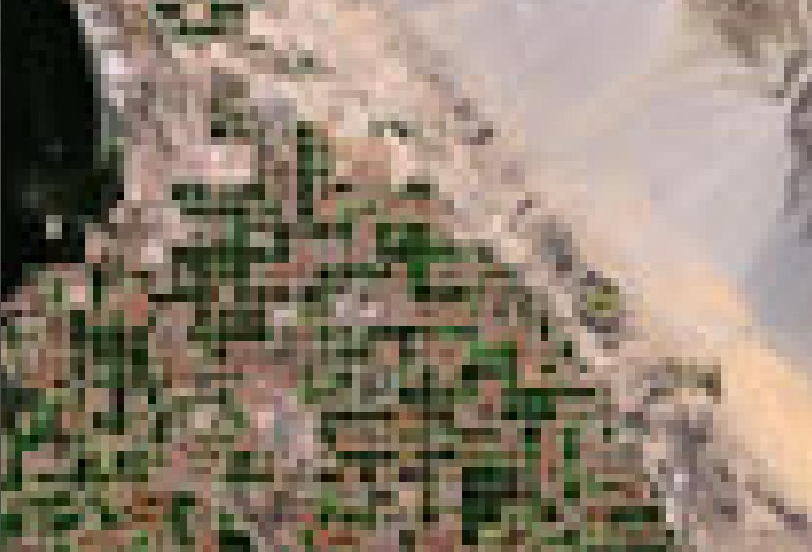
Pixels on an image of earth
Images from satellites are digital images with pixels
Resolution: area per pixel
Notes:
Resolution: area per pixel
2 km resolution is 2 square km per pixel or one pixel is the average color/brightness of a 2 km square area
1 mile resolution is 1 square mile per pixel or one pixel is the average color/brightness of a 1 mile square area

Slide 44
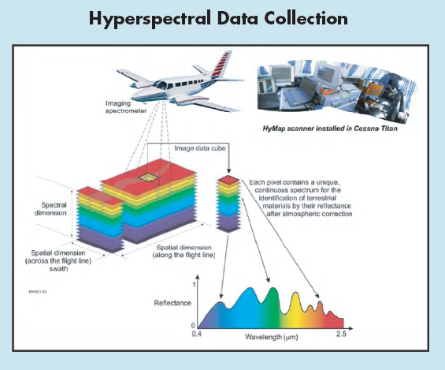
Hyperspectral Images
Hundreds of images
  One at each wave band
  Can view an image
  Construct a spectrum at each pixel position

Slide 45
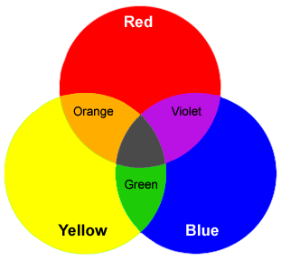

Background: Making color
Every color can be created from primary colors
  Red, yellow, blue are additive
    Adjust the red, yellow or blue light (or “gun”) to get any color
  Yellow, magenta, and cyan are subtractive
    Adjust yellow, magenta, and cyan filters to block light

Slide 46


Slide 47

Color composite image

Slide 48

Panchromatic Image
“Black and White” or Panchromatic (all color) image covering a part of the spectrum (visible, blue, NIR, etc.)
Each pixel is the average brightness of the wavelengths included at that point in the image
NIR Panchromatic Image of the Salton Sea

Slide 49

Multiband panchromatic images
Blue
NIR
Green
MIR
Red
MIR
MIR
Notes:
Here is a multiband image taken of the Salton Sea in California
Note that each image shows brightness in a particular wavelength: blue, green (2), red, NIR, MIR (2)

Slide 50
Turning panchromatic images into a color image
Panchromatic images viewed as grey shaded (black and white)
But view them in blue, green, and red (primary colors)
  And combine them

Slide 51

Image processing to generate color composite
Individual bands can be displayed in gray shades
Bands can be combined in color composites
False Color Composite
Spectral band | Color assignment
green (TM2) | blue
red (TM3) | green
near-infrared (TM4) | red
Reds, depicting vegetation
Medium grayish-browns, mainly along the bright sun-facing slopes
Deep blue, depicting ocean and bay
Near the shore, a bit lighter blue where thicker sediments add reflectance

Slide 52
Major Components of Technology
Energy Source
  Passive System: Irradiance from earth's materials
  Active System: irradiance from artificially generated energy sources such as radar
Platforms: Vehicle to carry the sensor
Sensors: Device to detect electro-magnetic radiation
Notes:
The following are major components of Remote sensing System:
Energy Source
Passive System: sun, irradiance from earth's materials;
Active System: irradiance from artificially generated energy sources such as radar.
Platforms:(Vehicle to carry the sensor) (truck, aircraft, space shuttle, satellite, etc.)
Sensors:(Device to detect electro-magnetic radiation) (camera, scanner, etc.)
Detectors: (Handling signal data) (photographic, digital, etc.)
Processing (Handling Signal data) (photographic, digital etc.)
Institutionalisation: (Organization for execution at all stages of remote-sensing technology: international and national orrganisations, centres, universities, etc.).

Slide 53



Sensors
include cameras, scanners, radar
sensors are designed to address specific problems and data requirements
sensors complement one another; image fusion
Notes:
image fusion: Process of combining relevant information from two or more images into a single image
Output: high spatial and high spectral resolution in a single image

Slide 54




Sensors
Two major categories of sensors
  Along Track
    No moving parts
    “Push Broom”
    IPhone
  Across Track
    “Whisk Broom”
    MODIS, all Landsat
Swath Width

Slide 55



Platforms
field vehicles
light aircraft
high altitude aircraft
satellites (Landsat, SPOT, Ikonos, Terra)
space shuttle

Slide 56
Some Sensors and Platforms
Platform | Sensor(s)
Ikonos | Ikonos
Landsat-7 | Enhanced Thematic Mapper + (ETM+)
SPOT-4 | High Resolution Visible -Infrared (HRVIR); Vegetation
Terra | MODIS; ASTER
EO-1 | Advanced Land Imager (ALI); Hyperion
Radarsat | Synthetic Aperture Radar (SAR)

Slide 57
Sensor Capability
Four terms to “know”
  Spatial Resolution
  Radiometric Resolution
  Spectral Resolution
  Temporal Resolution

Slide 58
Sensor Capability: Spatial Resolution
Spatial Resolution
pixel size (instantaneous field of view)
smallest object one can discern/identify
commonly 1 meter to 1100 meters

Slide 59

Sensor Capability
Improving Spatial Resolution
  Panchromatic Sharpening
Notes:
Panchromatic Sharpening
Using a panchromatic image to improve the resolution of a color band image
Think of it as using the color (hue) from the color image and the brightness from the panchromatic image

Slide 60


Spatial Resolution
Image of Lincoln, NE
Coarse (30 m, multispectral)
Fine (1 m, panchromatic, Ikonos)

Slide 61



LIDAR (Light Detection and Ranging)

Slide 62


Radiometric Resolution
Number of “brightness levels” (gray shades; bits)
commonly 256 - 2048 levels (8 - 11 bit)

Slide 63
Radiometric Resolution

Slide 64



Sensor Capability
Radiometric Resolution
8 bits (256 levels)
4 bit (16 levels)
1 bit (2 levels)
Notes:
Brad Pitt and Julia Roberts

Slide 65


Spectral Resolution
how many spectral bands?
which bands?
band widths - narrow band vs broad band
http://geospatial.amnh.org/remote_sensing/widgets/spectral_curve/spectral.swf
Notes:
Spectral resolution refers to the number of different frequency bands recorded - usually, this is equivalent to the number of sensors carried by the platform(s).
Current Landsat collection is that of seven bands, including several in the infra-red spectrum.
The MODIS satellites are the highest resolving at 31 bands

Slide 66

Temporal Resolution
  Revisit Time
  How often does the satellite view a particular area?
  How much time between “visits?”
Usual view: Nadir, straight down
Off-nadir shortens revisit time
  Point to the side
  On some satellites
  More distortion, more atmosphere
Landsat 7 has a Sun-synchronous orbit,
allowing it to cross the Equator at a constant
time every day

Slide 67

Temporal Resolution
Varies from 1 day to 26 days (phased?)
Some sensors must be “tasked”; some are pointable
Historical archive?
Notes:
The temporal resolution is simply the frequency of flyovers by the satellite or plane, and is only relevant in time-series studies or those requiring an averaged or mosaic image as in deforesting monitoring.
Cloud cover over a given area or object makes it necessary to repeat the collection of said location.
Radiometric correction gives a scale to the pixel values, e.g. the monochromatic scale of 0 to 255 will be converted to actual radiance values.
Atmospheric correction eliminates atmospheric haze by rescaling each frequency band so that its minimum value (usually realised in water bodies) corresponds to a pixel value of 0. The digitizing of data also make possible to manipulate the data by changing gray-scale values.

Slide 68
Comparing Resolution
Sensor | Spatial | Spectral | Radiometric | Temporal
Ikonos | 1-4 m | 4 + pan bands | 11 bit | 1-3 days
SPOT-5 HRG | 2.5-10 m | 4 + pan bands | 8 bit | 1-26 days
Landsat-7 ETM+ | 15-30 m | 7 + pan bands | 8 bit | 16 days
Terra MODIS | 250 m – 1000 m | 36 bands | 12 bit | 1 day

Slide 69


Major Satellite Series: Landsat
Notes:
Landsat has instruments that look at major wavelength bands

Slide 70
http://www.youtube.com/watch?v=BPbHDKgBBxA

Slide 71
LANDSAT
LANDSAT refers to a series of satellites put into orbit around the earth to collect environmental data about the earth's surface.
The LANDSAT program was initiated by the U.S. Department of Interior and NASA under the name ERTS, Earth Resources Technology Satellites.
ERTS-1 was launched on July 23, 1972, and was the first unmanned satellite designed solely to acquire earth resources data on a systematic, repetitive, multispectral basis.
Over time, the sensors carried by the LANDSAT satellites have varied as technologies improved and certain types of data proved more useful than others

Slide 72
Landsat Observation Bands
﻿Landsat 5 TM and Landsat 7 ETM+ Spectral Bands | Wavelength | Useful for mapping
Band 1 – blue | 0.45-0.52 | Bathymetric mapping, distinguishing soil from vegetation and deciduous from coniferous vegetation
Band 2 -green | 0.52-0.60 | Emphasizes peak vegetation, which is useful for assessing plant vigor
Band 3 – red | 0.63-0.69 | Discriminates vegetation slopes
Band 4 -Near Infrared | 0.77-0.90 | Emphasizes biomass content and shorelines
Band 5 – Short-wave Infrared | 1.55-1.75 | Discriminates moisture content of soil and vegetation; penetrates thin clouds
Band 6 – Thermal Infrared | 10.40-12.50 | Thermal mapping and estimated soil moisture
Band 7 – Short-wave Infrared | 2.09-2.35 | Hydrothermally altered rocks associated with mineral deposits
Band 8 – Panchromatic (Landsat 7 only) | .52-.90 15 | meter resolution, sharper image definition
Notes:
Principal applications of different wavelengths
1) 0.45-0.52. Blue. Designed for water body penetration, making it useful for coastal water mapping. Also useful for soil/vegetation discrimination, forest type mapping, and cultural feature identification.
2) 0.52-0.60. Green. Designed to measure green reflectance peak of vegetation for vegetation discrimination and vigor assessment. Also useful for cultural feature identification.
3) 0.63-0.69. Red. Designed to sense in a chlorophyll absorption region aiding in plant species differentiation. Also useful for cultural feature identification.
4) 0.76-0.90. Near-infrared. Useful for determining vegetation types, vigor, and biomass content, for delineating water bodies, and for soil moisture discrimination.
5) 1.55-1.75. Mid-infrared. Indication of vegetation moisture content and soil moisture. Also useful for differentiation of snow from clouds.
6) 10.4-12.5. Thermal infrared. Useful in vegetation stress analysis, soil moisture discrimination, and thermal mapping applications.
7) 2.08-2.35. Mid-infrared. Useful for discrimination of mineral and rock types. Also sensitive to vegetation moisture content.

Slide 73


Landsat Images to Cover Nebraska
http://earthnow.usgs.gov/earthnow_app.html?sessionId=a0d0c8de12ec09f065837276c5d8ab6b4155

Slide 74

Image Coverage
2005
P33R30
10
P32R30
9
P31R30
10
P30R30
9
P29R30
10
P33R31
11
P32R31
10
P31R31
12
P30R31
9
P29R31
11
P28R31
8
P33R32
15
P32R32
8
P31R32
12
P30R32
10
P29R32
12
P28R32
10
P27R32
8
Number of images to cover study area
Generally, higher spatial resolution = smaller area coverage per frame = more scenes

Slide 75

Landsat – 30 m x 30 m pixels
1972 – present
Thermal imager since 1984
Center Pivot irrigated fields
near Kearney, Nebraska, 2011

Slide 76

http://landsatlook.usgs.gov/

Slide 77

Zoom In – Here is Nebraska

Slide 78

Press “Select Scenes” to: a) get Landsat image background
b) “Find” 657 !!! Landsat scenes for Lincoln, Nebraska from 1999-2012
c) Move the “Slide bar” to progress through the scenes in viewer

Slide 79
The Moderate Resolution Imaging Spectroradiometer (MODIS)
Operating on both the Terra and Aqua spacecraft.
It has a viewing swath width of 2,330 km
Views the entire surface of the Earth every one to two days.
Its detectors measure 36 spectral bands
It acquires data at three spatial resolutions: 250-m, 500-m, and 1,000-m.
Bands 1–2 - 250-meter
Bands 3–7 - 500-meter
Bands 8–36 - 1000-meter

Slide 80

MODIS download steps http://reverb.echo.nasa.gov

Slide 81



Image processing
Leica ERDAS Imagine

Slide 82


Slide 83


Slide 84



Remote Sensing
The Good News
sensors - spectral bands, higher resolution (< 1m)
lower data costs?
inexpensive, powerful software
global datasets
improved interface to GIS
biophysical analyses - biomass, soil moisture, turbidity

Slide 85
Aerial or satellite images?
A number of factors including spectral range, price, availability, reliability and flexibility are important in deciding between aerial and satellite images.
Aerial images are the main source of coordinate and attribute data, and provide more detailed information than satellite images.
National, state, and local governments are the main source of aerial images.
The National Aerial Photography Program (NAPP) provides full coverage of the lower 48 United States at 1:40,000 scale at 5 to 10 year return intervals.
Satellite systems provide a broader range of spatial, spectral and temporal data relative to aerial images, and cover large areas.
Often used to create or update landcover classification, and to detect and monitor change over large areas.

Slide 86


Remote Sensing
Some Typical Applications
Mapping or monitoring land cover and land use
Measuring area, volume, trajectory

Slide 87



Estimating biomass, surface temperature, turbidity
Extent/impacts of natural hazards (e.g., drought, fires)

Slide 88


Mapping Invasive species (Albuquerque, NM)

Slide 89

Global Normalized Difference Vegetation Index (NDVI) Image Produced Using (AVHRR) Imagery

Slide 90


Leaf Area Index
The area of green leaf per unit area of ground

Slide 91

Actual Evapotranspiration (ET) at Central Platte Natural Resources District , NE

Slide 92


Witch Wildland fire San Diego
Witch Wildland fire, burned 198,000 acres north of San Diego, destroying 1125 homes, commercial structures, and outbuildings. Over 3,000 firefighters finally contained the fire two weeks after it started on October 21. Fire started on Oct 8th 2007
This ASTER image depicts the area after the fire, on November 6; vegetation is green, burned areas are dark red, and urban areas are blue. On the burn severity index image, calculated using infrared and visible bands, red areas are the most severely burned, followed by green and blue. This information can help the US Forest Service to plan post-fire activities.
http://www.nasa.gov/vision/earth/lookingatearth/socal_wildfires_oct07.html

Slide 93

Remote Sensing in Forestry
Progression of deforestation in Bolivia from 1975 to 2000 using LANDSAT 2, 4, and 7 images. The image on the left was acquired on June 17, 1975; the middle image on July 10, 1992; and the right image on August 1, 2000.
Photo credit: USGS
http://pubs.usgs.gov/fs/2010/3026/pdf/FS2010-3026.pdf

Slide 94

Airborne Remote Sensing to Support Precision Farming
Maturity Map of Brown Rice
(Red: High, Purple: Low)
Protein Map of Brown Rice
(Red: High, Purple: Low)
Detail Map
(Red: High, Purple: Low)
Hyperspectral airborne remote sensing can be used for leaf color analysis, soil classification, and monitoring the growth stage of rice in a large area.
Tokyo, Japan
By PASCO Corporation
http://www.esri.com/mapmuseum/mapbook_gallery/volume20/agriculture3.html

Slide 95


Mapping Riparian Vegetation with Lidar Data
The figure on the left is a 0.3048-meter-resolution aerial photograph of the Walker River in Nevada. The image on the right is the height-above- river map using a 300-meter kernel size and classified into 50-centimeter vertical intervals. In the upper left-hand corner is a eutrophic oxbow lake that is low lying yet disconnected from the river channel. Near the bottom of the map is a shallow river channel that periodically fills with water, cutting off the point bar. An irrigation ditch is visible on the right-hand side of the image.
http://www.esri.com/news/arcuser/0110/mapping-with-lidar.html

Slide 96

Landsat 5 Image of the Oil Slick in the Gulf of Mexico
On April 20, 2010, an explosion at an oil well in the Gulf of Mexico resulted in a major oil spill. Since then, emergency response efforts have been underway to cap the leaking well system and contain the growing oil slick before it reaches wildlife refuges, fisheries, and beaches along the southern coast of the United States.
Landsat imagery, acquired by the U.S. Geological Survey on May 9 shows the extent of the oil slick. The Landsat data are being used by emergency response teams to monitor the extent and movement of the slick.
http://remotesensing.usgs.gov/feature/description.php?id=190
Notes:
On April 20, 2010, an explosion at an oil well in the Gulf of Mexico resulted in a major oil spill. Since then, emergency response efforts have been underway to cap the leaking well system and contain the growing oil slick before it reaches wildlife refuges, fisheries, and beaches along the southern coast of the United States.
Landsat imagery, acquired by the U.S. Geological Survey on May 9 shows the extent of the oil slick. The Landsat data are being used by emergency response teams to monitor the extent and movement of the slick.

Slide 97

Gulf of Mexico Oil Spill 2010
In this image the Mississippi Delta is displayed on the left and the oil spill can be seen on the right. The image colors have been enhanced to increase visibility of the oil spill. Vegetation appears green, sediment-laden effluence from the delta appears light blue, clouds are white, the Gulf of Mexico is magenta, and the oil spill is a deep to light purple.
This Landsat 7 false-color composite image was created using ETM+ bands 7,4, and 2. It was acquired on May 1, 2010. The image falls on Landsat WRS-2 Path 21 Row 40.
http://landsat.gsfc.nasa.gov/images/archive/e0024.html

Slide 98


Remote Sensing for Land Use
http://calmit.unl.edu/2005landuse/

Slide 99

The CDL Program uses medium resolution satellites. CDL products prior AWiFS to 2006 relied primarily on Landsat 4/5/7. Beginning with the 2006 CDL products, the CDL program transitioned to using the senor on the IRS-P6 Resourcesat-1 satellite.
http://www.nass.usda.gov/research/Cropland/sarsfaqs2.html#_What_satellite_sensors
http://www.nass.usda.gov/research/Cropland/CDL09_greatplains_l.png

Slide 100

The Giza Pyramids were constructed around 2500 BC as monumental tombs. The largest and oldest pyramid was originally over 480 feet high and is made of 5.7 million tons of limestone.
QuickBird Satellite Sensor, February 2002
http://www.satimagingcorp.com/gallery/quickbird-pyramids-egypt.html

Slide 101





Slide 102

Hurricane Katrina
Notes:
Hurricane Katrina was the costliest and one of the five deadliest hurricanes in the history of the United States.
The storm surge caused severe damage along the Gulf Coast, devastating the Mississippi cities of Waveland, Bay St. Louis, Pass Christian, Long Beach, Gulfport, Biloxi, Ocean Springs, and Pascagoula

Slide 103


Landsat Change Analysis
Las Vegas
September 13, 1972
Las Vegas
June 20, 1997
Notes:
Urban development has expanded rapidly in Las Vegas, Nevada of the United States, over the last fifty years.
A major environmental change associated with this urbanization trend is the transformation of the landscape from natural cover types to increasingly anthropogenic impervious surface
--Total urban land-use increases approximately 110 percent from 1984 to 2002. Most of the increases are associated with medium-to high-density urban development.
---Places having significant increases in impervious surfaces are in the northwestern and southeastern parts of Las Vegas. Most high-density urban development, however, appears in central Las Vegas.

Slide 104


NOAA Advanced Very High Resolution Radiometer (AVHRR)
  1 km spatial resolution
  5 spectral bands
  daily revisit
  inexpensive “real-time” data capture
  Defining hydrologic, oceanographic, and meteorological parameters
Notes:
The AVHRR is a radiation-detection imager that can be used for remotely determining cloud cover and the surface temperature
The first AVHRR was a 4-channel radiometer, first carried on TIROS-N (launched October 1978). This was subsequently improved to a 5-channel instrument (AVHRR/2) that was initially carried on NOAA-7 (launched June 1981). The latest instrument version is AVHRR/3, with 6 channels, first carried on NOAA-15 launched in May 1998.
AVHRR/3 Channel Characteristics
Channel Number Resolution at Nadir Wavelength (um) Typical Use
1) 1.09 km 0.58 - 0.68 Daytime cloud and surface mapping
2) 1.09 km 0.725 - 1.00 Land-water boundaries
3A) 1.09 km 1.58 - 1.64 Snow and ice detection
3B) 1.09 km 3.55 - 3.93 Night cloud mapping, sea surface temperature
1.09 km 10.30 - 11.30 Night cloud mapping, sea surface temperature
1.09 km 11.50 - 12.50 Sea surface temperature
Measuring the same view, after processing, permits multi spectral analysis for more precisely defining hydrologic, oceanographic, and meteorological parameters. Comparison of data from two channels is often used to observe features or measure various environmental parameters. The three channels operating entirely within the infrared band are used to detect the heat radiation from and hence, the temperature of land, water, sea surfaces, and the clouds above them.

Slide 105

Worldwide Sea-surface Temperature (SST) Map
Derived From NOAA-14 AVHRR Data
Three-day composite of thermal infrared data centered on March 4, 1999.
Each pixel as allocated the highest surface temperature that occurred during the three days.
Jensen, 2000

Slide 106

Global Land Cover 1992

Slide 107



Landsat 7 - Black Hills, SD
August 20, 2000
September 5, 2000
Leaf Area Index for Fire Consequences (August 24, 2000) of the Black Hills
Notes:
The 2000 wildfire season was one of the worst ever recorded in the Western United States
The Black Hills of South Dakota is dominated by ponderosa pine forest characterized by low LAI values, allowing to avoid the saturation of vegetation indices that often occurs with higher LAI values.
In three days the fire covering an area of more than 70,000 acres.

Slide 108


Monitoring Volcanic Eruptions
3,2,1
6,5,4
Mt. Etna, Sicily, Italy Bands 321 and 654. Here Band 6 is Red, Band 5 is Green, Band 4 is Blue. Notice how the thermal band 6 does not pick up the smoke, or the clouds. You can see where the hot lava flows underground in lava tubes. The hotter the signal the brighter the pixel.
Notes:
Band Wavelength (micro-m) Nominal spectral
location Principal applications
1) 0.45-0.52 Blue Designed for water body penetration, making it useful for coastal water mapping. Also useful for soil/vegetation discrimination, forest type mapping, and cultural feature identification.
2) 0.52-0.60 Green Designed to measure green reflectance peak of vegetation for vegetation discrimination and vigor assessment. Also useful for cultural feature identification.
3) 0.63-0.69 Red Designed to sense in a chlorophyll absorption region aiding in plant species differentiation. Also useful for cultural feature identification.
4) 0.76-0.90 Near-infrared Useful for determining vegetation types, vigor, and biomass content, for delineating water bodies, and for soil moisture discrimination.
5) 1.55-1.75 Mid-infrared Indication of vegetation moisture content and soil moisture. Also useful for differentiation of snow from clouds.
6) 10.4-12.5 Thermal infrared Useful in vegetation stress analysis, soil moisture discrimination, and thermal mapping applications.
7) 2.08-2.35 Mid-infrared Useful for discrimination of mineral and rock types. Also sensitive to vegetation moisture content.

Slide 109
Lecture Summary
Remote Sensing – measurement when not in contact with the object
Remote Sensing measures characteristics of electromagnetic radiation emitted by or reflected from objects
Remote Sensing typically uses radio, microwave, and light wavelengths
Active or Passive Remote Sensing
Aerial Photography can be used to identify objects and places on the ground

Slide 110
Lecture Summary
Atmospheric absorption of light
Atmospheric scattering of light
I=R+A+T
  Light hitting an object is reflected, absorbed or transmitted
Defined reflectance, absorptance and transmittance
Multiband and hyperspectral reflectance measurement
Characteristics of reflectance spectra from plants, soil, etc.
Normalized Difference Vegetation Index – NDVI
Premier example: Landsat

