Slide 1
GIS in Water Resources
Midterm Review 2012
David Maidment, David Tarboton and Ayse Kilic

Slide 2
Review for Midterm Exam
Location on the Earth
ArcGIS as a Geographic Information System
Working with Raster Data
Working with Vector Data
Remote Sensing

Slide 3
Review for Midterm Exam
Location on the Earth
ArcGIS as a Geographic Information System
Working with Raster Data
Working with Vector Data
Remote Sensing

Slide 4
Latitude and Longitude on a Spherical Earth
Longitude line (Meridian)
N
W
E
S
Range: 180ºW - 0º - 180ºE
Latitude line (Parallel)
N
W
E
S
(0ºN, 0ºE)
Equator, Prime Meridian
Range: 90ºS - 0º - 90ºN

Slide 5
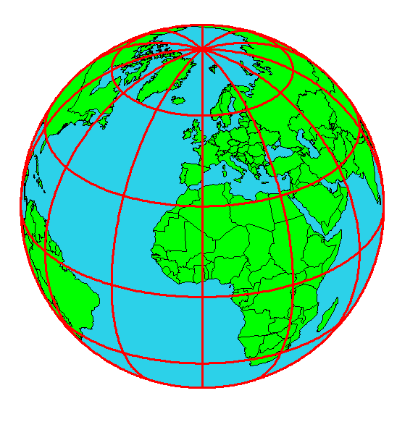
Origin of Geographic Coordinates
Equator
(0,0)
Prime Meridian

Slide 6

Length on Meridians and Parallels (Spherical Earth)
(Lat, Long) = (φ, λ)
Length on a Meridian:
AB = R_{e} Δφ
(same for all latitudes)
R
Δλ
D
30 N
R
C
R_{e}
Δφ
B
0 N
R_{e}
Length on a Parallel:
CD = R Δλ = R_{e} Δλ Cos φ
(varies with latitude)
A

Slide 7
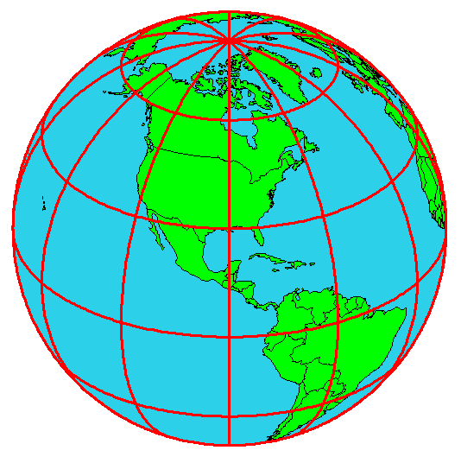
Example: What is the length of a 1º increment along
on a meridian and on a parallel at 30N, 90W?
Radius of the earth = 6370 km.
Solution:
A 1º angle has first to be converted to radians
π radians = 180 º, so 1º = π/180 = 3.1416/180 = 0.0175 radians
For the meridian, ΔL = R_{e} Δφ = 6370 ∗ 0.0175 = 111 km
For the parallel, ΔL = R_{e} Δλ Cos φ
= 6370 ∗ 0.0175 ∗ Cos 30
= 96.5 km
Parallels converge as poles are approached

Slide 8
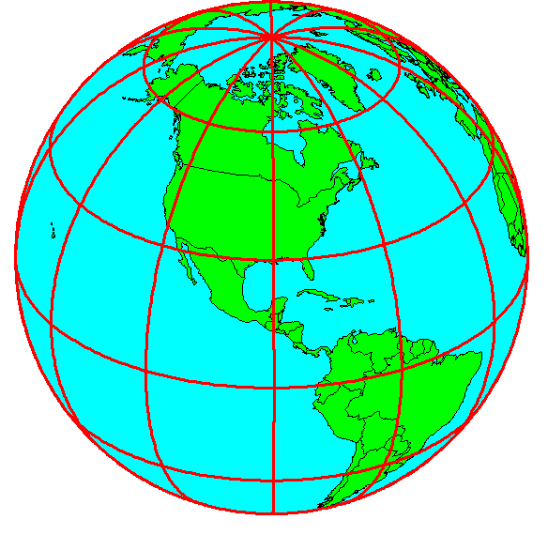
Shape of the Earth
It is actually a spheroid, slightly larger in radius at the equator than at the poles
We think of the
earth as a sphere

Slide 9
Ellipse
An ellipse is defined by:
Focal length = ε
Distance (F1, P, F2) is
constant for all points
on ellipse
When ε = 0, ellipse = circle
Z
b
O
a
X
F₁
ε
ε
F₂
For the earth:
Major axis, a = 6378 km
Minor axis, b = 6357 km
Flattening ratio, f = (a-b)/a
~ 1/300
P

Slide 10
Ellipsoid or Spheroid
Rotate an ellipse around an axis
Z
b
O
a
Y
a
X
Rotational axis

Slide 11
Horizontal Earth Datums
An earth datum is defined by an ellipse and an axis of rotation
NAD27 (North American Datum of 1927) uses the Clarke (1866) ellipsoid on a non geocentric axis of rotation
NAD83 (NAD,1983) uses the GRS80 ellipsoid on a geocentric axis of rotation
WGS84 (World Geodetic System of 1984) uses GRS80, almost the same as NAD83

Slide 12
Definition of Latitude, φ
m
S
p
O
n
φ
q
r
(1) Take a point S on the surface of the ellipsoid and define there the tangent plane, mn
(2) Define the line pq through S and normal to the
tangent plane
(3) Angle pqr which this line makes with the equatorial
plane is the latitude φ, of point S

Slide 13
Cutting Plane of a Meridian
P
Prime Meridian
Equator
Meridian
plane

Slide 14
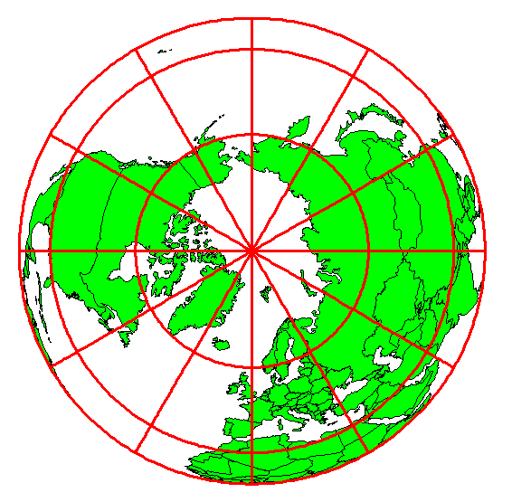
Definition of Longitude, λ
λ = the angle between a cutting plane on the prime meridian
and the cutting plane on the meridian through the point, P
180°E, W
-150°
150°
-120°
120°
90°W
(-90 °)
90°E
(+90 °)
-60°
P
λ
-60°
-30°
30°
0°E, W

Slide 15
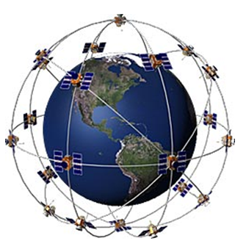
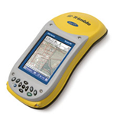
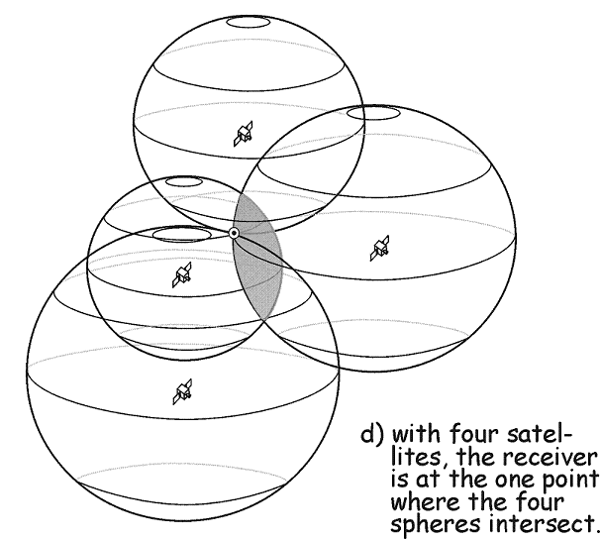
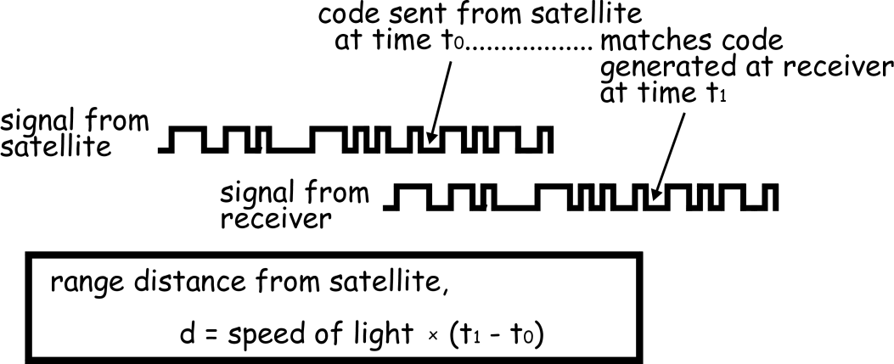
Global Positioning Systems
Distance to four satellites gives (x,y,z)
Notes:
If we then make a measurement from a third satellite and find that we're 13,000 miles from that one, that narrows our position down even further, to the two points where the 13,000 mile sphere cuts through the circle that's the intersection of the first two spheres.
So by ranging from three satellites we can narrow our position to just two points in space.
To decide which one is our true location we could make a fourth measurement. But usually one of the two points is a ridiculous answer (either too far from Earth or moving at an impossible velocity) and can be rejected without a measurement.
A fourth measurement does come in very handy for another reason however, but we'll tell you about that later

Slide 16
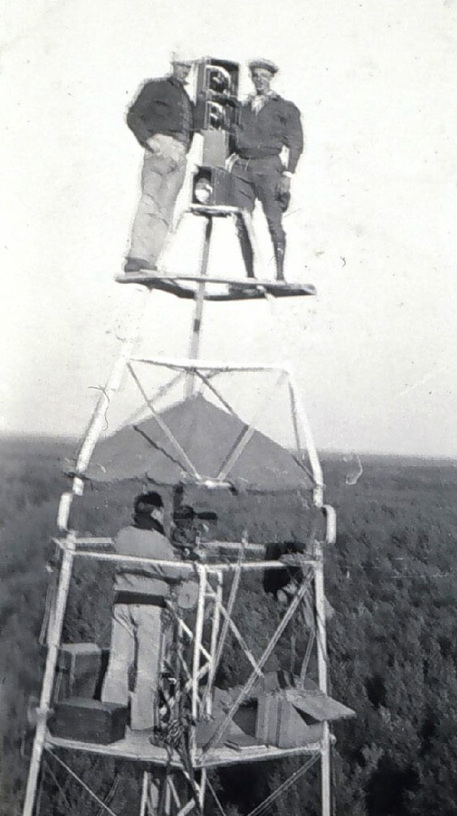
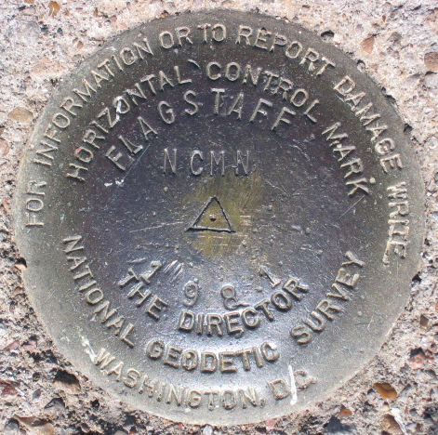
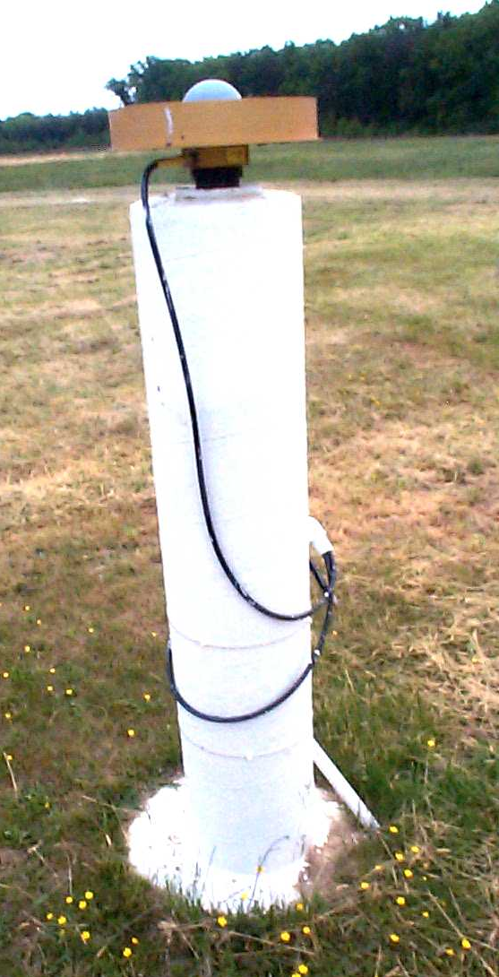
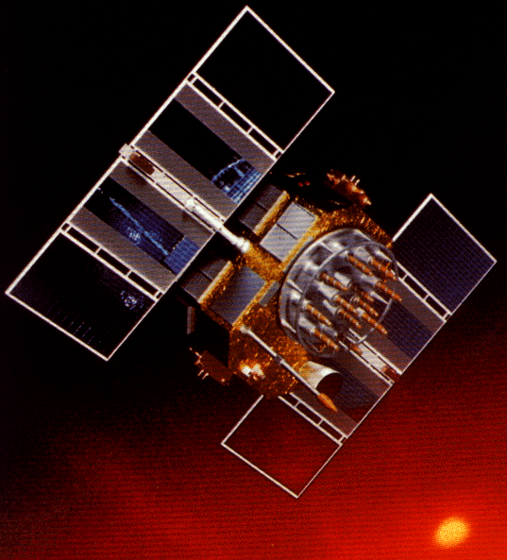
Revolution in Earth Measurement
Some images and slides from Michael Dennis, National Geodetic Survey and Lewis Lapine, South Carolina Geodetic Survey
Traditional Surveying uses benchmarks as reference points
Global Positioning uses fixed GPS receivers as reference points (Continuously Operating Reference System, CORS)

Slide 17
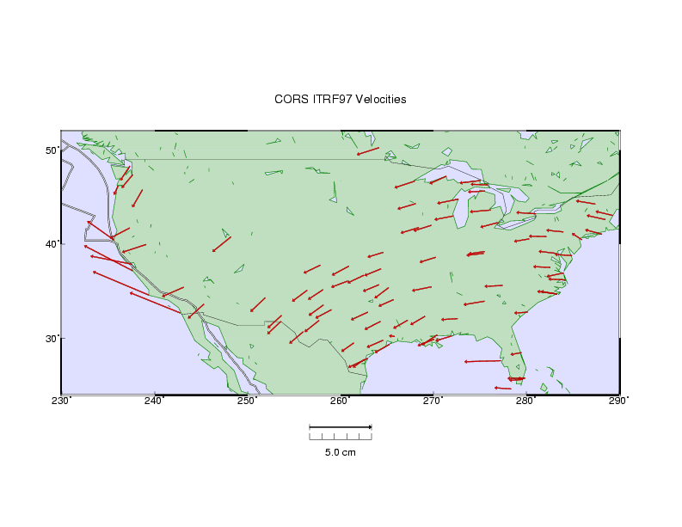

HORIZONTAL TECTONIC MOTIONS
Motion in cm/year
North American Plate
Pacific Plate
When is California not in North America …
…. when its on the Pacific Plate!

Slide 18
Representations of the Earth
Geoid is a surface of constant
gravitational potential
~ Sea surface
Ellipsoid
Earth surface
Geoid

Slide 19
Definition of Elevation
Elevation Z
P
z = z_{p}
•
z = 0
Land Surface
Mean Sea level = Geoid
Elevation is measured from the Geoid

Slide 20
Vertical Earth Datums
A vertical datum defines elevation, z
NGVD29 (National Geodetic Vertical Datum of 1929)
NAVD88 (North American Vertical Datum of 1988)
The National Elevation Dataset is in the NAVD88 datum
Heights are “elevation above datum”

Slide 21
Geodesy and Map Projections
Geodesy - the shape of the earth and definition of earth datums
Map Projection - the transformation of a curved earth to a flat map
Coordinate systems - (x,y) coordinate systems for map data

Slide 22
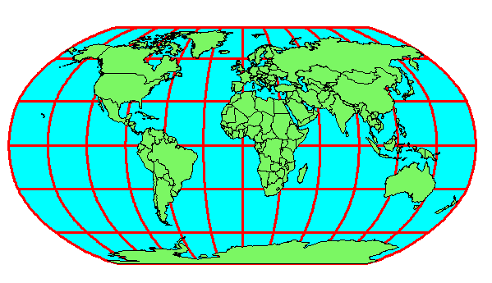
Earth to Globe to Map
Map Scale:
Map Projection:
Representative Fraction
Globe distance
Earth distance
Scale Factor
Map distance
Globe distance
=
=
(e.g. 1:24,000)
(e.g. 0.9996)

Slide 23
Types of Projections
Conic (Albers Equal Area, Lambert Conformal Conic) - good for East-West land areas
Cylindrical (Transverse Mercator) - good for North-South land areas
Azimuthal (Lambert Azimuthal Equal Area) - good for global views

Slide 24
Projections Preserve Some
Earth Properties
Area - correct earth surface area (Albers Equal Area) important for mass balances
Shape - local angles are shown correctly (Lambert Conformal Conic)
Direction - all directions are shown correctly relative to the center (Lambert Azimuthal Equal Area)
Distance - preserved along particular lines
Some projections preserve two properties

Slide 25
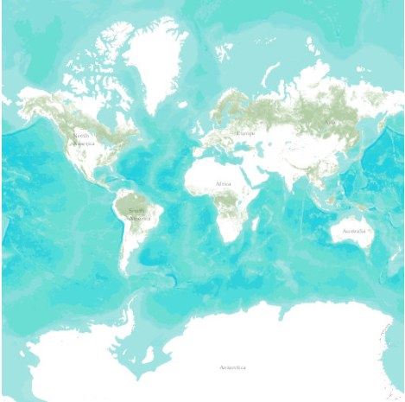
Web Mercator Projection
(used for ESRI Basemaps)
Web Mercator is one of the most popular coordinate systems used in web applications because it fits the entire globe into a square area that can be covered by 256 by 256 pixel tiles.
The spatial reference for the ArcGIS Online / Google Maps / Bing Maps tiling scheme is WGS 1984 Web Mercator (Auxiliary Sphere).

Slide 26
Coordinate Systems
A planar coordinate system is defined by a pair
of orthogonal (x,y) axes drawn through an origin
Y
Origin
X
(x_{o},y_{o})
(φ_{o},λ_{o})

Slide 27
State Plane Coordinate System
Defined for each State in the United States
East-West States (e.g. Texas) use Lambert Conformal Conic, North-South States (e.g. California) use Transverse Mercator
Texas has five zones (North, North Central, Central, South Central, South) to give accurate representation
Greatest accuracy for local measurements

Slide 28
Review for Midterm Exam
Location on the Earth
ArcGIS as a Geographic Information System
Working with Raster Data
Working with Vector Data
Remote Sensing

Slide 29




What is GIS
A geographic information system (GIS) is a system designed to capture, store, manipulate, analyze, manage, and present all types of geographical data. -- Wikipedia
data
computers
maps
tools

Slide 30
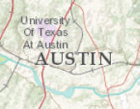
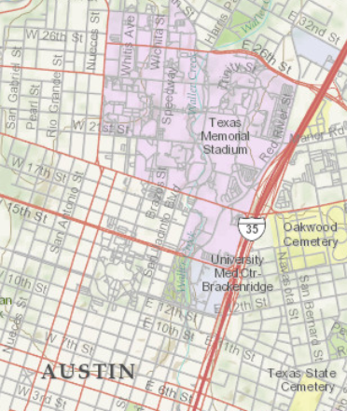
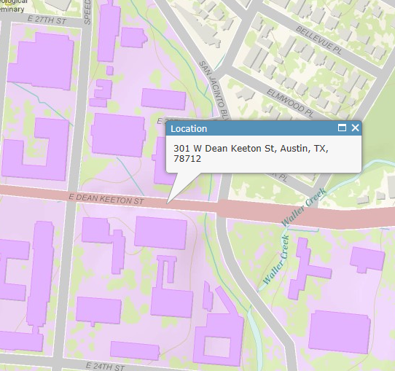
Geography is visualized in maps
map
www.arcgis.com

Slide 31
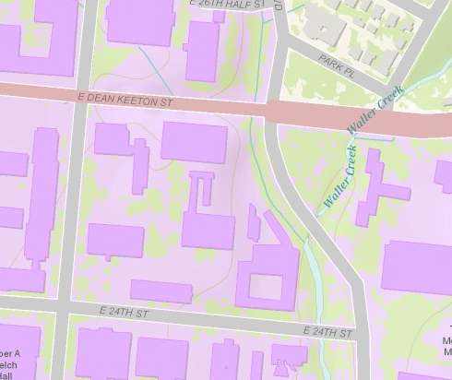
Maps are built from data
Road
Name: E. Dean Keeton St
Type: Div Highway
Speed: 35 mph
Shape: [Geometry]
Building
Name: Ernest Cockrell Jr Hall
Address: 301 E. Dean Keeton St
Shape: [Geometry]
data
Shape includes the geometry of the feature and where it is located on earth
map

Slide 32
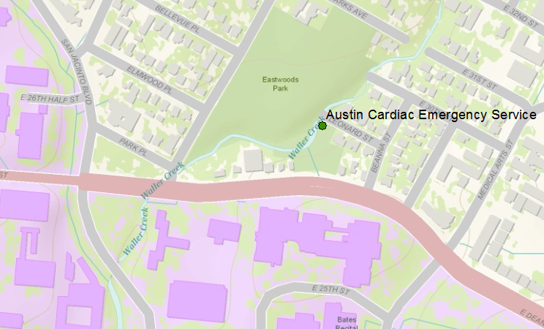
Vector data represent discrete features
points
lines
data
polygons
map

Slide 33
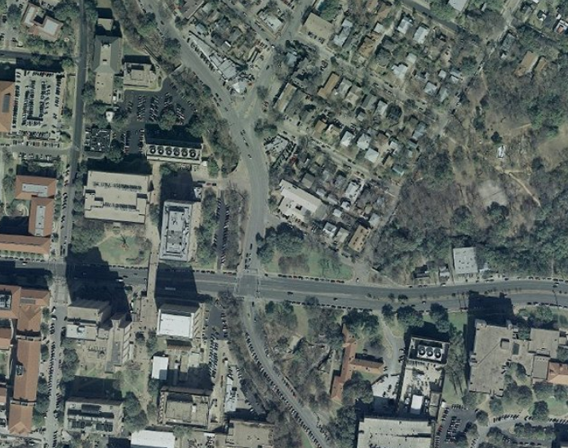
Raster data form a grid of cells or pixels
data
map

Slide 34
Data Model
Conceptual Model – a set of concepts that describe a subject and allow reasoning about it
Mathematical Model – a conceptual model expressed in symbols and equations
Data Model – a conceptual model expressed in a data structure (e.g. ascii files, Excel tables, …..)
Geographic Data Model – a conceptual model for describing and reasoning about the world expressed in a GIS database

Slide 35
Linking Geography and Attributes
GIS has a one to one association between a geographic feature and a record in an attribute table.
Geographic coordinates
Tabular attributes

Slide 36
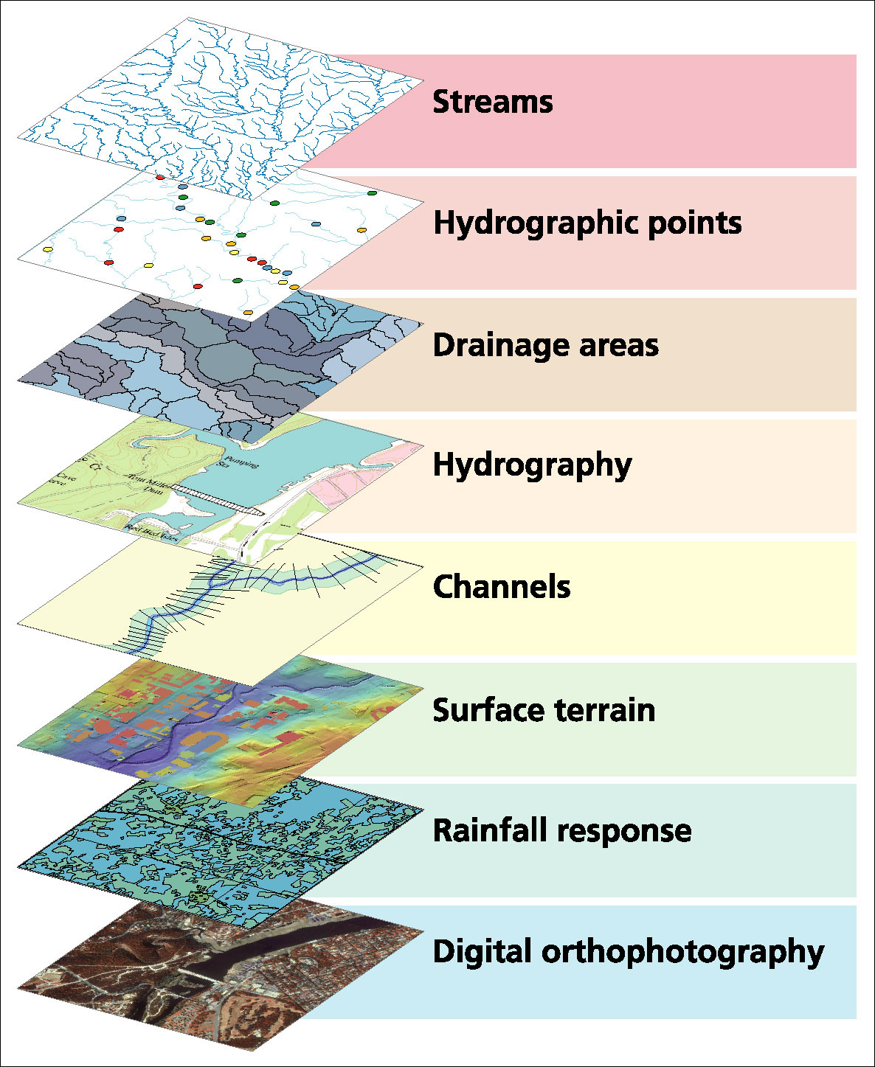
Data Model based on Inventory of data layers

Slide 37
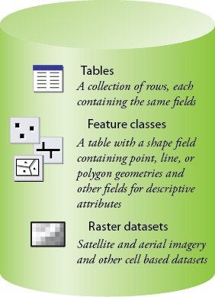
Common Geospatial Information Types
Image: Michael Zeiler, ESRI

Slide 38
Raster and Vector Data
Raster data are described by a cell grid, one value per cell
Vector
Raster
Point
Line
Zone of cells
Polygon

Slide 39
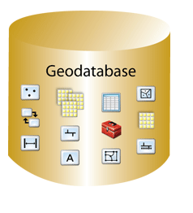
Geodatabase – a store for all types of geospatial information

Slide 40
Geodesy, Map Projections and Coordinate Systems
Geodesy - the shape of the earth and definition of earth datums
Map Projection - the transformation of a curved earth to a flat map
Coordinate systems - (x,y) coordinate systems for map data
Spatial Reference = Datum +
Projection +
Coordinate system

Slide 41
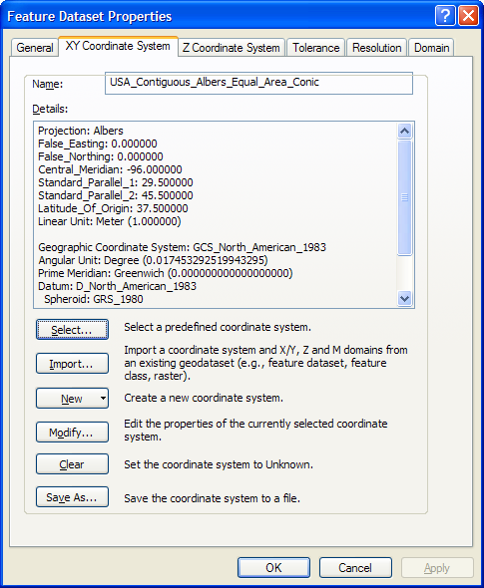
ArcGIS Spatial Reference Frames
Defined for a feature dataset in ArcCatalog
XY Coordinate System
  Projected
  Geographic
Z Coordinate system

Slide 42
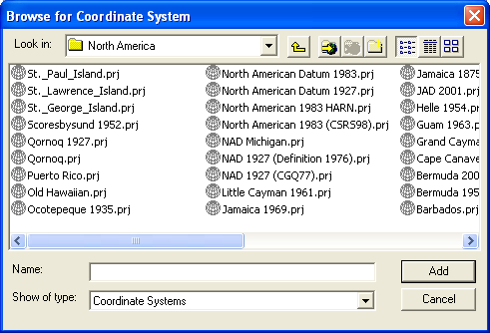
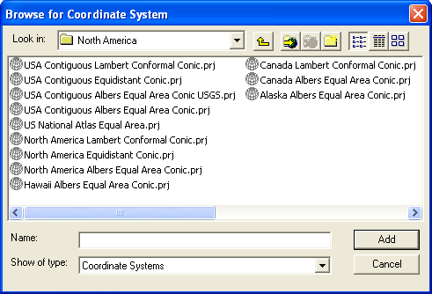
Horizontal Coordinate Systems
Geographic coordinates (decimal degrees)
Projected coordinates (length units, ft or meters)

Slide 43
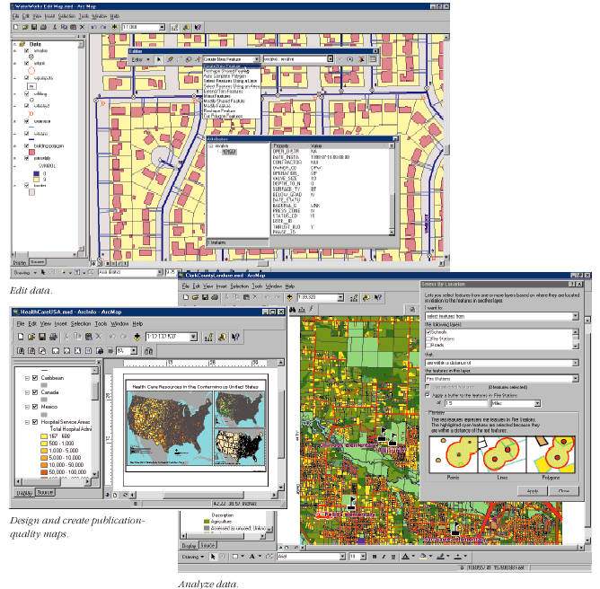
Key ArcGIS Software Components
ArcMap
ArcCatalog
ArcToolbox
Extensions
Geoprocessing

Slide 44
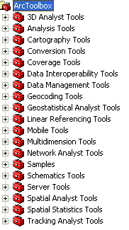
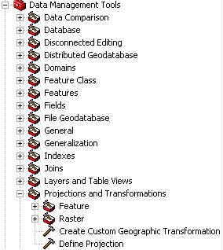
Arc Toolbox
Tools for commonly used tasks
Map Projections

Slide 45
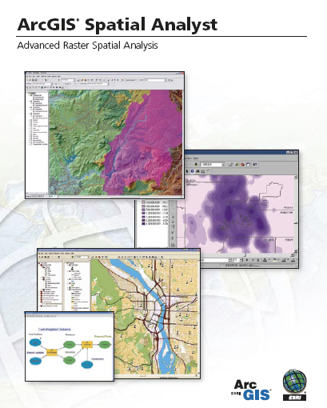
Spatial Analyst
Analysis of land surface terrain as a grid
Key means of defining drainage areas and connectivity to stream network

Slide 46
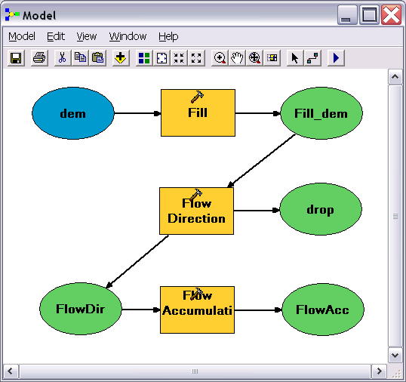
Geo-Processing
Toolbox tools linked together using the model builder to automate data processing

Slide 47



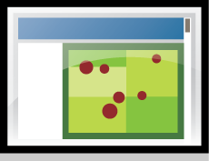










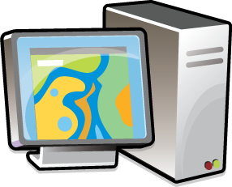
Web-centered GIS
ArcGIS
Online

Slide 48
Review for Midterm Exam
Location on the Earth
ArcGIS as a Geographic Information System
Working with Raster Data
Working with Vector Data
Remote Sensing

Slide 49
f(x,y)
y
x

Slide 50
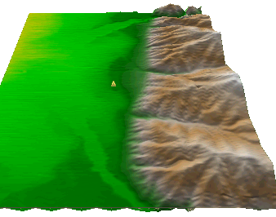
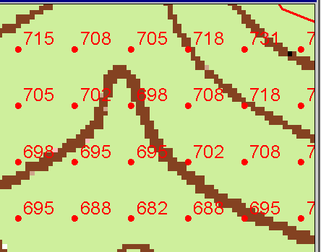
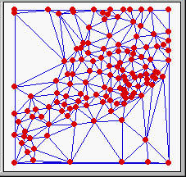
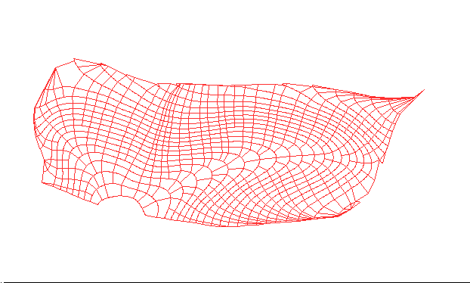
Numerical representation of a spatial surface (field)
Grid
TIN
Contour and flowline

Slide 51
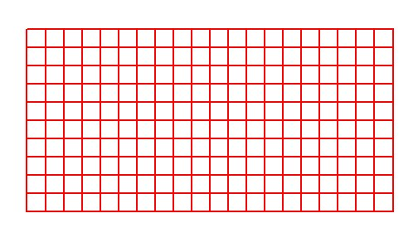
Grid Datasets
Cellular-based data structure composed of square cells of equal size arranged in rows and columns.
The grid cell size and extent (number of rows and columns), as well as the value at each cell have to be stored as part of the grid definition.
Number of columns
Cell size
Number of rows

Slide 52
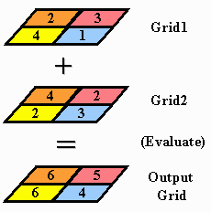
Raster Calculator
Cell by cell evaluation of mathematical functions

Slide 53



Nearest Neighbor Resampling with Cellsize Maximum of Inputs
100 m
40
50
55
40-0.5*4 = 38
42
47
43
55-0.5*6 = 52
38
52
42
44
41
42-0.5*2 = 41
41-0.5*4 = 39
41
39
150 m
4
6
2
4

Slide 54
Interpolation
Estimate values between known values.
A set of spatial analyst functions that predict values for a surface from a limited number of sample points creating a continuous raster.
Apparent improvement in resolution may not be justified

Slide 55
Interpolation methods
Nearest neighbor
Inverse distance weight
Bilinear interpolation
Kriging (best linear unbiased estimator)
Spline

Slide 56
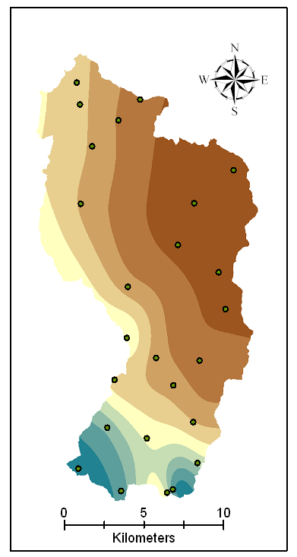
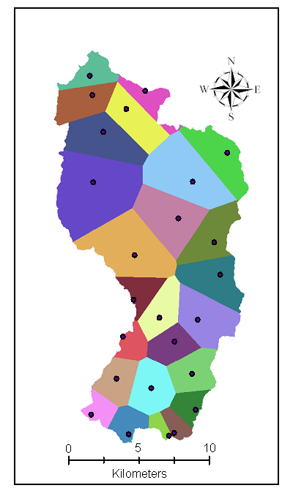
Nearest Neighbor “Thiessen” Polygon Interpolation
Spline Interpolation

Slide 57
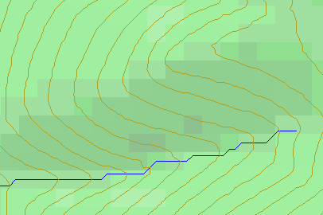
Topographic Slope
Defined or represented by one of the following
  Surface derivative ∇z
  Vector with x and y components
  Vector with magnitude (slope) and direction (aspect)

Slide 58
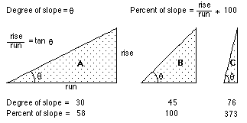
ArcGIS “Slope” tool
a
b
c
d
e
f
g
h
i

Slide 59
DEM Based Watershed and Stream Network Delineation Steps
DEM Reconditioning/Burning in Streams
Fill Sinks
Eight direction pour point model to evaluate flow directions
Flow accumulation
Threshold stream network definition
Stream segmentation
Watershed delineation
Raster to vector conversion of streams and watersheds

Slide 60
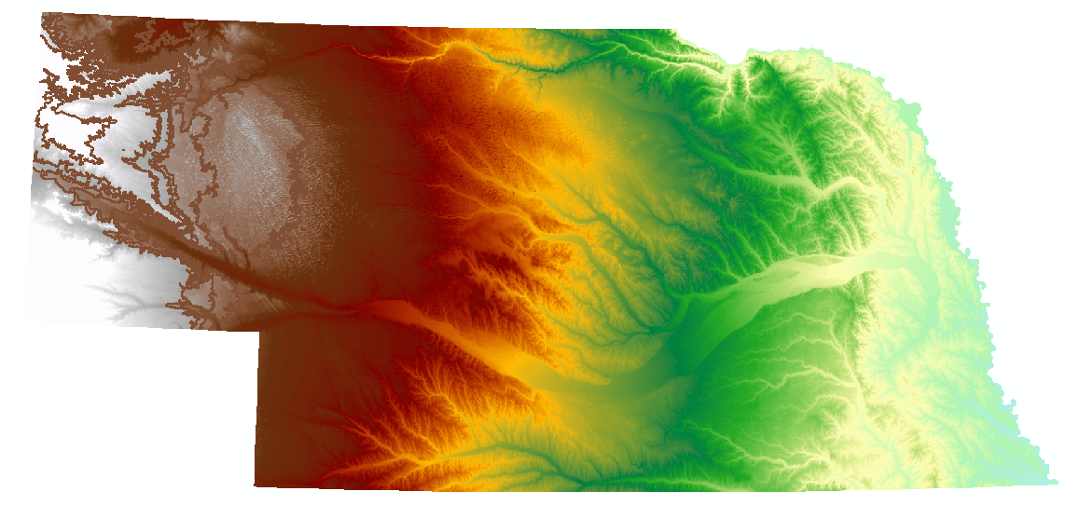
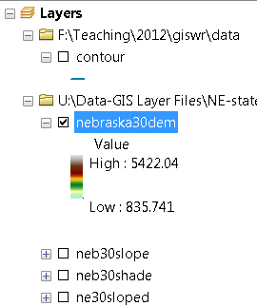
Digital Elevation Model (DEM)-30 meter
National Elevation Dataset

Slide 61
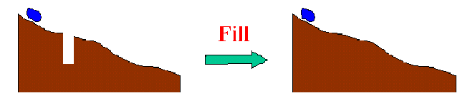
Filling in the Pits
DEM creation results in artificial pits in the landscape
A pit is a set of one or more cells which has no downstream cells around it
Unless these pits are filled they become sinks and isolate portions of the watershed
Pit filling is first thing done with a DEM

Slide 62
Identifying and Removing Pits/Sinks in a DEM
Contains pits
Filled
5 | 5 | 4 | 5 | 5 | 5 | 5 | 3 | 5 | 5
6 | 6 | 5 | 6 | 6.1 | 5 | 6 | 6 | 6 | 6
7 | 7 | 6 | 7 | 7 | 4 | 7 | 5 | 7 | 7
9 | 9 | 8 | 9 | 9 | 3.9 | 9 | 5 | 9 | 9
11 | 11 | 10 | 11 | 11 | 11 | 11 | 9 | 11 | 11
12 | 12 | 8 | 12 | 12 | 12 | 12 | 10 | 12 | 12
13 | 12 | 7 | 12 | 13 | 13 | 13 | 11 | 13 | 13
14 | 7 | 6 | 11 | 14 | 14 | 14 | 12 | 14 | 14
15 | 7 | 7 | 8 | 9 | 15 | 15 | 8 | 15 | 15
15 | 8 | 8 | 8 | 7 | 16 | 16 | 14 | 16 | 16
15 | 11 | 9 | 11 | 11 | 17 | 17 | 17 | 17 | 17
15 | 15 | 8 | 15 | 15 | 18 | 18 | 15 | 18 | 18
5 | 5 | 4 | 5 | 5 | 5 | 5 | 3 | 5 | 5
6 | 6 | 5 | 6 | 6.1 | 5 | 6 | 6 | 6 | 6
7 | 7 | 6 | 7 | 7 | 4 | 7 | 5 | 7 | 7
9 | 9 | 8 | 9 | 9 | 3.9 | 9 | 5 | 9 | 9
11 | 11 | 10 | 11 | 11 | 11 | 11 | 9 | 11 | 11
12 | 12 | 8 | 12 | 12 | 12 | 12 | 10 | 12 | 12
13 | 12 | 7 | 12 | 13 | 13 | 13 | 11 | 13 | 13
14 | 7 | 6 | 11 | 14 | 14 | 14 | 12 | 14 | 14
15 | 7 | 7 | 8 | 9 | 15 | 15 | 8 | 15 | 15
15 | 8 | 8 | 8 | 7 | 16 | 16 | 14 | 16 | 16
15 | 11 | 9 | 11 | 11 | 17 | 17 | 17 | 17 | 17
15 | 15 | 8 | 15 | 15 | 18 | 18 | 15 | 18 | 18
5 | 5 | 4 | 5 | 5 | 5 | 5 | 3 | 5 | 5
6 | 6 | 5 | 6 | 6.1 | 5 | 6 | 6 | 6 | 6
7 | 7 | 6 | 7 | 7 | 4 | 7 | 5 | 7 | 7
9 | 9 | 8 | 9 | 9 | 3.9 | 9 | 5 | 9 | 9
11 | 11 | 10 | 11 | 11 | 11 | 11 | 9 | 11 | 11
12 | 12 | 8 | 12 | 12 | 12 | 12 | 10 | 12 | 12
13 | 12 | 7 | 12 | 13 | 13 | 13 | 11 | 13 | 13
14 | 7 | 6 | 11 | 14 | 14 | 14 | 12 | 14 | 14
15 | 7 | 7 | 8 | 9 | 15 | 15 | 8 | 15 | 15
15 | 8 | 8 | 8 | 7 | 16 | 16 | 14 | 16 | 16
15 | 11 | 9 | 11 | 11 | 17 | 17 | 17 | 17 | 17
15 | 15 | 8 | 15 | 15 | 18 | 18 | 15 | 18 | 18
5 | 5 | 4 | 5 | 5 | 5 | 5 | 3 | 5 | 5
6 | 6 | 5 | 6 | 6.1 | 5 | 6 | 6 | 6 | 6
7 | 7 | 6 | 7 | 7 | 4 | 7 | 6 | 7 | 7
9 | 9 | 8 | 9 | 9 | 3.9 | 9 | 6 | 9 | 9
11 | 11 | 10 | 11 | 11 | 11 | 11 | 9 | 11 | 11
12 | 12 | 9 | 12 | 12 | 12 | 12 | 10 | 12 | 12
13 | 12 | 9 | 12 | 13 | 13 | 13 | 11 | 13 | 13
14 | 9 | 9 | 11 | 14 | 14 | 14 | 12 | 14 | 14
15 | 9 | 9 | 9 | 9 | 15 | 15 | 12 | 15 | 15
15 | 9 | 9 | 9 | 9 | 16 | 16 | 14 | 16 | 16
15 | 11 | 9 | 11 | 11 | 17 | 17 | 17 | 17 | 17
15 | 15 | 8 | 15 | 15 | 18 | 18 | 15 | 18 | 18
A pit is a set of one or more cells which has no downstream cells around it.

Slide 63
Hydrologic Slope
- Direction of Steepest Descent
30
30
67
56
49
67
56
49
52
48
37
52
48
37
58
55
22
58
55
22
Slope:

Slide 64
Eight Direction Pour Point Model
32
64
128
16
1
8
4
2
Water flows in the direction of steepest descent

Slide 65
Flow Accumulation Grid.
Area draining in to a grid cell
0
0
0
0
0
0
0
0
0
0
0
2
2
2
0
0
2
2
2
0
0
0
10
0
1
0
0
1
0
10
1
0
0
14
0
1
0
0
0
14
0
4
1
19
1
0
4
1
1
19
Flow Accumulation > Threshold
ArcHydro Page 72

Slide 66
Watershed Draining to Outlet

Slide 67
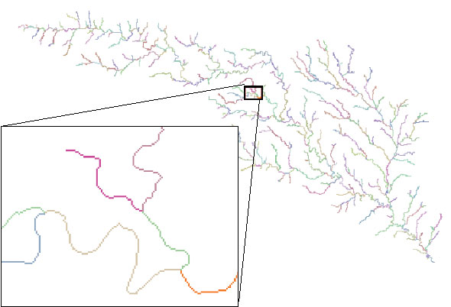
Stream links grid for the San Marcos subbasin
201
172
202
203
206
204
209
Each link has a unique identifying number

Slide 68
Review for Midterm Exam
Location on the Earth
ArcGIS as a Geographic Information System
Working with Raster Data
Working with Vector Data
Remote Sensing

Slide 69
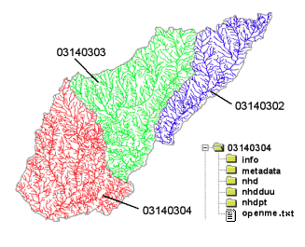
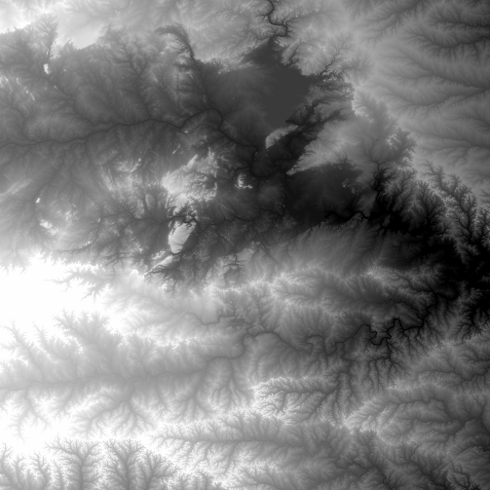


Data Sources for GIS in Water Resources
National Hydro Data Programs
National Elevation Dataset
(NED)
National Hydrography Dataset
(NHD)
What is it?
What does it contain?
What is the GIS format?
Where would it be obtained
NED-Hydrology
Watershed Boundary Dataset

Slide 70

Watershed Boundary Dataset for Nebraska
2990 HUC12 watersheds of average area 39.3 square miles
HUC12:HUC8 ~ 40:1 watersheds
Notes:
HUCs are important for estimating water supply, water quality, and runoff. They are building blocks of water studies

Slide 71


SSURGO:
County Level
Digital Soil Maps
1:24,000 scale
soil information
http://www.soils.usda.gov/survey/geography/ssurgo/

Slide 72


Ssurgo for Lancaster County, NE
96 soil map units described by 18,565 polygons

Slide 73

Catchments for Stream Links
Same Cell Value

Slide 74



Vectorized Streams Linked Using Grid Code to Cell Equivalents
Vector
Streams
Grid
Streams

Slide 75


Raster Zones and Vector Polygons
One to one connection
Raster pixel value
Catchment Grid_code
4
3
5
Raster Zones
Vector Polygons

Slide 76
Relationship
A relationship is an association or link between two objects in a database.
A relationship can exist between spatial objects (features in feature classes), non-spatial objects (objects in object classes), or between spatial and non-spatial objects.

Slide 77




Relationships linking Catchments and Drainage Lines

Slide 78



Zonal Average of Raster over Subwatershed joined to Subwatershed table
Join

Slide 79

Catchment, Watershed, Subwatershed.
Subwatersheds
Catchments
Watershed
Watershed outlet points may lie within the interior of a catchment, e.g. at a USGS stream-gaging site.

Slide 80

Network Tracing on the Guadalupe Basin

Slide 81




Connecting Land and Water
Four key ideas:
  Cell to cell water movement on DEMs
  Line to Line water movement on networks
  Area flows to line (connect land and water systems – Reach Catchments)
  Area flows to point on line (Watershed delineation from designated points)

Slide 82

Cell Flows to a Cell
Core concept of flow on digital elevation models

Slide 83


Line Flows to a Line
Geometric Network of NHDFlowlines

Slide 84

Area Flows to a Line
Reach Catchments from NHDPlus
Flowline and Catchment have the same COMID

Slide 85

Area Flows to a Point on a Line
Watersheds for USGS Gages

Slide 86
Review for Midterm Exam
Location on the Earth
ArcGIS as a Geographic Information System
Working with Raster Data
Working with Vector Data
Remote Sensing

Slide 87

Remote Sensing: A Definition
The art and science of acquiring information about the earth and its environment using sensors mounted in aircraft and spacecraft

Slide 88
Remotely sensed images have a number of features which make them ideal GIS data sources
Remote sensing provides a regional view
Remote sensing provides repetitive looks at the same area
Remote sensors "see" over a broader portion of the electromagnetic spectrum than the human eye

Slide 89
Remote Sensing Raster (Matrix) Data Format
Jensen 2000
Notes:
Digital remote sensor data are stored as matrix of numbers
Each digital value is located at a specific row and column in that matrix
Sensor systems creates pixels with a brightness value (BV) range of 8 to 12 bits. This is called “Quantization” level of remote sensor data.
8 bits have BV that range from 0 to 255
Data quantized to 12 bits range from 0 to 1023
The greater the range of values, the more precise we may able to measure the amount of radiance recorded by the sensor

Slide 90
Digital Image
25 | 22 | 19 | 47 | 44
22 | 18 | 25 | 22 | 44
19 | 21 | 22 | 23 | 42
21 | 116 | 121 | 125 | 134
118 | 125 | 123 | 135 | 126
125 | 133 | 136 | 221 | 234
244 | 243 | 212 | 232 | 178
Pixel (picture element)

Slide 91

Looking more closely: Visible” spectrum
Micrometers (one million of meter) or Nanometers (one billionth of a meter
Our eyes perceive light in the visible portion of spectrum
Satellites can operationally measure multi-spectral imagery (the simultaneous sensing of two or more wavebands).
Notes:
We can see only a small portion of the spectrum
But we have instruments that tell us there is radiation at other wavelengths
Our radios and televisions, for example, use invisible radio frequency electromagnetic radiation
We have infrared cameras that can take pictures in those invisible wavelengths
One reason that birds of prey can spot a mouse hundreds of feet away is that their eyes allow them to see ultraviolet radiation. Shorter wavelength means that their lenses can resolve the image better than our eyes can.

Slide 92

When light “hits” an object
Reflected
I=R+A+T
Incident Light
Absorbed
Transmitted
Remote Sensing deals with the Reflected light
Notes:
When light hits a target, three things can happen.
The light can be reflected, transmitted or absorbed.
This is embodied in the equation I=R+A+T. Incident light equals reflected, absorbed and transmitted light.

Slide 93

Reflectance
Typical reflectance signatures
Notes:
Here are three typical reflectance spectra
Bare soil. Higher reflectance in the infrared
Water. Hi absorption as the wavelength getes longer
Vegetation. More on this later
Key feature: absorption in blue and red. Some reflectance in green.

Slide 94


Major Satellite Series: Landsat
Notes:
Landsat has instruments that look at major wavelength bands

Slide 95

Color composite image

Slide 96


Landsat Images to Cover Nebraska
http://earthnow.usgs.gov/earthnow_app.html?sessionId=a0d0c8de12ec09f065837276c5d8ab6b4155

Slide 97

Remote Sensing Coverage of Nebraska
P33R30
10
P32R30
9
P31R30
10
P30R30
9
P29R30
10
P33R31
11
P32R31
10
P31R31
12
P30R31
9
P29R31
11
P28R31
8
P33R32
15
P32R32
8
P31R32
12
P30R32
10
P29R32
12
P28R32
10
P27R32
8

Slide 98



Vegetation Index
As plants grow, canopy and biomass increase
Green leaves absorb more red and blue light –
Increase in NIR reflectance
Vegetation indices express the difference between NIR and red reflectance
“Greenness” - associated with plant photosynthetic activity, biomass, fractional cover of vegetation
Normalized vegetation index (-1, 1)

Slide 99


Slide 100


Slide 101




Evaporation from Remote Sensing (Dr Kilic)

