Slide 1
Spatial Analysis Using Grids
Learning Objectives
Continuous surfaces or spatial fields representation of geographical information
Grid data structure for representing numerical and categorical data
Map algebra raster calculations
Interpolation
Calculate slope on a raster using
  ArcGIS method based in finite differences
  D8 steepest single flow direction
  D∞ steepest outward slope on grid centered triangular facets

Slide 2
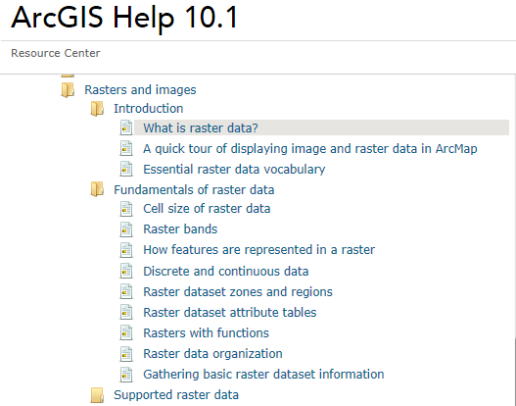
Readings – at http://resources.arcgis.com/en/help/
http://resources.arcgis.com/en/help/main/10.1/index.html#/What_is_raster_data/009t00000002000000/ Raster and Images, starting from "Introduction/What is raster data" to end of " Fundamentals of raster data/Raster dataset attribute tables"

Slide 3
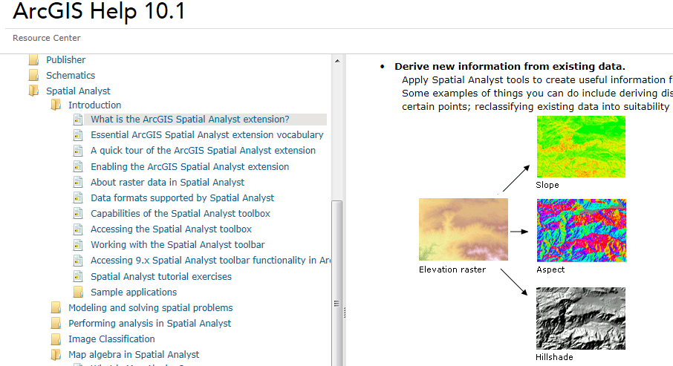
Readings – at http://resources.arcgis.com/
What is the ArcGIS Spatial Analyst extension http://resources.arcgis.com/en/help/main/10.1/index.html#/What_is_the_ArcGIS_Spatial_Analyst_extension/005900000001000000/

Slide 4
f(x,y)
y
x
Notes:
DRM

Slide 5
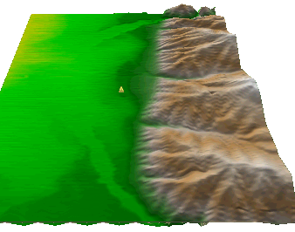
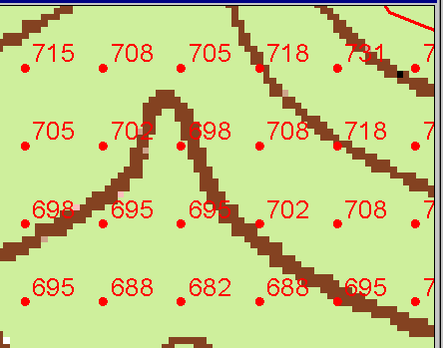
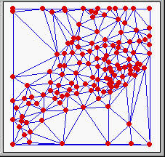
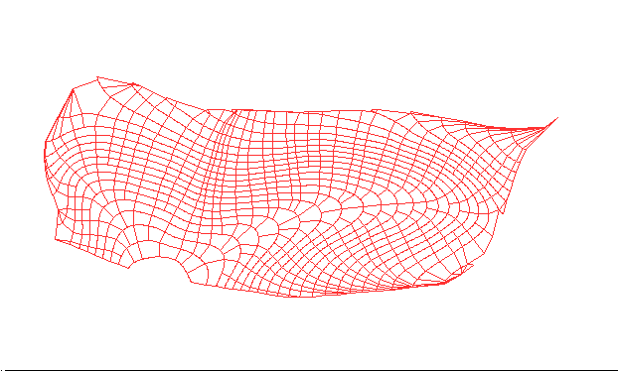
Numerical representation of a spatial surface (field)
Grid or Raster
TIN
Contour and flowline

Slide 6
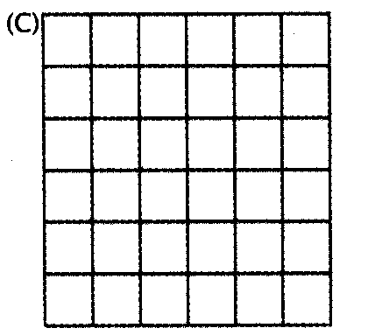
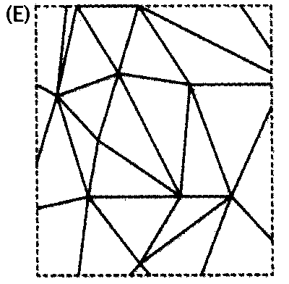
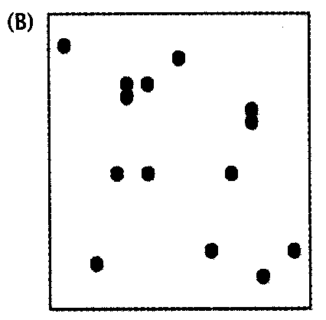
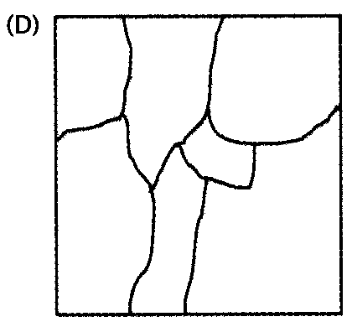
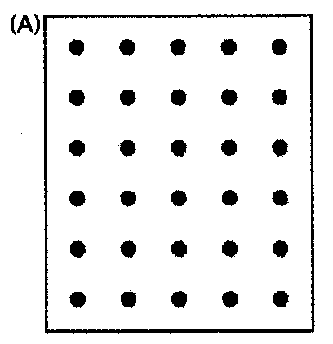
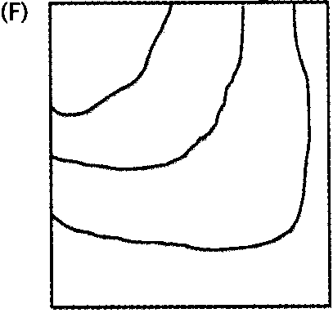
Six approximate representations of a field used in GIS
Regularly spaced sample points
Irregularly spaced sample points
Rectangular Cells
Irregularly shaped polygons
Triangulated Irregular Network (TIN)
Polylines/Contours
from Longley, P. A., M. F. Goodchild, D. J. Maguire and D. W. Rind, (2001), Geographic Information Systems and Science, Wiley, 454 p.

Slide 7
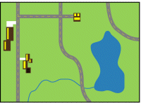
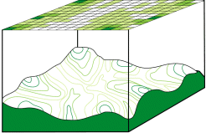
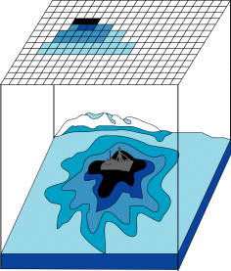
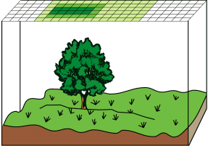
Discrete (vector) and continuous (raster) data
Images from http://resources.arcgis.com/en/help/main/10.1/index.html#/Discrete_and_continuous_data/009t00000007000000/

Slide 8
Raster and Vector Data
Raster data are described by a cell grid, one value per cell
Vector
Raster
Point
Line
Zone of cells
Polygon
Notes:
DRM

Slide 9
Raster and Vector are two methods of representing geographic data in GIS
Both represent different ways to encode and generalize geographic phenomena
Both can be used to code both fields and discrete objects
In practice a strong association between raster and fields and vector and discrete objects
Notes:
DRM

Slide 10
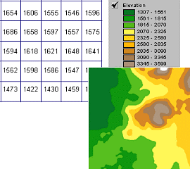
A grid defines geographic space as a mesh of identically-sized square cells. Each cell holds a numeric value that measures a geographic attribute (like elevation) for that unit of space.

Slide 11
The grid data structure
Grid size is defined by extent, spacing and no data value information
  Number of rows, number of column
  Cell sizes (X and Y)
  Top, left , bottom and right coordinates
Grid values
  Real (floating decimal point)
  Integer (may have associated attribute table)
Number of Columns
Number
of
rows
(X,Y)
NODATA cell
Cell size

Slide 12
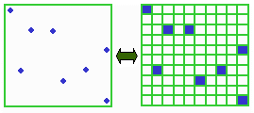
Points as Cells

Slide 13
Line as a Sequence of Cells

Slide 14
Polygon as a Zone of Cells

Slide 15
NODATA Cells

Slide 16
Cell Networks

Slide 17
Grid Zones

Slide 18
Floating Point Grids
Continuous data surfaces using floating point or decimal numbers

Slide 19
Value attribute table for categorical (integer) grid data
Attributes of grid zones

Slide 20
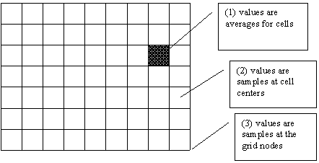
Raster Sampling
from Michael F. Goodchild. (1997) Rasters, NCGIA Core Curriculum in GIScience, http://www.ncgia.ucsb.edu/giscc/units/u055/u055.html, posted October 23, 1997

Slide 21
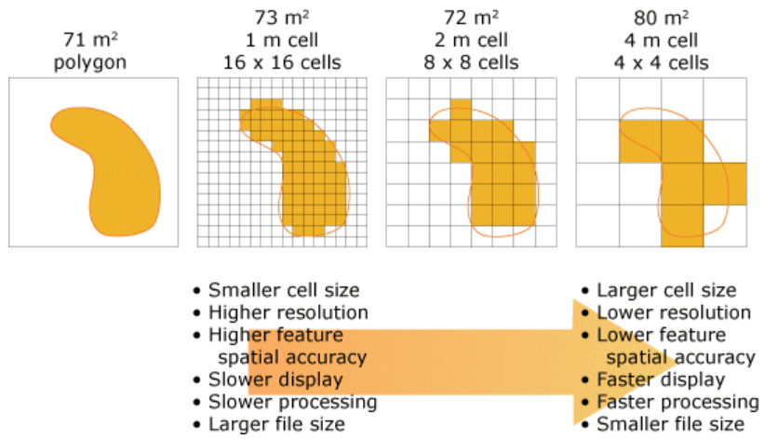
Cell size of raster data
From http://help.arcgis.com/en/arcgisdesktop/10.0/help/index.html#/Cell_size_of_raster_data/009t00000004000000/

Slide 22
Raster Generalization
Largest share rule
Central point rule

Slide 23
Map Algebra/Raster Calculation
Example
5
6
Precipitation
-
Losses (Evaporation, Infiltration)
=
Runoff
Cell by cell evaluation of mathematical functions
7
6
-
3
3
2
4
=
2
3
5
2

Slide 24
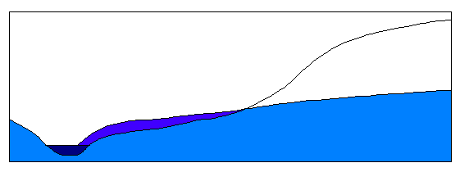
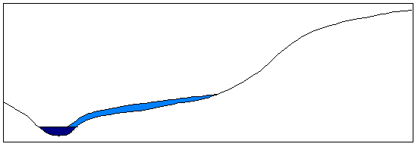
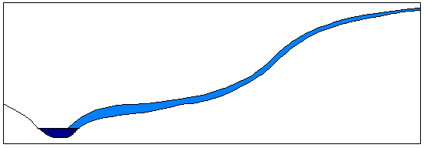
Runoff generation processes
P
Infiltration excess overland flow
aka Horton overland flow
P
f
P
q_{o}
f
Partial area infiltration excess overland flow
P
P
P
q_{o}
f
Saturation excess overland flow
P
P
P
q_{o}
q_{r}
q_{s}

Slide 25
Runoff generation at a point depends on
Rainfall intensity or amount
Antecedent conditions
Soils and vegetation
Depth to water table (topography)
Time scale of interest
These vary spatially which suggests a spatial geographic approach to runoff estimation

Slide 26
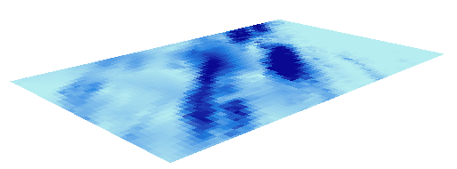
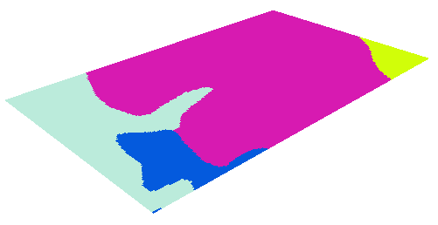
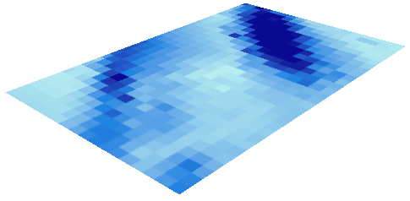
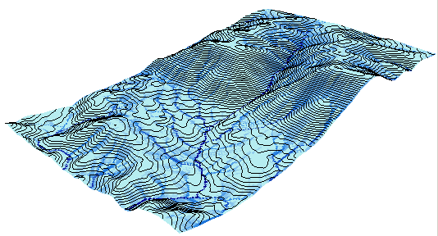
Cell based discharge mapping flow accumulation of generated runoff
Radar Precipitation grid
Soil and land use grid
Runoff grid from raster calculator operations implementing runoff generation formula’s
Accumulation of runoff within watersheds

Slide 27
Raster calculation – some subtleties
Resampling or interpolation (and reprojection) of inputs to target extent, cell size, and projection within region defined by analysis mask
+
=
Analysis mask
Analysis cell size
Analysis extent

Slide 28


Spatial Snowmelt Raster Calculation Example
100 m
150 m
100 m
40
50
55
150 m
4
6
42
47
43
2
4
42
44
41

Slide 29
Lets Experiment with this in ArcGIS
snow.asc
ncols 3
nrows 3
xllcorner 0
yllcorner 0
cellsize 100
NODATA_value -9999
40 50 55
42 47 43
42 44 41
temp.asc
ncols 2
nrows 2
xllcorner 0
yllcorner 0
cellsize 150
NODATA_value -9999
4 6
2 4

Slide 30
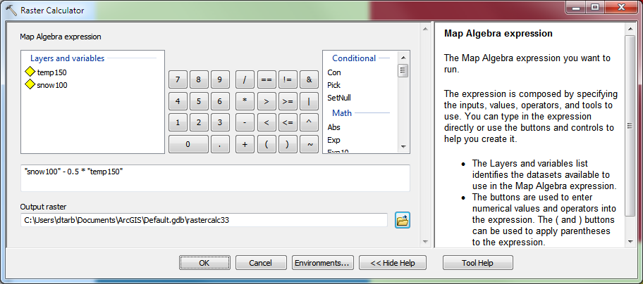
New depth calculation using Raster Calculator
“snow100” - 0.5 * “temp150”

Slide 31
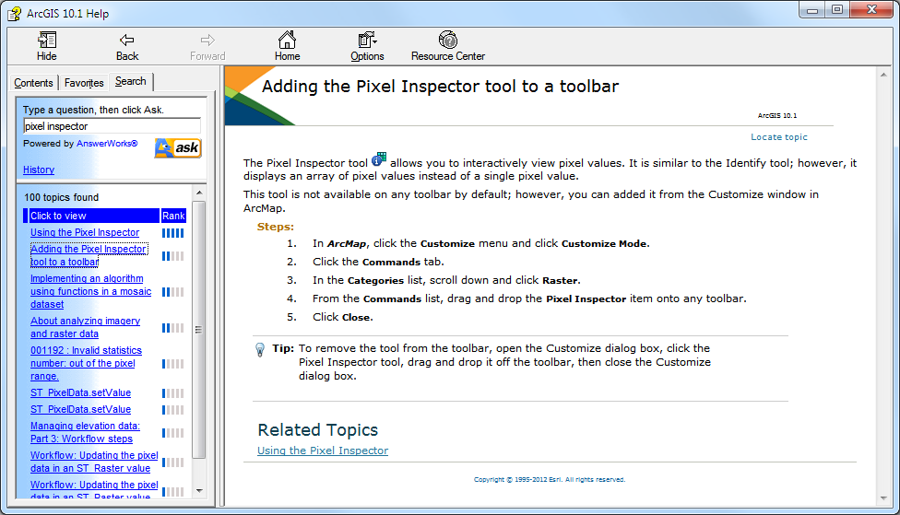
Example and Pixel Inspector

Slide 32
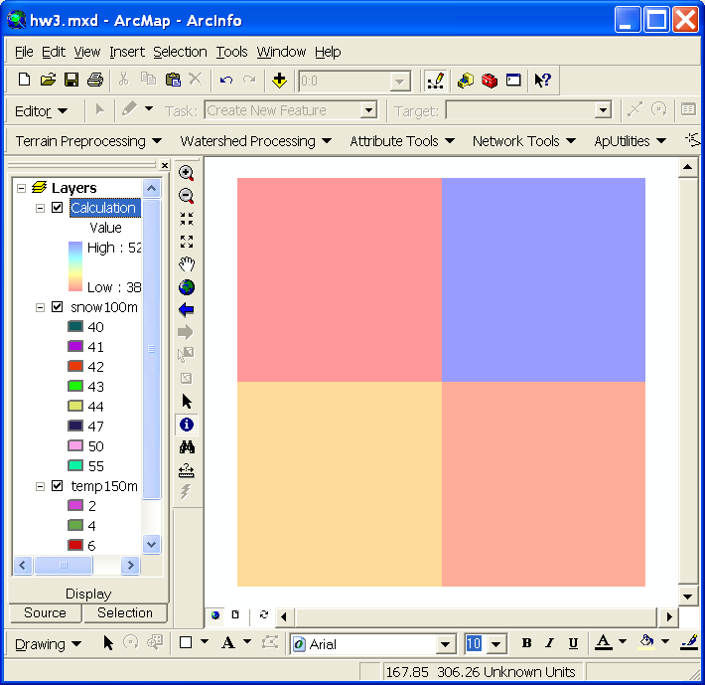
The Result
Outputs are on 150 m grid.
How were values obtained ?
38
52
41
39

Slide 33

Nearest Neighbor Resampling with Cellsize Maximum of Inputs
100 m
40
50
55
40-0.5*4 = 38
42
47
43
55-0.5*6 = 52
38
52
42
44
41
42-0.5*2 = 41
41-0.5*4 = 39
41
39
150 m
4
6
2
4

Slide 34
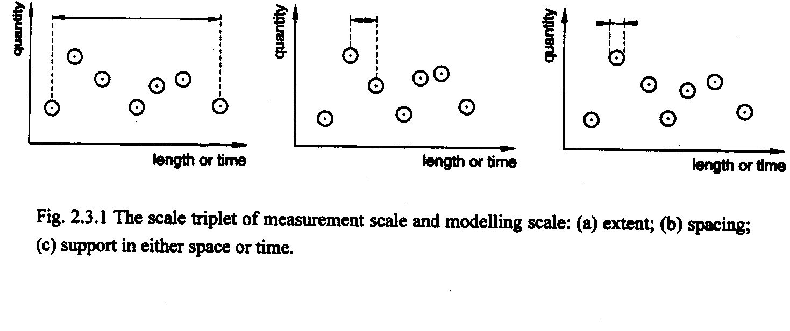
Scale issues in interpretation of measurements and modeling results
The scale triplet
a) Extent
b) Spacing
c) Support
From: Blöschl, G., (1996), Scale and Scaling in Hydrology, Habilitationsschrift, Weiner Mitteilungen Wasser Abwasser Gewasser, Wien, 346 p.

Slide 35
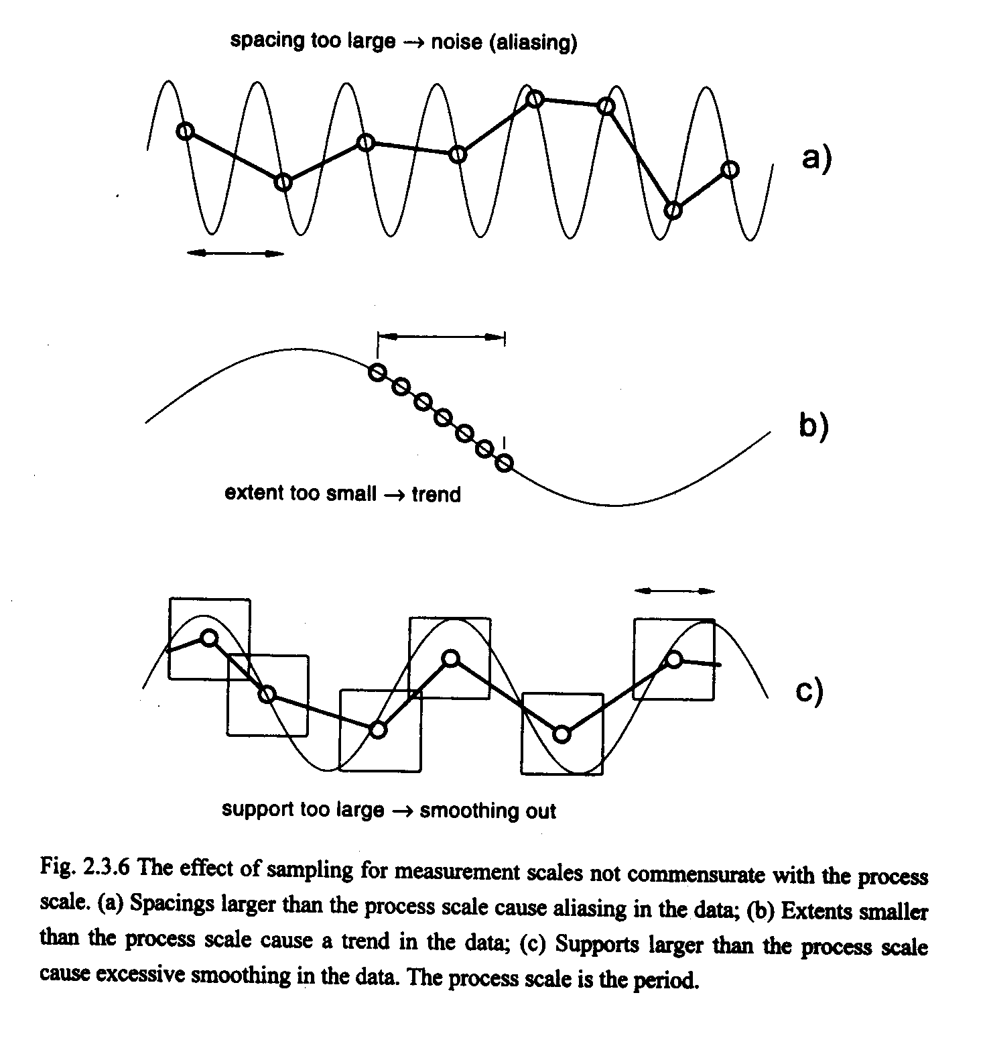
From: Blöschl, G., (1996), Scale and Scaling in Hydrology, Habilitationsschrift, Weiner Mitteilungen Wasser Abwasser Gewasser, Wien, 346 p.

Slide 36
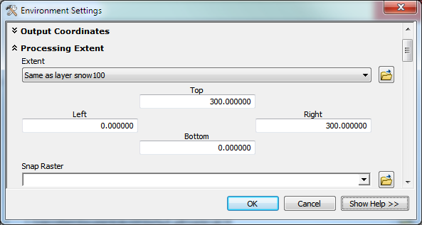
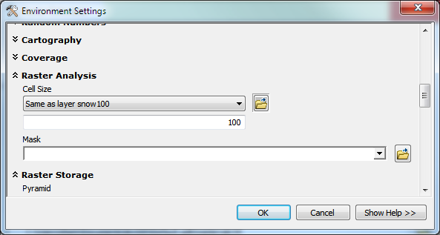
Use Environment Settings to control the scale of the output
Extent
Spacing & Support

Slide 37
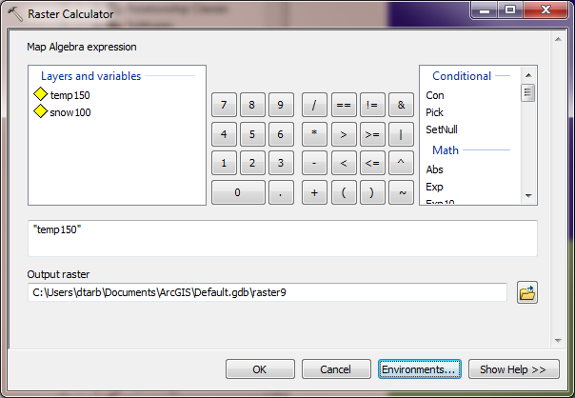
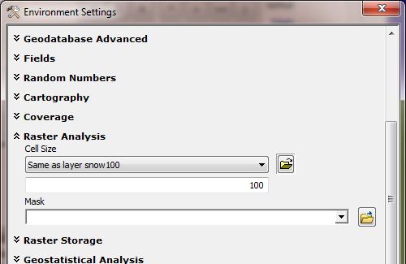
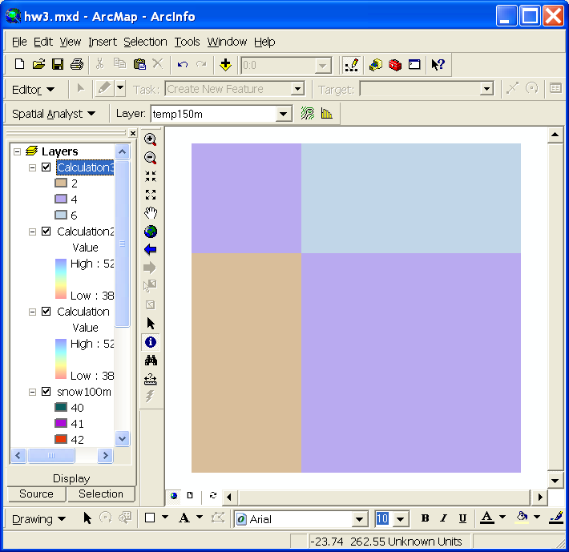
Raster Calculator “Evaluation” of “temp150”
4
4
6
6
6
2
4
4
2
4
2
4
4
Nearest neighbor to the E and S has been resampled to obtain a 100 m temperature grid.

Slide 38
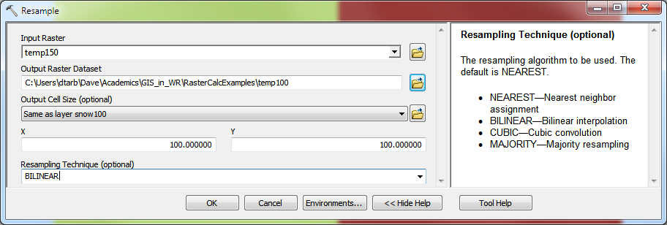
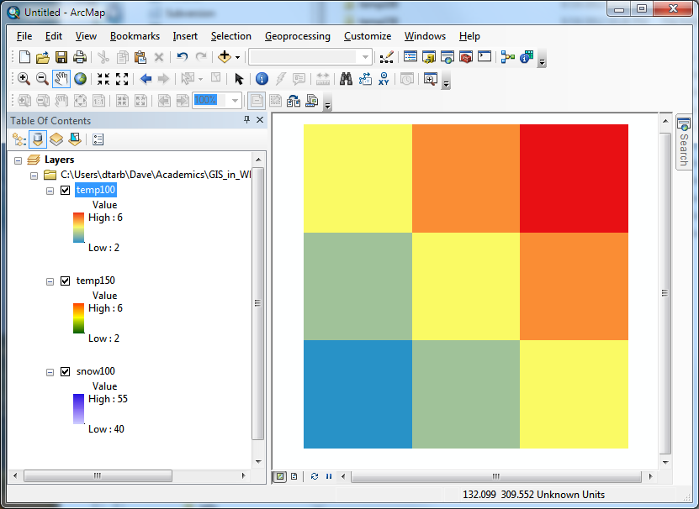
Resample to get consistent cell size
4
4
5
6
6
3
4
5
2
4
2
3
4

Slide 39
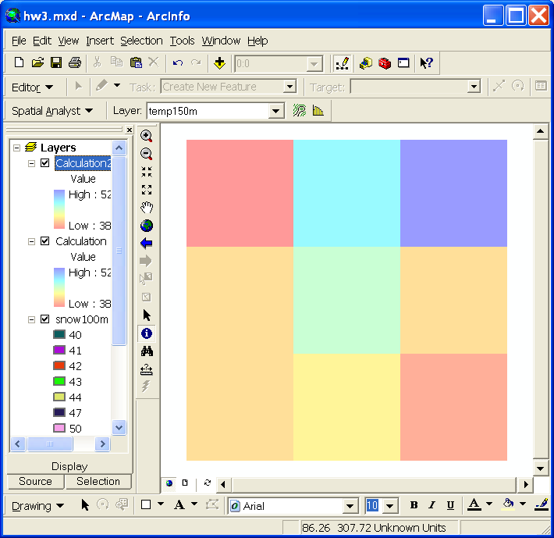
Calculation with consistent 100 m cell size grid
“snow100” - 0.5 * “temp100”
Outputs are on 100 m grid as desired.
How were these values obtained ?
38
47.5
52
40.5
45
40.5
41
42.5
39

Slide 40


100 m cell size raster calculation
40-0.5*4 = 38
100 m
40
50
55
50-0.5*5 = 47.5
55-0.5*6 = 52
42
47
43
42-0.5*3 = 40.5
47-0.5*4 = 45
38
47.5
52
42
44
41
43-0.5*5 = 40.5
40.5
45
40.5
42-0.5*2 = 41
4
5
6
44-0.5*3 = 42.5
150 m
41
42.5
39
4
6
41-0.5*4 = 39
3
4
5
2
4
2
3
4

Slide 41
What did we learn?
Raster calculator automatically uses nearest neighbor resampling
The scale (extent and cell size) can be set under options
What if we want to use some other form of interpolation?
From Point
  Natural Neighbor, IDW, Kriging, Spline, …
From Raster
  Resample (Nearest, Bilinear, Cubic)

Slide 42
Interpolation
Estimate values between known values.
A set of spatial analyst functions that predict values for a surface from a limited number of sample points creating a continuous raster.
Apparent improvement in resolution may not be justified

Slide 43
Interpolation methods
Nearest neighbor
Inverse distance weight
Bilinear interpolation
Kriging (best linear unbiased estimator)
Spline

Slide 44
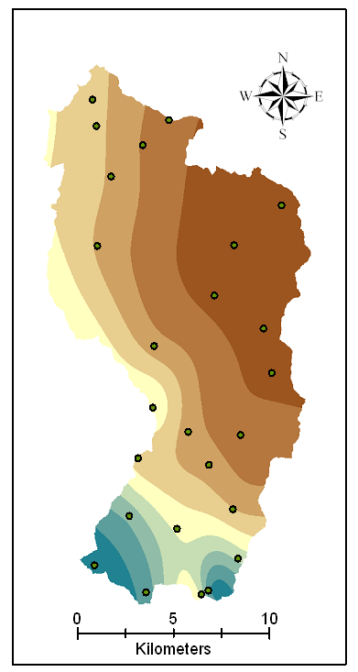
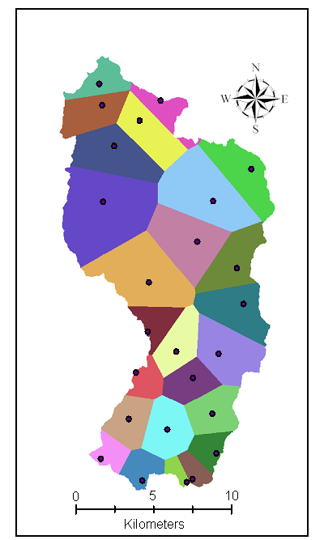
Nearest Neighbor “Thiessen” Polygon Interpolation
Spline Interpolation

Slide 45
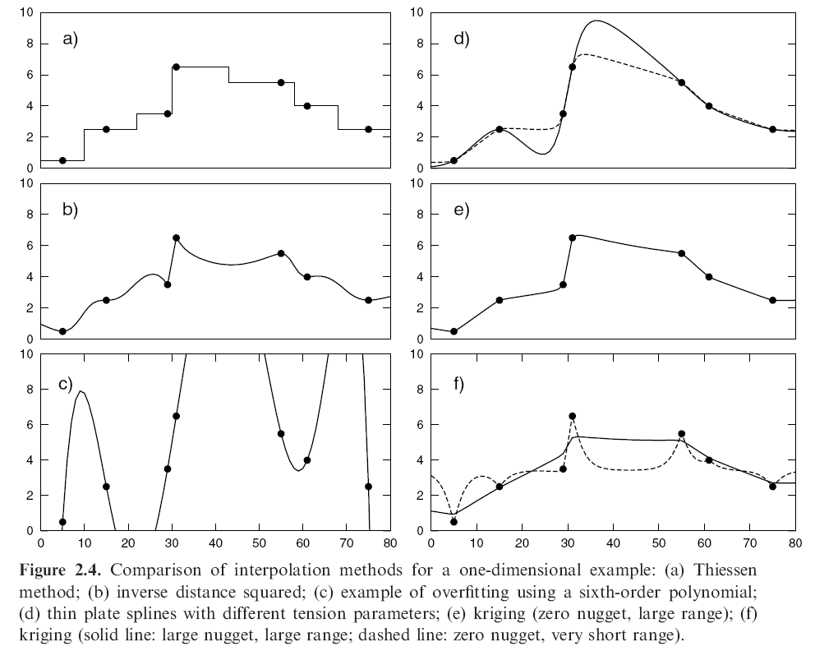
Interpolation Comparison
Grayson, R. and G. Blöschl, ed. (2000)

Slide 46
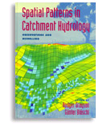
Further Reading
Grayson, R. and G. Blöschl, ed. (2000), Spatial Patterns in Catchment Hydrology: Observations and Modelling, Cambridge University Press, Cambridge, 432 p.
Chapter 2. Spatial Observations and Interpolation
Full text online at:
http://www.catchment.crc.org.au/special_publications1.html

Slide 47
Spatial Surfaces used in Hydrology
Elevation Surface — the ground surface elevation at each point

Slide 48
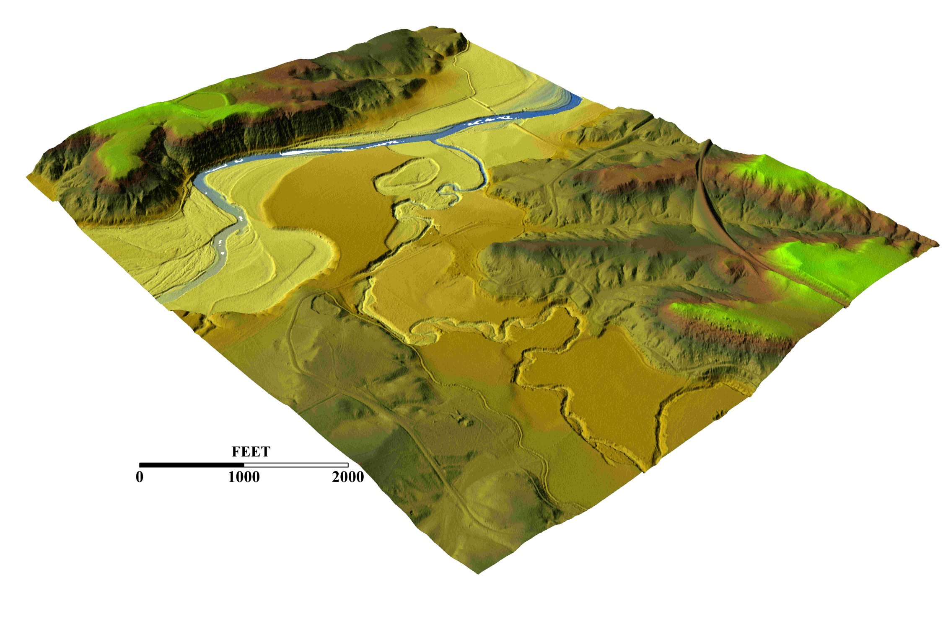
3-D detail of the Tongue river at the WY/Mont border from LIDAR.
Roberto Gutierrez
University of Texas at Austin

Slide 49
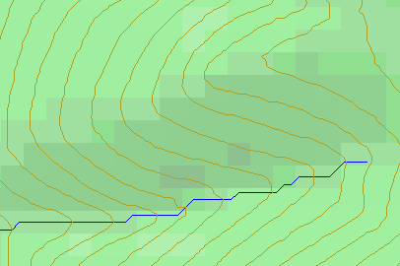
Topographic Slope
Defined or represented by one of the following
  Surface derivative ∇z (dz/dx, dz/dy)
  Vector with x and y components (S_{x}, S_{y})
  Vector with magnitude (slope) and direction (aspect) (S, α)
See http://www.neng.usu.edu/cee/faculty/dtarb/giswr/2012/Slope.pdf

Slide 50
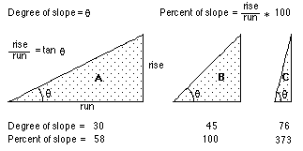
ArcGIS “Slope” tool
a
b
c
d
e
f
g
h
i

Slide 51
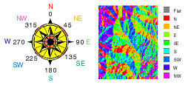
ArcGIS Aspect – the steepest downslope direction

Slide 52
Example
30
a
b
c
80
74
63
d
e
f
145.2º
69
67
56
g
h
i
60
52
48

Slide 53
Hydrologic Slope (Flow Direction Tool)
- Direction of Steepest Descent
30
30
80
74
63
80
74
63
69
67
56
69
67
56
60
52
48
60
52
48
Slope:

Slide 54
Eight Direction Pour Point Model
32
64
128
16
1
8
4
2
ESRI Direction encoding

Slide 55
Limitation due to 8 grid directions.
?

Slide 56
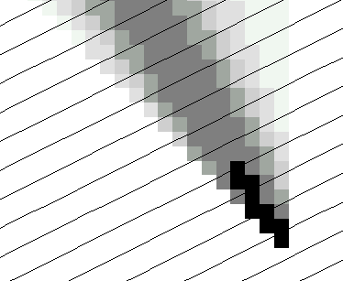
The D∞ Algorithm
Tarboton, D. G., (1997), "A New Method for the Determination of Flow Directions and Contributing Areas in Grid Digital Elevation Models," Water Resources Research, 33(2): 309-319.) (http://www.engineering.usu.edu/cee/faculty/dtarb/dinf.pdf)

Slide 57
The D∞ Algorithm
Δ
If α₁ does not fit within the triangle the angle is chosen along the steepest edge or diagonal resulting in a slope and direction equivalent to D8

Slide 58
D∞ Example
30
80
74
63
69
e_{o}
67
56
60
e₇
e₈
52
48
284.9º
14.9º

Slide 59
Summary Concepts
Grid (raster) data structures represent surfaces as an array of grid cells
Raster calculation involves algebraic like operations on grids
Interpolation and Generalization is an inherent part of the raster data representation

Slide 60
Summary Concepts (2)
The elevation surface represented by a grid digital elevation model is used to derive surfaces representing other hydrologic variables of interest such as
  Slope
  Drainage area (more details in later classes)
  Watersheds and channel networks (more details in later classes)

Slide 61
Summary Concepts (3)
The eight direction pour point model approximates the surface flow using eight discrete grid directions.
The D∞ vector surface flow model approximates the surface flow as a flow vector from each grid cell apportioned between down slope grid cells.

