Slide 1

Modeling Natural Gas Liquid Infrastructure in the United States
Sean DeRosa

Slide 2
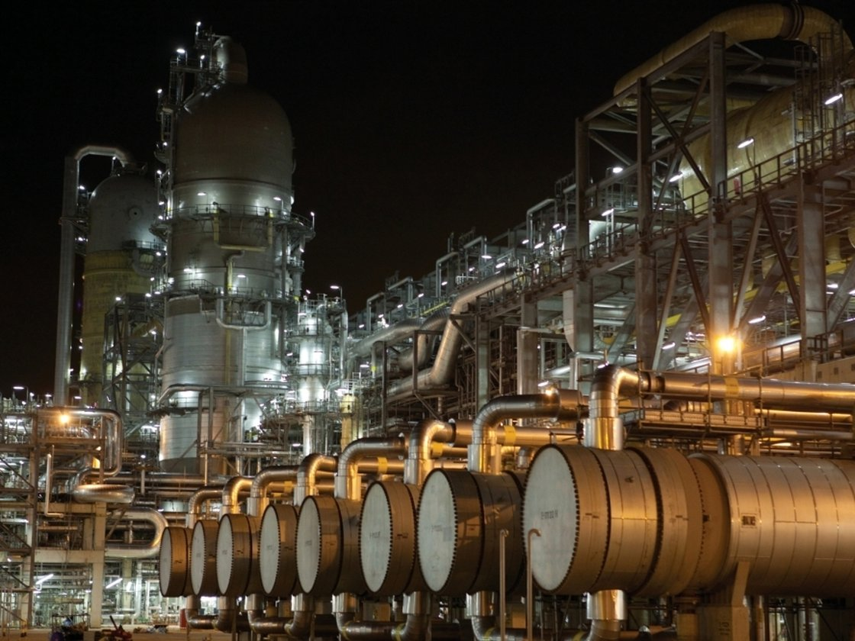
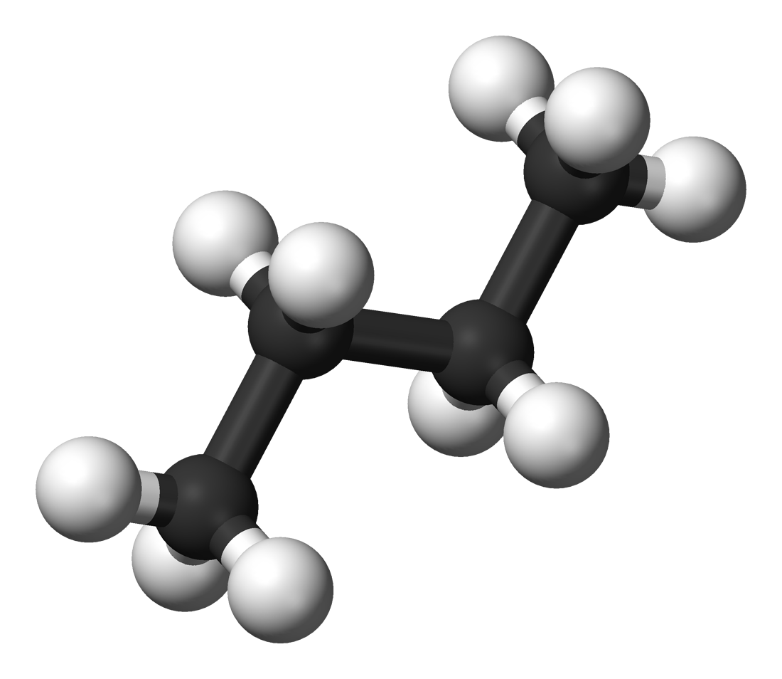
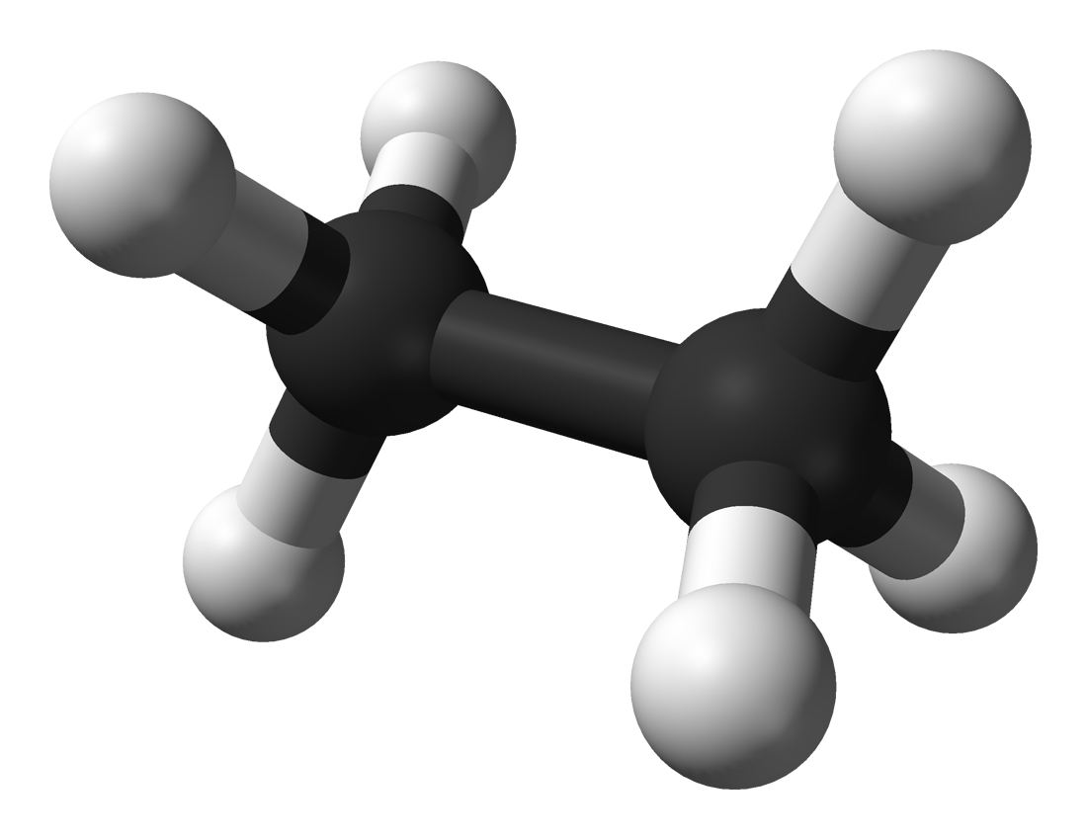
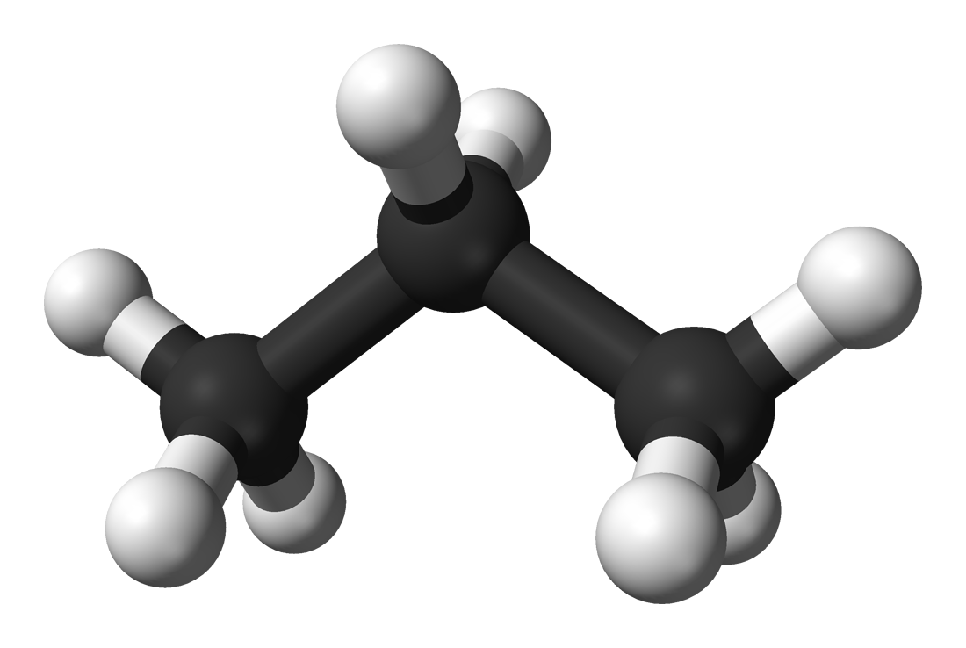
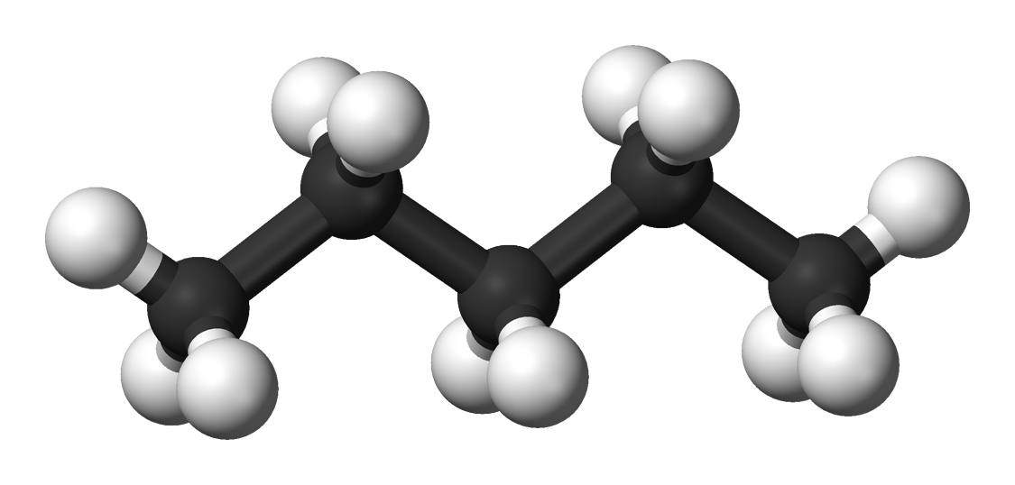
Background/Relevance

Slide 3
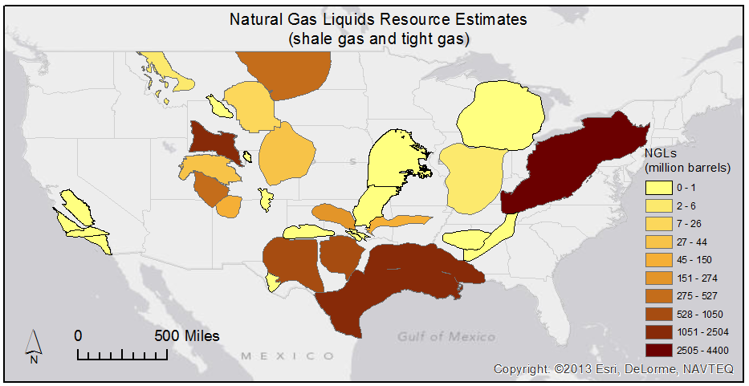
Shale Basins in the U.S.
NGL estimates from USGS National Oil and Gas Assessment http://energy.usgs.gov/OilGas/AssessmentsData/NationalOilGasAssessment.aspx#.UpAKD8Ssim4

Slide 4
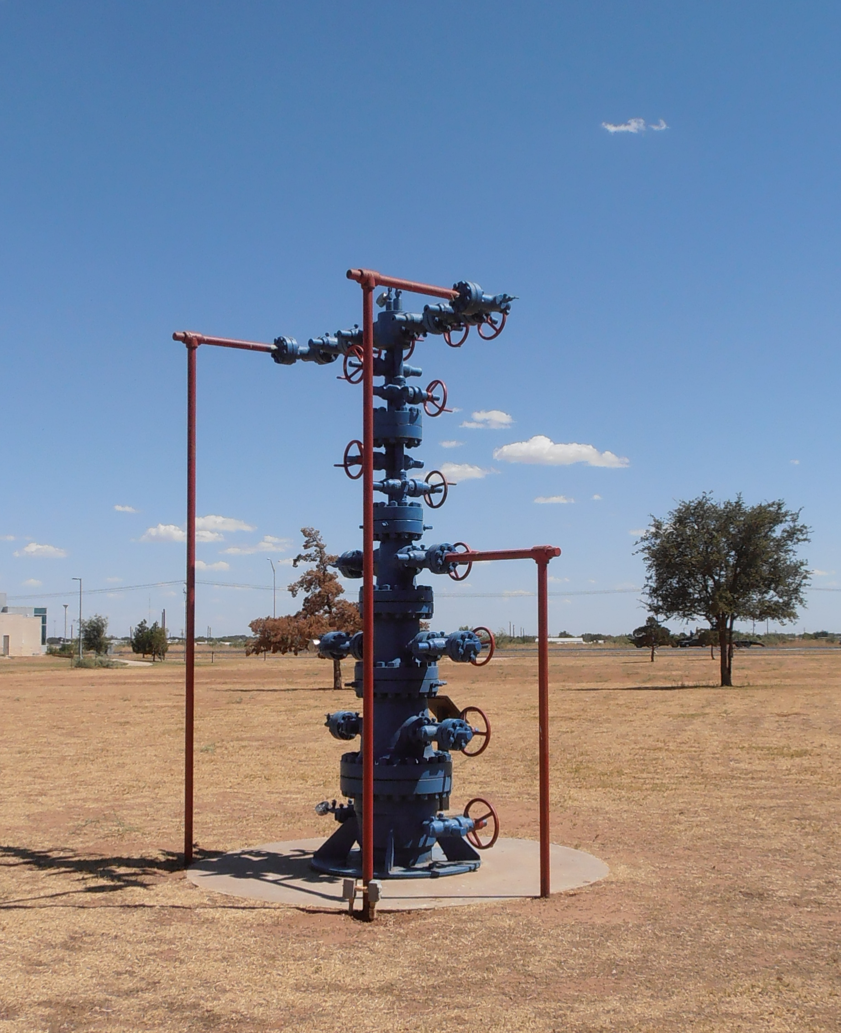
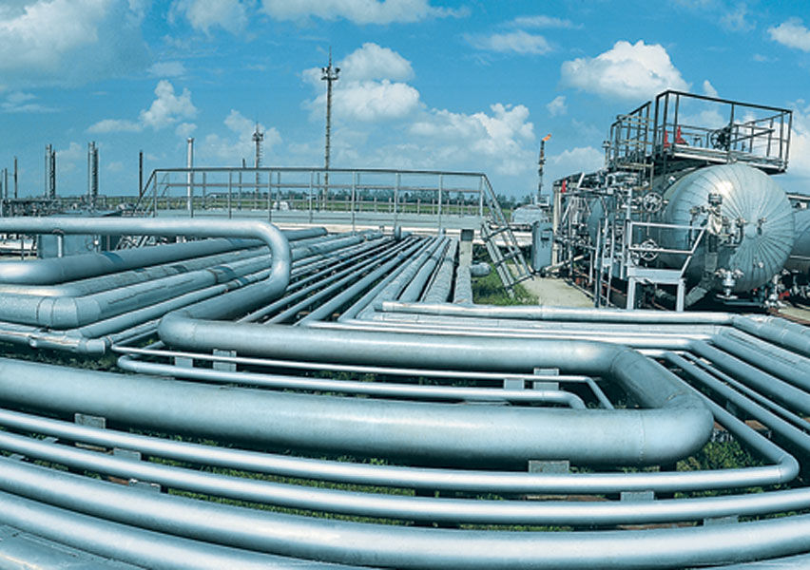
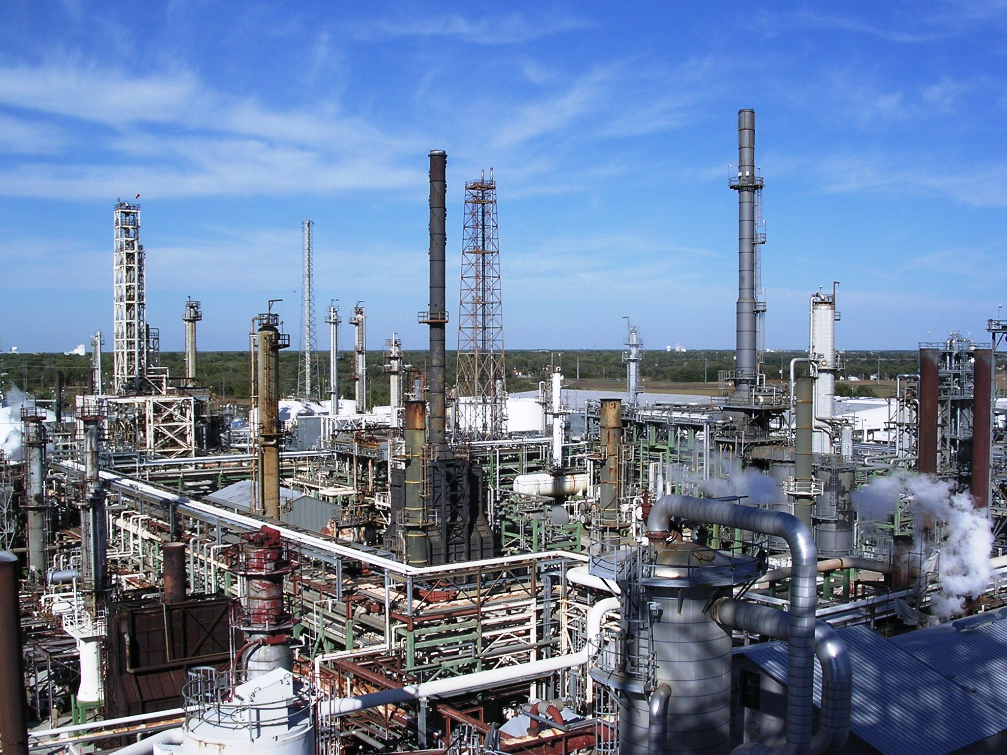
Model Formulation
Supply
Demand
Transportation

Slide 5
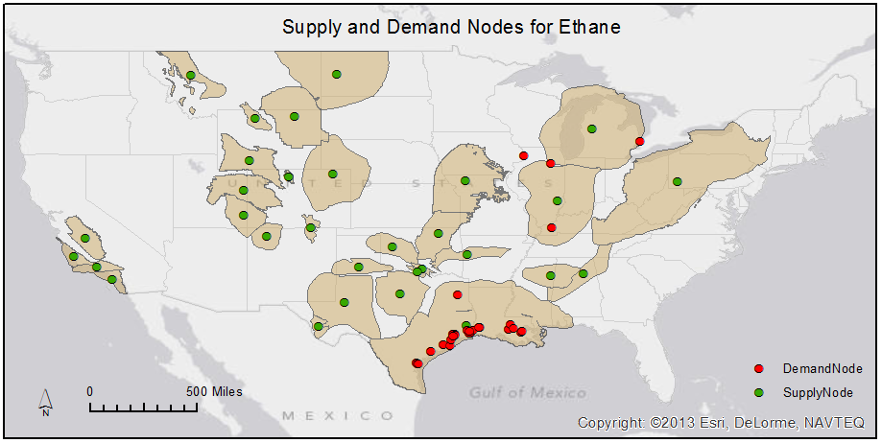
Model Formulation

Slide 6
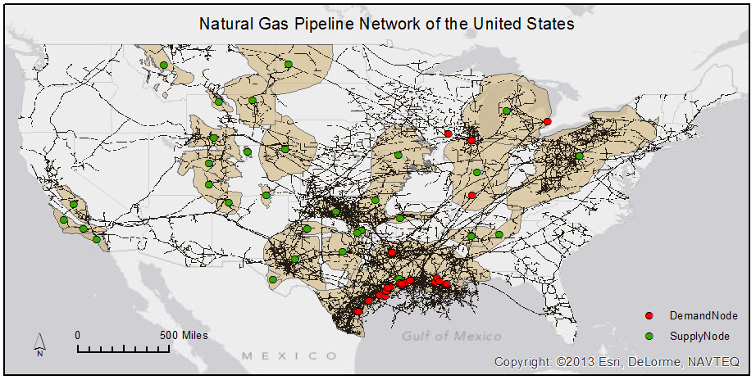
Model Formulation

Slide 7
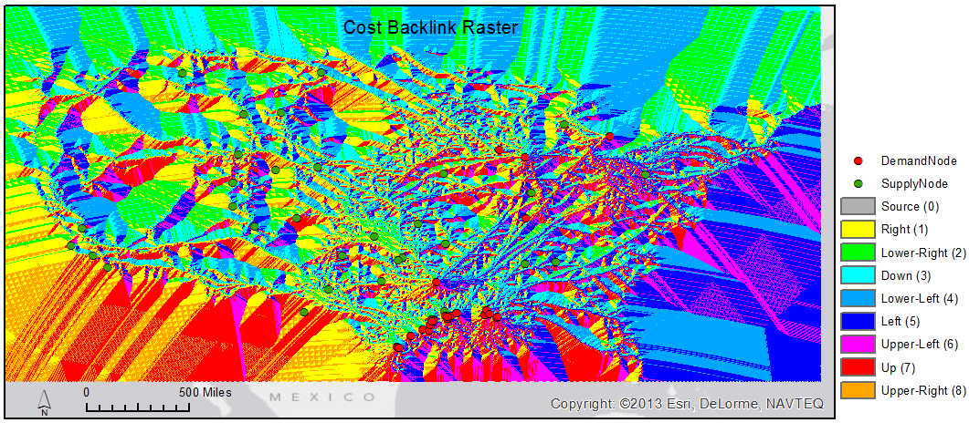
Calculating Route Solutions
Cost raster
Distance/Backlink tools
Cost Path tool

Slide 8
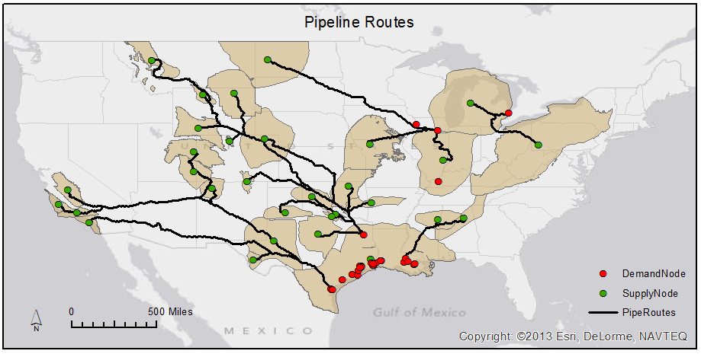
Route Solutions

Slide 9
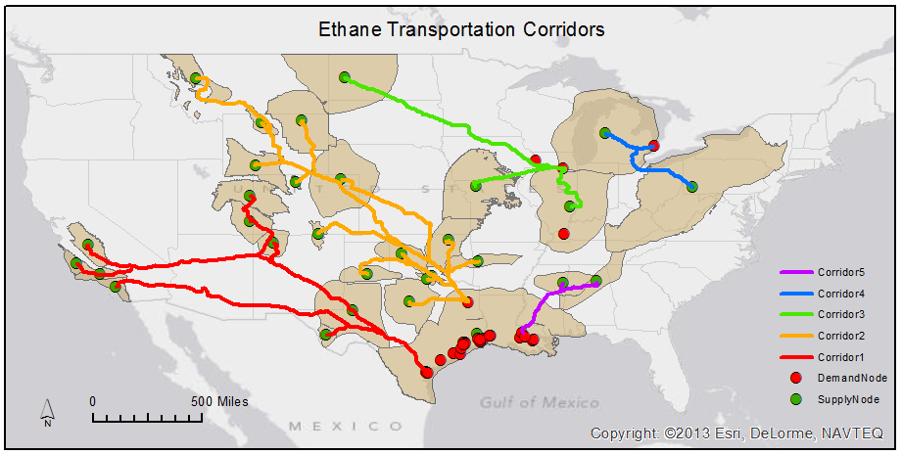
Route Solutions

Slide 10
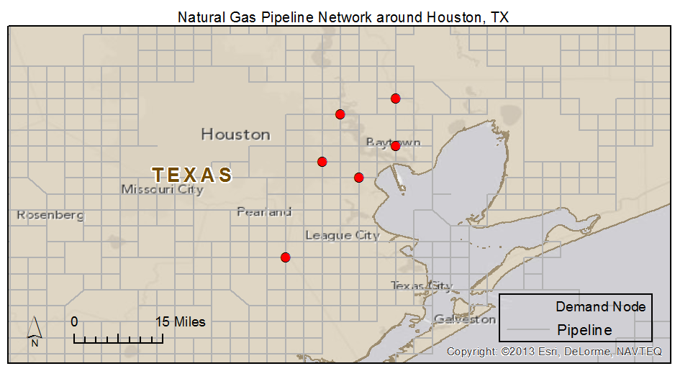
Location-Allocation
Locate distribution centers to most effectively serve demand

Slide 11
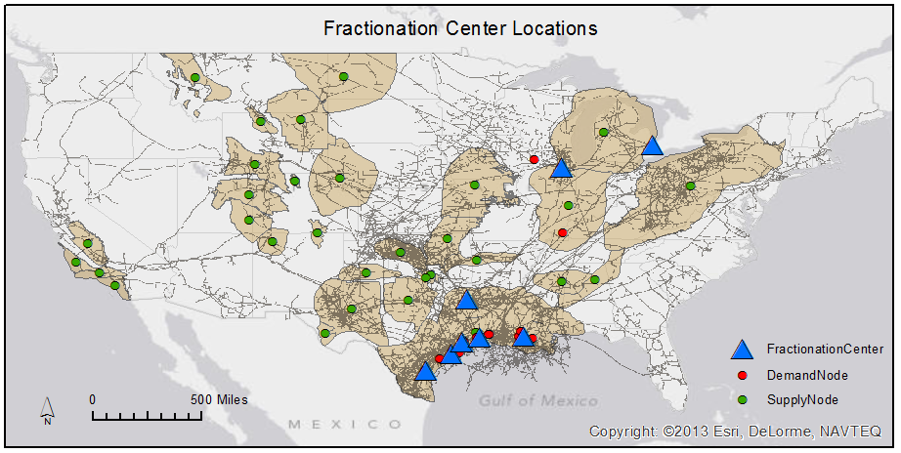
Location-Allocation

Slide 12
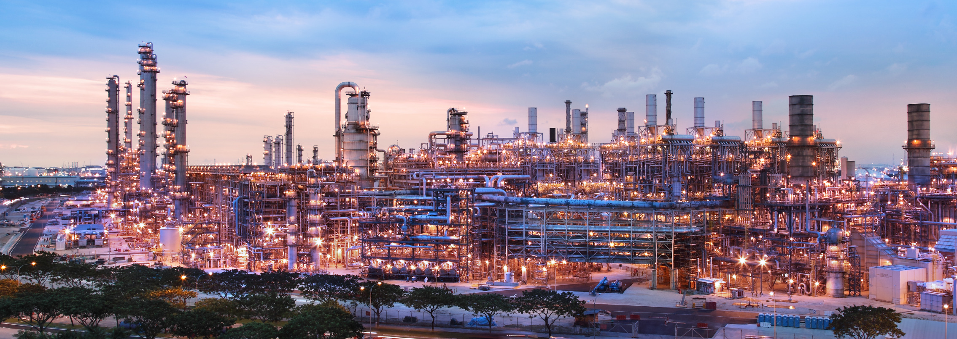
Future Work
Pipeline routes to incorporate distribution centers
Include other components of natural gas liquids

Slide 13
Image Sources
Ethylene Cracker http://www.npr.org/2012/02/13/146803953/natural-gas-boom-energizing-the-chemical-industry
  Shell ethylene cracker Singapore
Chemical models http://upload.wikimedia.org/wikipedia/commons/8/8a/Pentane-3D-balls.png
Supply, personal photo
Demand http://nextchem-analyzers.com/wp-content/themes/nextchem/images/homebanner1.jpg
Pipeline http://energymixreport.com/wp-content/uploads/2013/07/gas-pipelines.jpg
Ethylene plant http://www.businesswire.com/news/home/20130530005473/en/ExxonMobil-Singapore-Chemical-Plant-Expansion-Operation
  ExxonMobil ethylene cracker Singapore

