Slide 1
Land Data Assimilation System Water Balance
Flux variables
RF | Rainfall (unfrozen precipitation) (kg/m^2)
SF | Snowfall (frozen precipitation) (kg/m^2)
Qsurf | Surface runoff (non-infiltrating) (kg/m^2)
Qbase | Subsurface runoff (baseflow) (kg/m^2)
ET | Total evapotranspiration (kg/m^2)
RF
ET
SF
Cstor
SWE
Qsurf
Storage variables
SM
SM | 0-200 cm Total column soil moisture content (kg/m^2)
SWE | Accumulated snow water-equivalent (kg/m^2)
Cstor | Plant canopy surface water (kg/m^2)
200 cm
Qbase

Slide 2
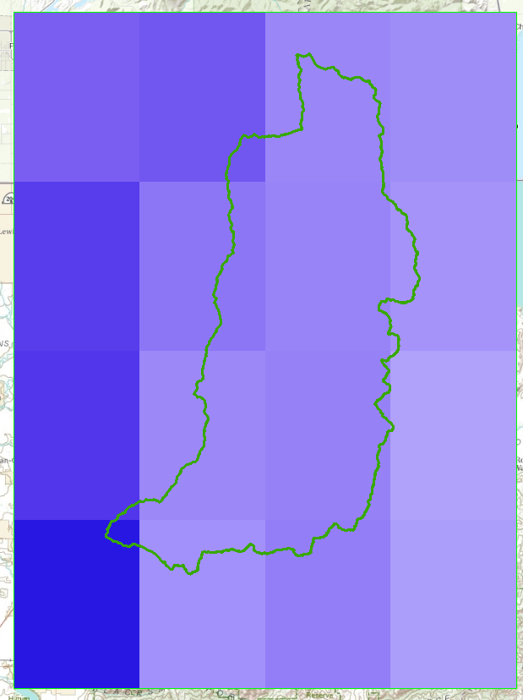
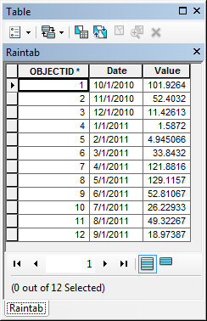
Zonal Average of Raster Series over Basin

Slide 3
Land Data Assimilation System Water Balance
RF
ET
SF
Cstor
SWE
Qsurf
SM
200 cm
Qbase

Slide 4
Storage Variable
Wrong Net Storage Change
Correct Net Storage Change

Slide 5
Logan River Water Balance 2013
mm
mm
mm

