Slide 1
Hydrology of the Hawaiian Islands
Colleen Dawes, Energy and Earth Resources
November 19, 2013

Slide 2
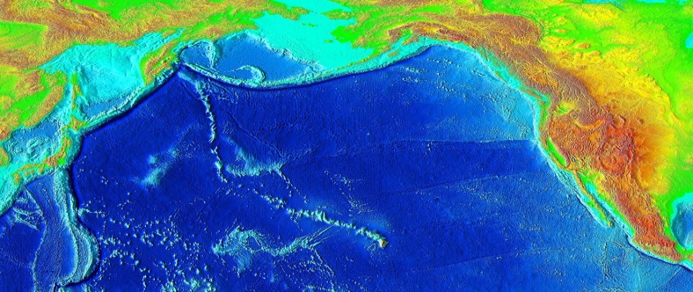
Hawaiian Islands
Freshwater Resources:
  Precipitation
  Streamflow
  Runoff
  Soil moisture
  Groundwater aquifers
Notes:
Image: Wikipedia

Slide 3
Project Description
Elevation
Topography
Wind Direction
Use GIS to explore the natural factors that influence freshwater distribution on Hawaii

Slide 4
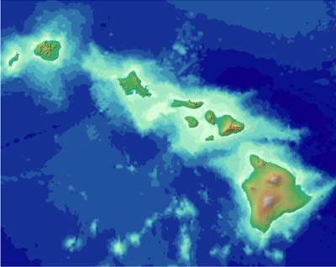
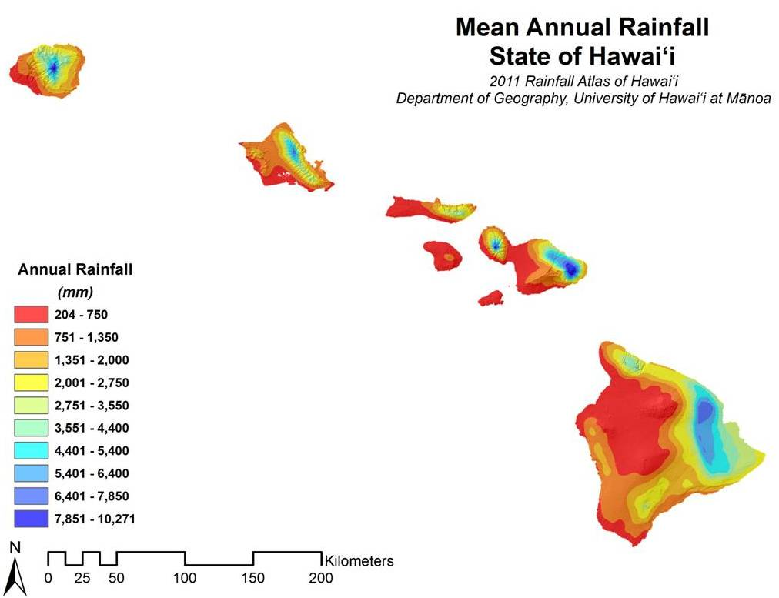
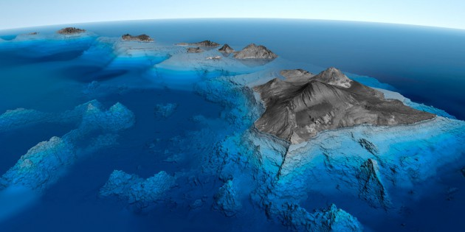
Hawaii’s Topography and Elevation
Notes:
Image: Virginia Tech hokiecurriculum.org
Top Left: noaa.gov

Slide 5
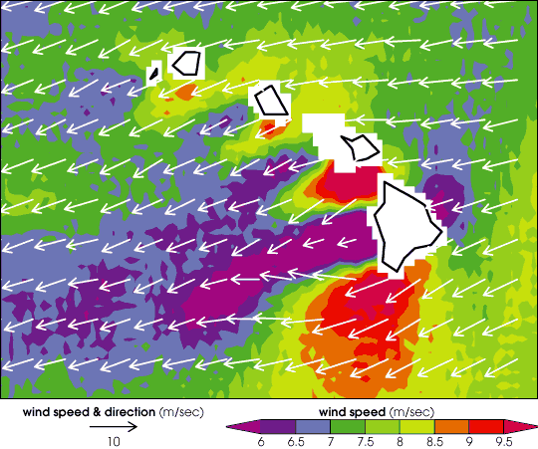
Wind Speed and Direction:
Hawaii interrupts Pacific patterns

Slide 6
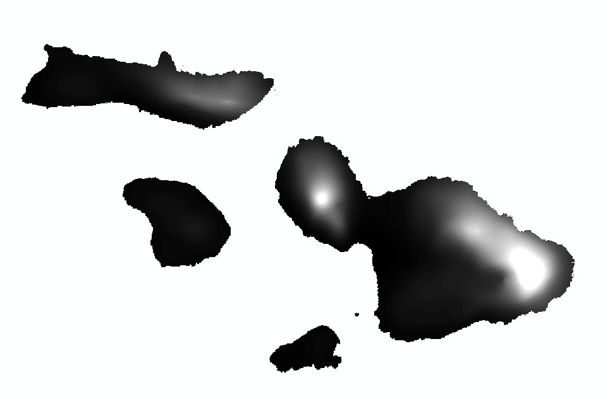
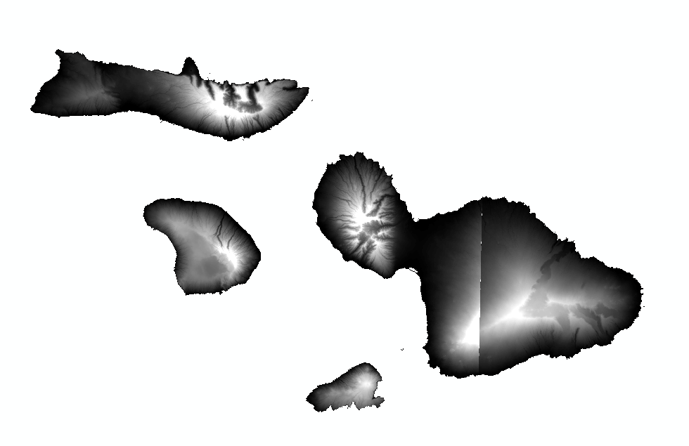
Rainfall Distribution:
Influenced by Topography and Wind
Rainfall
Elevation
Trade Winds

Slide 7
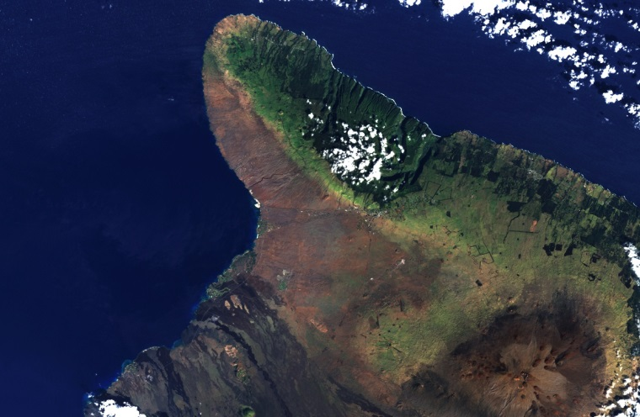
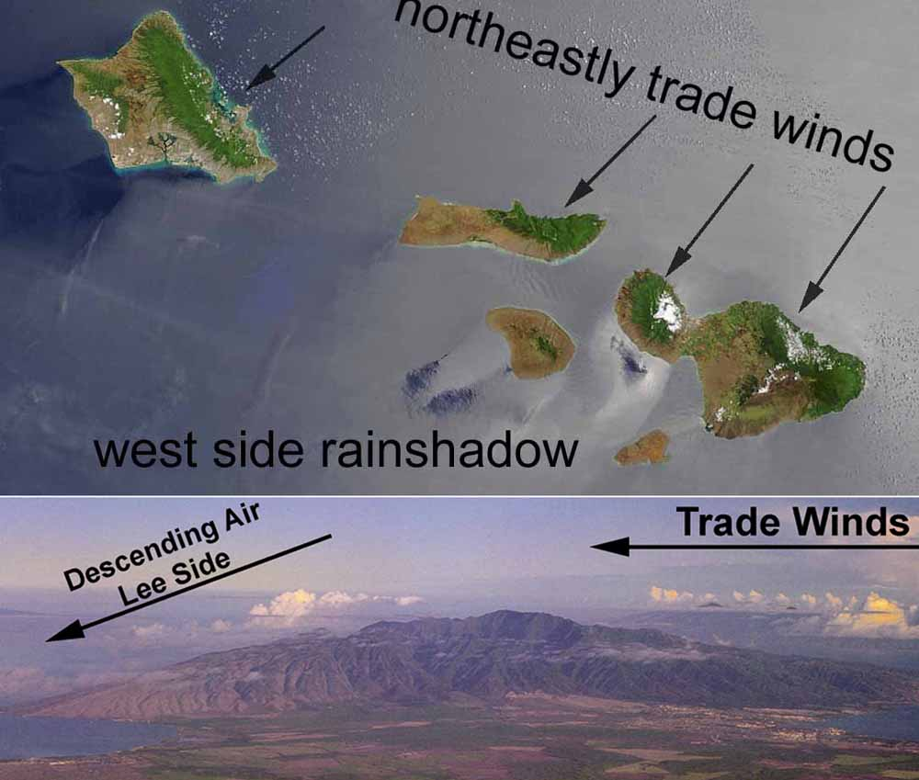
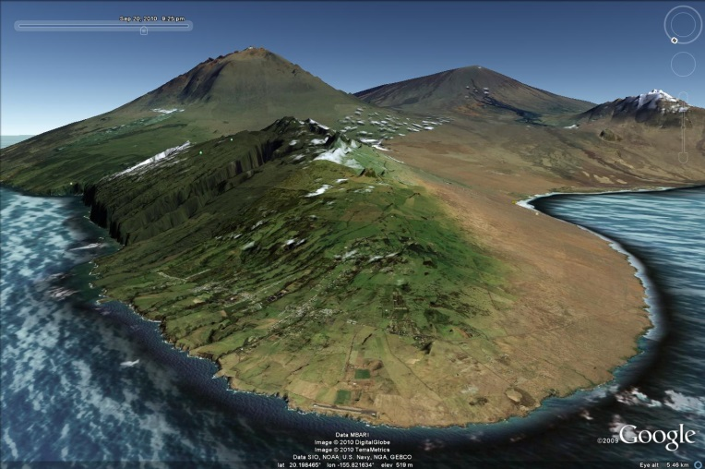
Rain Shadows Visualized:
Vegetative Cover
Notes:
Top left: Climate.gov.
Bottom left: ig.utexas.edu
Right: clasfaculty.ucdenver.edu

Slide 8
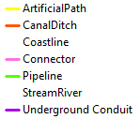
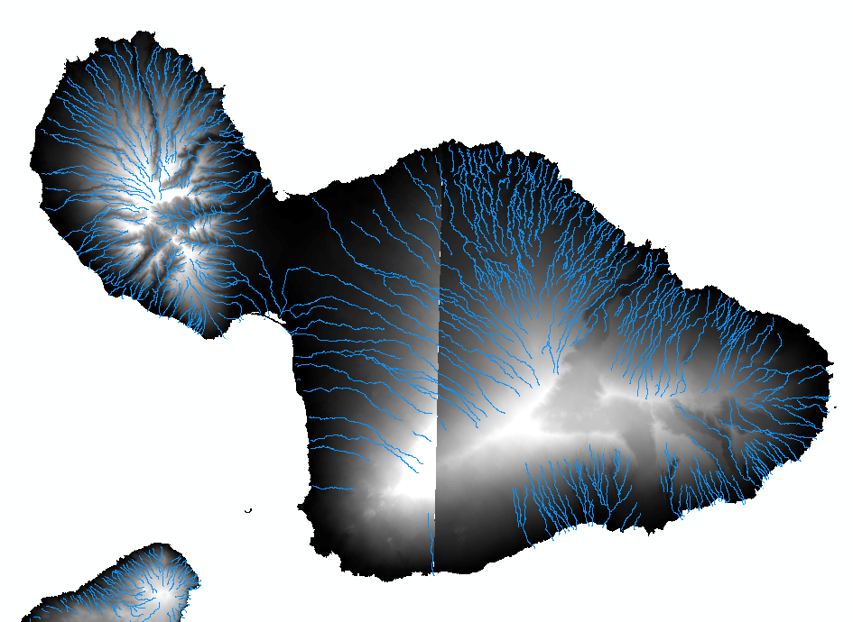
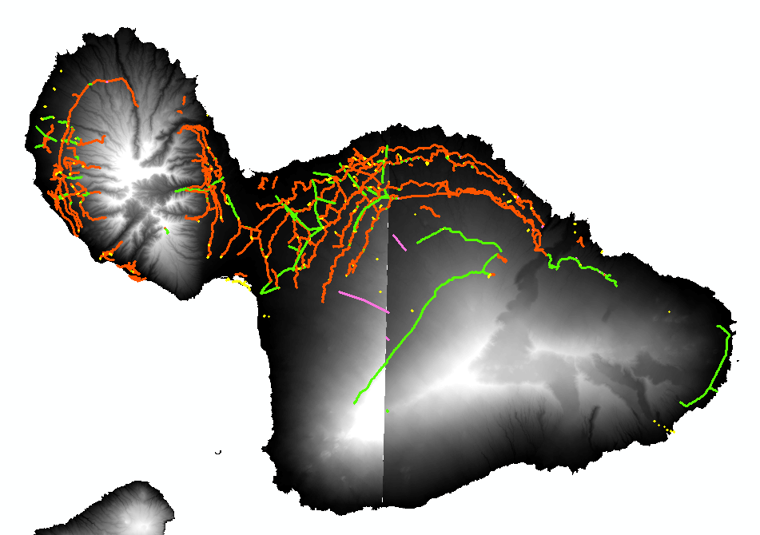
Rain Shadows Visualized:
Stream Location, Need for man-made diversion
NHD Flowline: Maui

Slide 9
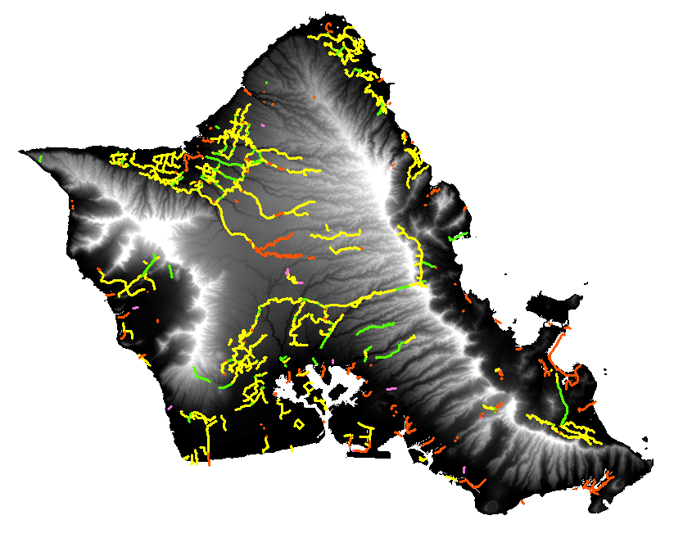
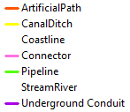
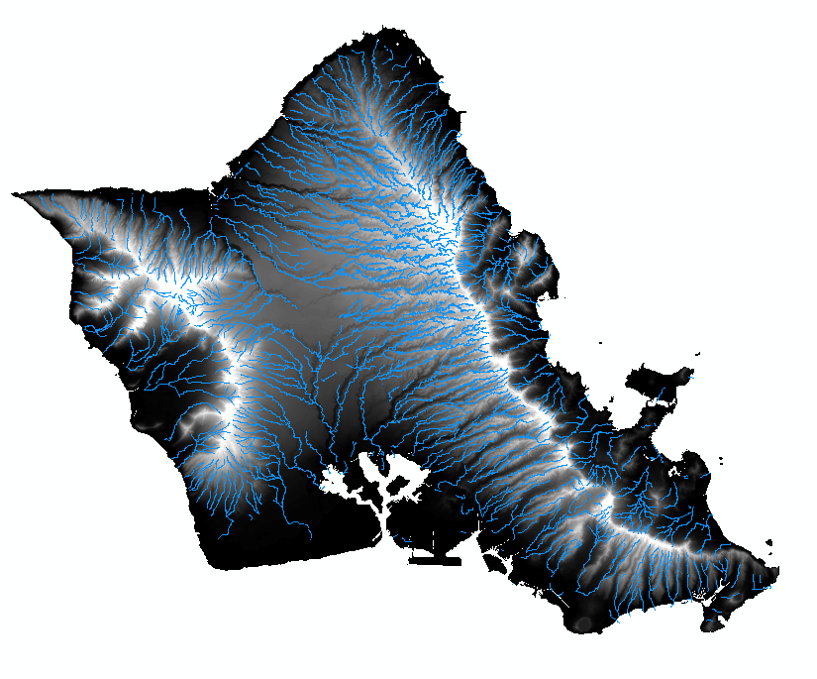
Part 2: Man-Made Factors
Freshwater Distribution and Artificial Paths
NHD Flowline: Oahu

Slide 10
Progress Report
Quantify relationships between topography, wind direction and flow
Data I Have
Data I Need
Topography: DEM
Wind Speed
NHD
Monthly & Annual Rainfall Rasters
Aquifers & Streams
Wind direction
Other freshwater: snow, fog, soil moisture
Time-Series Data: Flow and Consumption

Slide 11
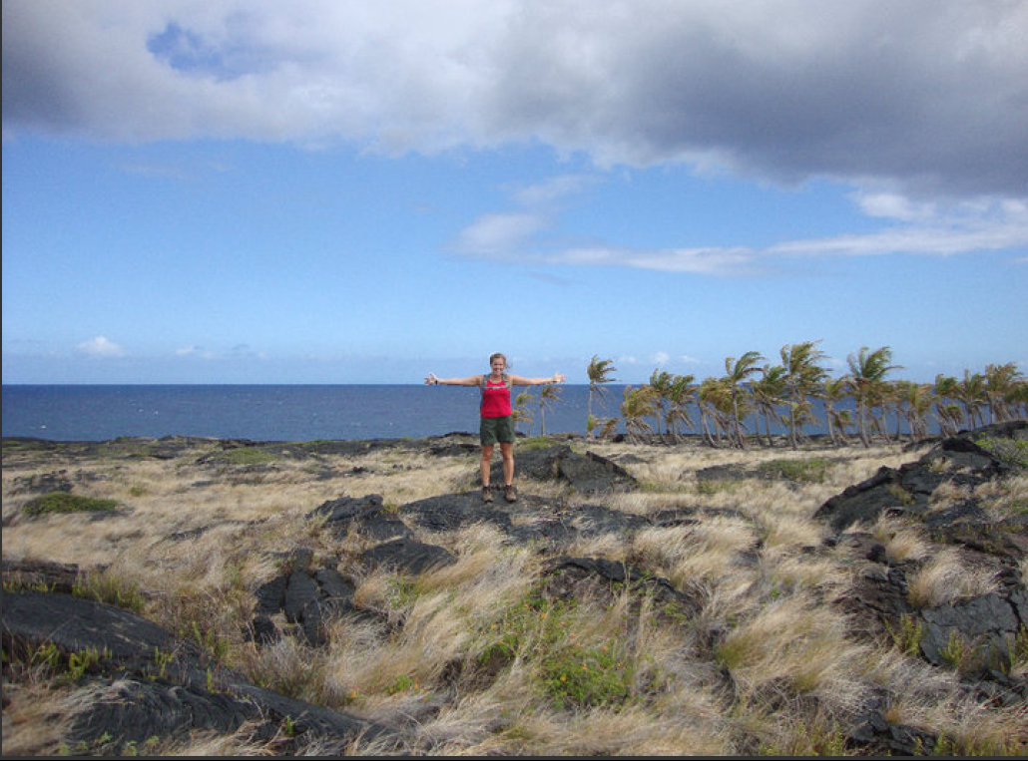
Questions?
Colleen Dawes
EER ’14
cdawes@utexas.edu

