Slide 1
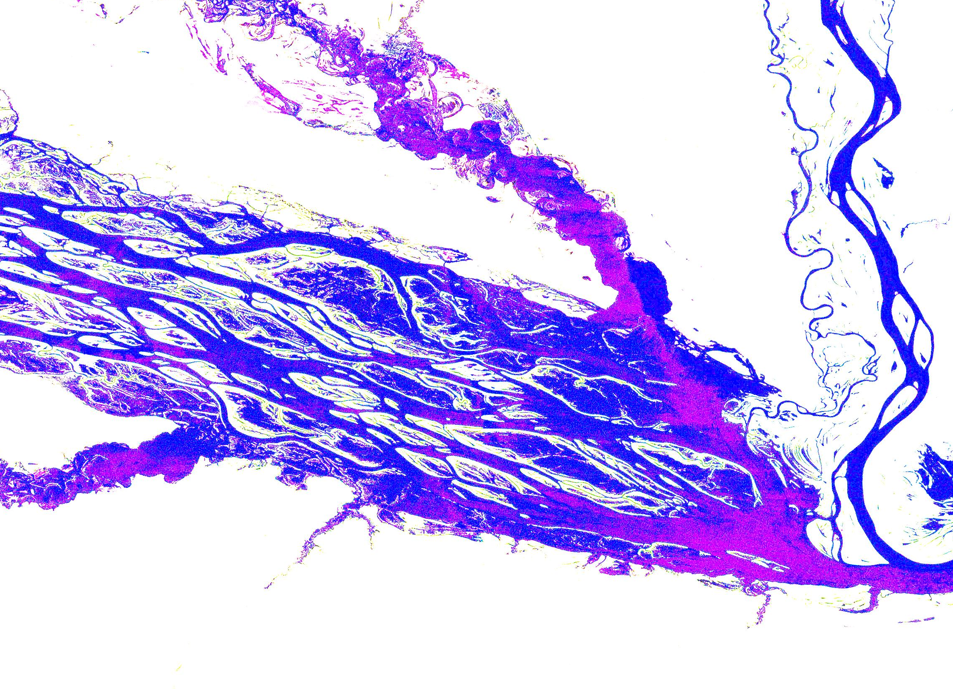
GIS feature extraction tools in diverse landscapes
Anna Kladzyk
M.S. Candidate, Expected 2015
Department of Environmental and Water Resources Engineering
University of Texas-Austin
Image: EROS, USGS

Slide 2
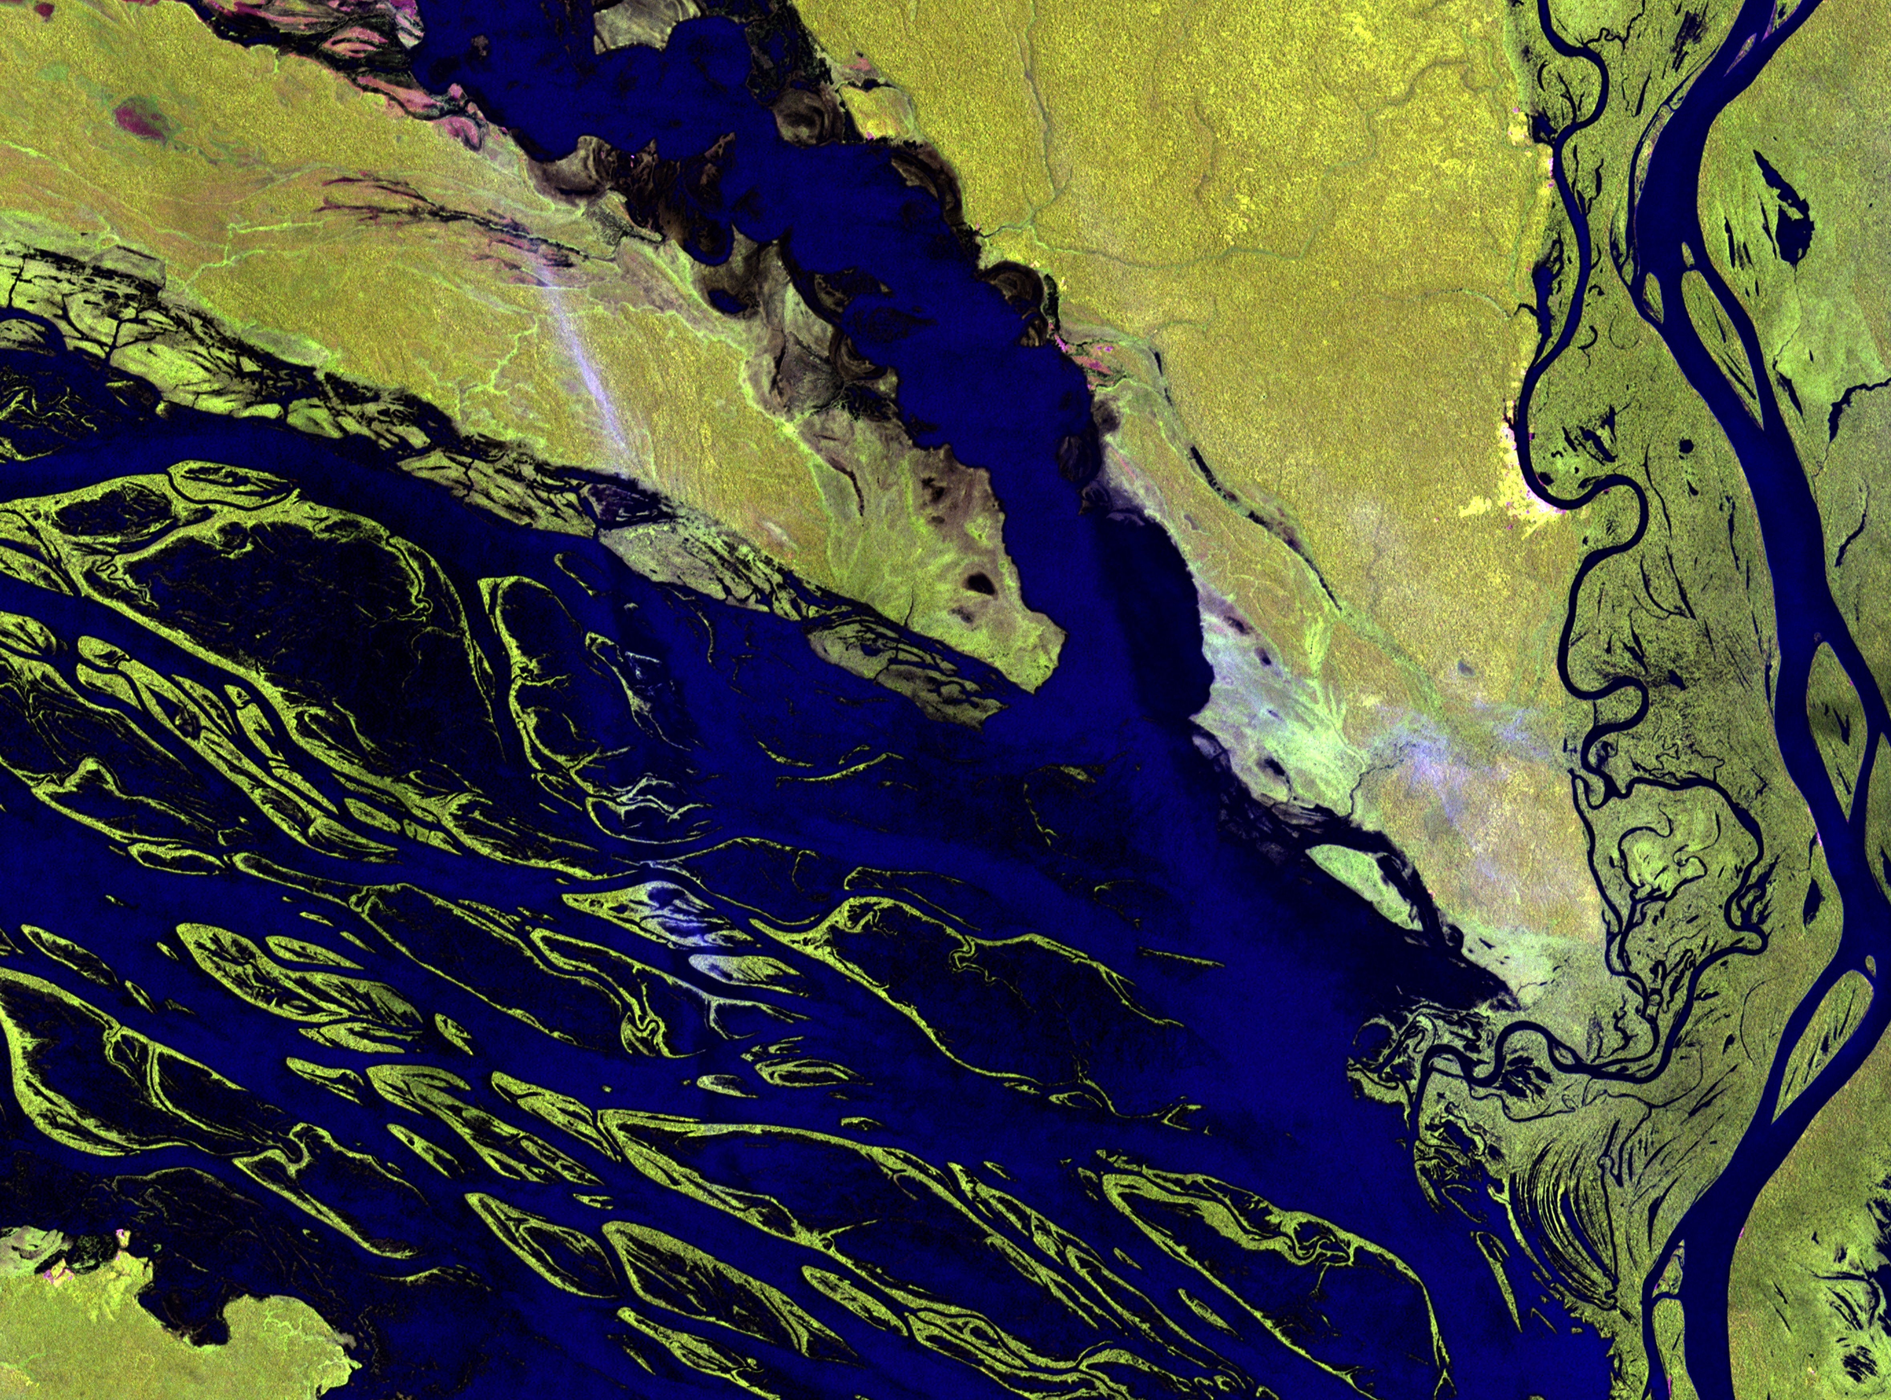
Presentation Outline
Introduction
Objectives
Test cases
Methods
Results & Discussion

Slide 3
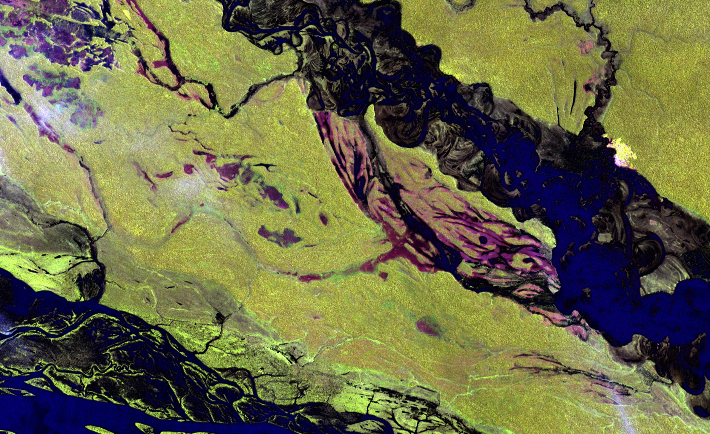
Introduction
Feature extraction from high resolution imagery data allows us to identify and characterize channel networks.
Channel networks are dynamic pathways
for mass and energy transport across the landscape.
Improved understanding of these transport processes will provide critical insights into river basin morphology, and inform water resources management.

Slide 4
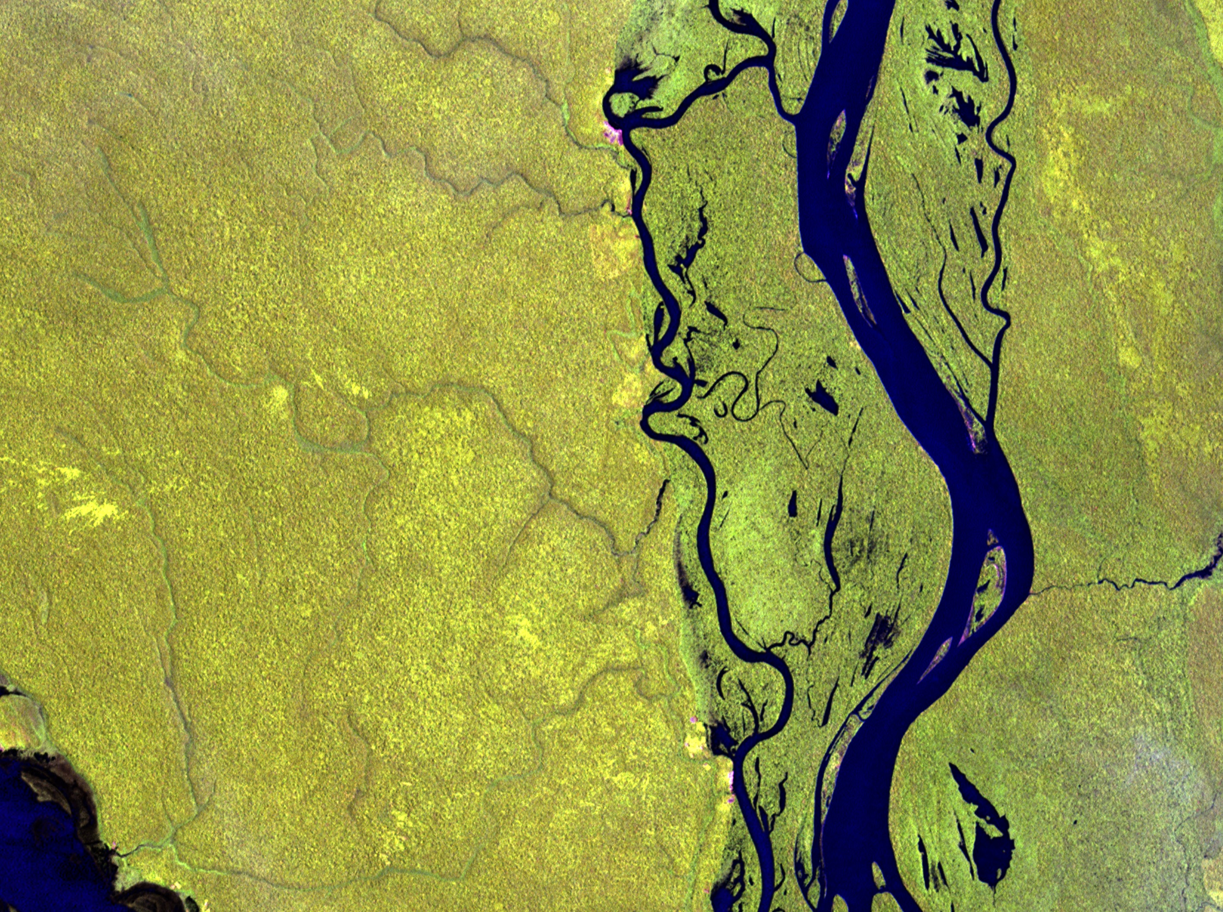
Objectives
Extract channel network features from two different sub-basins using different extraction methods
Employ stochastic and graphical methods compare the results from different methods in each basin

Slide 5
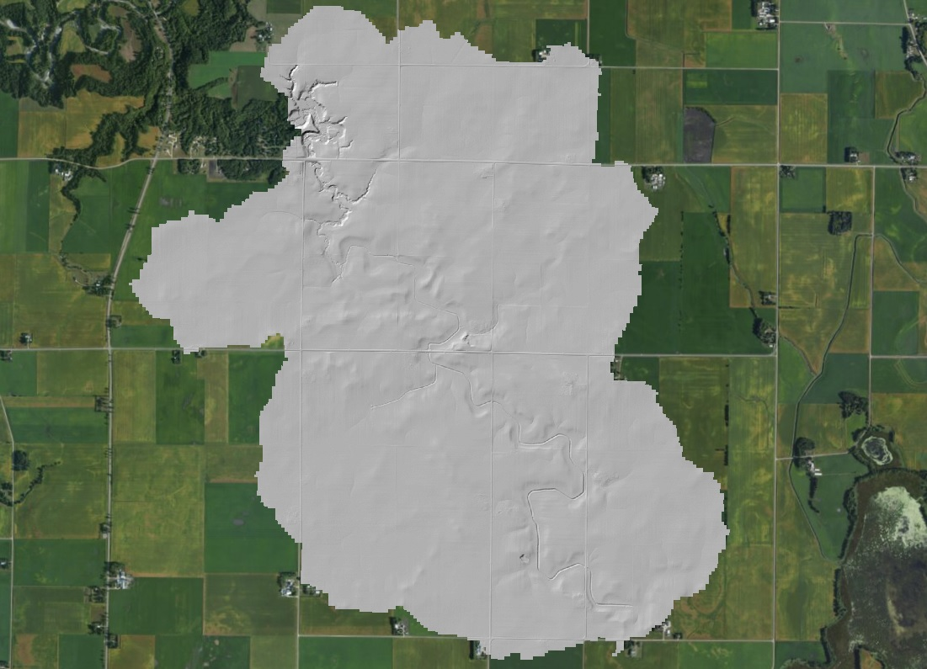
Test Case 1: Le Seuer Basin, MN
[17.9 sq. km]
Characterized by:
low-relief terrain
engineered
features
meandering
river channels
Notes:
Low-relief, heterogeneous, low gradient

Slide 6
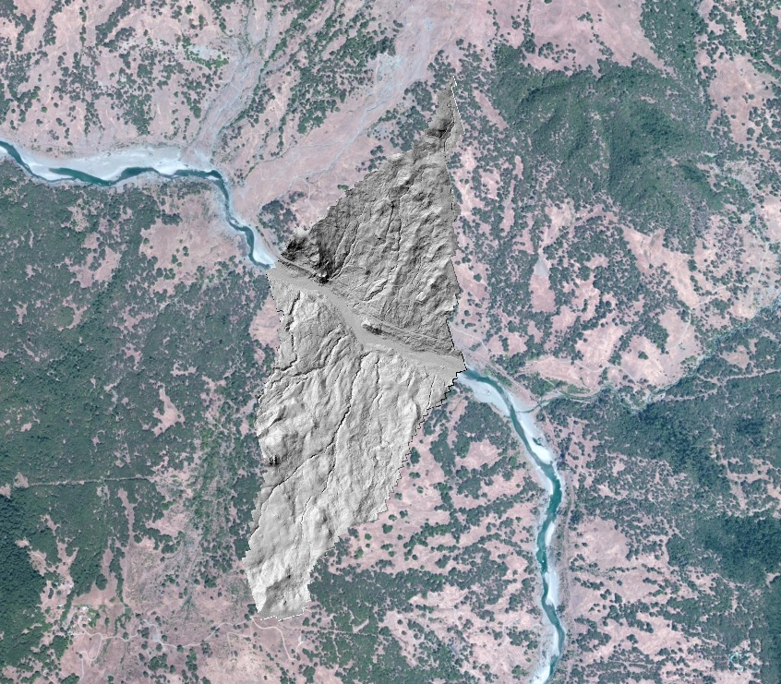
Test Case 2: Eel River
Basin, CA
[1.7 sq. km]
Characterized by:
Steep slopes
vegetative
highly variable
Notes:
Steep slopes, vegetative, highly variable landscape- transitions from steep to flat

Slide 7
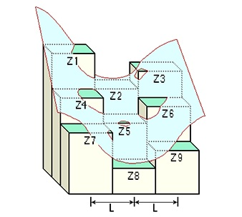
Methods
Surface features measured using:
  Spatial Analyst toolbox in ArcMap
    Similar to homework assignment
  GeoNet: MatLab-based computational tool
    Uses nonlinear filtering and geodesic minimization principles
Features extracted:
  Slope (first derivative of the surface)
  Curvature (second derivative of the surface)
  Accumulation area
  Channel networks
Image: ArcGIS Resources; ‘How Curvature Works’

Slide 8
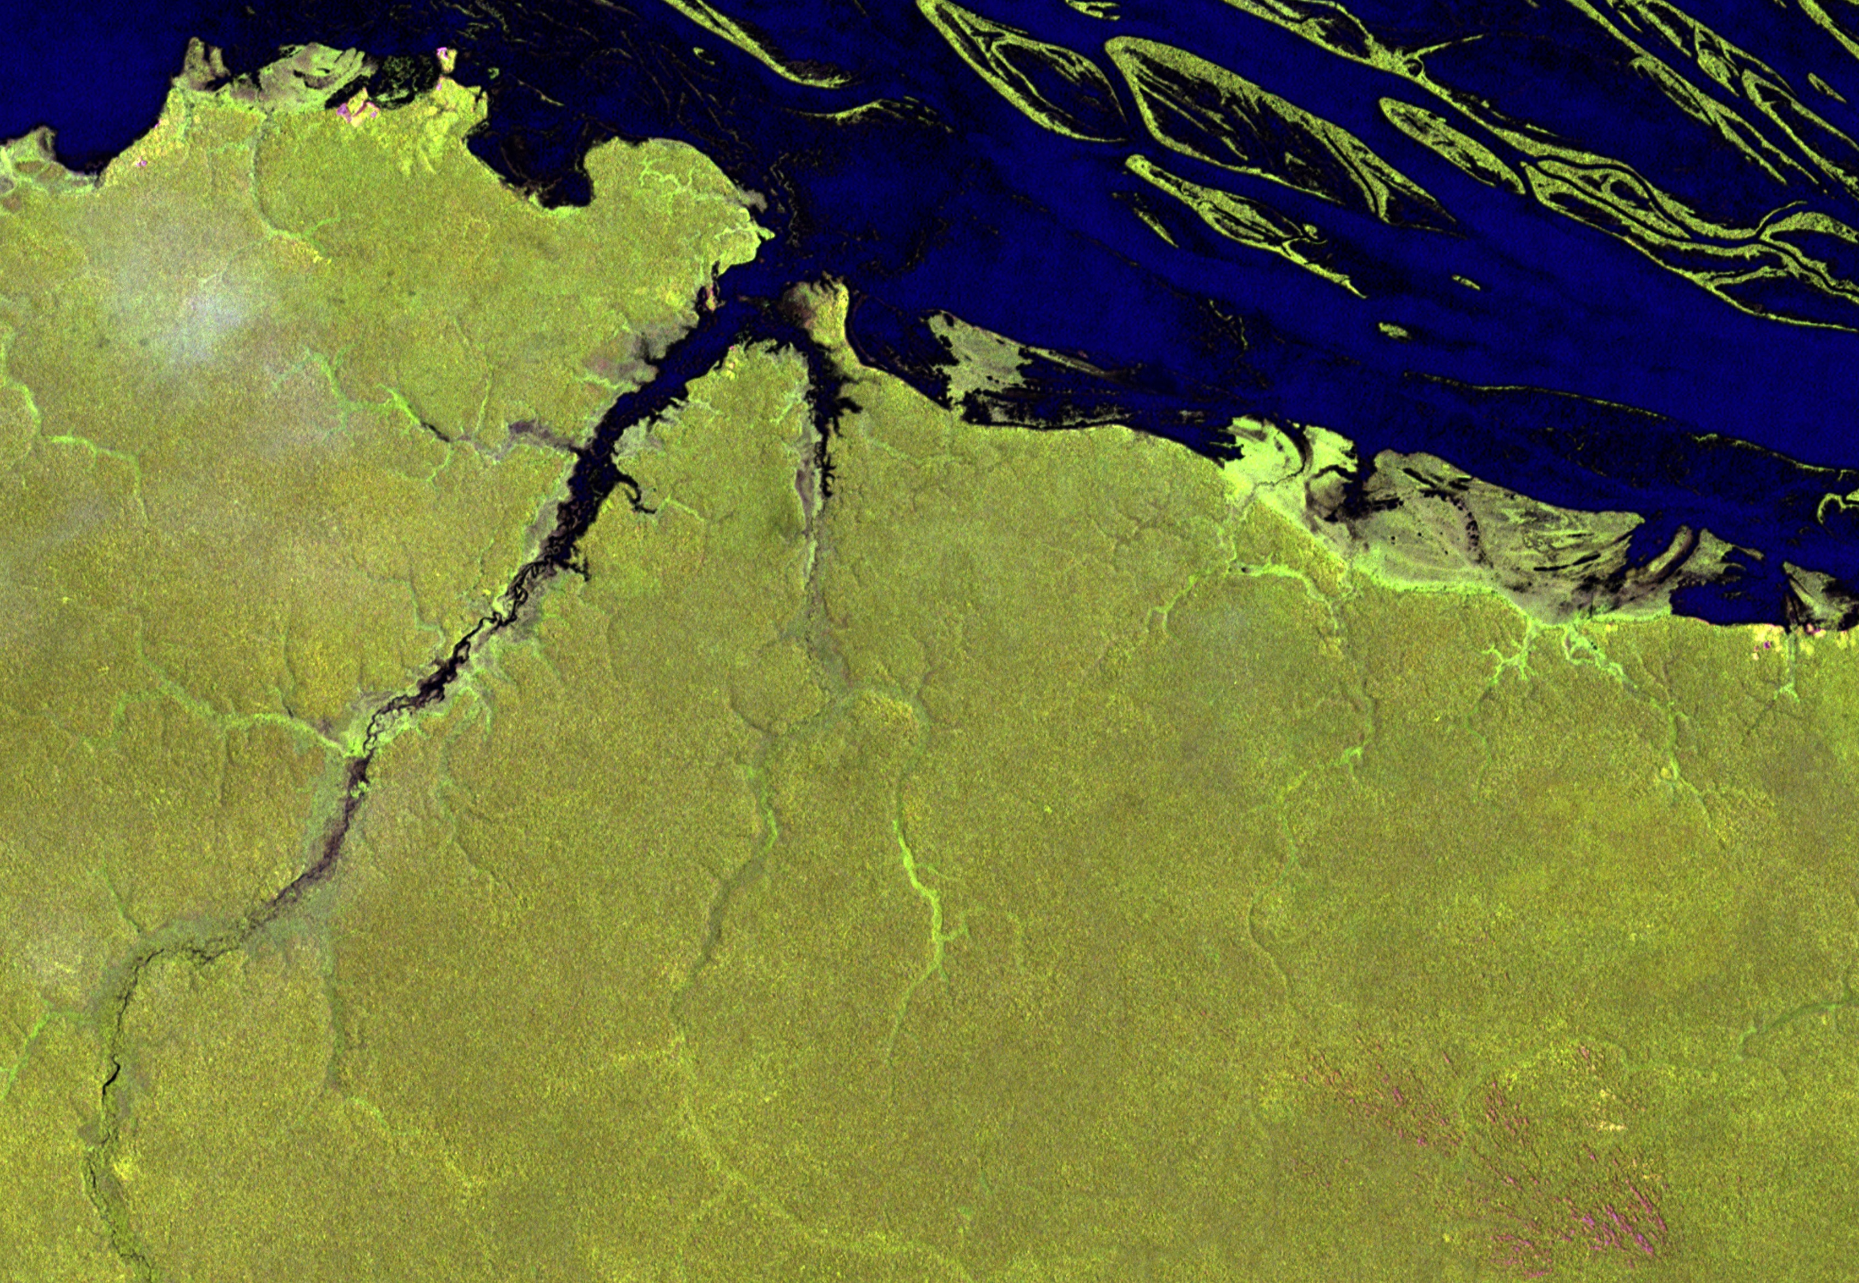
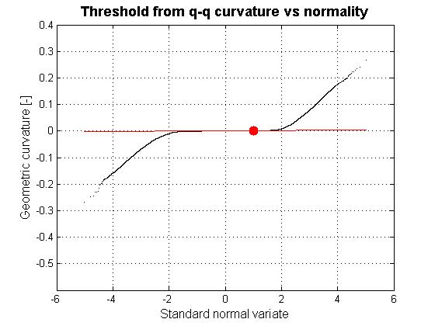
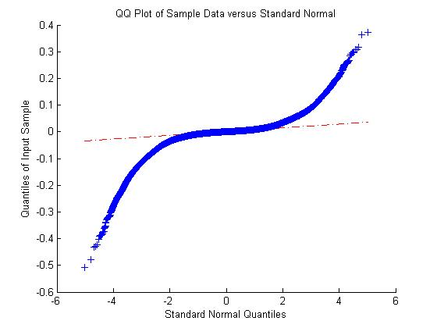
Results: Le Seuer sub-basin- Curvature
[GeoNet]
[ArcMap]

Slide 9

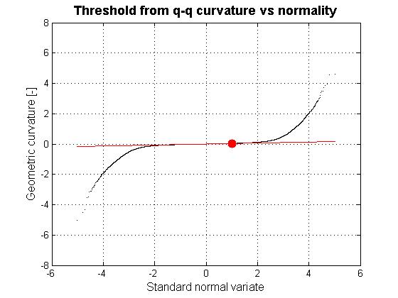
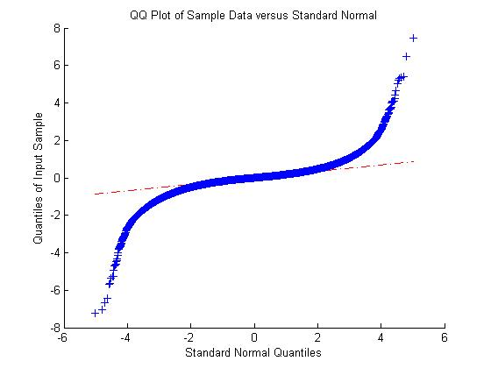
Results: Eel River Sub-basin – Curvature
[GeoNet]
[ArcMap]

Slide 10
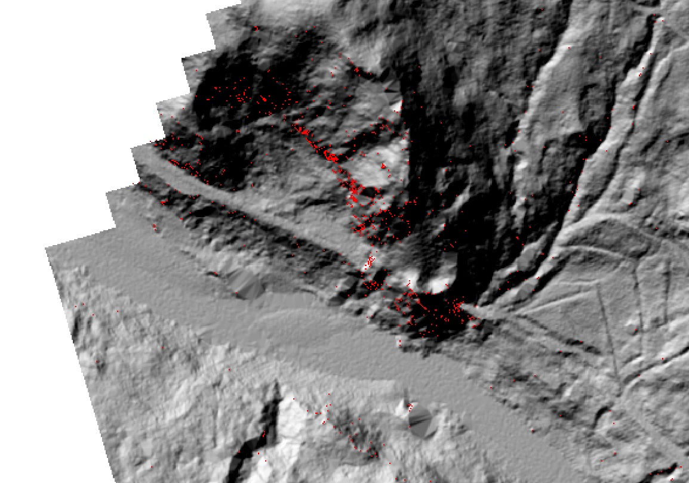
Discussion: Filtering operations affect curvature results
Detail of ArcMap curvature results in Eel River Basin

Slide 11
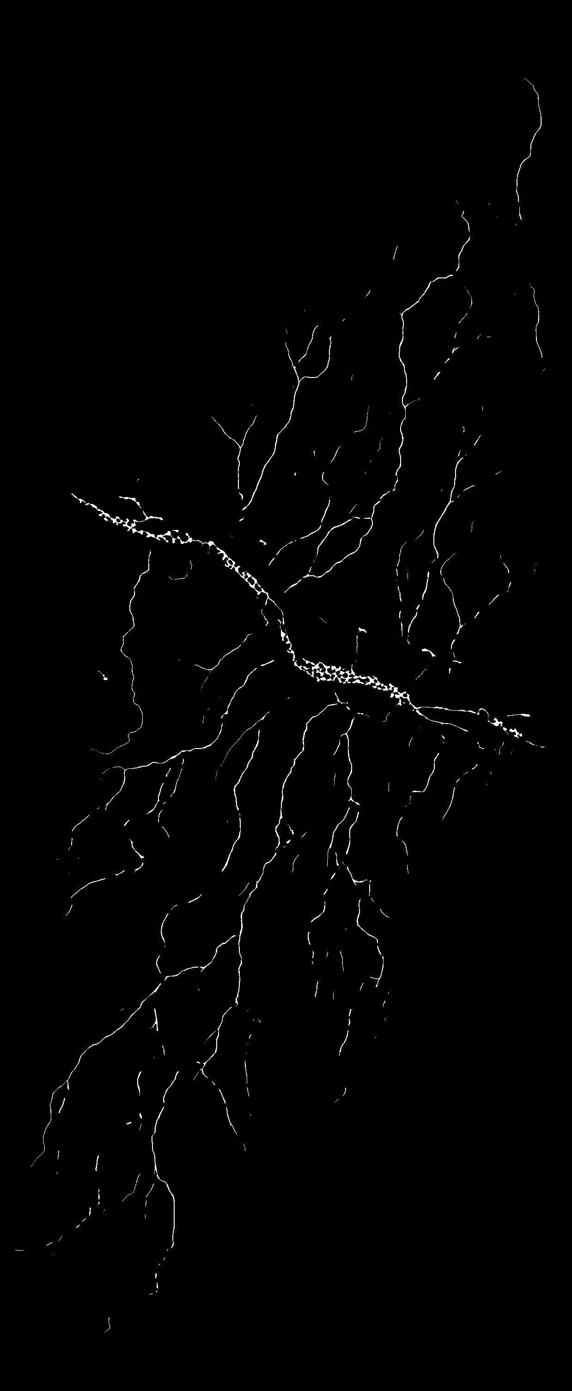
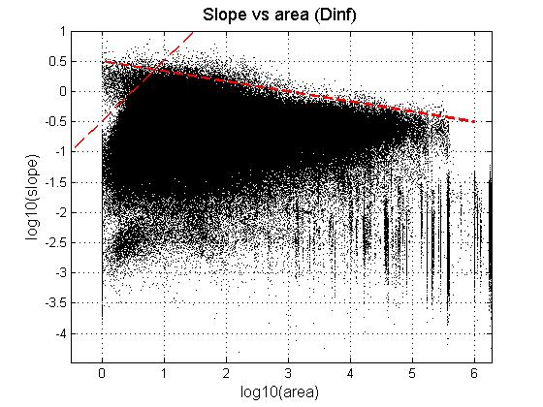
Preliminary Results:
Slope v. Accum. Area plots & Drainage networks [GeoNet]
[Eel River Basin]
Notes:
the initiation area/channel head which corresponds to the inflection point on the graph

Slide 12
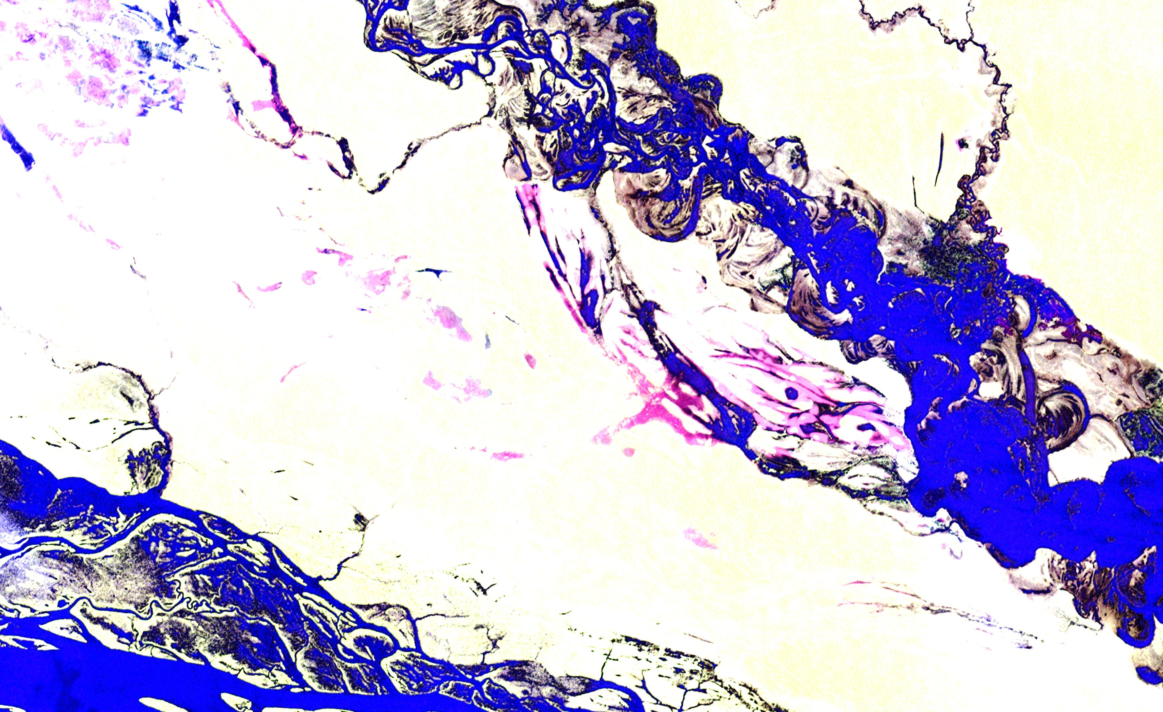
Further work
Continue comparison of curvature results
Calculate accumulation areas for basins in ArcMap
Generate channel networks in ArcMap
Compare slope v. accumulation area graphs
Compare channel networks in basins

Slide 13
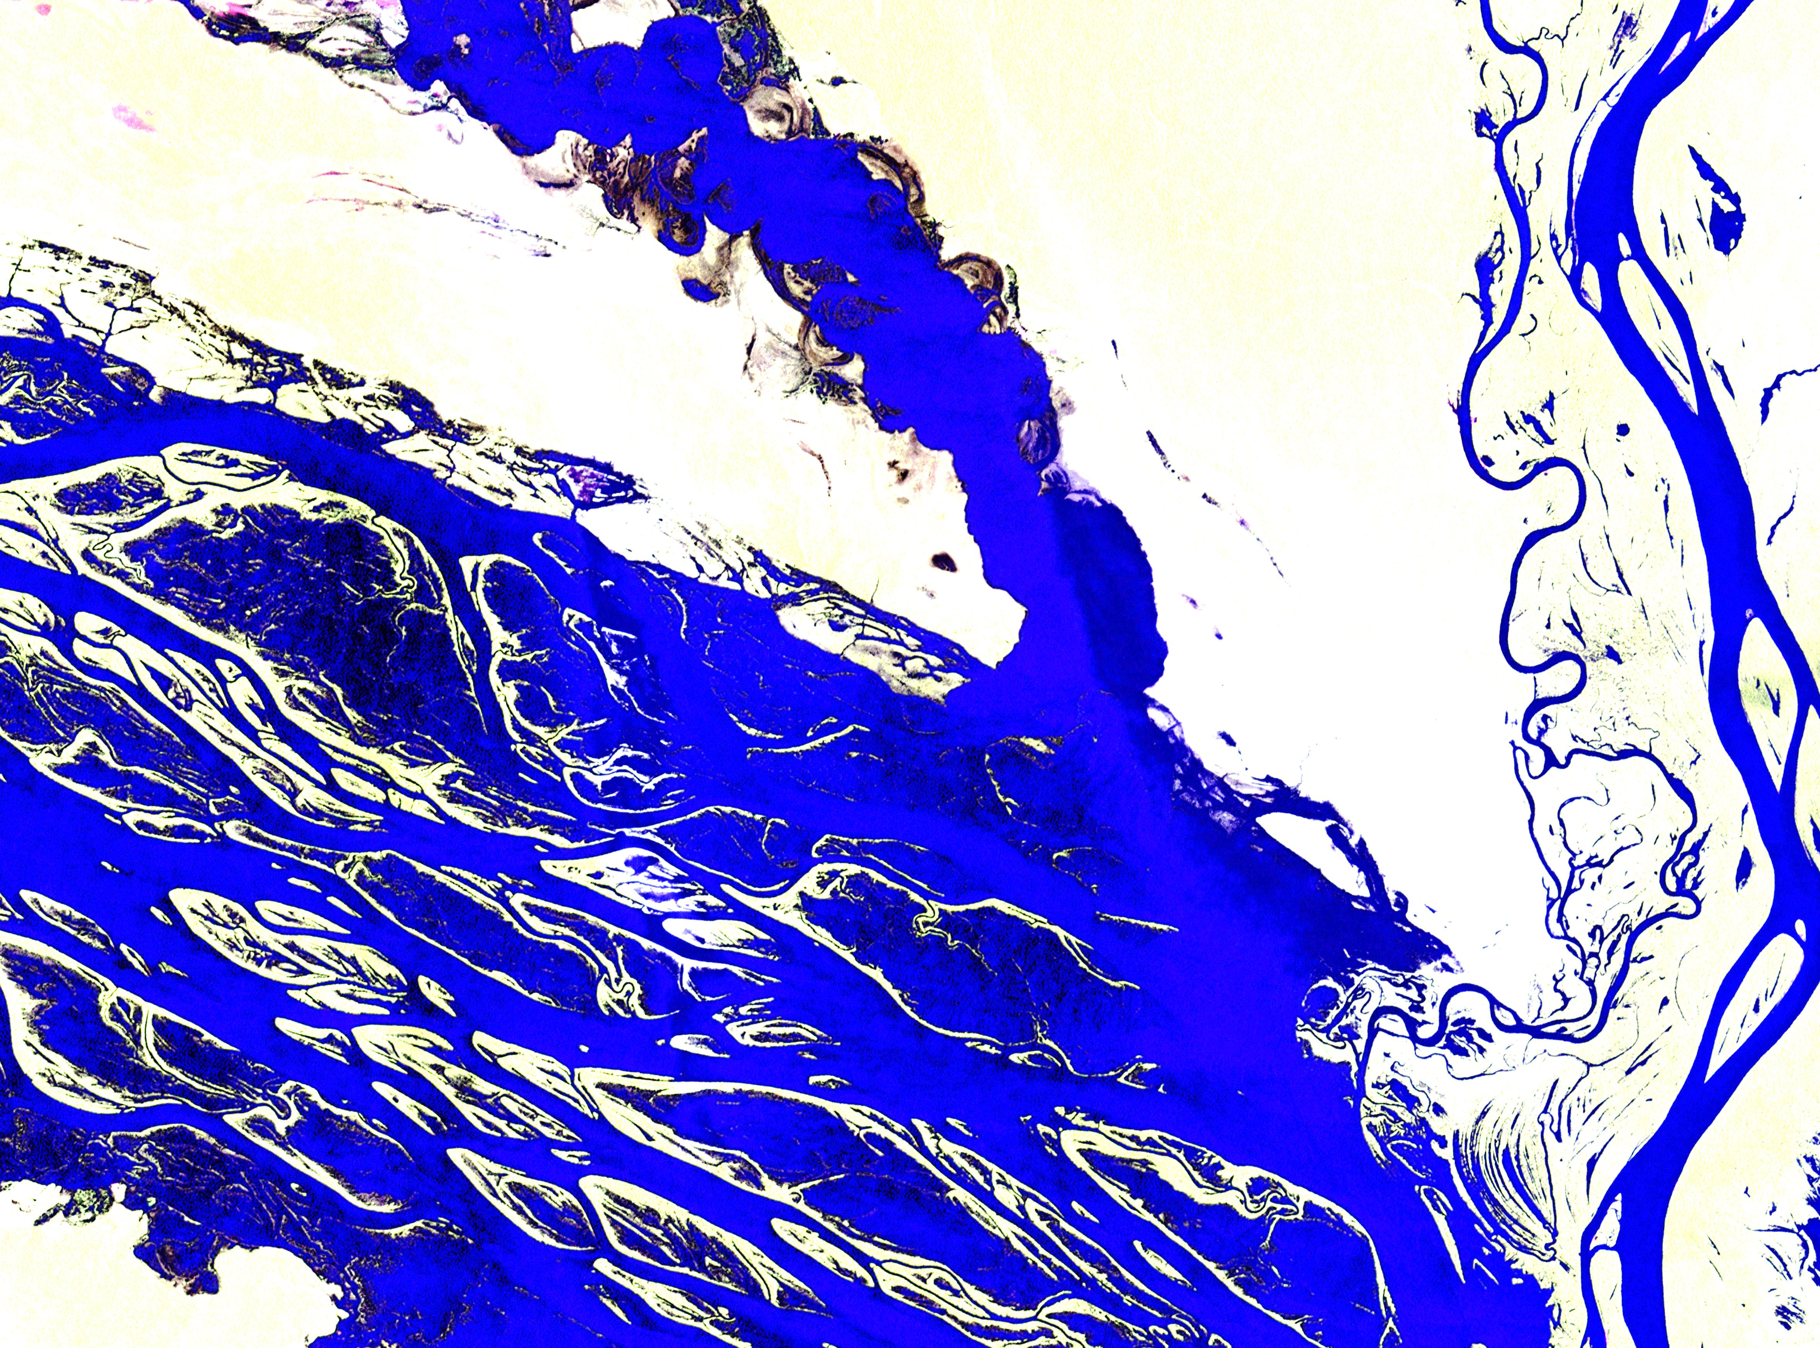
Acknowledgements
Drs. Passalacqua & Maidment
Harish Sangireddy
Alicia & Corey

Slide 14
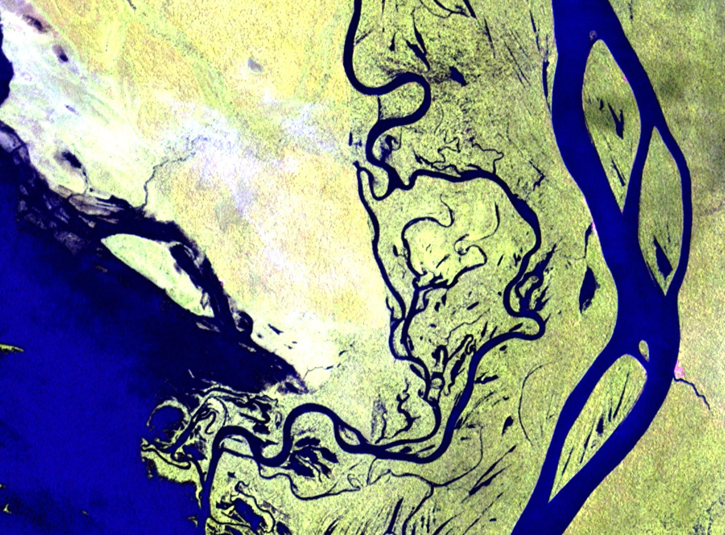
References
Passalacqua, P., T. Do Trung, E. Foufoula-Georgiou, G. Sapiro, and W. E. Dietrich (2010a), A geometric framework for channel network extraction from lidar: Nonlinear diffusion and geodesic paths, J. Geophys. Res., 115, F01002,doi:10.1029/2009JF001254.
Passalacqua, P., P. Tarolli, and E. Foufoula-Georgiou (2010b), Testing space-scale methodologies for automatic geomorphic feature extraction from lidar in a complex mountainous landscape, Water Resour. Res., 46, W11535, doi:10.1029/2009WR008812.
Passalacqua, P., P. Belmont, and E. Foufoula-Georgiou (2012), Automatic channel network and geomorphic feature extraction in flat and engineered landscapes, Water Resour. Res., 48, W03528, doi:10.1029/2011WR010958.
Roering, J.J., Mackey, B.H., Marshall, J.A., Sweeney, K.E., Deligne, N.I., Booth, A.M., Handwerger, A.L., Cerovski-Darriau C. (2013). You are HERE: connecting the dots with airborne lidar for geomorphic fieldwork. Geomorphology, Volume 200, http://dx.doi.org/10.1016/j.geomorph.2013.04.009

Slide 15
Thank you!
Questions?

