Slide 1
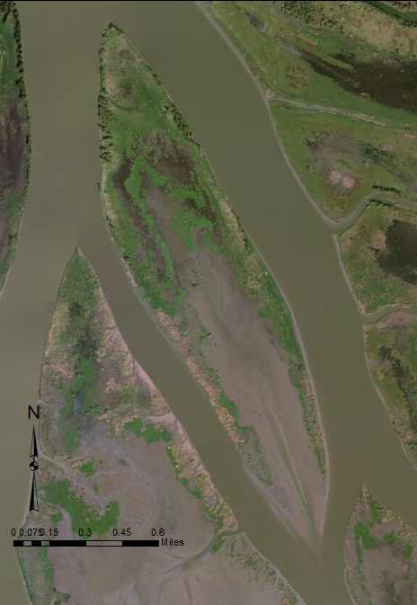
Flow analysis on Pintail island, Wax Lake Delta
Alicia Sendrowski
November 19, 2013
GIS in water resources CE394K.3

Slide 2
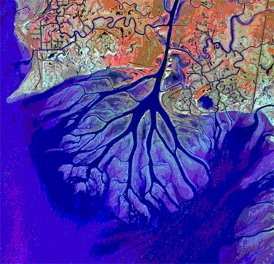
Wax Lake Delta, Louisiana
140 km southwest of New Orleans
Deltaic system that is building land
Interested in island hydrodynamics
Tracer study: sensors set up around island to detect Rhodamine dye in order to measure travel time on Pintail island
Tests done for falling tide and rising tide in 2 arrangements
Pintail Island
http://www.mississippiriverdelta.org/blog/files/2011/09/waxlake1.jpg

Slide 3
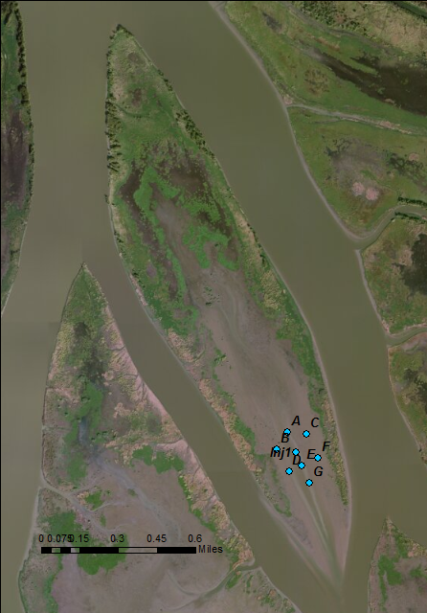
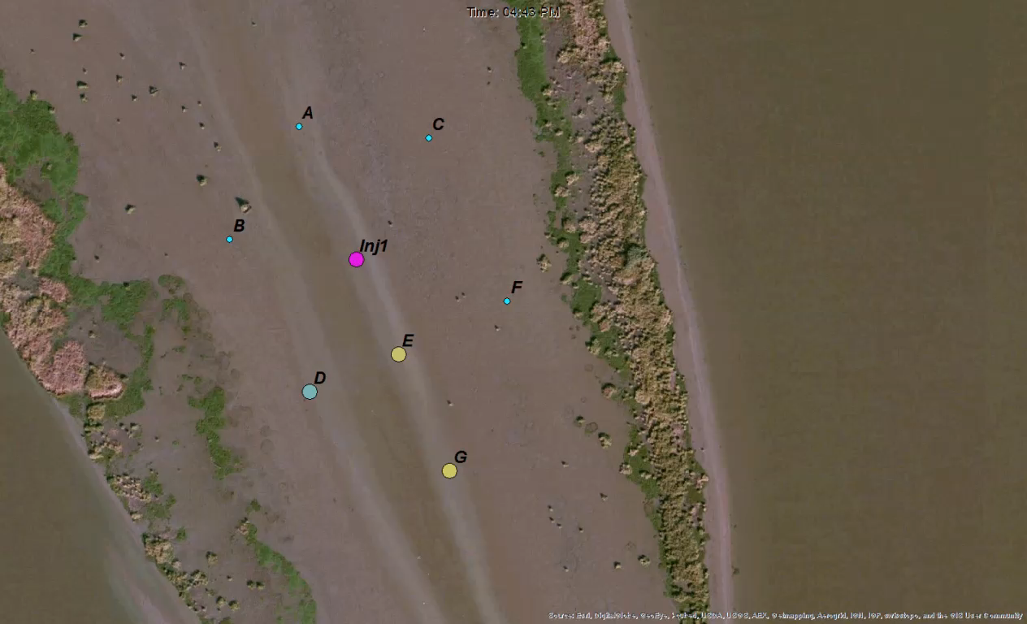
Tracer Study 1: Sensors D, E, G
First arrangement
Falling tide
Added 160mL of Rhodamine dye
Results:
Tracer moves from Injection Point to Sensor E and then to G.

Slide 4
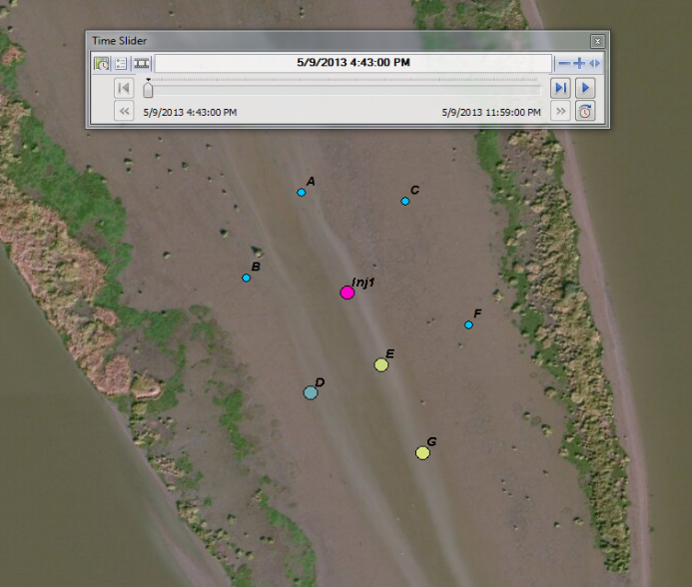
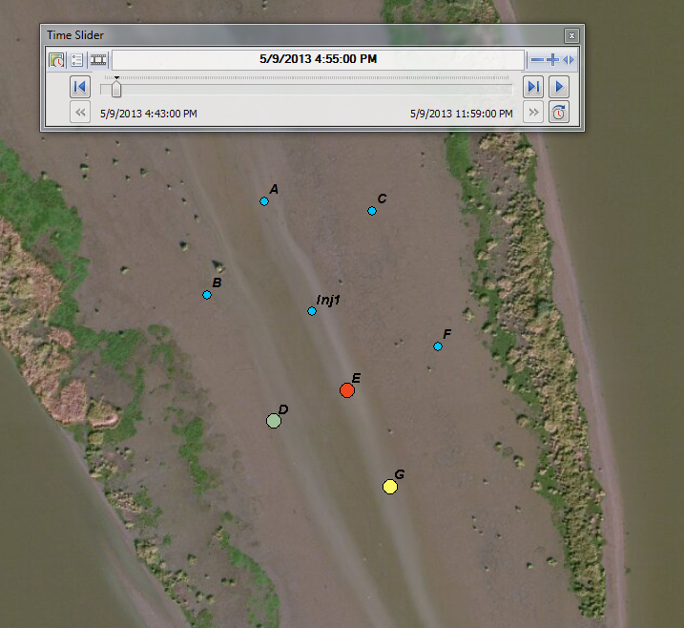
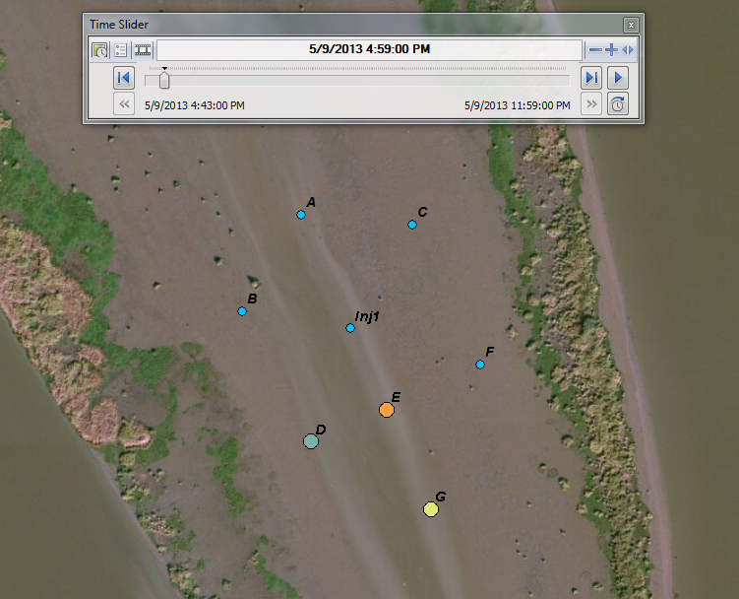
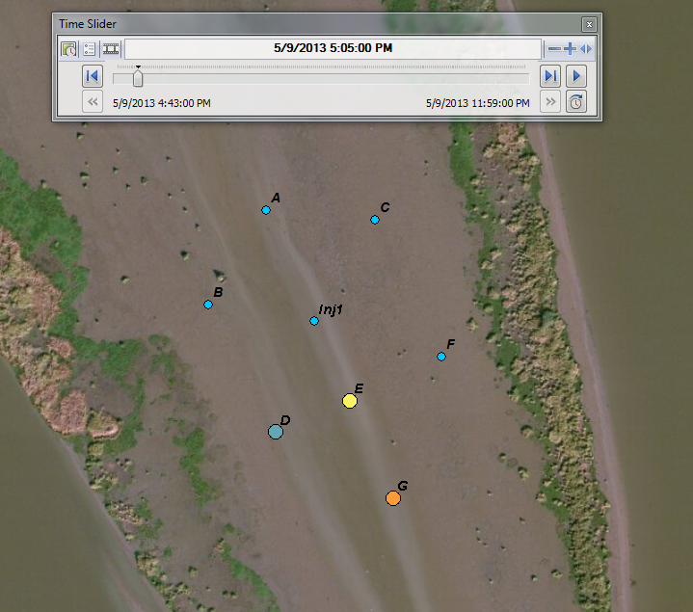
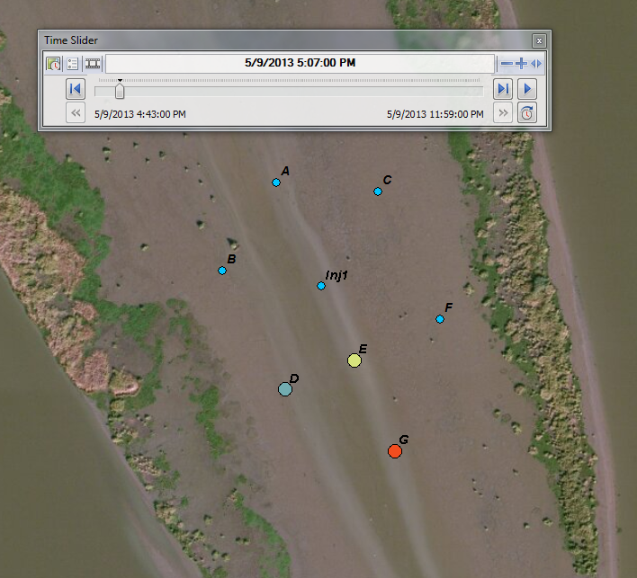
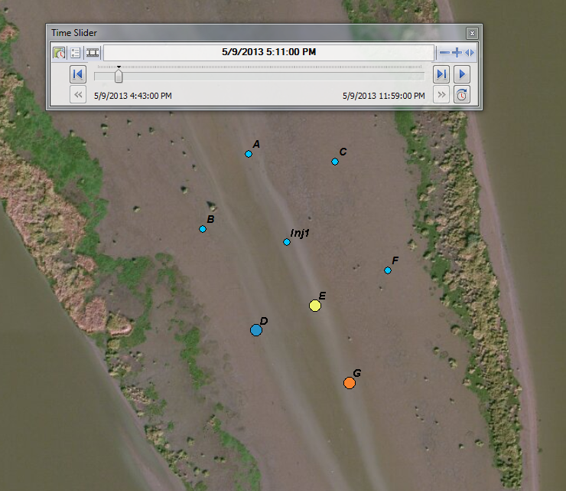
Time series breakdown
4:43 PM
4:55 PM
4:59 PM
5:05 PM
5:07 PM
5:11 PM

Slide 5
Results
The peak of Sensor E comes at ~ 14 minutes after injection
Sensor G peak ~ 11 minutes after sensor E detection
Sensors have detection limit of 200 µg/L
Zoomed in, there is some dispersion
Total travel time was 25 minutes
Distance between Injection point and Sensor G ~ 184 m

Slide 6
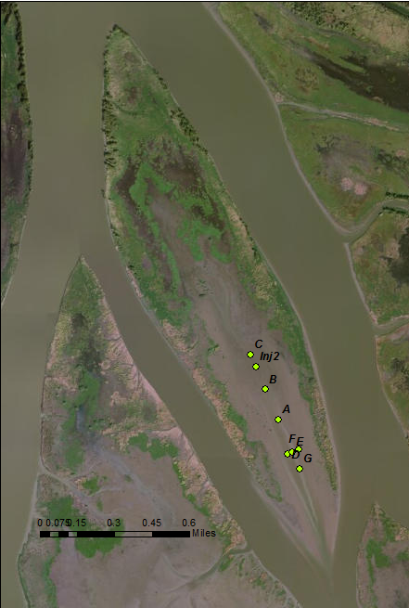
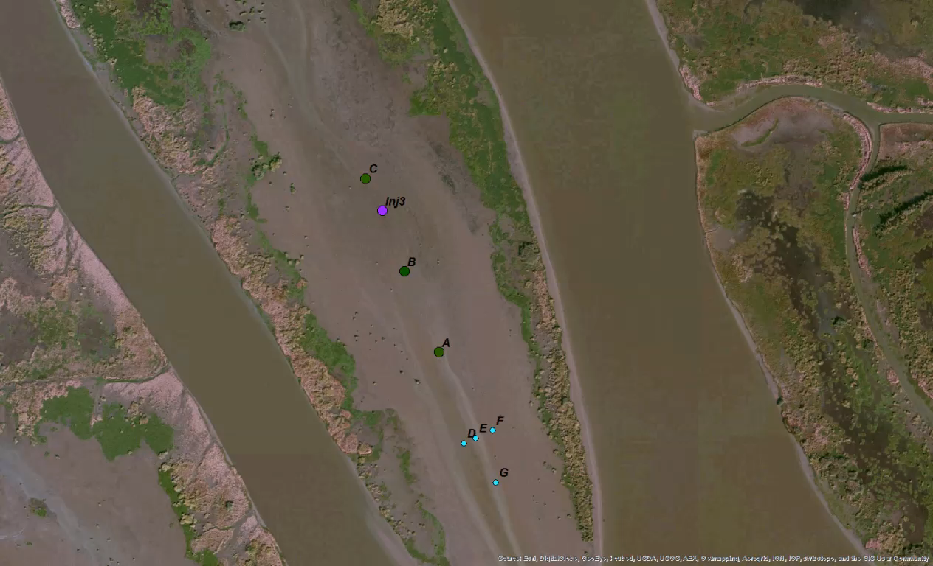
Tracer Study 2: Sensors C, B, A
Arrangement 2
Rising tide then falling tide
310 mL of Rhodamine Dye

Slide 7
Results
First peak comes 43 minutes after injection for Sensor C
Tide begins to fall and another peak occurs 66 minutes after the first peak for Sensor C
Sensor B sees peak 181 minutes after injection
Sensor A also detects rhodamine but very dispersed
Much more dispersion than first test

Slide 8
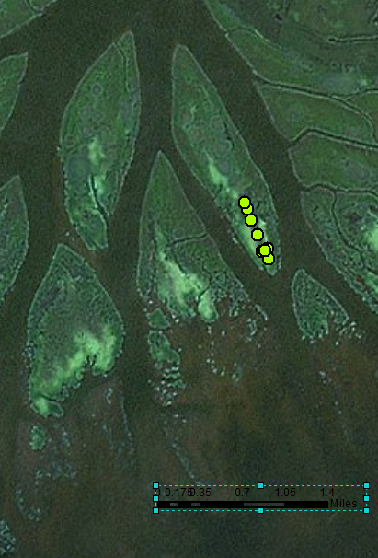
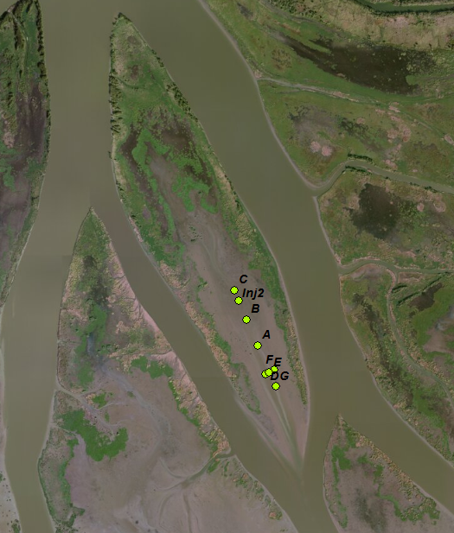
Future Work
Objective 1
Input time series for Tracer study 3
Same arrangement as 2nd tracer study but for falling tide only
Further analysis into all tracer results to obtain characteristics about Pintail island hydrology
Objective 2
Use results from tracer studies on Pintail Island to suggest sensor locations for Mike Island tracer study
Mike Island

Slide 9
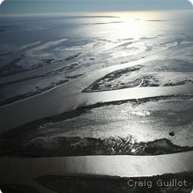
Acknowledgments
Dr. Paola Passalacqua
Matt Hiatt
Research Group
https://www.nwf.org/~/media/Content/Environmental%20Issues/Flooding/WaxLakeDelta2_CraigGuillot_219X219.ashx

Slide 10
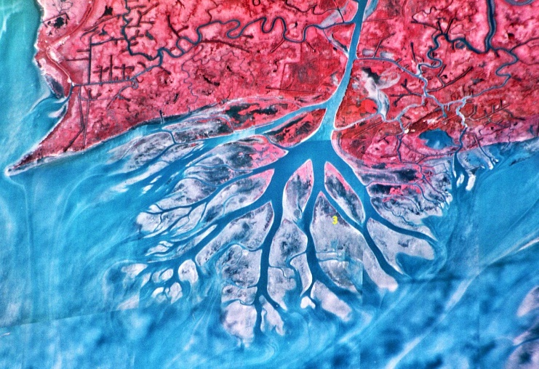
QUESTIONS?
http://lab.visual-logic.com/wp-content/uploads/2010/02/wax-lake-delta.jpg

