Slide 1
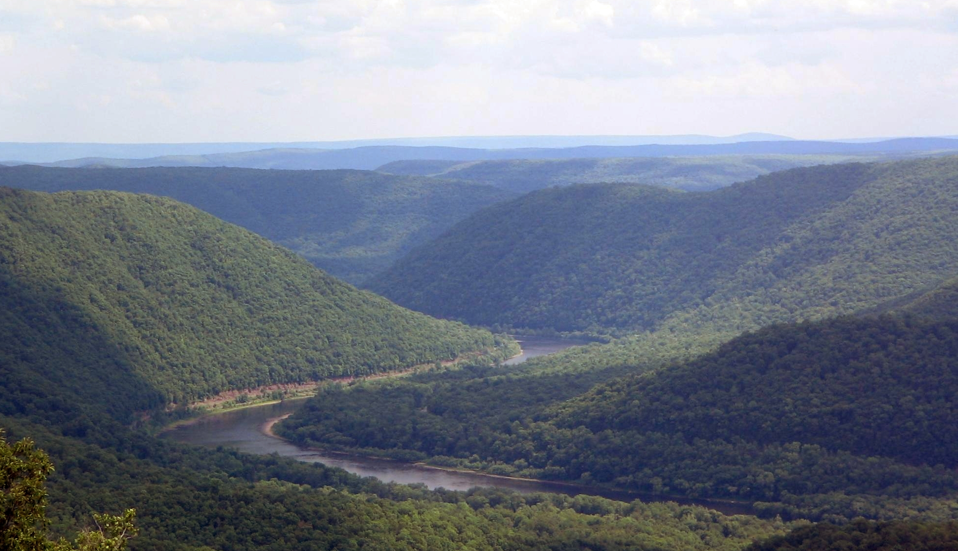
Effects of N Loadings from Dairy Cows to the
Susquehanna River
Austin Weidner
CE394K : GIS in Water Resources
University of Texas at Austin
November 19, 2013

Slide 2
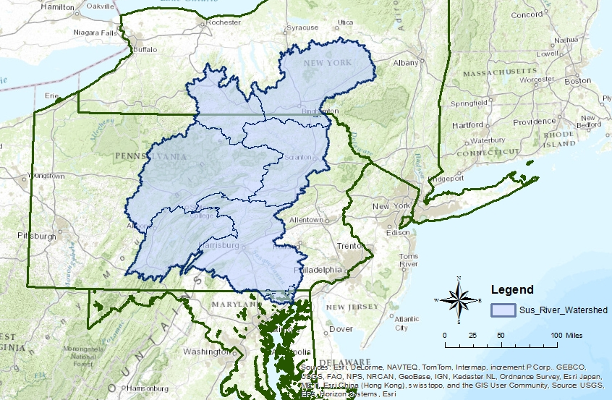
Susquehanna River
River Length = 444 miles
Basin Area = 27,510 mi²
  Covers 3 states (PA, NY, MD)
  67 counties
Average Flow = 40,174 ft³/s

Slide 3
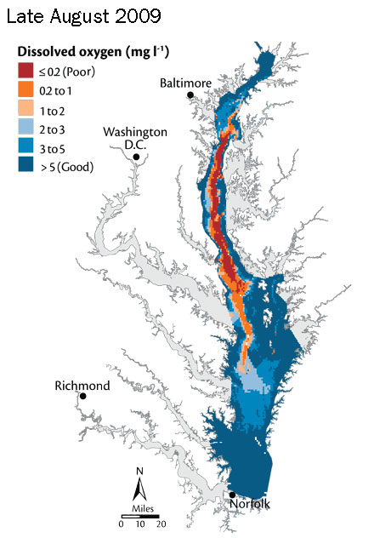
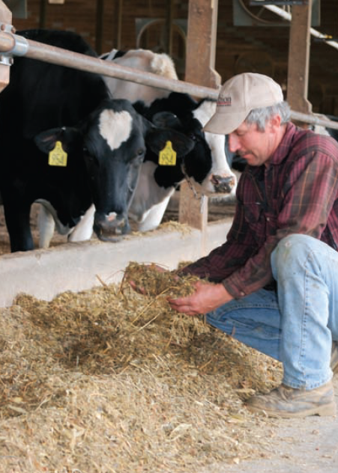
Impacts on Chesapeake Bay
Non-point pollution leads to dead zones
  Agricultural Runoff
Susquehanna River provides
  40% of N Loading
  50% of which is manure
Photo: Chesapeake Bay Foundation. Waters at Risk, 2006
Photo: Chesapeake Bay Foundation, 2013

Slide 4
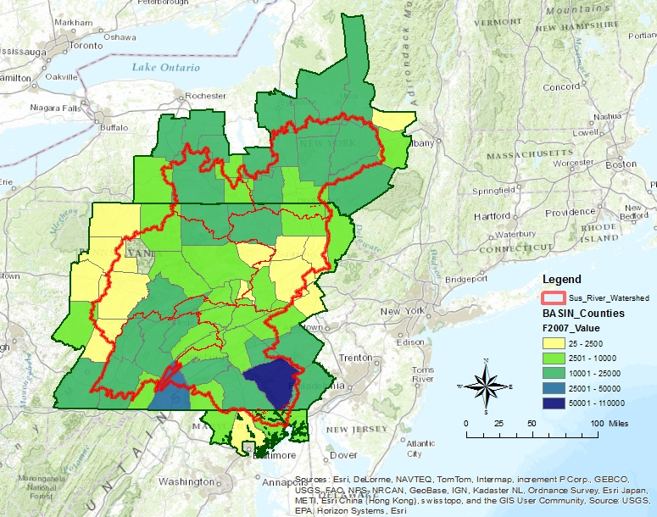
2007 Dairy Cow Population
USDA Ag Census
Lacks Spatial Detail
Lancaster County, PA

Slide 5
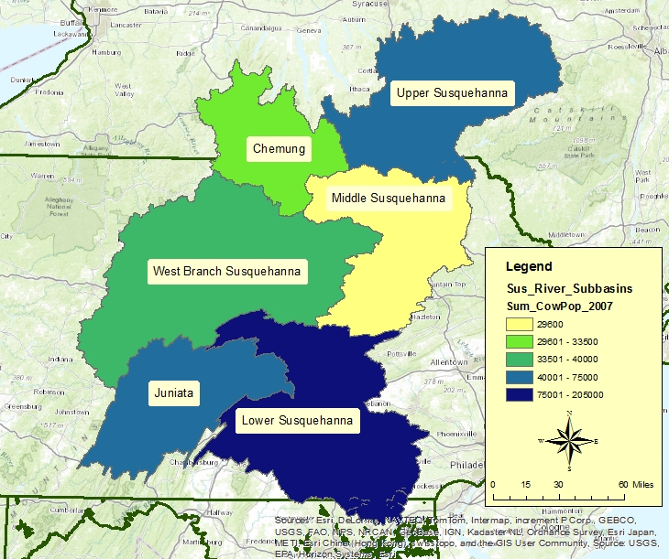
2007 Dairy Cow Population
Spatial Estimation Used
Dairy Cows produce 121 kg N / year in Manure (Boyer, et al. 2002)
Subbasin Name | 2007 Cow Population | N from Manure (kg/year)
Upper Susquehanna | 72,290 | 8,747,090
Chemung | 33,466 | 4,049,386
Middle Susquehanna | 29,600 | 3,581,600
West Branch Susquehanna | 39,851 | 4,821,971
Juniata | 69,990 | 8,468,790
Lower Susquehanna | 202,668 | 24,522,828
TOTALS | 447,865 | 54,191,665
119.4 tons N/year

Slide 6
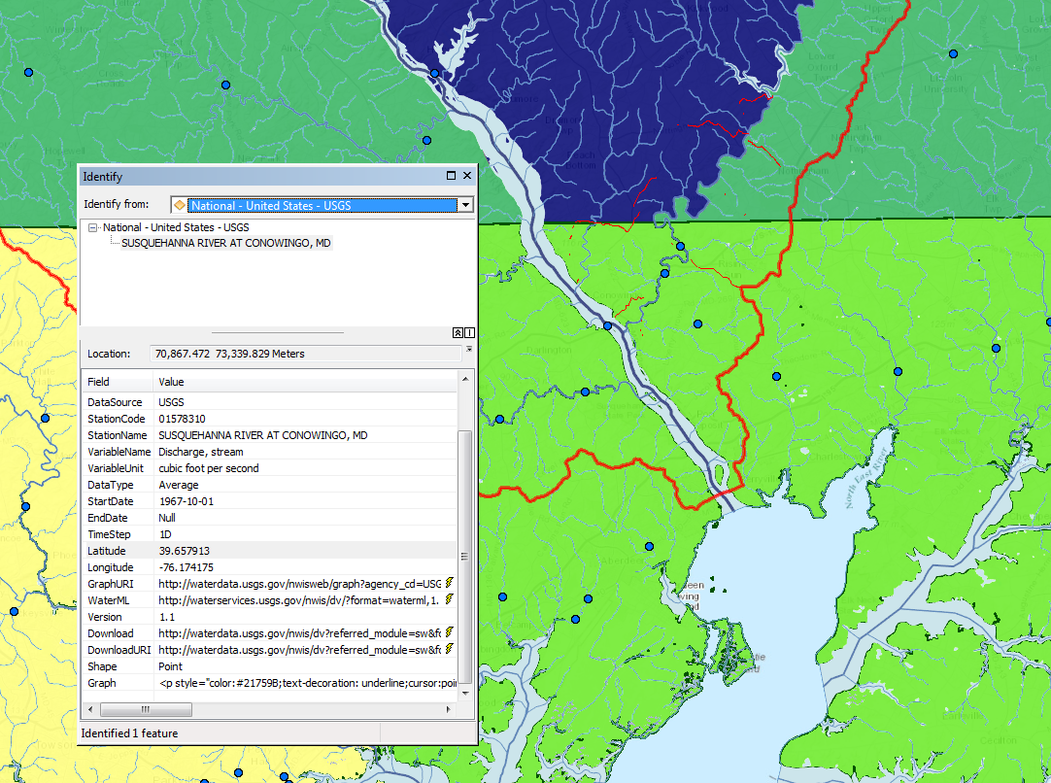
Future Work
Water Quality
  Compare N estimates to actual stream measurements
  Determine at risk streams
Precipitation impacts on runoff rates
  Compare yearly precipitation / # of large storm events to N loadings
  Precipitation varies spatially
Discharge Stream Gauge: Susquehanna River at Conowingo, MD; Site ID 01578310

Slide 7
Conclusions
Susquehanna River is a major source of non-point source pollution to the Chesapeake Bay
  Difficult to Analyze Non-Point Pollution in ArcGIS
Much of the Nutrient Loading comes from Dairy Cattle
An estimated 447,865 dairy cows live within the Susquehanna Basin producing 120 tons N / year
Future Work to analyze water quality data of subbasins and precipitation impacts

Slide 8
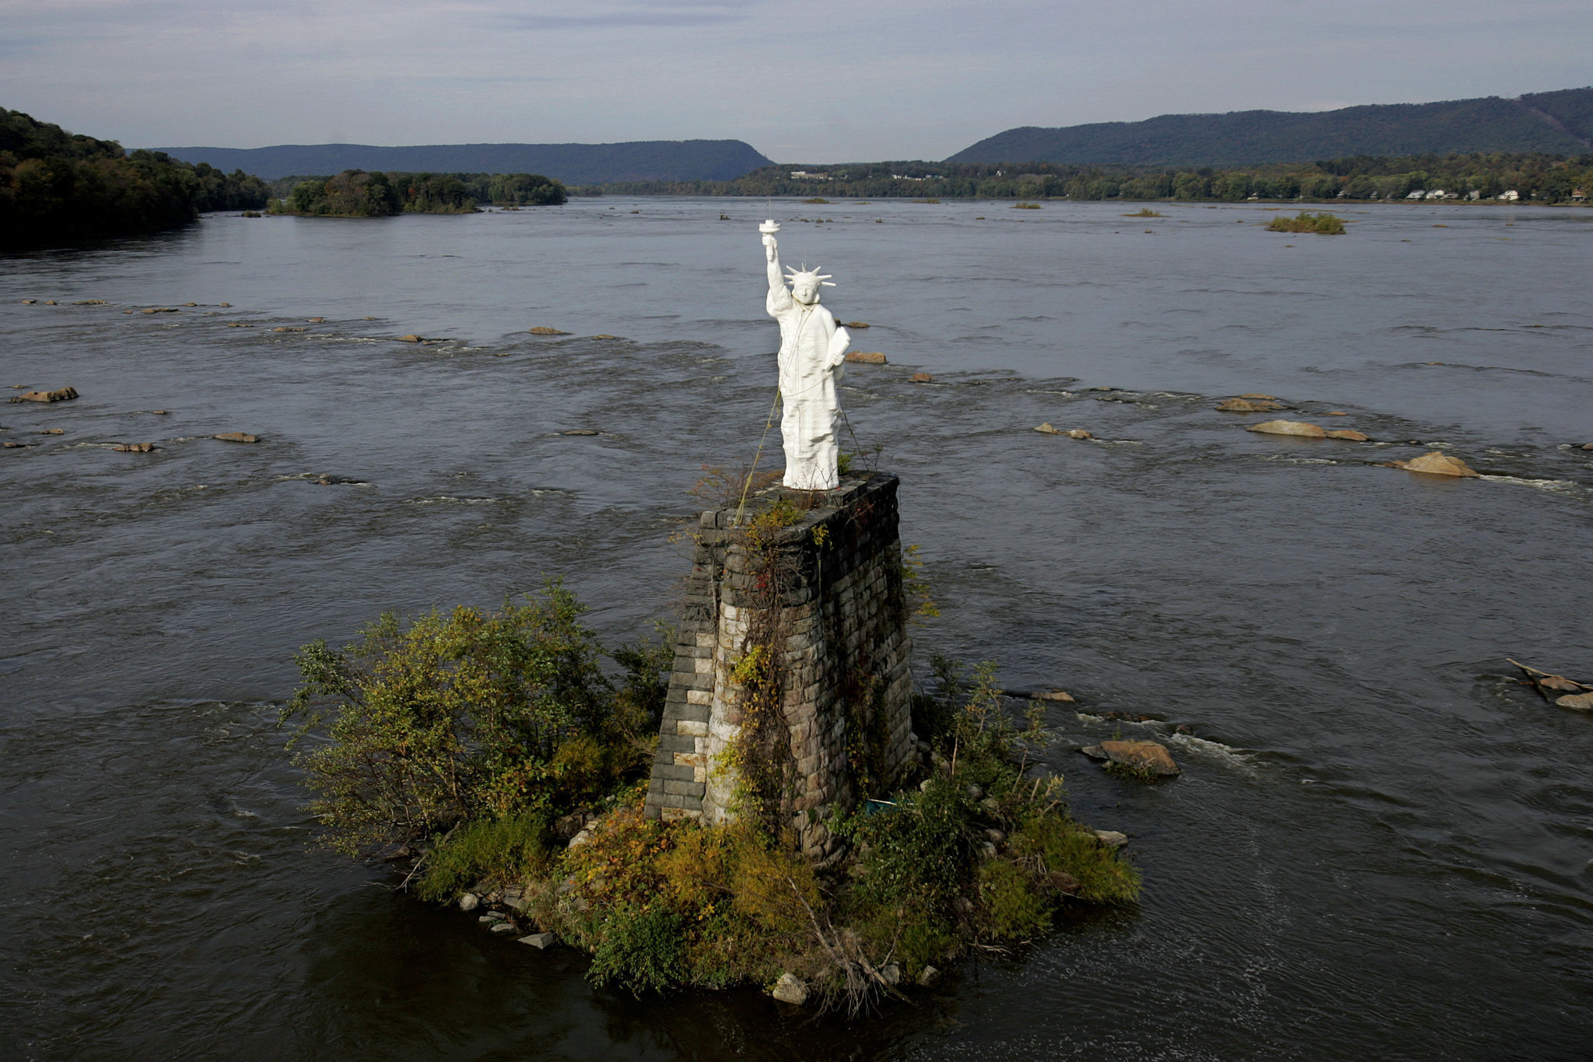
Questions?

