Slide 1
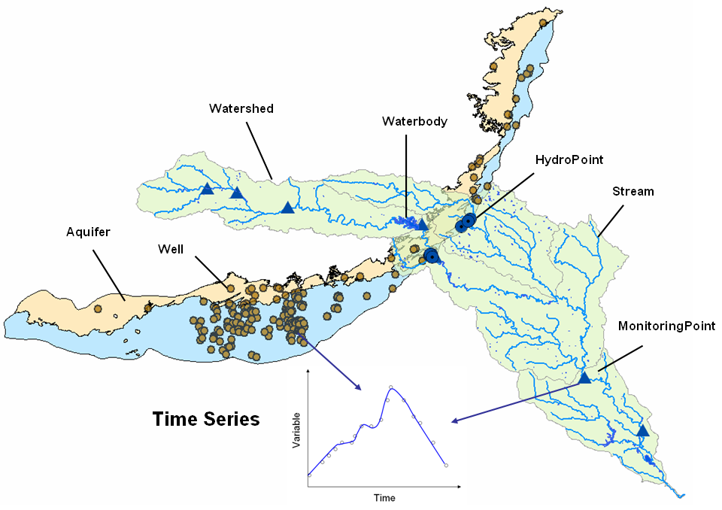
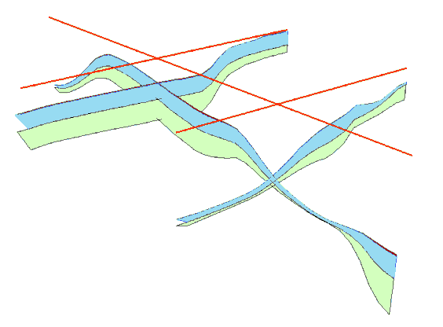
Arc Hydro Groundwater Data Model
GIS in Water Resources
Fall 2013
Some slides in this presentation are from Dr Norman Jones, Brigham Young University

Slide 2
Resources
Hydro Resource Center: Groundwater
http://resources.arcgis.com/en/communities/hydro/01vn00000011000000.htm
Groundwater Tools and Data Model
http://www.aquaveo.com/archydro-groundwater
Tutorials
http://www.aquaveo.com/ahgw-learning
Contact for tool support
support@aquaveo.com

Slide 3
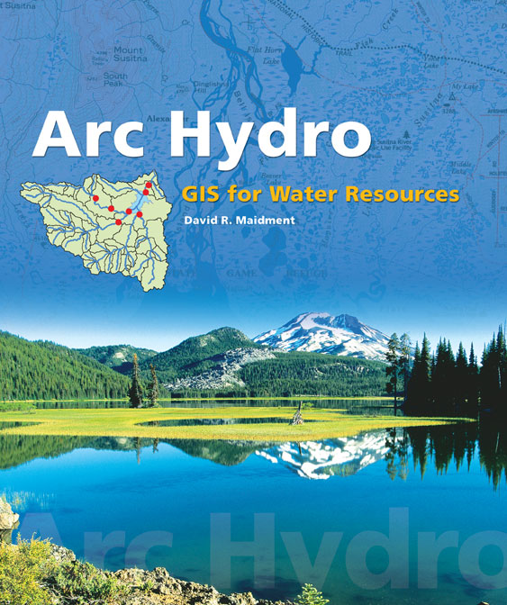
Arc Hydro: GIS for Water Resources
Published in 2002
Arc Hydro
  An ArcGIS data model for water resources
  Arc Hydro toolset for implementation
  Framework for linking hydrologic simulation models
The Arc Hydro data model and
application tools are in the public
domain
Notes:
Notes:
Industrial partners: ESRI, Danish Hydraulic Institute, Camp,Dresser and McKee, Dodson and Associates
Government partners:
Federal: EPA, USGS, Corps of Engineers (Hydrologic Engineering Center)
State: Texas Natural Resource Conservation Commission, Texas Water Development Board
Local: Lower Colorado River Authority, City of Austin, Dept of Watershed Protection
Academic Partners: University of Texas, Brigham Young University, Utah State University

Slide 4
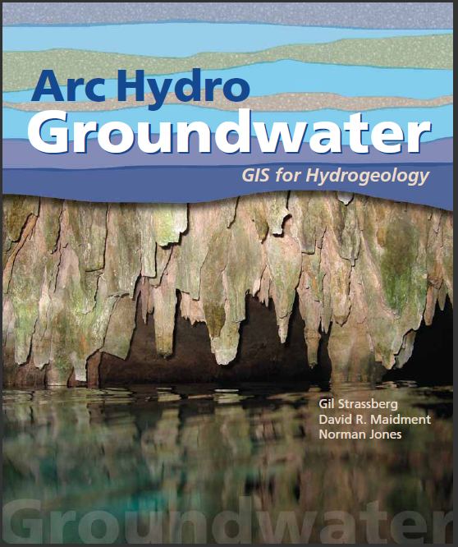
Arc Hydro Groundwater:
GIS For Hydrogeology
Describes the data model – public domain
Chapter for each data model component
Published in 2011
Notes:
Notes:
Industrial partners: ESRI, Danish Hydraulic Institute, Camp,Dresser and McKee, Dodson and Associates
Government partners:
Federal: EPA, USGS, Corps of Engineers (Hydrologic Engineering Center)
State: Texas Natural Resource Conservation Commission, Texas Water Development Board
Local: Lower Colorado River Authority, City of Austin, Dept of Watershed Protection
Academic Partners: University of Texas, Brigham Young University, Utah State University

Slide 5
Arc Hydro Groundwater Data Model
Notes:
This is an overview diagram of the AHGW data model.
You can review the different components, talk about what each component is for:
Framework – includes hydrography, monitoring points, wells, aquifers, tables for managing time series (the framework includes a simplified temporal component). – with the framework you can get started on most water resources projects.
Borehole data – description of vertical information recorded along boreholes (hydrostratigraphy, well construction).
Geology – representation of data from geologic maps.
Hydrostratigraphy – building 2D and 3D hydrogeologic models including surfaces, cross sections, volumes.
Temporal – dealing with time varying data – plots, tracks, animations.
Simulation – integration with groundwater simulation models, especially MODFLOW.

Slide 6
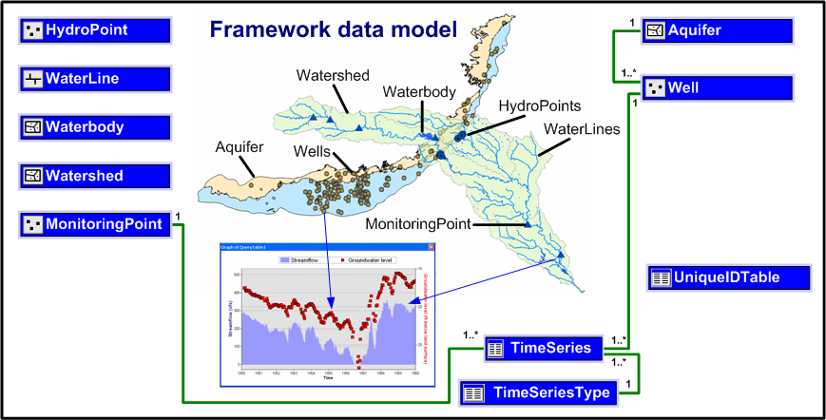
Arc Hydro Framework
Basic representation of surface water and groundwater
Components can be added to the framework to represent specific themes in more detail

Slide 7
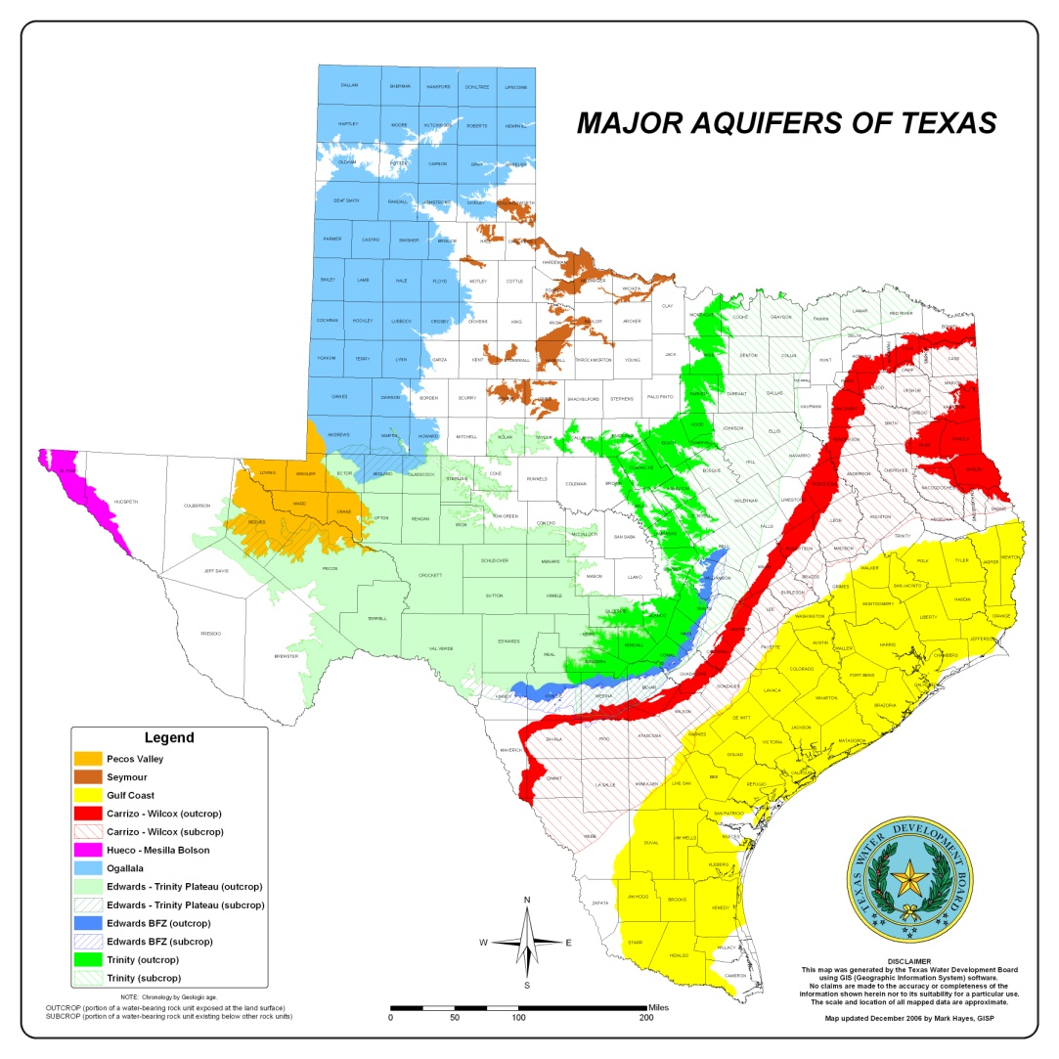
Aquifer features
Polygon features for representing aquifer boundaries

Slide 8
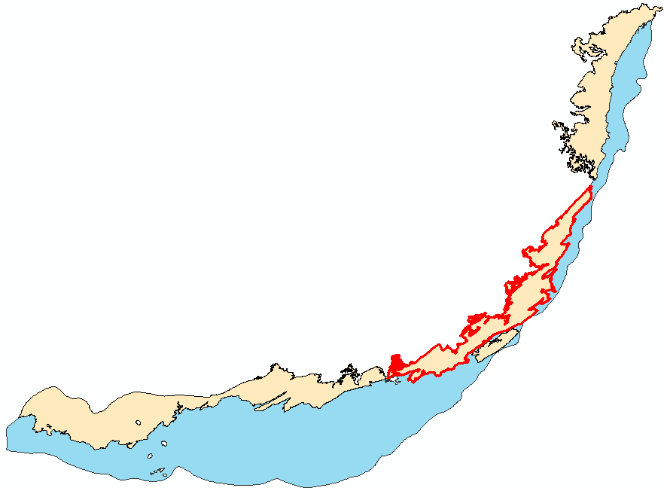
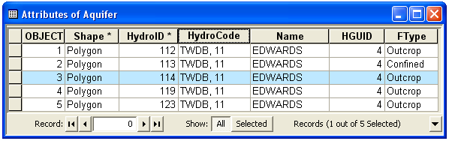

Aquifer features
An aquifer is defined by one or a set of polygon features
Aquifer features can be grouped by HGUID

Slide 9
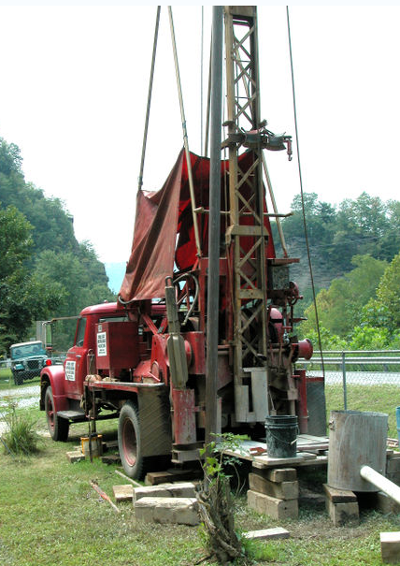
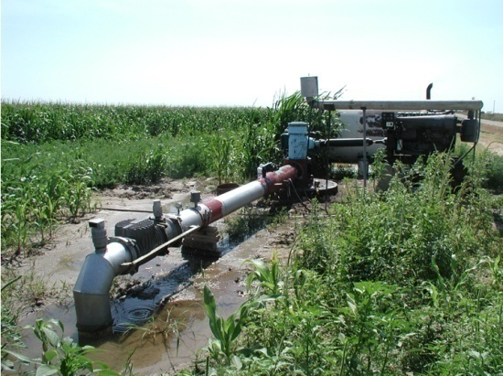
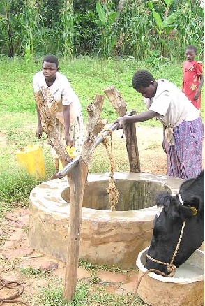
Well
Location where the subsurface has been drilled
Attributes of wells describe the location, depth, water use, owner, etc.

Slide 10
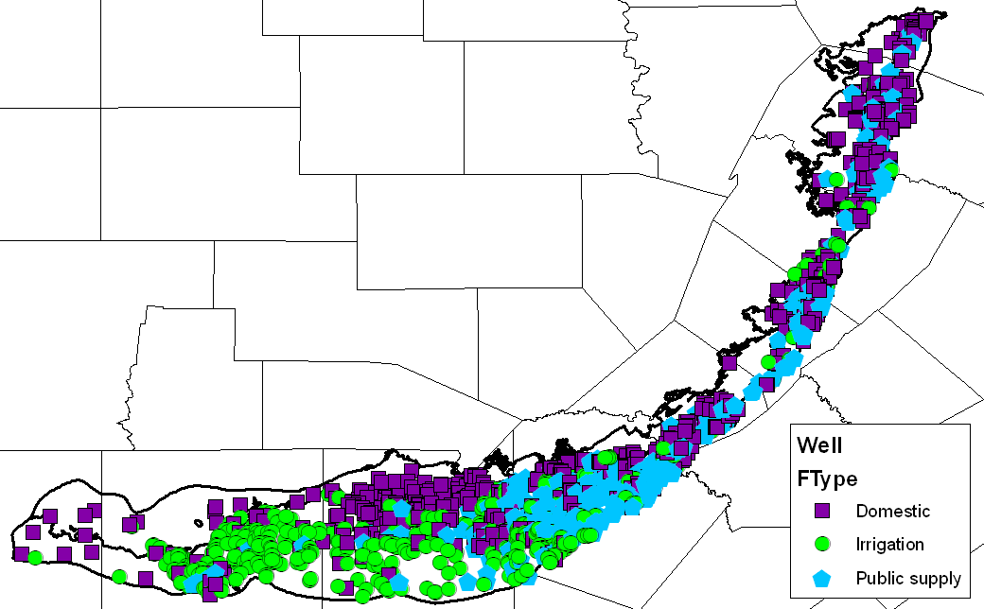
Well
Wells are defined as 2D point features
Only some basic attributes are predefined to describe the well use, and geometry and relationship with aquifers
Wells in the Edwards Aquifer

Slide 11
Aquifer and well
Well features are related to Aquifers
An aquifer can be associated with one or more wells (1:M relationship)
Can take a different approach to support M:N relationship
Aquifer
Well
1
HydroID
HydroID
HydroCode
HydroCode
Name
LandElev
HGUID
WellDepth
*
FType
AquiferID
AqCode
HGUID
FType

Slide 12
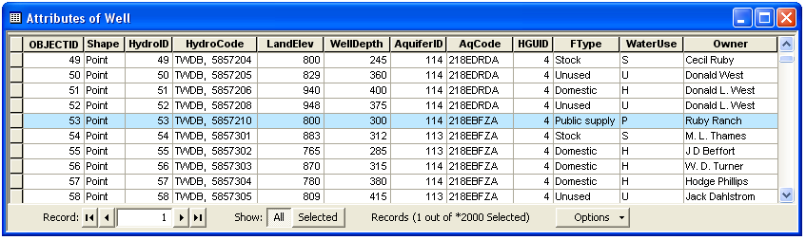
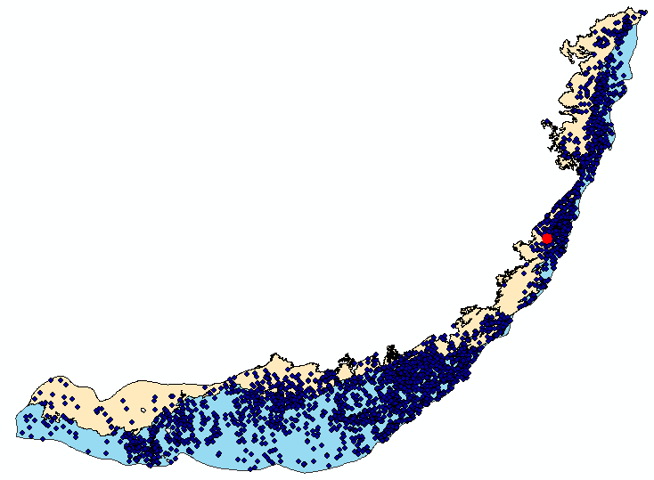
Aquifer and well
Well HydroID = 53

Slide 13
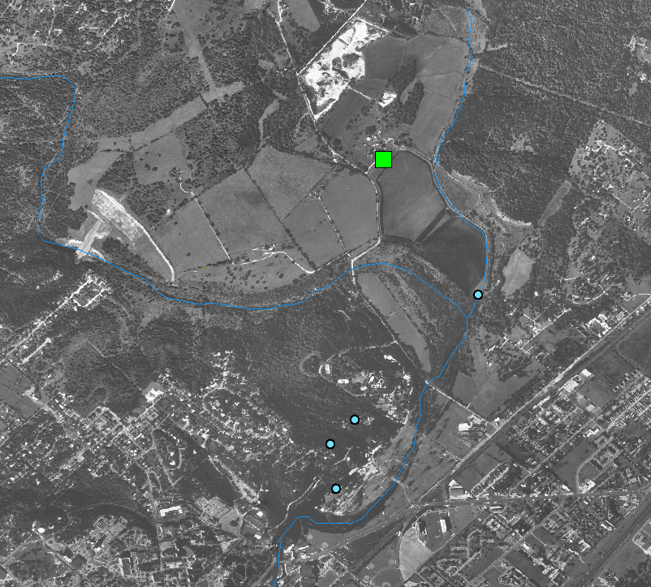
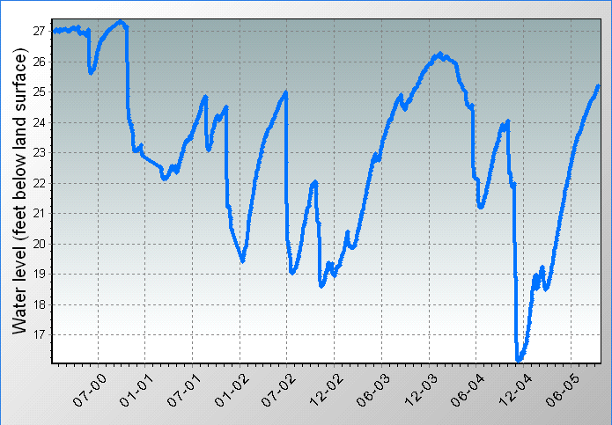
Wells and TimeSeries
Well features are related with time series (water levels, water quality)
Monitoring Well
(
295443097554201
)
Sink Creek
San Marcos springs
Springs
San Marcos

Slide 14
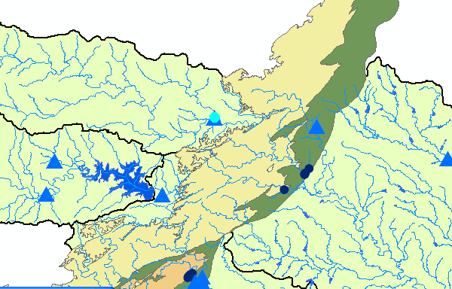
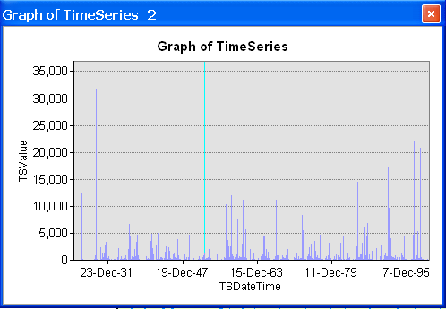
MonitoringPoint has time series
Monitoring points are related with time series (streamflow, water quality, precipitation)

Slide 15
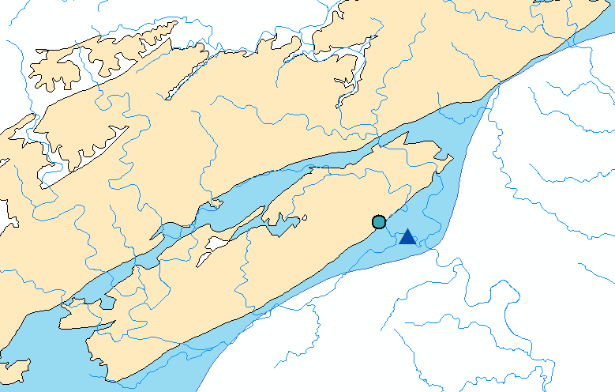
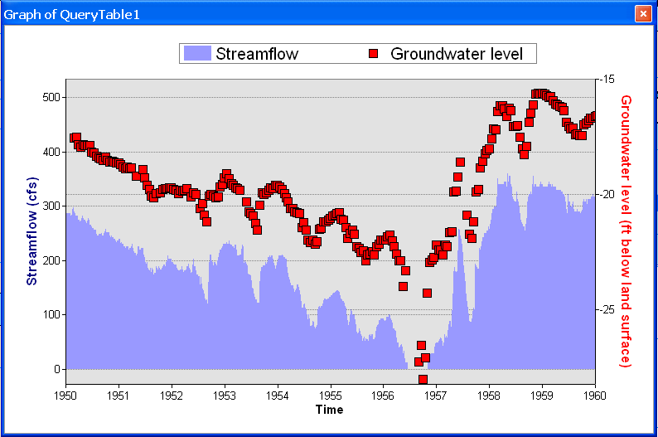
Integration of surface water and groundwater data
The common framework supports analysis of surface water and groundwater data together
Well in the Edwards Aquifer)
Streamflow Gage at Comal Springs, New Braunfels Texas

Slide 16
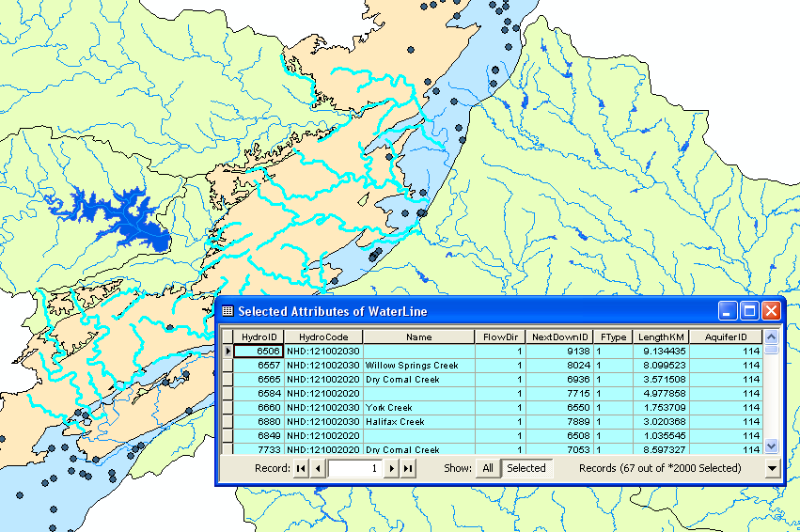
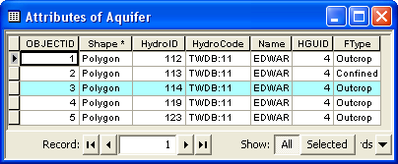
Surface water - groundwater linkage
Relationships between surface water and aquifer enable analysis based on spatial and hydrologic relationships
Streams over the outcrop = recharge features

Slide 17
Components
Geology - Representation of data from geologic maps
Boreholes – Description of well attributes and borehole data
Hydrostratigraphy – 2D and 3D description of hydrostratigraphy
Temporal – Representation of time varying data
Simulation – Representation of groundwater simulation models (focus on MODFLOW)

Slide 18
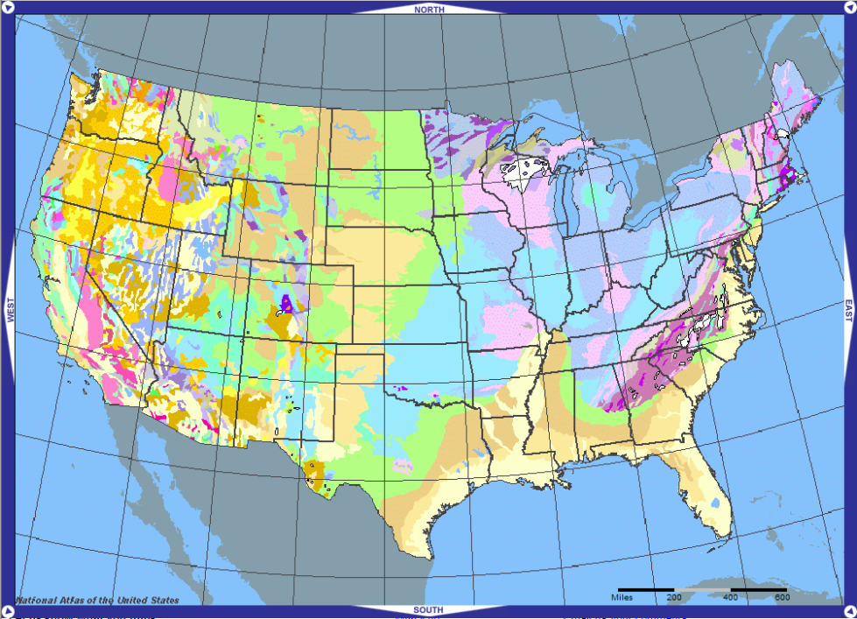
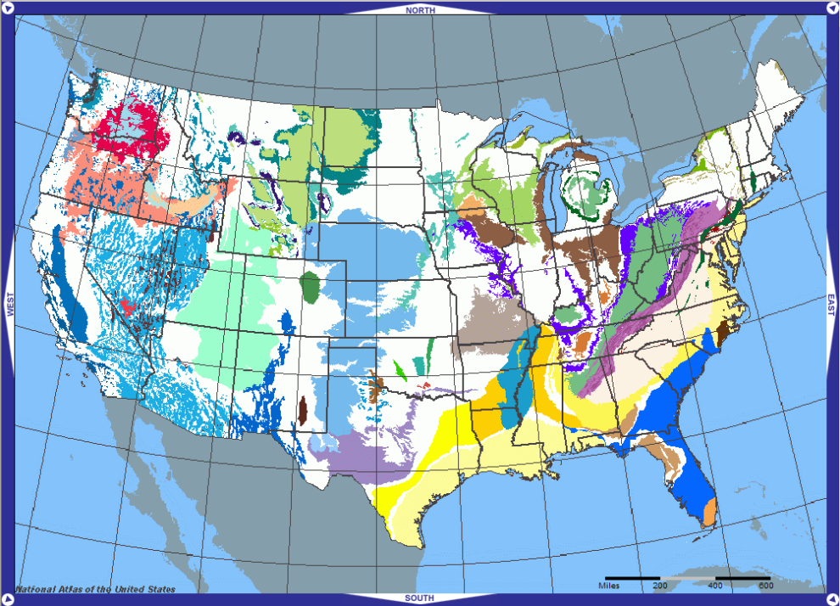
Geologic maps
A geologic map is a cartographic product that portrays information about the geologic character of a specific geographic area
Groundwater features are closely tied to geology
Geologic maps vary in scale (continental, regional, local)
Provide a simple data structure to support mapping
Geology
Aquifers
Maps from the United States National Atlas (http://nationalatlas.gov/).

Slide 19
Geology component
GeologyPoint: Point feature (e.g. springs, caves, sinks, and observation points)
GeologyLine: Line features (e.g. faults, contacts)
GeologyArea: Areal features (e.g. rock units and alteration zones)
Map modified from: Geologic map of the Edwards Aquifer recharge zone, south-central Texas. U.S. Geological Survey SIM 2873

Slide 20
Components
Geology - Representation of data from geologic maps
Boreholes – Description of well attributes and borehole data
Hydrostratigraphy – 2D and 3D description of hydrostratigraphy
Temporal – Representation of time varying data
Simulation – Representation of groundwater simulation models (focus on MODFLOW)

Slide 21
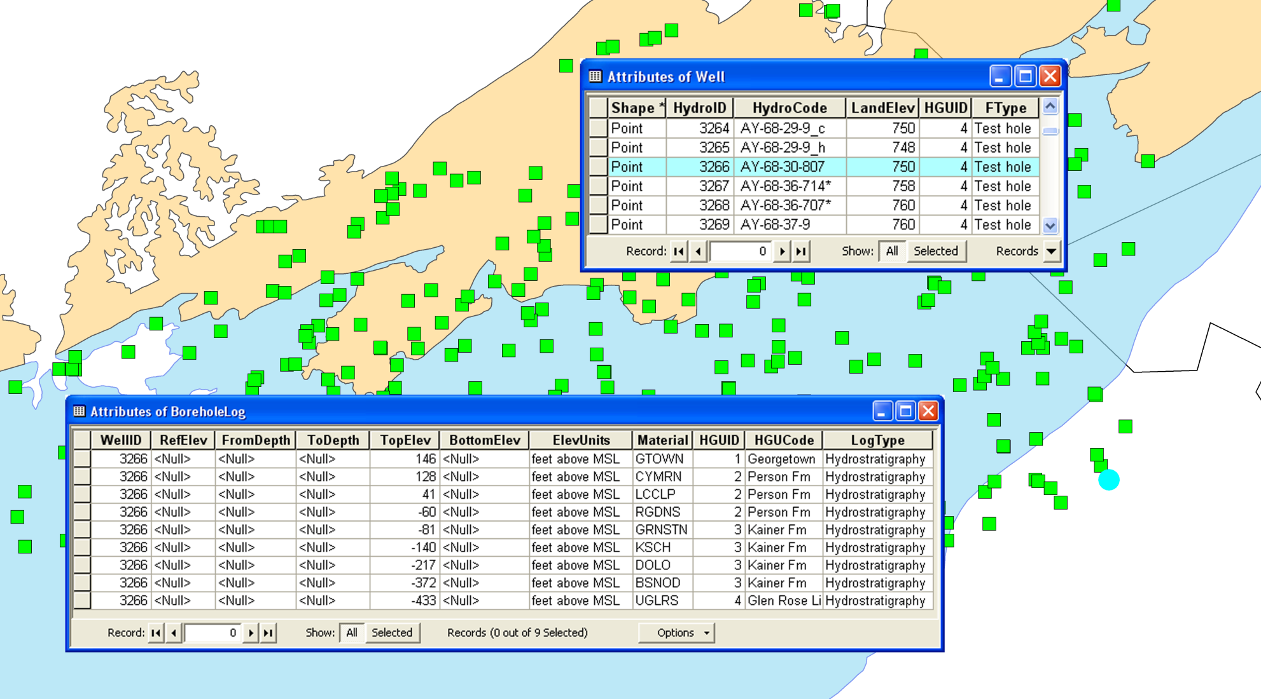
BoreholeLog table
Stores 3D borehole data related with well features
Each row represents a point/interval along a borehole
Data are related to Wells using the WellID attribute
3D geometry is defined by the TopElev and BottomElev attributes

Slide 22
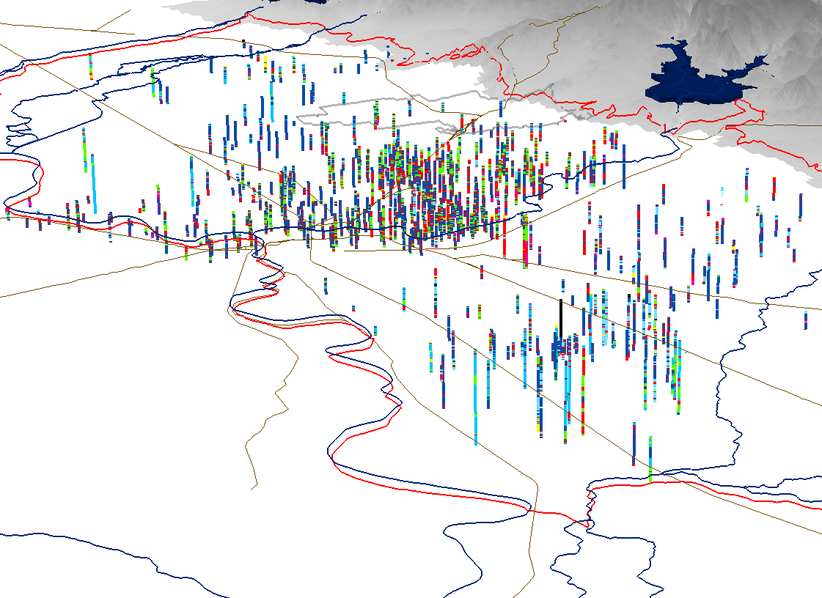
3D features (BorePoints and BoreLines)
Can create 3D features representing data in the BoreholeLog table
BorePoint is a 3D point feature class for representing point locations along a borehole (e.g. geologic contacts, samples)
BoreLine is a 3D line feature class for representing intervals along a borehole

Slide 23
Components
Geology - Representation of data from geologic maps
Boreholes – Description of well attributes and borehole data
Hydrostratigraphy – 2D and 3D description of hydrostratigraphy
Temporal – Representation of time varying data
Simulation – Representation of groundwater simulation models (focus on MODFLOW)

Slide 24
Hydrogeologic units
“Hydrogeologic unit is any soil or rock unit or zone which by virtue of its hydraulic properties has a distinct influence on the storage or movement of ground water” (USGS glossary of hydrologic terms)
Hydrogeology can be derived by classifying stratigraphic units
Stratigraphic units
Hydrogeologic units
Upper confining unit
Georgetown Fm. (GTOWN)
Georgetown Fm.
Cyclic + Marine member (CYMRN)
Leached + collapsed member (LCCLP)
Pearson Fm.
Regional dense member (RGDNS)
Edwards Aquifer
Grainstone member (GRNSTN)
Kirschberg evaporite member (KSCH)
Kainer Fm.
Dolomitic member (DOLO)
Basal Nodular member (BSNOD)
Upper Glen Rose (UGLRS)

Slide 25
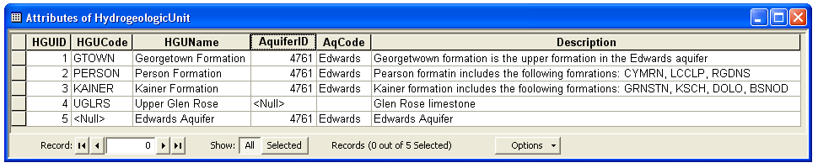
Hydrogeologic unit table
HydroGeologicUnit table provides a conceptual description of hydrogeologic units
Hydrogeologic units can be attributed with an AquiferID such that they can be grouped to represent an aquifer
Spatial features are indexed with a HGUID to relate to the conceptual representation of the units

Slide 26

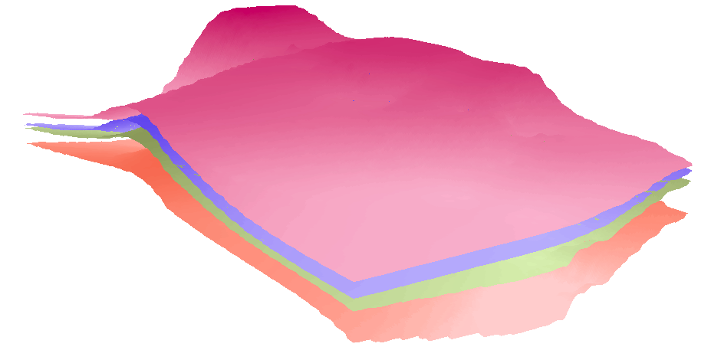
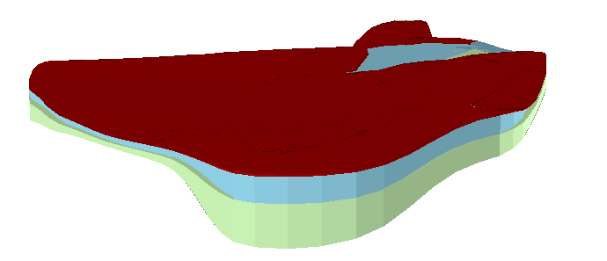
Hydrogeologic unit table
Hydrogeologic units are described with different spatial instances (outcrops, borehole intervals, surfaces, cross sections, and volumes)
HGUID is the key attribute
GeoArea
Polygon
feature class
1
SectionLine
GeoSection
*
PointZ
feature class
HydrogeologicUnit
Multipatch
feature class
Table
HGUID
Conceptual description
GeoRasters
Raster dataset
HGUID
GeoVolume
Spatial description
Multipatch
feature class

Slide 27
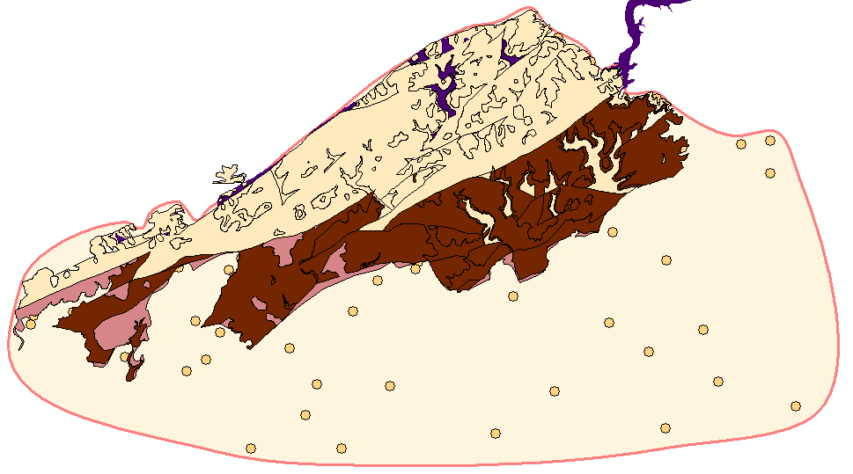

GeoArea
2D polygons defining boundaries of hydrogeologic units
GeoArea (conceptual/interpolated boundary) ≠ GeologyArea (mapped outcrop)
GeologyArea features represent data from geologic maps
GeologyArea
GeoArea feature representing the Kainer hydrogeologic unit
Data points representing top elevations of the Kainer formation

Slide 28
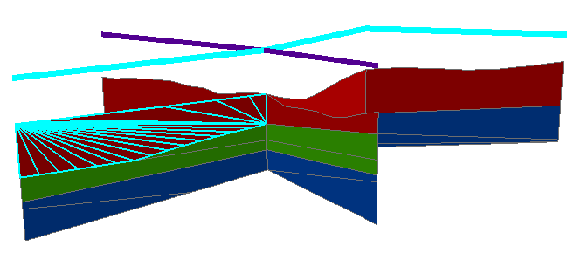
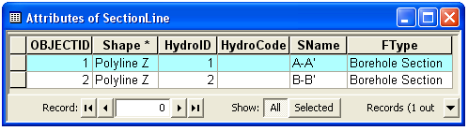
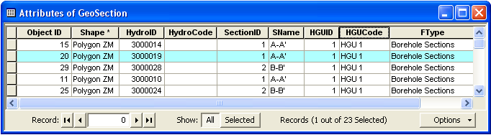
Representation of Cross Sections
SectionLine defines the 2D cross section
GeoSection represent 3D sections as 3D features
SectionID of the polygon relates back to the section line
B
B’
A’
A

Slide 29
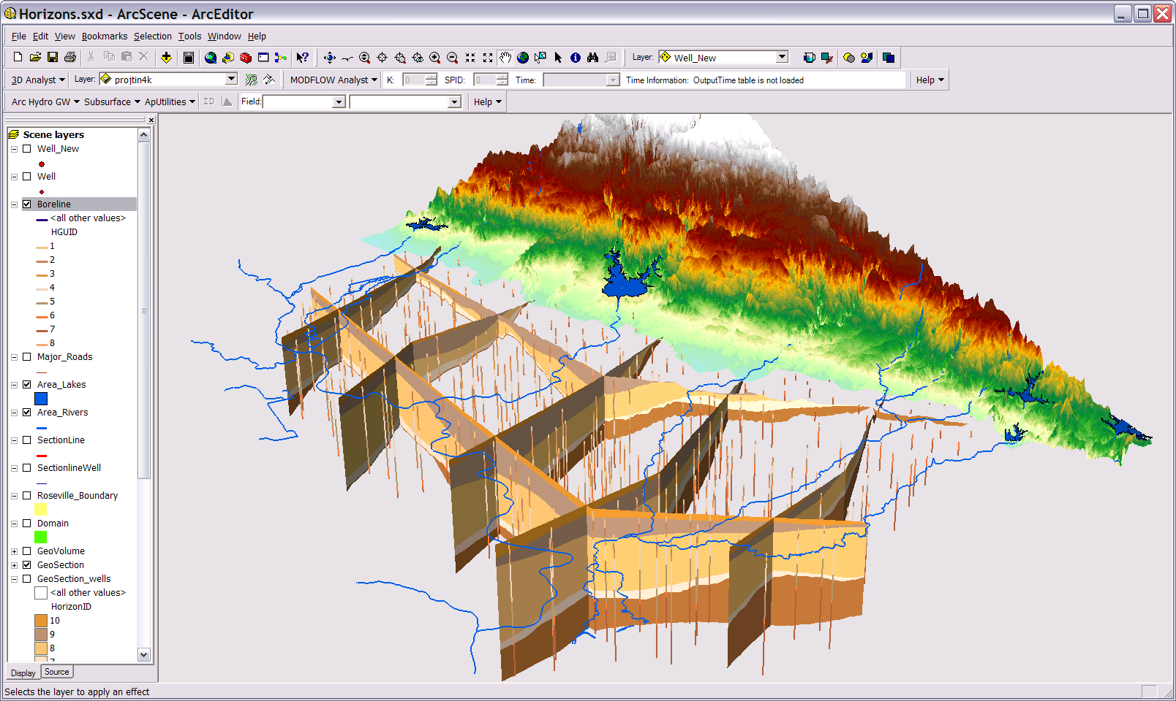
GeoSections

Slide 30
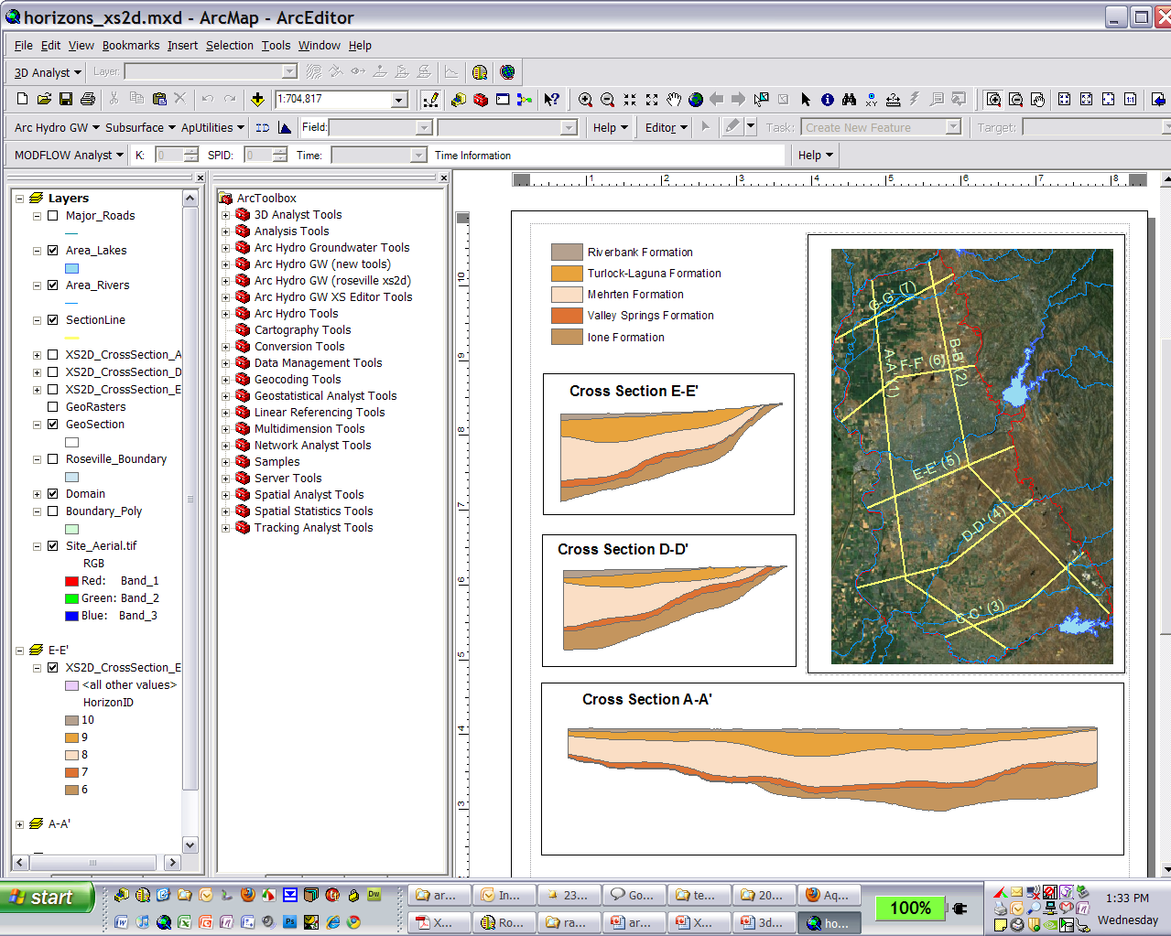
XS2D Component

Slide 31
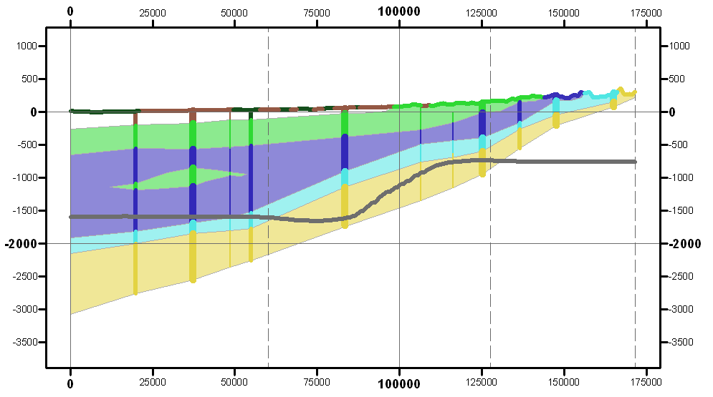
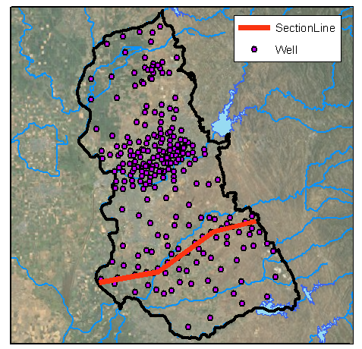
2D Cross Section Editing
Edit cross sections in ArcMap
Borehole data
Outcrop
Salt water interface
Panel divider
Panel

Slide 32
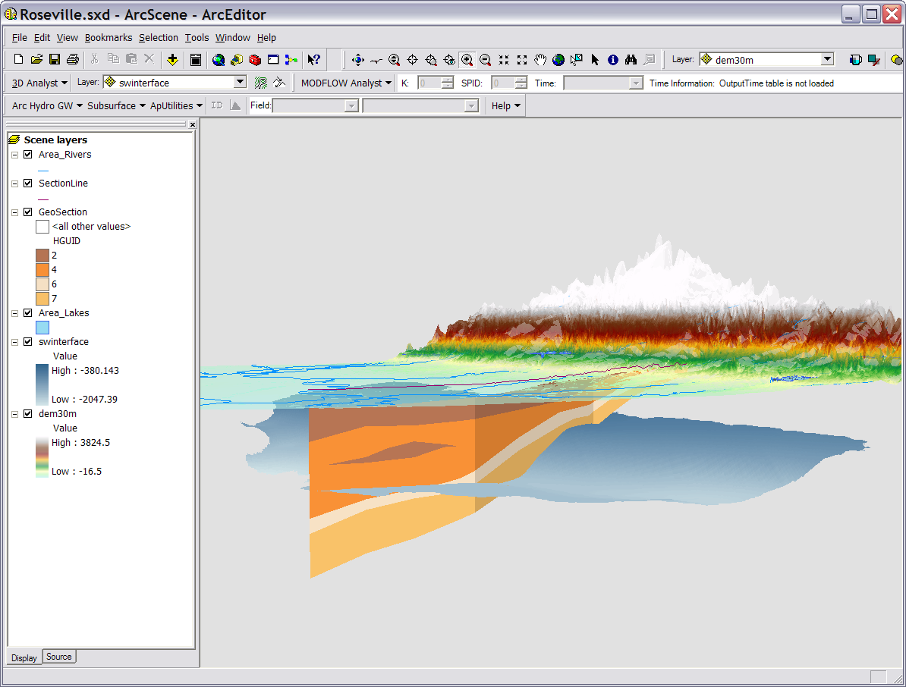
Transform to 3D GeoSection

Slide 33
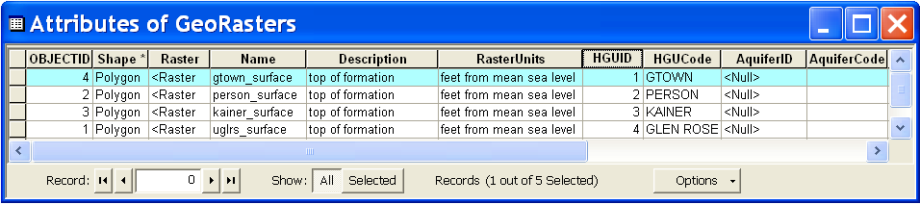
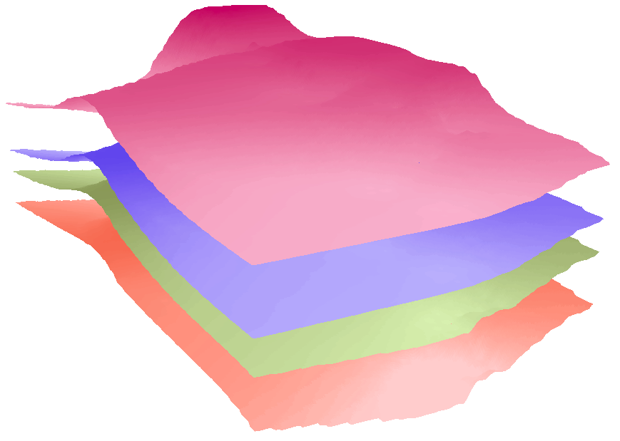
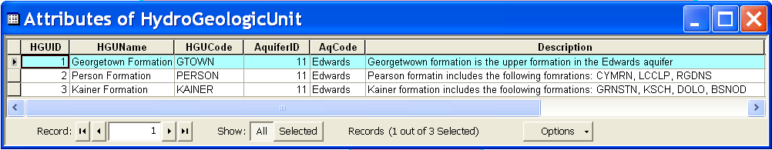
GeoRasters
Raster catalog for storing and indexing raster datasets
Can store top and bottom of formations
Each raster is related with a HGU in the hydrogeologic unit table
Georgetown
Person
Kainer
Glen Rose

Slide 34
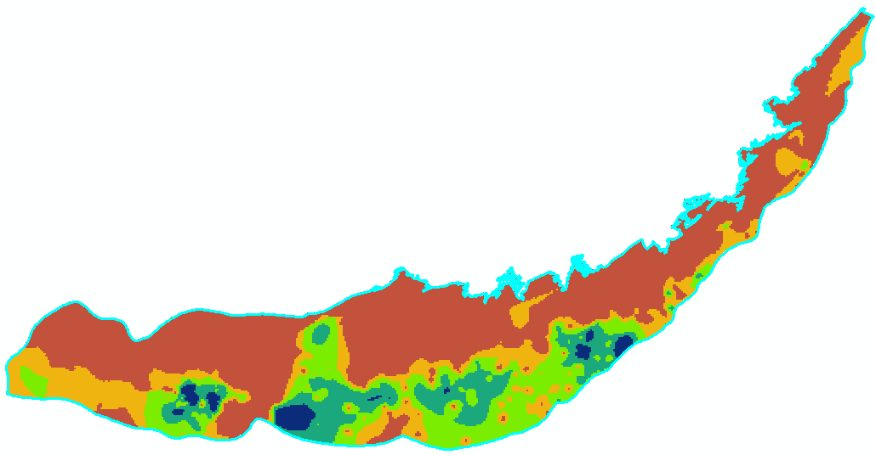
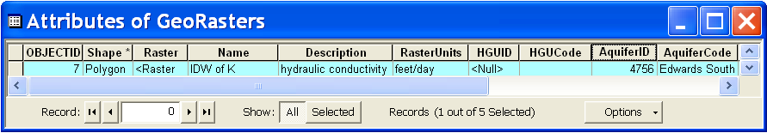
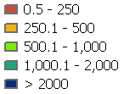
GeoRasters
GeoRasters also store hydraulic properties such as transmissivity, conductivity, and specific yield
K (feet/day)
Raster of hydraulic conductivity in the Edwards Aquifer

Slide 35
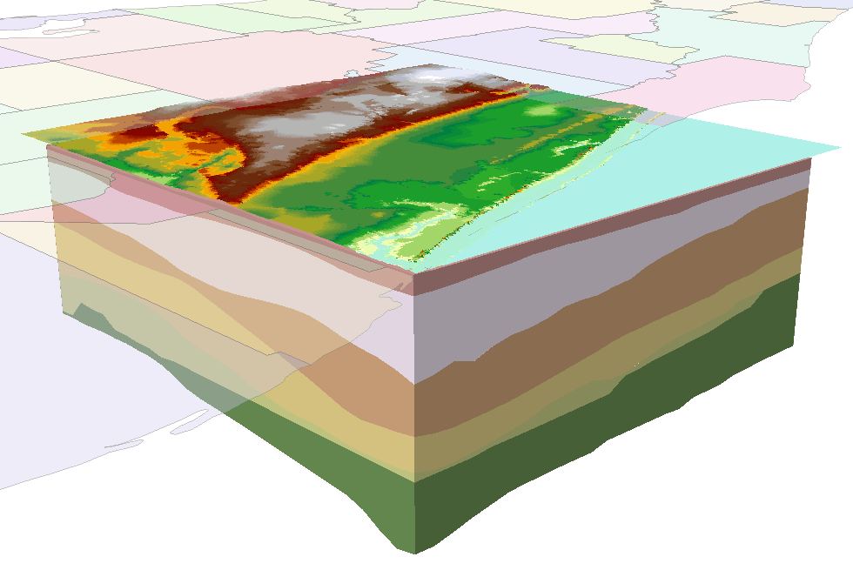
GeoVolume
Objects for representing 3D volume objects
Geometry is multipatch - Can create the volumes as a set of 3D triangles
Not real volume – can’t do any 3D operations

Slide 36
Components
Geology - Representation of data from geologic maps
Boreholes – Description of well attributes and borehole data
Hydrostratigraphy – 2D and 3D description of hydrostratigraphy
Temporal – Representation of time varying data
Simulation – Representation of groundwater simulation models (focus on MODFLOW)

Slide 37
Space-time datasets

Slide 38
Types of time varying datasets

Slide 39
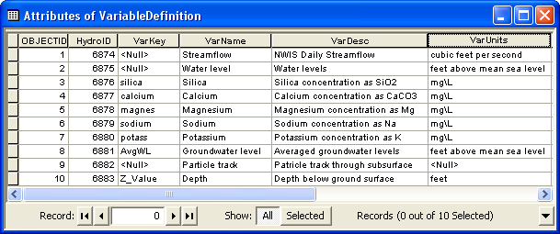
Variable Definition table
Catalog of time varying parameters (e.g. streamflow, water levels, concentrations, etc.)
Each variable is indexed with a HydroID

Slide 40
TimeSeries table
Each measurement is indexed by space, time, and type
Space = FeatureID
Time = TsTime
Type = VarID
VarID provides information on the variable

Slide 41
Time series views
We can “slice” through the data cube to get specific views of the data
Where?
What?
Where and What?
Query by location
(FeatureID = 2791)
Query by type
(VarID = 6875)
Query by location and type
(FeatureID = 2791 VarID = 6875)
TsTime
TsTime
TsTime
2791
FeatureID
FeatureID
2791
FeatureID
6875
6875
VarID
VarID
VarID

Slide 42
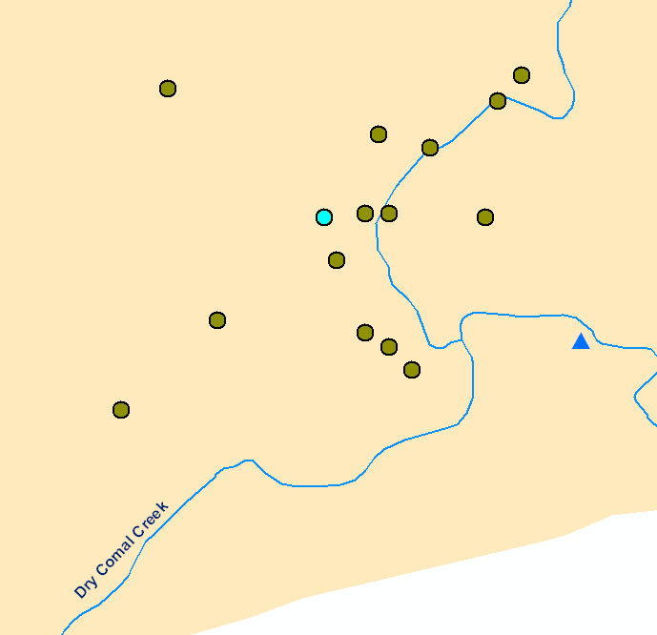
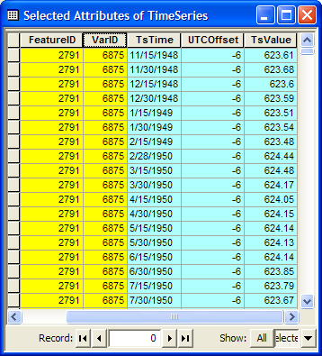
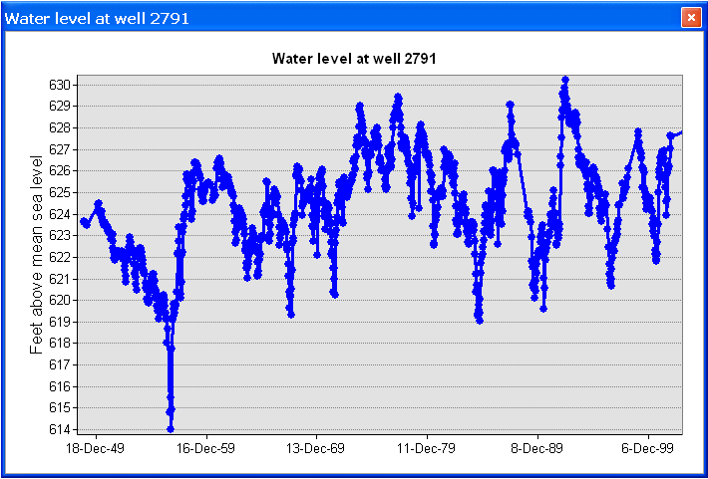
Time series views
Create a plot of time series related to a feature
Get all the data of VarID 6875 measured at Feature 2791
Well HydroID = 2791

Slide 43
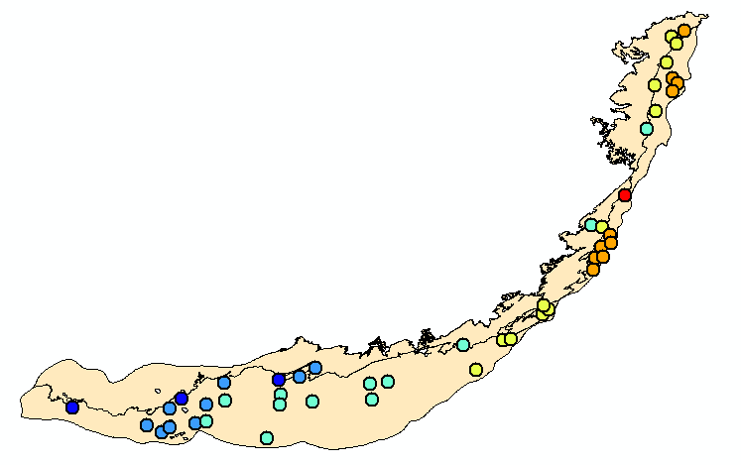


Time series views
A type-time view: Get water levels (TSTypeID =2) for 1/1999
TsTime
Water level in the Edwards Aquifer in 1/1999
1/1991
FeatureID
6875
VarID
Set of layers for different times creates an animation

Slide 44
Cloud-Based Water Level Mapping Utility
Norm Jones
Brigham Young University

Slide 45












Component 2 Objective
Geodatabase
Model Files
Server
GIS Workflow
Web Mapping
Cloud-Based Modeling and Visualization
Engineers, Decision Makers, Advocacy Groups, Public

Slide 46
Cloud-Based Water Level Mapping Utility
Detailed maps showing water level changes over time are essential for aquifer management and planning
Water
Level
Mapping
Utility
Water Levels
Drawdown
Depth to GW
Subregion
Date(s)
Inputs
Outputs
TWDB Well Database
Arc Hydro GW Tools
Python-Based Workflow
Google Earth Web Plug-in

Slide 47

TWDB Well Database
274,904 wells w/meas.
781,864 measurements

Slide 48

Measurements per Well

Slide 49

Measurements per Year

Slide 50
Wells
The Well location is defined as a 2D point in the Well feature class
In the Arc Hydro model we only predefine a set of basic attributes
Wells in the Edwards Aquifer

Slide 51

Geoprocessing Tools

Slide 52
Workflow Components
Query wells in selected region
Estimate water levels at selected date
Interpolate water levels to raster
Calculate Drawdown & Depth to GW
Archives maps to database
Export rasters to KMZ

Slide 53
Time Series Interpolation
Water levels are measured sporadically
To get a value at each well, we must perform time series interpolation
Z
time

Slide 54
Least Squares Fit
Z
time

Slide 55
Least Squares Fit, n=2
Z
time

Slide 56
Least Squares Fit, Extrapolation
Z
time

Slide 57

Google Earth
Plug-In
For generating new maps
Archive of existing maps
Static map components
http://ci-water.groups.et.byu.net/groundwater1

Slide 58

Region Selection

Slide 59

Water Level Map

Slide 60

Depth to GW Map

Slide 61

Depth to GW
Map

Slide 62







Animations
12/25/2000
12/25/2005
12/25/2004
12/25/2001
12/25/1999
12/25/2002
12/25/2003

Slide 63

Thank You!
Norm Jones
njones@byu.edu
This material is based upon work supported by the National Science Foundation under Grant
No. 1135482.
Special Thanks to:
Michael Burns
Scott Christiansen
Gil Strassberg
http://www.ci-water.org
http://ci-water.groups.et.byu.net/groundwater1

Slide 64
Summary Concepts
Arc Hydro Groundwater…
  extends Arc Hydro to represent groundwater datasets in GIS
  includes components for aquifers, wells, hydrogeologic features, time series, and simulation model output
  links features to hydrogeologic layers via HGUID, and to aquifers via AquiferID

