Slide 1
Data Sources for GIS in Water Resources by David R. Maidment, and David G. Tarboton
GIS in Water Resources
Fall 2013

Slide 2
Learning Objectives
The hierarchical system of watersheds and basins
Where to obtain data and maps
  National/State/Global Data repositories
  Hydrography
  USGS National Water Information System
  Land Cover
  Elevation
  Soil (Statsgo/Surgo)
  Weather

Slide 3
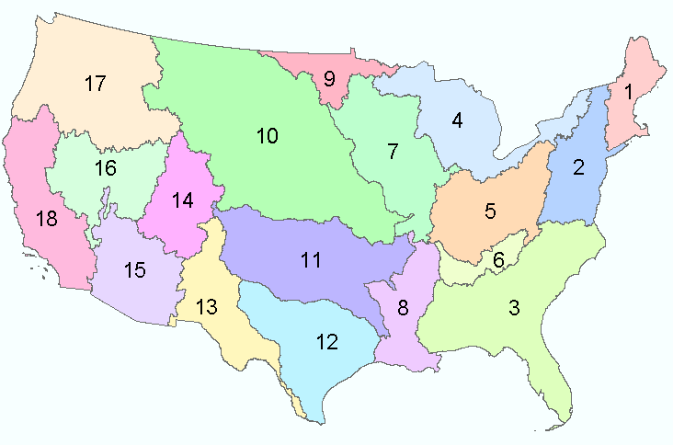
Water Resources Regions of the US
There are 18 water resources regions in the Continental United States
2-digit water resource regions
Region 01 New England
Region 02 Mid-Atlantic
Region 03 South Atlantic-Gulf
Region 04 Great Lakes
Region 05 Ohio
Region 06 Tennessee
Region 07 Upper Mississippi
Region 08 Lower Mississippi
Region 09 Souris-Red-Rainy
Region 10 Missouri
Region 11 Arkansas-White-Red
Region 12 Texas-Gulf
Region 13 Rio Grande
Region 14 Upper Colorado
Region 15 Lower Colorado
Region 16 Great Basin
Region 17 Pacific Northwest
Region 18 California
Region 19 Alaska (Old numbering system)
Region 20 Hawaii
Region 21 Caribbean

Slide 4
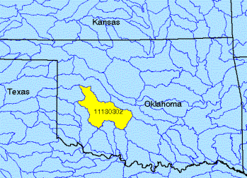
Watershed Hierarchy
Each hydrologic unit is identified by a unique hydrologic unit code (HUC) consisting of two to eight digits based on the four levels of classification in the hydrologic unit system.
Digit #
2
4
6
8 HUC
10
12
NHDPlus
Available
In Progress

Slide 5
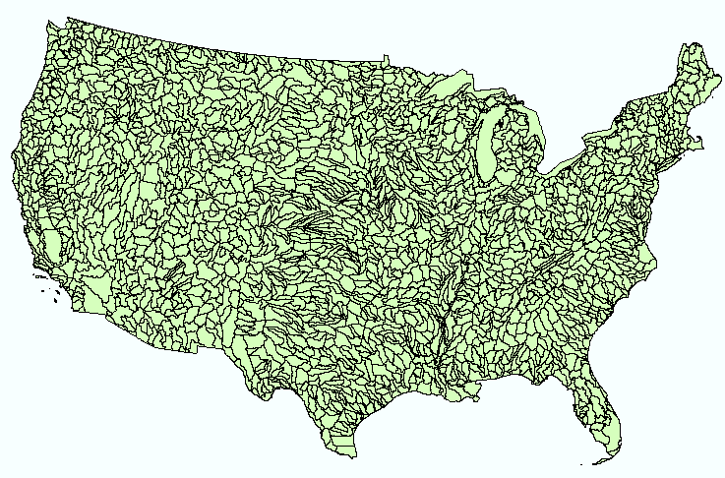
Hydrologic Unit Code Watersheds
~ 2000 HUC 8 for US, about the size of counties

Slide 6
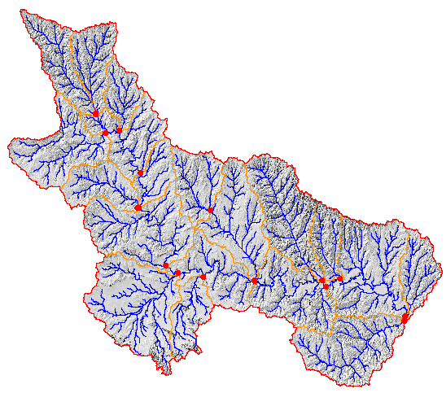
Watershed Boundary Dataset
ftp://ftp.ftw.nrcs.usda.gov/wbd/WBD_Latest_Version_June2013/
National Program by USGS and USDA (NRCS)
Boundaries for 10- and 12- digit watersheds
First cut is by automated delineation from NED
Hand checked and edited
10-digit watersheds

Slide 7
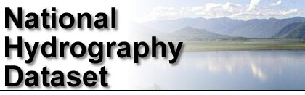
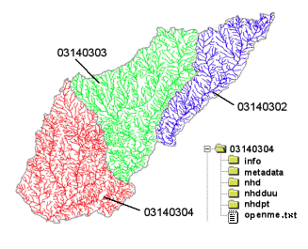
River networks
for 8-digit HUC
watersheds
http://nhd.usgs.gov/

Slide 8
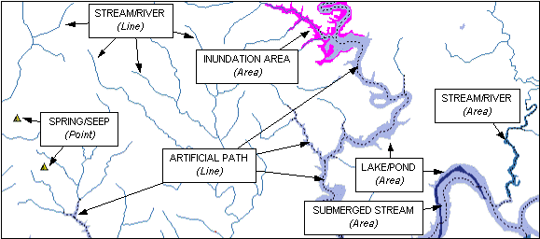

Slide 9
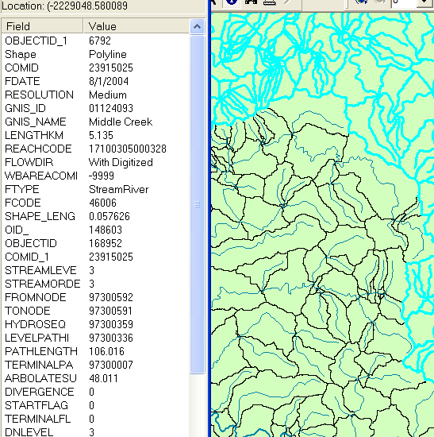
NHDPlus Reach Attributes
Slope
Elevation
Mean annual flow
  Corresponding velocity
Drainage area
% of upstream drainage area in different land uses
Stream order

Slide 10
River Reach Codes
Used for river address locations
ReachCode =
12030102000151
ReachCode = 12030102000005
HUC#
Segment#
Location 0.392
on Reach
12030102000005

Slide 11
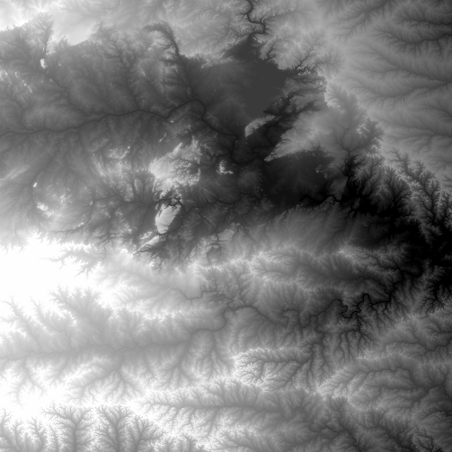
National Elevation Dataset
http://ned.usgs.gov/
Digital Elevation Model with 1 arc-second (30m) cells
Seamless in 1° blocks for the United States
10 billion data
Derived from USGS 1:24,000 quadrangle sheets
Get the data:
http://nationalmap.gov/viewer.html

Slide 12
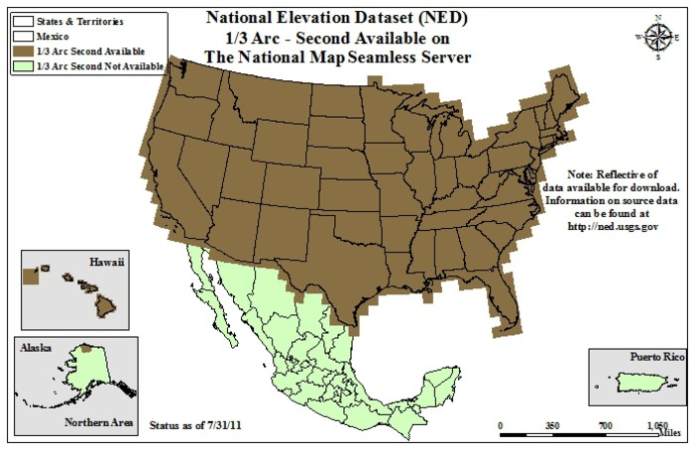
From hhttp://nationalmap.gov/viewer.html

Slide 13
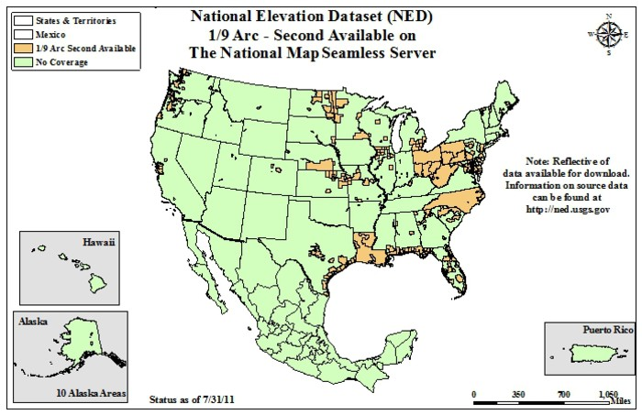
For LIDAR data: Go to http://lidar.cr.usgs.gov/

Slide 14
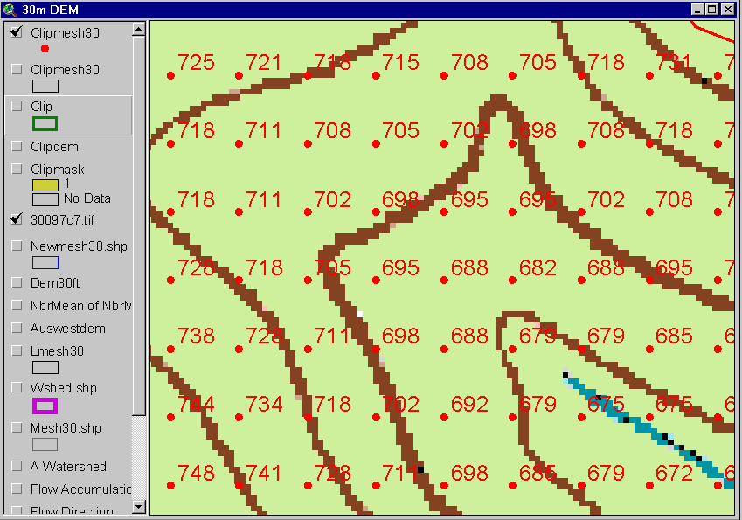
Digital Elevation Model (DEM)
720
720
Contours
740
720
700
680
740
720
700
680

Slide 15
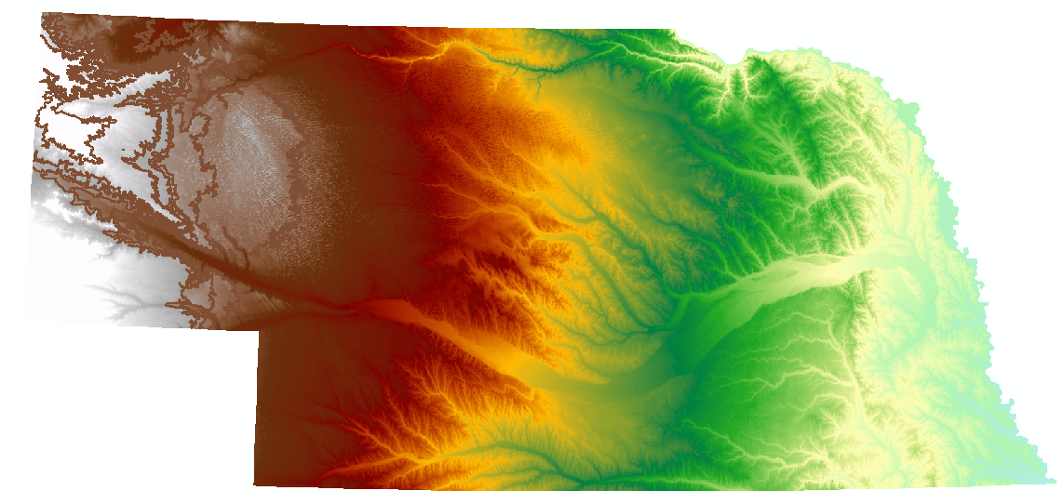
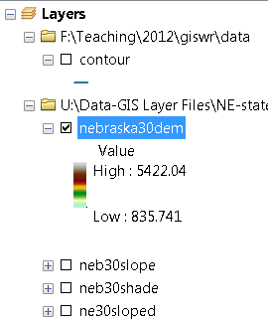
Digital Elevation Model (DEM)-30 meter

Slide 16
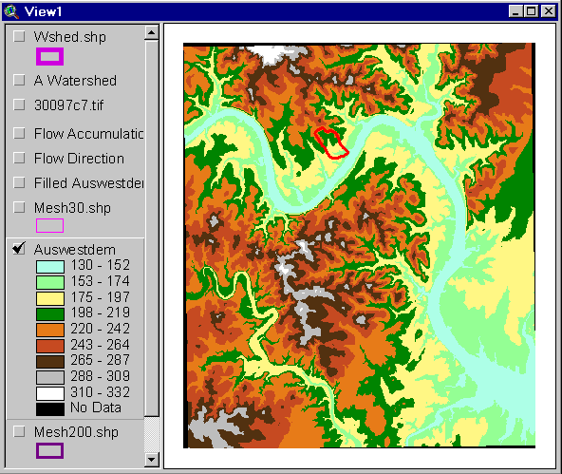
Austin West 30 Meter DEM

Slide 17
Eight Direction Pour Point Model
ArcGIS raster operations involved in watershed delineation are derived from the premise that “water flows downhill, in doing so, will follow the steepest descent
32
64
128
16
1
8
4
2
Water in a given cell flows one or more of eight adjacent cells in the direction of steepest descent (ArcGIS)

Slide 18
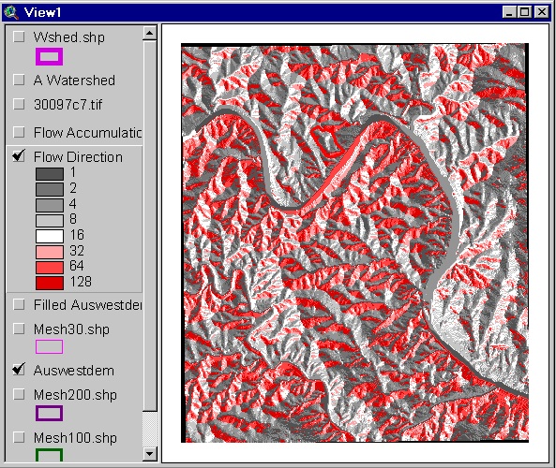
Flow Direction Grid
32
64
128
16
1
8
4
2

Slide 19
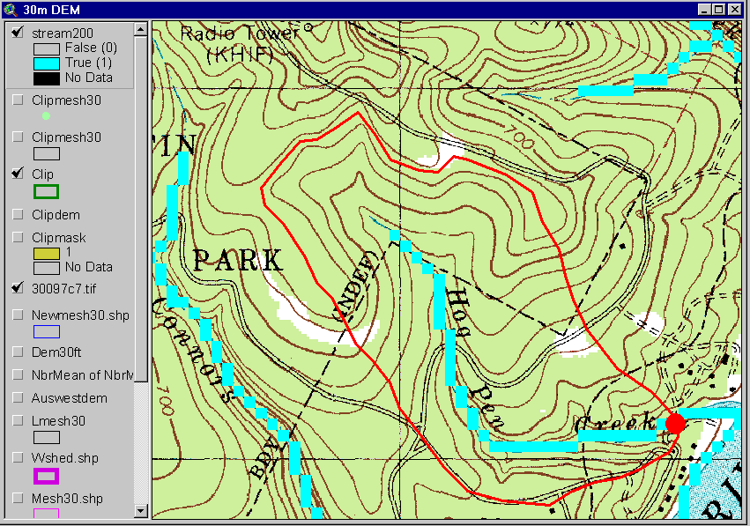
Delineation of Streams and Watersheds on a DEM

Slide 20
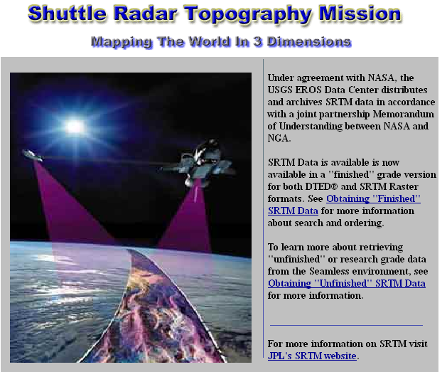
http://srtm.usgs.gov/

Slide 21
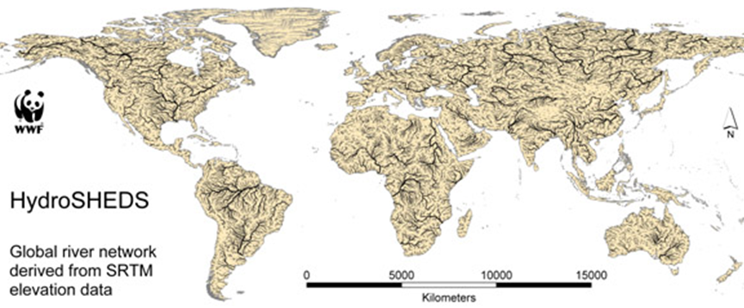
HydroSheds derived from SRTM
http://hydrosheds.cr.usgs.gov/

Slide 22
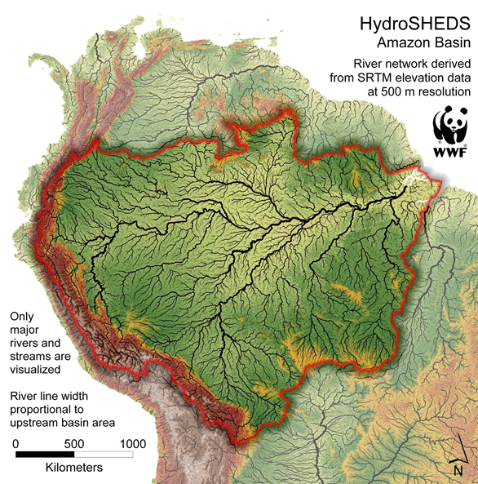

Slide 23
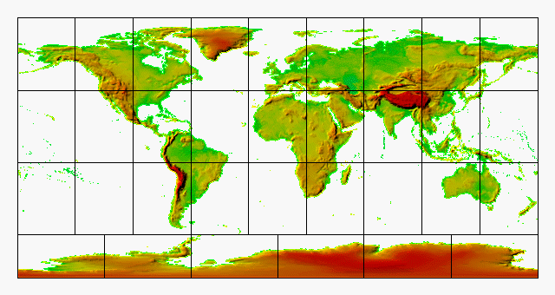
GTOPO30 - 1 km Digital Elevation Model of the Earth
https://lta.cr.usgs.gov/GTOPO30

Slide 24
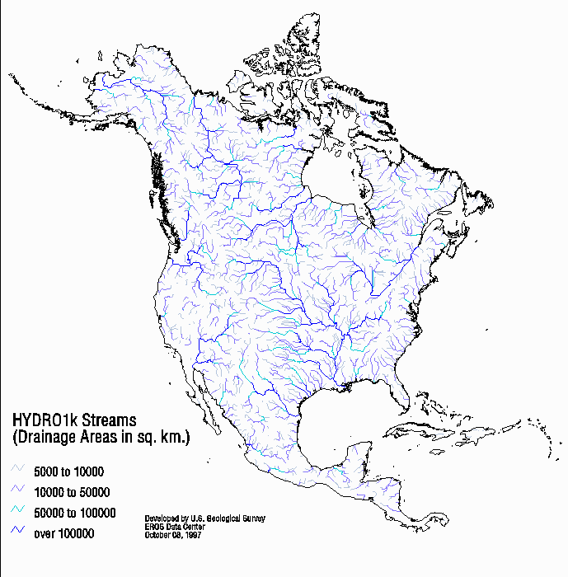
Drainage in North America
Hydro1K is
derived from
GTOPO30
using raster
GIS analysis
https://lta.cr.usgs.gov/HYDRO1K

Slide 25
Soil Data
Natural Resources Conservation Service (NRCS)
National Cartography and Geospatial Center (NCGC)
State Soil Geographic Database-STASGO
Soil Survey Geographic Database- SURGO
http://websoilsurvey.nrcs.usda.gov/app/WebSoilSurvey.aspx
http://www.soils.usda.gov/survey/geography/ssurgo/
http://www.soils.usda.gov/survey/geography/ssurgo/description_statsgo2.html

Slide 26

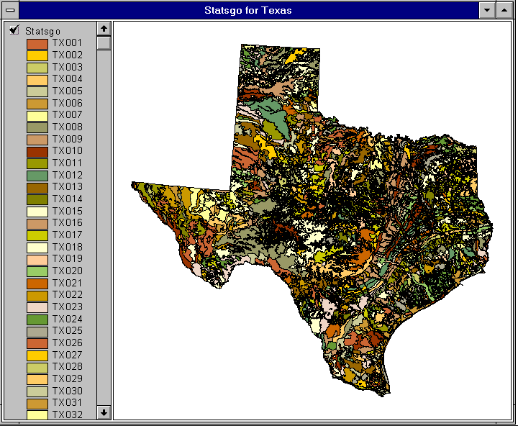

1:250,000 Scale Soil Information

Slide 27
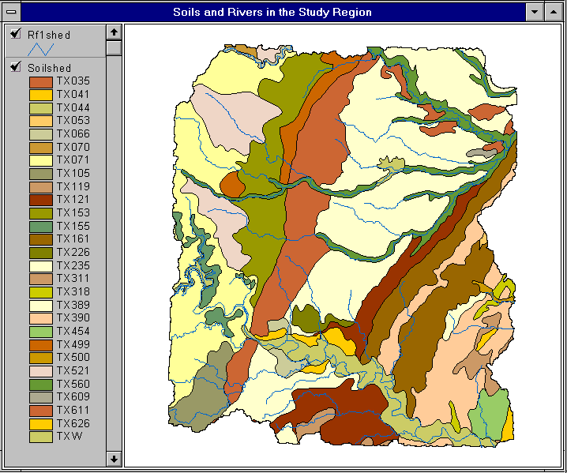

Slide 28
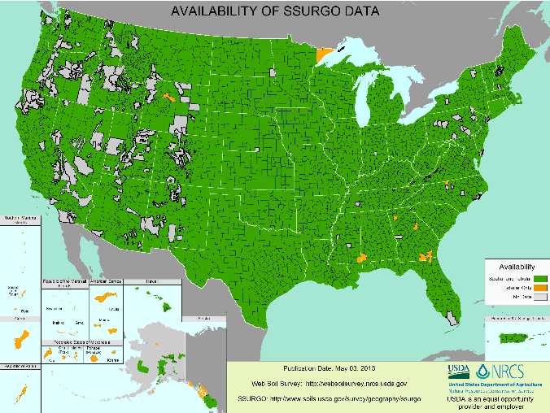
SSURGO:
County Level
Digital Soil Maps
1:24,000 scale
soil information
http://websoilsurvey.sc.egov.usda.gov/DataAvailability/SoilDataAvailabilityMap.jpg

Slide 29
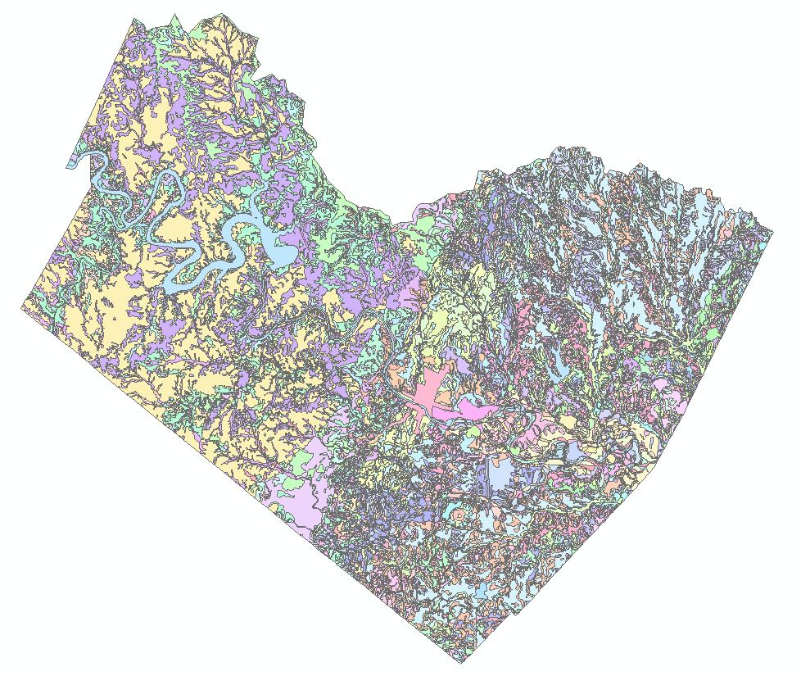
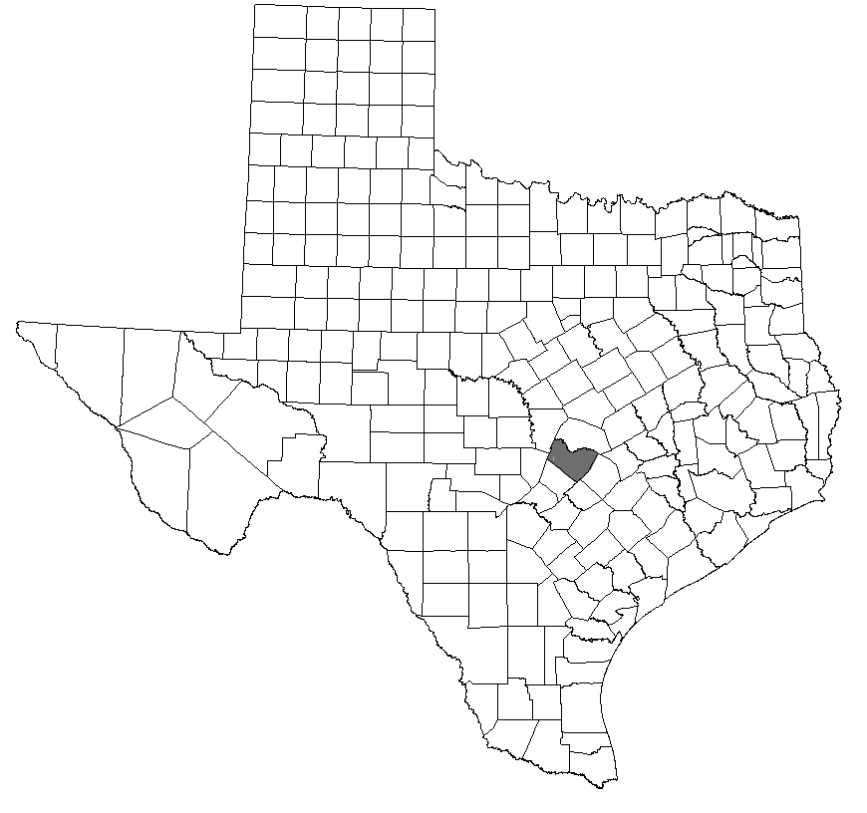
Ssurgo for Travis County
103 soil map units described by 7530 polygons of average area 35.37 ha (87 acres)

Slide 30

http://landcover.usgs.gov/

Slide 31
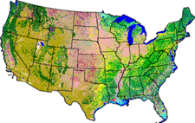
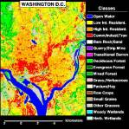
National Land Cover Dataset
1992, 2001, and 2006
Get the data:
http://www.mrlc.gov/

Slide 32
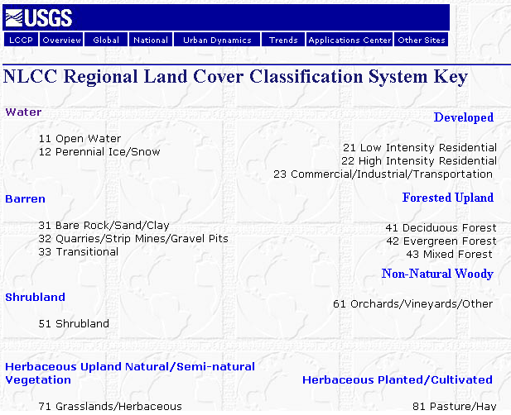

Slide 33

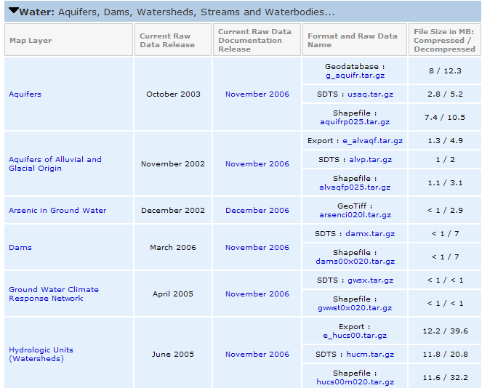
http://www.nationalatlas.gov/atlasftp.html

Slide 34
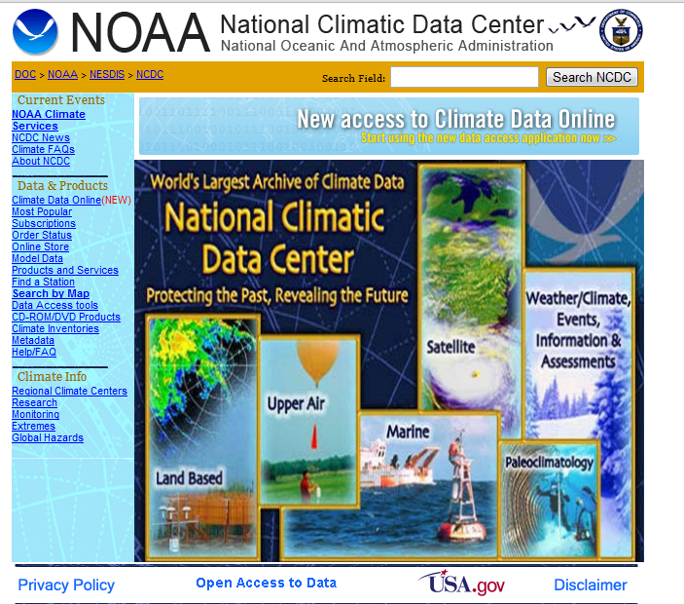
http://www.ncdc.noaa.gov/oa/ncdc.html

Slide 35

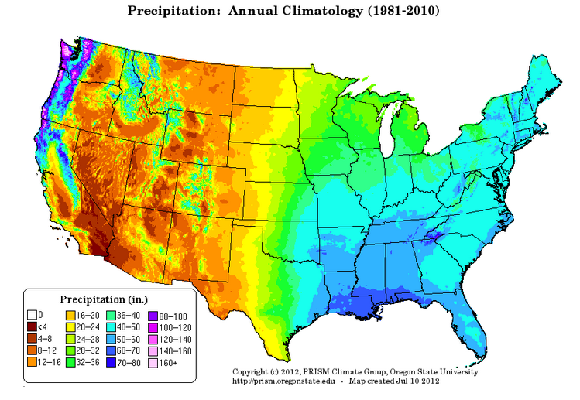
PRISM Mean Annual Precipitation (Oregon State U.)
http://www.wcc.nrcs.usda.gov/climate/prism.html

Slide 36
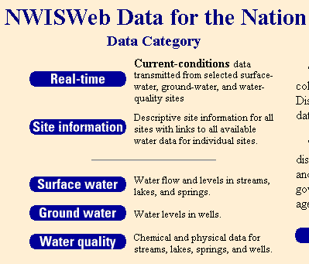
National Water Information System
Web access to USGS water
resources data in real time
http://waterdata.usgs.gov/usa/nwis/

Slide 37
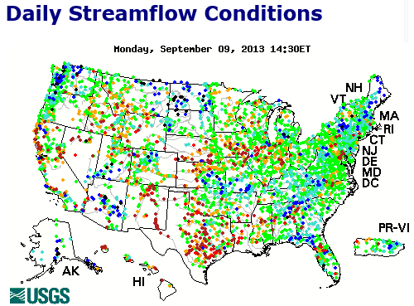
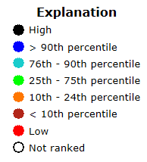
USGS Water Watch
Web access to USGS water resources data in real time
http://waterdata.usgs.gov/nwis/rt

Slide 38
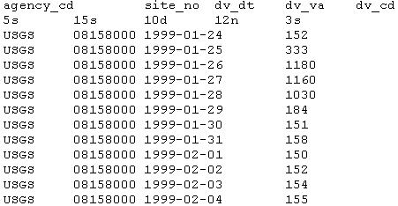
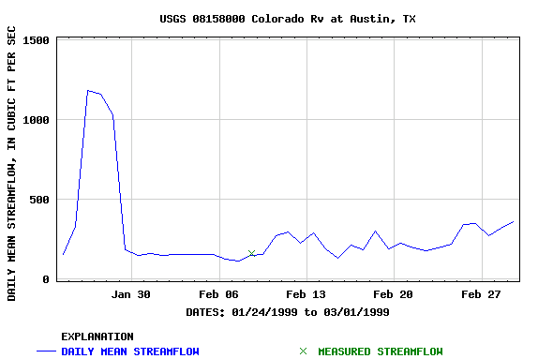
USGS National Water Information System.
Real-time and Historic Data
  Streamflow and stage
  Groundwater levels
  Water Quality
  Site information
Tabular or Graphical Format

Slide 39
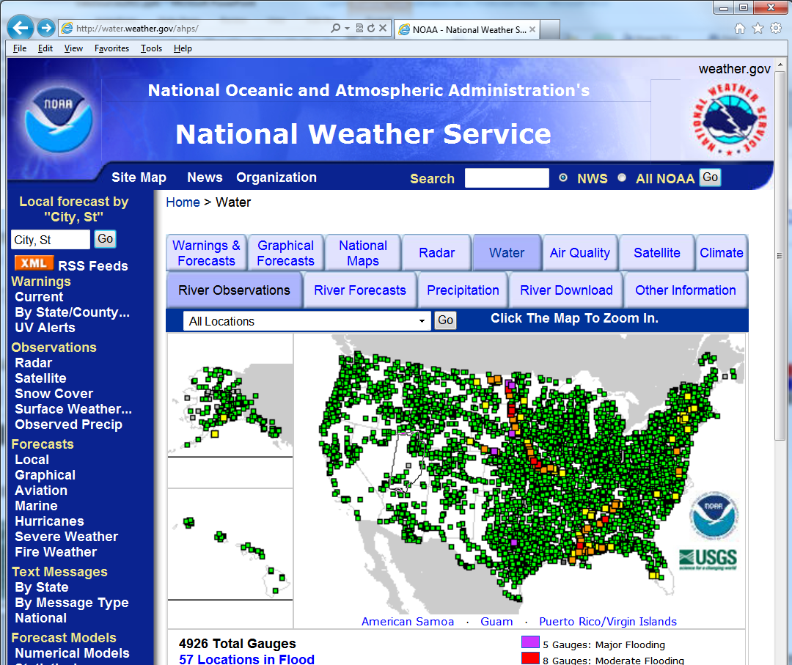
http://water.weather.gov/ahps/

Slide 40
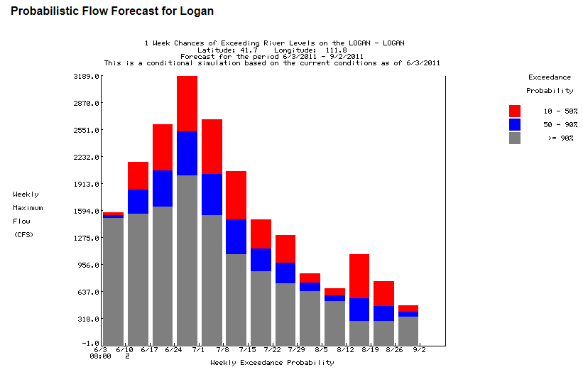
http://water.weather.gov/ahps/

Slide 41
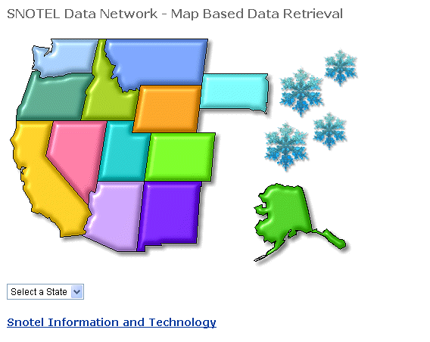
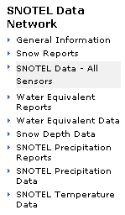
http://www.wcc.nrcs.usda.gov/snotel/

Slide 42
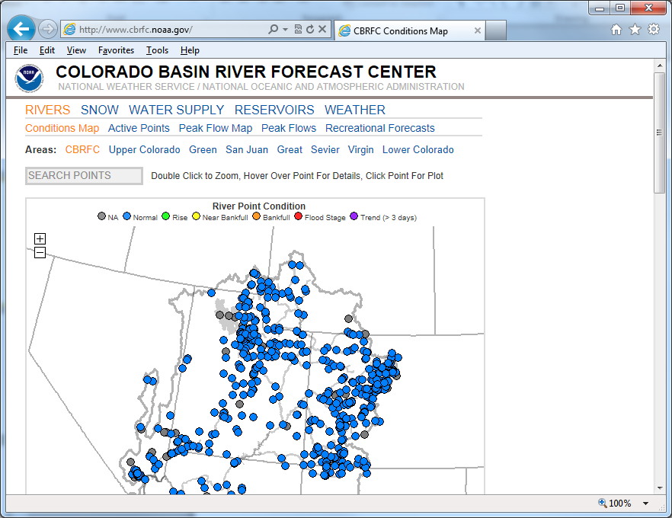
http://www.cbrfc.noaa.gov

Slide 43
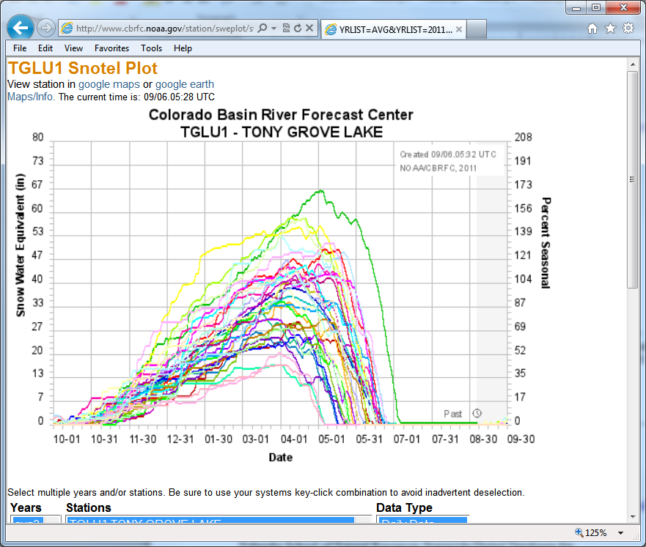
CBRFC SNOTEL Ensemble
http://www.cbrfc.noaa.gov/station/sweplot/sweplot.cgi?tglu1

Slide 44
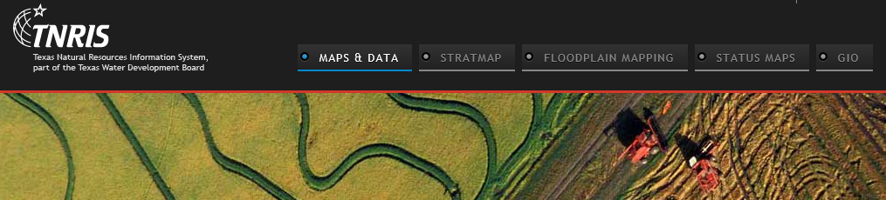
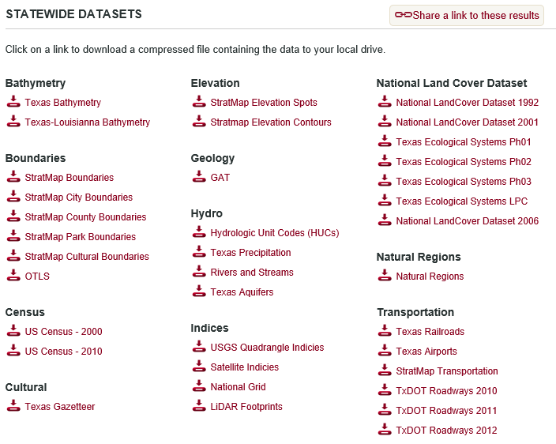
Texas Natural Resource Information System http://www.tnris.org/

Slide 45
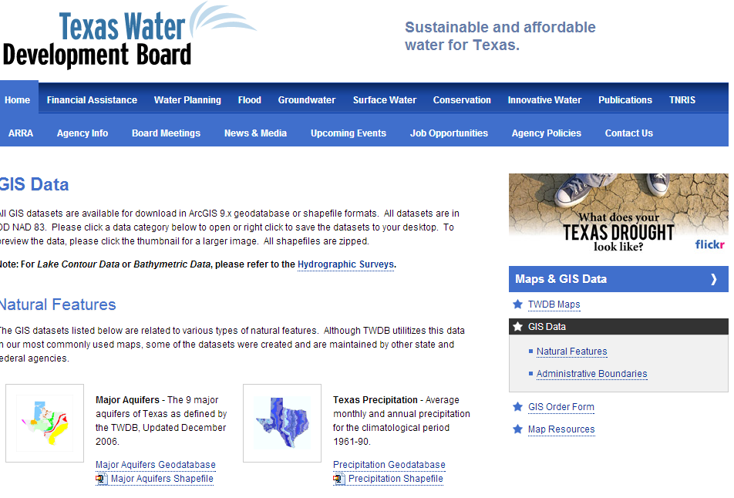
TWDB http://www.twdb.state.tx.us/mapping/gisdata.asp

Slide 46
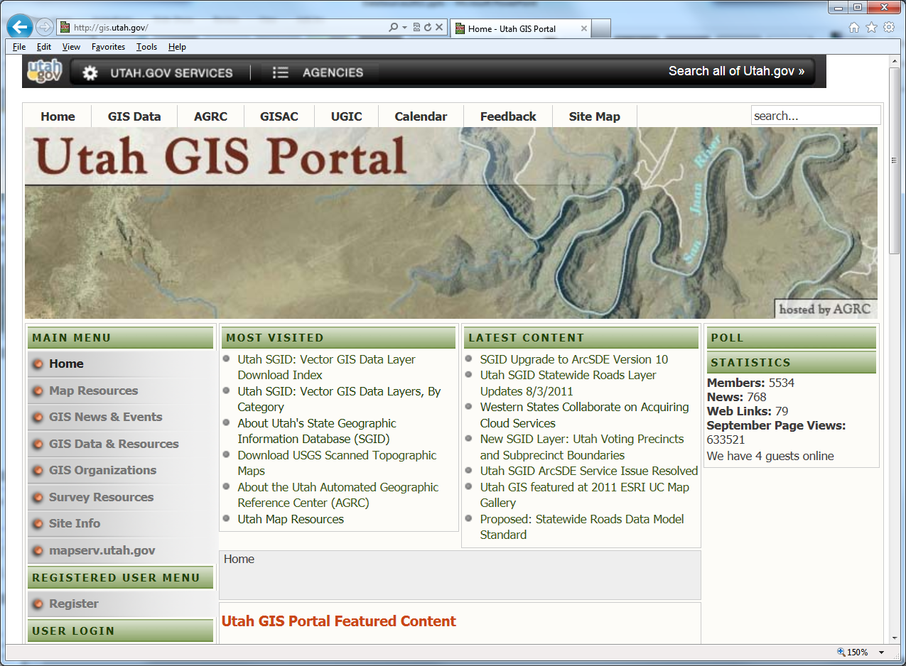
http://gis.utah.gov

Slide 47
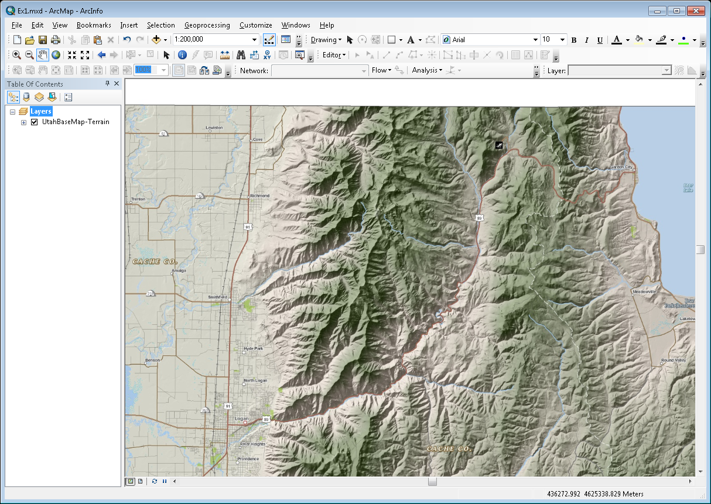
Utah Terrain Basemap
To use as a basemap in ArcGIS see instructions at
http://gis.utah.gov/map-services/new-utah-terrain-base-map-and-cached-tile-service-available

Slide 48
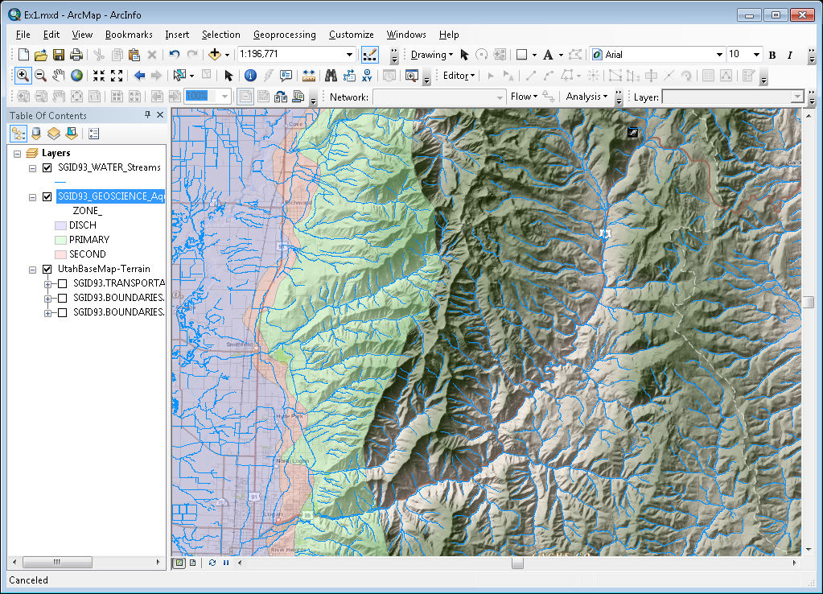
Utah GIS Portal Download GIS Data
http://gis.utah.gov/data/

Slide 49

http://geology.utah.gov/maps/gis/index.htm

Slide 50

http://www.wrcc.dri.edu/

Slide 51

Bear River Watershed
http://www.bearriverinfo.org/

Slide 52

Great Salt Lake Info System
http://greatsaltlakeinfo.org/

Slide 53

What is Cloud Computing?
Following Slides are from Dr Kristin Tolle, Microsoft Research Connections
Notes:
Slide Objectives:
Main points you want to make
Transition:
Transition statement(s) to setup the slide
Speaking Points:
Speaking Point #1
Speaking Point #2
Notes:

Slide 54


Global Footprint
Where is the Cloud?
Notes:
Speaking Points:
Windows Azure itself is deployed around the world
With Windows Azure, we have a concept of regions, which is where you choose to place your code and run.
In each of the regions, we have a Microsoft datacenter.
These datacenters are massive facilities that host 10s or in some cases hundreds of thousands of servers
We have currently four regions in North America, two regions in Europe, and two in Asia
As you can see on this slide we also have a number of CDN edge points, which we can use to cache your content and deliver it even faster for customers. %
What you’re going to see in the next couple months and years is that we will rapidly expand our datacenter footprint around the world, so you will have more options for running your applications.
Once you build an application, you can choose where you want to run in the world and you can move your workloads from region to region.
You can also run your application in multiple regions simultaneously and just direct traffic and customers to whichever version of the app is closest to them.
That gives you a global footprint and a chance to reach a bigger customer base or audience in new markets
Notes:
Windows Azure services such as compute and storage are now available in 8 worldwide datacenters with an additional 24 Content Delivery Network endpoints.
You can’t have a real cloud without a data center.

Slide 55








Microsoft’s Data Center Evolution
  Data Center Co-Location Generation 1
  Quincy and San Antonio Generation 2
  Chicago and Dublin Generation 3
  Modular Data Center Generation 4
  Deployment Scale Unit
Server
Rack
Containers
IT PAC
Capacity
Density & Deployment
Scalability &
Sustainability
Time to Market
Lower TCO
Notes:
Slide Objectives:
Main points you want to make
Transition:
Transition statement(s) to setup the slide
Speaking Points:
Speaking Point #1
Speaking Point #2
Notes:

Slide 56

Disk Sled Rack
Compute Rack
2 “Side by Side” Servers
On the truck
At the Manufacturer’s
Austin Plant (Dell)
Disk Sled Rack
Inside a Container
Notes:
Slide Objectives:
I want to demystify the cloud for the audience
Transition:
Transition statement(s) to setup the slide
Speaking Points:
These are containers built by the PC manufacturer at their Austin facility
Speaking Point #2
Notes:

Slide 57

Containers arriving in Longmont Colorado
Notes:
Slide Objectives:
Main points you want to make
Transition:
Transition statement(s) to setup the slide
Speaking Points:
Speaking Point #1
Speaking Point #2
Notes:

Slide 58



Modular Cloud Construction
Notes:
Slide Objectives:
Main points you want to make
Transition:
Transition statement(s) to setup the slide
Speaking Points:
Speaking Point #1
Speaking Point #2
Notes:

Slide 59


Compute/Storage Container
Transformer & UPS
Air Flow Vents
Notes:
Slide Objectives:
Main points you want to make
Transition:
Transition statement(s) to setup the slide
Speaking Points:
Speaking Point #1
Speaking Point #2
Notes:

Slide 60

Completed Cloud Computing facility in Longmont, Colorado
Notes:
Slide Objectives:
Main points you want to make
Transition:
Transition statement(s) to setup the slide
Speaking Points:
Speaking Point #1
Speaking Point #2
Notes:

Slide 61



ArcGIS Online: Maps about the Earth
http://www.arcgis.com/features/maps/earth.html
Land Cover
Elevation
Soils

Slide 62


Landscape Grid Services

Slide 63



Elevation Services

Slide 64



Dynamic Map Services

Slide 65



Extract the NHDPlus Flowlines

Slide 66




Elevation Profile of the Blanco River
Slope = 0.2%

