Slide 1


Hydrologic Information Systems to discover and combine data from multiple sources for hydrologic analysis
David Tarboton
Utah State University
CUAHSI
HIS
Sharing hydrologic data
http://his.cuahsi.org/
Support
EAR 0622374

Slide 2

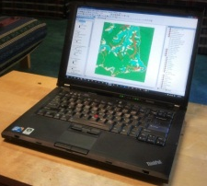
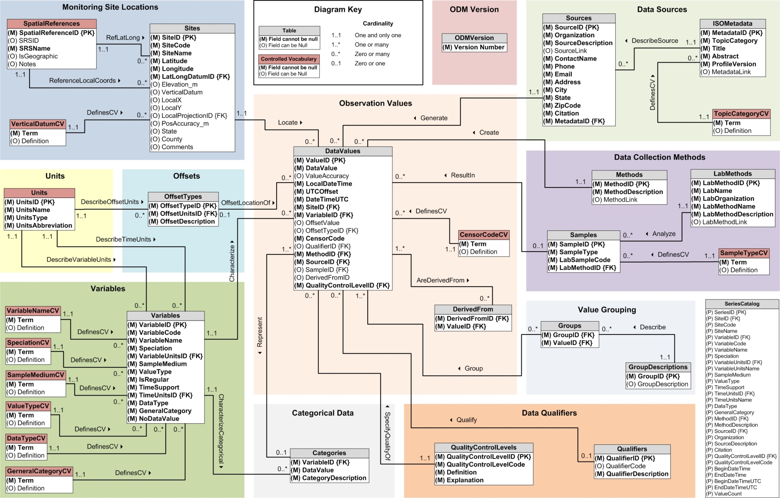
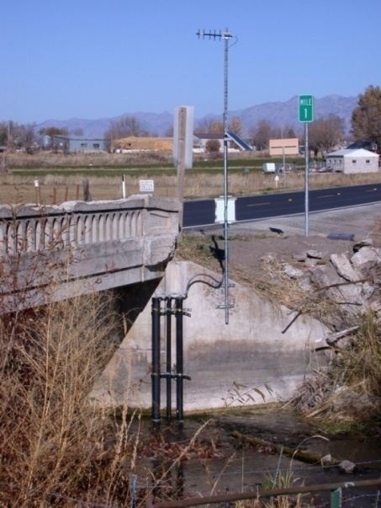
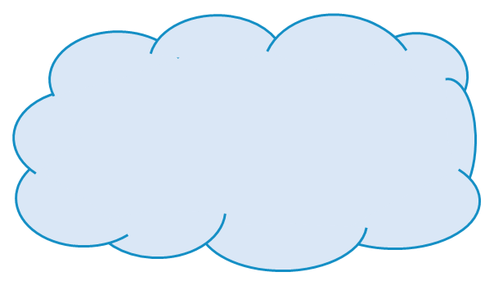
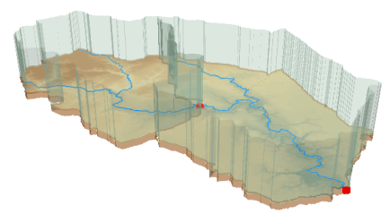



Outline
The CUAHSI HIS
  A Services-Oriented Architecture Based System for Sharing Hydrologic Data
  Including demo of HydroDesktop
HydroShare
  A Web-Based Collaborative Environment for the Sharing of Hydrologic Data and Models

Slide 3
What proportion of your research time do you spend on preparing or preprocessing data into appropriate forms needed for research purposes?
http://his.cuahsi.org/documents/HISStatusSept15.pdf
Notes:
Surveys of the hydrology community have indicated that data gathering and preprocessing is an inordinate fraction of the time required for modeling and analysis
In hydrology most of the easy single site, single variable, low hanging fruit research problems are solved and advances in understanding and better predictions require
combining information from multiple sources,
sharing and collaboration
Easier access to advanced computational capability
Sustainability and reliability in software

Slide 4
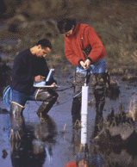
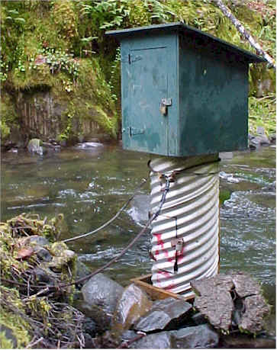
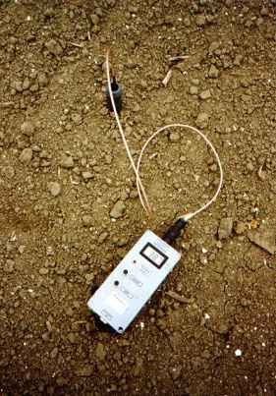
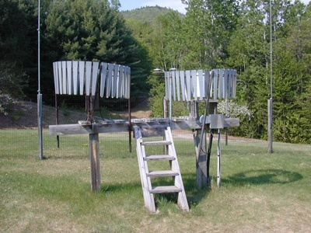
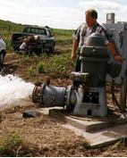
Hydrologic Data Challenges
Water quality
Water quantity
From dispersed federal agencies
From investigators collected for different purposes
Different formats
  Points
  Lines
  Polygons
  Fields
  Time Series
Rainfall and Meteorology
Soil water
Data Heterogeneity
Groundwater
The way that data is organized can enhance or inhibit the analysis that can be done
GIS

Slide 5

The way that data is organized can enhance or inhibit the analysis that can be done
I have your information right here …
Picture from: http://initsspace.com/

Slide 6










Data Searching – What we used to have to do
Searching each data source separately
NWIS
request
return
request
request
return
return
NAWQA
request
return
NAM-12
request
return
request
return
request
return
request
return
NARR
Michael Piasecki
Drexel University
Notes:
6

Slide 7

What HIS enables
Searching all data sources collectively
GetValues
GetValues
NWIS
GetValues
GetValues
generic
request
GetValues
GetValues
NAWQA
Michael Piasecki
Drexel University
GetValues
NARR
GetValues
ODM
Notes:
7

Slide 8
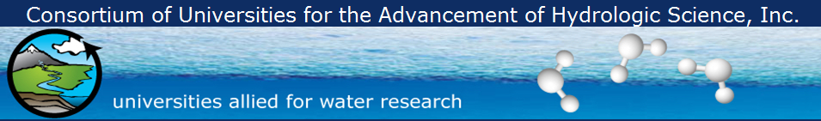
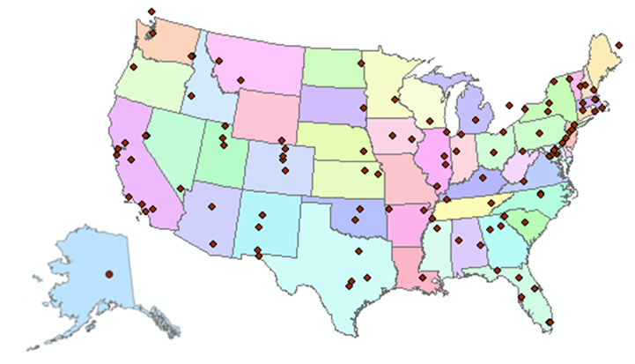
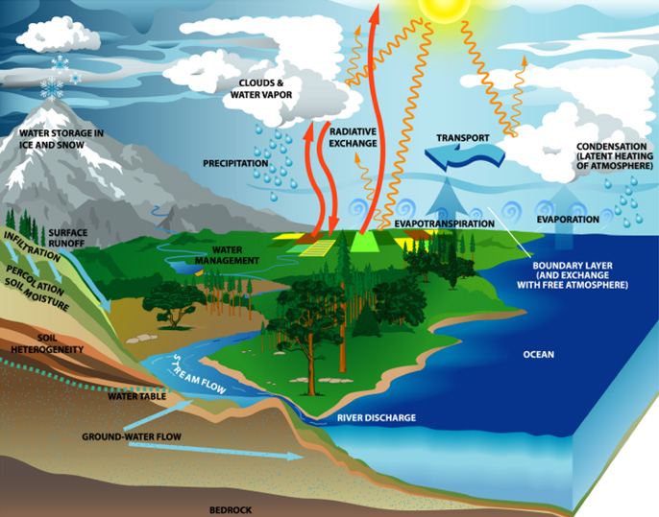
What is CUAHSI?
http://www.cuahsi.org
109 US University members
7 affiliate members
20 International affiliate members
3 corporate members
(as of January 2013)
provides community and research support services to advance water research
Support
EAR 0753521

Slide 9
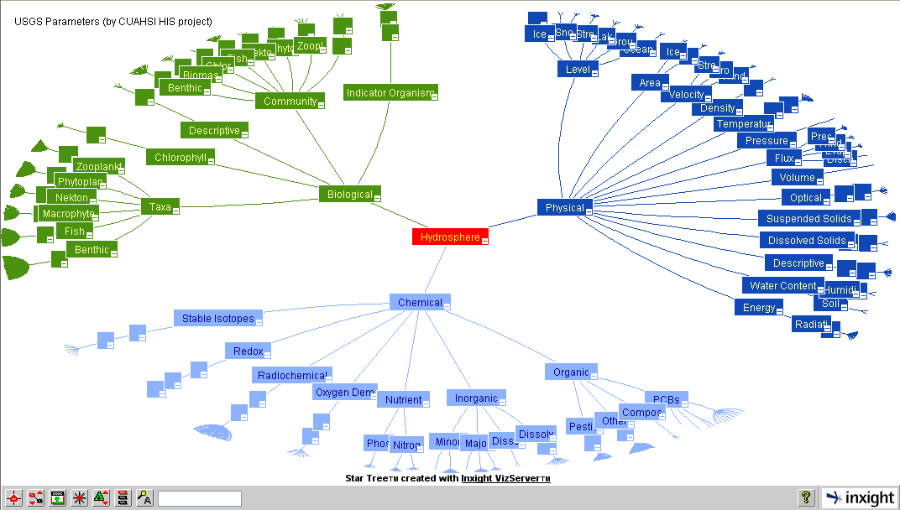
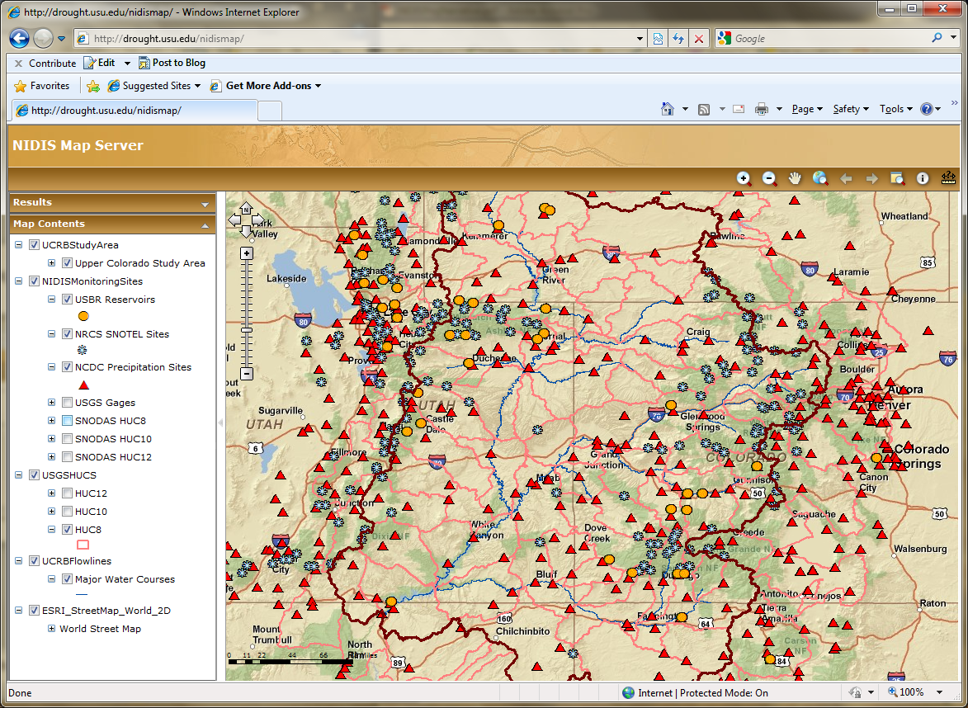
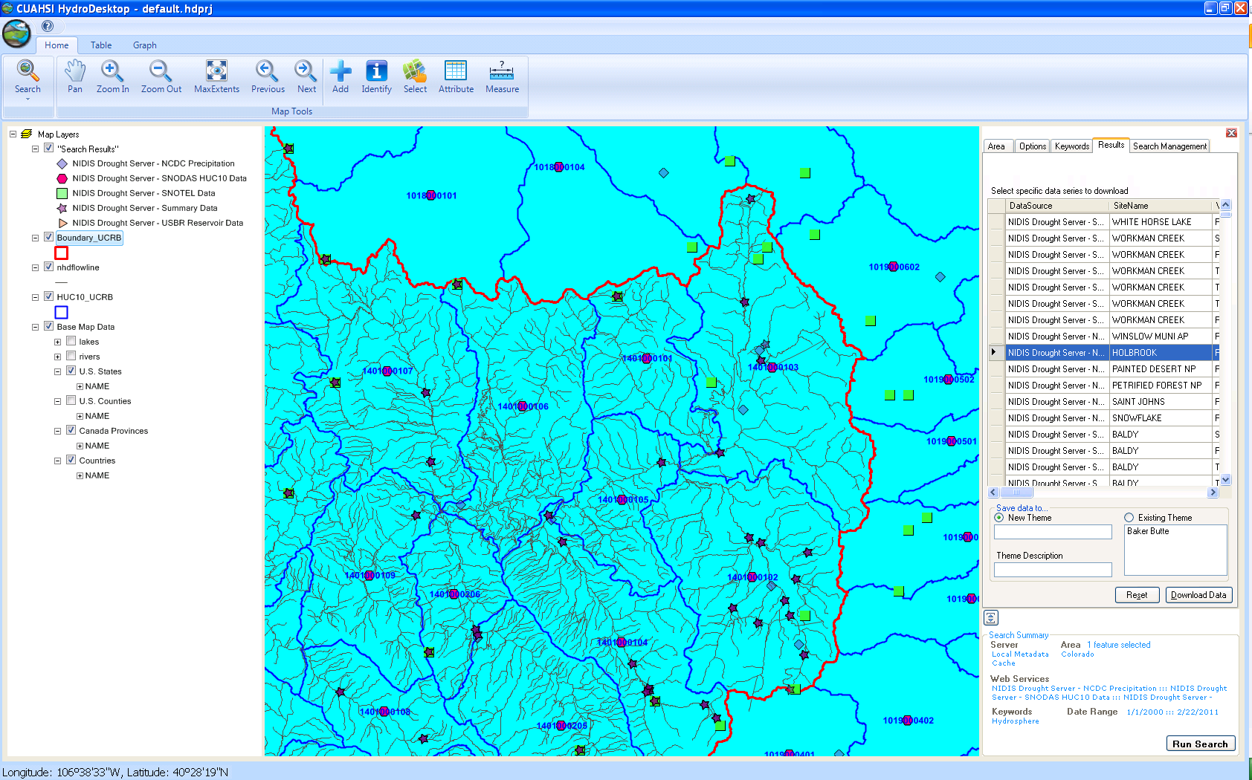
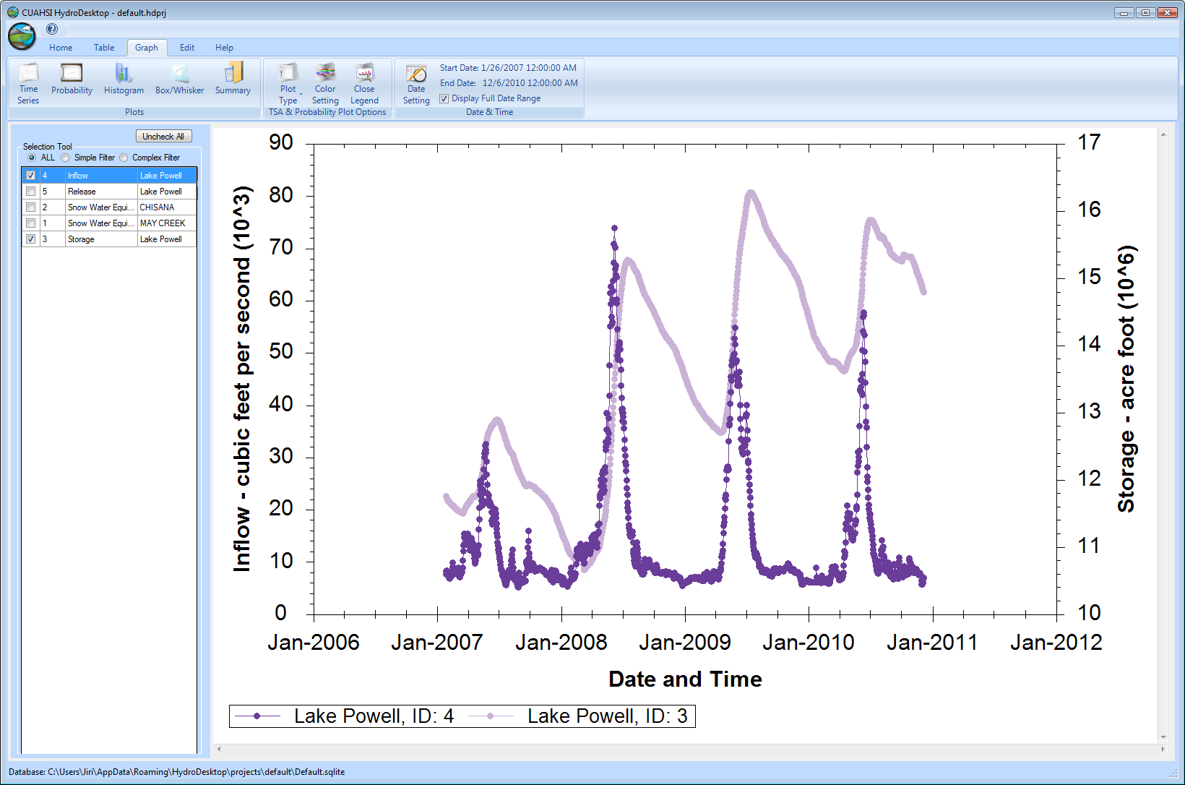
CUAHSI HIS
The CUAHSI Hydrologic Information System (HIS) is an internet based system to support the sharing of hydrologic data. It is comprised of hydrologic databases and servers connected through web services as well as software for data publication, discovery and access.
HydroServer – Data Publication
HydroCatalog
Data Discovery
Lake Powell Inflow and Storage
HydroDesktop – Data Access and Analysis
HydroDesktop – Combining multiple data sources

Slide 10
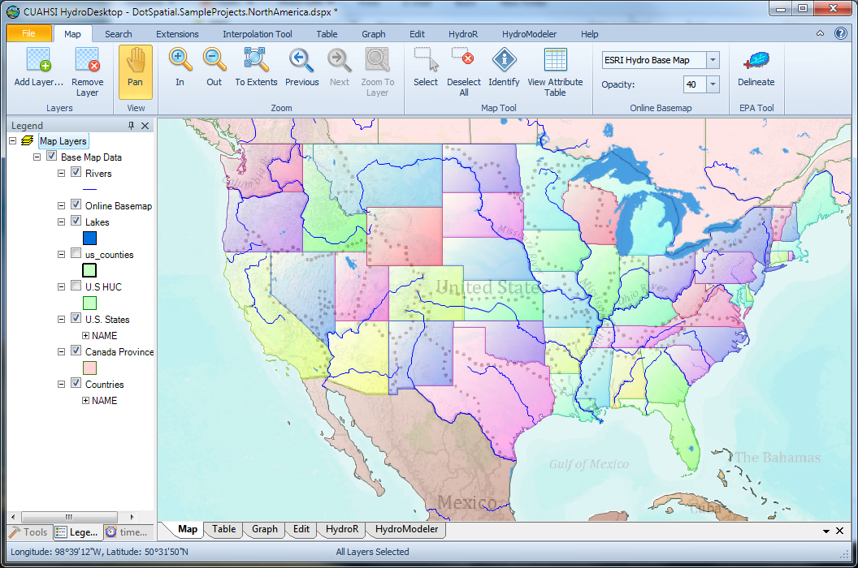
HydroDesktop Demo
An open source
dotSpatial GIS based desktop client that supports discovery and analysis of hydrologic observations data

Slide 11
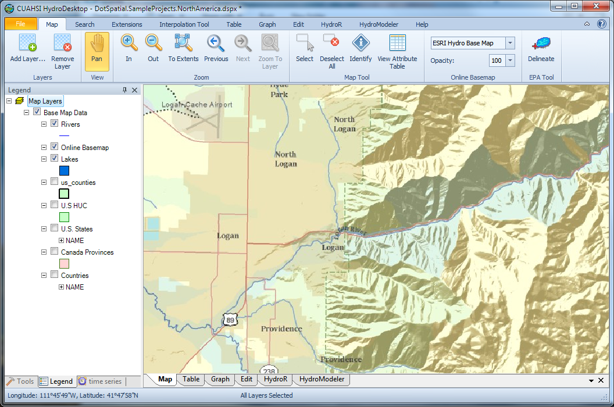
HydroDesktop
An open source
dotSpatial GIS based desktop client that supports discovery and analysis of hydrologic observations data
Uses EPA WATERS Web, Mapping, and Database Services at http://www.epa.gov/waters/geoservices/index.html to delineate Watersheds
Notes:
The service URLs that the HD tool uses are seen in http://hydrodesktop.codeplex.com/SourceControl/changeset/view/475b15a84bf4#Source%2fEPADelineation%2fCallWebService.cs The HD tool uses the Point Indexing Service to find the nearest NHD reach to where the user clicked. This returns a location on that reach. This point location is then used as input to the Navigation Delineation Service to get the watershed, and the Upstream/Downstream Service to get the river lines. The delineation service has two limitations: * It only works up to a certain distance upstream. I think we have it set to 100km. So for large watersheds (those with more than 100km of stream length upstream of where the user clicked), we don't get the most upstream portions of the watershed. * It doesn't delineate exactly to where the user clicked. It delineates to the endpoint of the NHD reach. (Can't remember if it is the clicked reach or the upstream reach -- try it and see.)

Slide 12
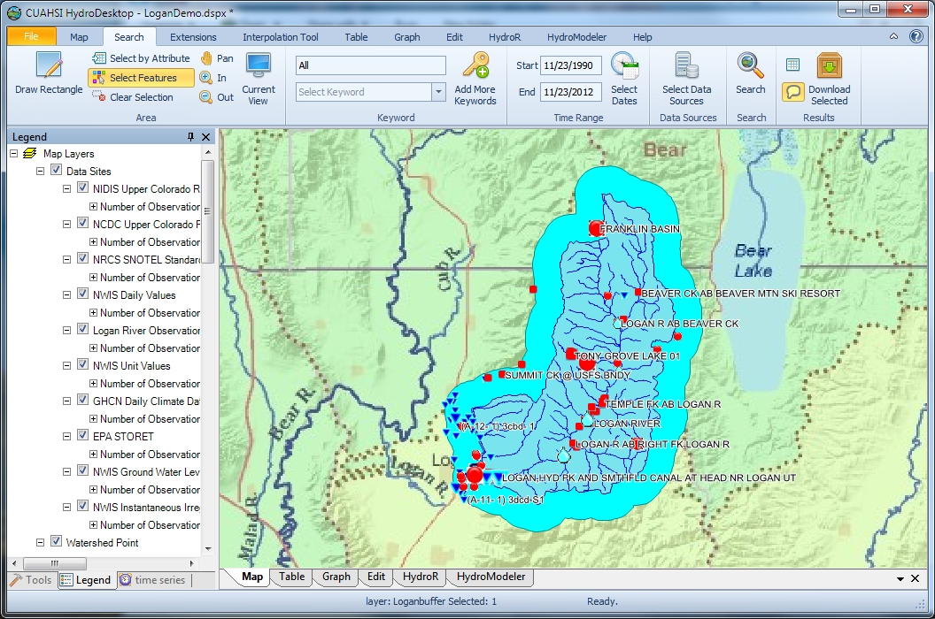
Search last 22 years for all data in buffer around watershed

Slide 13
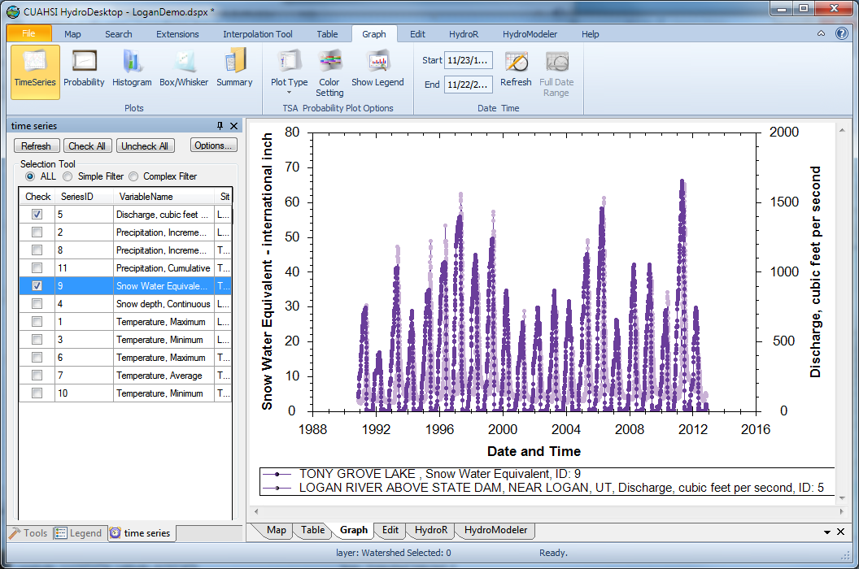
Download and Plot the Data
Combining information from multiple sources

Slide 14
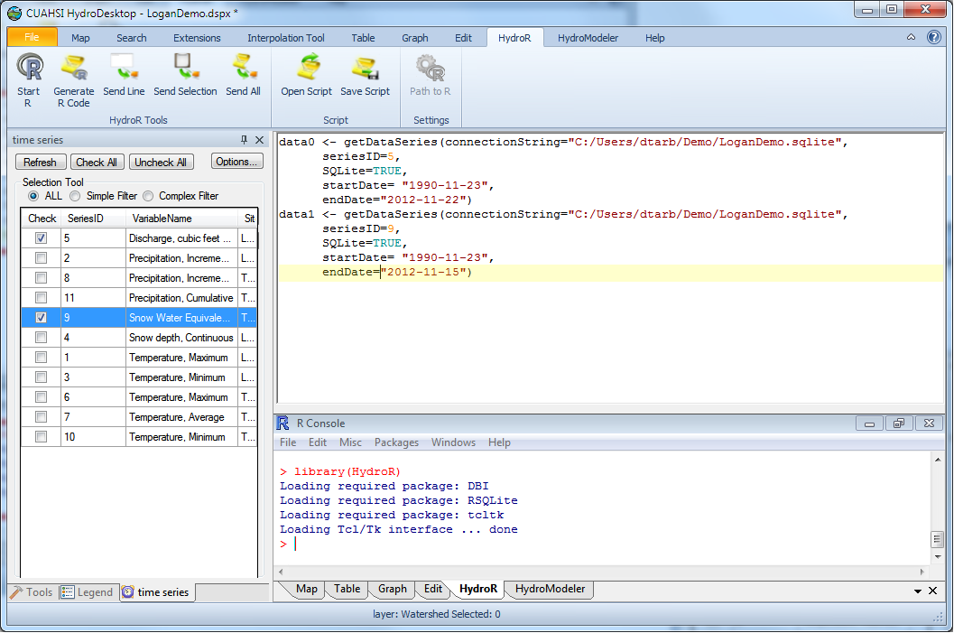
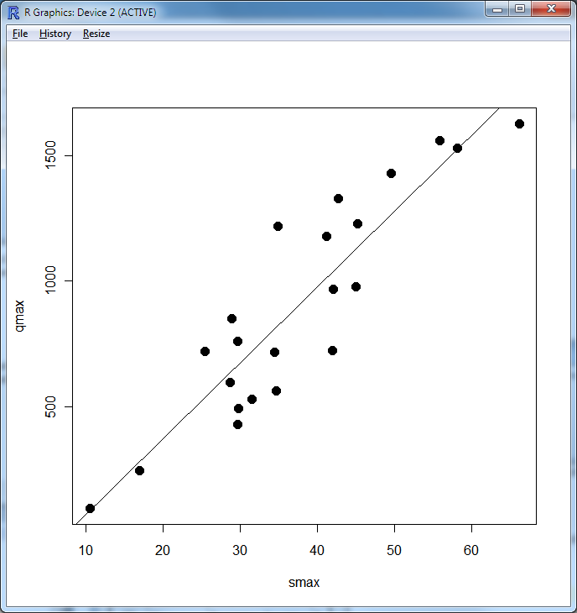
Perform an analysis using R
At your fingertips
the full analysis capability of R
data from multiple sources
accessed from distributed (cloud) resources.
importance of interoperability

Slide 15
Services-Oriented Architecture Paradigm of the World Wide Web
Catalog
(Google)
Crawl and Catalog
Search
Web Server
(CNN.com)
Access
Browser
(Firefox)

Slide 16


CUAHSI HIS Services-Oriented Architecture System for Sharing Hydrologic Data
HydroCatalog
Data Discovery and Integration
Metadata Services
WaterML, Other OGC Standards
Search Services
HydroServer
HydroDesktop
Data Publication
Data Services
Data Analysis and Synthesis
ODM
Geo Data
Information Model and Community Support Infrastructure

Slide 17
Geographic Data Models
All geographic information systems are built using formal models that describe how things are located in space. A formal model is an abstract and well-defined system of concepts. A geographic data model defines the vocabulary for describing and reasoning about the things that are located on the earth. Geographic data models serve as the foundation on which all geographic information systems are built.
Scott Morehouse, Preface to “Modeling our World”, First Edition

Slide 18



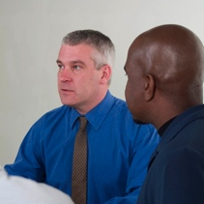

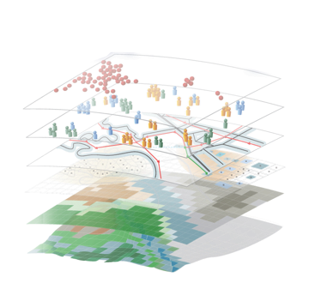
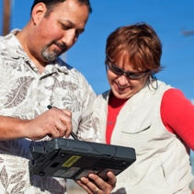

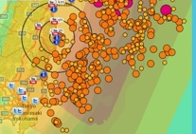

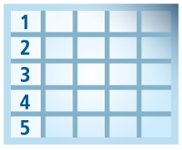
Geospatial Systems Are Helping Us Understand
Understanding
Sharing and Collaboration
Knowledge
Information
Integration
Mapping
Data
. . . Helping Us Make Better Decisions
From Jack Dangermond via David Maidment

Slide 19
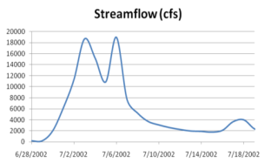
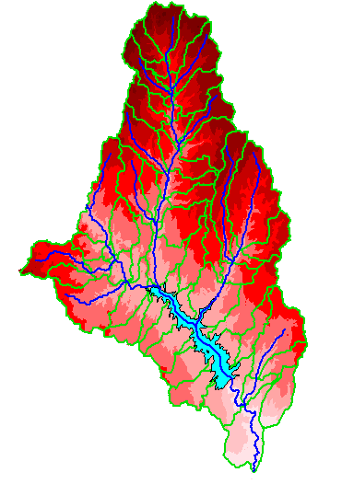
Hydrologic Science
It is as important to represent hydrologic environments precisely with
data as it is to represent hydrologic processes with equations
Physical laws and principles
(Mass, momentum, energy, chemistry)
Hydrologic Process Science
(Equations, simulation models, prediction)
Hydrologic conditions
(Fluxes, flows, concentrations)
Hydrologic Information Science
(Observations, data models, visualization
Hydrologic environment
(Physical earth)

Slide 20
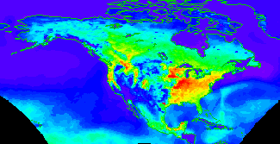


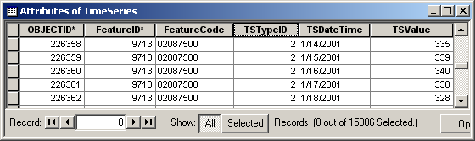
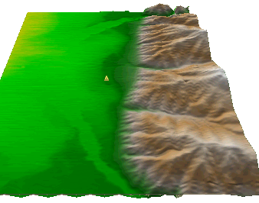
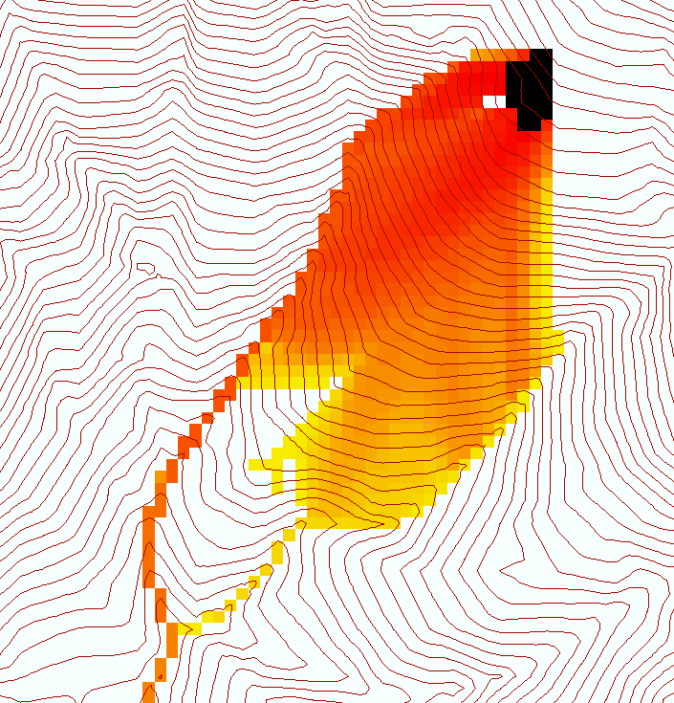
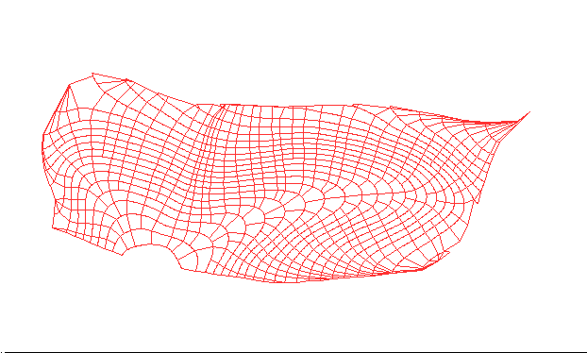
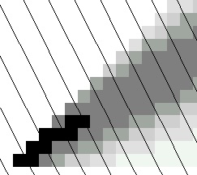
Data models capture the complexity of natural systems
NetCDF (Unidata) - A model for Continuous Space-Time data
ArcHydro – A model for Discrete Space-Time Data
Time, TSDateTime
Time, T
Coordinate
dimensions
{X}
TSValue
D
Space, FeatureID
Space, L
CUAHSI Observations Data Model: What are the basic attributes to be associated with each single data value and how can these best be organized?
Variables, TSTypeID
Variables, V
Variable dimensions
{Y}
Terrain Flow Data Model used to enrich the information content of a digital elevation model

Slide 21
What are the basic attributes to be associated with each single data value and how can these best be organized?
DateTime
Interval (support)
“When”
Time, T
t
A data value
v_{i} (s,t)
Variable
Method
Quality Control Level
Sample Medium
Value Type
Data Type
Source/Organization
“Where”
Location
Feature of interest
Latitude
Longitude
Site identifiers
s
Space, S
V_{i}
“What”
Variables, V
Units
Accuracy
Censoring
Qualifying comments

Slide 22
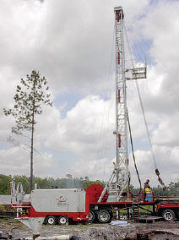
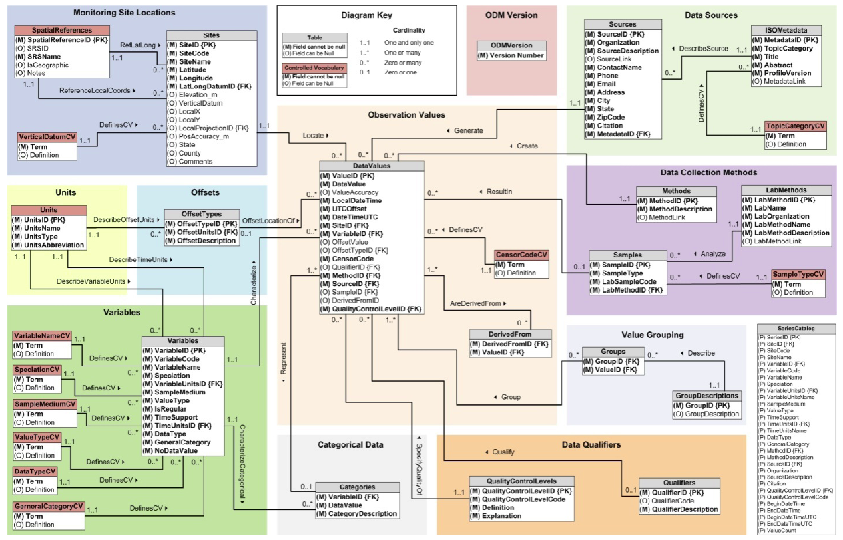
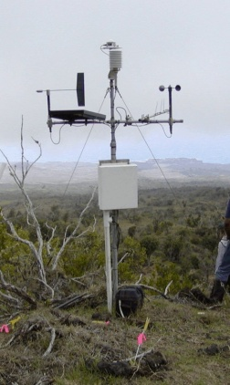
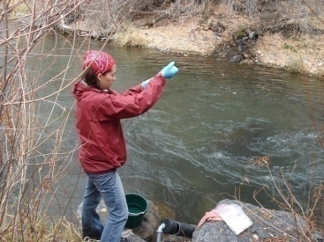
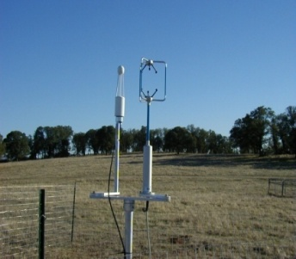
Observations Data Model (ODM)
Streamflow
Provides a common persistence model for data storage
Groundwater
levels
Precipitation
& Climate
Soil
moisture
data
Water Quality
Flux tower data
A relational database at the single observation level
Metadata for unambiguous interpretation
Traceable heritage from raw measurements to usable information
Promote syntactic and semantic consistency
Cross dimension retrieval and analysis
Horsburgh, J. S., D. G. Tarboton, D. R. Maidment, and I. Zaslavsky (2008), A relational model for environmental and water resources data, Water Resources Research, 44, W05406, doi:10.1029/2007WR006392.

Slide 23
CUAHSI Observations Data Model http://his.cuahsi.org/odmdatabases.html
Horsburgh, J. S., D. G. Tarboton, D. R. Maidment and I. Zaslavsky, (2008), A Relational Model for Environmental and Water Resources Data, Water Resour. Res., 44: W05406, doi:10.1029/2007WR006392.
Notes:
In designing ODM we asked: What are the basic attributes to be associated with each single data value and how can these best be organized? This involved community survey at a workshop and by email and based on the feedback received we came up with the ODM schema illustrated, published last year in WRR
This is quite a detailed slide, but it is the entire schema. Few database designs are simple enough to fit the entire schema on one slide. This shows at the center the data values table and off to the sides, the ancillary or metadata tables that record.

Slide 24
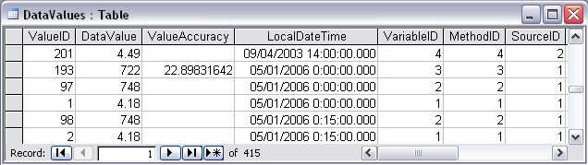
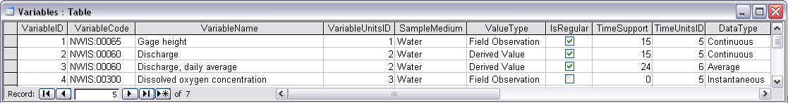
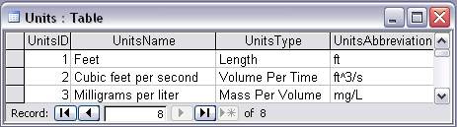
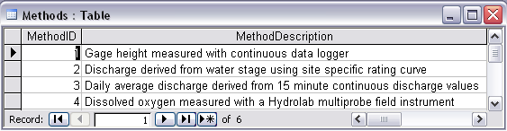
Discharge, Stage, Concentration and Daily Average Example

Slide 25
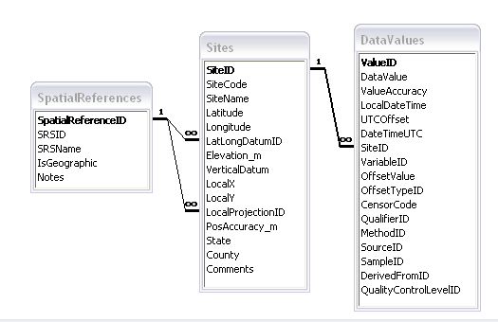
Site Attributes
SiteCode, e.g. NWIS:10109000
SiteName, e.g. Logan River Near Logan, UT
Latitude, Longitude Geographic coordinates of site
LatLongDatum Spatial reference system of latitude and longitude
Elevation_m Elevation of the site
VerticalDatum Datum of the site elevation
Local X, Local Y Local coordinates of site
LocalProjection Spatial reference system of local coordinates
PosAccuracy_m Positional Accuracy
State, e.g. Utah
County, e.g. Cache

Slide 26
Independent of, but can be coupled to Geographic Representation
ODM
e.g. Arc Hydro
Feature
Observations Data Model
1
HydroPoint
Waterbody
Watershed
Sites
1
HydroID
HydroID
HydroID
SiteID
HydroCode
*
HydroCode
HydroCode
SiteCode
FType
FType
DrainID
SiteName
OR
Name
Name
AreaSqKm
Latitude
JunctionID
AreaSqKm
JunctionID
Longitude
JunctionID
NextDownID
…
ComplexEdgeFeature
*
SimpleJunctionFeature
*
CouplingTable
1
SiteID
HydroID
1
HydroEdge
HydroJunction
HydroJunction
HydroID
1
HydroJunction
1
HydroID
HydroID
HydroCode
HydroID
HydroCode
HydroCode
ReachCode
HydroCode
NextDownID
NextDownID
Name
NextDownID
LengthDown
LengthDown
LengthKm
HydroNetwork
LengthDown
DrainArea
DrainArea
LengthDown
DrainArea
FType
FType
FlowDir
FType
Enabled
Enabled
FType
Enabled
AncillaryRole
AncillaryRole
EdgeType
AncillaryRole
Enabled
EdgeType
Flowline
Shoreline

Slide 27
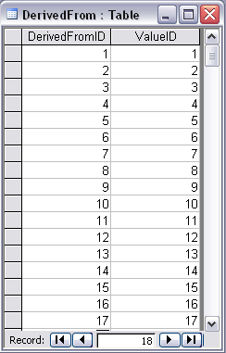
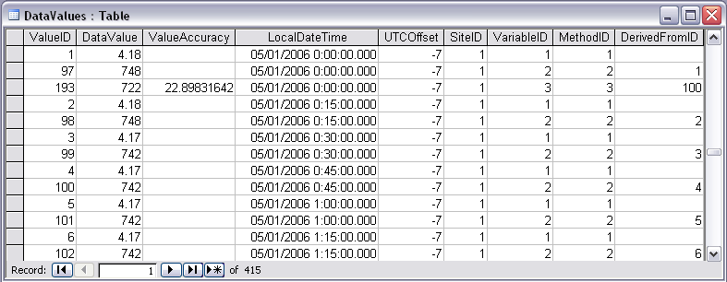
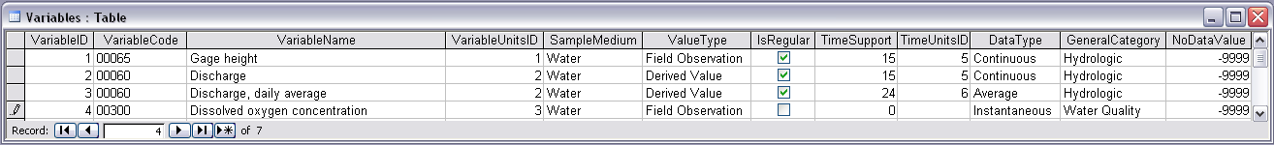
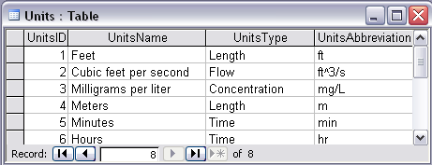

Stage and Streamflow Example
Notes:
Discharge Derived from Gage Height
Concepts:
Data derived from other data – single data point derived from a single observation (discharge from stage)
Data derived using a specific method (discharge from stage using rating curve)
Relationships:
Relationships between Values table and DerivedFrom table on DerivedFromID and ValueID
Relationship between Values table and Variables table on VariableID
Relationship between Values table and Methods table on MethodID
Relationship between Variables table and Units table on UnitID

Slide 28






Water Chemistry from a profile in a lake
Notes:
Water Chemistry From a Lake Profile
Concepts:
Grouped observations (all observations in one reservoir profile)
Observations made using an offset (observations made at multiple depths below the surface of a reservoir)
Observations made using a specific method (observations made using a particular field instrument)
Relationships:
Relationship between Values table and the Variables table on VariableID
Relationship between Values table and OffestTypes table on OffsetTypeID
Relationship between Values table and Methods table on MethodID
Relationship between Variables table and Units table on UnitID
Relationship between GroupDescriptions table and Groups table on GroupID
Relationship between OffsetTypes table and Units table on UnitID and OffsetUnitID

Slide 29



Loading data into ODM
OD Data Loader
Interactive OD Data Loader (OD Loader)
  Loads data from spreadsheets and comma separated tables in simple format
Scheduled Data Loader (SDL)
  Loads data from datalogger files on a prescribed schedule.
  Interactive configuration
SQL Server Integration Services (SSIS)
  Microsoft application accompanying SQL Server useful for programming complex loading or data management functions
SDL
SSIS

Slide 30
Importance of the Observations Data Model
Provides a common persistence model for observations data
Syntactic consistency (File types and formats)
Semantic consistency
  Language for observation attributes (structural)
  Language to encode observation attribute values (contextual)
Publishing and sharing research data
Metadata to facilitate unambiguous interpretation
Enhance analysis capability

Slide 31

WaterML and WaterOneFlow
WaterML is an XML language for communicating water data
WaterOneFlow is a set of web services based on WaterML
Set of query functions
Returns data in WaterML
GetSites
GetSiteInfo
GetVariableInfo
GetValues
WaterOneFlow
Web Service
Notes:
31

Slide 32

Open Geospatial Consortium Web Service Standards
http://www.opengeospatial.org/standards/waterml
This document is an OGC® Encoding Standard for the representation of hydrological observations data with a specific focus on time series structures.
These standards have been developed over the past 10 years …. by 400 companies and agencies ....

Slide 33










HydroServer – Data Publication
Point Observations Data
Internet Applications
Ongoing Data Collection
Historical Data Files
ODM Database
GetSites
GetSiteInfo
GetVariableInfo
GetValues
GIS Data
WaterML
WaterOneFlow
Web Service
OGC Spatial Data Service from ArcGIS Server
Data presentation, visualization,
and analysis through Internet enabled applications
Notes:
A platform for publishing space-time hydrologic datasets that:
Autonomous with local control of data
Part of a distributed system that makes data universally available
Basis for Experimental Watershed or Observatory data management system
Standards based approach to data publication
Accepted and emerging standards for data storage and transfer (OGC, WaterML)
Built on established software
MS SQL Server, ArcGIS server
Open Source Community Code Repository
Sustainability

Slide 34




HydroCatalog
Service Registry
Hydrotagger
Search over data services from multiple sources
Supports concept based data discovery
WaterML
Harvester
Water Metadata Catalog
GetSites
GetSiteInfo
GetVariableInfo
GetValues
WaterOneFlow
Web Service
Search Services
CUAHSI Data Server
3rd Party Server
e.g. USGS
Discovery and Access
Hydro
Desktop
http://hiscentral.cuahsi.org

Slide 35

A growing collection of HydroServers and community of users
University of Maryland, Baltimore County
Montana State University
University of Texas at Austin
University of Iowa
Utah State University
University of Florida
University of New Mexico
University of Idaho
Boise State University
University of Texas at Arlington
University of California, San Diego
Idaho State University
Dry Creek Experimental Watershed (DCEW)
(28 km² semi-arid steep topography, Boise Front)
68 Sites
24 Variables
4,700,000+ values
Published by Jim McNamara, Boise State University

Slide 36
A growing collection of HydroServers and community of users
Server Networks Registered at HIS Central
Get Values Requests

Slide 37

Open Development Model
http://hydrodesktop.codeplex.com
http://hydroserver.codeplex.com
http://hydrocatalog.codeplex.com

Slide 38
CUAHSI HIS: A common window on water observations data for the United States unlike any that has existed before
Storage in a community data model
Publication from a server
Data access through internet-based services using consistent language and format
Tools for access and analysis
Discovery through thematic and geographic search functionality
Integrated modeling and analysis combining information from multiple sources
Desktop
Catalog
Server

Slide 39

HydroShare - A web-based collaborative environment for the sharing of hydrologic data and models
beta.hydroshare.org
Can sharing data and models be as easy as sharing photos on Facebook or videos on YouTube?
Can finding data and models be as easy as shopping on Amazon?
Currently in beta testing. First release due next year
Notes:
HydroShare will be a collaborative environment for sharing hydrologic data and models aimed at giving hydrologists the technology infrastructure they need to address critical issues related to water quantity, quality, accessibility, and management.
HydroShare will expand the data sharing capability of the CUAHSI Hydrologic Information System by broadening the classes of data accommodated, expanding capability to include the sharing of models and model components, and taking advantage of emerging social media functionality to enhance information about and collaboration around hydrologic data and models.
Functionality will include
A web portal for model and data sharing
Sharing features added to HydroDesktop client software
Access to more types of hydrologic data using standards compliant data formats and interfaces
Enhanced catalog functionality that broadens discovery functionality to different data types and models
New model sharing and discovery functionality
Enhanced easy to use access to high performance computing
Social media and collaboration functionality
Linkages to other data and modeling systems such as USGS and CUAHSI data services, NASA earth exchange and HPC resources e.g. at CSDMS

Slide 40
HydroShare Functionality to be Developed
A new, web-based system for advancing model and data sharing
Sharing features to HydroDesktop
Access more types of hydrologic data using standards compliant data formats and interfaces
Enhance catalog functionality that broadens discovery functionality to different data types
New model sharing and discovery functionality
Facilitate and ease access to use of high performance computing
New social media and collaboration functionality
Links to other data and modeling systems

Slide 41


Slide 42


Slide 43


Slide 44

Upload

Slide 45



_{Imagine the Possibilities…}
Discover and Analyze/Model (in Desktop or Cloud)
Observe
Publish and Catalog
Collaboration
Analysis
3
Observers and instruments
HydroServer (ODM)
Data
Models
1
2
Publication, Archival, Curation
HydroShare to support integrated collaborative analysis, modeling and data publication

Slide 46
_{Imagine the Possibilities…}
Share the results (Data and Models)
Collaboration
Analysis
4
Observers and instruments
HydroShare resource
store
Data
Models
Publication, Archival, Curation
HydroShare to support integrated collaborative analysis, modeling and data publication

Slide 47

_{Imagine the Possibilities…}
Group Collaboration using HydroShare
Preparation of a paper
Collaboration
5
Analysis
6
Observers and instruments
Data
Models
Publication, Archival, Curation
HydroShare to support integrated collaborative analysis, modeling and data publication

Slide 48
_{Imagine the Possibilities…}
Submittal of paper, review, archival of electronic paper with data, methods and workflow
Collaboration
Analysis
7
Observers and instruments
Data
Models
Publication, Archival, Curation
HydroShare to support integrated collaborative analysis, modeling and data publication
DataOne, EarthCube, …

Slide 49






HydroShare Modeling
Flow
Time
t
y
x
Data: Links to national and global data sets of essential terrestrial variables (e.g. NASA NEX, HydroTerre)
Tools to preprocess and configure inputs (TauDEM + CyberGIS)
Preconfigured models and modeling systems as services (CI-WATER)
Standards for information exchange for interoperability (OpenMI, CSDMS BMI)
Tools for visualization and analysis
Automated reasoning to couple models based on purpose, context, data and resources (Aaron Byrd)
Notes:
Data: Links to national and global data sets of essential terrestrial variables (e.g. NASA NEX, HydroTerre)
Tools to preprocess and configure inputs
Preconfigured models and modeling systems as services
Standards for information exchange for interoperability (OpenMI, CSDMS BMI)
Tools for Visualization and Analysis
Automated reasoning to couple models based on purpose, context, data and resources

Slide 50
Resource Repository Centric Paradigm for Modeling and Analysis
Models
Visualization Tools
Analysis Tools
Resource Repository
Data Loaders
Data Discovery Tools
Enable multiple models to use common “best practice” tools

Slide 51

E.g. SWATShare
A web based tool for publishing, sharing, and accessing Soil Water Assessment Tool (SWAT)
www.water-hub.org/swat-tool
Notes:
You need to log-in to use the functions of SWAT share. On this slide, you see a map the watershed in red are the one for which SWAT models are available. Once you click a on one of the watersheds (highlighted in yellow), then you see then you see the associated metadata with the model. If the model is only published (and not shared), one cannot download or run the model. However, if the model is published and shared, any user can download, modify, and run the model on the SWATShare.

Slide 52
Model pre and post processing workflow
Model
Models
Visualization Tools
Analysis Tools
Input Files
Output Files
Resource Repository
Pre-Processing
Post -Processing
Data Loaders
Data Discovery Tools
Resource Repository
Each model interacts with information in the common data store
The modeler does not need to be concerned with and can take advantage of standardized analysis, visualization loading and discovery tools

Slide 53

Architecture and Development

Slide 54
Drupal – Content Management System
Extensible Open Source Content Management Framework for Publication written in PHP
  Over 14,000 user contributed modules
Themed and Styled Presentation of HydroShare Resources with in page visualization
Off the shelf modules provide a Social Experience surrounding Hydrologic Data: Comments, Ratings, Group Behavior
Custom module development supports HydroShare Data Model, GeoAnalytics and iRODS Integration

Slide 55

Summary
CUAHSI HIS
  Enhanced Access to Hydrologic Data
  Combining information from multiple sources
HydroShare
  A collaborative website for the sharing of hydrologic data and models
  To expand data sharing capability of CUAHSI HIS
    Additional data classes
    Models, scripts, tools and workflows
Ingredients for success
  Community participation
  Interoperability
  Standards
  Open Development
To boldly go where no one has gone before

Slide 56


Thanks to a lot of people
  USU
  RENCI/UNC
  CUAHSI
  BYU
  Tufts
  USC
  Texas
  Purdue
  SDSC
HydroShare team: Dave Tarboton, Ray Idaszak, Dan Ames, Jeff Horsburgh, Jon Goodall, Larry Band, Venkatesh Merwade, Jeff Heard, Carol Song, Alva Couch, David Valentine, Rick Hooper, Jennifer Arrigo, David Maidment, Tim Whiteaker, Alex Bedig, Laura Christopherson, Pabitra Dash, Tian Gan, Tony Castronova, Karl Gustafson, Stephen Jackson, Cuyler Frisby, Stephanie Mills, Brian Miles, Jon Pollak, Stephanie Reeder, Ash Semien, Yaping Xiao, Lan Zhao
http://www.cuahsi.org/hydroshare.aspx
OCI-1148453
OCI-1148090
Notes:
The HydroShare project is part of a broad effort in CUAHSI in the area of Hydrologic Information Systems. We have a team of developers and domain scientists from eight universities working on HydroShare. This is part of the even broader focus in NSF on data management, Cyberinfrastructure and sustainable software.

Slide 57
Are there any questions ?
AREA 2
3
AREA 1
12

