Slide 1
Hydro Networks in GIS
Review of key concepts in Ex 4
Connecting the Land and Water Systems
Hydrologic networks
Linear referencing on networks

Slide 2
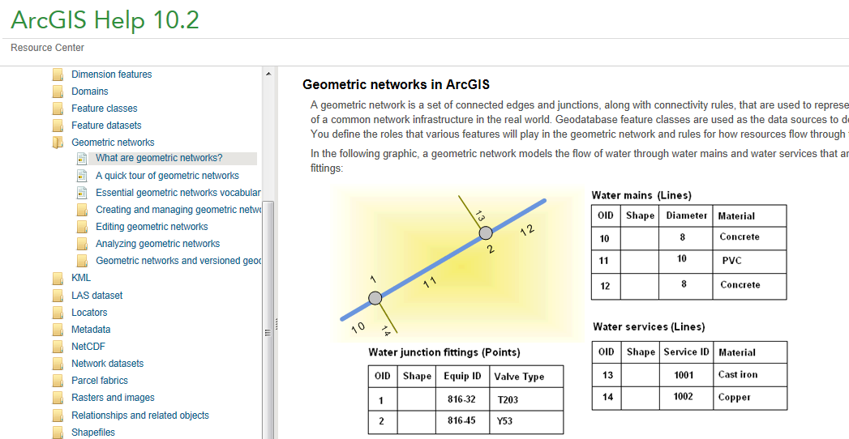
Reading (1)
What are geometric networks, A quick tour of geometric networks, Essential geometric networks
http://resources.arcgis.com/en/help/main/10.2/index.html#/What_are_geometric_networks/002r00000001000000/

Slide 3
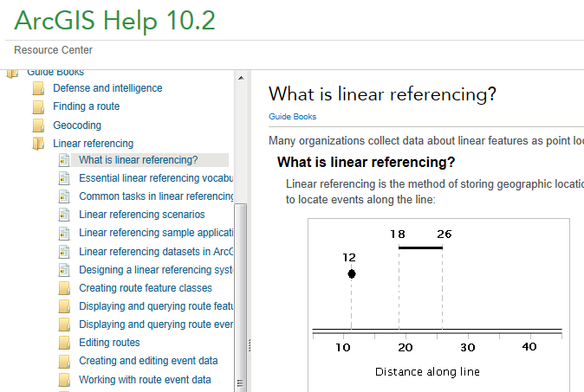
Reading (2)
- What is linear referencing; Essential linear referencing vocabulary
http://resources.arcgis.com/en/help/main/10.2/index.html#/What_is_linear_referencing/003900000001000000/

Slide 4
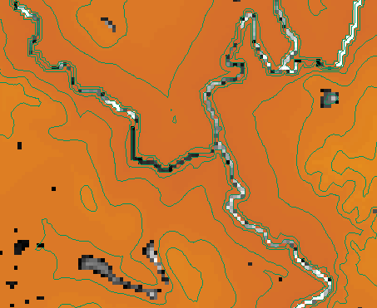
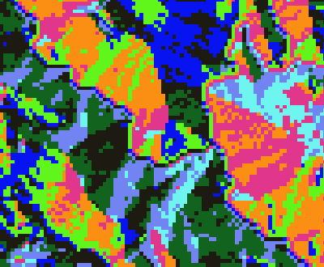
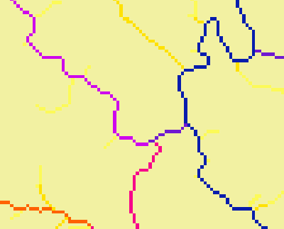
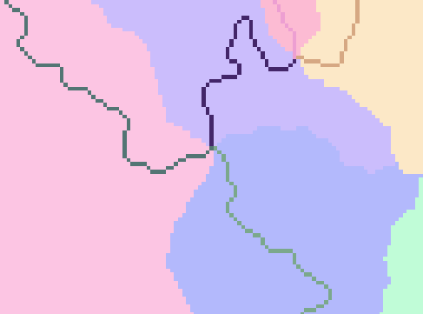
Key Concepts from Exercise 4
Raster Analysis Layers
Fill
Flow Direction
Flow Accumulation
Stream Definition
Stream Links
Catchments

Slide 5
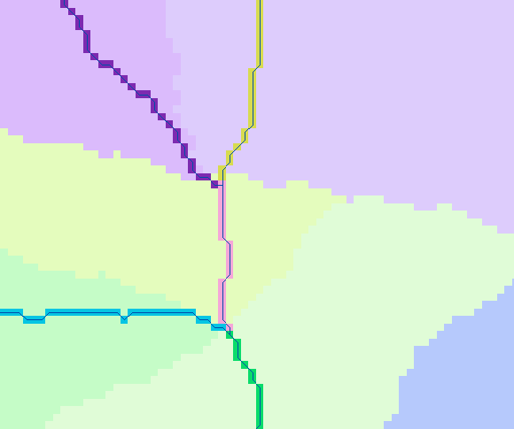
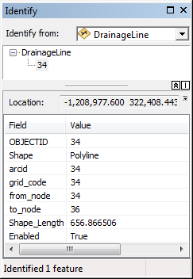
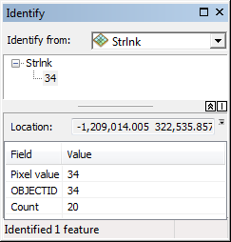
Vectorized Streams Linked Using Grid Code to Cell Equivalents
Grid
Streams
Vector
Streams

Slide 6
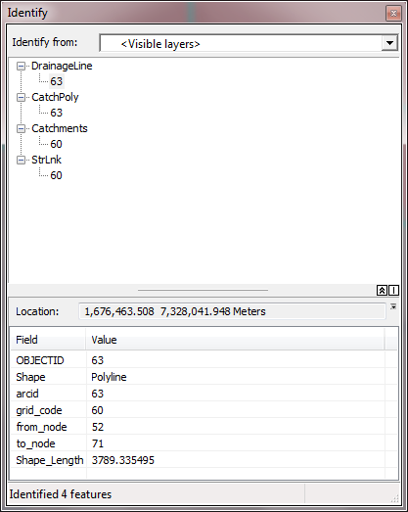
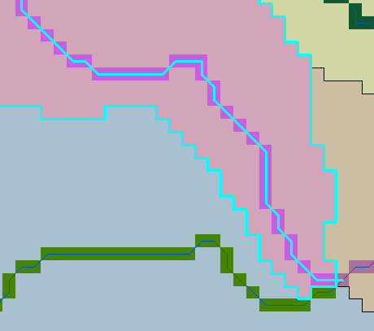
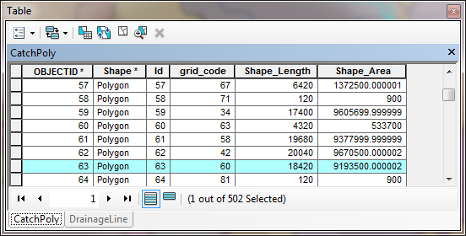
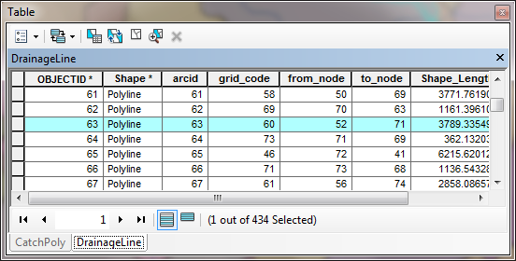
Relationships linking Catchments and Drainage Lines

Slide 7
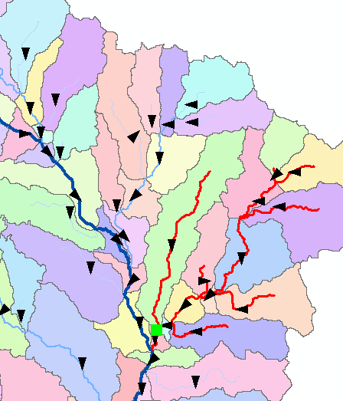
Vector Analysis Layers
Vector streams
Vector catchments
Attribute feature with raster zonal statistics
Geometric Network
Tracing
Selection statistics

Slide 8
Raster to Vector Transition
During the first part of Ex4, you are dealing with the flow of water through the landscape based on the raster data structures
During the last part of Ex 4 we are using vector network data to describe water pathways.
We will connect the land and water flow systems by attaching the catchments and watersheds derived from raster data processing to our vector networks

Slide 9
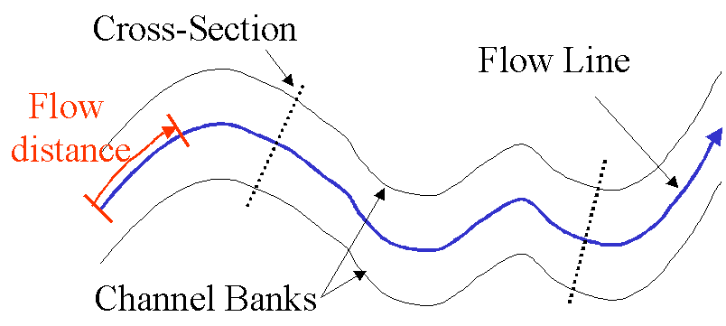
Flow Line
Traces movement of water in a one-dimensional flow system

Slide 10
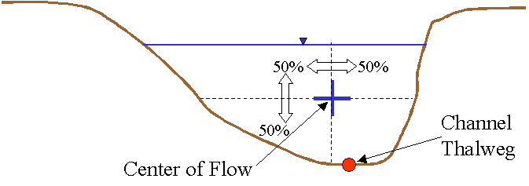
Location of the Flowline

Slide 11
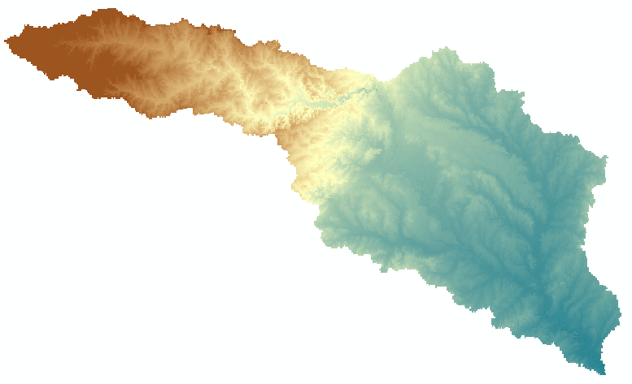
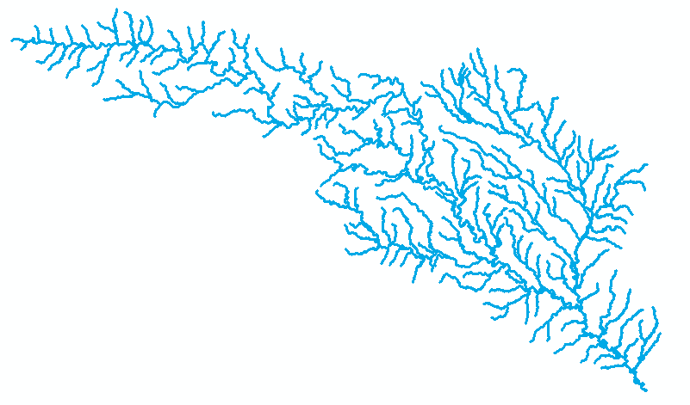
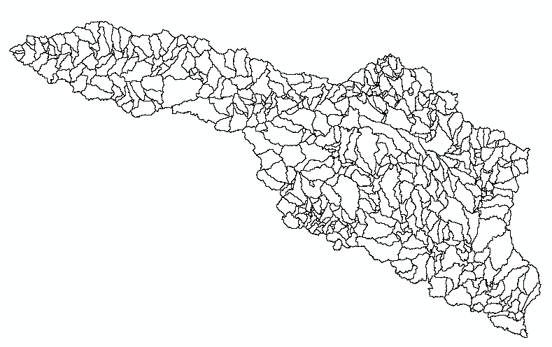
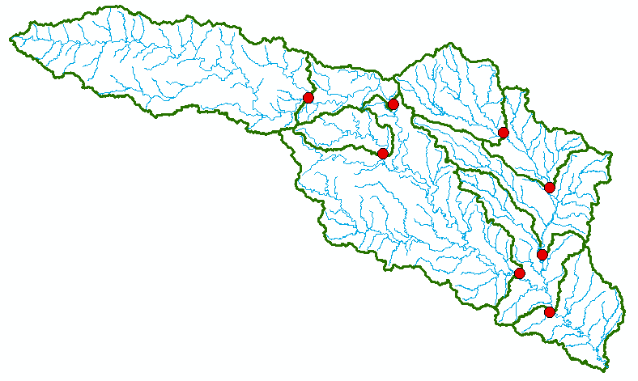
Four Key Concepts
Four key constructs
  Cell to cell water movement on DEMs
  Line to Line water movement on networks
  Area flows to line (connect land and water systems – Reach Catchments)
  Area flows to point on line (Watershed delineation from designated points)

Slide 12

Cell Flows to a Cell
Core concept of flow on digital elevation models

Slide 13

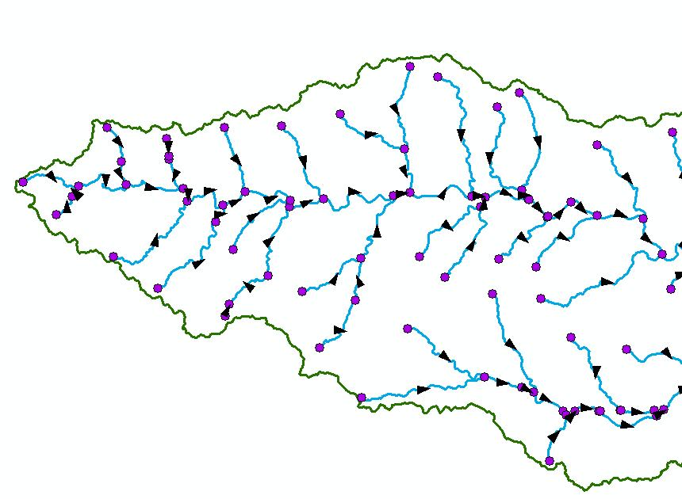
Line Flows to a Line
Geometric Network of NHDFlowlines

Slide 14
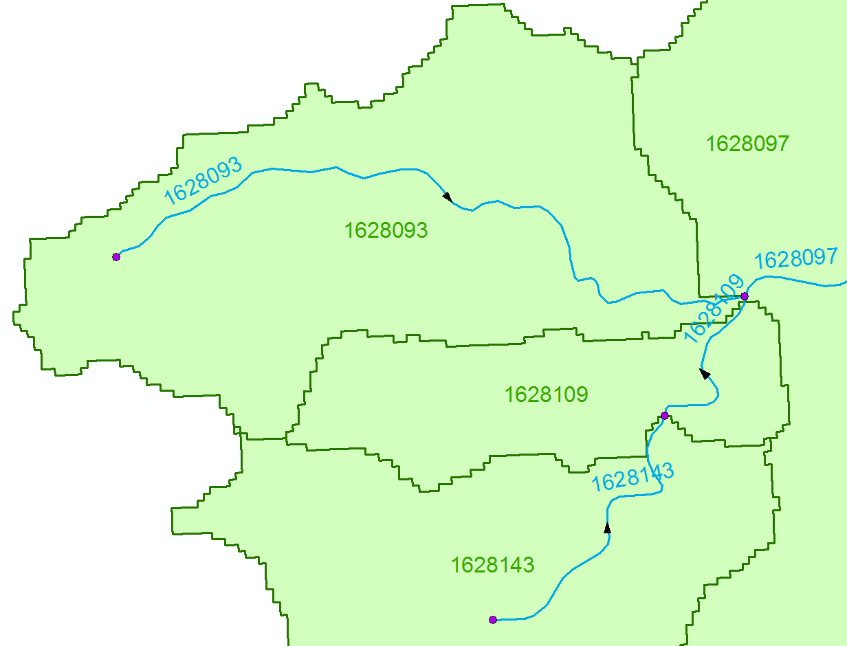
Area Flows to a Line
Reach Catchments from NHDPlus
Flowline and Catchment have the same COMID

Slide 15
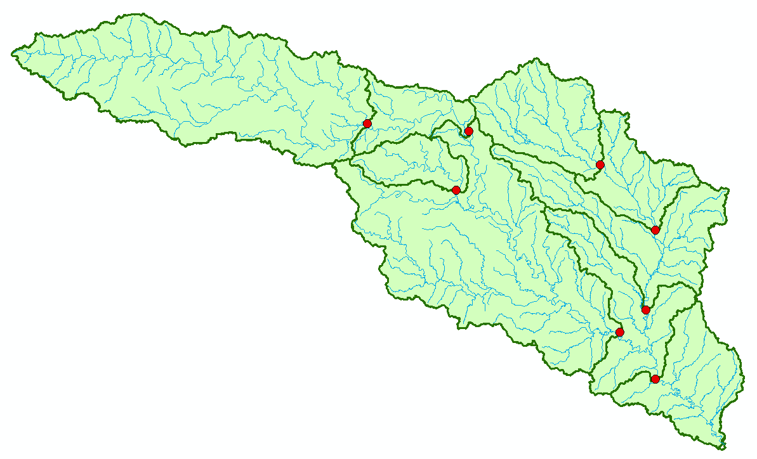
Area Flows to a Point on a Line
Watersheds for USGS Gages
Tesselation using gage points

Slide 16
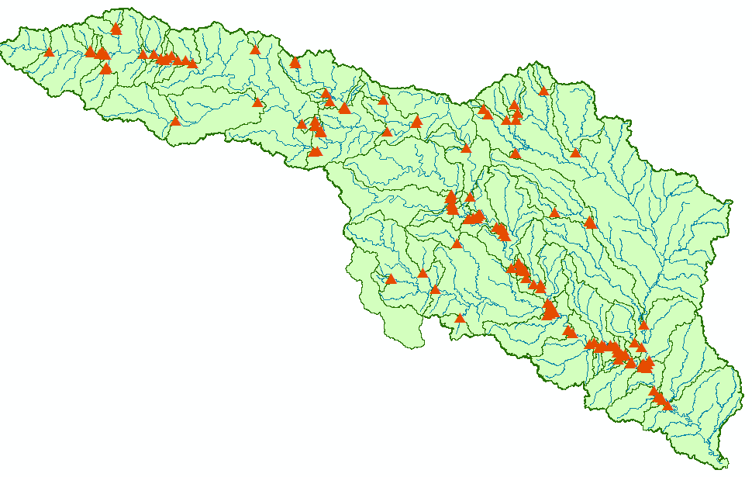
Area Flows to a Point on a Line
Tesselation using Water Rights Diversion Points

Slide 17
Topology
Topology (from the Greek τόπος, "place", and λόγος, "study") is the mathematical study of shapes and spaces. It is a major area of mathematics concerned with the most basic properties of space, such as connectedness, continuity and boundary. It is the study of properties that are preserved under continuous deformations including stretching and bending, but not tearing or gluing.
http://en.wikipedia.org/wiki/Topology
Connection by relationship
Connection by geometry

Slide 18
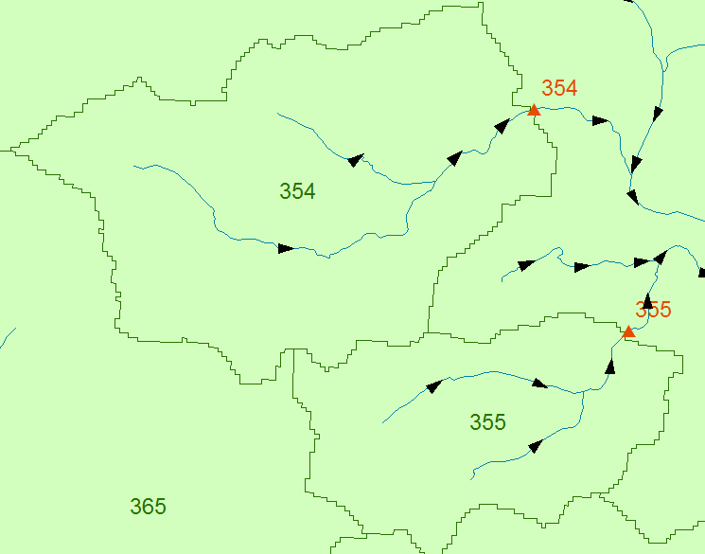
Connection by relationship
Area 354 flows to point 354

Slide 19

Connection by Geometry
A network is a set of edges and junctions that are topologically connected to each other.

Slide 20
Network Model in GIS
Three components
  Geometric model: (x,y,z,m) coordinates of edges and junctions
  Logical model: which edges are connected to what junctions
  Addressing model: location on the network using measure

Slide 21
Edges and Junctions
Simple feature classes: points and lines
Network feature classes: junctions and edges
Edges can be
  Simple: one attribute record for a single edge
  Complex: one attribute record for several edges in a linear sequence
A single edge cannot be branched
No!!

Slide 22
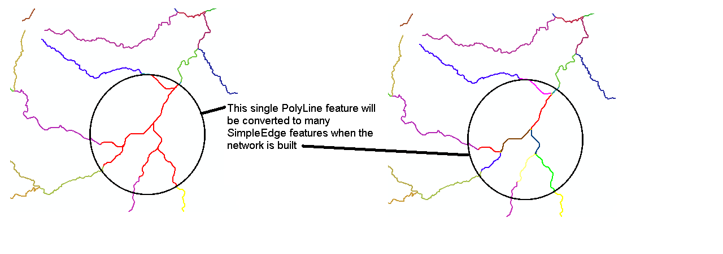
Polylines and Edges

Slide 23
Junctions
Junctions exist at all points where edges join
  If necessary they are added during network building (generic junctions)
Junctions can be placed on the interior of an edge e.g. stream gage
Any number of point feature classes can be built into junctions on a single network

Slide 24
Connectivity Table
J125
Junction
Adjacent Junction and Edge
J123 | J124, E1
J124 | J123, E1 | J125, E2 | J126, E3
J125 | J124, E2
J126 | J124, E3
E2
J124
E1
E3
J123
J126
This is the “Logical Network”

Slide 25
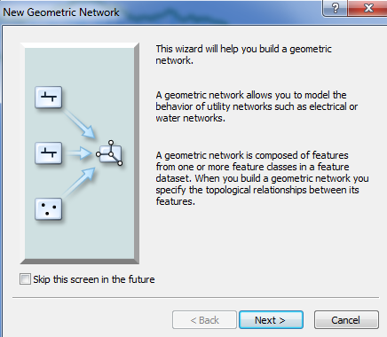
Build Network Tables
Establishes connectivity of Edge and Junction features
Enables tracing
Generates Generic Junctions
Geometric Network Wizard in ArcCatalog

Slide 26
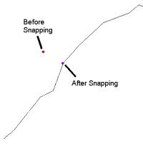
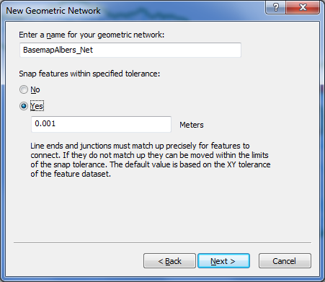
Snapping Features

Slide 27
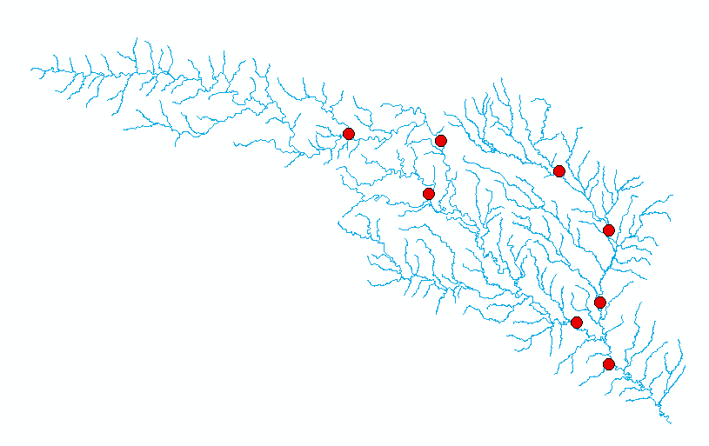
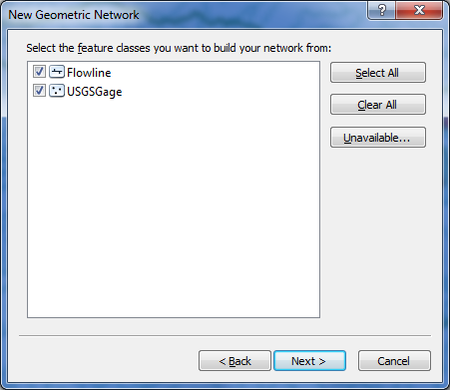

Slide 28
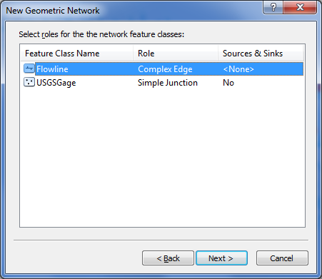
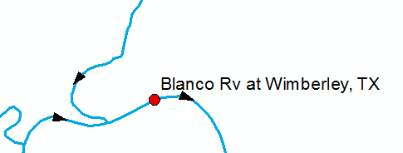
Network Sources and Sinks
Each junction
feature class
in a network can
have junctions
which are sources
or sinks for flow
Use complex edge so that junction can be interior to edge

Slide 29
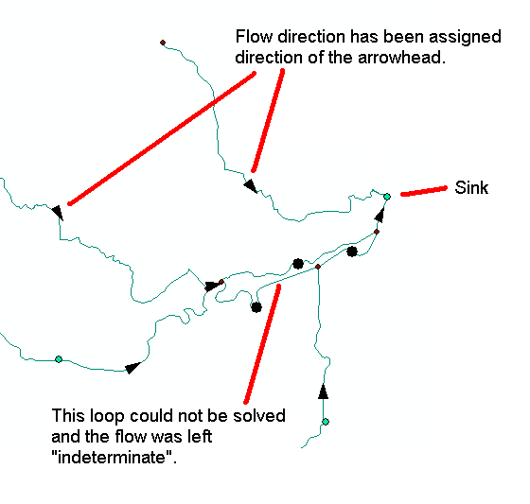
Flow to a sink

Slide 30
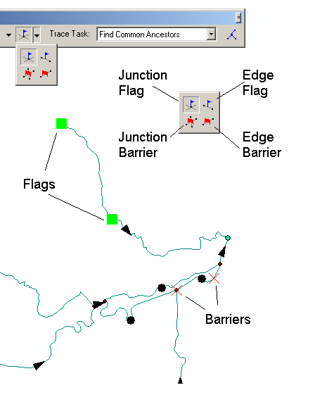

Flags

Slide 31
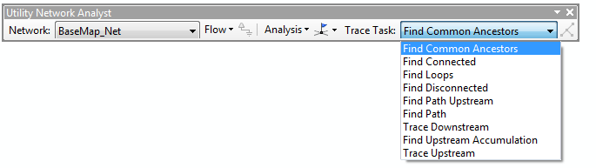
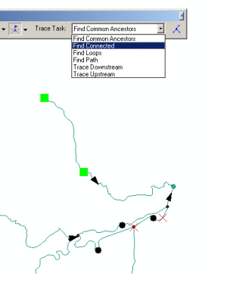
Trace Solvers

Slide 32
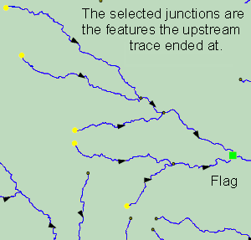
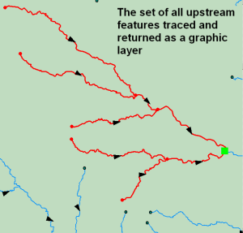
Upstream Trace Solvers

Slide 33
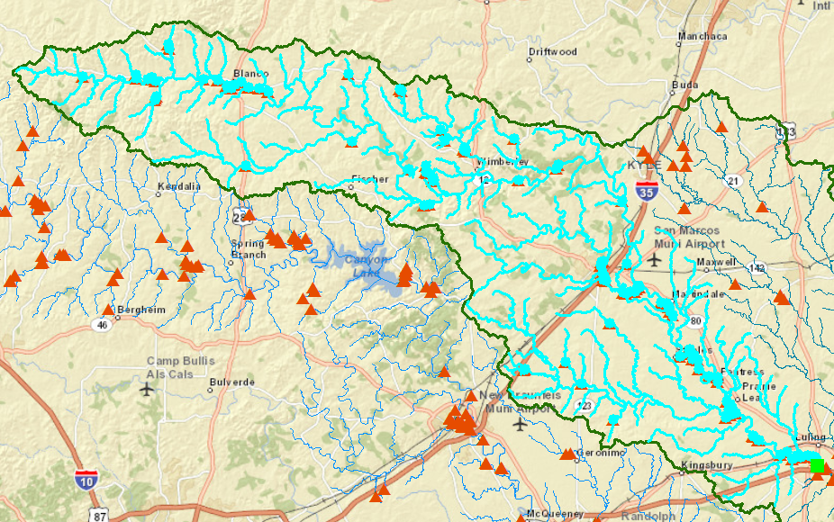
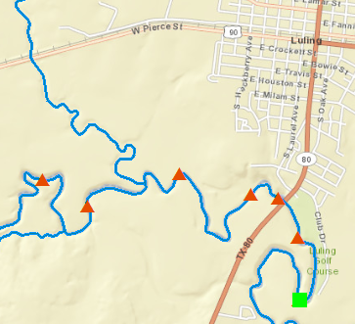
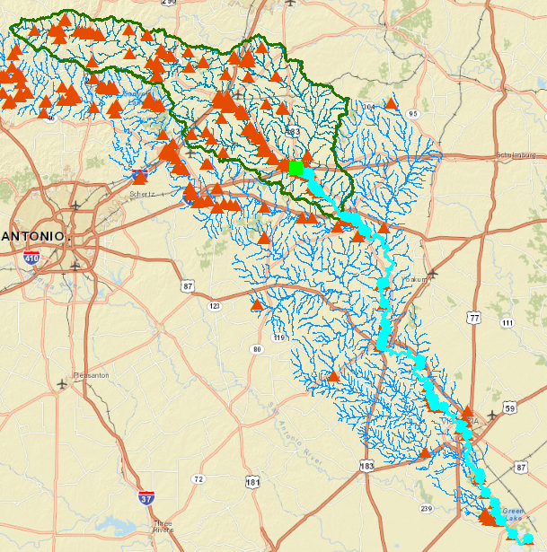
Water Rights in Luling, Tx
111 water right points upstream from Luling
Trace Upstream
54 water right points downstream from Luling
Trace Downstream

Slide 34
Addressing

Slide 35
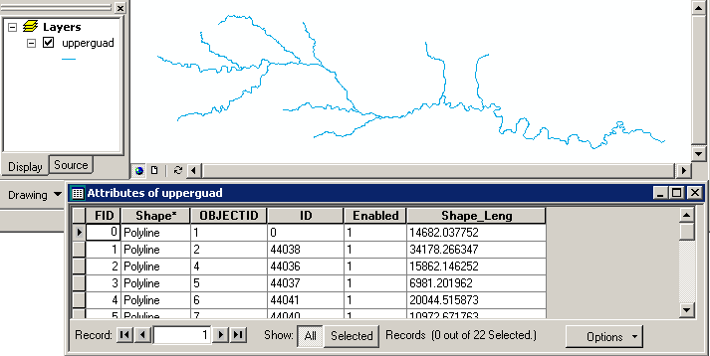
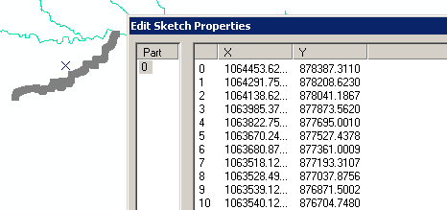
Coordinates of a 2-D Polyline

Slide 36
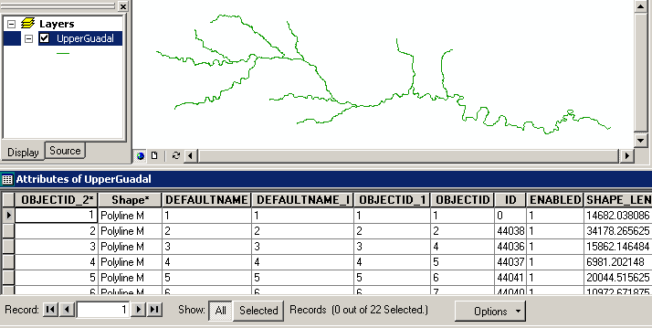
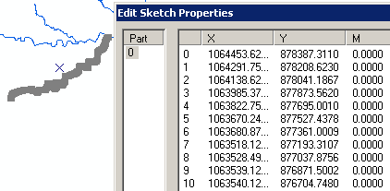
Coordinates of a 2-D Polyline M

Slide 37
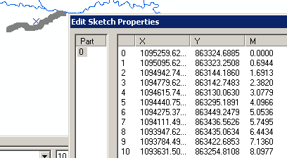
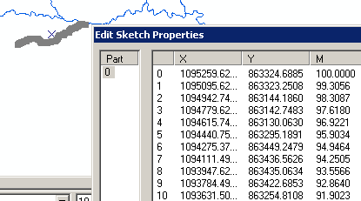
Setting Percent Measure
pMSeg.SetAndInterpolate
MsBetween 0, 100
pMSeg.SetAndInterpolate
MsBetween 100, 0
0 – 100 going upstream
0 – 100 going downstream

Slide 38
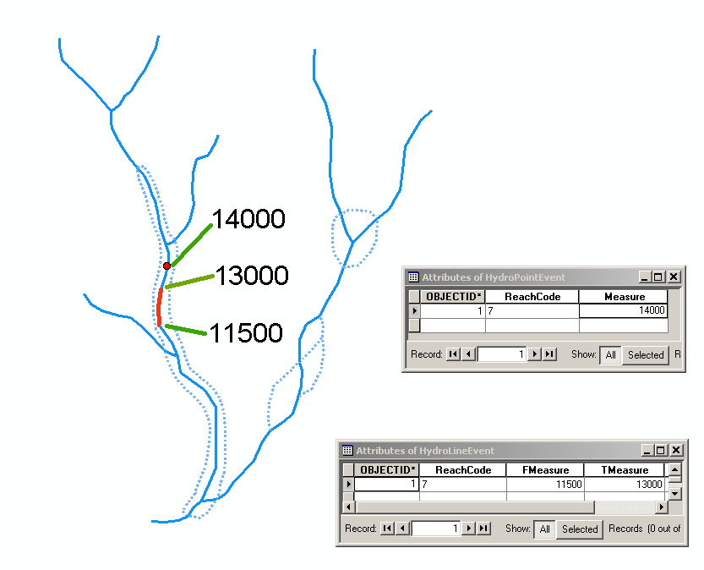
Point and Line Events

Slide 39
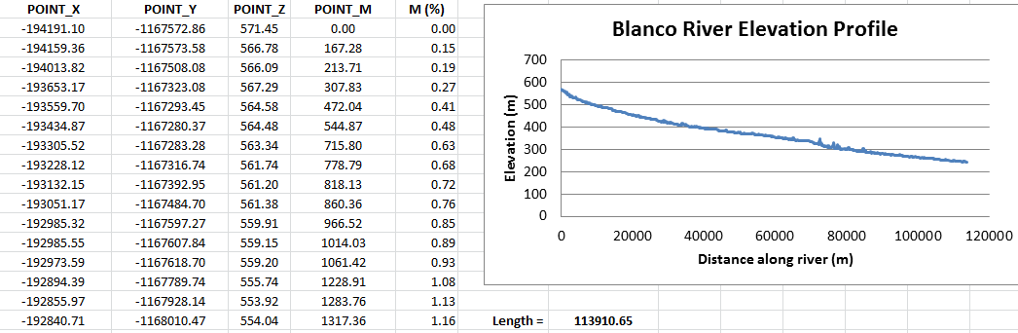
Longitudinal River Profile
Absolute Measure (M_{a})
Relative Measure (M_{r}) = M_{a}/L

Slide 40
Summary Concepts
Four key constructs
  Cell to cell water movement on DEMs
  Line to Line water movement on networks
  Area flows to line (connect land and water systems – Reach Catchments)
  Area flows to point on line (Watershed delineation from designated points)

Slide 41
Summary Concepts (2)
A network is a connected set of points (junctions) and lines (edges) that supports tracing functions
  Three data model components
    Geographic (x,y,z)
    Logical (point-line topology connections)
    Addressing (position m along the line)

