Slide 1
GIS in Water Resources: Lecture 1
In-class and distance learning
Geospatial database of hydrologic features
GIS and HIS
Curved earth and a flat map
Reading Assignment: Introduction to Map Projections
http://resources.arcgis.com/en/help/main/10.2/#/What_are_map_projections/003r00000001000000/

Slide 2
Six Basic Course Elements
Lectures
  Powerpoint slides
  Video streaming
Readings
  Online readings and lecture synopses
Homework
  Computer exercises
  Hand exercises
Term Project
  Oral presentation
  PDF report
Class Interaction
  Email
  Discussion
Examinations
  Midterm, final

Slide 3
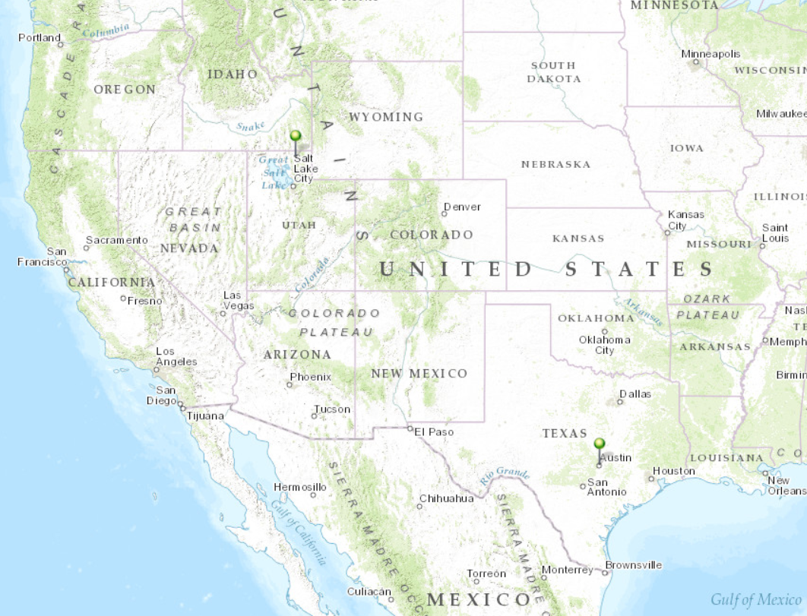
Our Classroom
Dr David Tarboton
Students at Utah State University
Dr David Maidment Students at University of Texas at Austin

Slide 4

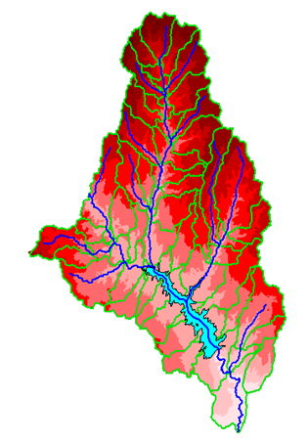
David R. Maidment
B.E. in Agricultural Engineering (with First Class Honors) from University of Canterbury, Christchurch, New Zealand, 1972
MS, PhD in Civil Engineering from University of Illinois, 1974 and 1976, respectively
1981 – joined University of Texas at Austin as an Assistant Professor, and have been on the faculty ever since. Now Hussein M. Alharthy Centennial Chair in Civil Engineering
Initiated the GIS in Water Resources course in 1991.
Worked with ESRI since 1994 on a GIS Hydro Preconference seminar for the ESRI Users Conference
Leader of the CUAHSI Hydrologic Information System project from 2004-2011
Developing World Water Online with ESRI and Kisters

Slide 5

David Tarboton
B.Sc Eng in Civil Engineering from the University of Natal, Durban, South Africa 1981
M.S. and Sc.D from MIT, Cambridge, Massachusetts, 1987 and 1990 respectively
1990 - Joined Faculty at Utah State University in Civil and Environmental Engineering
1996 - Developed D-Infinity and gradually adapted research terrain analysis codes (Fortran and C) into TauDEM
Participated in GISWR since 1999 (this year is the 14th time)
Research includes snow energy balance, stochastic streamflow and physically based hydrologic modeling
Leader of HydroShare project to extend the capability of CUAHSI HIS to collaborative data sharing, additional data types and models

Slide 6
University Without Walls
Traditional Classroom
Community
Inside and Outside
The Classroom

Slide 7
Learning Styles
Instructor-Centered Presentation
Community-Centered Presentation
Instructor
Student
We learn from the instructors and each other

Slide 8
GIS in Water Resources: Lecture 1
In-class and distance learning
Geospatial database of hydrologic features
GIS and HIS
Curved earth and a flat map

Slide 9




What is GIS
A geographic information system (GIS) is a system designed to capture, store, manipulate, analyze, manage, and present all types of geographical data. -- Wikipedia
data
computers
maps
tools

Slide 10
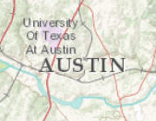
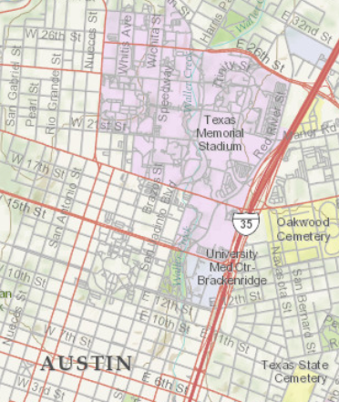
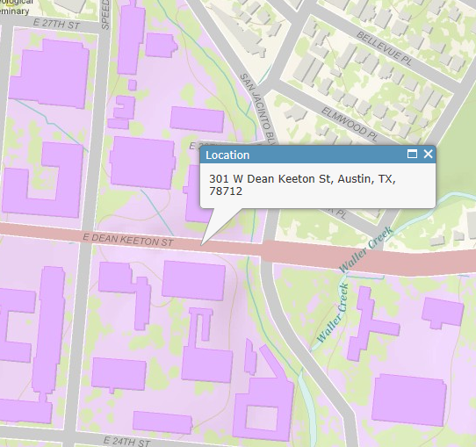
Geography is visualized in maps
map
www.arcgis.com

Slide 11
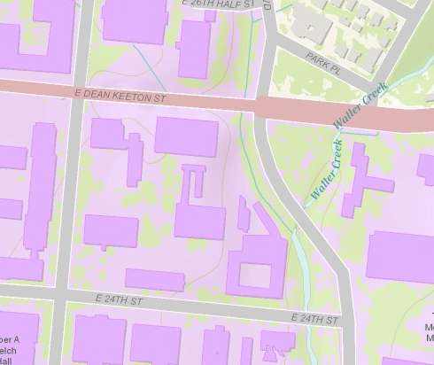
Maps are built from data
Road
Name: E. Dean Keeton St
Type: Div Highway
Speed: 35 mph
Shape: [Geometry]
Building
Name: Ernest Cockrell Jr Hall
Address: 301 E. Dean Keeton St
Shape: [Geometry]
data
Shape includes the geometry of the feature and where it is located on earth
map

Slide 12
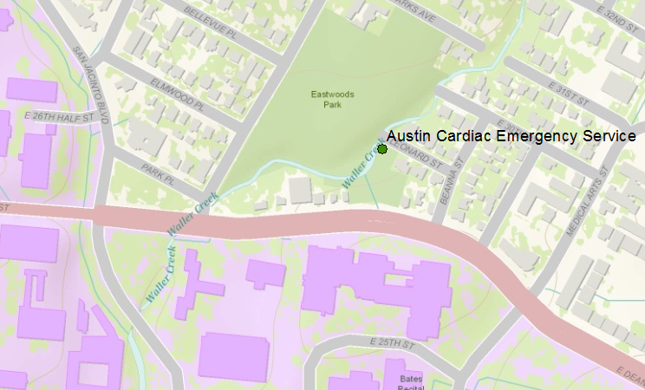
Vector data represent discrete features
points
lines
data
polygons
map

Slide 13
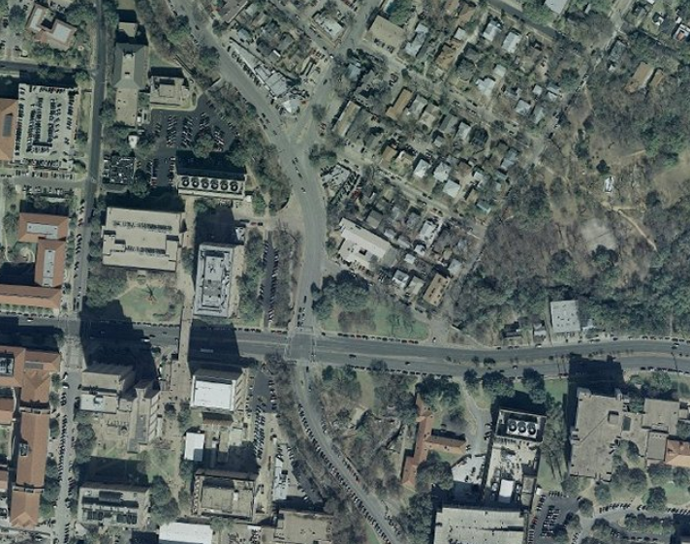
Raster data form a grid of cells or pixels
data
map

Slide 14
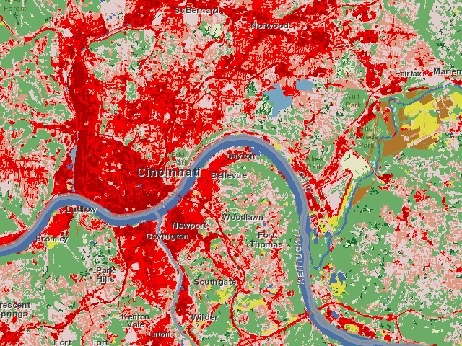
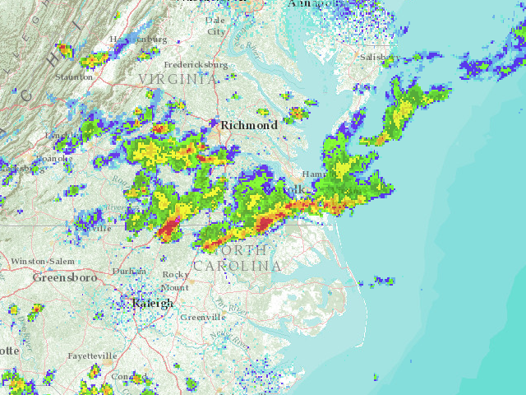
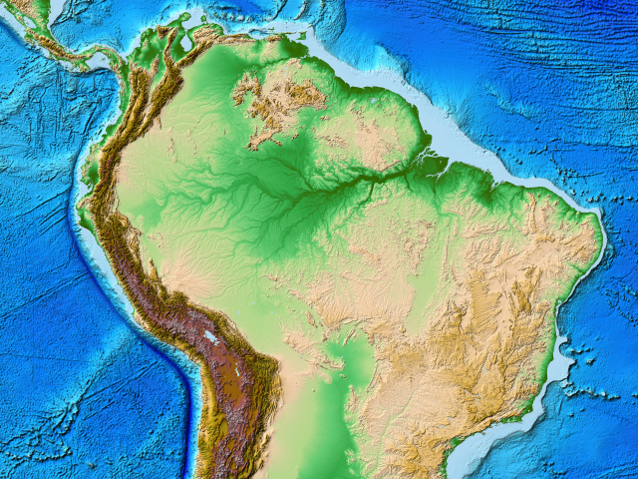
More Raster Examples
data
land use
rainfall
elevation
map

Slide 15
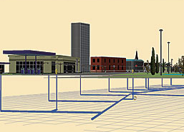
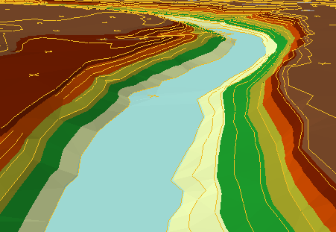
There are many more data types
multipatch
triangulated
irregular network
data
Martin Luther King Dr W
annotation
map

Slide 16
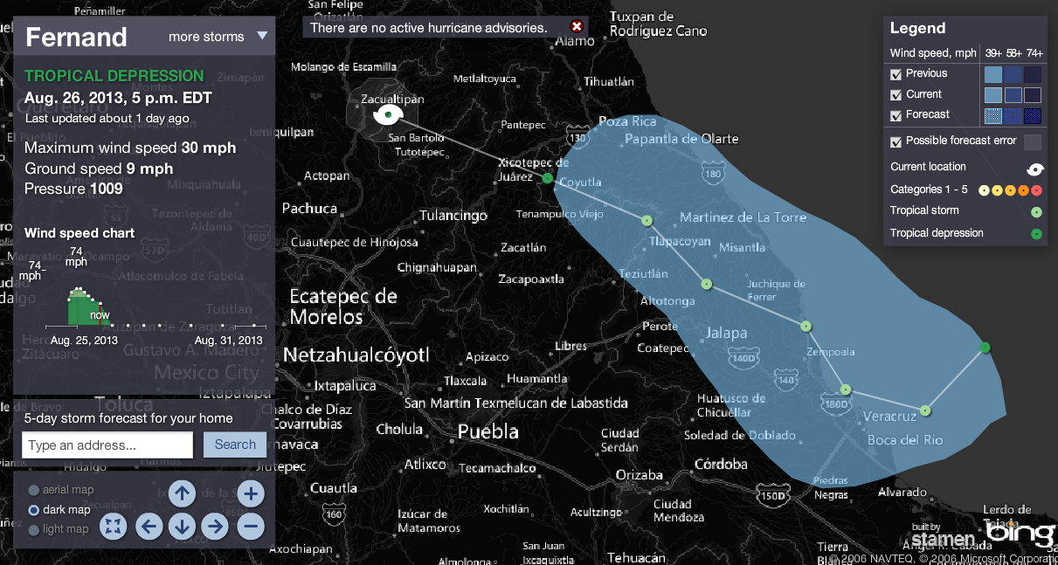
Connected Map, Chart and Animation
Tropical Storm Fernand
http://www.msnbc.msn.com/id/26295161/ns/weather/

Slide 17
Geographic Data Model
Conceptual Model – a set of concepts that describe a subject and allow reasoning about it
Mathematical Model – a conceptual model expressed in symbols and equations
Data Model – a conceptual model expressed in a data structure (e.g. ascii files, Excel tables, …..)
Geographic Data Model – a conceptual model for describing and reasoning about the world expressed in a GIS database

Slide 18
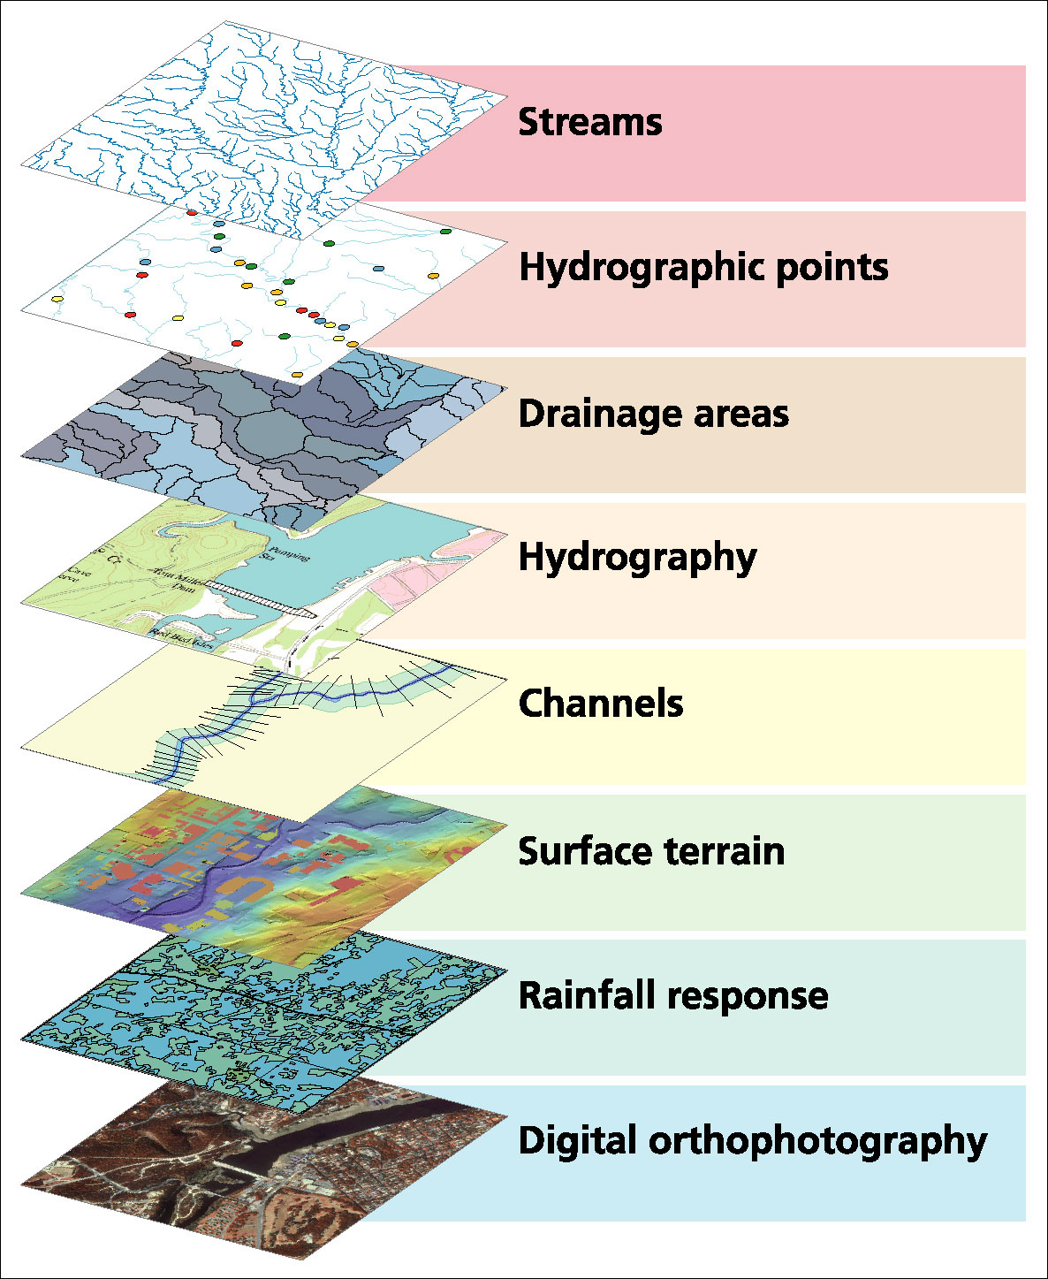
Data Model based on a collection of data themes

Slide 19
Spatial Data: Vector format
Vector data are defined spatially:
(x₁,y₁)
Point - a pair of x and y coordinates
vertex
Line - a sequence of points
Node
Polygon - a closed set of lines
Notes:
DRM

Slide 20
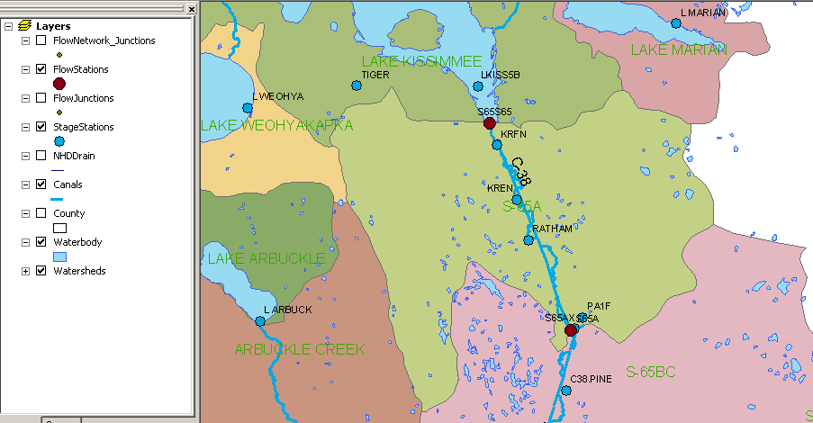
Kissimmee watershed, Florida
Themes

Slide 21
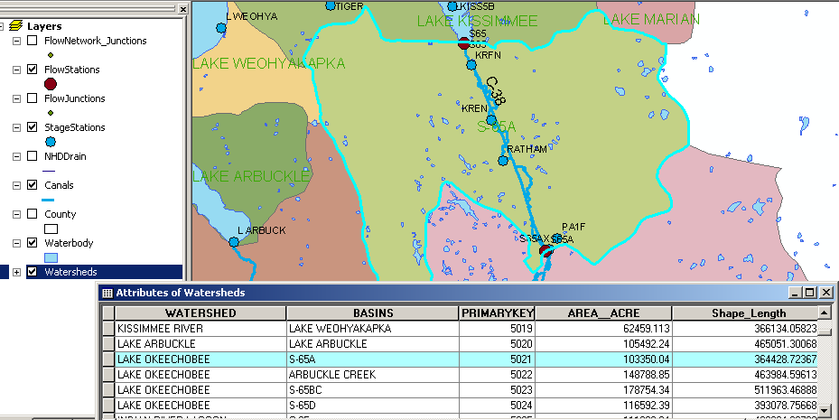
Attributes of a Selected Feature

Slide 22
Raster and Vector Data
Raster data are described by a cell grid, one value per cell
Vector
Raster
Point
Line
Zone of cells
Polygon
Notes:
DRM

Slide 23

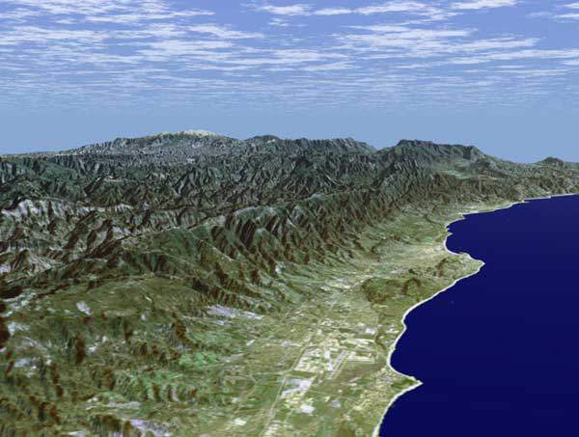
Santa Barbara, California
http://srtm.usgs.gov/srtmimagegallery/index.html

Slide 24
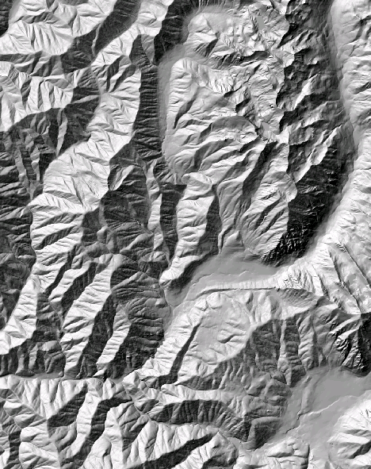
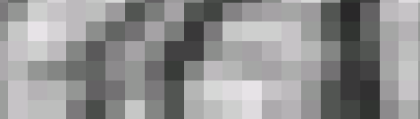
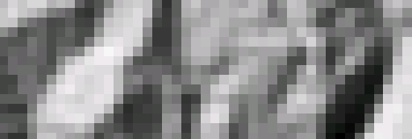
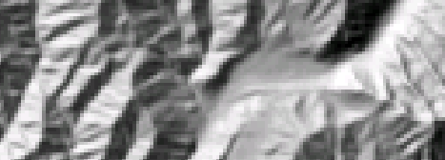
The challenge of increasing Digital Elevation Model (DEM) resolution (Dr Tarboton’s research)
1980’s DMA 90 m
10² cells/km²
1990’s USGS DEM 30 m
10³ cells/km²
2000’s NED 10-30 m
10⁴ cells/km²
2010’s LIDAR ~1 m
10⁶ cells/km²

Slide 25
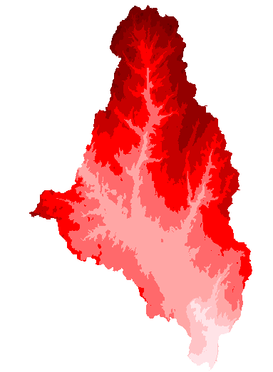
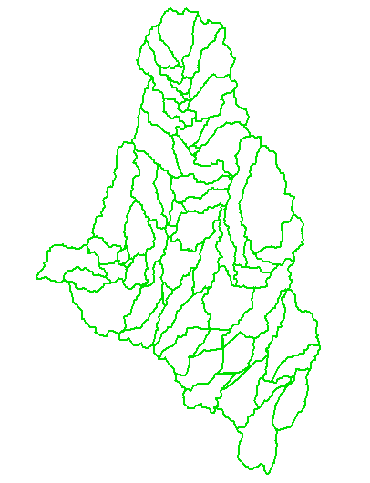
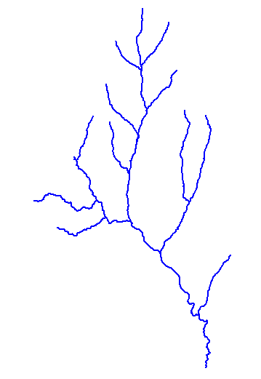
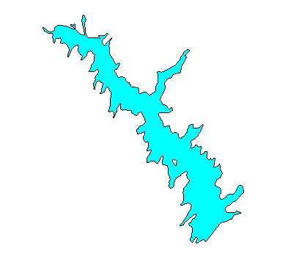
How do we combine these data?
Digital Elevation
Models
Watersheds
Streams
Waterbodies

Slide 26
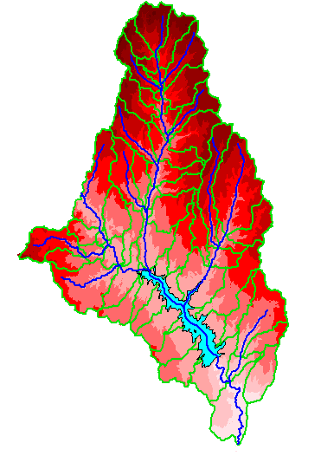
An integrated raster-vector database

Slide 27
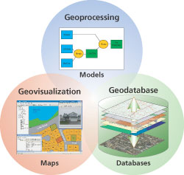
Three Views of GIS
Geodatabase view: Structured data sets that represent geographic information in terms of a generic GIS data model.
Geovisualization view: A GIS is a set of intelligent maps and other views that shows features and feature relationships on the earth's surface. "Windows into the database" to support queries, analysis, and editing of the information.
Geoprocessing view: Information transformation tools that derive new geographic data sets from existing data sets.
adapted from www.esri.com

Slide 28
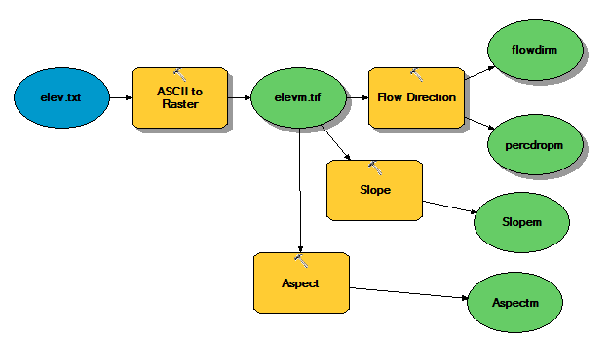
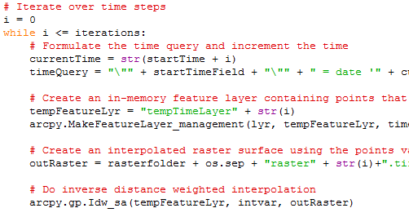
Programming
Automation of repetitive tasks (workflows)
Implementation of functionality not available (programming new behavior)

Slide 29
GIS in Water Resources: Lecture 1
In-class and distance learning
Geospatial database of hydrologic features
GIS and HIS
Curved earth and a flat map

Slide 30
Linking Geographic Information Systems and Water Resources
Water
Resources
GIS

Slide 31

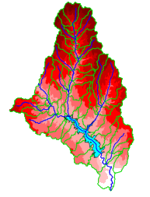
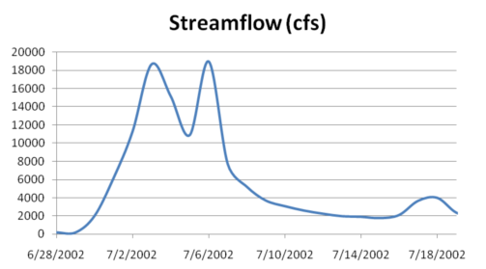

A Key Challenge
How to connect water environment with water observations
GIS
Water Environment
(Watersheds, streams,
gages, sampling points)
Time Series Data
Water Observations
(Flow, water level
concentration)

Slide 32

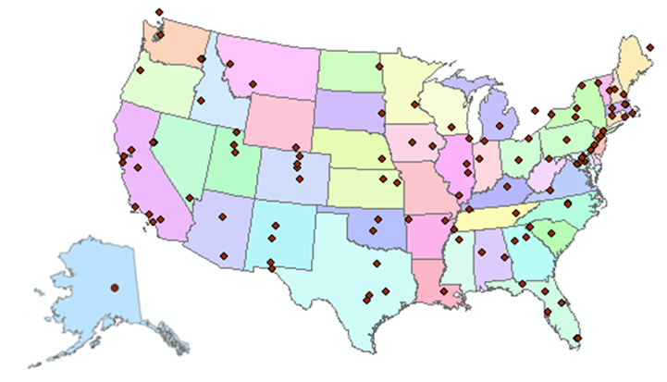
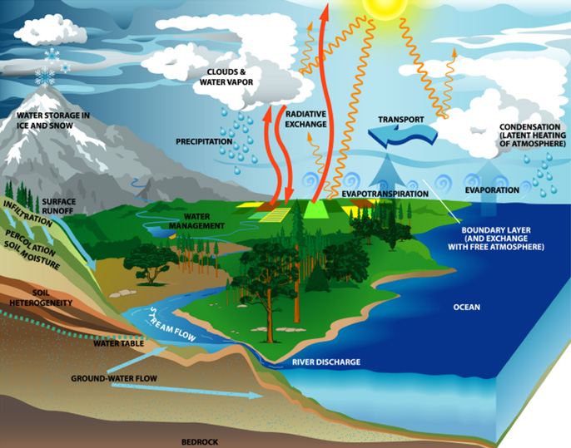
http://www.cuahsi.org
CUAHSI is a consortium representing 125 US universities
Supported by the National Science Foundation Earth Science Division
Advances hydrologic science in nation’s universities
Includes a Hydrologic Information System project

Slide 33
How the web works
Catalog
(Google)
Catalog harvest
Search
Web Server
(CNN.com)
Access
Browser
(Firefox)
HTML – web language for text and pictures

Slide 34
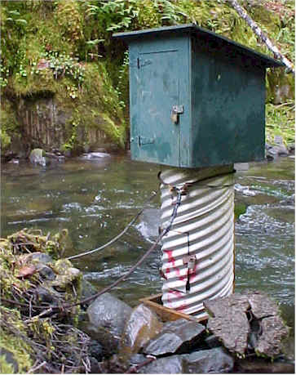
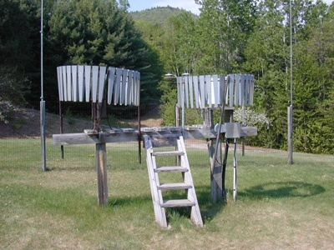
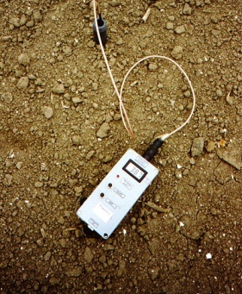
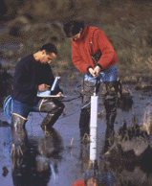
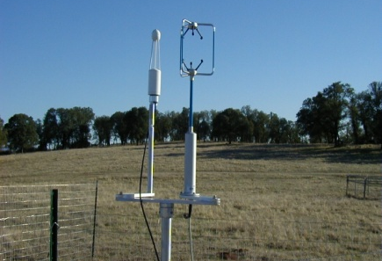
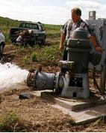
We Collect Lots of Water Data
Water quantity
Rainfall
Soil water
Water quality
Meteorology
Groundwater

Slide 35
The Data have a Common Structure
A point location in space
A series of values in time
Gaging – regular time series
Sampling – irregular time series
Notes:
These data are recorded over time to monitor a hydrologic process or property.

Slide 36
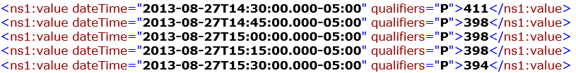
WaterML as a Web Language for Colorado River at Austin
I accessed this WaterML service from USGS at 4:06PM
http://waterservices.usgs.gov/nwis/iv?sites=08158000&period=P17D&parameterCd=00060
and got back these flow data from USGS which are up to 3:30PM
USGS has real-time WaterML services for about 11,000 sites available 24/7/365
http://waterservices.usgs.gov/nwis/iv?sites=08158000&period=P1D&parameterCd=00060

Slide 37
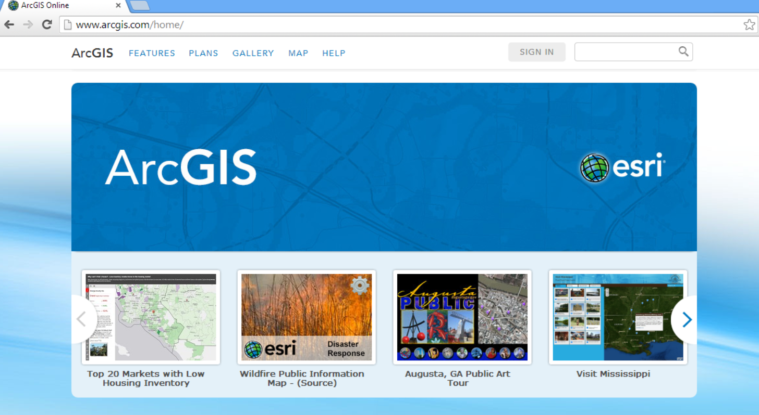
ArcGIS Online
GIS on the web – online map services
http://www.arcgis.com

Slide 38
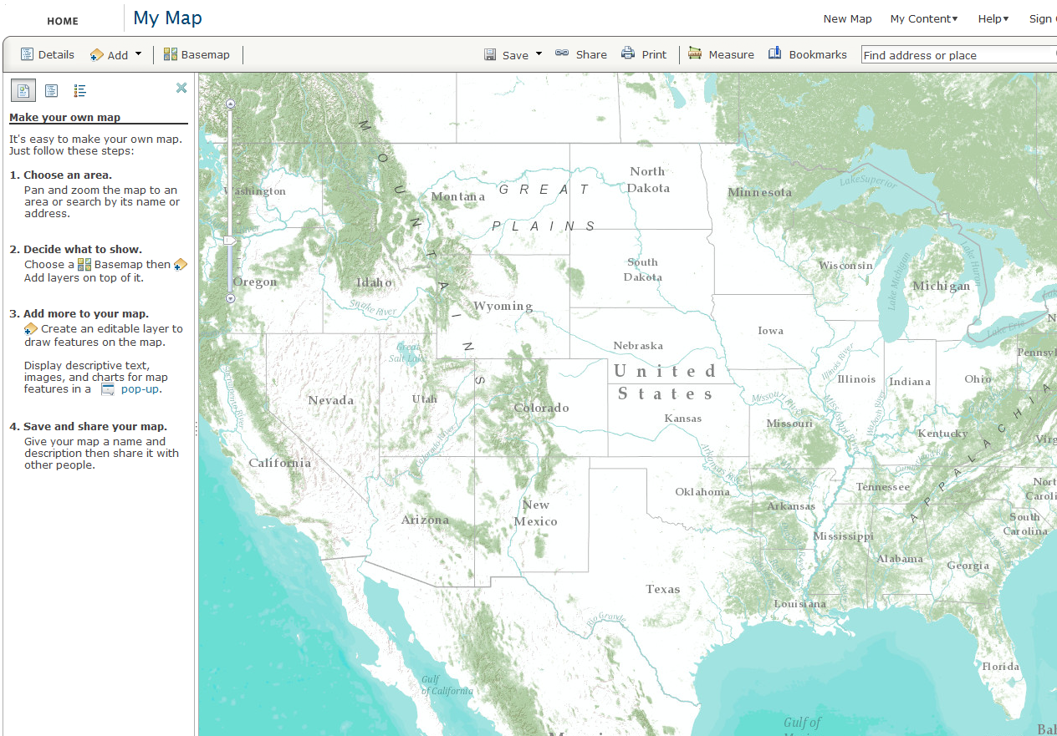
Online Base Maps (20 scales)

Slide 39
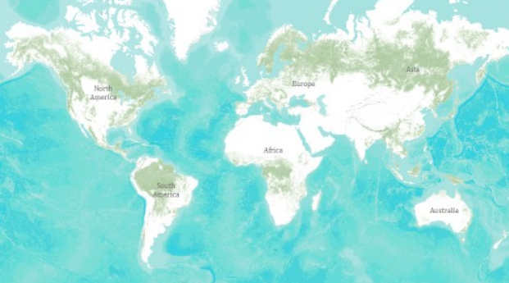
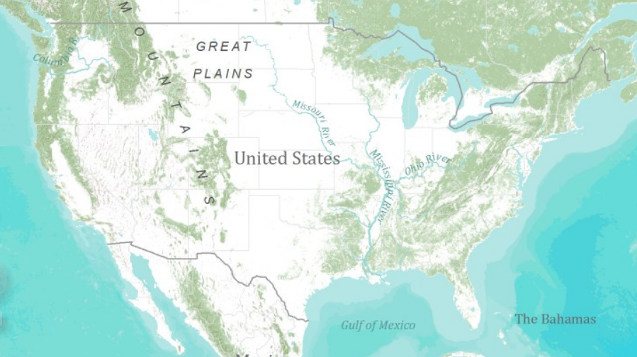
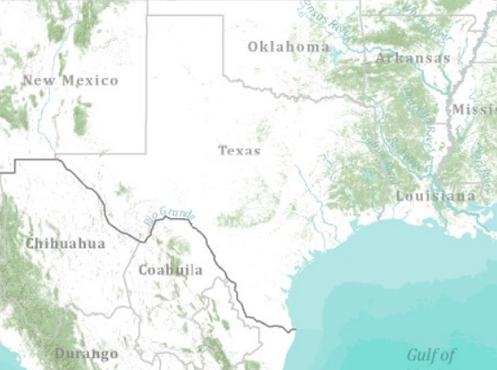
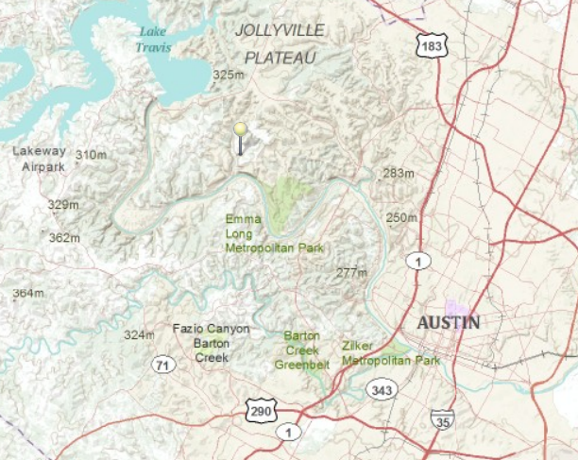
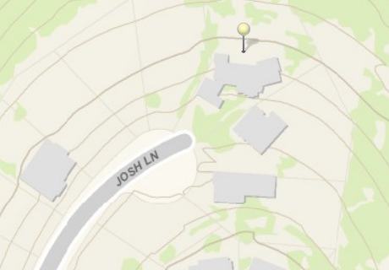
Topographic Base Map in ArcGIS Online
World
United States
Texas
Austin
Home

Slide 40
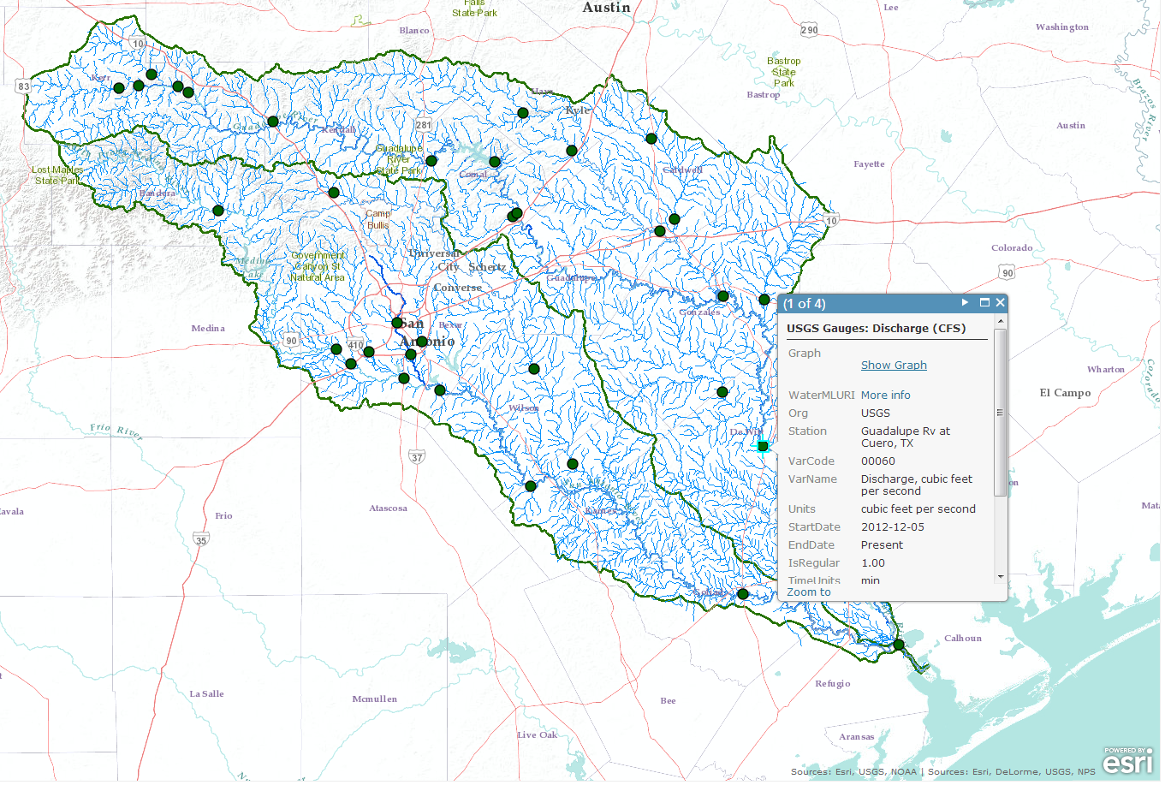
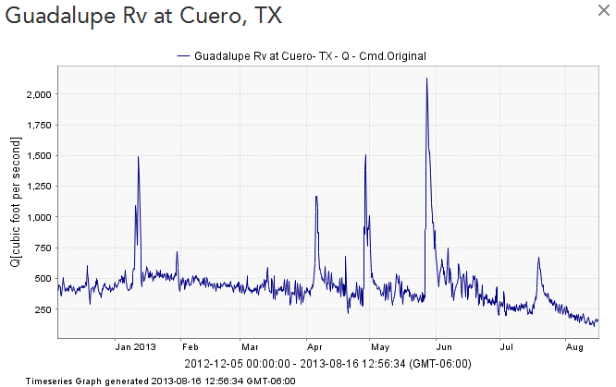
Map and Data Services for USGS Water Observations
Map Service
Data Service
ArcGIS Online Map
http://bit.ly/13KKQyi

Slide 41

ArcGIS Resources
http://resources.arcgis.com/

Slide 42

Hydro Resource Center
http://resources.arcgis.com/en/communities/hydro/

Slide 43





World Hydro Overlay Map
World
United States
Texas
My Home
My Stream

Slide 44





HydroShare is a web based collaborative system to support analysis, modeling and data publication
Collaboration
Analysis
Observers and instruments
Data
Models
Publication, Archival, Curation
Notes:
HydroShare will be a collaborative environment for sharing hydrologic data and models aimed at giving hydrologists the technology infrastructure they need to address critical issues related to water quantity, quality, accessibility, and management.
HydroShare will expand the data sharing capability of the CUAHSI Hydrologic Information System by broadening the classes of data accommodated, expanding capability to include the sharing of models and model components, and taking advantage of emerging social media functionality to enhance information about and collaboration around hydrologic data and models.
Functionality will include
A web portal for model and data sharing
Sharing features added to HydroDesktop client software
Access to more types of hydrologic data using standards compliant data formats and interfaces
Enhanced catalog functionality that broadens discovery functionality to different data types and models
New model sharing and discovery functionality
Enhanced easy to use access to high performance computing
Social media and collaboration functionality
Linkages to other data and modeling systems such as USGS and CUAHSI data services, NASA earth exchange and HPC resources e.g. at CSDMS

Slide 45
GIS in Water Resources: Lecture 1
In-class and distance learning
Geospatial database of hydrologic features
GIS and HIS
Curved earth and a flat map

Slide 46

Origin of Geographic Coordinates
Equator
(0,0)
Prime Meridian

Slide 47
Latitude and Longitude
Longitude line (Meridian)
N
W
E
S
Range: 180ºW - 0º - 180ºE
Latitude line (Parallel)
N
W
E
S
(0ºN, 0ºE)
Equator, Prime Meridian
Range: 90ºS - 0º - 90ºN

Slide 48

Latitude and Longitude in North America
Austin:
Logan:
(30°18' 22" N, 97°45' 3" W)
60 N
30 N
(41°44' 24" N, 111°50' 9" W)
120 W
60 W
90 W
0 N

Slide 49
Map Projection
Flat Map
Cartesian coordinates: x,y
(Easting & Northing)
Curved Earth
Geographic coordinates: φ, λ
(Latitude & Longitude)
Notes:
DRM

Slide 50


Earth to Globe to Map
Map Scale:
Map Projection:
Representative Fraction
Globe distance
Earth distance
Scale Factor
Map distance
Globe distance
=
=
(e.g. 1:24,000)
(e.g. 0.9996)

Slide 51
Coordinate Systems
A planar coordinate system is defined by a pair
of orthogonal (x,y) axes drawn through an origin
Y
Origin
X
(x_{o},y_{o})
(φ_{o},λ_{o})
Projected Coordinates
Geographic Coordinates

Slide 52

ArcGIS Help for Map Projections
http://resources.arcgis.com/en/help/main/10.2/#/What_are_map_projections/003r00000001000000/

Slide 53
Summary (1)
GIS in Water Resources is about empowerment through use of information technology – helping you to understand the world around you and to investigate problems of interest to you
This is an “open class” in every sense where we learn from one another as well as from the instructors

Slide 54
Summary (2)
GIS offers a structured information model for working with geospatial data that describe the “water environment” (watersheds, streams, lakes, land use, ….)
Water resources also needs observations and modeling to describe “the water” (discharge, water quality, water level, precipitation)

Slide 55
Summary (3)
Geography “brings things together” through georeferencing on the earth’s surface
Understanding geolocation on the earth and working with geospatial coordinate systems is fundamental to this field
GIS has traditionally been used on the desktop but increasingly there is a transition to information sharing on the web

