Slide 1
Water Data in Space and Time
David R. Maidment
GIS in Water Resources
Lecture 12, Fall 2013

Slide 2
Linking GIS and Water Resources
Water
Resources
GIS
Water Environment
(Watersheds, gages, streams)
Water Conditions
(Flow, head, concentration)

Slide 3

GEOSS and Water Science
David R. Maidment
Center for Research in Water Resources
University of Texas at Austin
Presented to GEOSS Future Products Workshop
Silver Spring, MD | 26 March 2013
Acknowledgements: David Arctur, Martina Bussettini, Cedric David, Amaree Israngkura,
Steve Kopp, Barbara Minsker, Matt Rodell, Fernando Salas, Jochen Schmidt, Bill Teng

Slide 4
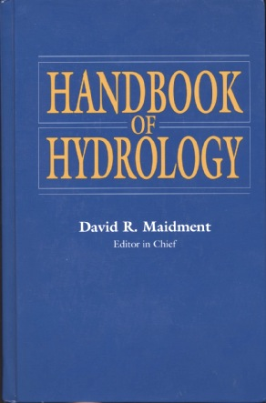
How is new knowledge discovered?
After completing a Handbook of Hydrology, I asked myself the question: how is new knowledge discovered in hydrology?
Deduction
from existing knowledge
By deduction from existing knowledge
By experiment in a laboratory
By observation of the natural environment
Experiment
in a laboratory
Observation
of the natural environment
Notes:
After completing a Handbook of Hydrology, I asked myself the question: how is new knowledge discovered in hydrology?
<Click> to show answers
By deduction from existing knowledge
By experiment in a laboratory
By observation of the natural environment

Slide 5

Deduction – Isaac Newton
“The ancients divided mechanics into two parts; the rational, which proceeds accurately by demonstration; and the practical.
It occurs that mechanics is so distinguished from geometry, that what is perfectly accurate is called geometrical, what is less so, is called mechanical. Yet the errors do not come from the art but from those who practice the art.
In this sense rational mechanics will be the science of motions resulting from any forces whatsoever, and of the forces required to produce any motions, accurately proposed and demonstrated.”
Isaac Newton
Trinity College, Cambridge
8 May, 1686

Slide 6
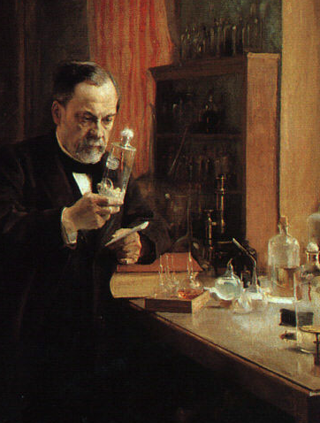
Experiment – Louis Pasteur
Experiment is the classical path of laboratory science – a simplified view of the natural world is replicated under controlled conditions
Pasteur showed that microorganisms cause disease and discovered vaccination
  a foundation of scientific medicine
Laboratory experiments are more for microscale than the macroscale
  hard to conduct at the global scale
Experiment – a simplified view of the natural world is replicated under controlled conditions
Pasteur showed that microorganisms cause disease and discovered vaccination
    a foundation of scientific medicine
Laboratory experiments are more for microscale than the macroscale
    hard to conduct at the global scale
Notes:
Experiment is the classical path of laboratory science – a simplified view of the natural world is replicated under controlled conditions
Pasteur showed that microorganisms cause disease and discovered vaccination
a foundation of scientific medicine
Laboratory experiments are more for microscale than the macroscale
hard to conduct at the global scale

Slide 7

Observation – Charles Darwin
“When on board H.M.S. Beagle, as naturalist, I was much struck with certain facts in the distribution of the inhabitants of South America, and in the geological relations of the present to the past inhabitants of that continent. These facts seemed to me to throw some light on the origin of species -- that mystery of mysteries, as it has been called by one of our greatest philosophers. On my return home, it occurred to me, in 1837, that something might perhaps be made out on this question by patiently accumulating and reflecting on all sorts of facts which could possibly have any bearing on it.
I can here give only the general conclusions at which I have arrived, with a few facts in illustration, but which, I hope, in most cases will suffice.”
Published 24 November,1859
Most accessible book of great
scientific imagination ever written

Slide 8
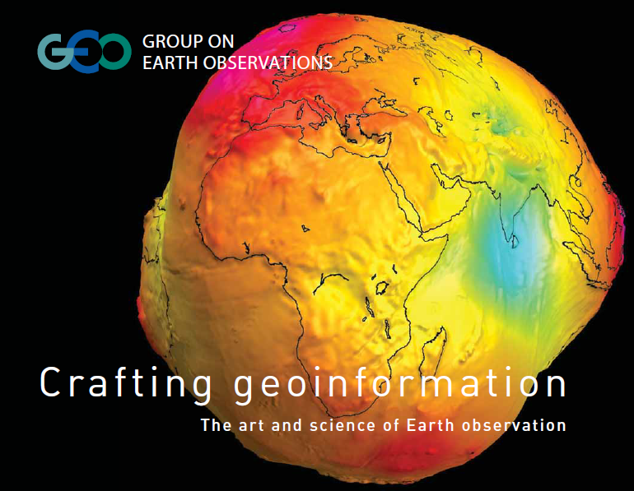
Observation – the heart of GEOSS
GRACE gravity anomaly map of the earth

Slide 9
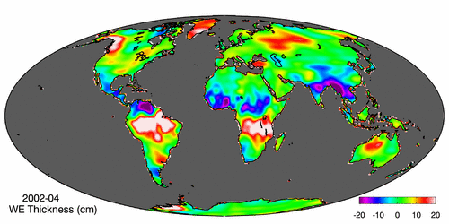
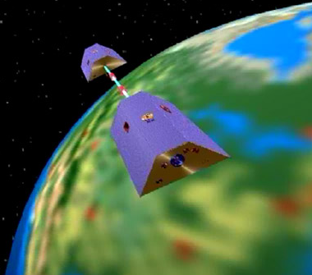
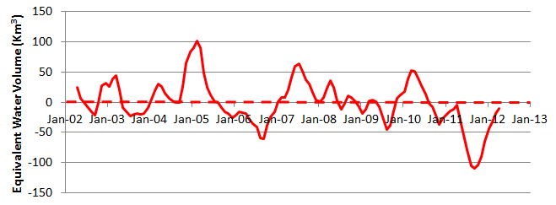
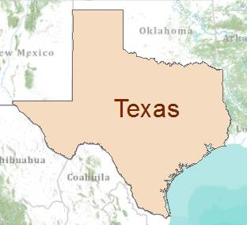
Water Observation – from satellites
Measuring the gravity anomaly (GRACE)
Normal
In 2011 Texas lost 100 Km³ of water
Global processes . . .
. . . Local consequences
Global processes . . .
. . . Local consequences

Slide 10
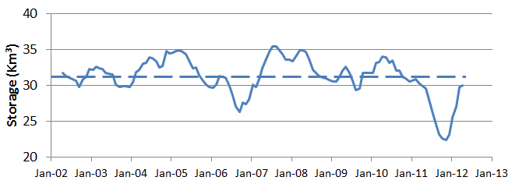
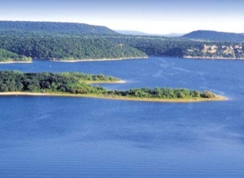
GRACE and Texas Reservoir Water Storage
GRACE
Normal
In 2011, Texas lost 100 Km³ of water overall
Surface Water
Reservoirs
Normal
In 2011, Texas lost 9 Km³ of water from reservoirs

Slide 11
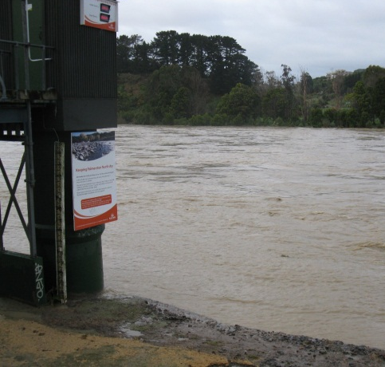
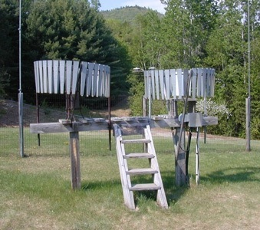
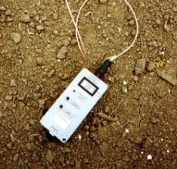
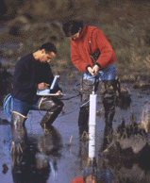
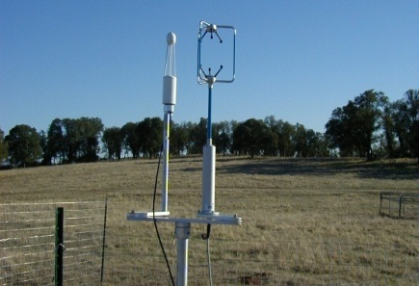
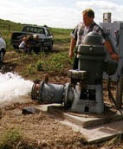
Water Observation – In Situ
Time series data at point locations
Water Quantity
Rainfall
Soil Water
Water Quality
Meteorology
Groundwater

Slide 12
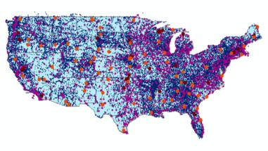

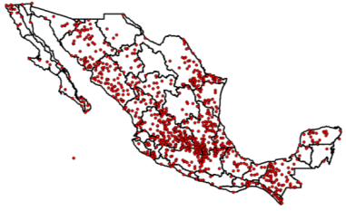
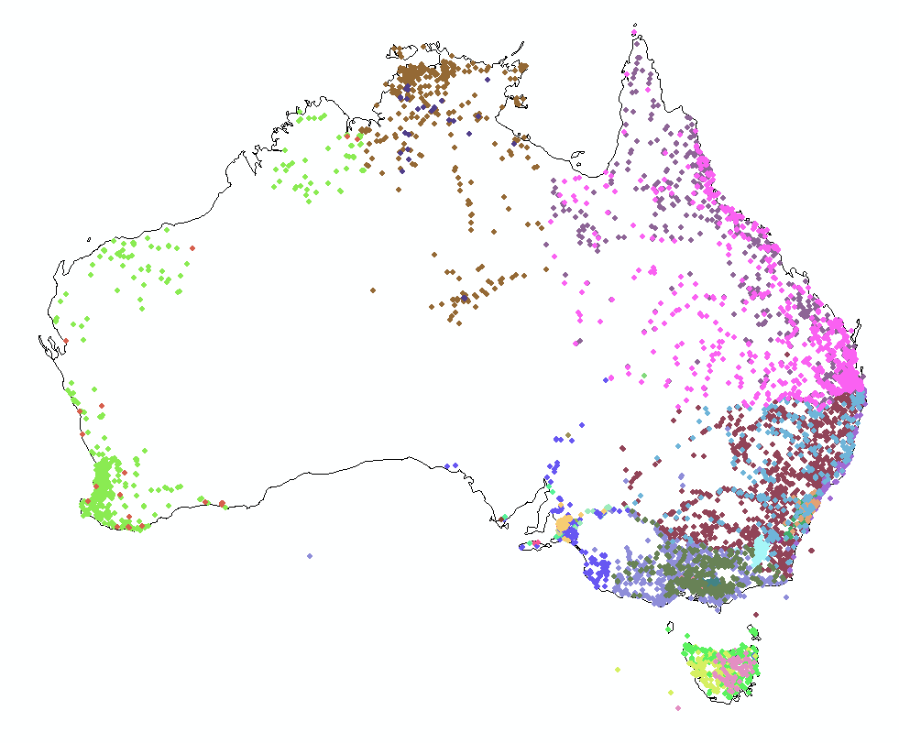
Every Country Collects These Data
We need
Global Water
Data Integration
United
States
Mexico
Australia

Slide 13
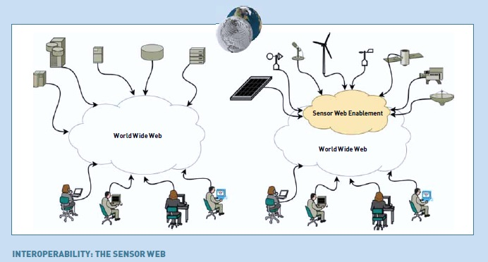
Observation in GEOSS – Sensor Web

Slide 14
Deduction in GEOSS – Model Web
Deduction
is the classical path of mathematical physics:
  Given a set of axioms
  Then by a logical process
  Derive a new principle or equation
Computer Modeling
is a modern equivalent that says:
  Given a set of input data
  Then using an algorithm
  Derive a computational result
Model Web
is interconnection on the internet of computer models and data: Model as a Service
Sensor Web and Model Web are important for the advancement of science

Slide 15

Connecting the Sensor Web and Model Web
Deduction
Observation
Model
Web
Sensor
Web
Contribution of GEOSS to Science

Slide 16


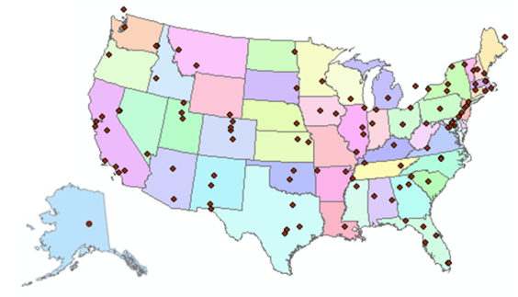
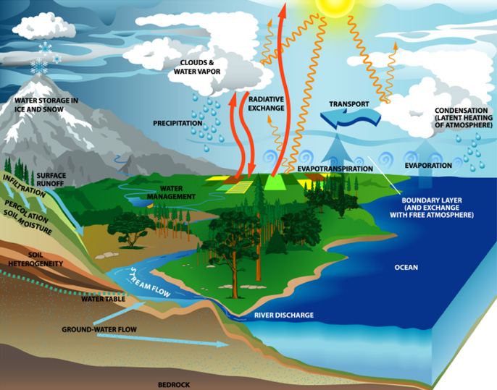
Consortium of Universities for the Advancement of Hydrologic Science, Inc.
www.cuahsi.org
CUAHSI
A consortium representing 125 US universities
Dr. Richard Hooper, President and CEO
Supported by the National Science Foundation Earth Science Division
Advances hydrologic science in nation’s universities
Includes a Hydrologic Information System project
Invented WaterML language for water resources time series
Building an academic prototype system

Slide 17
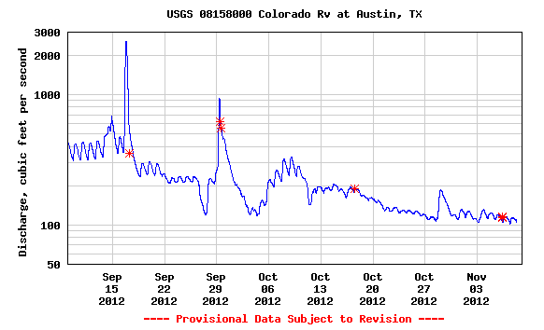

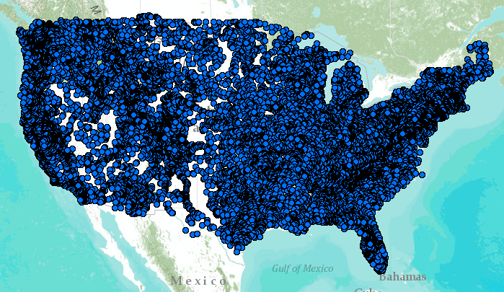
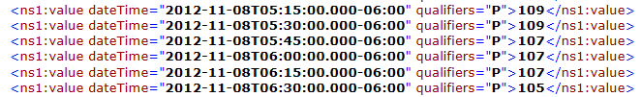
WaterML – the US Geological Survey
Water time series data on the internet
24/7/365 service
For daily and real-time data
. . . Operational water web services system for the United States
http://waterservices.usgs.gov/nwis/iv?sites=08158000&period=P1D&parameterCd=00060

Slide 18
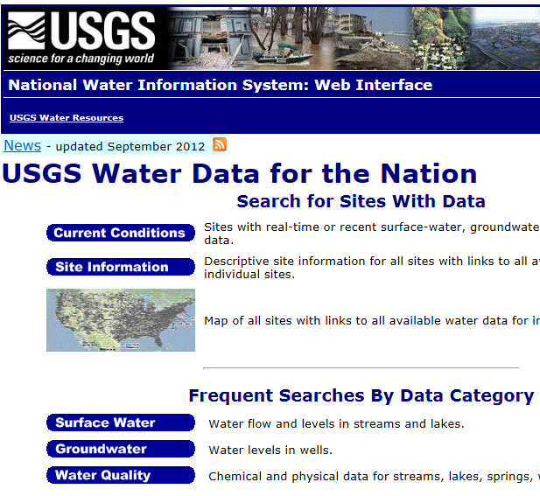
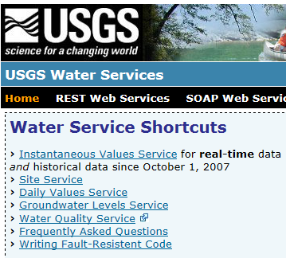
Web Pages and Web Services
Web pages deliver text and images
http://water.usgs.gov
Web services deliver data encoded in XML
http://waterservices.usgs.gov/

Slide 19

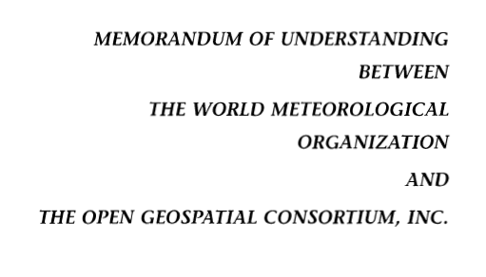
OGC/WMO Hydrology Domain Working Group
4-Year International Effort – WaterML
A time series for one variable at one location
Hydrology Domain Working Group formed
OGC observer at WMO Congress on Hydrology
Technical Meetings Each 3 Months
Four Interoperability Experiments
(Surface water, groundwater, forecasting)
Annual week-long workshops
Involvement by many countries
November 2009
Acknowledgements: OGC, WMO, GRDC, CUAHSI, BoM/CSIRO, USGS, GSC, Kisters, …….
2008
2009
2010
2011
2012
Notes:
(1) A four-year international effort has been undertaken to reconcile WaterML with international standards;
(2) This effort was initiated with the establishment of an Hydrology Domain Working Group by the Open Geospatial Consortium in September 2008;
(3) An OGC representative attended the WMO Congress of the Commission for Hydrology in 2008
(4) A formal agreement between Secretary General of WMO and President of OGC in 2009 to jointly develop standards for hydrology, climatology, oceanography and climatology;
(5) The joint OGC/WMO Hydrology Domain Working Group was supported by a large work effort, annual week-long workshops, four interoperability experiments for surface and groundwater data exchange, and participation by many countries;
(6) In June 2012, the OGC voted to adopt the revised version, WaterML2 as an international standard for exchange of water resources time series (the first such public standard that has existed);
(7) This Congress to the WMO Commission for Hydrology to whom I am speaking is considering WaterML2 for adoption as an official standard by WMO

Slide 20
GEOSS Water Services proposed for AIP- 6
GEOSS
WMO
Catalogs
Implementation
OGC
WMO
Standards
GIS
Water
Resources
Domains
Maps and time series . . .
. . . interoperability of connected systems

Slide 21

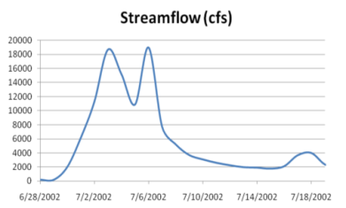
Web Services Stack
For Time Series
Catalog Service for the Web with standard metadata: ISO, FGDC, ANZLIC, Dublin Core
Who?
What?
Catalog (CSW)
Time Series Services
Where? When?
Metadata (WFS)
Data (WaterML2)
CSW = OGC Catalog Service for the Web
WFS = OGC Web Feature Service for Maps
Access
Data
Existing OGC Data Services are Adequate . . .
. . . Need to Be Customized for Water Information

Slide 22
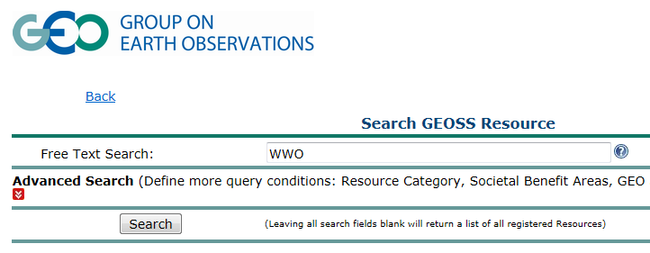
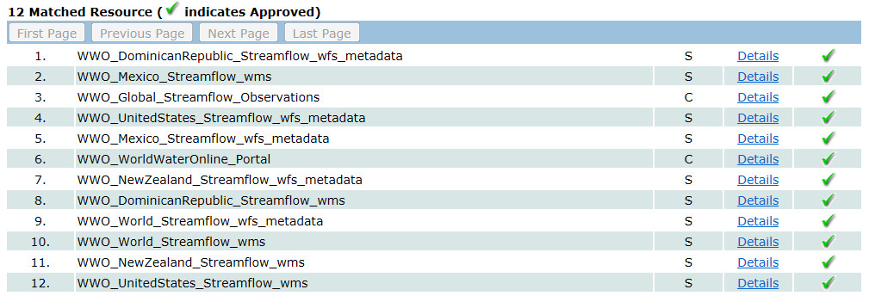
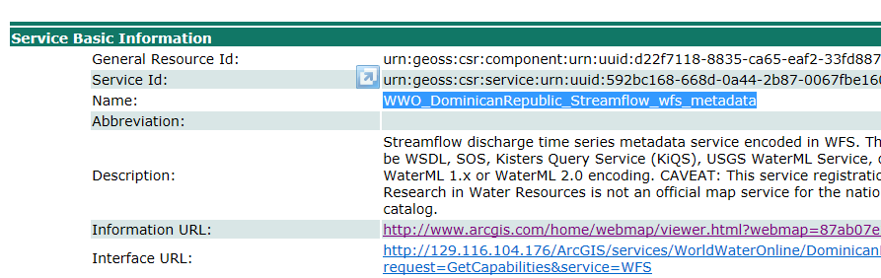
Searching GEOSS Portal
Search for water information
Find streamflow maps for countries
Streamflow map for the Dominican Republic
http://geossregistries.info/geosspub/resource_search_ns.jsp

Slide 23
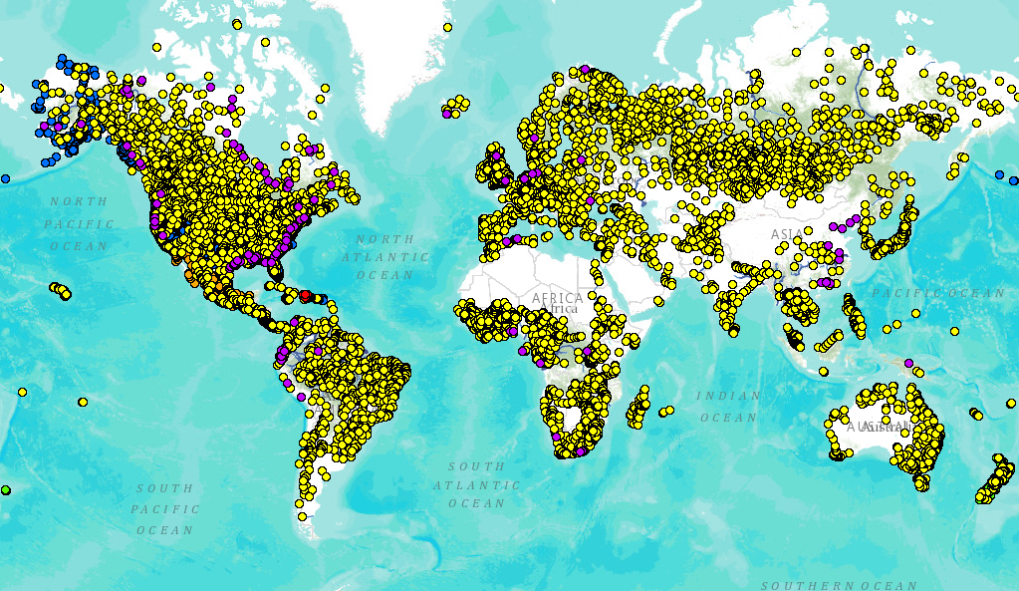
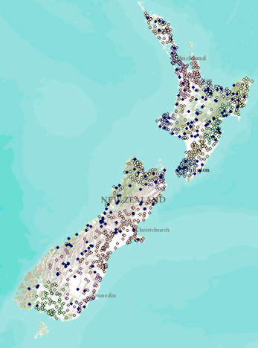
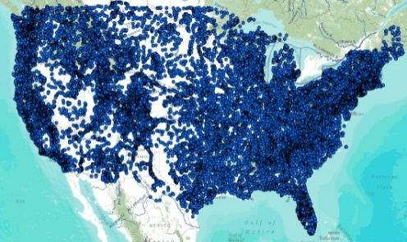
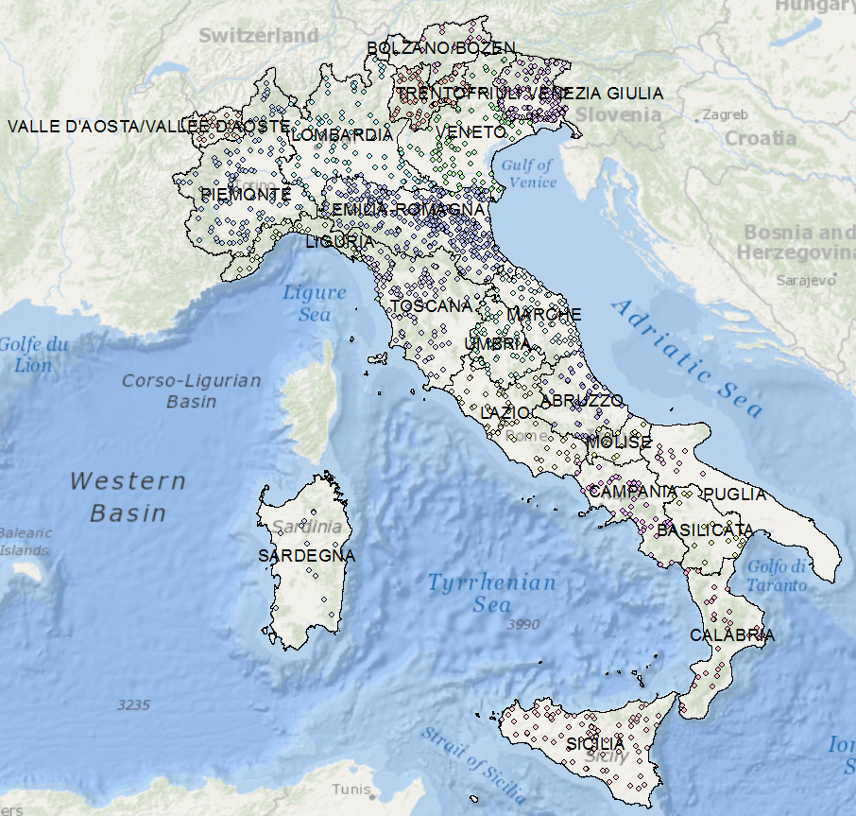
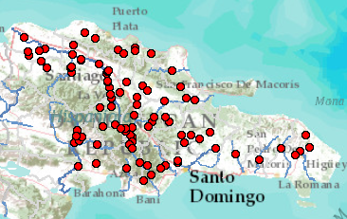
Global Streamflow Services
Global Runoff Data Centre
New Zealand
USA
Italy
Dominican Republic
Building a national system federating regions . . .
. . . builds a global system federating countries
http://www.arcgis.com/home/webmap/viewer.html?webmap=87ab07e2aba840828033e80b15fd6727

Slide 24

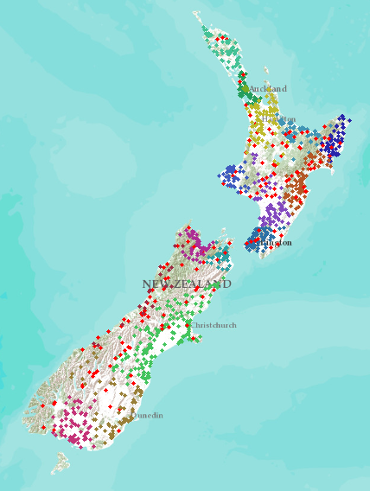
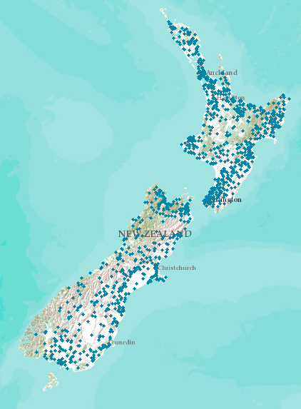
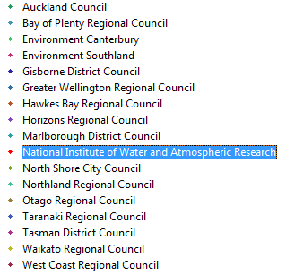
New Zealand – 16 regions
New Zealand Water Information System
NIWA operates about 20% of 1300 hydrometric stations
Regional authorities operate about 80% of stations.
Develop a federated hydrological information infrastructure . . .
. . . linking nationally and regionally collected data

Slide 25

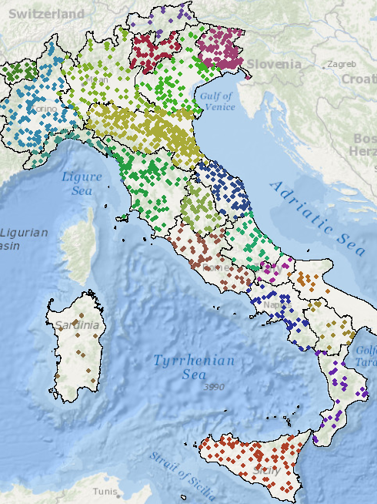
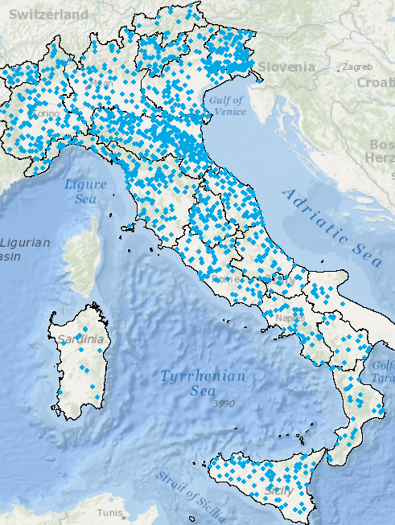
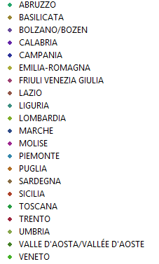
Italy – 21 regions
Italian Water Information System
National Institute for Environmental Protection and Research (ISPRA)
Regional authorities operate 100% of hydrometric stations
Linking observations data within countries. . .
. . . is same challenge as linking observations data between countries

Slide 26
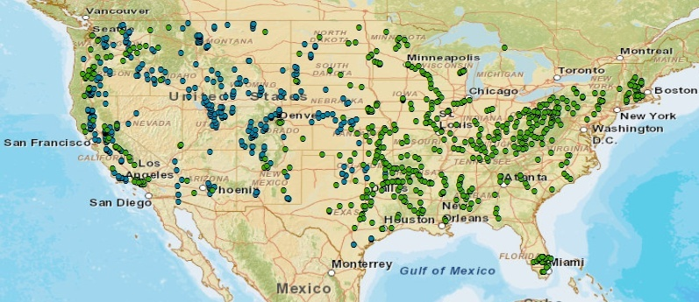

United States – surface water reservoirs
Information distributed across district and field offices
(608)
(348)
United States also needs a federated water information system. . .
. . . across water agencies and levels of government

Slide 27
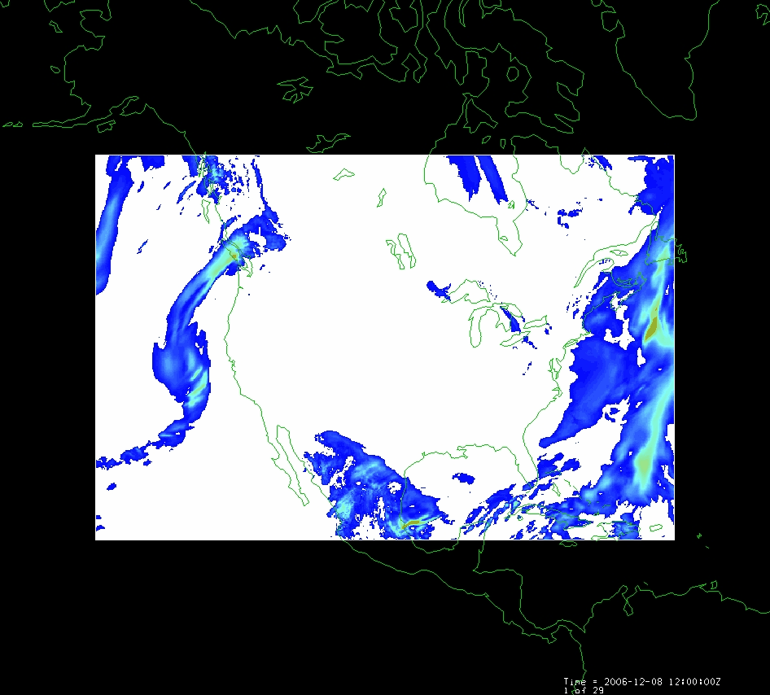

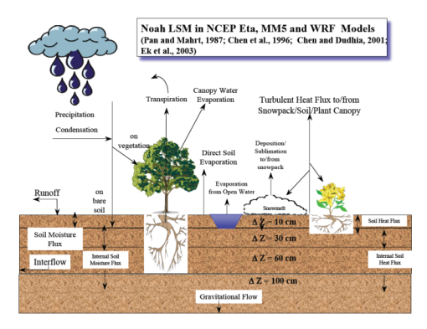
Land Data Assimilation System (LDAS)
Forcing:
Radiation
Precipitation
Surface climate
Evaporation
Soil Moisture
Runoff
Recharge
Observations Datasets, Numerical Weather Model
Soil
Vegetation
Terrain
1979 to present
Domain | Space | Time
North America | 1/8 degree | 1 hour
Global | 1/4 degree | 3 hours
Land Surface Model
Deduction:
Given these forcing and land surface conditions
Then, using a land surface simulation model
Derive surface moisture and energy balance

Slide 28
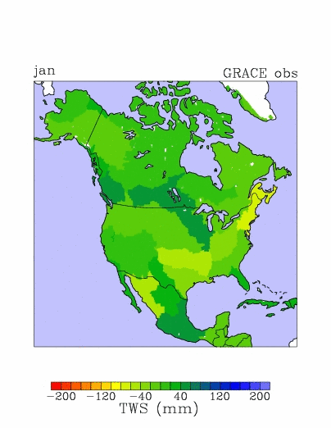
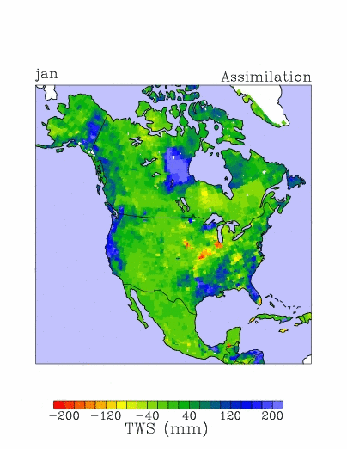
Total water storage in 2003
GRACE Observations
LDAS Assimilation
Updated from Zaitchik, Rodell, and Reichle, J. Hydromet., 2008.

Slide 29
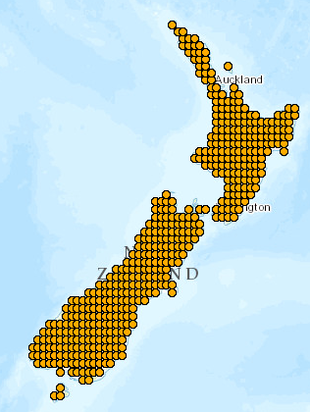
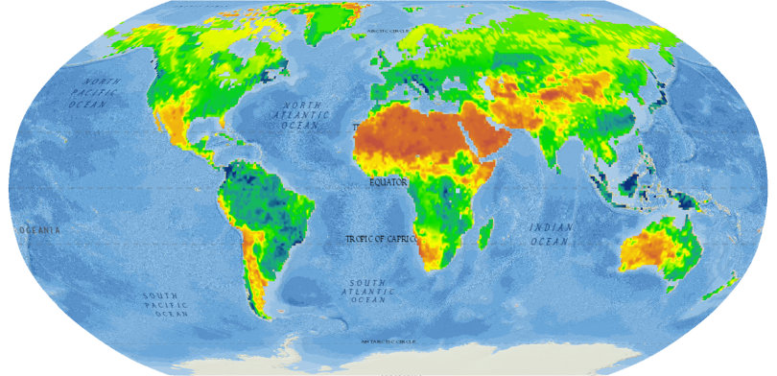
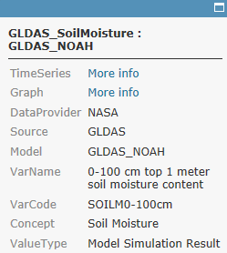


World Soil Moisture
from the NASA Global Land Data Assimilation System (GLDAS)
http://www.arcgis.com/home/webmap/viewer.html?webmap=7d6cefdf3f324b55b08c136654e91612
Charts show 3-hourly variation (37,000 values)
of soil water content of the top 1m of soil from 2000 to 2012
Popup on point links to data and chart
New Zealand
A very wet region with little seasonality
A dryer region with significant seasonality

Slide 30



River Flow – Model as a Service
Observations Datasets, Numerical Weather Model
Land Surface Model
RAPID River Flow Model
Automated workflow at Univ. of Illinois uses LDAS data from NASA to run river model at Univ. of Texas

Slide 31

Flow in the Mississippi River Basin
RAPID model, March-May 2008, 3 hour time steps
GIS data describes 1.2 million river reaches . . .
. . . simulate flow in each reach in each time step

Slide 32

Global Water Maps
Model
Web
Sensor
Web
Describe a water property over
a domain of space and time
    History
    Current conditions
    Forecasts
Water Property
Precipitation
Evaporation
Soil Moisture
Streamflow
Groundwater
Reservoirs
Past
Present
Future

Slide 33
Land Data Assimilation System (LDAS)
Forcing:
Radiation
Precipitation
Surface climate
Evaporation
Soil Moisture
Runoff
Recharge
Observations Datasets, Numerical Weather Model
Soil
Vegetation
Terrain
1979 to present
Domain | Space | Time
North America | 1/8 degree | 1 hour
Global | 1/4 degree | 3 hours
Land Surface Model
Deduction:
Given these forcing and land surface conditions
Then, using a land surface simulation model
Derive surface moisture and energy balance

Slide 34


LDAS “Data Rods” project
Time series at every point

Slide 35

Current Soil Moisture Conditions
Time series at every point

Slide 36


“Data Rods” for Texas
2012
2011
2010
April 25, 2013
Soil moisture
in top 1m of soil

Slide 37



GRACE and Texas Soil Water Storage
Soil water reservoir storage is closely correlated with the GRACE data
Grace Satellites
Normal
Texas had a 100 Km³ total water deficit
Soil Water in top 1m
Normal
and an 8.4 Km³ deficit in reservoir water storage
Of this 45 Km³ is in top 1 m of soil

Slide 38

Real-Time Water Operations
https://ut-austin.maps.arcgis.com/home/webmap/viewer.html?webmap=d107aa9260534ddbb96db302e3643a93

Slide 39


Map and Data Services for USGS Water Observations
Map Service
Data Service
ArcGIS Online Map
http://bit.ly/13KKQyi

Slide 40


Map and Data Services for TCEQ Water Diversions
Map Service
Data Service

Slide 41



Map and Data Services for NWS River Forecasts
Map Service
Data Service
Legend
NWS Subbasin Outlet Point

Slide 42

Transform NWS data from 47 forecast points to 5500 NHDPlus Catchments and River Reaches
Legend
NHDPlus Catchment
NWS Subbasin

Slide 43


Add in the TCEQ river diversions in each Catchment
Flow
Runoff
Diversion
Runoff
Flow

Slide 44


Map and Data Services for RAPID Water Flow Simulations
Map Service
Data Service
Model as a Service at University of Illinois (supported by MS Research)

Slide 45

Rapid River Flow Model (parallel computing, model as a service)
http://www.ucchm.org/david/rapid.htm

Slide 46

WISKI Time Series Data System (KISTERS)

Slide 47

Daily Workflow

Slide 48

Water Operations Model

Slide 49
Conclusions
GIS is concerned with spatial information, largely static in time
Water resources is concerned with the condition of the natural waters of the earth, continually varying in time
Need to be concerned with observations (sensor web) and with modeling (model web)
Spatial domain can be continuous or discrete

