Slide 1
The effects of dissolved oxygen, pH, and light attenuation on seagrass distributions along the Texas Coastal Bend
Meaghan Cuddy
GIS in Water Resources
Fall 2015
10 Nov. 2015

Slide 2
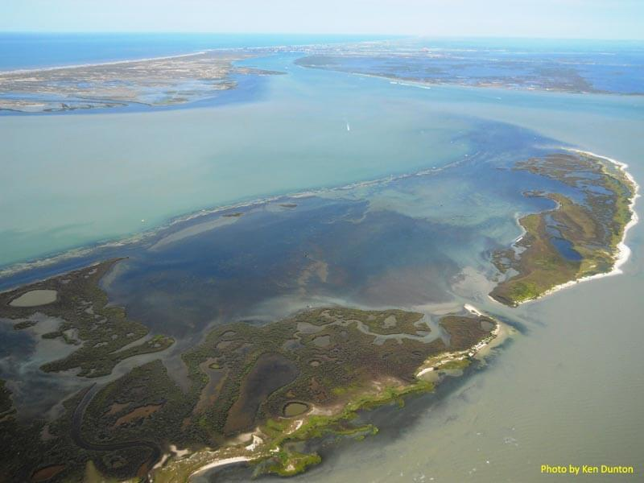
Seagrass meadows, East Flats, Mustang Island TX
Notes:
Seagrass distribution in TX – 230,000 acres
Importance of seagrasses as ecosystem engineers, habitat for juvenile fish, invertebrates
Food source for marine mammals like manatees, sea turtles, a variety of fish
Water filtration, wave attenuation, sediment stabilization
Incredibly productive and valuable, but threatened by pollution, nutrient loading, and physical disturbance (prop scars, dredging)

Slide 3
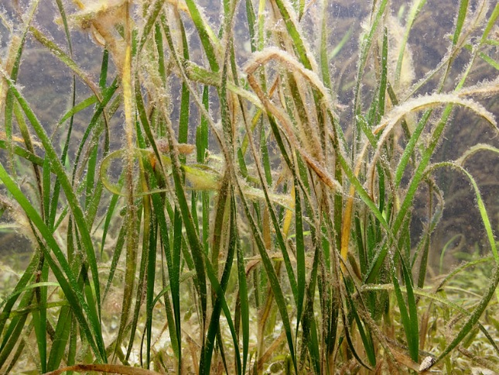
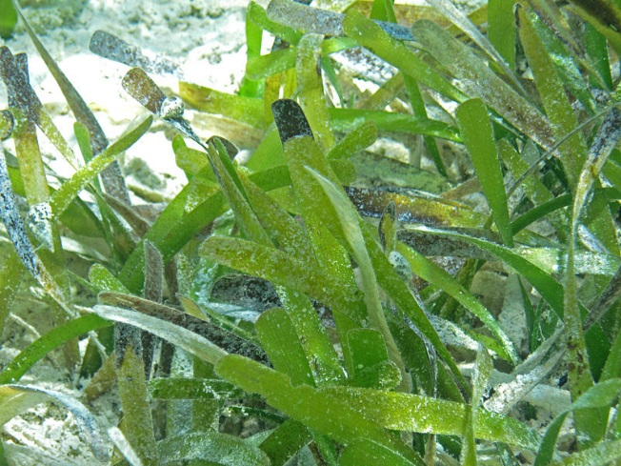
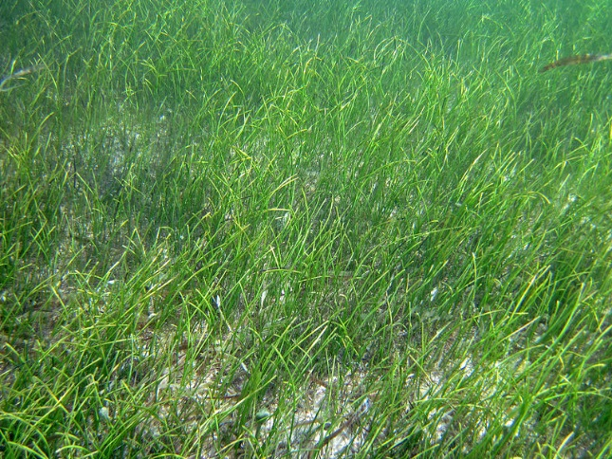
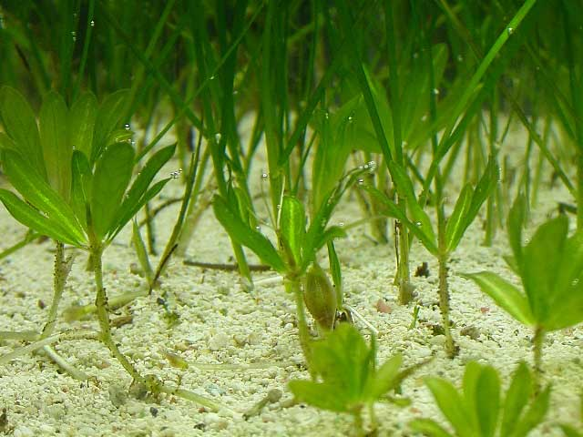
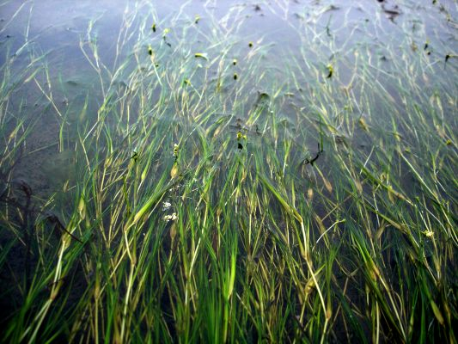
Haldule wrightii
Thalassia testudinum
Halophila engelmannii
Ruppia maritima
Syringodium filiforme
Photos: Wiki Commons, ian.iamces.edu, reefkeeping.com
Notes:
Five species in TX

Slide 4
Questions
How do water quality parameters affect seagrass species distributions?
Does human proximity have an effect on pH, dissolved oxygen levels, and other water quality parameters, and thus an indirect effect on seagrasses beds?
How do seagrass species distributions change over time?

Slide 5
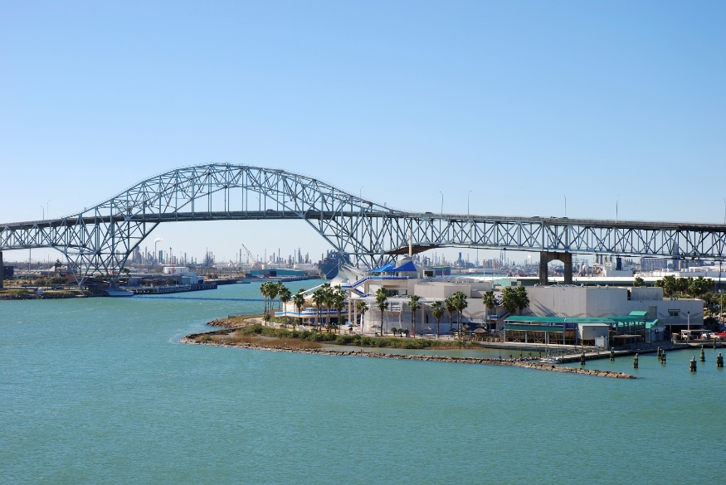
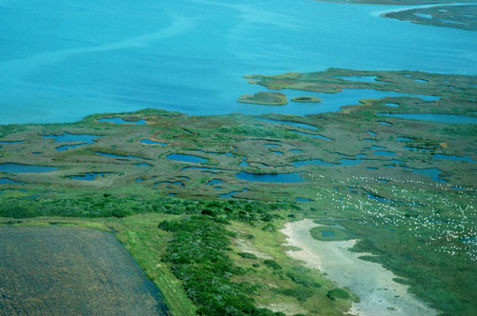
Corpus Christi Bay
Heavily populated coastline
Significant boat and automobile traffic
N=81
Mission Aransas NERR
Protected area designated for research and education
Significantly reduced public impact
N=57
Photos: utexas.edu, pbase.com
Notes:
Both part of the Texas Seagrass monitoring program
Comparison – MANERR (protected area with reduced human influence) vs. Corpus Christi Bay (heavily populated coast, significant amount of traffic, industry, etc)
NERR = shallower, more turbid

Slide 6
Parameters of Interest
Water Quality Parameters
Dissolved Oxygen (%)
Seagrass Characteristics
Percent Cover
Species Distribution
pH
Light attenuation

Slide 7
Methods
Rapid assessment sampling 2011-2015
Add XY data for sampling sites (established using tessellated hexagons, general coverage determined by NOAA field surveys)
Average field measurements of dissolved oxygen (%), pH, salinity, and light attenuation from 2011-2014
Summarize % cover and species distributions from 2011-2014
Add table to ArcMap, join with sampling site layer
TO DO: Interpolation (Thiessen polygons, Bayesian Kriging)

Slide 8
Notes:
Imported XY data to lay out sites of interest – color coded for two different regions

Slide 9
Corpus Christi
Bay
Mission Aransas NERR
µ = 108.27, SD = 22.85
µ = 118.9, SD = 26.24
Notes:
P-value = 0.013
F stat = 6.401
Significant difference between DO in CCB and NERR – lower in CCB
Clustering of low DO values around roadways

Slide 10
Corpus Christi
Bay
Mission Aransas NERR
µ = 8.13, SD = 0.19
µ = 8.15, SD = 0.18
Notes:
PH regular across areas – p value = 0.535, f stat = 0.387

Slide 11
Corpus Christi
Bay
Mission Aransas NERR
µ = 68.19, SD = 30.03
µ = 76.55, SD = 17.14
Notes:
P cover fairly consistent across CCB and NERR – some isolated areas of low cover more inland (in NERR: Copano Bay, in CCB: beyond the bay bridge towards ULM)
ANOVA p-value = 0.059, F stat = 3.614

Slide 12
Species Distribution
Notes:
Haldoule dominates east side of bay closer to the Gulf – the most salt-tolerant out of the top three
Thalassia and a Hw/Tt mix more common in the NERR – thalassia able to handle a more impacted area (large leaves, longer)
Syringdoium prominent in the southernmost area of CCB - salinity or temperature data? Hasn’t been mapped yet but NERR is shallow/turbid

Slide 13
Next steps
Addition of light attenuation and salinity data
Interaction between DO, light attenuation, and pH data
  Synergistic, antagonistic, additive effects?
Interpolation
Questions/Adjustments:
  Temporal in addition to spatial analysis
  Interpolation method
  Time series to account for variation in DO data

Slide 14
Provisional conclusions
Percent cover appears consistent throughout study area and relatively unaffected by DO and pH
Species varies spatially along the coast and within the two sampling zones
Proximity to roadways and shorelines may have a negative effect on water quality parameters
Thalassia dominates in areas of low oxygen
Halodule dominant overall, and preferentially settles the eastern edge of the bays –related to its high salt tolerance?

Slide 15
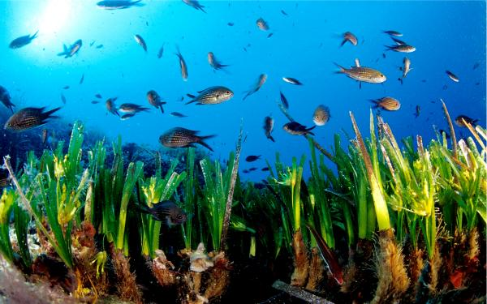
Questions?

