Slide 1
Examination of high pulse flows duration in Neches Basin
Presenter: Runnan Li
Instructor: Dr. Maidment

Slide 2
Environmental flows and high pulse flow
A certain level of flow is necessary to maintain healthy stream ecology
A collection of varying flow requirements is called “environmental flows”.
High pulse flow is one category of environmental flows.

Slide 3
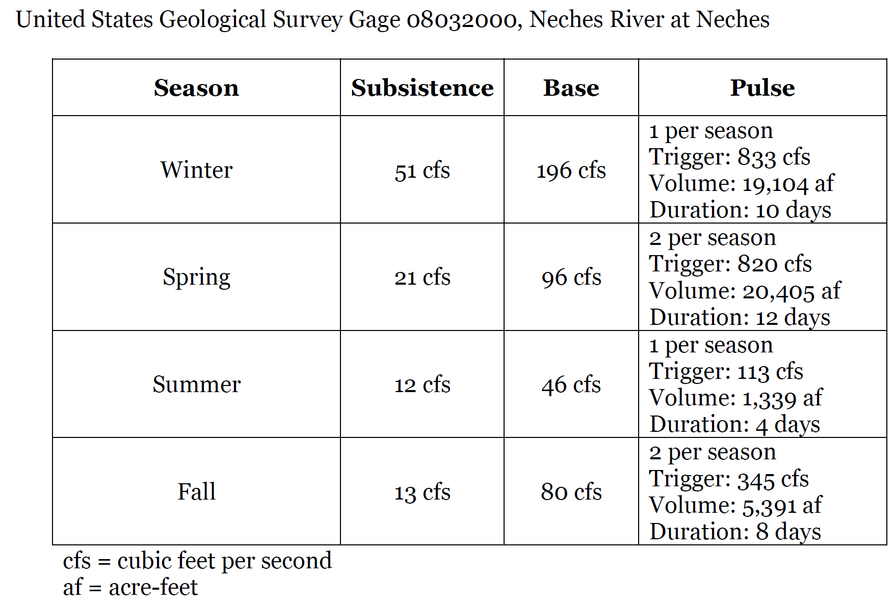
Example of Environmental Flow Standards at One Gage

Slide 4
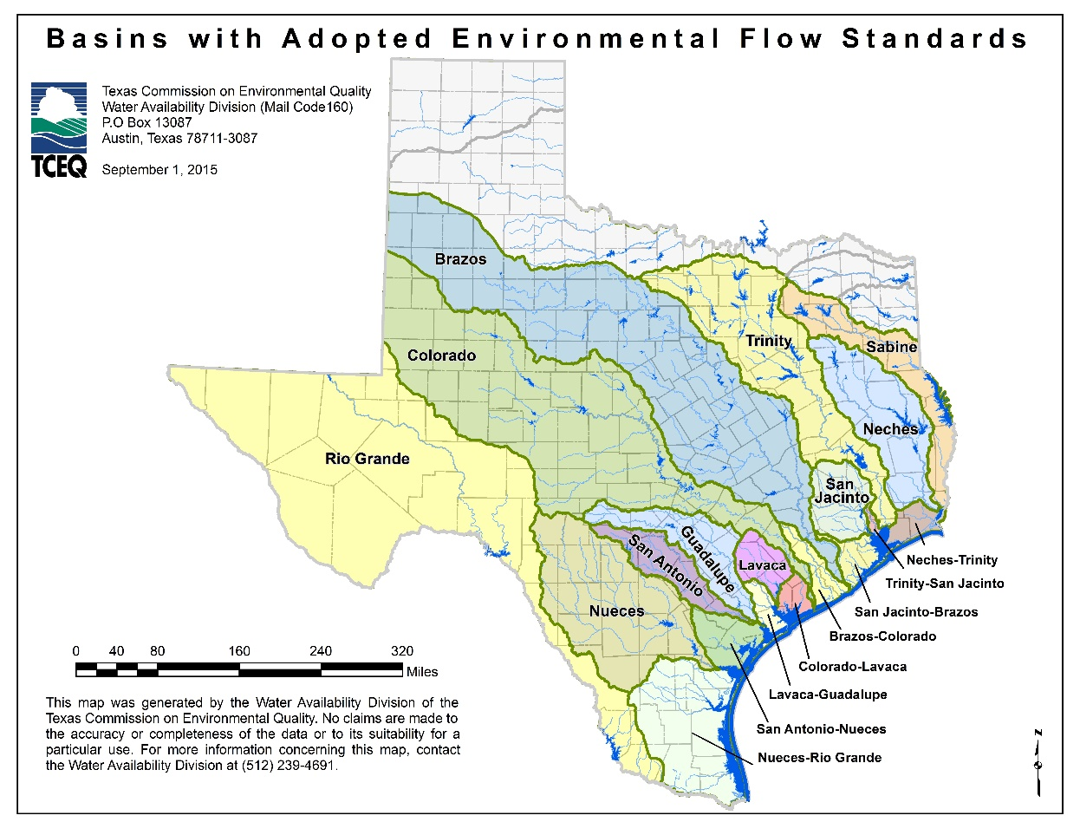

Slide 5
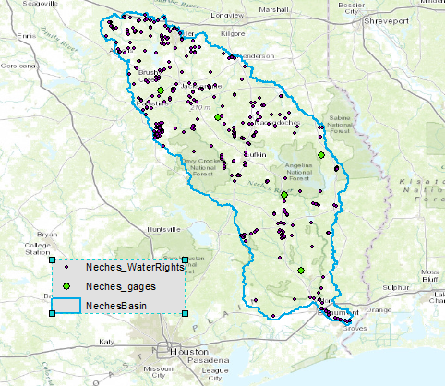
Map of Regulated Gages and TCEQ Water Right Points
Notes:
But take Neches Basin as an example, there are only five gages with standards written, but the water right points where people divert water are much more than that.
For decision makers, when taking environmental flows into account, Certain flow characteristics written in the regulations need to be converted to those unregulated water diversion locations.

Slide 6
Transposing pulse flow characteristics
A pulse scaling method works well within basins
The method does not succeed when points are in different basins.
Duration predictions are much more successful than the trigger flow or volume predictions

Slide 7
Objectives
Project the instream runoff in Neches Basin at a series of time steps in ArcGIS (https://www.youtube.com/watch?v=cctC_Y0W3d8)
Discuss the difference in the flow rate changing of main streams in different sub-basins.
Generate hydrograph for selected points
Compare the duration of certain flow rate magnitude
*video accessed from http://rapid-hub.org/animations.html

Slide 8
Data
NFIE real-time forecasting instream discharge of Memorial Weekends flooding (RAPID)
(starting from 2015.05.24 13:00,14 one-hour time steps)
NHDPlus: flowlines, watershed delineation
TCEQ environmental flow rules reports

Slide 9
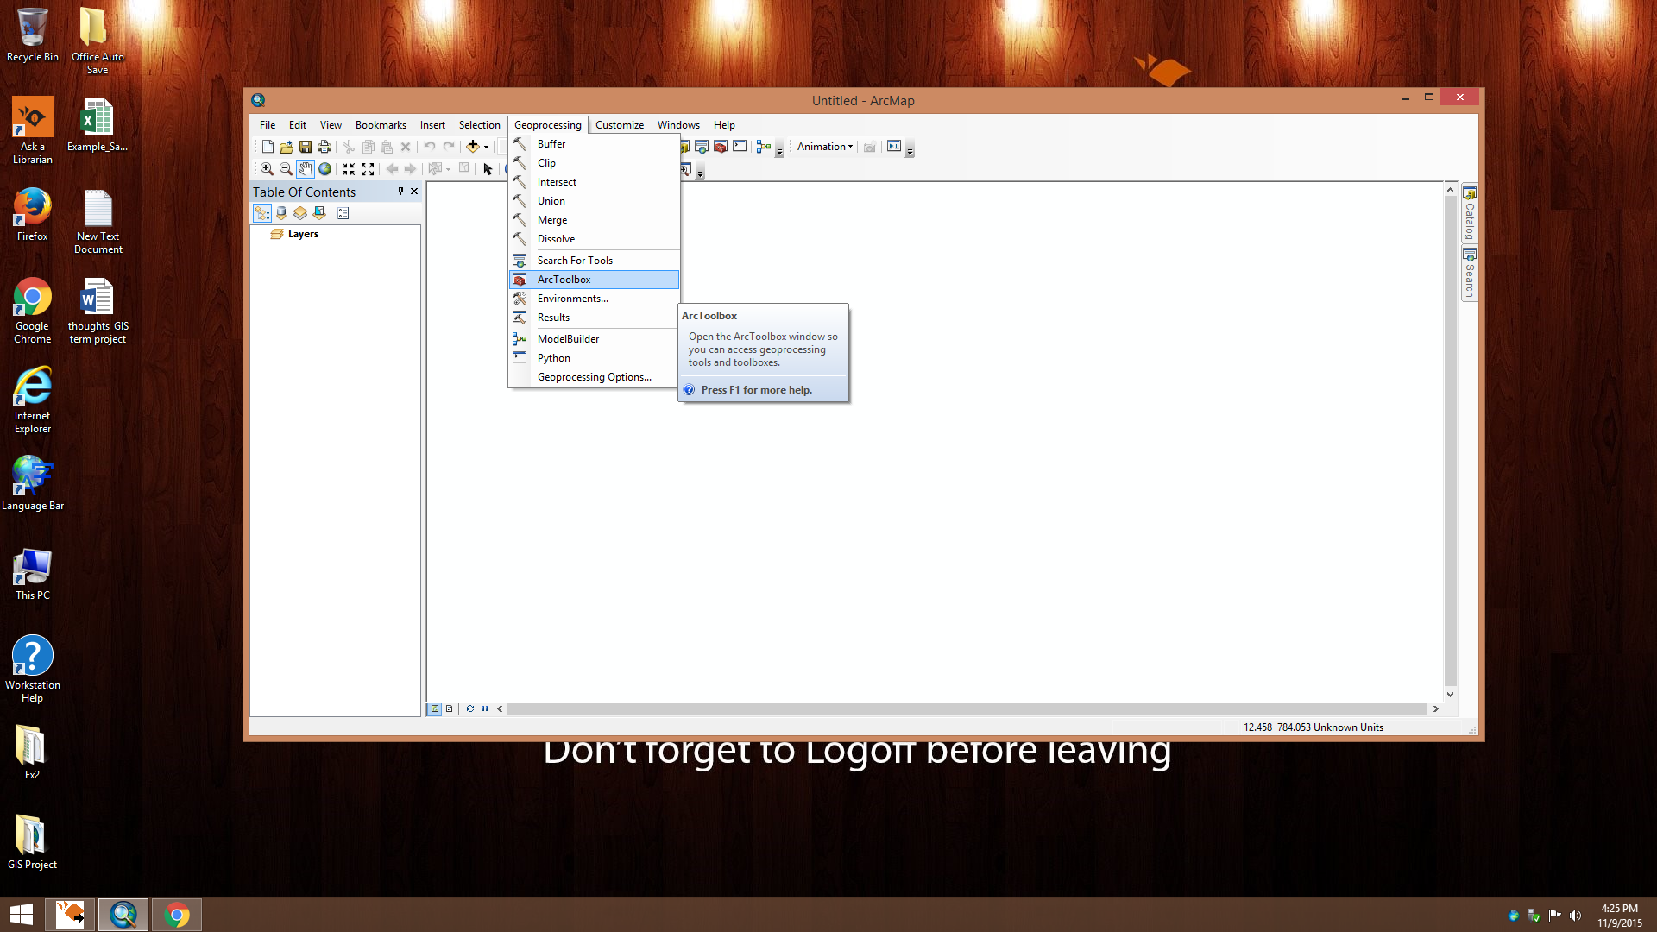
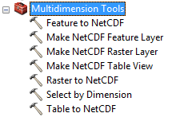
Display NFIE-RAPID outputs in ArcGIS
NetCDF file
Multidimension Tools!
Notes:
Here I used the “Make NetCDF Table View” tool.

Slide 10
Display NFIE-RAPID outputs in ArcGIS
Extract Qout of all reaches at a single time step – A flow map
Extract Qout of a single reach at all time step – A hydrograph

Slide 11
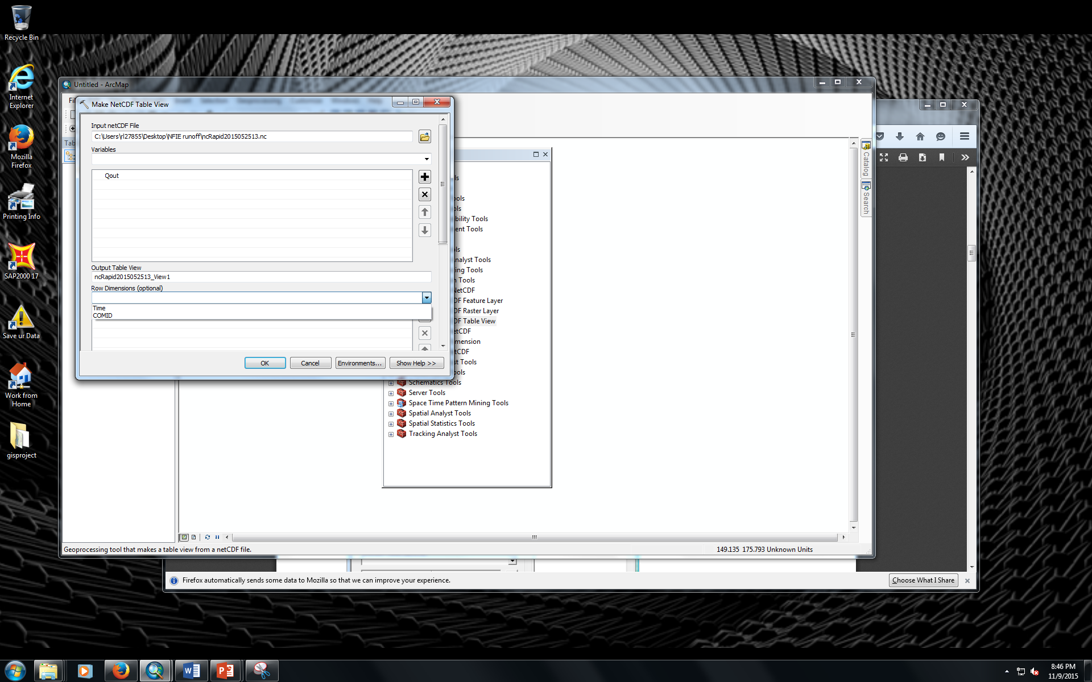
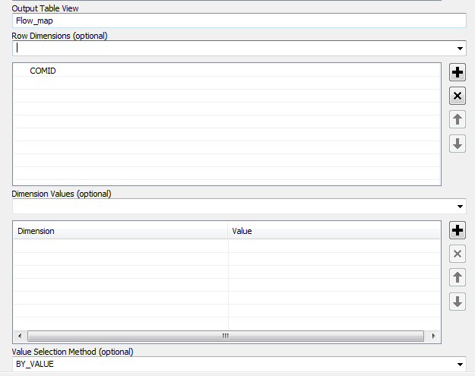
Flow map – all reaches at a single time step
Notes:
Main difference happens here: Row Dimensions set here determine the number of rows in the table view and the fields that will be present.
For instance, if stationID is a dimension in the netCDF file and has 10 values, by setting stationID as the dimension to use, 10 rows will be created in the table view. If stationID and time are used and there are 3 time slices, 30 rows will be created in the table view.
Dimension Values (optional) A set of dimension-value pairs used to specify a slice of a multidimensional variable.

Slide 12
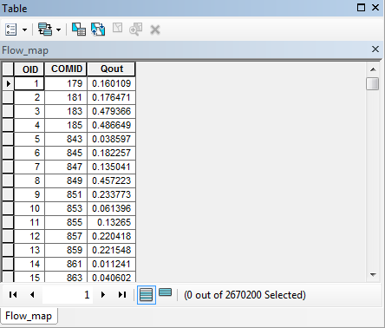
Flow map – all reaches at a single time step
Notes:
Display at first time step by default

Slide 13
Flow map – all reaches at a single time step
Then use the “Select by Dimension” tool
Notes:
Select by Dimension
Updates the netCDF layer display or netCDF table view based on the dimension value.

Slide 14
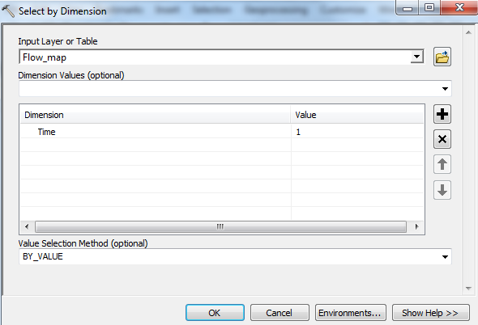
Flow map – all reaches at a single time step

Slide 15
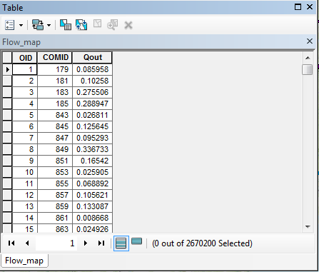
Flow map – all reaches at a single time step
Notes:
The table is updated like this

Slide 16
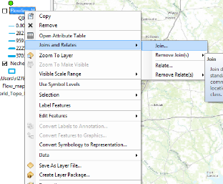
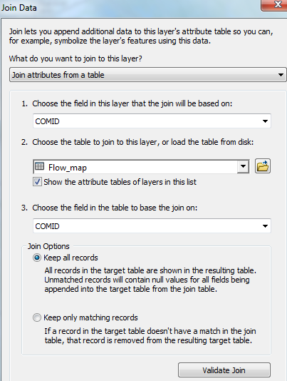
Flow map – all reaches at a single time step
Notes:
Join the data obtained from netcdf file to my prepared NHDPlus flowline shapefile. COMID is the unique identifier.

Slide 17
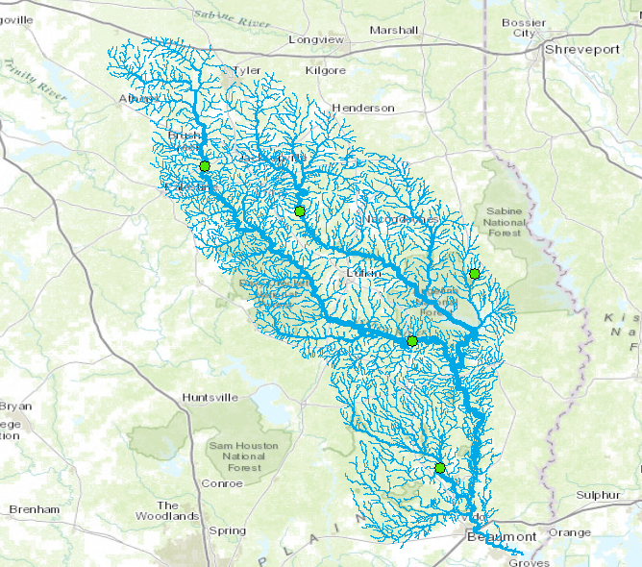
Flow map – all reaches at a single time step
Notes:
Result. Graduated symbology.

Slide 18
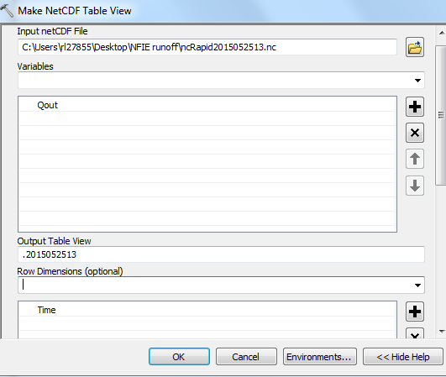
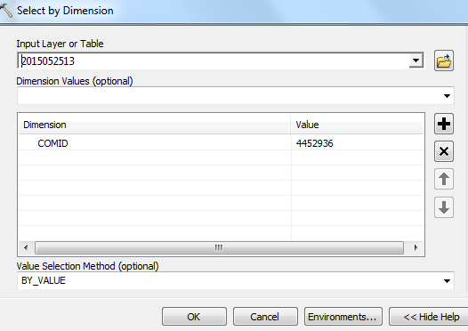
Hydrograph– a single reach at all time step

Slide 19
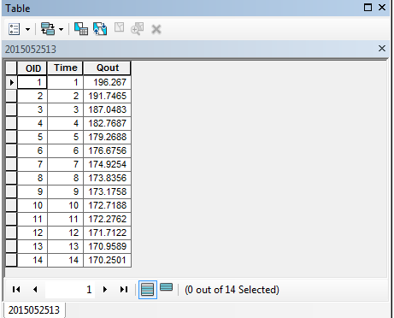
Hydrograph– a single reach at all time step

Slide 20
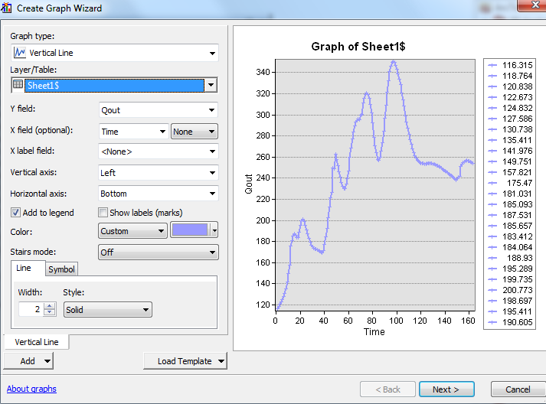
Hydrograph– a single reach at all time step

Slide 21
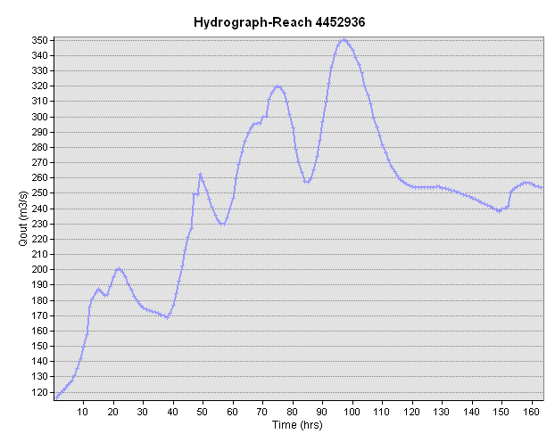
Hydrograph– a single reach at all time step
High pulse flow magnitude written in rules is 820 cfs – 23 m3/s
Not suitable for high pulse flow study
Notes:
Result. At the right end, the discharge rate is still continuing at a high level. Need following data to finish this flooding period.

Slide 22
Thank you!

