Slide 1
Scarcity on the Upper Rio Grande Valley
(Work in progress)

Slide 2
Intro
PRP: Sustainable River Governance
Features:
Prolonged drought patterns
Increasing population
Agricultural and Urban area
Complex region
Area of interest: Paso del Norte

Slide 3
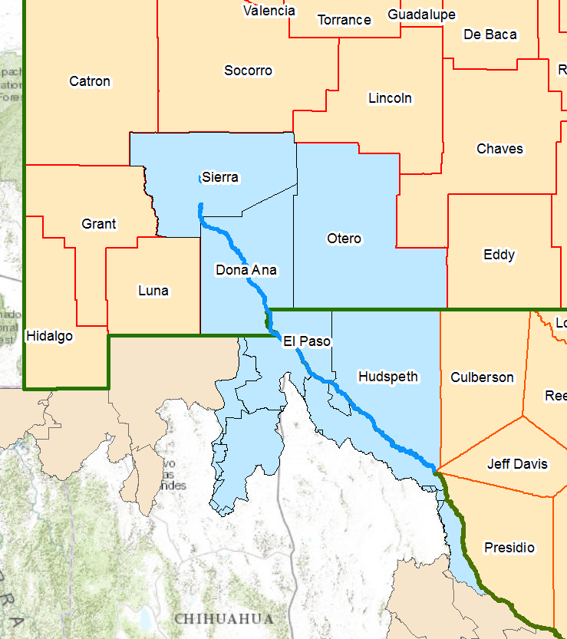
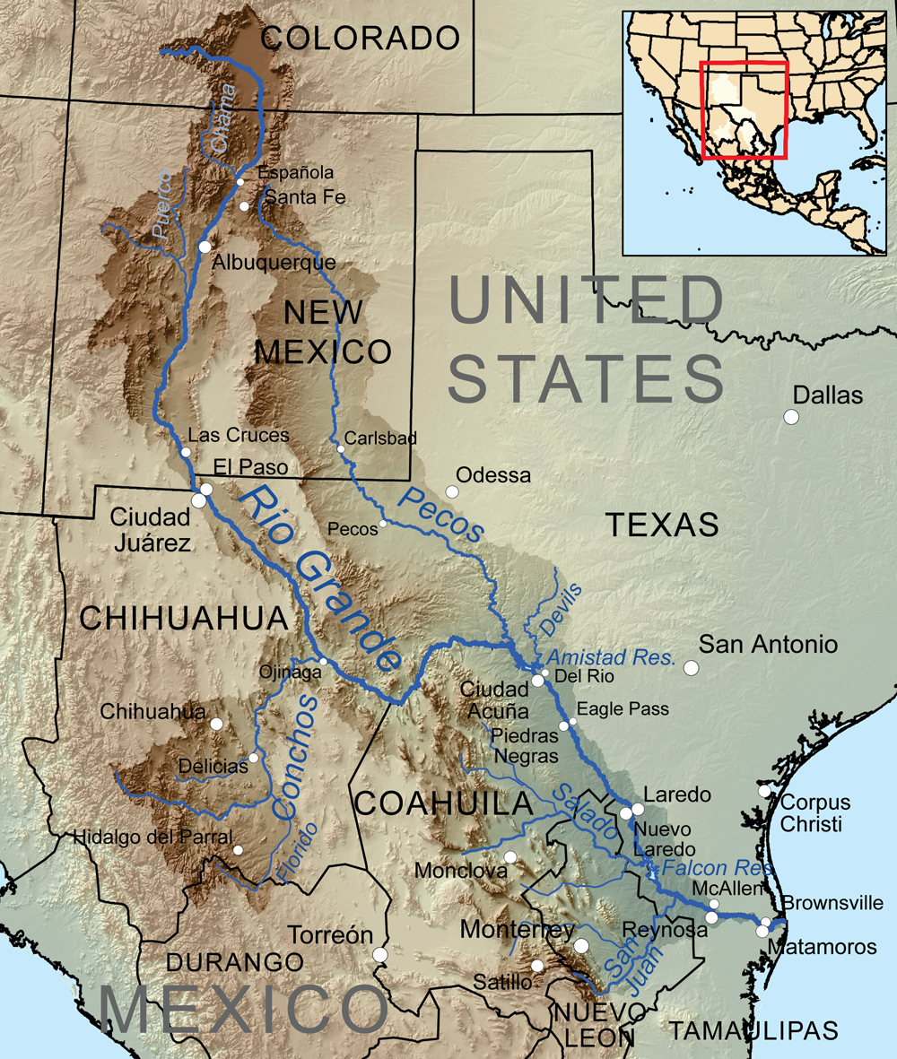

Slide 4
Administrative Framework
USBR
IBWC
EBID
OSE
EPCWID
TCEQ
MUD’S
Users

Slide 6
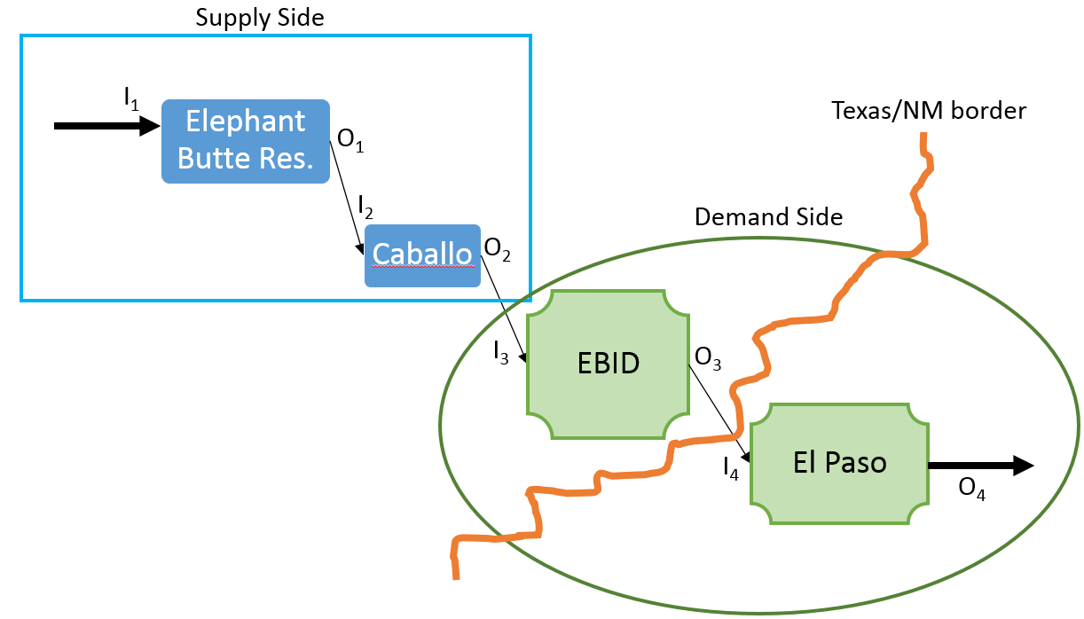
SCARCITY
Supply and demand:
Delimit Storage locations
Delimit Consumer locations: Agricultural, Industrial, Municipal
Trace streamlines, connections and key junctions
Account for consumptive and non-consumptive uses + Losses
CONCLUSIONS

Slide 7
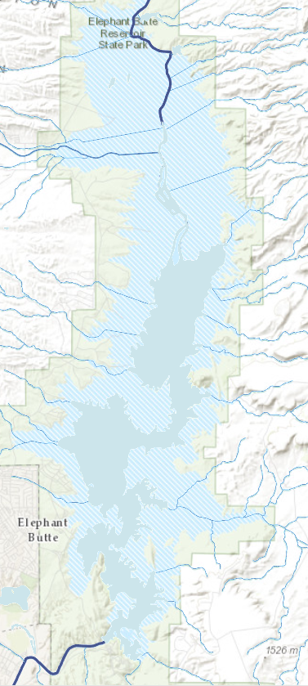
SUPPLY:
Reservoir capacity
Integrated measurements of precipitation over time interval
Integral Inflow from snowmelt and upstream conditions
Elephant Butte
Caballo

Slide 8
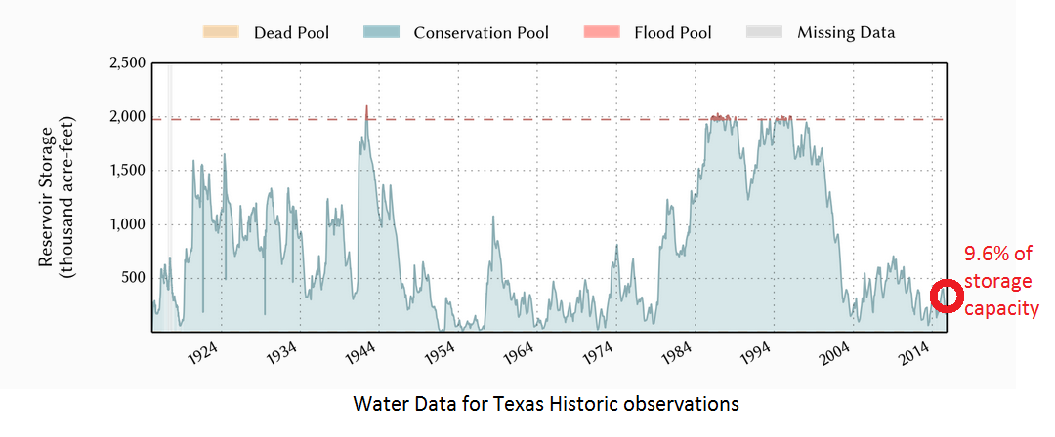

Slide 9
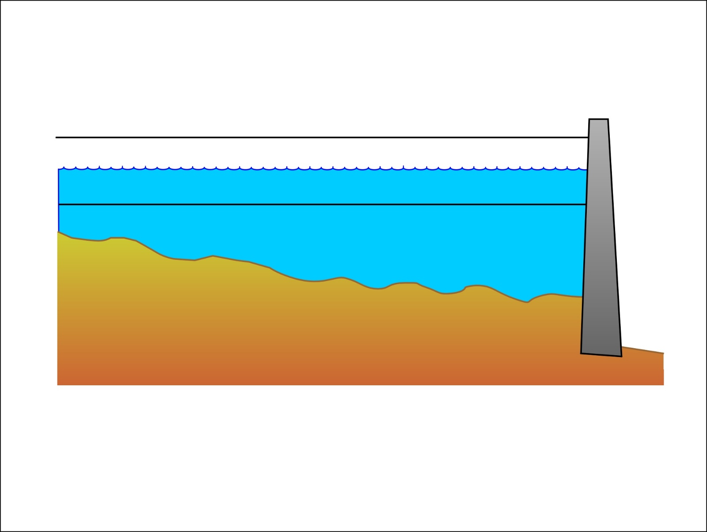
FLOOD CONTROL
CONSERVATION

Slide 10
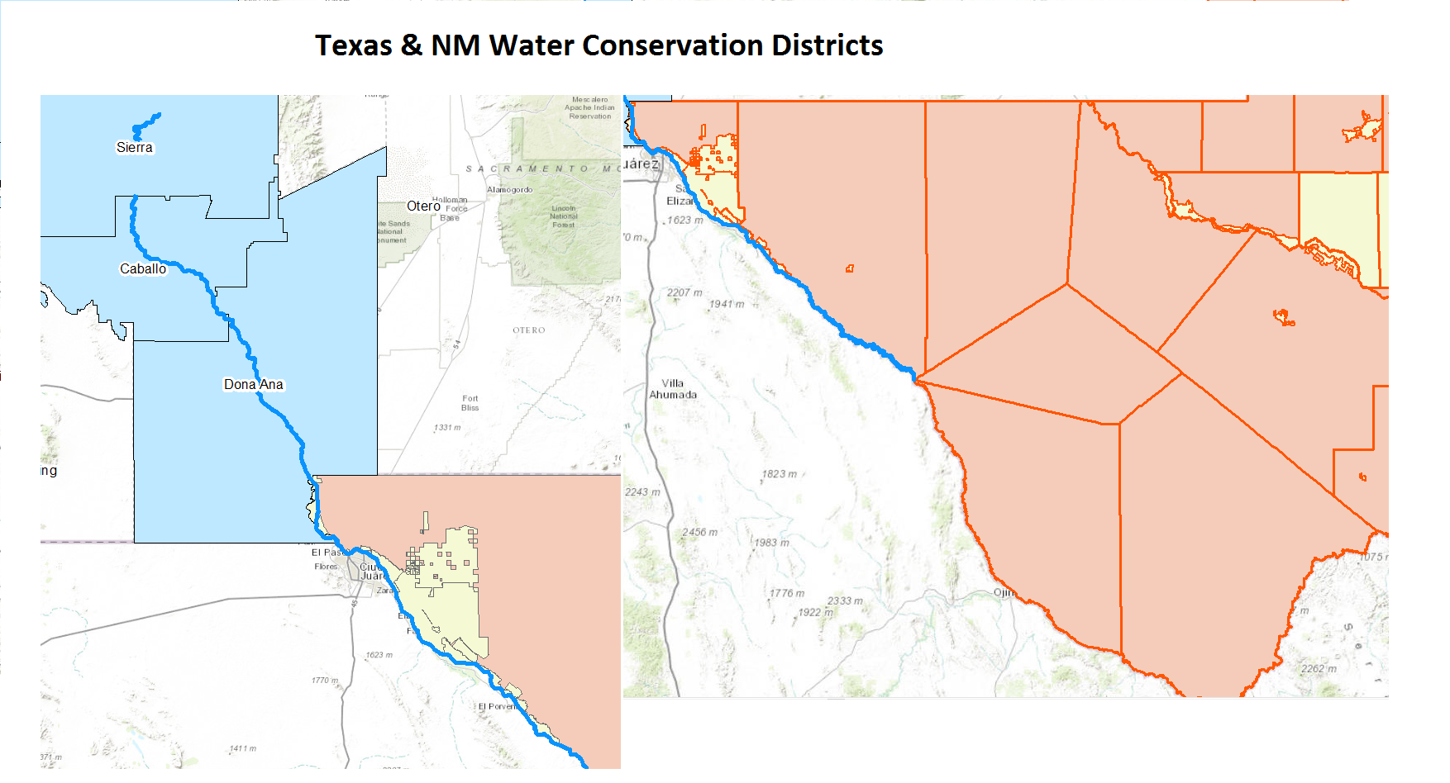

Slide 11
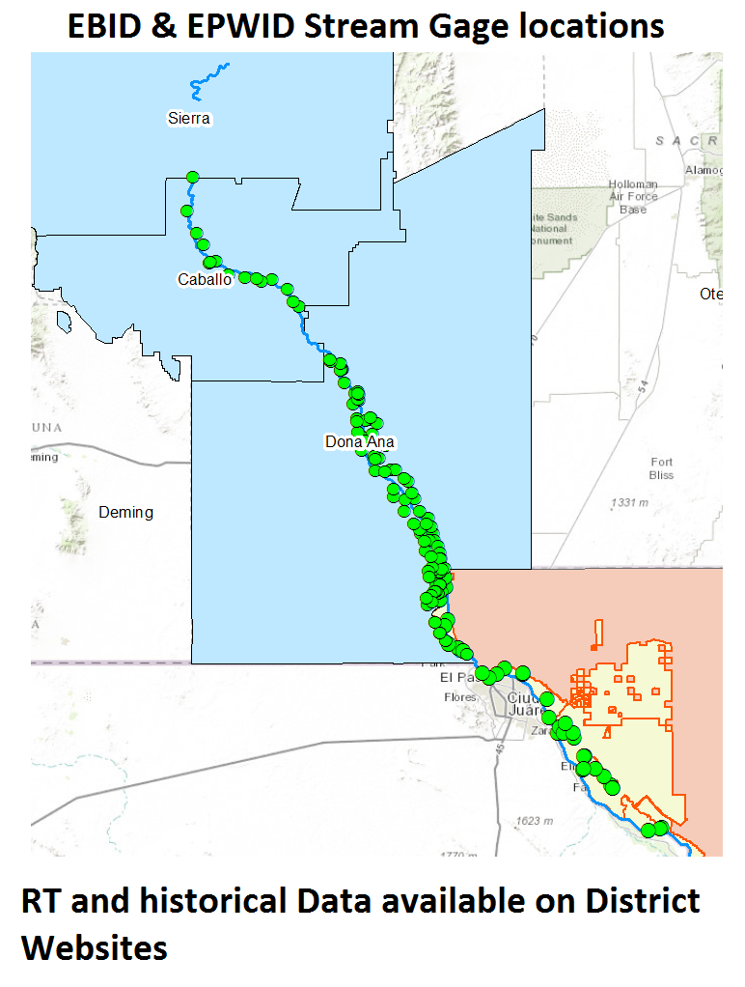
Track flows to integrate in Geometric Model

Slide 12
El Paso / Hydspeth Surface Water Rights table
OwnerName | OwnerTypeCode | DivAmtValue | UseCode | ResName | SiteName
UNITED STATES OF AMERICA | 2 | 376000 | 1 | ELEPHANT BUTTE RES & CABALLO RES | MESILLA, AMERICAN, RIVERSIDE DIV DAMS
UNITED STATES OF AMERICA | 2 |  | 2 | ELEPHANT BUTTE RES & CABALLO RES | MESILLA, AMERICAN, RIVERSIDE DIV DAMS
UNITED STATES OF AMERICA | 2 |  | 3 | ELEPHANT BUTTE RES & CABALLO RES | MESILLA, AMERICAN, RIVERSIDE DIV DAMS
UNITED STATES OF AMERICA | 2 |  | 4 | ELEPHANT BUTTE RES & CABALLO RES | MESILLA, AMERICAN, RIVERSIDE DIV DAMS
UNITED STATES OF AMERICA | 2 |  | 7 | ELEPHANT BUTTE RES & CABALLO RES | MESILLA, AMERICAN, RIVERSIDE DIV DAMS
EL PASO CO WID 1 | 2 |  | 1 | ELEPHANT BUTTE RES & CABALLO RES | MESILLA, AMERICAN, RIVERSIDE DIV DAMS
EL PASO CO WID 1 | 2 |  | 2 | ELEPHANT BUTTE RES & CABALLO RES | MESILLA, AMERICAN, RIVERSIDE DIV DAMS
EL PASO CO WID 1 | 2 |  | 3 | ELEPHANT BUTTE RES & CABALLO RES | MESILLA, AMERICAN, RIVERSIDE DIV DAMS
EL PASO CO WID 1 | 2 |  | 4 | ELEPHANT BUTTE RES & CABALLO RES | MESILLA, AMERICAN, RIVERSIDE DIV DAMS
EL PASO CO WID 1 | 2 |  | 7 | ELEPHANT BUTTE RES & CABALLO RES | MESILLA, AMERICAN, RIVERSIDE DIV DAMS
CEMEX EL PASO INC | 2 | 178 | 2 | CEMENT LAKE
CITY OF EL PASO | 2 | 11000 | 1
INDIAN CLIFFS RANCH INC | 2 |  | 7
UNITED STATES OF AMERICA | 2 | 26600 | 3
HUDSPETH COUNTY CRD 1 | 2 |  | 3
HUDSPETH COUNTY CRD 1 | 2 |  | 2
HUDSPETH COUNTY CRD 1 | 2 |  | 4
HUDSPETH COUNTY CRD 1 | 2 |  | 7
413778 acr.ft / yr
New Mexico Water rights in Dona ana
WR File Nbr | Subbasin | Use | Diversion | Owner | County | POD Number | Code | Grant | Source | q64 | q16 | q4 | Sec | Tws | Rng
RG 69740 |  | DOM | 64.52 | PAULINE, ESTATE OF HANOSH MICHAEL | DA | RG 69740 |  |  |  | 2 | 2 | 1 | 20 | 11N | 05W
RG 69741 |  | DOM | 150.55 | PAULINE, ESTATE OF HANOSH MICHAEL | DA | RG 69741 |  |  |  | 3 | 1 | 2 | 20 | 11N | 05W
Only a few are accredited from Elephant Butte

Slide 13
Groundwater
NM
Owned by State
Permits to drill well issued by OSE
+
Limitation: 1 acr.ft / year/ household
TX
Private: Land Owner
Report to TCEQ
No limit: Rule of capture

Slide 14
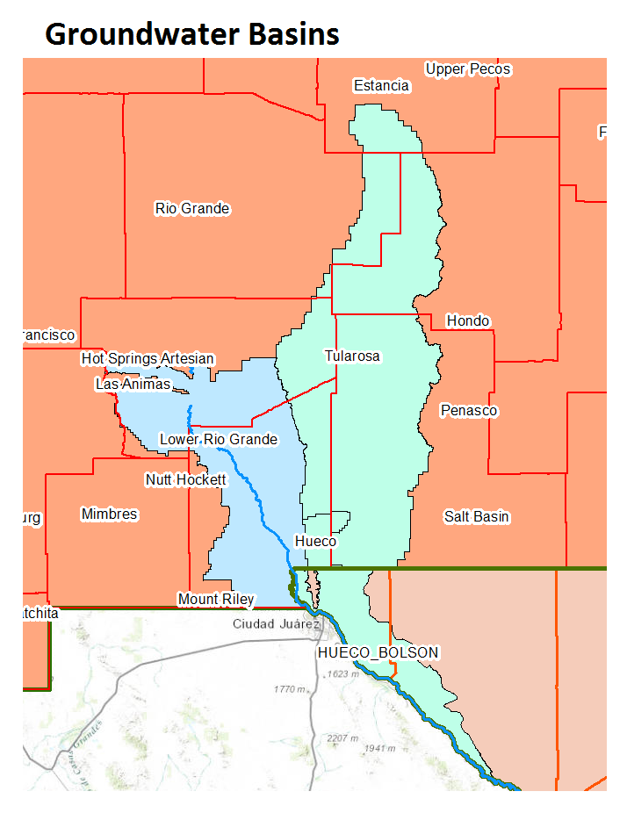
Hueco – Tularosa:
Considered as one, thick sediment pocket from nearby mountains
Recharged with treated water in El Paso
Current trend:
Predictions of drying out in 25 years
OSE data available for monitoring wells: Water depth below surface

Slide 15
Summary
TOTALS
Municipal:
From Water utilities
Demand estimated from population count
Relying mainly on Groundwater
Agriculture:
Water rights directly from river (POD’s) or Irrigation districts
Groundwater

Slide 16
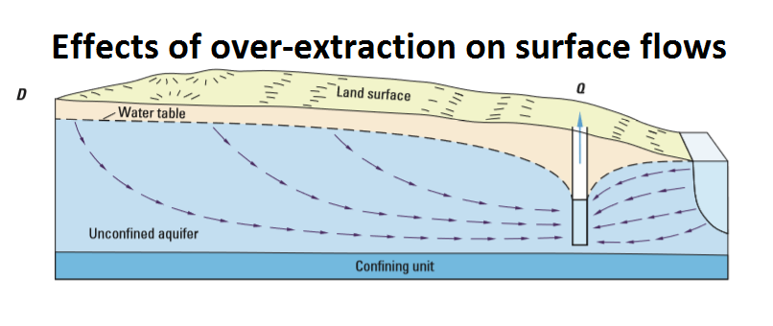
TX vs NM & Co litigation
Dependent on:
Pumping Patterns
Well locations
Geological features

Slide 17
Summary (Cont’d):
Current population demands are known (Estimated)
balance is maintained
Groundwater basins likely to dry in near future
Current supply is known: Volumes, Inflows from Cochiti + other gauges on the water system
IMPLICATIONS ON SURFACE WATER USES:
Calculation of Additional volumes needed.

Slide 18
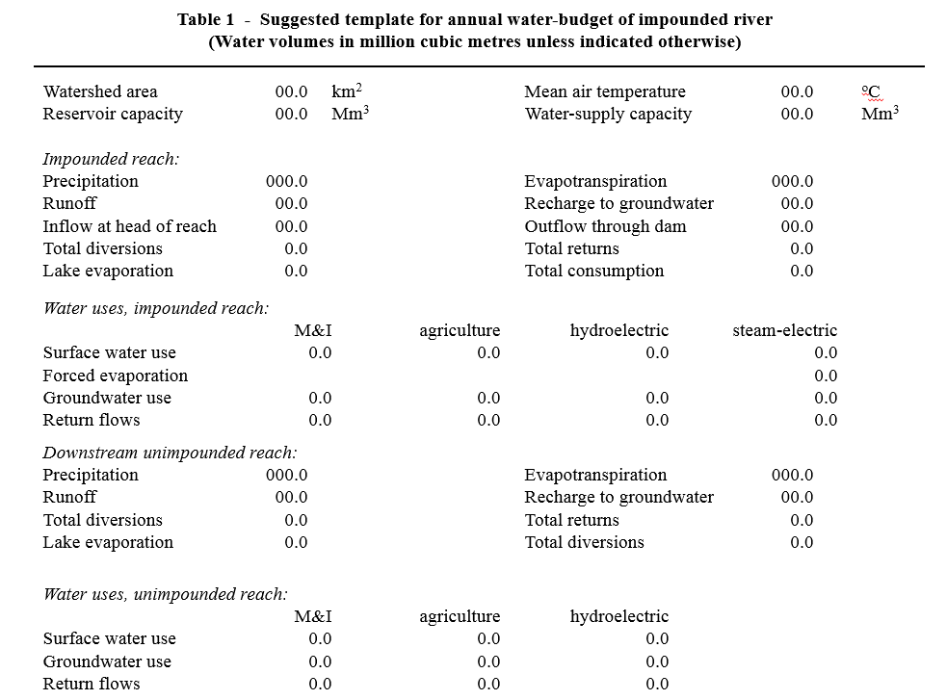
Water Budget
Compare with Annual supplies

Slide 19
Questions

