Slide 1
Total Nitrogen Input, Output, and Land Cover in the Mission and Aransas Watersheds
Hengchen Wei
Department of Marine Science

Slide 2
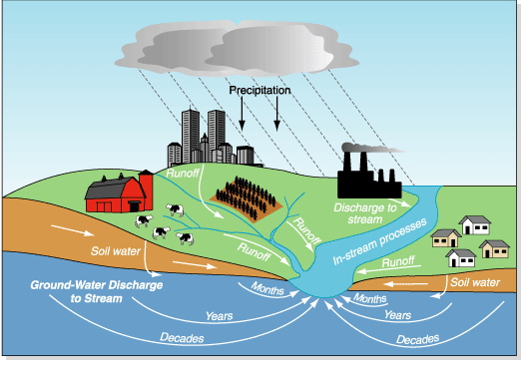
Watershed Inputs (?)
(?)
River Outputs (?)
(modified from Philips and others, 1999)
Notes:
Objectives:
Obtain watershed TN input;
Obtain riverine output at river mouths;
How output responds to input in dry and wet conditions, and the effects of land cover.

Slide 3
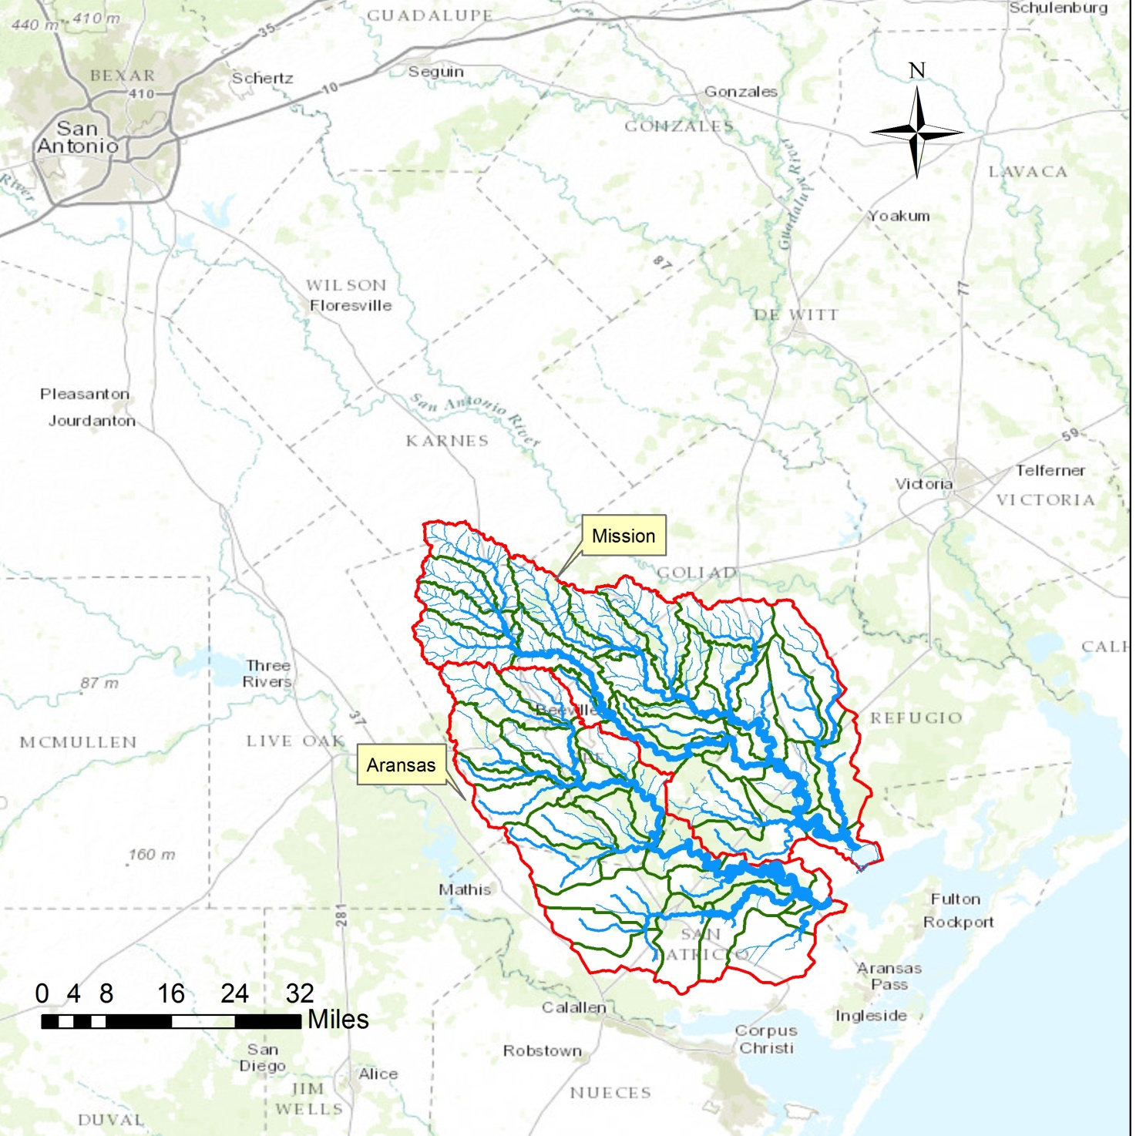
Notes:
This study focuses on the entire Mission and Aransas watersheds.

Slide 4
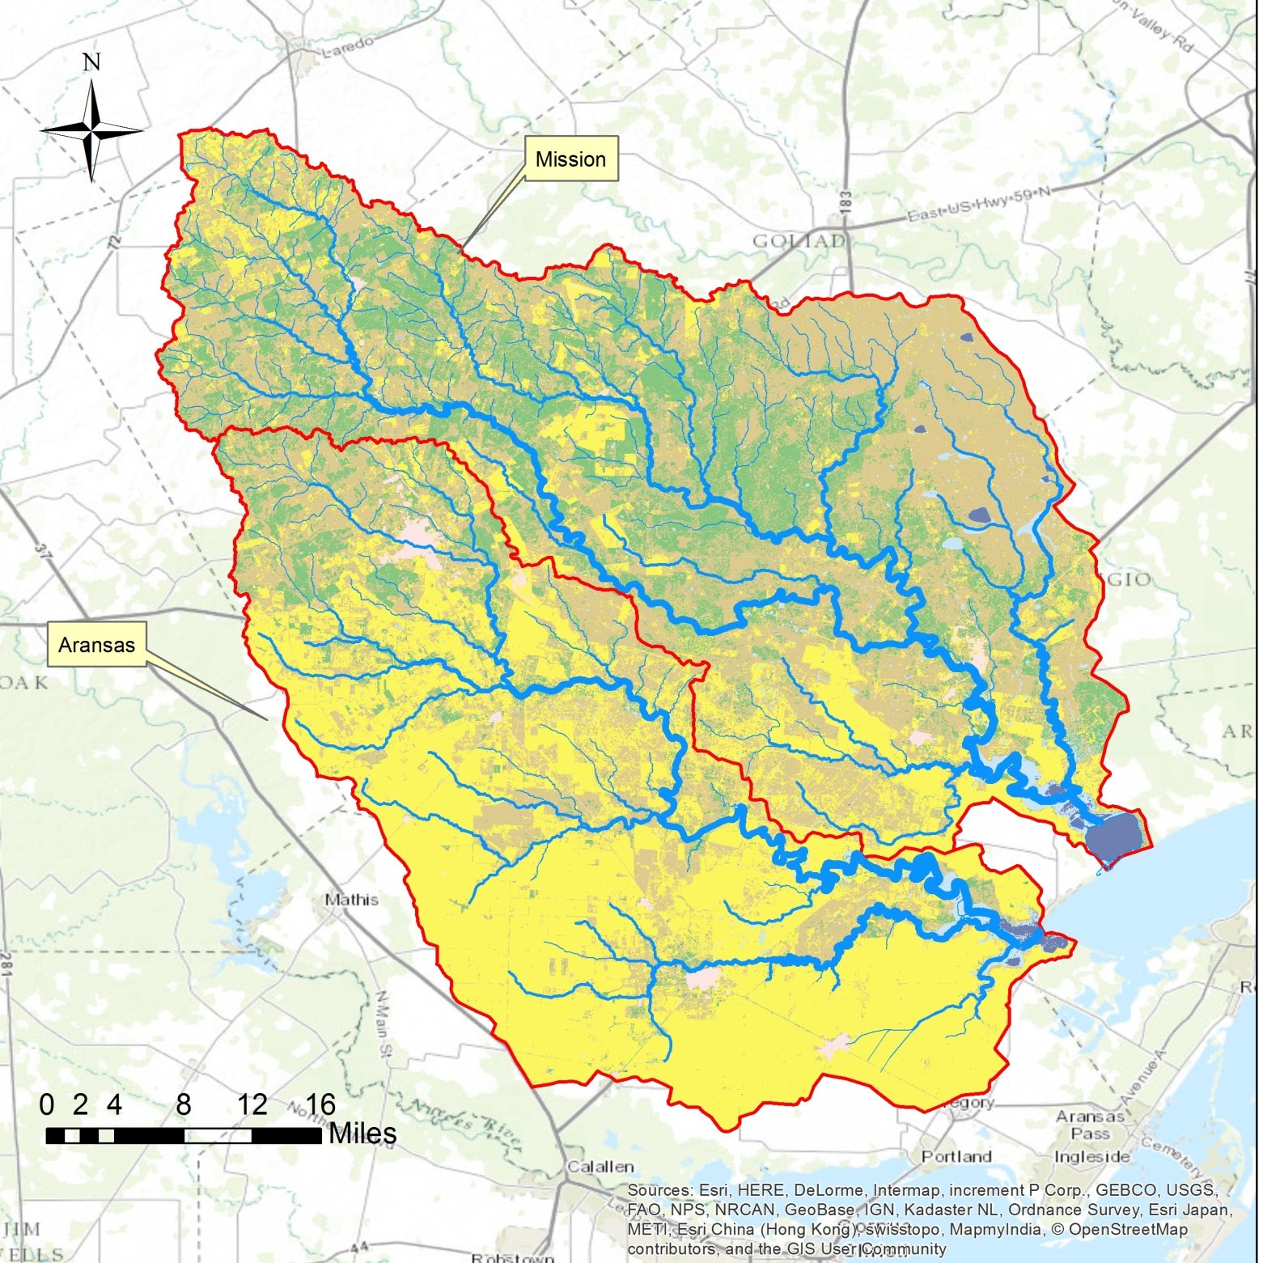
Notes:
The Aransas river flows into the west end of Copano Bay, whereas the Mission flows into Copano Bay more centrally, via Mission Bay.
The two red points are the river mouth sites, for which the TN output fluxes were estimated.
The lower reach of the Mission and Aransas rivers are tidally influenced, with fresh water residence times vary from hours to few days during high flow, to several months during low flow.

Slide 5

Land cover data (NLCD 2006)
Notes:
2006 data were used because the TN output data were 2007 and 2008.
Aransas is agriculture-dominated, developed watersheds.
Mission is shrub and grassland-dominated, less agricultural, less developed, more natural watershed.
Aransas has 10 WWTP discharging 14.4 mld, whereas Mission has 3 WWTP discharging 1.9 mld. ()

Slide 6
Land Cover Change From 1992 to 2006
Notes:
During the past 2 decades, agriculture land has increased significantly (tripled in Mission), developed land increased a lot too. Forest and shrub/grassland decreased but increased again. (Forest has never recovered to 1992 level, perhaps degraded to shrub/grassland).
In summary, both Aransas and Mission are becoming more agricultural, developed, and more human-influenced.
Hope we can do temporal analysis on TN output, but no data are available.

Slide 7
 | Mission |  |  |  | Aransas
 | Annual Export (kg/yr) |  | % Export during storms |  | Annual Export (kg/yr) |  | % Export during storms
 | 2007 | 2008 | 2007 | 2008 | 2007 | 2008 | 2007 | 2008
Nitrate | 32547 | 262 | 96 | 5 | 67324 | 22376 | 66 | 23
Ammonium | 12242 | 142 | 94 | 4 | 5492 | 773 | 90 | 73
DON | 195815 | 1742 | 97 | 8 | 54600 | 5388 | 95 | 76
PON | 91286 | 1057 | 95 | 3 | 77496 | 4786 | 97 | 84
TN | 331890 | 3203 |  |  | 204912 | 33323
Discharge (m3/yr) | 30*10^7 | 0.6*10^7 |  |  | 8*10^7 | 1*10^7
Table 1. Annual TN riverine export from LoadRunner/LOADEST. Modified from (Mooney and McClelland, 2012 )
Notes:
2007 was a wet year and 2008 was relatively dry.
Nitrogen export is driven by rainfall events. In 2007 about 95% of the nitrogen was exported during storms for Mission and from 66 to 97 % was exported for Aransas (depend on the forms of N).
Mission has discharge 4 times as large as Aransas, but its N export is not 4 times as much, therefore, Aransas is more problematic.
In Aransas, more than 70% of N was exported during storms even in dry condition. The agriculture land cover probably makes the N easier to leach to runoffs.

Slide 8
Future Work
Obtain and use ArcGIS to compile the TN input data for the Mission and Aransas watersheds.
TX-ANB dataset (Mayer, 2012)
Compare the TN input with riverine output and land cover.

