Slide 1
Urban Flooding Memorial Day flood in Austin, TX
Emily Poston

Slide 2
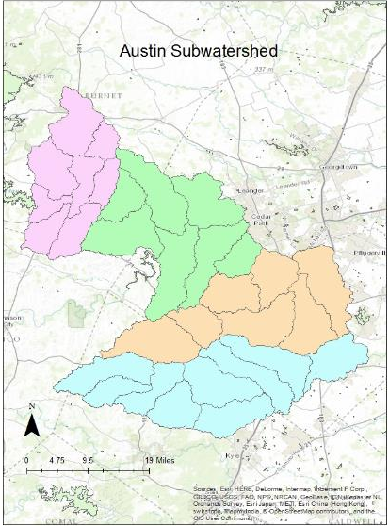
Analyzing Austin Basin
4 HUC_10 watersheds
31 HUC_12 watersheds

Slide 3
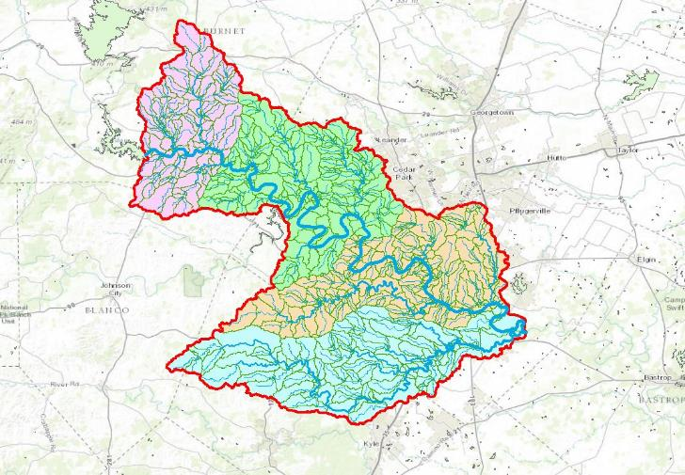
Flow lines and Catchments

Slide 4
Summary of results
Catchment area = 3199.3 km^2
Total length of flow paths = 1834.2 km

Slide 5
Memorial Day flood event in Austin
Parts of the city got 18+ inches of rain
Flash flooding of several creeks (Shoal and Waller)
Austin is located in “flash flood alley”
Why can’t we predict these events?

Slide 6
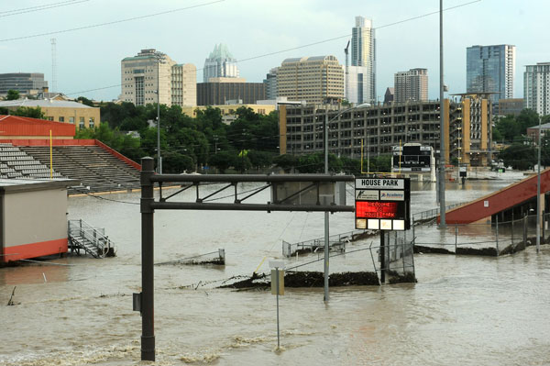
May 2015

Slide 7
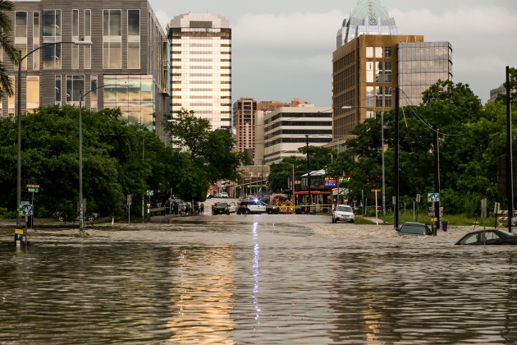
May 2015

Slide 8
Why are we concerned about urban environments?
Feature extraction tools for urban environments not completely developed
Sharp features in urban landscapes makes flood modeling very difficult
How do urban systems respond to tremendous amounts of water?

Slide 9
Why are we concerned about urban environments?
54% of the world resides in urban areas
Global warming effects have led to new extreme rainfall events
Urban environments incur more runoff due to impervious surfaces

Slide 10
Let’s compare urban to rural landscapes
Austin, very developed
San Marcos area- more rural
How does land cover affect runoff?

Slide 11
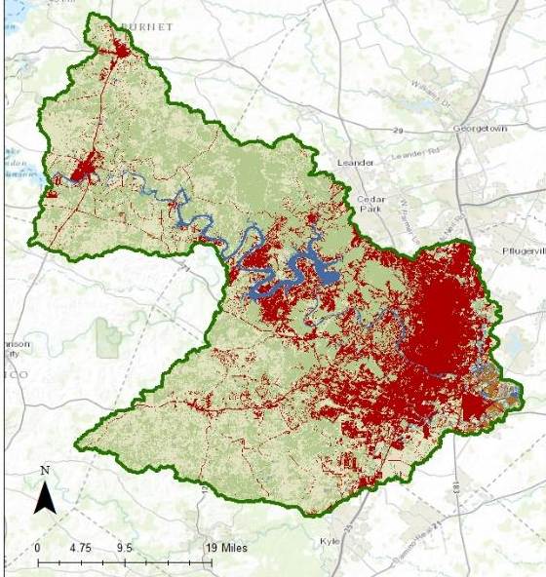
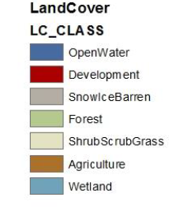
Austin Land Cover

Slide 12
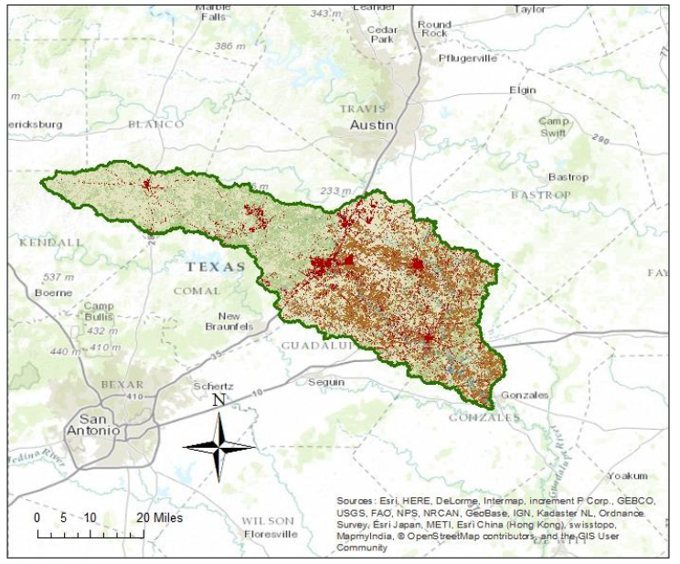
San Marcos Land Cover

Slide 13
Austin Land Cover Distribution
Land Cover | Area (%) | Area (km^2)
Agriculture | 1.17 | 50.7
Development | 21.47 | 930.1
Forest | 40.91 | 1772.0
OpenWater | 2.74 | 118.6
ShrubScrubGrass | 32.34 | 1400.8
SnowIceBarren | 0.36 | 15.5
Wetland | 1.01 | 43.9
Total | 100.00 | 4331.62

Slide 14
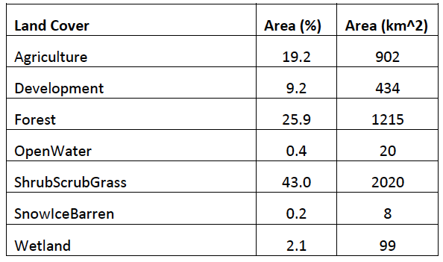
San Marcos Land Cover Distribution

Slide 15
Urban flooding vs. rural flooding
San Marcos – 9.2% developed
Austin – 21.5% developed
Want to compare runoff from same event and see the effect land cover has on flooding

Slide 16
Set up gage locations in GIS
SiteCode | SiteName | Lat DD | Long DD | DA sqMile | MA Flow (cfs)
8157540 | Waller Ck at Red River st | 30.27162778 | -97.7355583 | 4.13 | 13.5
8156910 | Waller Ck at Koenig Lane | 30.32277778 | -97.7227778 | 1.09 | 3.08
8155400 | Barton Ck abv Barton Spgs at Austin, TX | 30.26354168 | -97.772228 | 125 | 68
8155300 | Barton Ck at Loop 360, Austin, TX | 30.24465306 | -97.8022283 | 116 | 175.1
8156800 | Shoal Ck at W 12th St, Austin, TX | 30.27659704 | -97.7502834 | 12.3 | 13.6
8156675 | Shoal Ck at Silverway Dr, Austin, TX | 30.35416667 | -97.7388889 | 5.59 | 3.46

Slide 17
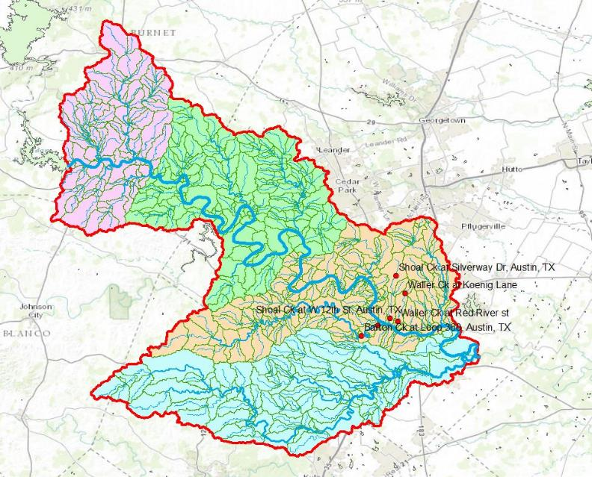

Slide 18
Waller Creek Gages

Slide 19
Shoal Creek Gages

Slide 20
Barton Creek Gages

Slide 21
What next?
Comparing streamflow not good comparison
Obtain areal precipitation data
Runoff ratios for Austin and San Marcos
Solutions for mitigating flood risks in Austin
Pervious pavement?

