Slide 1
Demographic Change in Travis County, TX between 2000 and 2013
Luke Snell

Slide 2
Travis County, Texas

Slide 5
How about looking at trends over time?
Let’s look at some year 2000 data

Slide 6
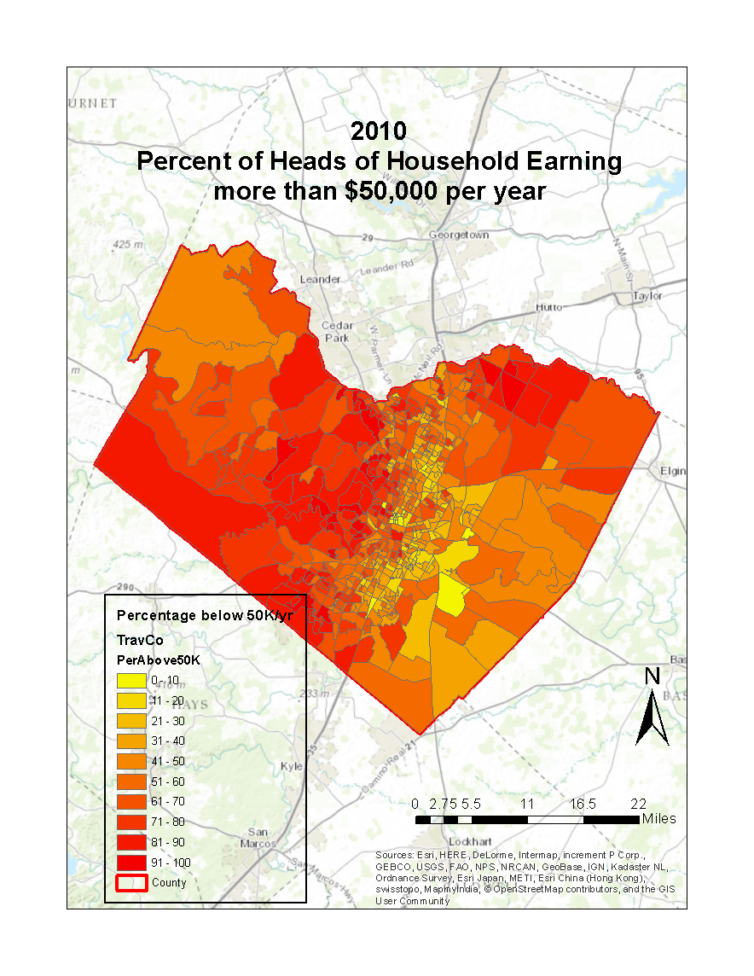

Slide 7
`
Decided to look at a smaller section
of Travis County to mitigate complications from lack of comprehensive data.
Significance of Block Group Code
48 – State
453 – County
000902 – Census Tract
2 – Block group
484530009022

Slide 8
Households earning less than $50,000 per year
2000 vs 2013

Slide 9
Overall, it appears that a smaller proportion of people are making less than $50,000 per year
Or, a larger proportion are making more than $50,000 per year
How does this compare with other demographic trends?

Slide 10
Percentage of Hispanic Households: 2000 and 2013

Slide 11
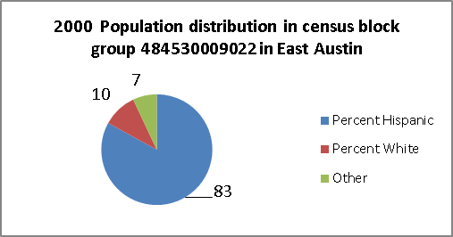
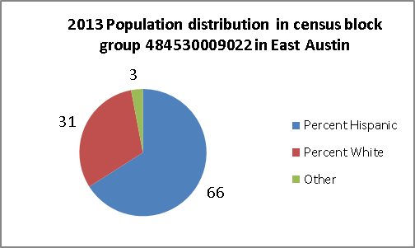
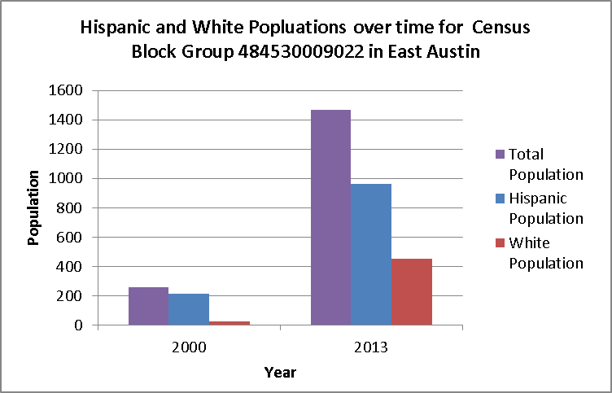
570% increase in households between 2000 and 2013

Slide 12
Next Steps
More in-depth statistical analysis of (available) data
Integrate some hydrologic analysis that takes into account the increased land cover associated with this growth

Slide 13
Questions?

