Slide 1
Stormwater Runoff in Waller Creek Watershed
Prepared by Robert Spencer
November 12, 2015

Slide 2
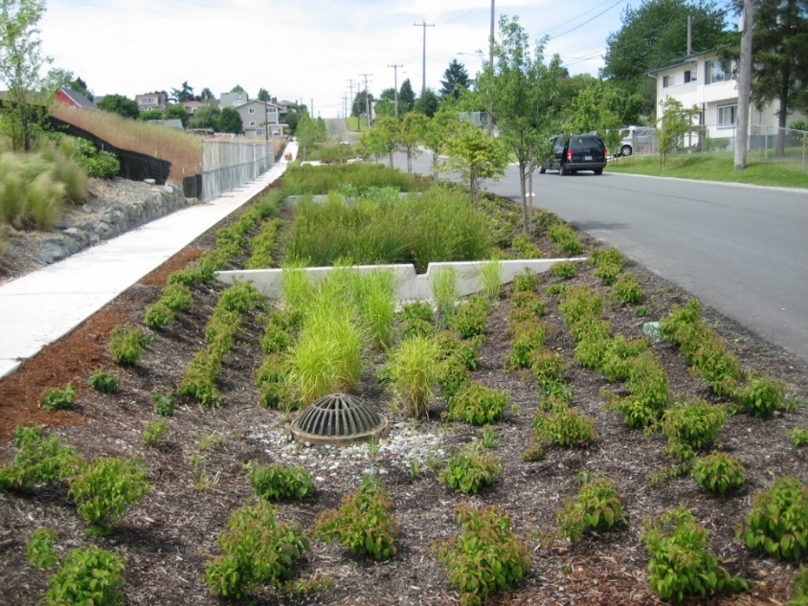
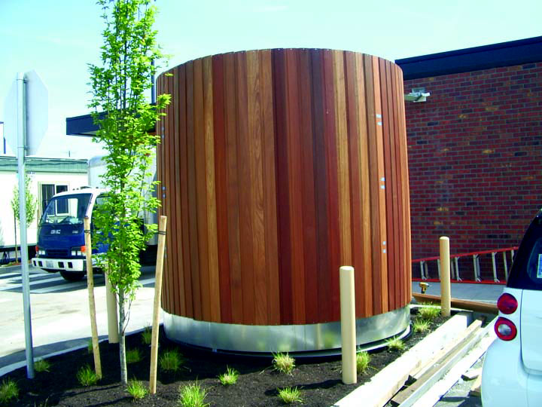
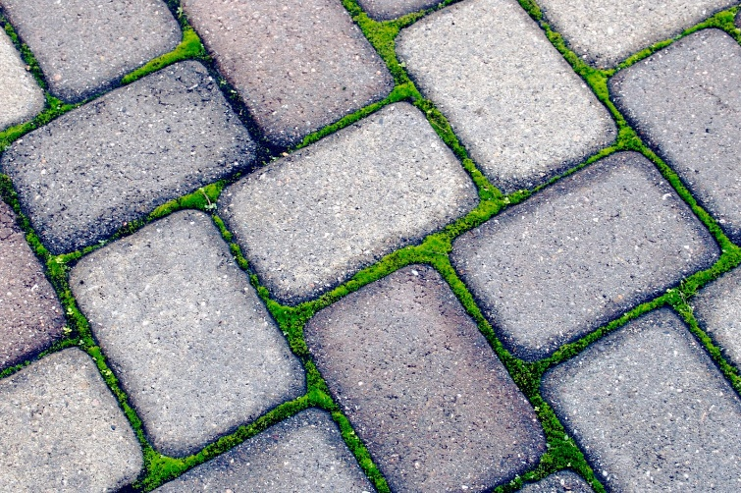
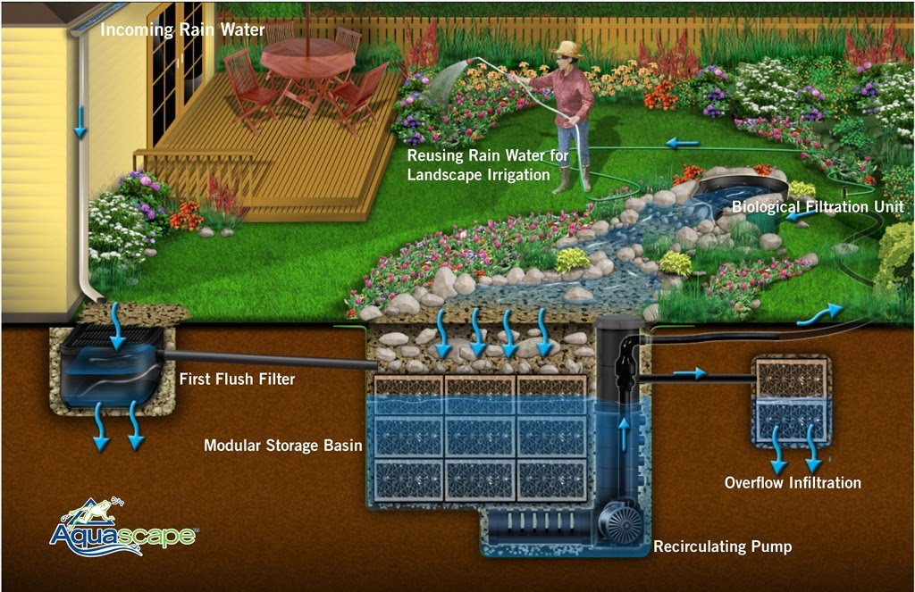
Stormwater Runoff Green Infrastructure (GI)
Rain Gardens
Rainwater Harvesting
Bioretention Swales
Permeable Pavers

Slide 3
Waller Creek Watershed
N

Slide 4
Permeability of Waller Creek Watershed
Impervious
61.7%
Pervious
38.3%
N
Building Footprints
20.6% (of Watershed Area)
33.4% (of Impervious Area)

Slide 5
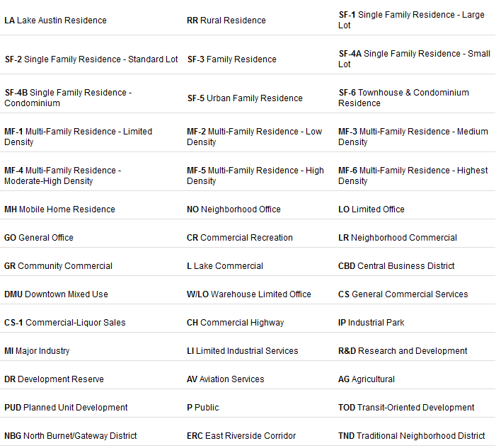
City of Austin
Zoning Classification
RESIDENTIAL
COMMERCIAL
UNIVERSITY
INDUSTRIAL
PUBLIC
MISC.

Slide 6
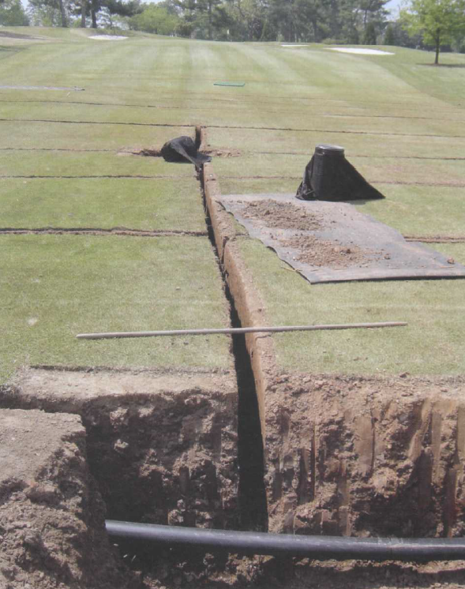
Hancock Golf Course
Patrick M. O`Brien USGA Green Section Record

Slide 7
Zoning in Waller Creek Watershed
N

Slide 8
Composition:
Residential Commercial University
Permeability
Impermeable Surface Composition
Building Size Statistics (squared feet)
MEAN:
STD.DEV:
1,533
3,274
5,509
12,042
16,023
34,518

Slide 9
Questions?
Looking Forward: Roadway Corridors
N
All datasets obtained from the City of Austin

