Slide 1
Effects of Land Cover Changes on the Austin-Travis Lakes Watershed
Prepared By: Mengjia Tang
Instructed By: Dr. David R. Maidment

Slide 2
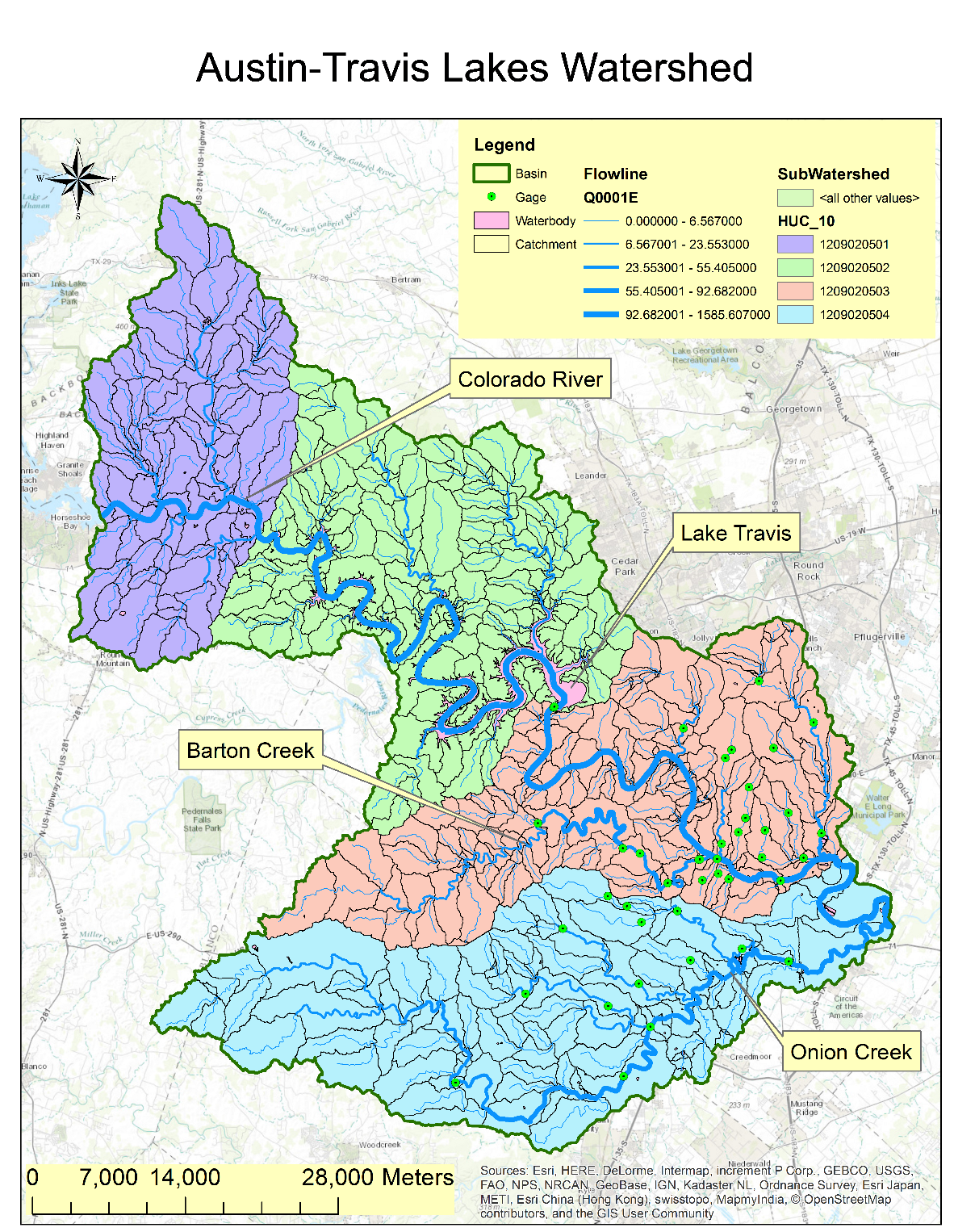
Introduction
Austin-Travis Lakes Watershed: Downstream of the Colorado River; Covering Austin
Lake Travis: Important reservoir

Slide 3
Introduction
Source: EnviroAtlas
Percent of land within each subwatershed that was frequently or periodically wet and has been developed or urbanized.
Dark blue: >6.5% wet areas that has been changed into developed areas

Slide 4
Steps
Analyzing land cover change
Delineating watershed from DEM
Calculating runoff ratio to illustrate change of the watershed
Using HEC-HMS model to quantify change of the watershed due to land cover change

Slide 5
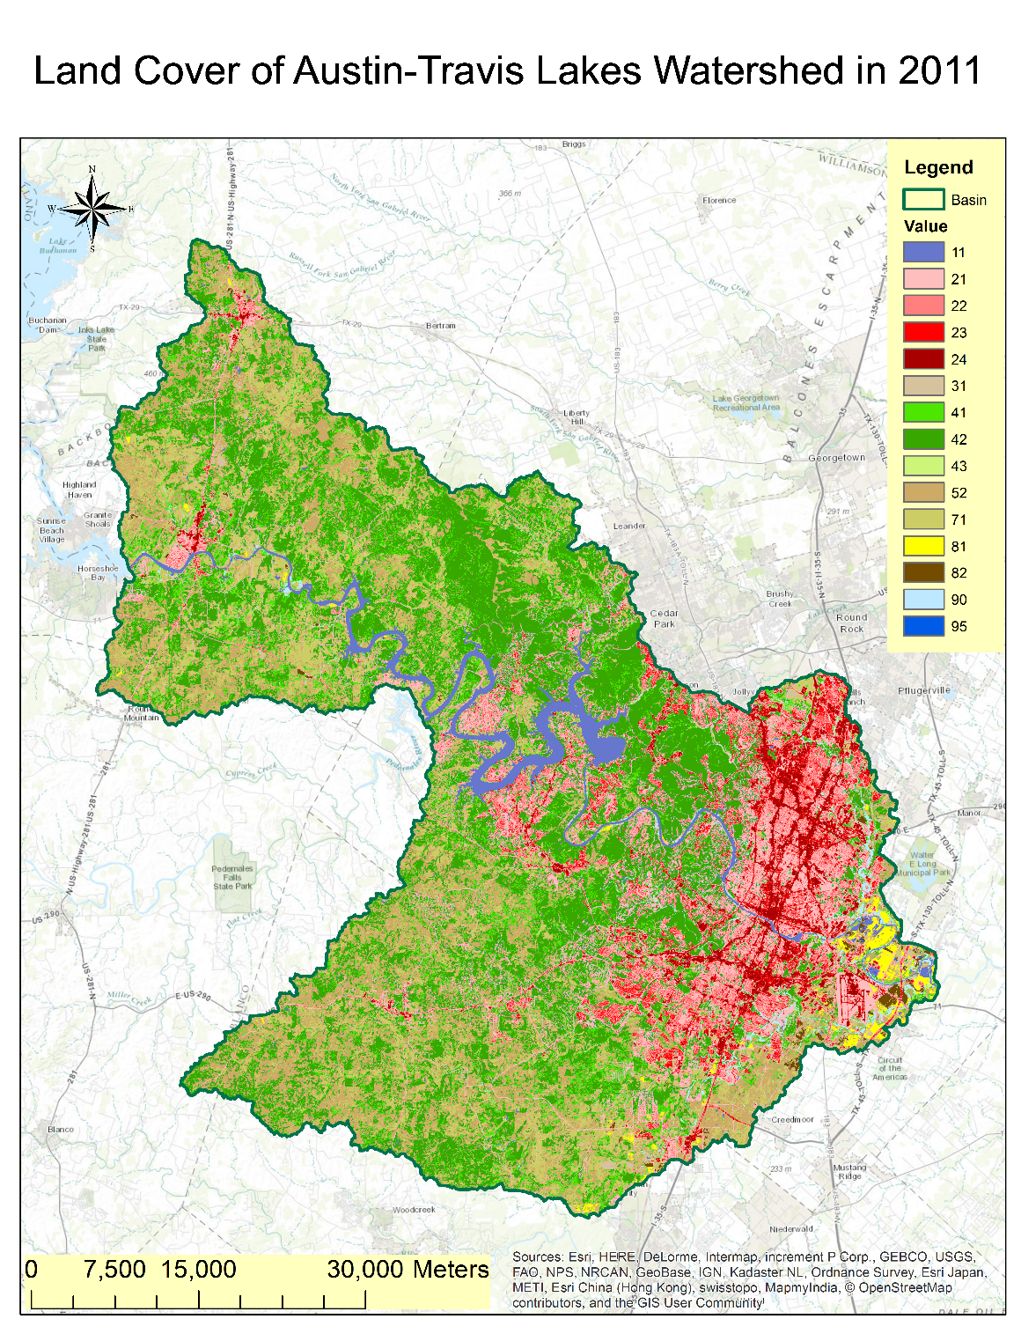
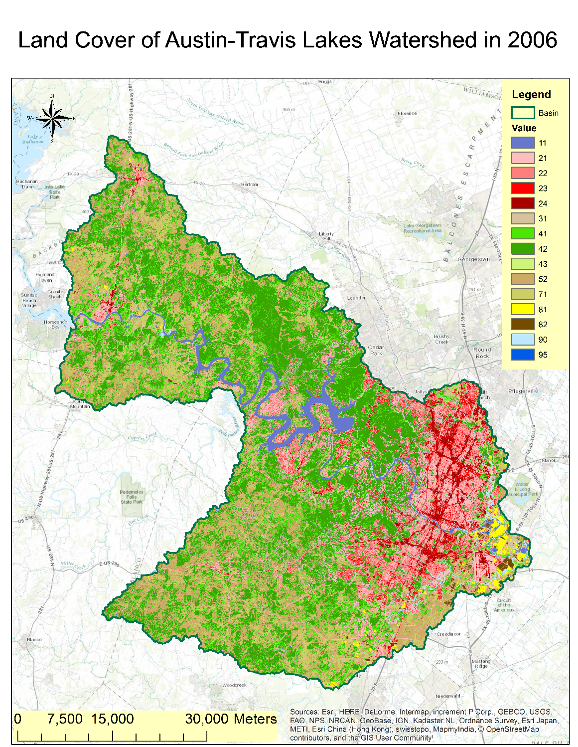
Land Cover Change
1.2%
Source: NLCD 2001, 2006, 2011
Class | 2001 | 2006 | 2011
Water | 2.741 | 2.736 | 2.736
Developed | 20.545 | 21.591 | 22.862
Barren | 0.115 | 0.373 | 0.373
Forest | 42.491 | 40.877 | 39.207
Shrubland | 19.750 | 19.704 | 19.944
Herbacious | 12.139 | 12.506 | 12.755
Planted/Cultivated | 1.181 | 1.195 | 1.123
Wetlands | 1.036 | 1.018 | 1.001

Slide 6
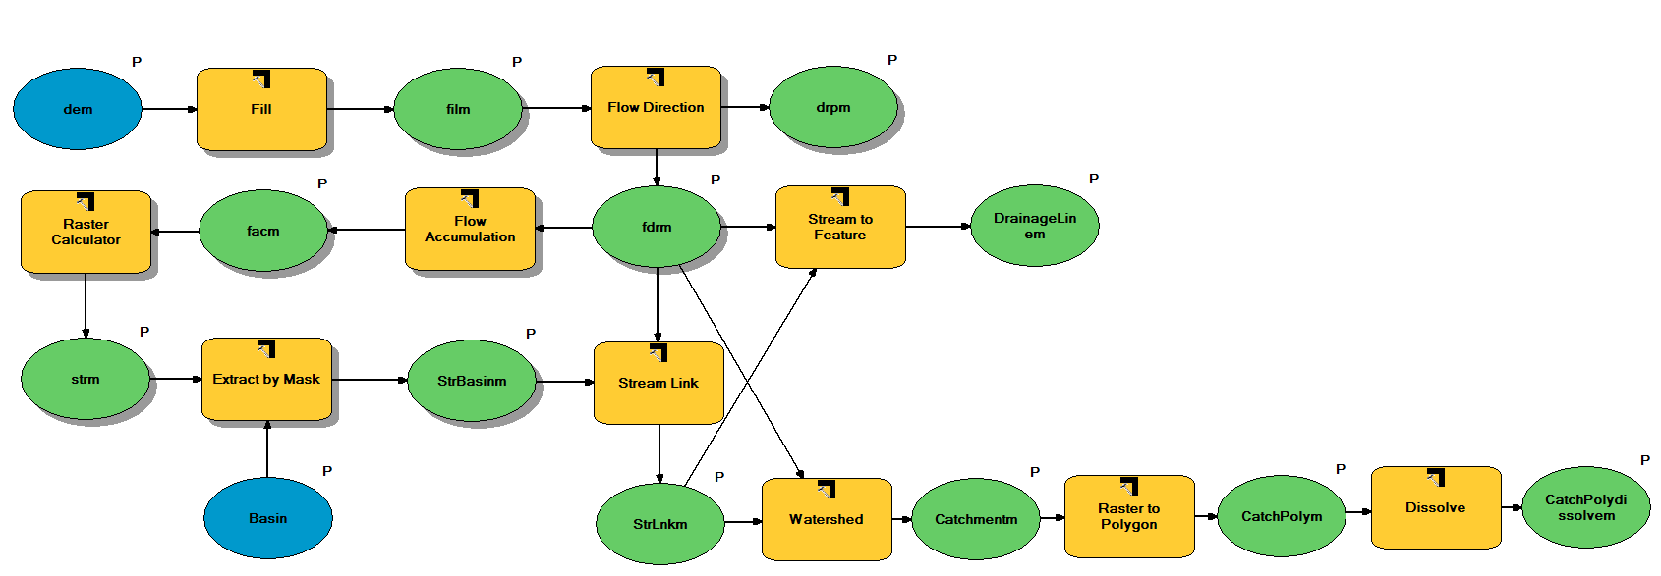
Watershed Delineation

Slide 7
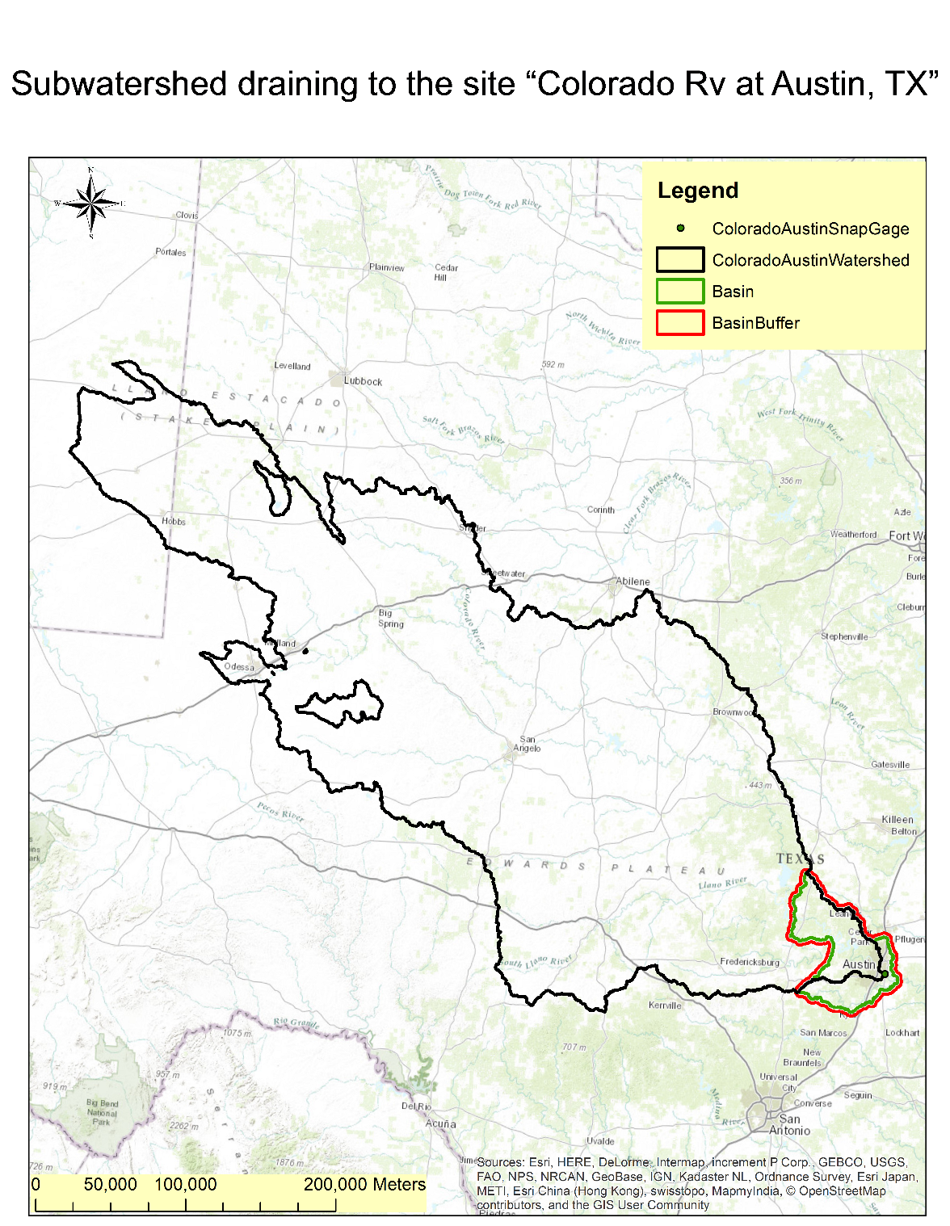
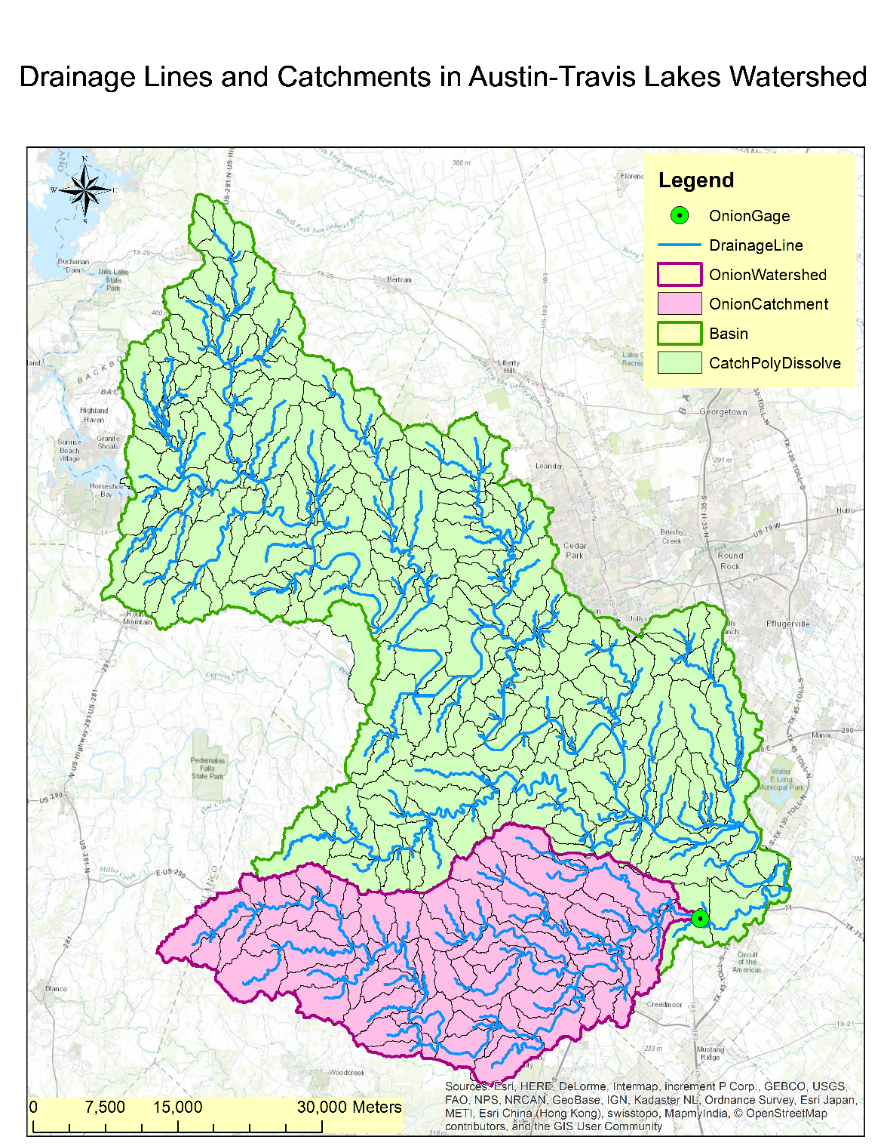
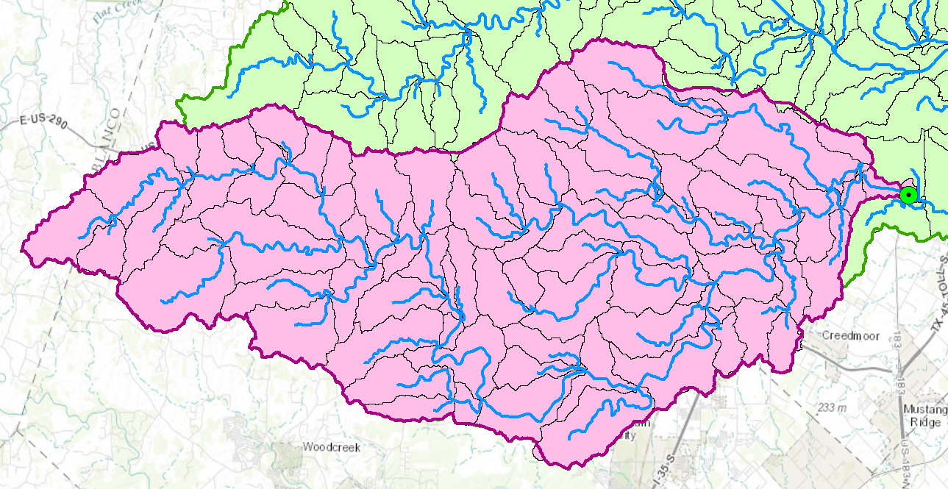
Watershed Delineation
Runoff-Precipitation
Gage-Drainage area
Gage: Onion Ck at US Hwy 183, Austin, TX
Drainage Area: 839.08 km²
Notes:
Watershed tool

Slide 8
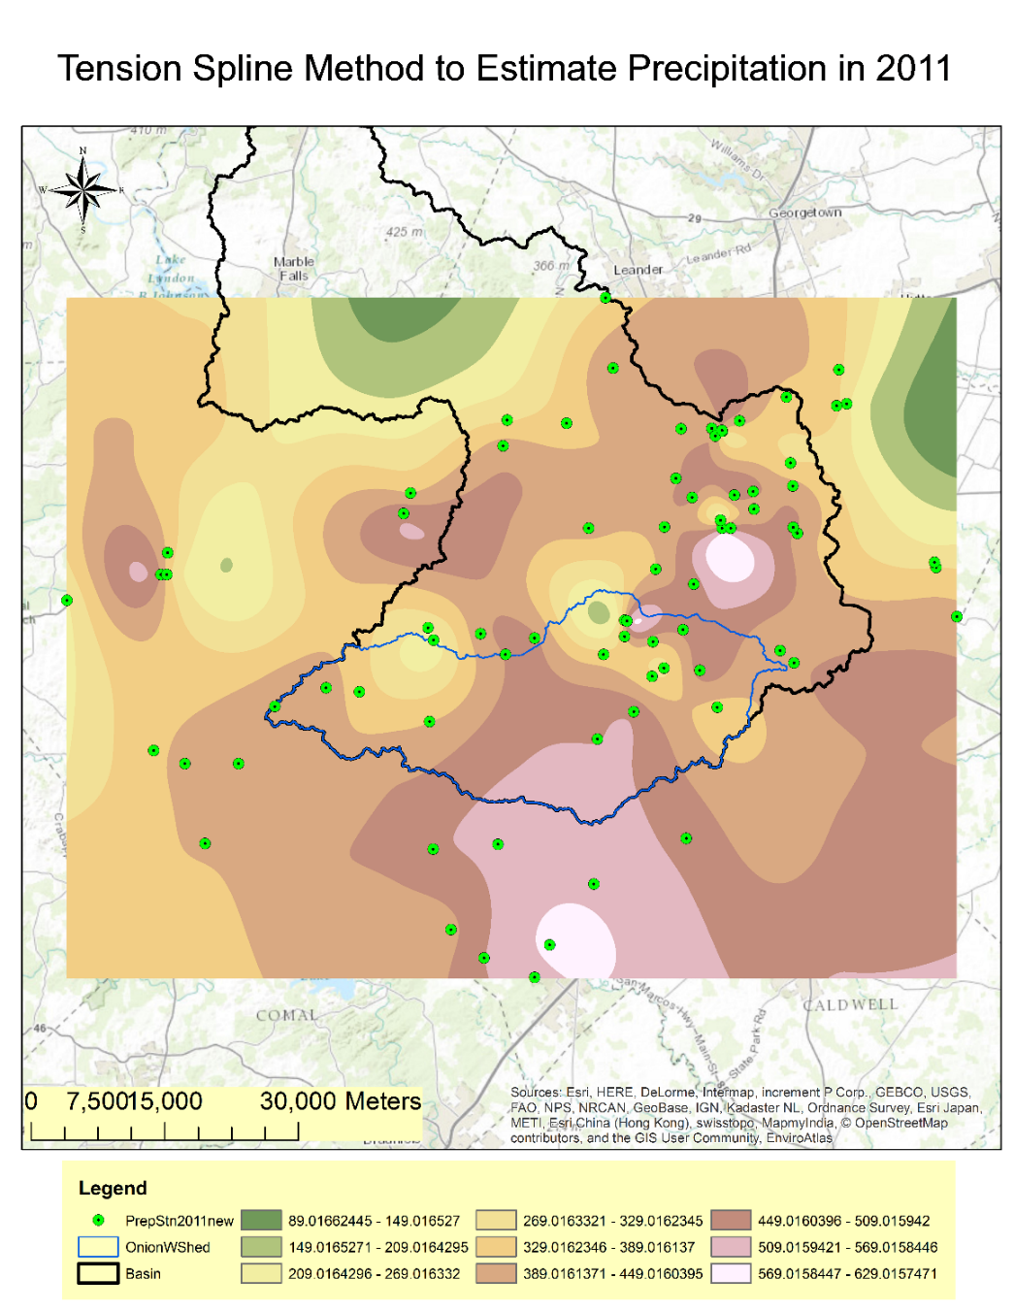
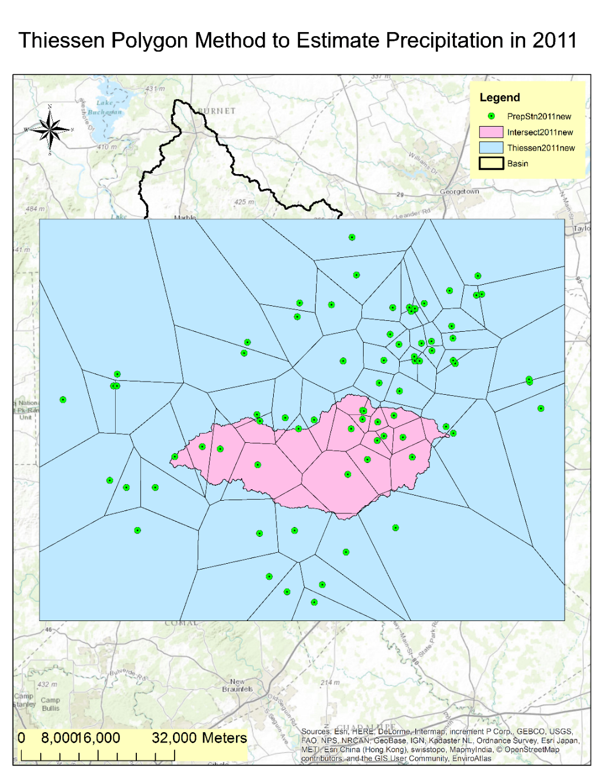
Runoff Ratio Calculation
Precipitation
Source: NOAA National Climatic Data Center
Data: monthly summaries
(Only retaining those with 12 months of data in a specific year)
Data range: Blanco, Hays, Travis
Methods: Thiessen Polygon, Tension Spline

Slide 9
Runoff Ratio Calculation
Mean Annual Flow
More impervious area
Less infiltration
Larger runoff ratio
Source: USGS
Annual Runoff Ratio
 | 2001 | 2006 | 2011
Precipitation by Thiessen Polygon Method(mm) | 1029.418 | 704.672 | 422.111
Precipitation by Tension Spline Method(mm) | 1027.377 | 733.176 | 423.564
Mean Precipitation(mm) | 1028.397 | 718.924 | 422.838
MAFlow(ft³/s) | 149.1 | 9.81 | 4.34
Runoff Ratio | 0.1543 | 0.01452 | 0.01092
?

Slide 10
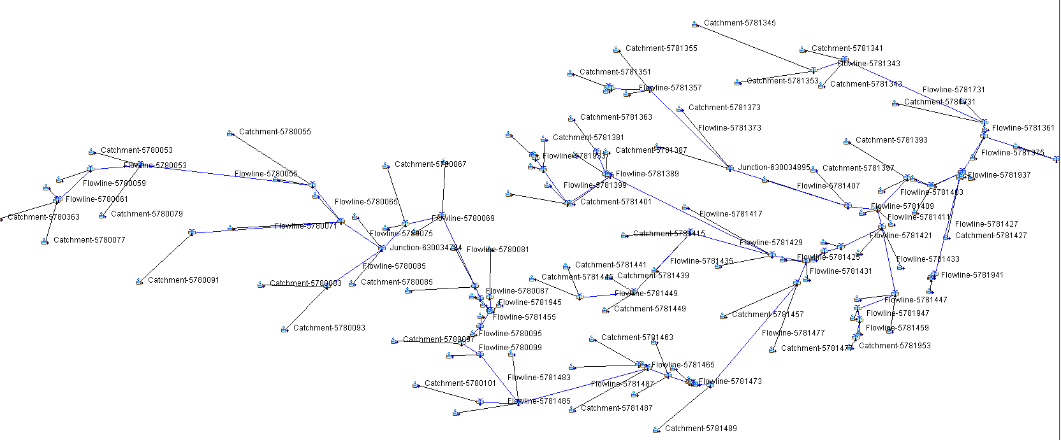
HEC-HMS Model
HEC-HMS model of the Onion Creek Watershed
Runoff-Precipitation
Model Parameter:
Precipitation: a 24-hour, 100-YR design storm
Impervious area: land cover data in each year
Possible solution:
Applying the same precipitation to each year
Method:
HEC-HMS model
Acknowledgement: This HEC-HMS model was established by Cyndi Castro
Notes:
Cyndi Castro

Slide 11
Future Work
Using HEC-HMS Model
Learn to use HEC-HMS model
Run storm events for 2001, 2006 and 2011 respectively
Compare peak flows to quantify the change of the Onion Creek Watershed
Find out subbasins with the most significant change in peak flows, and discuss reasons
Change the storm scenarios, e.g. more frequent storm events
Notes:
Cyndi Castro

Slide 12
Conclusion
Developed area in Austin-Travis Lakes Watershed increased by 1.2% every 5 years from 2001 to 2011.
Run-off ratio derived from actual precipitation data is not suitable for analyzing the watershed change caused by land cover change, though it can reflect the actual hydrological environment.
HEC-HMS model provides the method to simulate precipitation-runoff processes, thus able to quantify the hydrologic impact of land cover change to the watershed.
Notes:
Cyndi Castro

Slide 13
Questions?

