Slide 1
Comparing NFIE RAPID models with measured river flood hydrographs.
Jeffery A Watson
Department of Geosciences, University of Texas at Austin

Slide 2
Project objectives: Flood modelling
Generate flood hydrographs from in-situ water level data.
Generate hydrographs from NFIE RAPID data
Identify potential sources of disagreement between modelled and measured

Slide 3
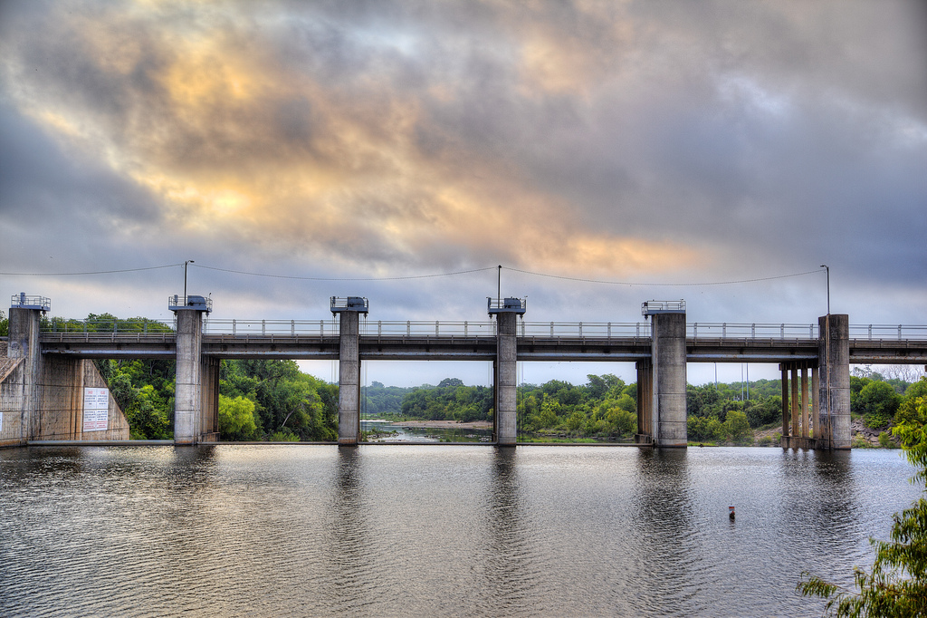
Study Reach: Lower Colorado River
Longhorn Dam

Slide 4
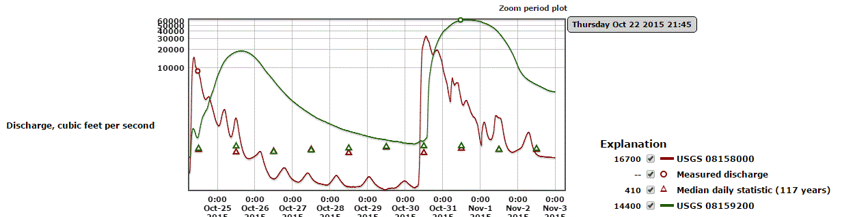
Late October Flooding
Flood peak arrival offset
How well does NFIE RAPID predict these floods?
Colorado River at 183
Colorado River at Bastrop

Slide 5
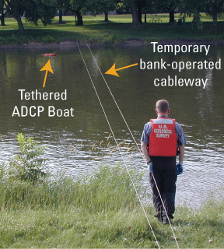
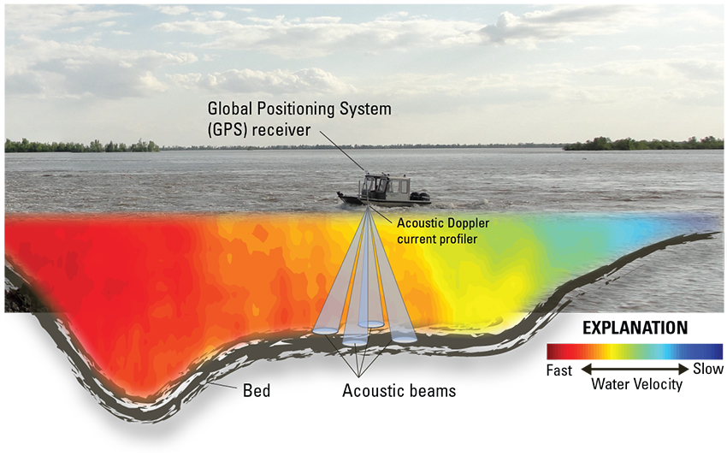
ADCP discharge measurements
Q=A*V
ADCP records depth and velocity along a cross-section.
Discharge calculated from these measurements.
Photo from USGS: http://pubs.usgs.gov/sir/2005/5183/Figure6.gif

Slide 6
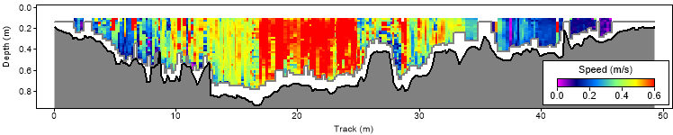
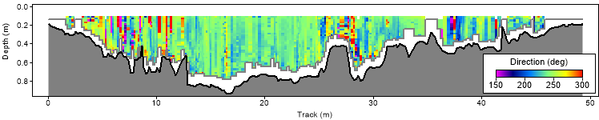
ADCP discharge measurements
Flow Velocity
Left Bank
RightBank
Q=8.1 +/- 0.4 m³/s
Flow Direction
Q=A*V
Flow Direction (azimuth)
Data collected by Peter Knappett’s Research team, Texas A&M, May 2015

Slide 7
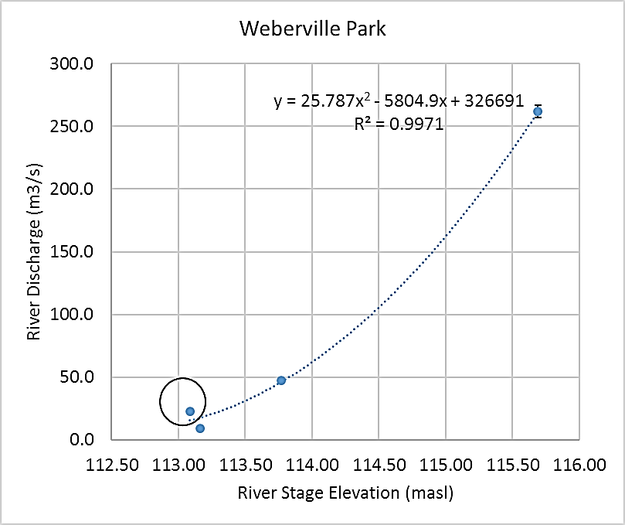
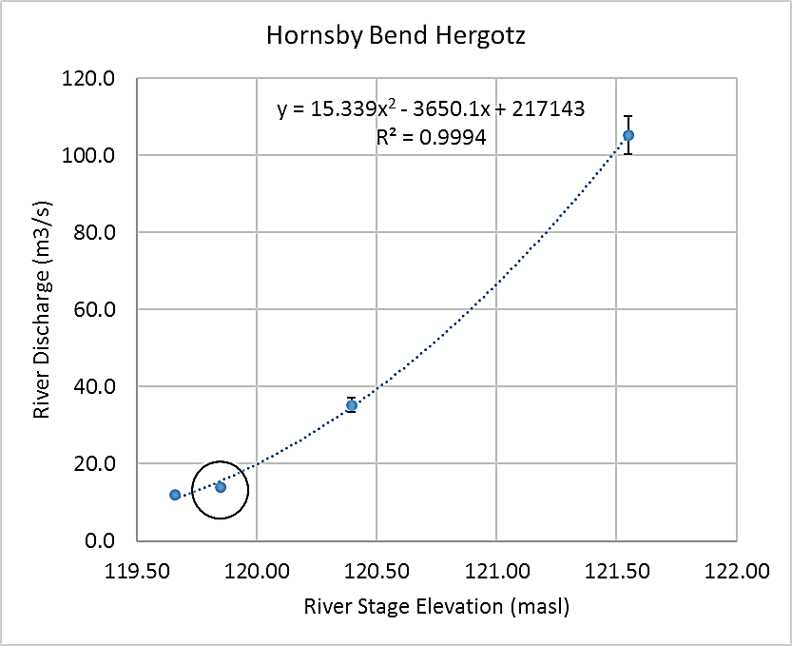
Stage-discharge curves
Provides relationship between water level and discharge.
We have water level time series from pressure transducers.
Allows us to calculate discharge hydrographs from water levels.
Data collected by Peter Knappett’s Research team, Texas A&M, May 2015

Slide 8
Do flood peak arrivals match NFIE RAPID modelled predictions?
Why is downstream site discharge lower?

Slide 9
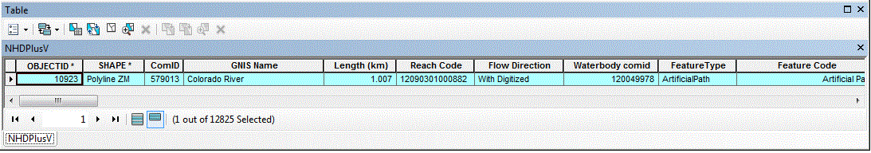
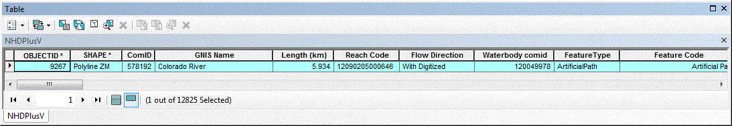
What’s next?
Identify stream segment comids
Create hydrographs from NFIE RAPID data at those stream segments.
Compare flood peak arrival time and discharge between NFIE and measured hydrographs.

Slide 10
Questions?

