Slide 1
Using GIS to apply Paramelle’s method to the search for water in karst terrain
Patricia Bobeck, M.A., P.G.
CE 394K.C
GIS in Water Resources
November 17, 2015

Slide 2
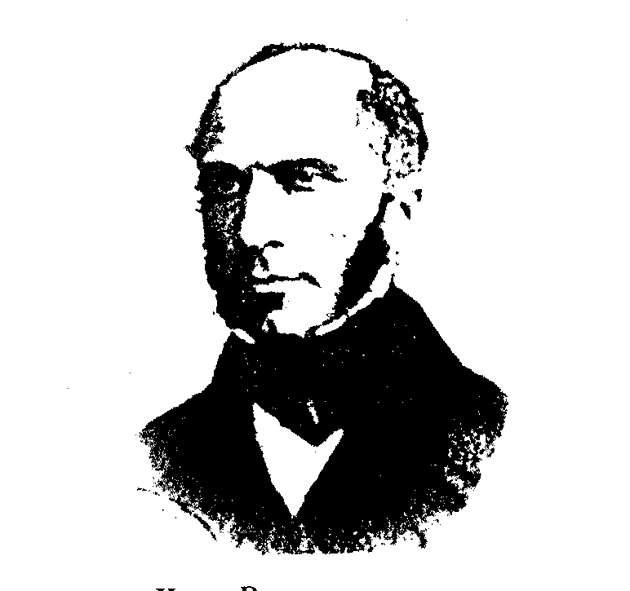
Jean-Baptiste Paramelle 1790-1875
Henry Darcy
1803-1858
The Public Fountains of the
City of Dijon, 1856
The Art of Finding Springs, 1856

Slide 3
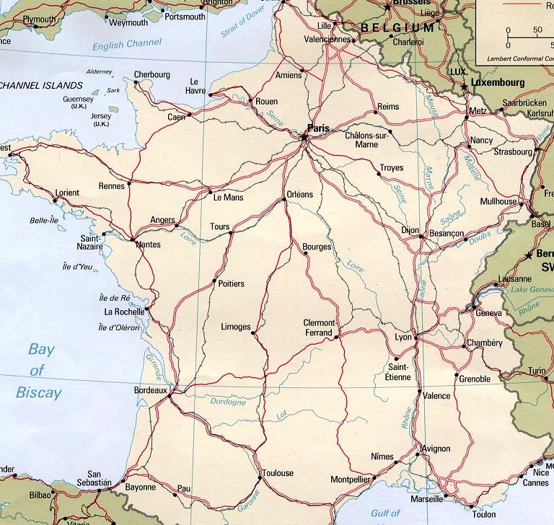
Geology of France, Location of Cahors
Cahors, in the Department of Lot, is located in SW France
Sources BRGM, Internet

Slide 4
Department of Lot: Surface Geology
Source: André Tarrisse

Slide 5
Paramelle’s Observations
Aligned dolines “mark out” underground conduits
An underground watercourse lies beneath a surface depression and rests on an impermeable layer
Evidence for conduits: Water flows out of dolines during storms; flows into downstream dolines during floods
Water flowing through the underground conduit erodes the walls and roof to create dolines
Disseminated dolines also contribute to springs
Surface water:
One thalweg is always lower than others; water follows the lower thalweg
The size of a watershed determines spring discharge
Estimated a 1:12 ratio of spring discharge to rainfall

Slide 6
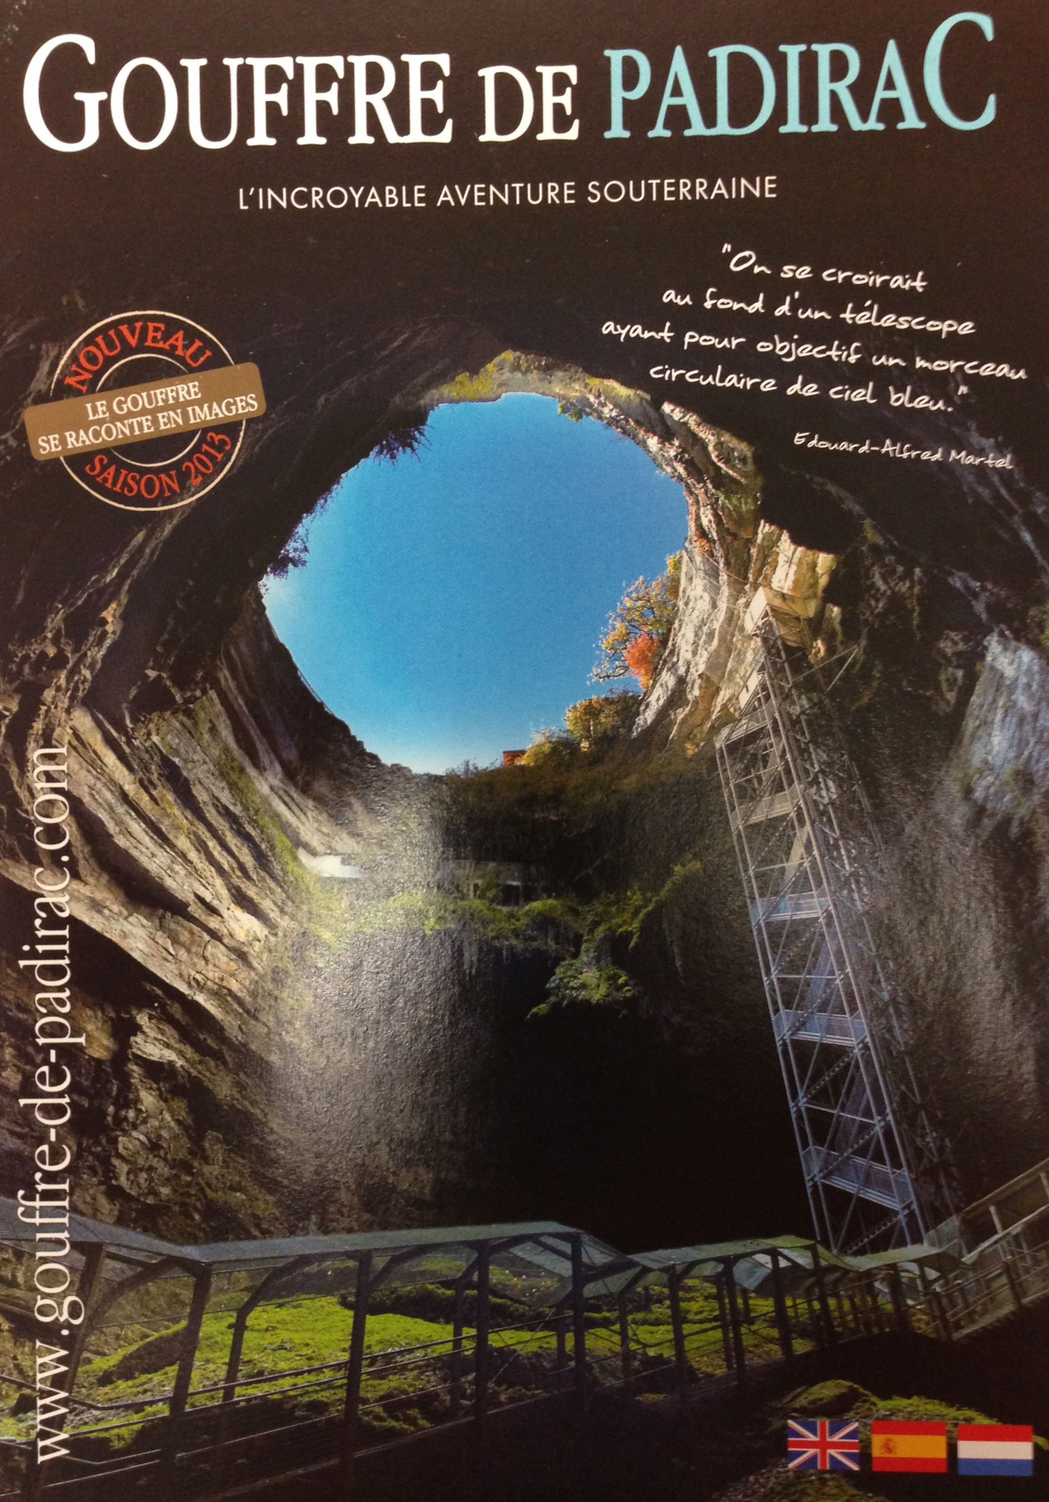
Gouffre de Padirac, Lot
Rim diameter: 35m (115 ft)
Depth: 103m (338 ft)
Subterranean river at bottom
First explored by E. A. Martel in 1889

Slide 7
21st century model of conduit formation Rocamadour, Poumeyssen site, Lot
A. Water moves through fractures and accumulates at a low point where there is a permeability contrast.
B. The accumulated water dissolves limestone until it forms a conduit.
Erosion creates a depression on the surface.
C. The conduit cannot move downward so it develops upward. Intense fractures above the conduit form a vertical shaft.
Source: Chalikakis, 2006

Slide 8
Project goals: Use GIS to
locate areas of surface subsidence on karst that may indicate large volumes of groundwater.
investigate the intersection/superposition of subsidence and faulting and the occurrence/storage of groundwater.
determine if highly productive water wells are spatially associated with the above features.

Slide 9
Study Area: Balcones Fault Zone near Canyon Lake and New Braunfels
30°00’N
98°00’W
98°30’W
29°45’N

Slide 10
GIS Tools
File types: Tiff and DEM
Tools:
Fill ←Spatial Analyst - Hydrology
Raster Calculator ← Arc Toolbox - Map Algebra
Region Group ← Spatial Analyst
Raster to Polygon

Slide 11
Fill tool: Difference between fill and DEM

Slide 12
Surface Geology with Subsidence

Slide 13
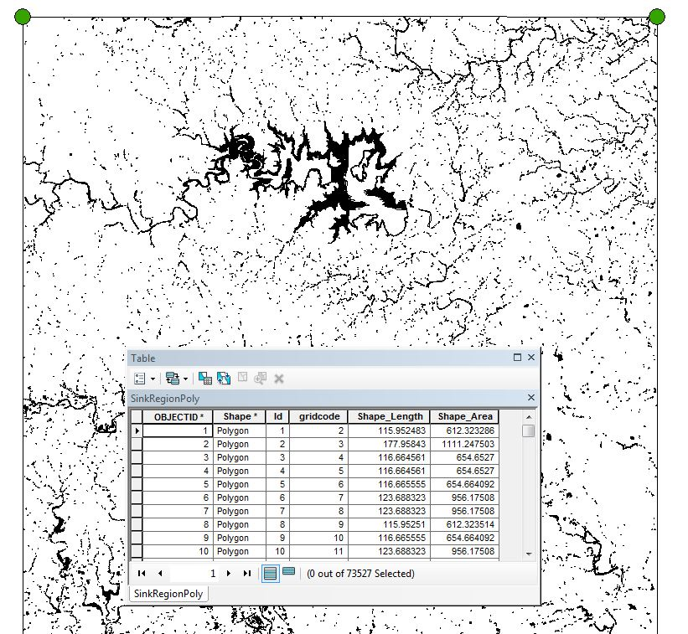

Slide 14
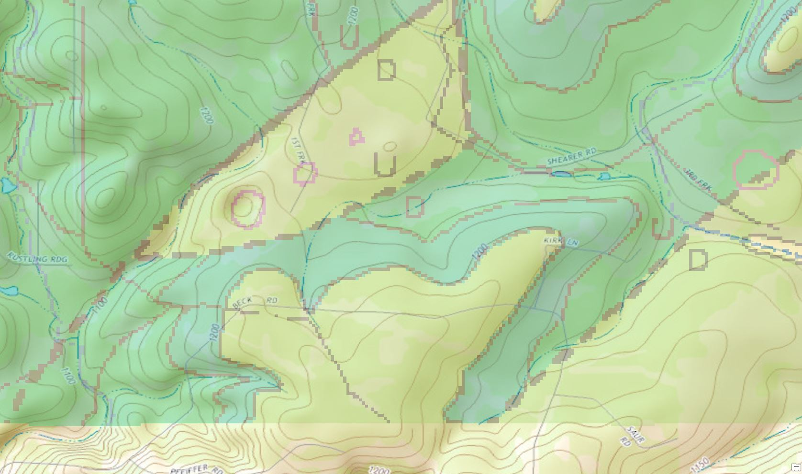
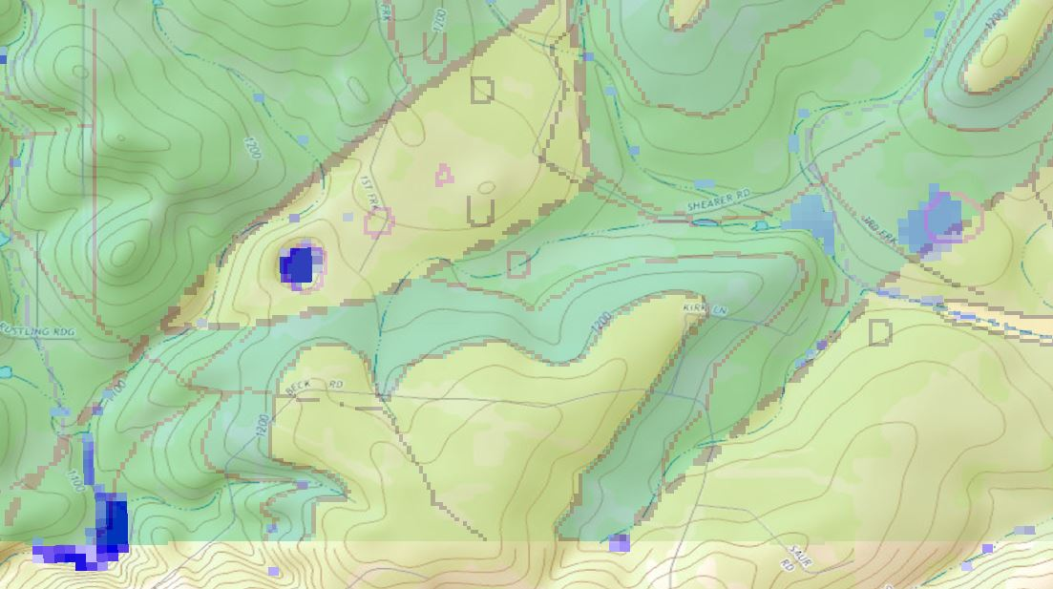
Closeup of SW corner of study area
Top: TIFF shows aligned subsidence areas (dolines, sinkholes)
Align along the strike of faults
Another subsided area intersects with fault
Bottom: TIFF with Elevation Difference superimposed
Elevation Difference
does not indicate all mapped subsidence
indicates some areas not mapped as subsidence area.
Kp = Person Fm, composed of limestone, dolomitic limestone, and dolomite. Person Fm hosts most surface subsidence.

Slide 15
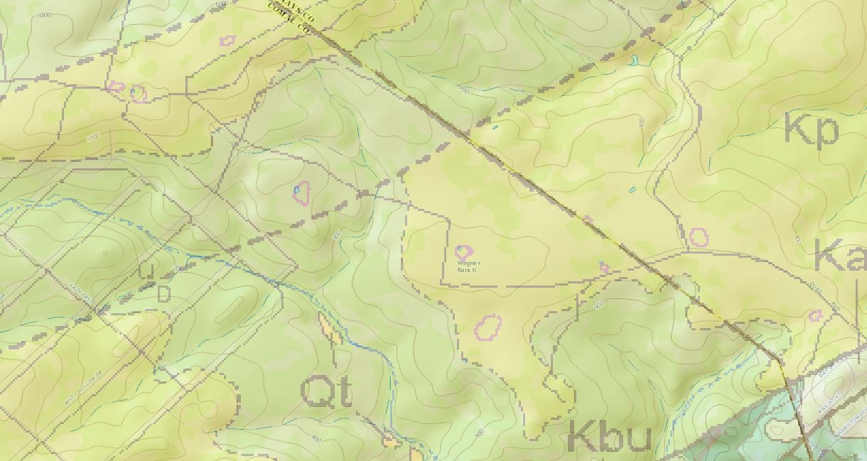
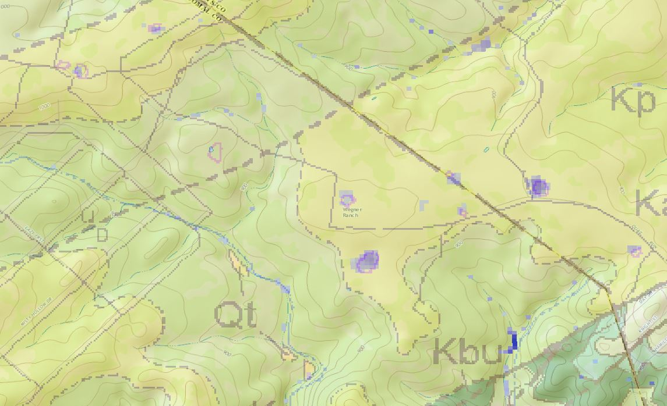
Closeup of SE part of study area shows disseminated subsidence
Top: TIFF.
Bottom: TIFF plus Elevation Difference

Slide 16
Next Steps
Add water well data
Analyze water well data to determine if subsidence areas (or intersections of subsidence and faulting) correlate with high-yield water wells.
Use the method to study karst areas in other areas of Texas and US.

Slide 17
References
Collins, E.W. 2000. Geologic Map of the New Braunfels, Texas 30x60 Minute Quadrangle: Geologic Framework of an Urban-Growth Corridor along the Edwards Aquifer, South Central Texas, Bureau of Economic Geology, University of Texas
Darcy, Henry. 1856 Public Fountains of the City of Dijon
Lattman and Parizek, 1964. Relationship between Fracture Traces and the Occurrence of Ground Water in Carbonate Rocks, Journal of Hydrology
Paramelle, J-P. 1856 L’Art de découvrir les sources

