Slide 1
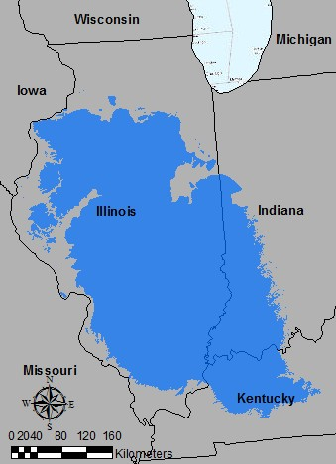
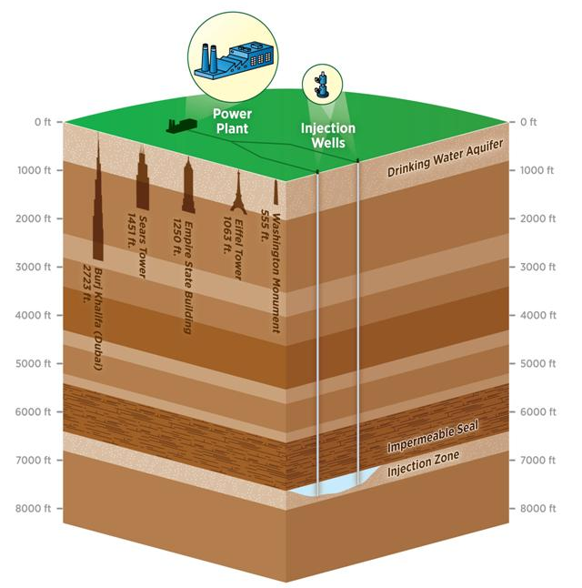
Potential for Geological Carbon Sequestration using deep saline aquifers in the Illinois Basin
GIS Term Project
Julien Botto

Slide 2
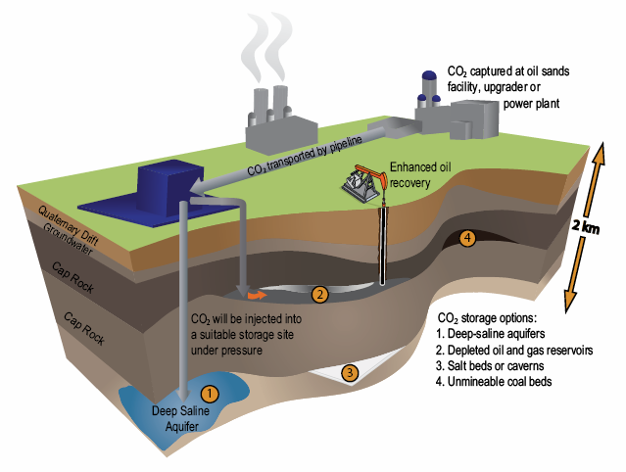
What is geological carbon sequestration ?
Capture of CO₂
Compression and transport of CO₂
Underground injection
Background
Parameters
Future work
Results
Conclusion

Slide 3
Main parameters for GCS in deep saline aquifers
Thickness of the impermeable layer ( >400ft)
Salinity (TDS > 30,000 ppm)
Is it possible?
Thickness of the formation (the higher the better)
How much can we store?
Is it easy?
Pressure ( >1070 psi)
Temperature ( >32°C)
Depth of the formation (8000ft>depth>2500ft)
Permeability (the higher the better)
Porosity (the higher the better)
Is it convenient?
Location of CO2 sources
Location of existing CO2 pipelines
Background
Parameters
Future work
Results
Conclusion

Slide 4
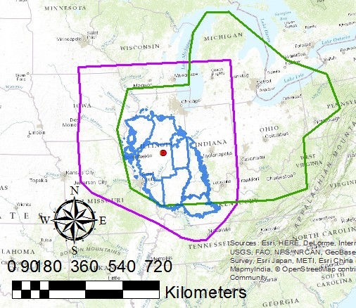
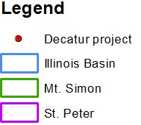
Potential formation candidates
Mt.Simon sandstone is the best candidate
Background
Parameters
Future work
Results
Conclusion

Slide 5
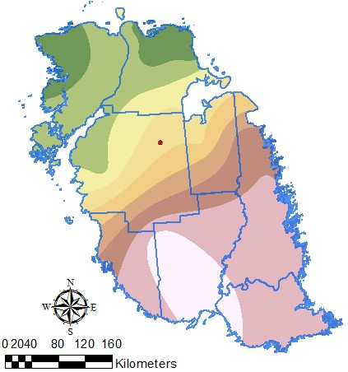
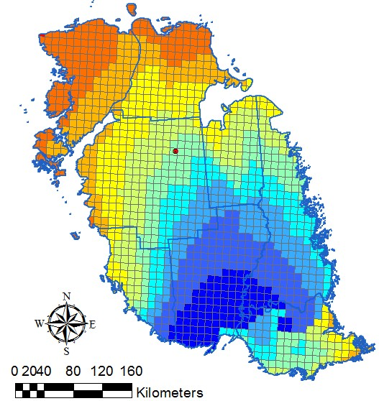
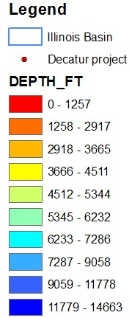
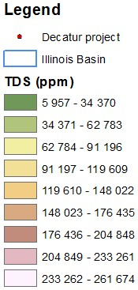
Is it possible?
Background
Parameters
Future work
Results
Conclusion

Slide 6
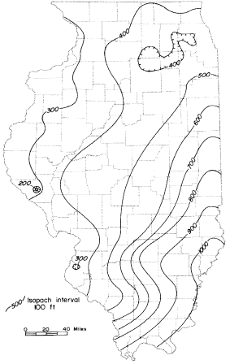
Is it possible? (contd.)
Thickness of the impermeable cap rock (Eau Claire)
Background
Parameters
Future work
Results
Conclusion

Slide 7
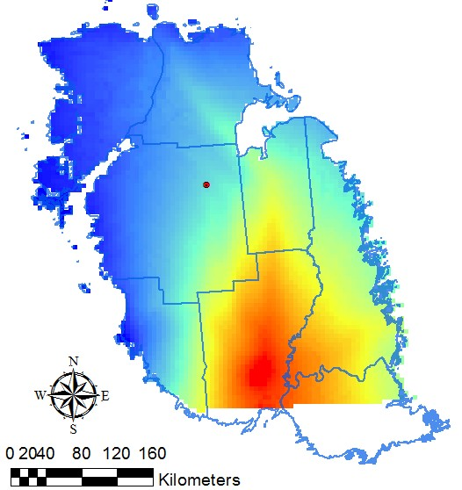
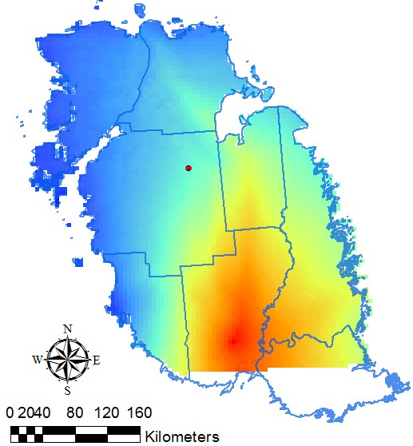
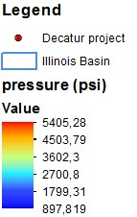
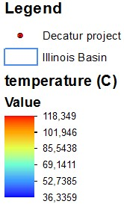
Is it easy?
Background
Parameters
Future work
Results
Conclusion

Slide 8
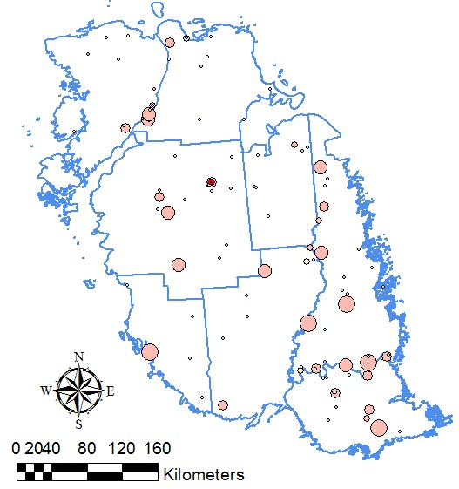
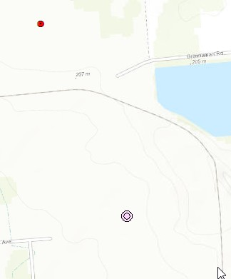
Is it convenient?
818 meters
Background
Parameters
Future work
Results
Conclusion

Slide 9
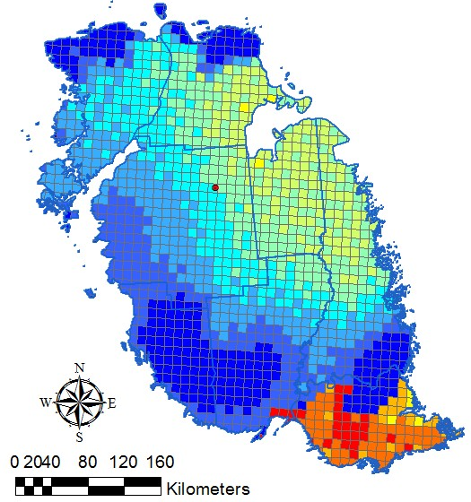
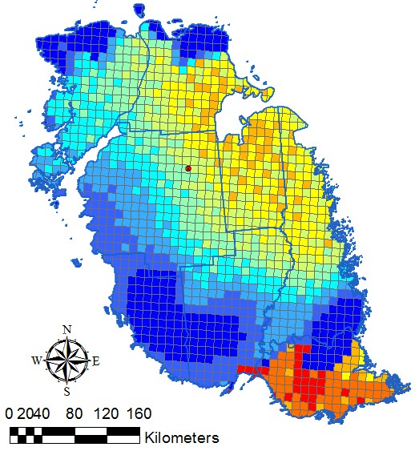
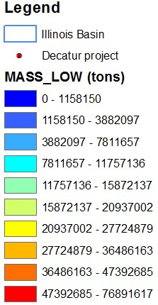
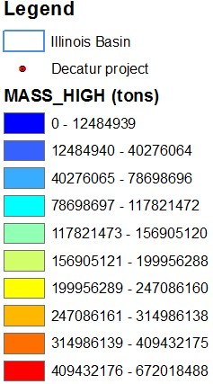
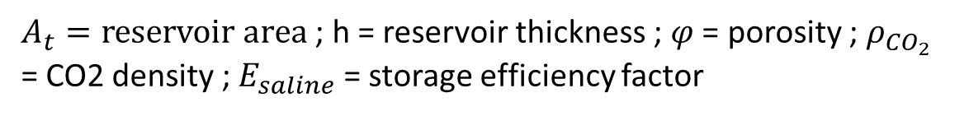



How much can we store?
$A_{t}=reservoir area$ ; h = reservoir thickness ; $φ$ = porosity ; $ρ_{CO_{2}}$ = CO2 density ; $E_{saline}$ = storage efficiency factor
$M_{CO_{2}}=A_{t}h{φρ_{CO_{2}}E}_{saline}$
$$E_{saline}=0.51\%$$
$$E_{saline}=5.5\%$$
Background
Parameters
Future work
Results
Conclusion

Slide 10
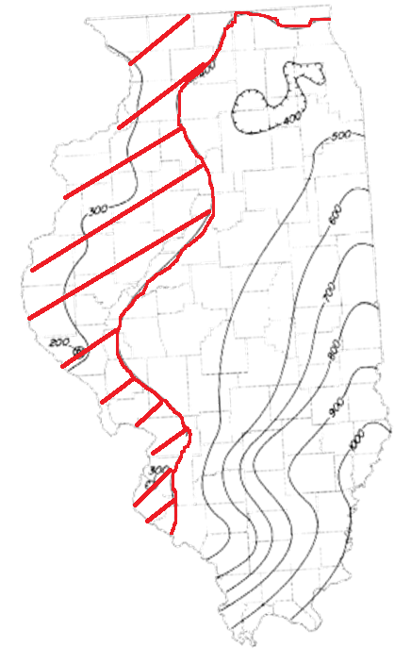
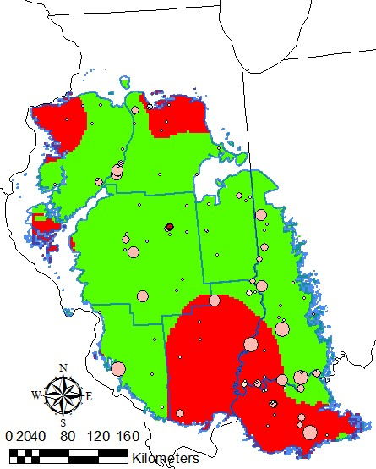
Conclusion
Optimal conditions
Depth [2500;800ft]
Thickness caprock > 400ft
TDS > 30,000 ppm
T > 32 °C
P > 1070 psi
CO2 sources nearby
Background
Parameters
Future work
Results
Conclusion

Slide 11
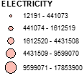
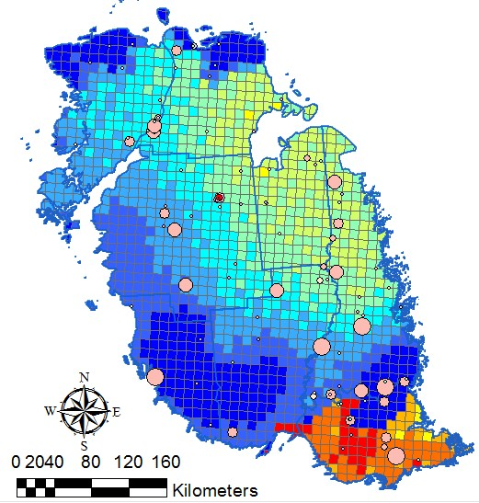
Conclusion
Background
Parameters
Future work
Results
Conclusion

Slide 12
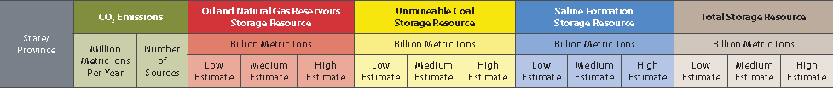
Conclusion
High potential for carbon sequestration in the Illinois Basin!
Background
Parameters
Future work
Results
Conclusion

Slide 13
Future work
Insert the jpeg of the thickness of the impermeable layer in GIS
Find data for missing parameters (CO2 pipelines, permeability)
Background
Parameters
Future work
Results
Conclusion

