Slide 1
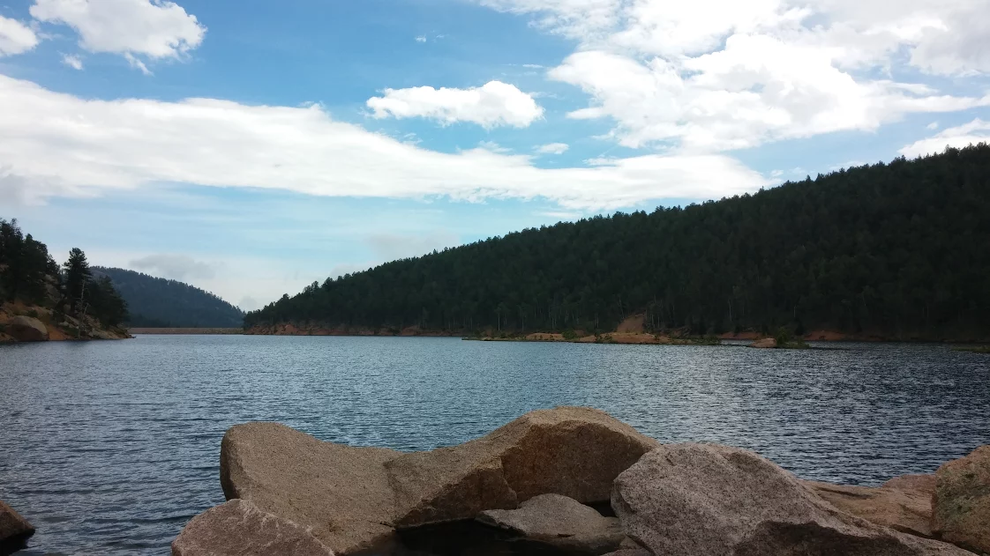
Spatial Analysis of Fluoride and Arsenic Contamination in Colorado Water
Isabella Gee
Environmental and Water Resources Engineering

Slide 2
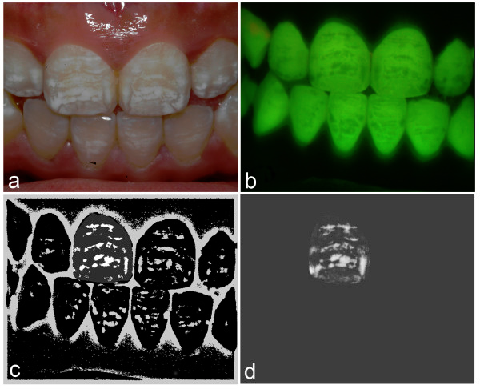
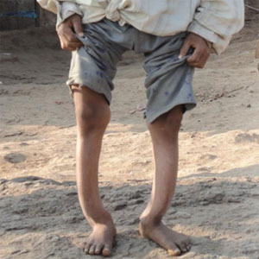
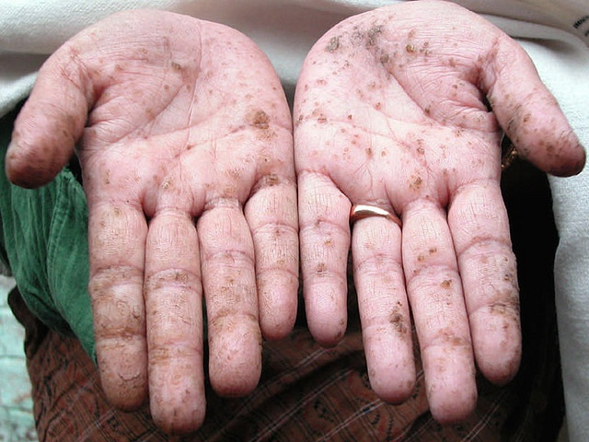
Regulations
Fluoride EPA Limit:
  [F] = 4 ppm
Arsenic EPA Limit:
  [As] = 10 ppb
<2 ppm
Notes:
Dental Fluorosis
Keratosis
Skeletal Fluorosis
BC fluorosis regulated
But may be lowered
Issues for small plants
expeditiously
Some examples of fluorosis and background on Fluoride regulations in the US
MCL is 4ppm, secondary MCL is 2ppm, but that’s non enforceable and just for prevention of aesthetic problems. Aluminum has a secondary MCL at 0.05-0.2ppm
Because the EPA is reviewing fluoride as part of the second 6-year plan, the MCL could be lowered to the WHO limit, which could in turn affect small plants that already have difficulties with fluoride
My research focuses on how small treatment plants can remove fluoride most expeditiously

Slide 3

F⁻
F⁻
F⁻
F⁻
Hydroxyapatite
Ca₁₀(PO₄)₆(OH)₂
Fluoride replaces OH⁻ groups in hydroxyapatite and is remineralized as fluorapatite
Fluorapatite
Ca₁₀(PO₄)₆F₂
F⁻
F⁻
Fluorosis
F⁻
F⁻
Notes:
Example of how fluoride affects the dental enamel
A little bit is beneficial as it protects from caries and cavities, but if it continues it can cause fluorosis

Slide 4
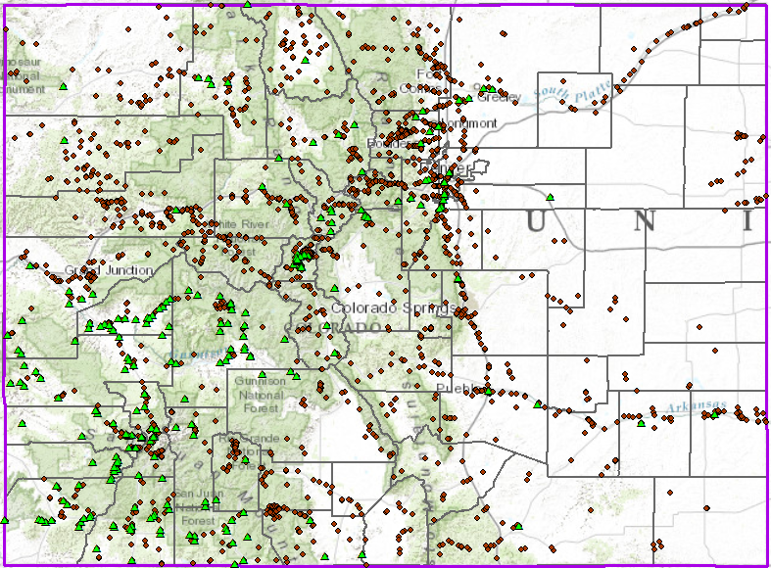
Data Sample Sites
Influencing Factors
Geology
Hydrology
Goals:
Interpret Fluoride and Arsenic data for trends
Identify areas of high risk for contamination
Investigate potentially impacted Water Systems

Slide 5
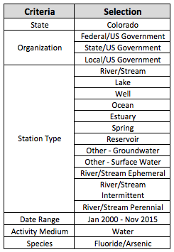

STORET Data Collection
All Government Data
All Relevant Water Sources
Basic Parameters

Slide 6
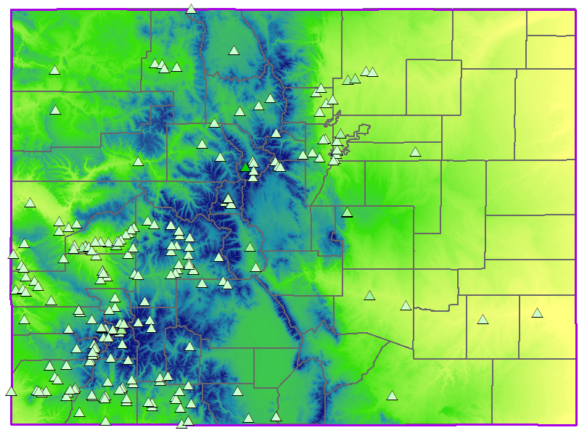
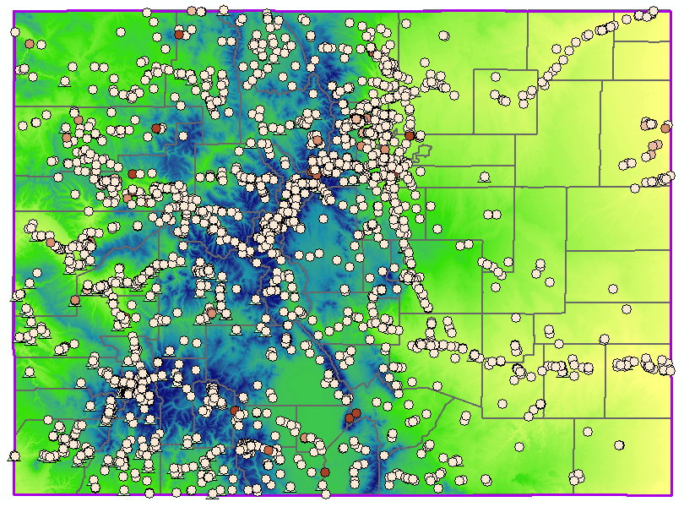
Colorado Geology
Notes:
SUMMIT County

Slide 7
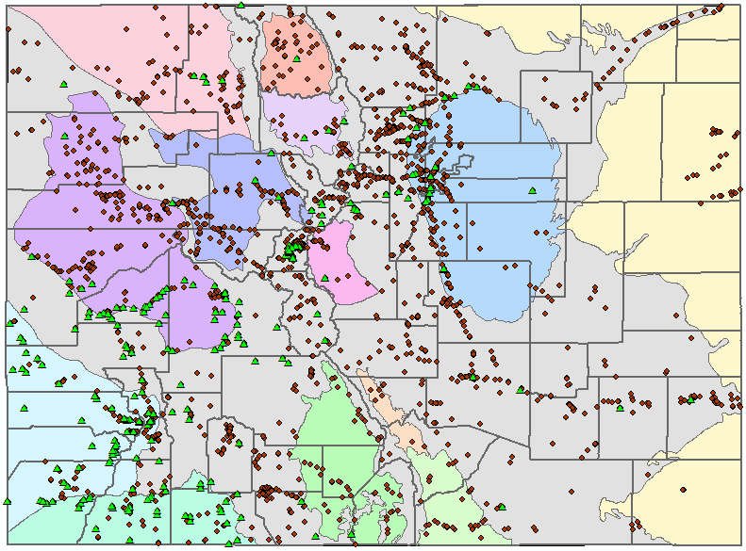
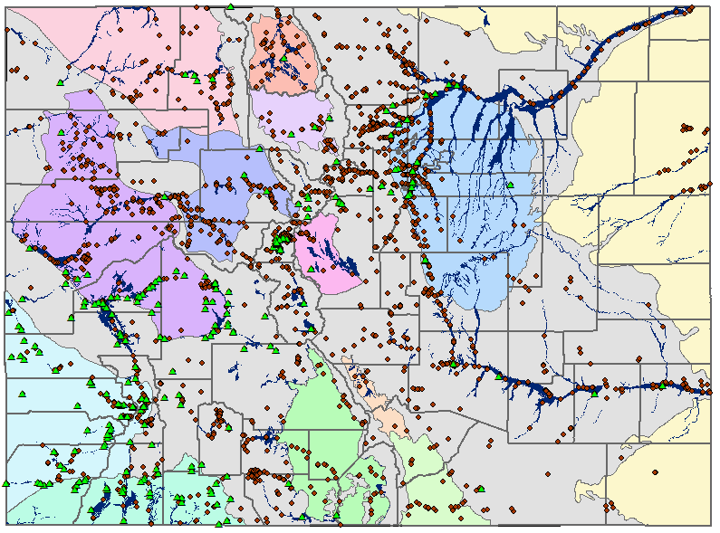
Colorado Hydrology
13 unique bedrock aquifers
Alluvial Aquifers: Streams and Creeks
Notes:
Groundwater located close enough to surface water to receive direct surface water recharge → means it’s at risk for certain pathogens and viruses groundwater isn’t typically known for

Slide 8
Distribution of Water Sources in CO Community Water Systems
1%
2%
17%
7%
54%
19%
Notes:
Going to link number of water systems and distributions to the counties

Slide 9
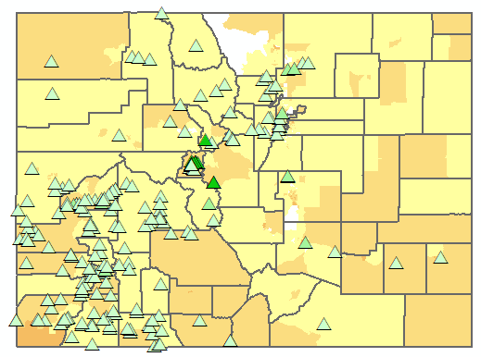
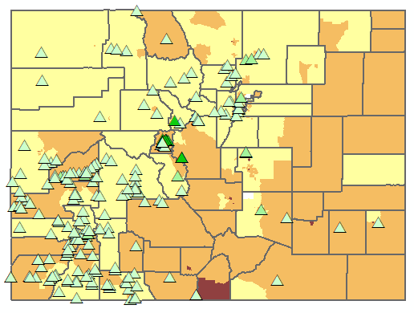
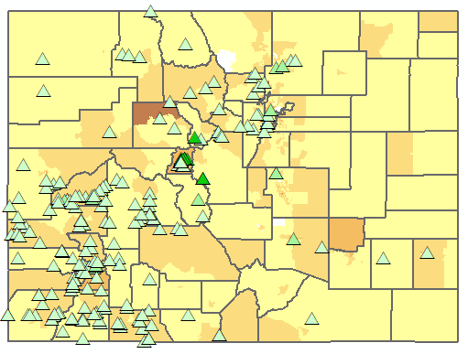
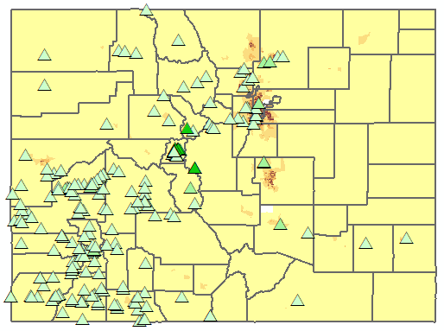




Colorado Demographics
Legend
Average Household Income
Population density (per SQM)
% Families Below the Poverty Level
Unemployment
Notes:
Families below poverty level High pop density in Colorado Springs and Denver Area
Income
Unemployment
Pop density

Slide 10
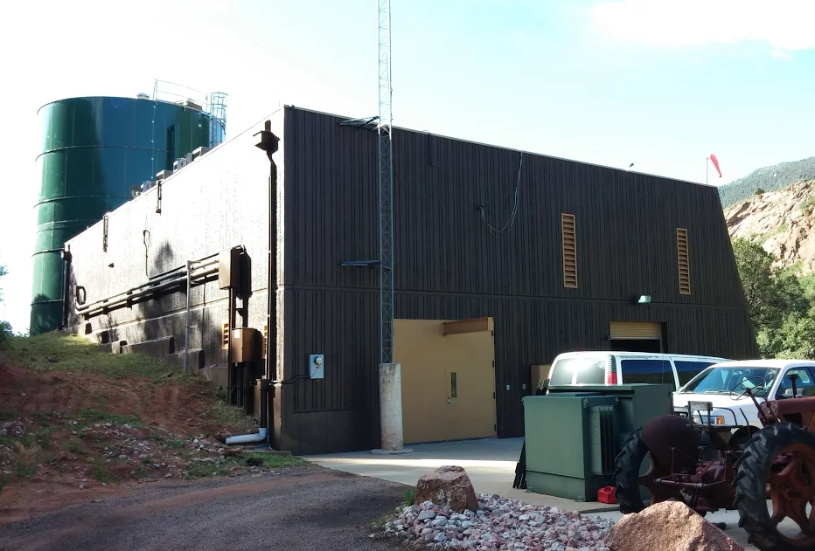

To Do
Data processing and interpretation
  Where is contamination occurring?
  What are the physical trends?
NHDplus stream mapping
Further demographic studies
  Who is at risk?
County and Water System Identification

