Slide 1
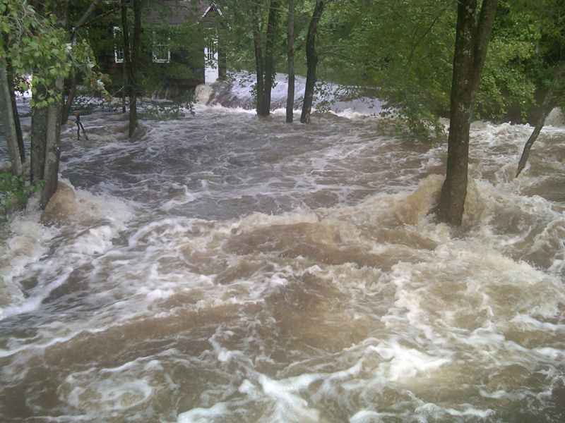
Hurricane Irene in Connecticut River Milena Spirova CE 394 K 2015

Slide 2
Connecticut River Facts
Located in New England Region
Begins at Fourth Connecticut Lake (Canada)
Flows to Long Island Sound. Accounts for 70% of the fresh water influent.
Has about 16 dams on the main stem. 12 of them used for hydropower.
Length: 410 miles
Drainage Area: ~11264 mile² (Estimated with ArcMap)
Average annual precipitation is ~ 45 inches

Slide 3
Hurricane Irene in Connecticut River
August 15th – August 31th 2011 (Hits US on August 27th)
Classified as Tropical Storm (Category I hurricane)
Highest Rainfall occurred in VT – 8 inch
Most affected state was Vermont. More than 500 miles of roads and more than 15 bridges were destroyed. Cost about $800 million.
Over 2 million outrages – homes and businesses
Total New England damage of about $2 billion
More than 10 lives lost in CT, MA, VT, and NH

Slide 4
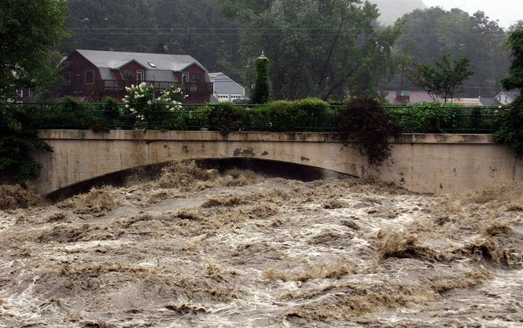

Slide 5
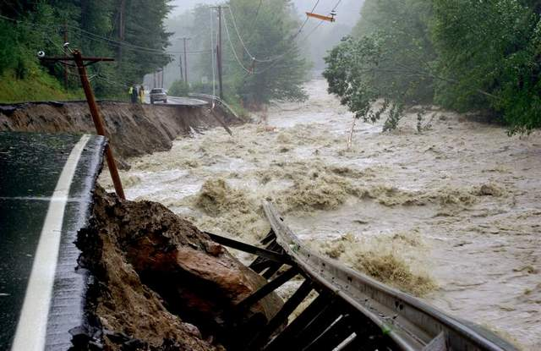

Slide 6
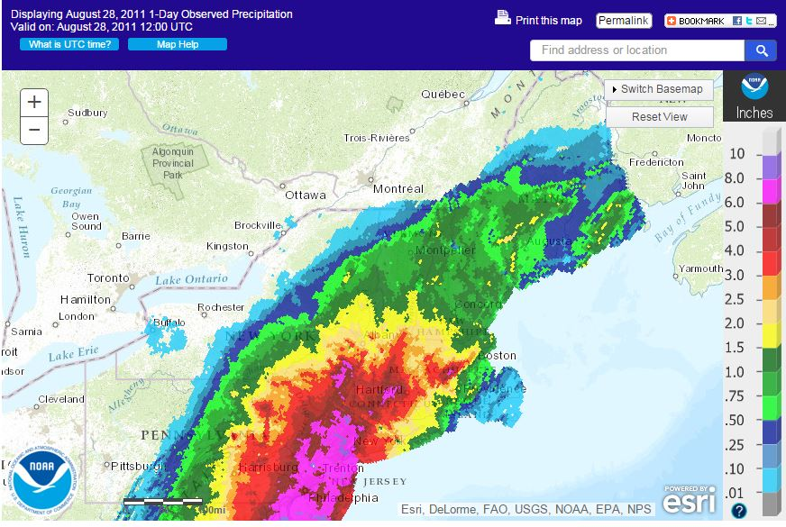
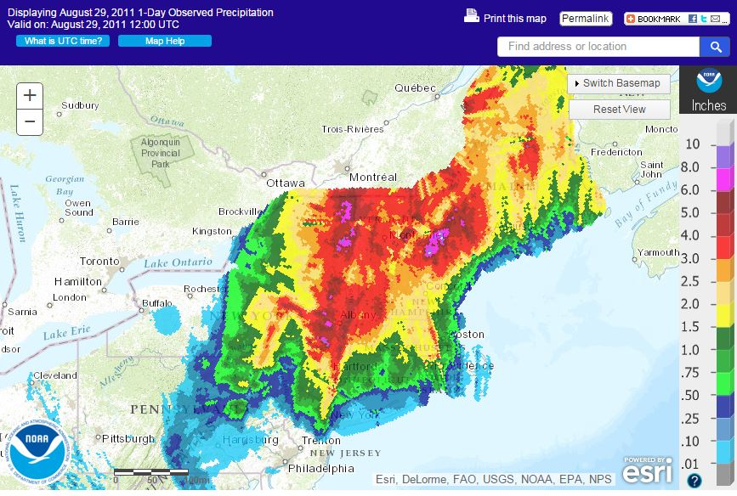
Daily Rainfall Totals for 28th and 29th of August in New England Region

Slide 7
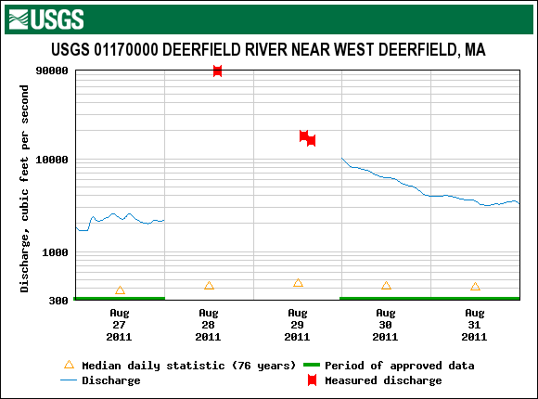
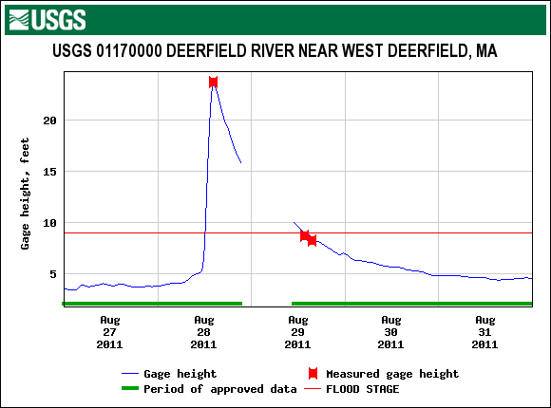
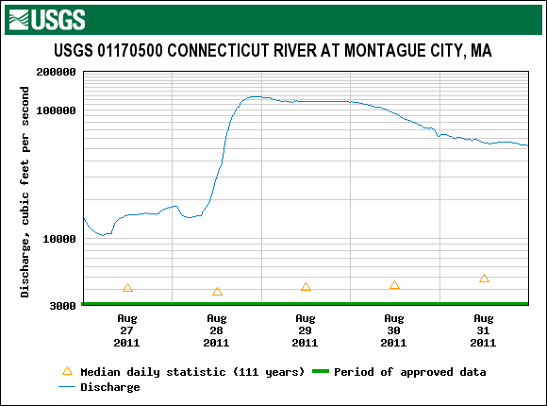
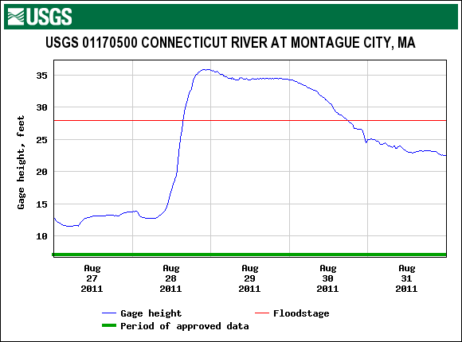
USGS 01170000 Deerfield River near West Deerfield, MA
USGS 01170500 Connecticut River at Montague City, MA

Slide 8
Data
Databases
NHDPlusV21 for the Northeast Region (HUC2 is 01)
Watershed Boundaries
Catchments
Flowlines
Water bodies
Stream Gages
Elevation Dataset
USGS National Elevation Dataset – NED30
NLCD 2011 – National Land Cover Database
SSURGO – Soil Survey Geographic Database
NLCD 2011 – Percent Imperviousness
Precipitation gage stations and hourly data obtained from NOOA as csv file

Slide 9
Progress
Basin Boundary was created using NHDPlusV21 watershed boundaries dataset and Dissolve tool in ArcMap
DEM was created by clipping NED30 to a 1000 m buffer
Flow lines and main stem were created in Basemap feature dataset
Stream gage feature class was exported from NHDPlusV21
Data for HEC-HMS model – using AutoHMS Get Data tool
Percent Imperviousness
Land Cover
Soil Groups

Slide 10
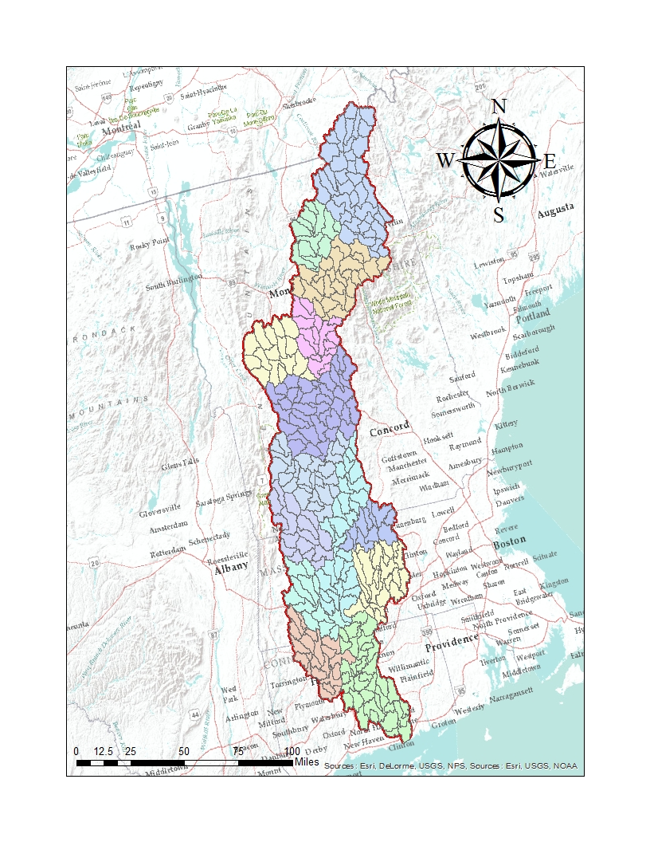
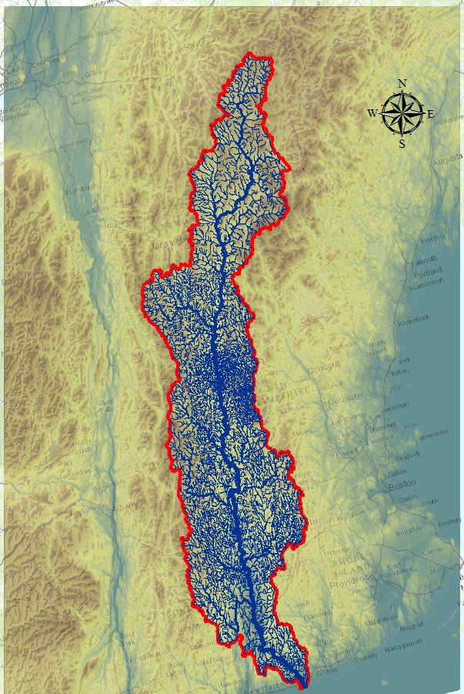
2 HUC 6
14 HUC8
76 HUC10
307 HUC12

Slide 11
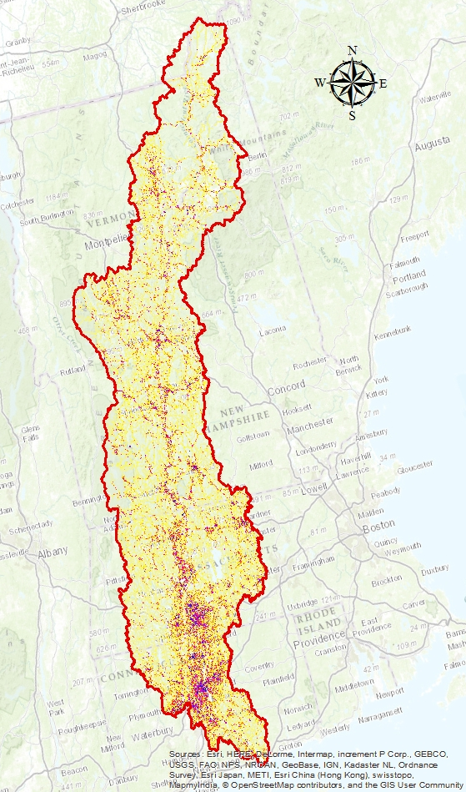
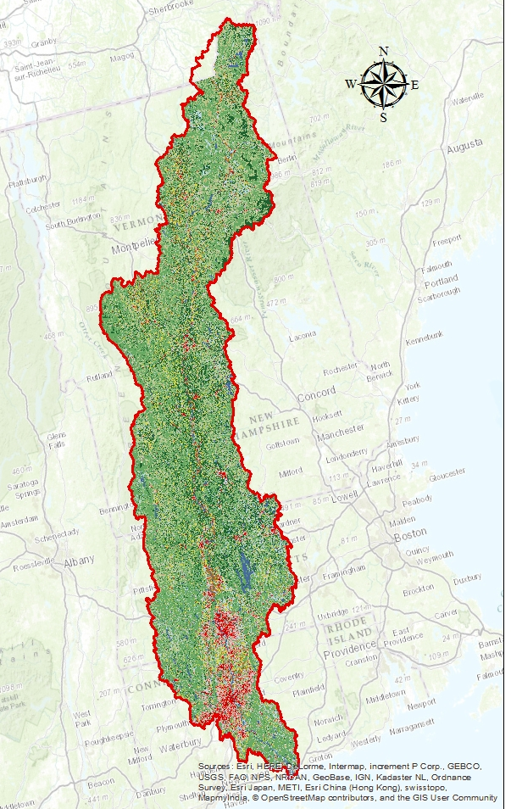
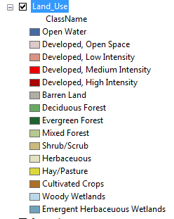

Slide 12
Issues and Lessons Learned
It takes a lot of time to find data (especially when getting familiar with the sources for the first time)
Initially project objective was to build HEC-RAS hydraulic model, but could not find appropriate elevation dataset

Slide 13
To Do List
Hydrologic Terrain Analysis
Create HEC-HMS Model
Create Flood Inundation Map

