Slide 1
Phytoplankton Aggregate Events And How They Relate To Sea Surface Slope; for July 2015
Emily Anderson
UT Marine Science Institute

Slide 2
My Question:
Do July aggregate events occur more often in areas of high sea surface slope?
  What information can I look at to answer this question?
    Aggregate Events
    Sea Surface Slope
  How can ArcGIS Help me?
    Mapping
    Time Series Mapping
    Statistical Analysis

Slide 3
Phytoplankton Aggregate Events in July
Measurements from the wave/sun powered, satellite controlled, marine robot: Honey Badger
For this project I used Fₒ (a measurement of chlorophyll fluorescence)
MS Excel: Convert raw data to show statistically significant events (Spikes)
  Find the standard deviation of the raw data
  Find instances where the measured value is greater than 3*SD
  Export these events into GIS to map them with sea surface slope

Slide 4
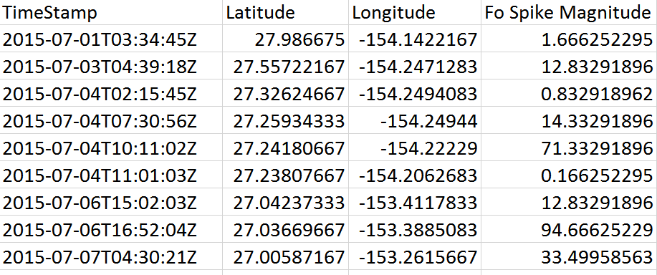
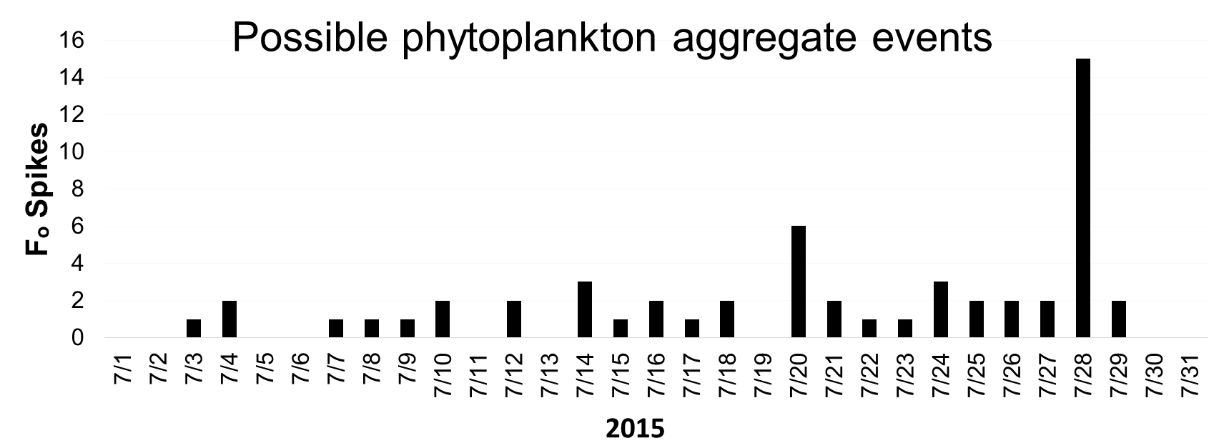

Slide 5
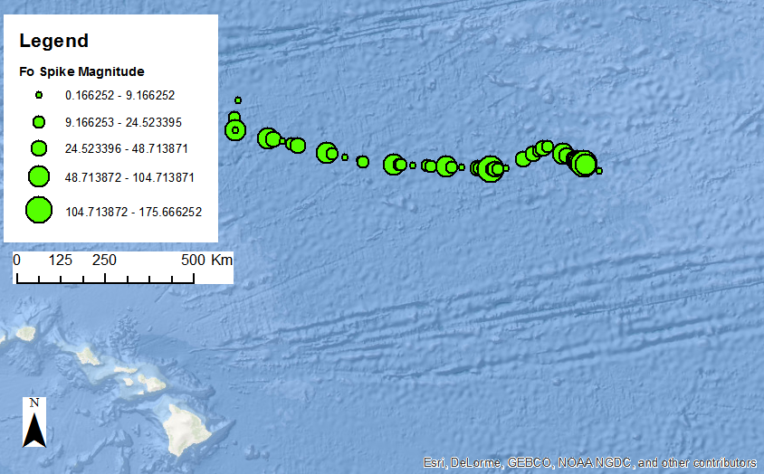

Slide 6
Quick note:
The oceans are not flat
The oceans have hills and valleys
These hills and valleys are formed by winds, currents, pressure systems, and the Earth’s rotation
These hills and valleys are slowly and continuously changing

Slide 7
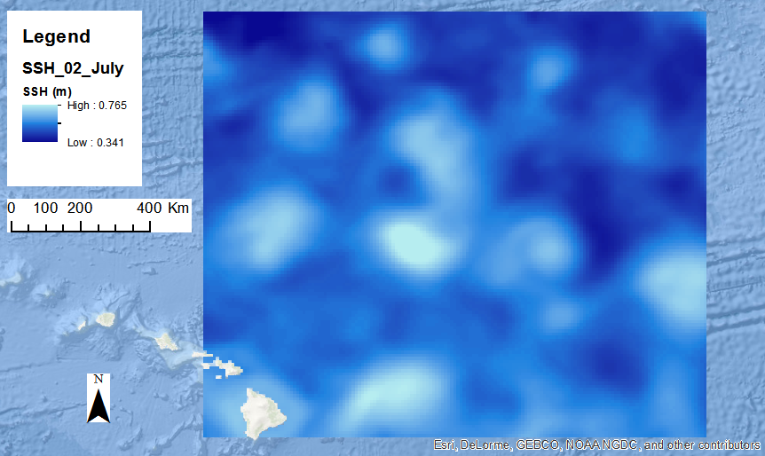

Slide 8
July Sea Surface Slopes
SSH data from ERDDAP Data Server
Use GIS to convert the gridded data into raster format
Use the Slope Tool to convert the SSH raster into a Sea Surface Slope raster
Repeat for 29 days of data (no SSH data for 2 days)

Slide 9
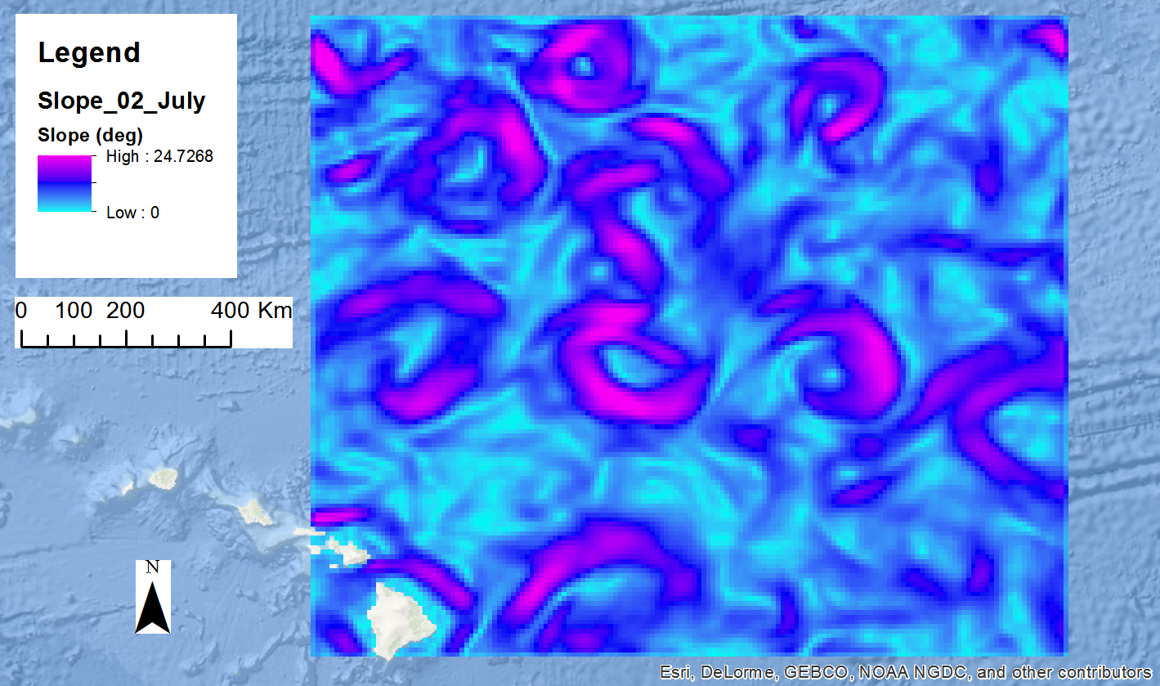

Slide 10
How can ArcGIS Help me?
Mapping
Time Series Mapping
Statistical Analysis

Slide 11
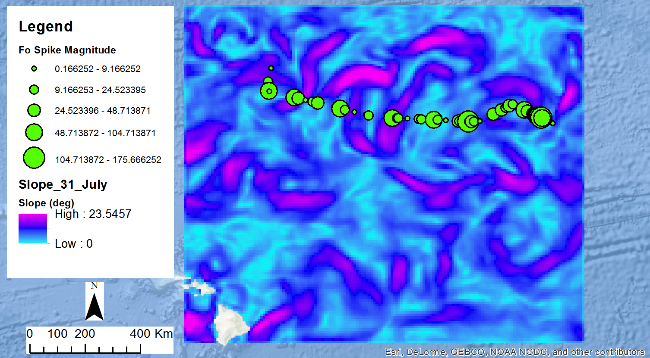
Mapping

Slide 12
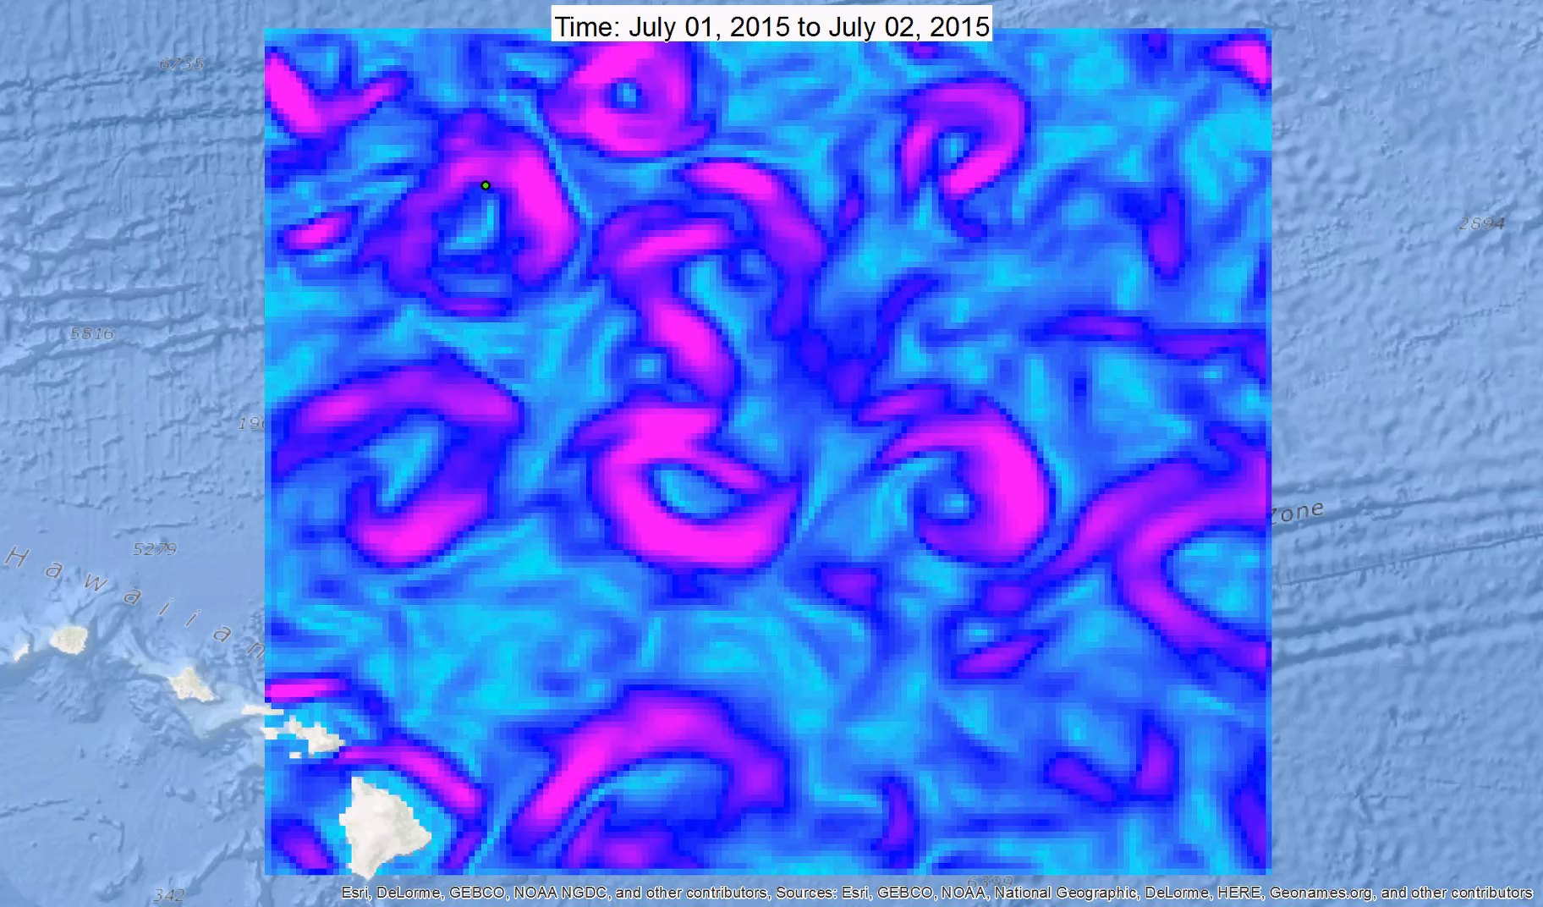
Time Slider Animation of Aggregate Events and SSH Slope
Hawaiian Islands

Slide 13
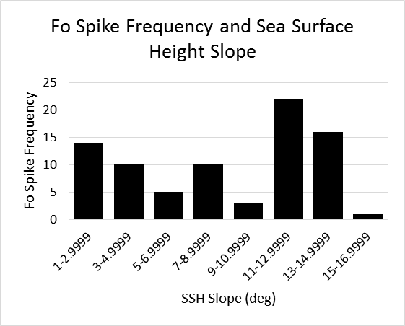
Statistical Analysis
Are the aggregate events more common in areas of higher Sea Surface Slope?
  Maybe, maybe not?

Slide 14
Conclusions and Future Work
Right now, the data does not seem to support the hypothesis that the slope affects the frequency of Fₒ spiking events
However:
  The data set is very small (only 81 Fₒ Events in July)
  Additional data will provide further evidence to more strongly support or reject the hypothesis.
    Honey Badger has data from June-October
      Future work will include this data

Slide 15
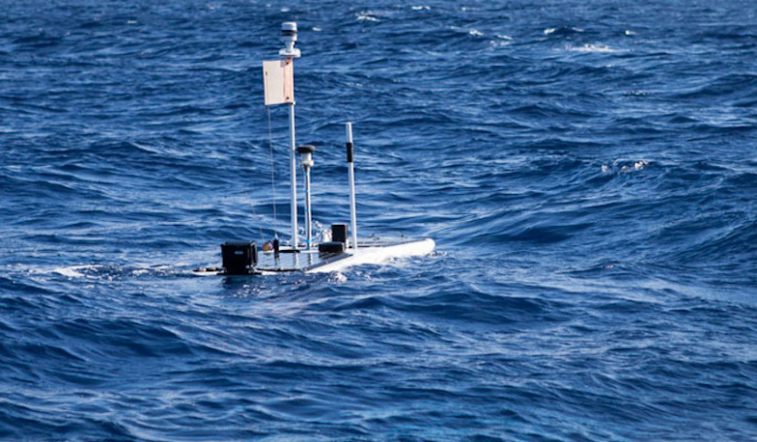
Thank you

