Slide 1
Runoff Water Management at Kirandul Mountain Range, India
Presented By
Anamika Kumari
UID: ak35339

Slide 2
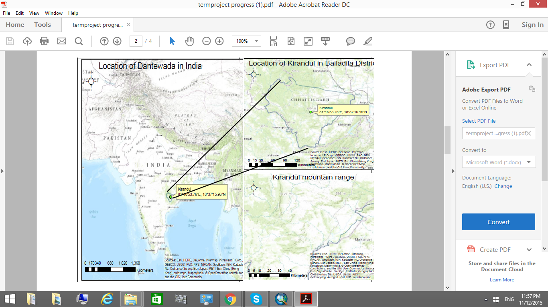
Location of Kirandul Mountain Range
EDIT IN POWERPOINT®
Go to the File menu and select Download as Microsoft PowerPoint. You will get a .pptx file that you can edit in PowerPoint.
Remember to download and install the fonts used in this presentation (you’ll find the links to the font files needed in the Presentation design slide)

Slide 3
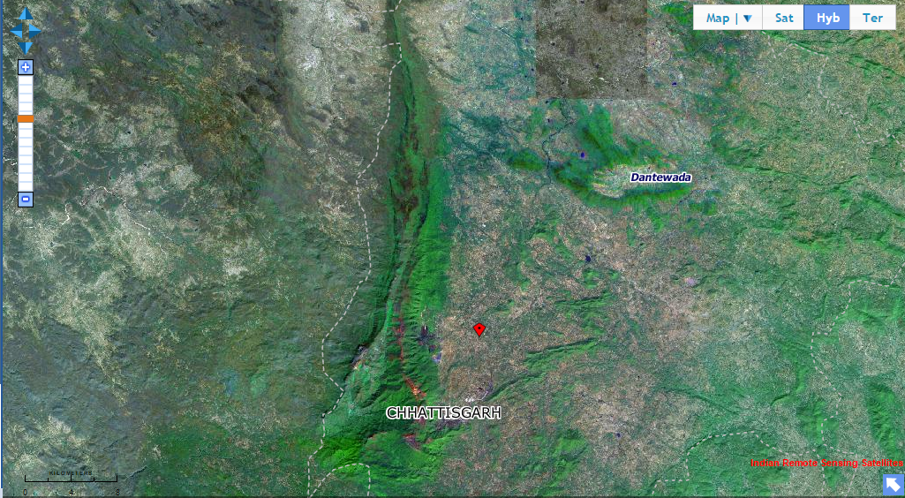
Satellite view of study region

Slide 4
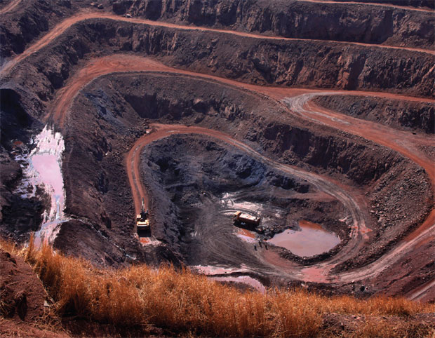
Transition headline
Close view of Mining at Kirandul Mountain Range
1

Slide 5
Sankhini River is the main source of water in the whole region
The runoff from the mine goes to Sankhini river.

Slide 6
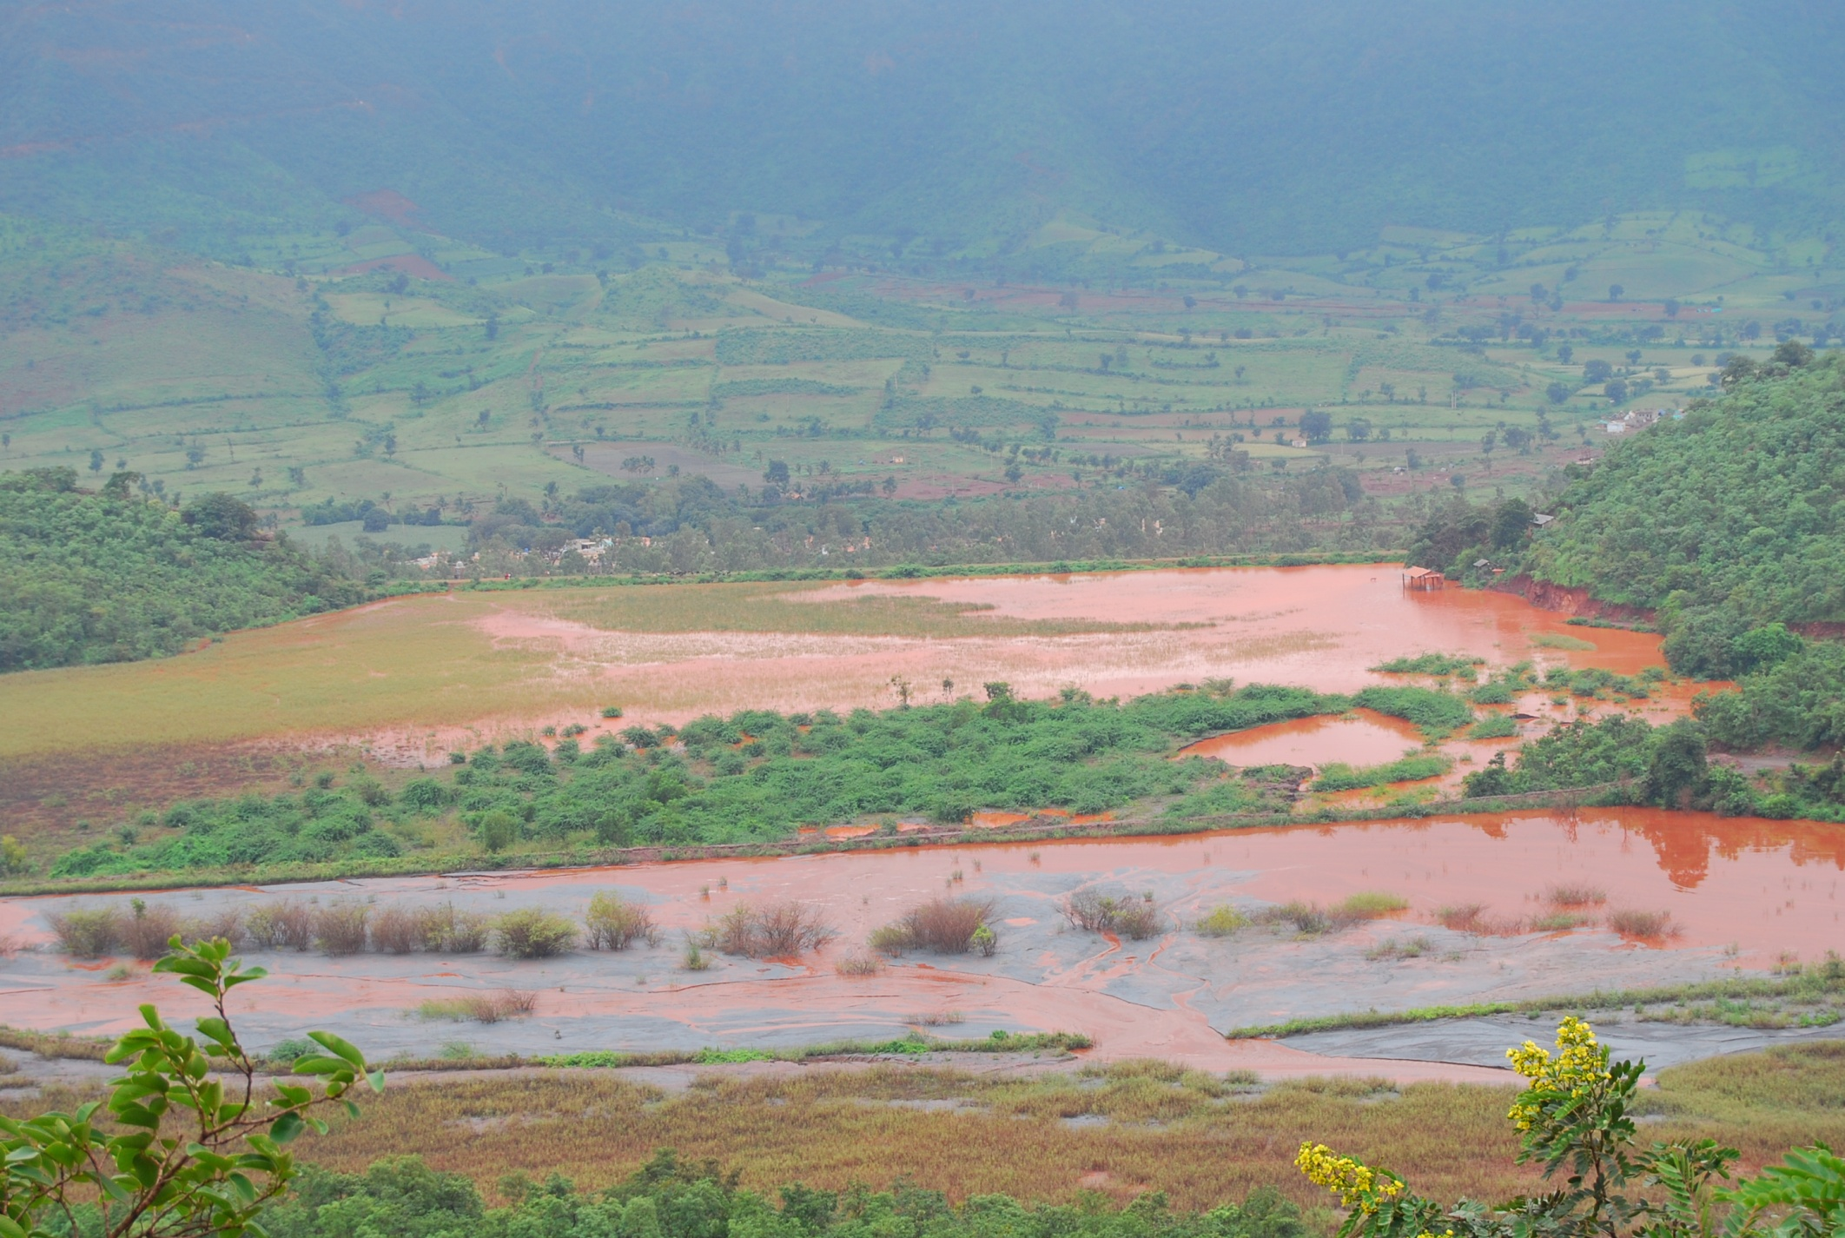
THIS IS A SLIDE TITLE
Tailing Dam

Slide 7
Objectives
Develop flow lines through DEM data.
Collect land cover data
Collect Rainfall data
Collect soil data
Develop Hydrological model
Calculate the volume of water flowing from mountain to river

Slide 8
Constraints
1. NHD Plus data: Not available to download
2. Flow Lines data: Not available to download
3. DEM Data: Available in CARTOSATDEM Version 1 (30m resolution)
4. Rainfall data: Available district wise but not region wise.
5. Soil data: Not available for study area.
6. Landuse data: Not available to download

Slide 9
Digital Elevation Data
Blue
Is the colour of the clear sky and the deep sea. It is located between violet and green on the optical spectrum.

Slide 10
Watershed and Stream Network Delineation with ARC HYDRO
DEM Manipulation
Fill Sinks
Flow Direction
Flow Accumulation
Stream Definition
Stream Segmentation
Catchment Grid Delineation
Catchment Polygon Processing
Drainage Line Processing

Slide 11
Subbasin and Watersheds

Slide 12
Flowlines to River

Slide 13

Rainfall Data Availability

Slide 14
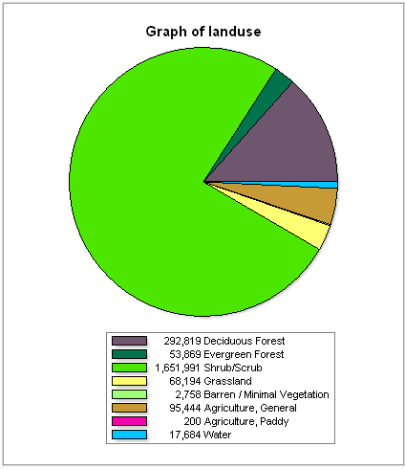
Landuse Map

Slide 15
Soil Class
As per UNESCO convention of Soil Classification
Luvisols:
Soils with strong accumulation of clay in the B-horizon and not dark in color. Under the revised legend, these soils have clays with high cation exchange capacity.
Lixisols: New soil class, formerly Luvisols, with clays having low cation exchange capacity.

Slide 16
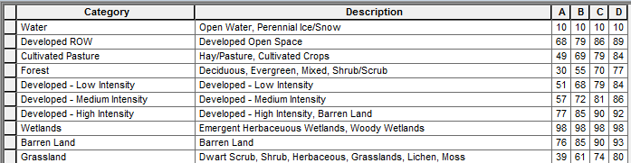
Retardance Factor Table
Our Area is mainly Type B

Slide 17
Curve Number Map

Slide 18
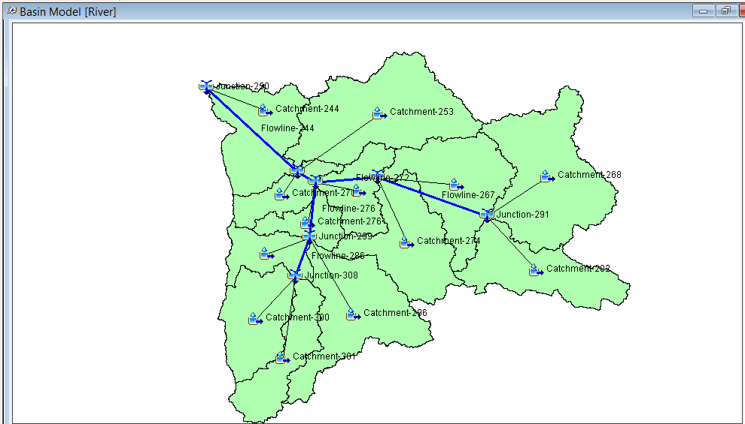
HEC HMS Model

Slide 19
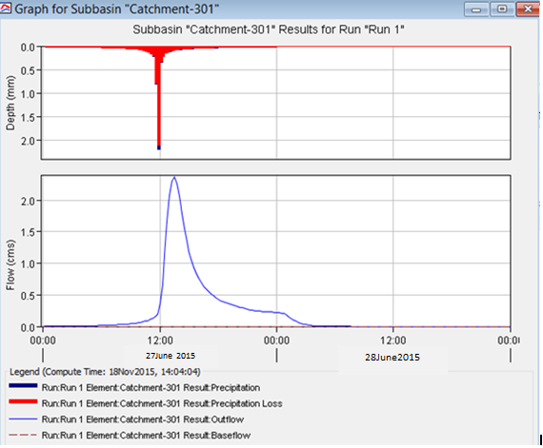

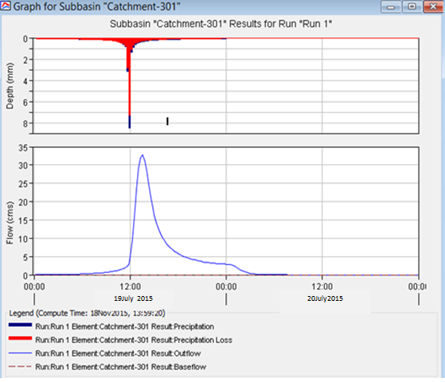
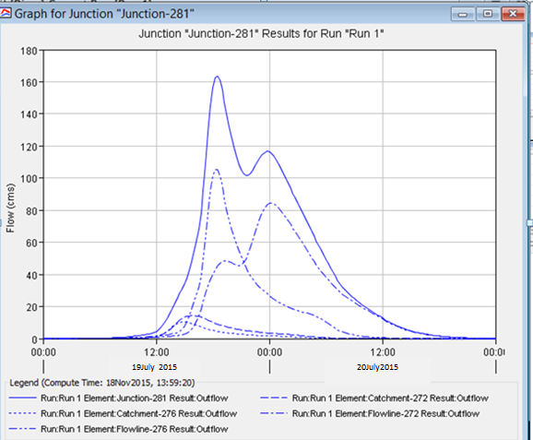
Data Analysis (June - July)
June 2015
Maximum rainfall: 7.90mm on 27th June 2015
July 2015
Maximum rainfall: 30.73mm on 19th July 2015
Source: NMDC Limited

Slide 20
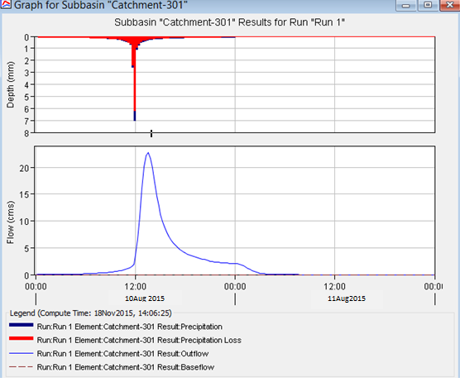
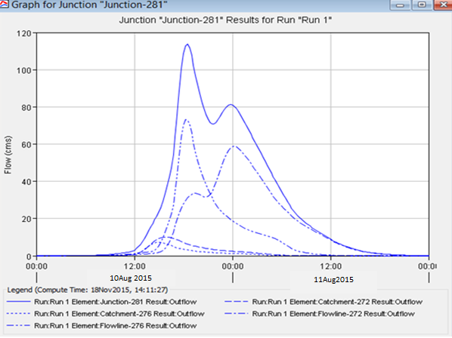
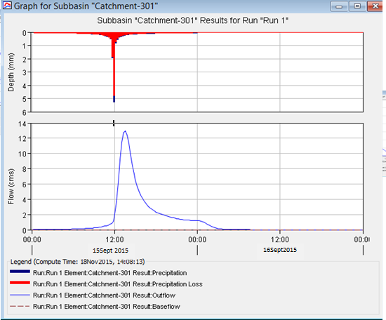
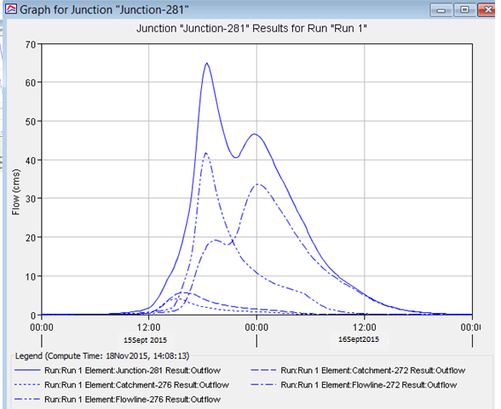
Data Analysis (August - Sept)
August 2015
Maximum rainfall: 25.37 mm on 10th August 2015
September 2015
Maximum rainfall: 18.92mm on 15th September 2015
Source: NMDC Limited

Slide 21
Conclusion
The run off from the mountain range meeting the Sankhini river is almost one third of total run off.
It takes 5 hours for water to reach the Sankhini river from the mountain range.
Maximum run off near the mountain was around 33.4 m³/s on 19th July 2015 and total runoff to the river was 163 m³/s.
Stream lines can be made available to entire India for free download.
If proper data is made available, more accurate results can be achieved that can help in better water management practices.

Slide 22
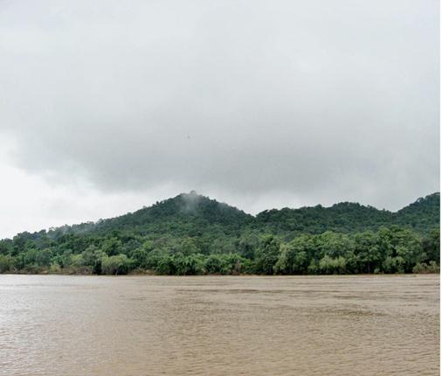
Need to work on:
Analyze the rainfall data of previous years and figure out the maximum run off water from this mountain range for which best treatment method can be adopted.
Find the best location to divert this whole runoff water for collection and settlement.

