Slide 1
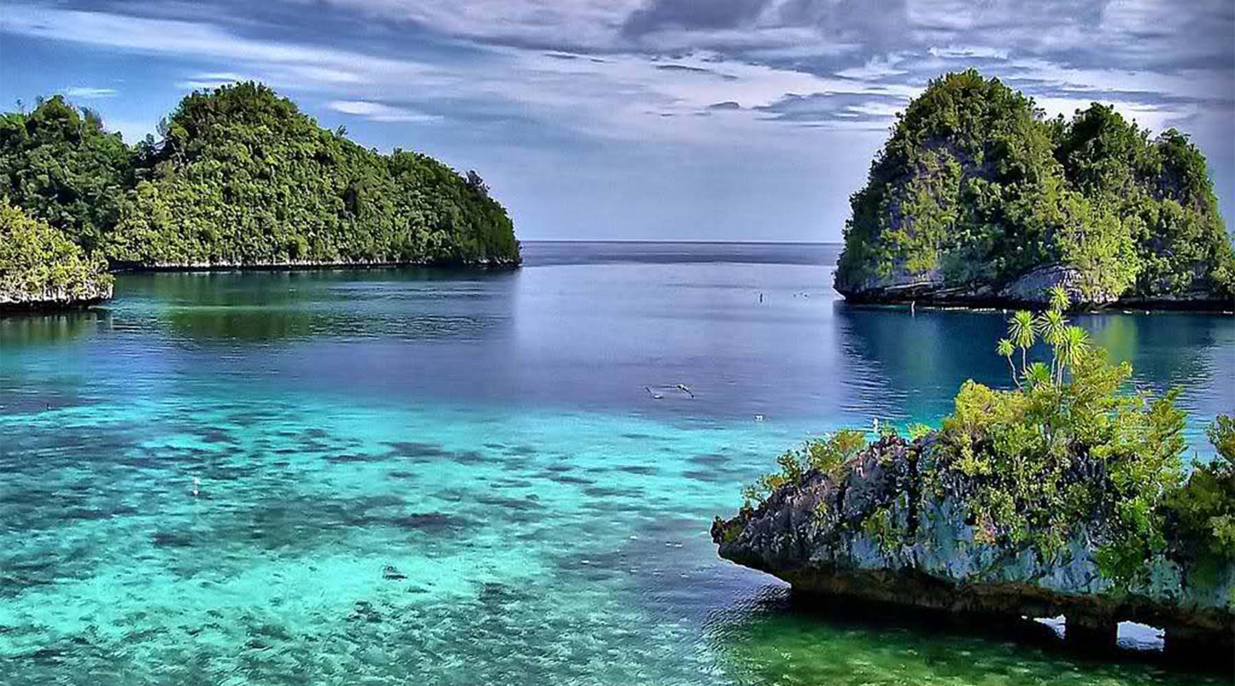
Flooding in the Philippines
GIS in Water Resources Engineering Term Project Presentation
Jonathan David D. Lasco
Cover photo: http://www.palawanresortshotels.com/el-nido-palawan-the-philippines-hidden-paradise/

Slide 2
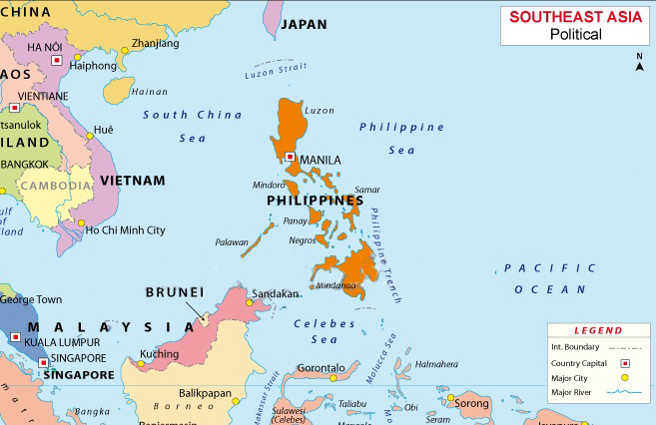
General objective
To apply GIS principles in discussing flooding in the Philippines

Slide 3
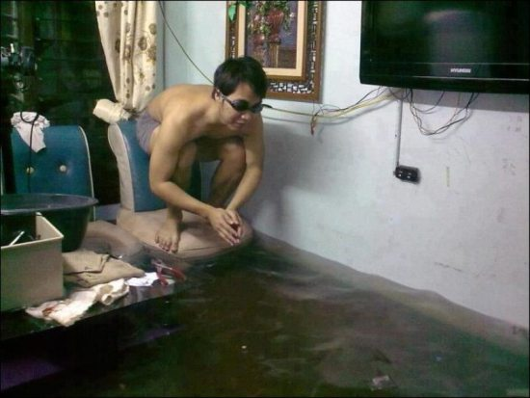
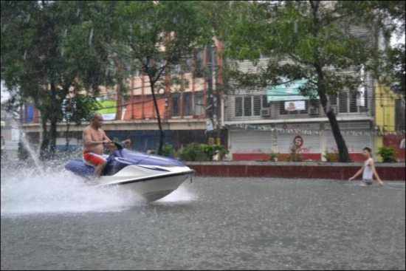
Filipinos can remain upbeat during floods…
Source: http://en.rocketnews24.com/2012/08/12/filipinos-remarkably-upbeat-during-massive-flood/

Slide 4
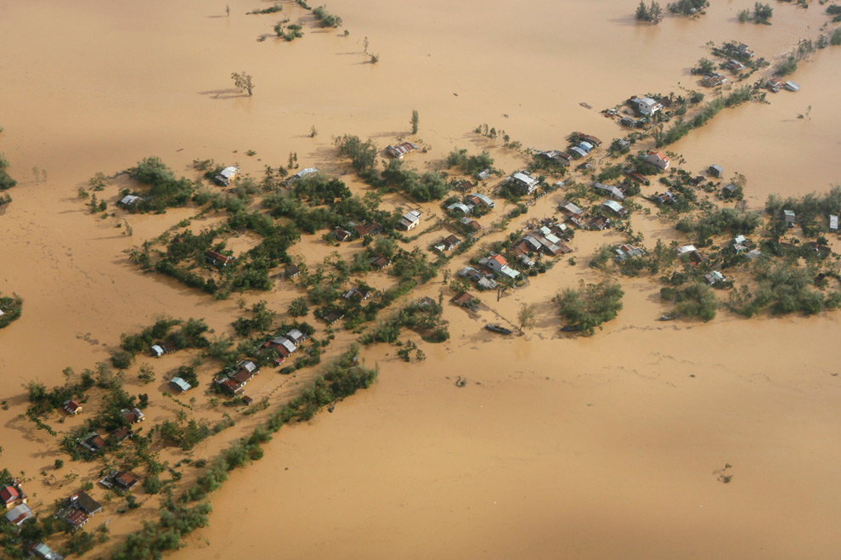
But being upbeat doesn’t solve the problem!
http://www.boston.com/bigpicture/2009/09/typhoon_ketsana_ondoy.html

Slide 5
Specific objectives
Discuss the current flood forecasting system of the Philippines
Conduct terrain analysis of Luzon
Map the land cover variation of the Philippines
Perform watershed delineation of a selected river basin in Luzon
Prepare a HEC-HMS Hydrologic model in the selected river basin
Validate the HEC-HMS model using historical streamflow data
Recommend future work in the Philippines

Slide 6
Flood forecasting in the Philippines

Slide 7
Flood forecasting in the Philippines
Director of Project NOAH: Alfredo Mahar F. Lagmay

Slide 8
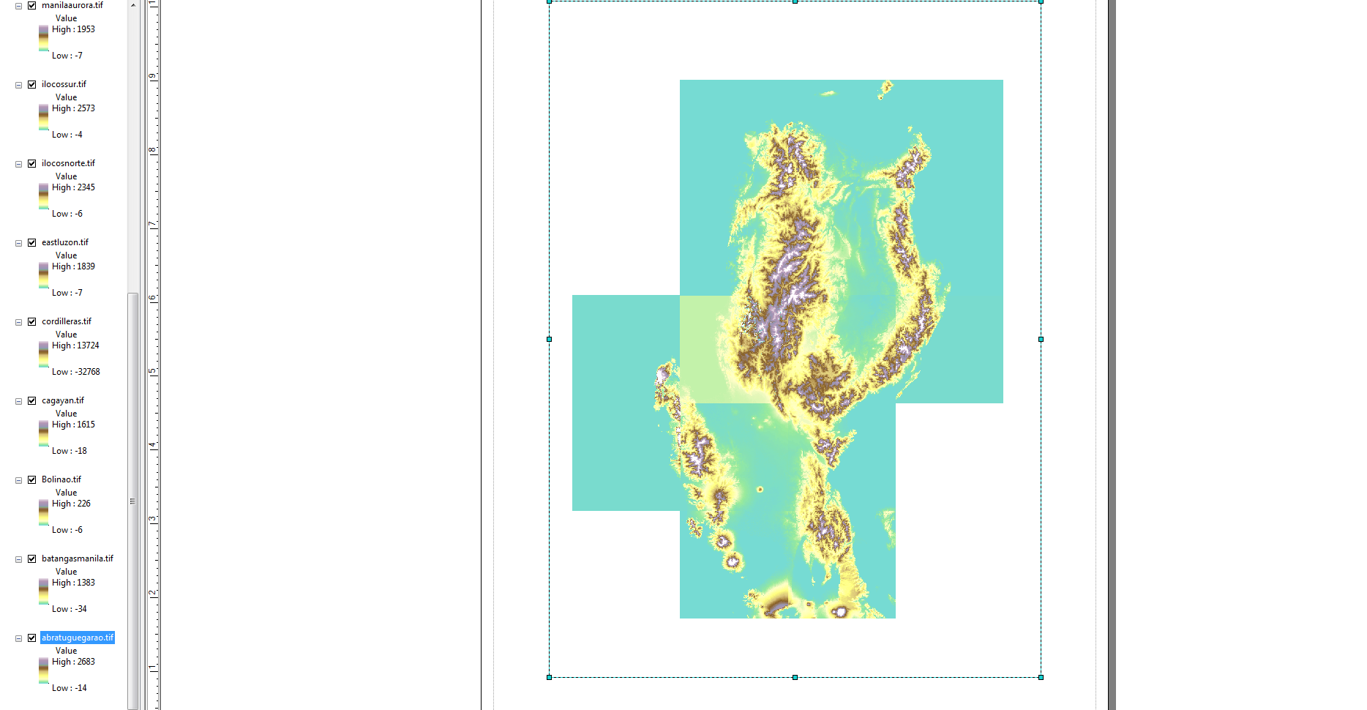
Terrain analysis of Luzon
Fifteen individual DEMs were obtained from SRTM
Problem: Result is not a coherent DEM

Slide 9
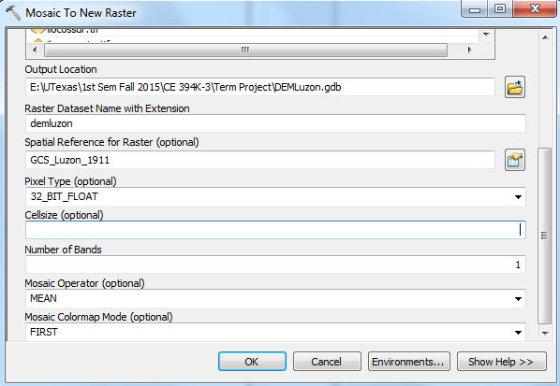
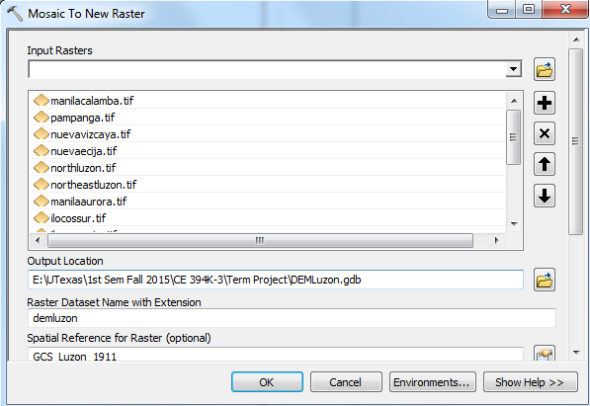
Terrain analysis of Luzon
Solution: Use Mosaic To New Raster tool

Slide 10
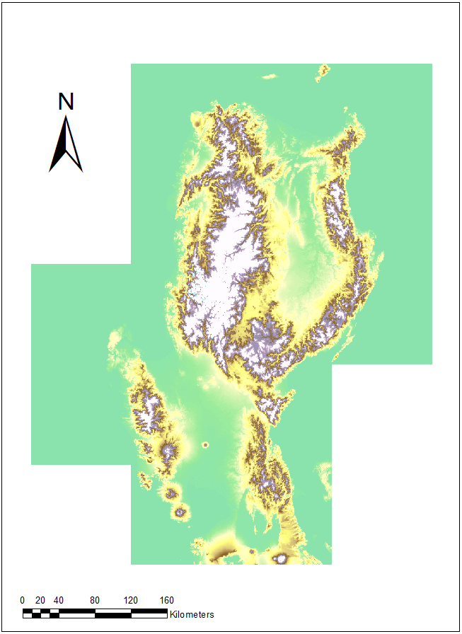
Terrain analysis of Luzon
Result: Coherent DEM of Luzon

Slide 11
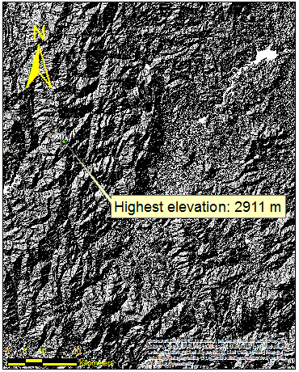
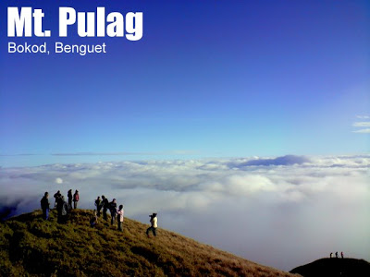
Terrain analysis of Luzon
http://www.pinoymountaineer.com/2007/09/mt-pulag-2922.html

Slide 12
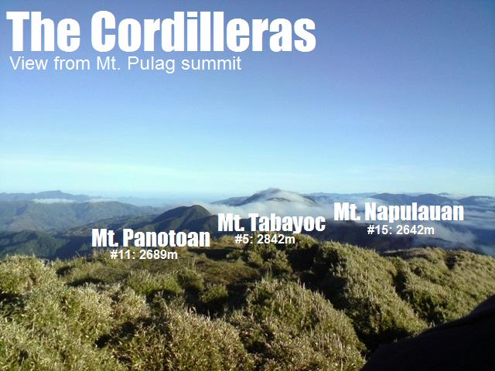
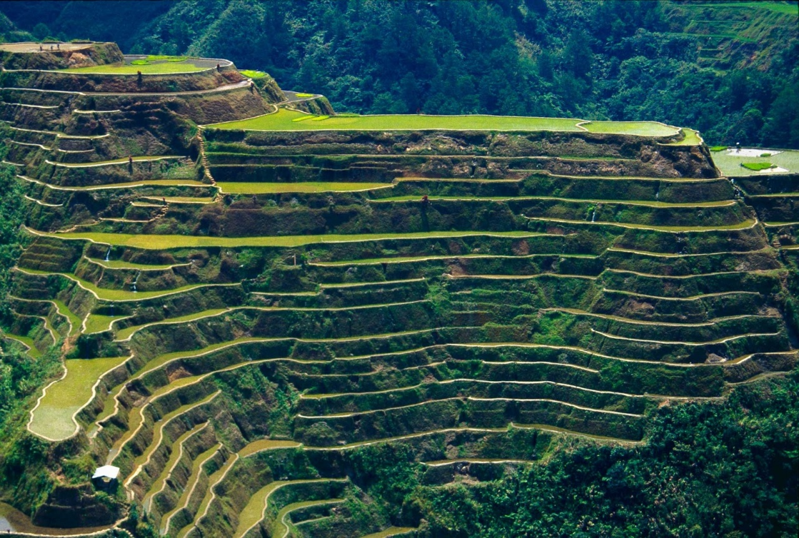
Terrain analysis of Luzon
http://www.pinoymountaineer.com/2008/05/cordilleras.html
http://explorewonders.com/wonders/rice-terraces-of-the-philippine-cordilleras

Slide 13
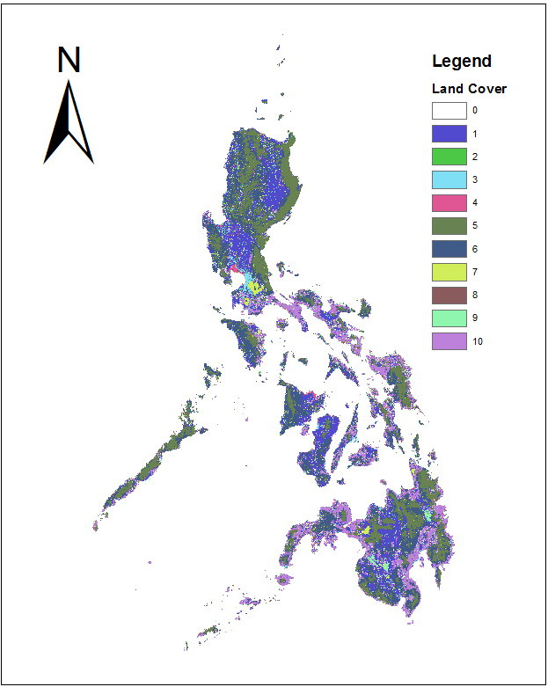
Land use of the Philippines
Code | Description | Total area (hectares) | %Total
1 | Annual crops | 6217767.123 | 21.0%
2 | Barren | 95694.37854 | 0.3%
3 | Built-up area | 694019.4828 | 2.3%
4 | Fishpond | 247348.6021 | 0.8%
5 | Forest | 6530137.254 | 22.1%
6 | Grassland | 8675408.056 | 29.4%
7 | Inland water | 482646.1804 | 1.6%
8 | Mangrove | 307879.5215 | 1.0%
9 | Marshland | 131439.595 | 0.4%
10 | Perennial crops | 6167900.41 | 20.9%
 |  | 29550240.6 | 100.0%
Acknowledgment: Rodel Lasco and Robert Coombs

Slide 14
Land use of the Philippines
Code | Description | Total area (hectares) | %Total
1 | Annual crops | 6217767.123 | 21.0%
2 | Barren | 95694.37854 | 0.3%
3 | Built-up area | 694019.4828 | 2.3%
4 | Fishpond | 247348.6021 | 0.8%
5 | Forest | 6530137.254 | 22.1%
6 | Grassland | 8675408.056 | 29.4%
7 | Inland water | 482646.1804 | 1.6%
8 | Mangrove | 307879.5215 | 1.0%
9 | Marshland | 131439.595 | 0.4%
10 | Perennial crops | 6167900.41 | 20.9%
 |  | 29550240.6 | 100.0%
Acknowledgment: Rodel Lasco and Robert Coombs

Slide 15
Land use of the Philippines
Code | Description | Total area (hectares) | %Total
1 | Annual crops | 6217767.123 | 21.0%
2 | Barren | 95694.37854 | 0.3%
3 | Built-up area | 694019.4828 | 2.3%
4 | Fishpond | 247348.6021 | 0.8%
5 | Forest | 6530137.254 | 22.1%
6 | Grassland | 8675408.056 | 29.4%
7 | Inland water | 482646.1804 | 1.6%
8 | Mangrove | 307879.5215 | 1.0%
9 | Marshland | 131439.595 | 0.4%
10 | Perennial crops | 6167900.41 | 20.9%
 |  | 29550240.6 | 100.0%
The Philippines is still an agricultural country.

Slide 16
Pampanga River Basin

Slide 17
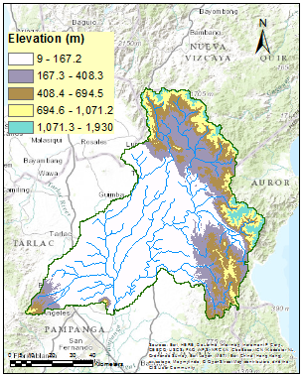
Watershed delineation
The streams were obtained from HydroSHEDS

Slide 18
Network analysis

Slide 19
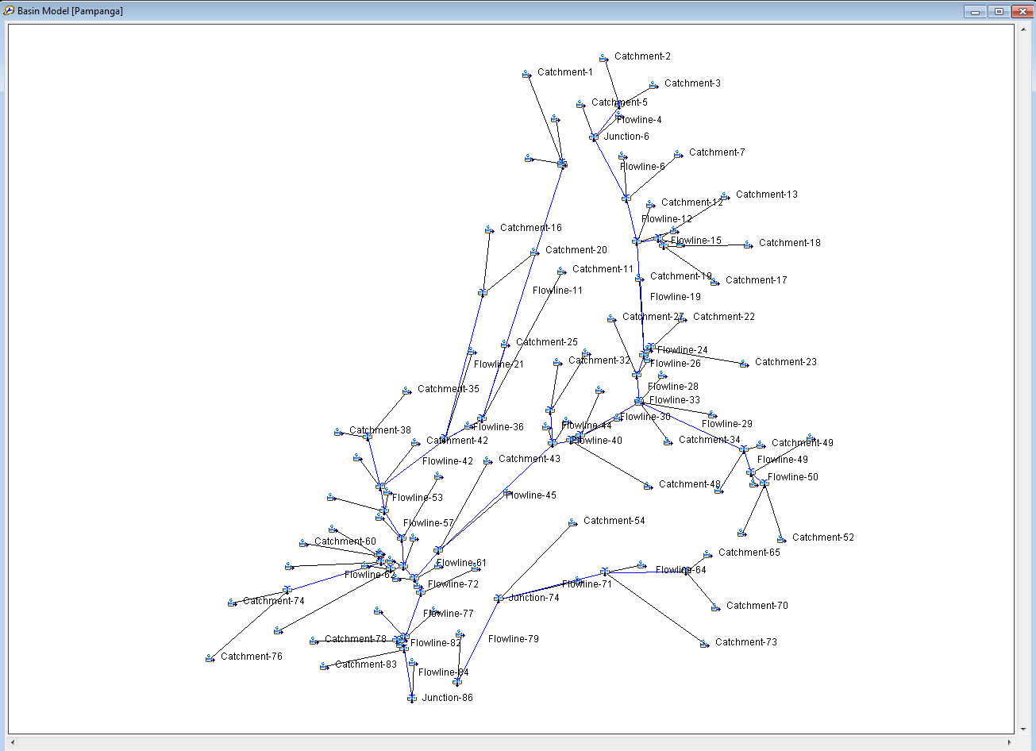
HEC-HMS Model
Acknowledgment: Cyndi Castro

Slide 20
HEC-HMS Model (test)

Slide 21
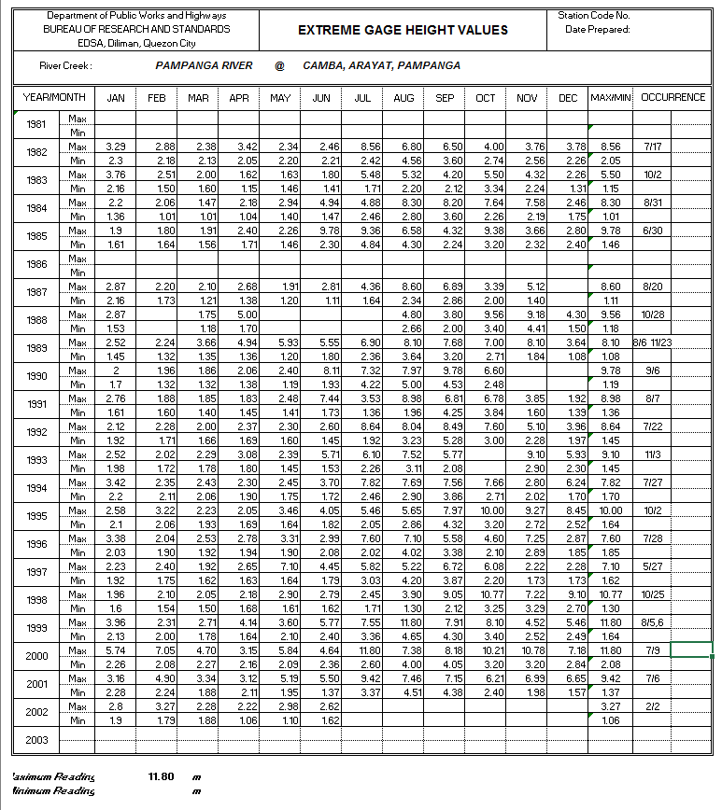
Validation
Using historical daily streamflow data from 1981 to 2002
Acknowledgment: Rodel Lasco and Pamela Tolentino

Slide 22
Future work
Complete the network analysis of Pampanga River Basin
Construct an appropriate meteorological model for the Pampanga River Basin
Simulate significant rainfall events in the basin (e.g. Typhoon Ketsana)
Validate HEC-HMS model using historical streamflow data

Slide 23
Recommendations to the Philippine Government
Organize data sources in the web (e.g. NFIE-Services)
Update the geographic coordinate system of the country
Develop a higher-resolution DEM
Create a geodatabase for hydrologic elements (e.g. NFIE-Geo and NFIE-River)
Develop a better flood response and flood warning system (e.g NFIE-Response)
Promote open sharing of data sources (e.g. HydroShare)

Slide 24
Acknowledgment
David Maidment and David Tarboton
Rodel Lasco, Pamela Tolentino, Robert Coombs, Edwin Combalicer, Glenn Tabios, Rafaela Jane Delfino, John Colin Yokingco, Maurice Duka
Cyndi Castro
Ahmad Tavakoly and Michael Follum, ERDC
Jim Nelson and Savannah Keane, BYU
USGS, ESRI
GIS in Water Resources class

Slide 25
MARAMING SALAMAT PO!
Source: http://en.rocketnews24.com/2012/08/12/filipinos-remarkably-upbeat-during-massive-flood/

