Slide 1
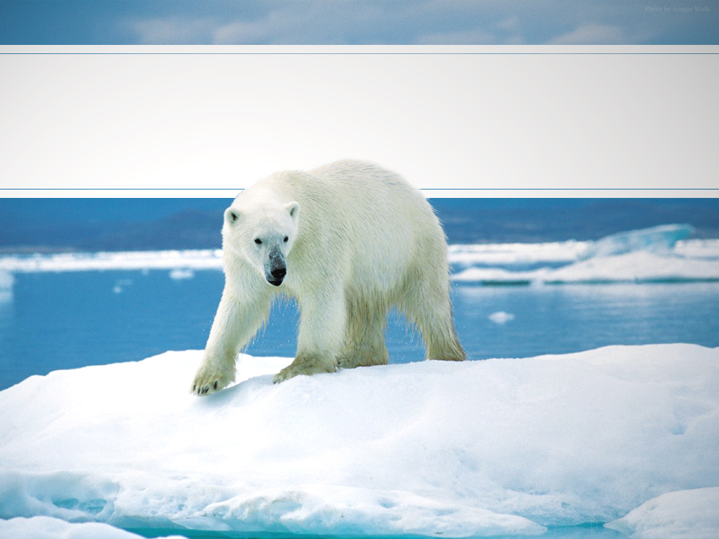
Arctic Bivalve in the Chukchi Sea
Hoang Minh “Thomas” Nguyen
Department of Marine Science
Notes:
Today I will present the background of my project to help you understand why I chose to work with Arctic bivalve and why in the Chukchi Sea

Slide 2
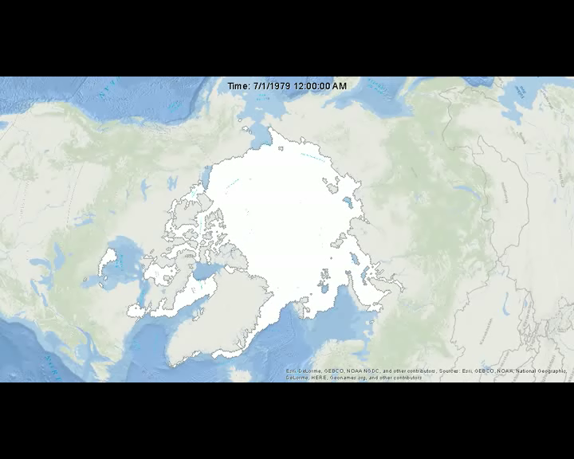
Sea Ice Decline in the Arctic Ocean
Notes:
From 1953–2006, Arctic sea ice extent at the end of the summer melt season in September has declined at a rate of 7.8%/decade. Over the period of modern satellite observations (1979–2006) the trend is even larger (9.1% per decade).
Conclusions of Stroeve et al. (2007)
Current (2006) summer minima are 30 years ahead of model forecasts

Slide 3
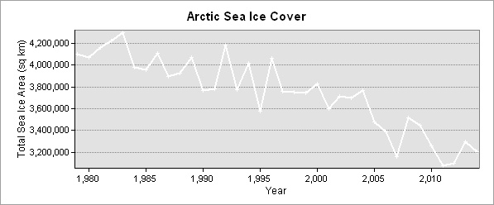
Sea Ice Decline in the Arctic Ocean
Notes:
In order to determine the effect of sea ice coverage decline on the Arctic marine ecosystem, we must observe the system over time scales that capture the scales of variation in the system, which can vary from seasonal to decadal. Unfortunately, this scale of observation is rarely possible for such a time scale

Slide 4
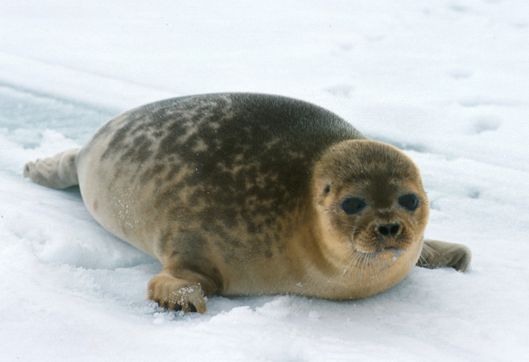

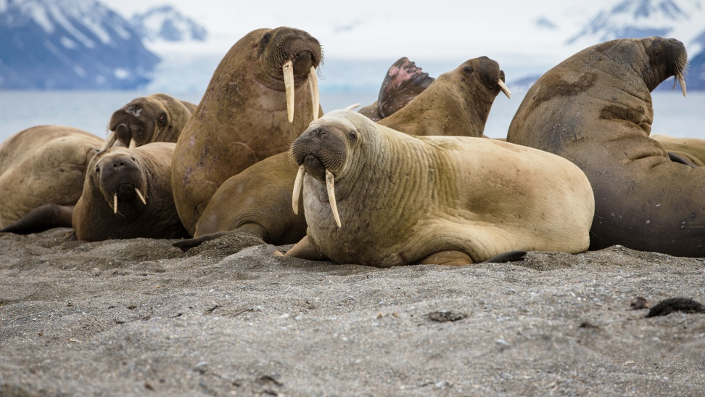
What is the effect on
Notes:
It is even harder when it comes to biological record. How did historical events affect the livelihood of polar bear, ringed seal or walrus? That is where bivalves come in handy.

Slide 5
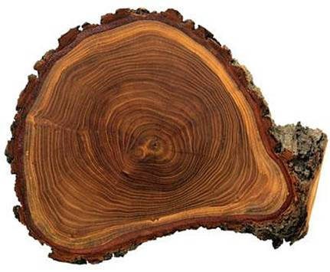
Applying dendrochronology techniques
Developed for tree ring studies
Proposed to use on otolith increments by Black et al. (2005)
Notes:
Several bivalve species are long lived and develop annual increments like tree rings. Tree rings are not only useful to determine how old the trees are but also how well or badly they have grown in the past. We attempt to extract the same data from bivalve. Serripes thin cut is only the left.

Slide 6
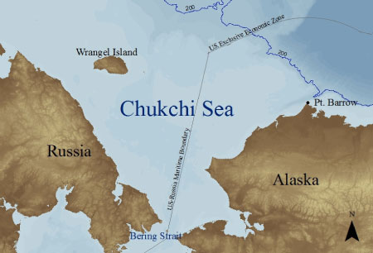
Chukchi Sea
One of the most productive seas in the world
Of which, at least 10% has been attributed to the production of sea ice algae
Notes:
Chukchi Sea: The marginal sea of the Arctic Ocean, neatly divided between Russia and the US
In 2012, scientists from the Cold Regions Research and Engineering Laboratory published findings describing the discovery of the largest-known oceanic phytoplankton algal bloom in the world.
Of which, at least 10% has been attributed to the production of sea ice algae ², which is a much higher proportion than any other shelf seas in the Arctic, with the exception of the Barren Sea

Slide 7
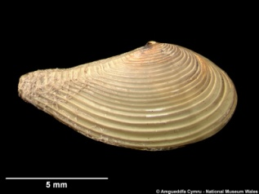
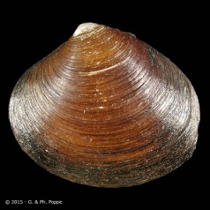
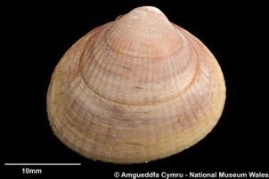
Chukchi Sea
Notes:
For this project, I collected more than 2,000 shells of multiple bivalve species from the central and northern Chukchi Sea (Figure 1) in summer 2015 on a research vessel funded by USGS. The sites were chosen based on the species distribution map from USGS. Artartidae: Astarte borealis. Cardiidae: Serripes groenlandicus. Nuculanidae: Nuculana minuta.
These regions contain several bivalve hotspots and attract a large number of Pacific walrus as well as other large consumers.
The shells from these bivalves would be cut and performed dendrochronology techniques upon. The flesh would be used in stable isotope analysis.
PacMARS Data Set: An Isotope synthesis database comprised of >4,000 stable carbon and nitrogen values from several studies in the
Arctic Ocean was compiled by Dr. Ken Dunton from the Marine Science Institute, University of Texas at Austin as part of the Pacific Marine Arctic Regional Synthesis (pacMARS) project

Slide 8
PacMARS data and ArcGIS
Notes:
For this presentation, I selected data points that fit within my researched region and related to my targeted species. From ~4,000 data points.

Slide 9
PacMARS data and ArcGIS
Notes:
To ~1,600 data in the Chukchi Sea

Slide 10
PacMARS data and ArcGIS
Notes:
To 176 data points from targeted species

Slide 11
PacMARS data and ArcGIS
Interpolation on d₁₃c
Interpolation on d₁₅N
Notes:
I have decided to focus on the natural neighbor interpolation method for my stable isotope analysis which interpolates over a small distance

Slide 12
Plans for the Future
Process samples
Perform spatial and temporal interpolation
  On stable isotope results
  Annual increment records
Build a multi-species historical record of how bivalves responded to past sea ice decline

Slide 13




Acknowledgement
Dr. Vanessa von Biela – USGS
Dr. Bryan A. Black – Marine Science Institute – Univ. of Texas at Austin
Dr. Kenneth Dunton – Marine Science Institute – Univ. of Texas at Austin
Captain and Crew of the Norseman II
Carolynn Harris – Marine Science Institute – Univ. of Texas at Austin
Janelle Trowbridge – Univ. of Alaska at Anchorage

