Slide 1
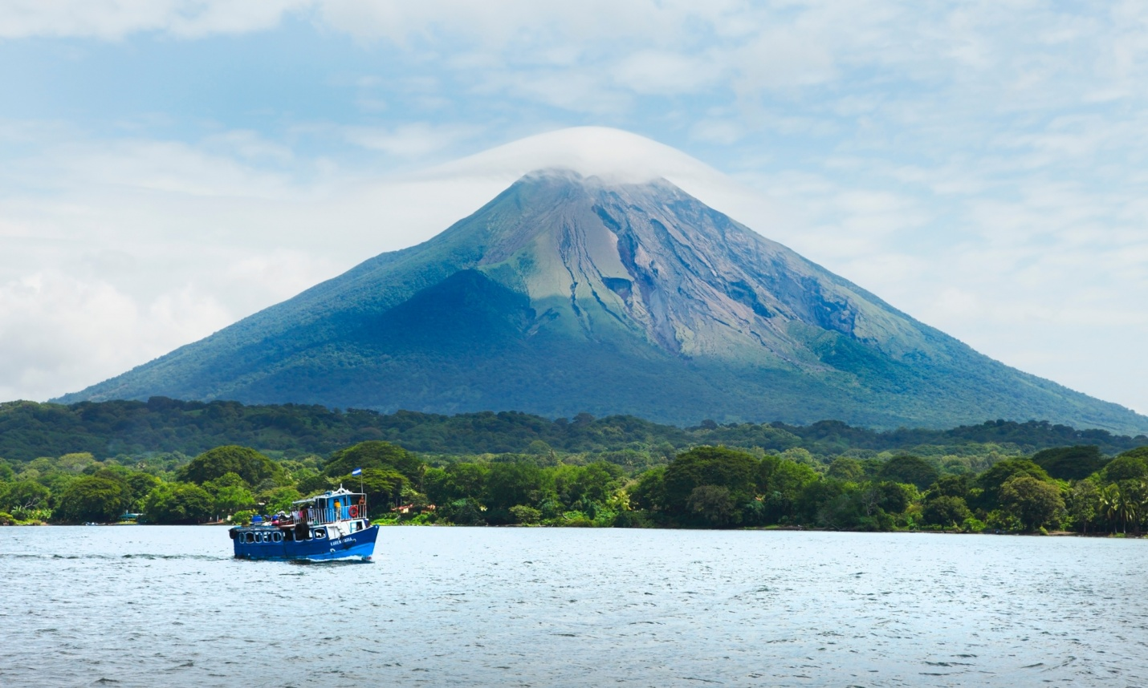

Hydrology of el Gran Lago de Nicaragua
Potential Impact Area of the Proposed Nicaragua Canal
by Dora Frances Sullivan-González
Photo credit: Getty Images, The Guardian
Notes:
http://www.theguardian.com/world/2015/jan/20/-sp-nicaragua-canal-land-opportunity-fear-route

Slide 2
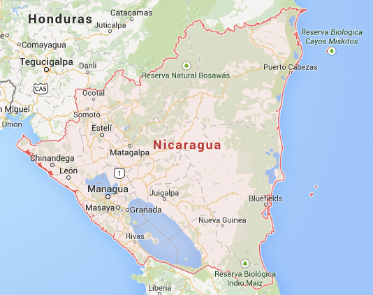
Map Credit: ©2015 Google
Notes:
Nicaragua is the largest country by area in the Central American isthmus with a population of 6.1 million people.
Lake Nicaragua is the large repository of freshwater in Central America: 108 km3

Slide 3
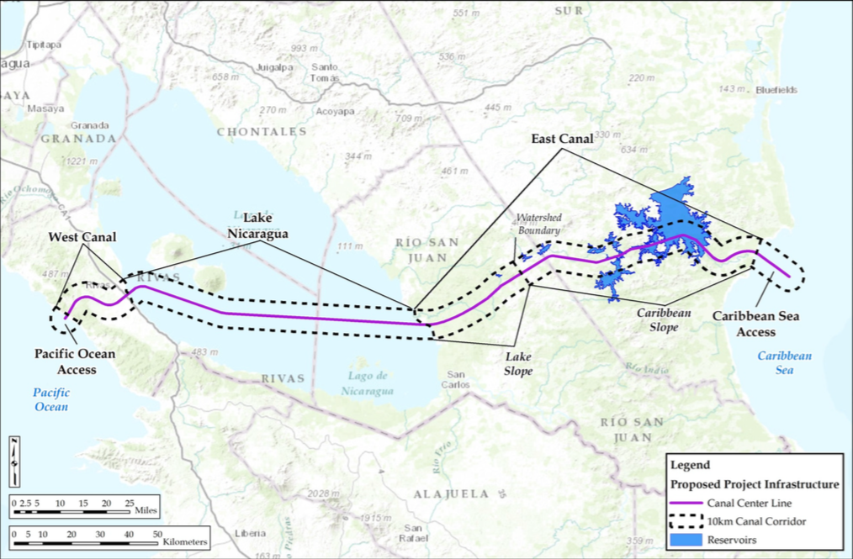
Map: HKND Group, Nicaragua Canal Project Description
Dimensions and Capacity
Length: 276 km (171mi)
Depth: 28 m (92 ft)
Width: 83 m (272 ft)
Capacity: <23,000 TEU
Notes:
The canal will stretch 276 km from Brito on the Pacific Coast to Punta Gorda on the Atlantic cost. The project will include two sets of locks as ships cross Lake Nicaragua just 5 km south of Ometepe Island, home of the volcanoes Concepción and Maderas.
The Project has several associated components that the HKND Group is contracted to build including ports in Brito and Punta Gorda, a free trade zone, and an international airport in a massive construction project estimated to cost 50 billion US dollars.

Slide 4
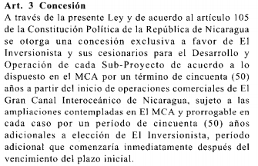
Nicaragua: Law 840 Article 3
Master Concession and Implementation Agreement in respect of the Nicaragua Canal and Development Project
“Through this Law and in agreement with Article 105 of the Political Constitution of the Republic of Nicaragua a concession is granted exclusively in favor of “HKND” and its subsidiaries for the Development and Operation of each subproject in agreement with the provisions of the MCA for a term of fifty (50) years from the start of commercial operations of the Grand Interoceanic Canal of Nicaragua, subject to the extensions considered in the MCA and renewable in each case for a period of fifty (50) additional years at the choosing of ”HKND”, any additional term beginning after the end of the initial term.”
Notes:
As no political relationship exists between the Chinese and Nicaraguan governments, legislation was passed for the project to commence. The legislative assembly of Nicaragua took 7 days to pass Law 840 concerning the construction of the canal and concession of land and rights to HKND. Key points from the law include:
-100yr concession agreement w/ HKND
-The Chinese firm is indemnified against any delays from protests or legal challenges
-No compensation will be awarded to Nicaragua if the canal is abandoned
-HKND, its subsidiaries, and subcontractors are exempted from local taxes
-HKND has the right to posses, occupy, use or perform any activities upon all government owned and privately owned real property

Slide 5
Data Sources
USGS HydroSHEDS
15sec SHAPE: River Network
15sec SHAPE: Drainage Basins
Data Basin
Land Cover, Central America (ESA GlobCover Team)
Los Peces de Latinoamérica (Conservation Biology Institute)
Los Anfibios de Latinoamérica (Conservation Biology Institute)
DIVA-GIS
Nicaragua and Costa Rica – Elevation
arcgis.com
Habitantes de Nicaragua (David Aguilar)
Mapa socioeconomico de Nicaragua (David Aguilar)

Slide 6
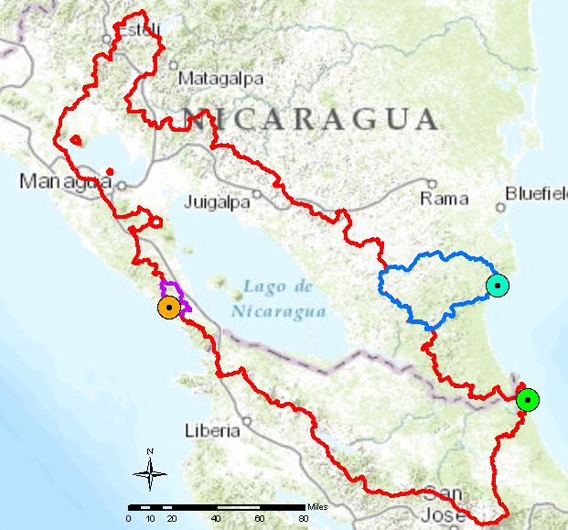
Key Watersheds
Rio Brito
11º21’21”N
85º58’11”W
Rio Punta Gorda
11º30’18”N
83º49’10”W
Rio Colorado
10º46’7”N
83º35’29”W
Notes:
Basins determined by arcgis.hydro Watersheds tool
Points: Rio Brito out, Rio Punta Gorda out, Rio Colorado/Rio San Juan out

Slide 7
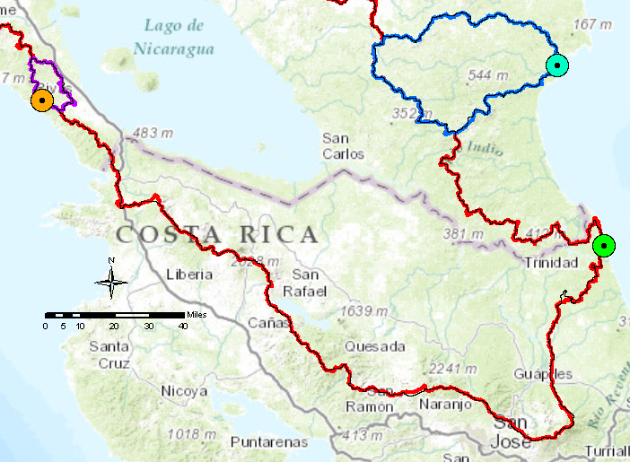
Comparing Data Sources
Notes:
Compared Hydrosheds 15s basins vs arcgis.hydro Watersheds tools

Slide 8
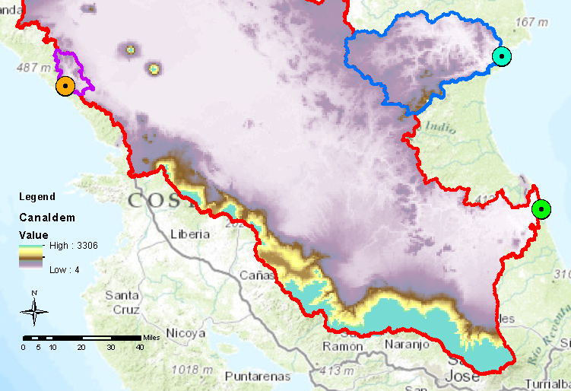
Digital Elevation Model
Notes:
dem

Slide 9
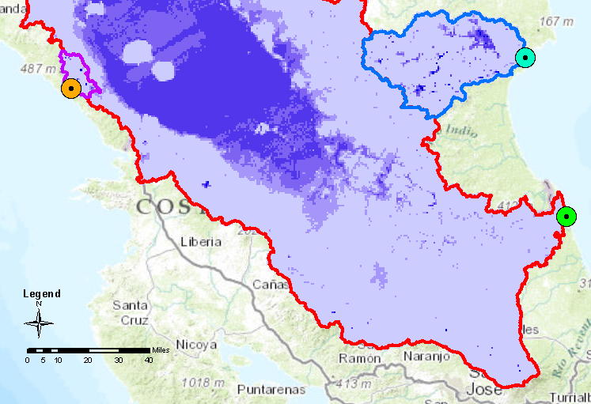
Watershed Sinks
Notes:
Sinks in basins

Slide 10
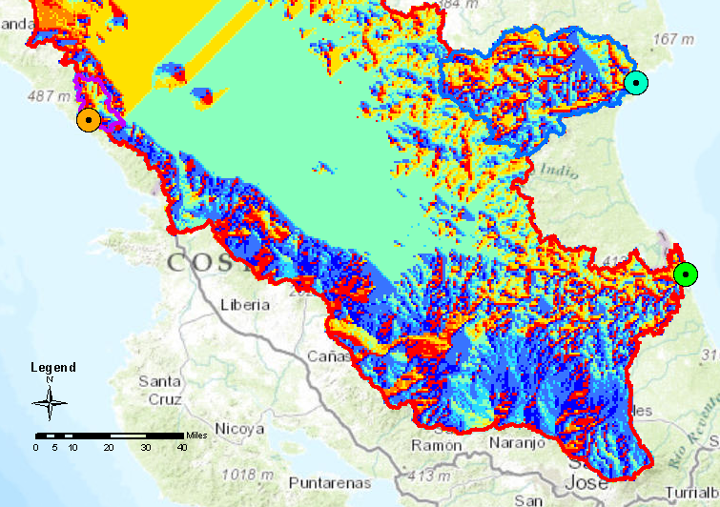
Flow Directions
Notes:
Flow directions

Slide 11
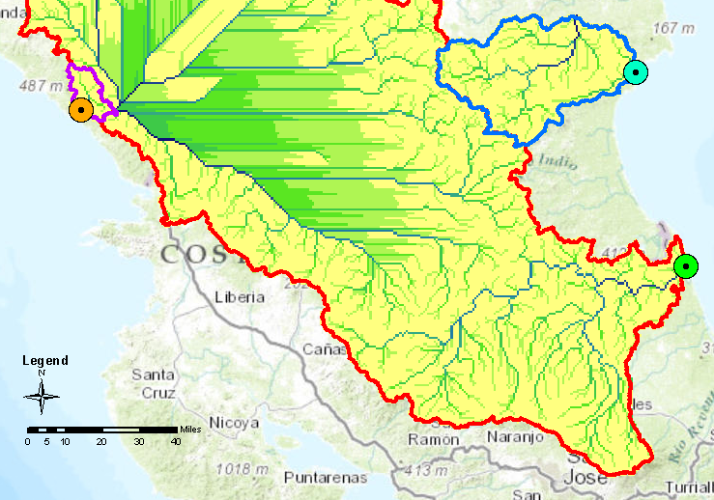
Flow Accumulation
Notes:
Flow accumulation

Slide 12
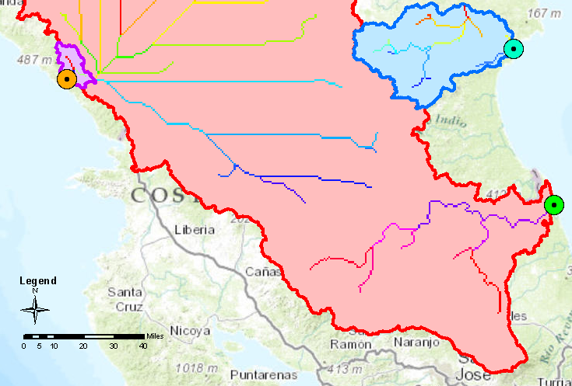
Delineated Streams
Notes:
Delineated streams over watersheds

Slide 13
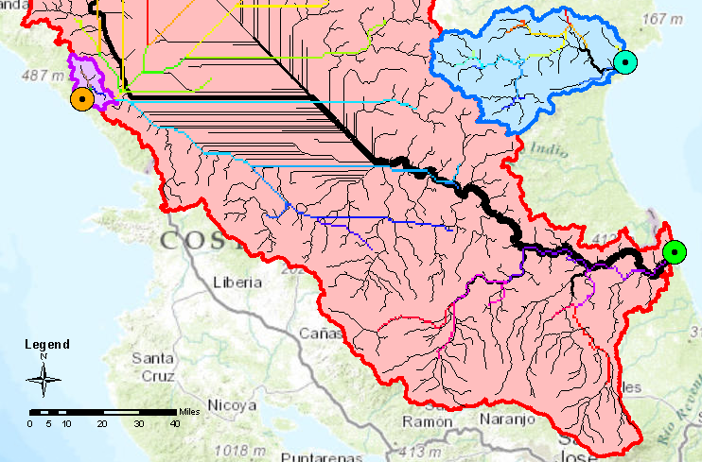
Comparing Data Sources
Notes:
Delineated streams vs hydroshed river network 15s

Slide 14
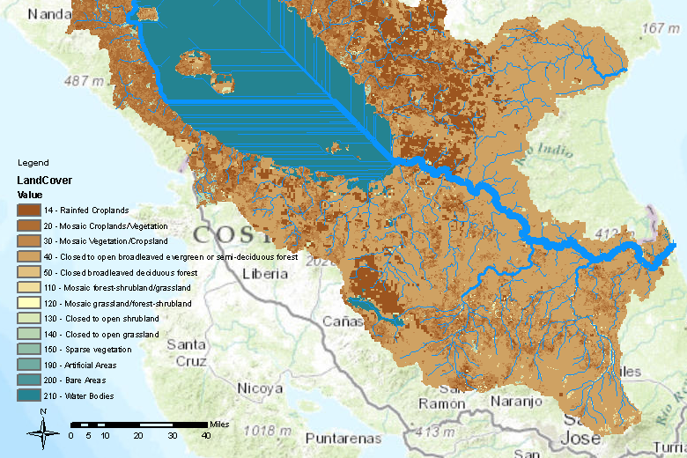
Land Cover over watersheds
Notes:
Landcover
32.9% closed to open broadleaved evergreen or semi-deciduous forest
21.1% water bodies
20.6% mosaic vegetation/croplands

Slide 15
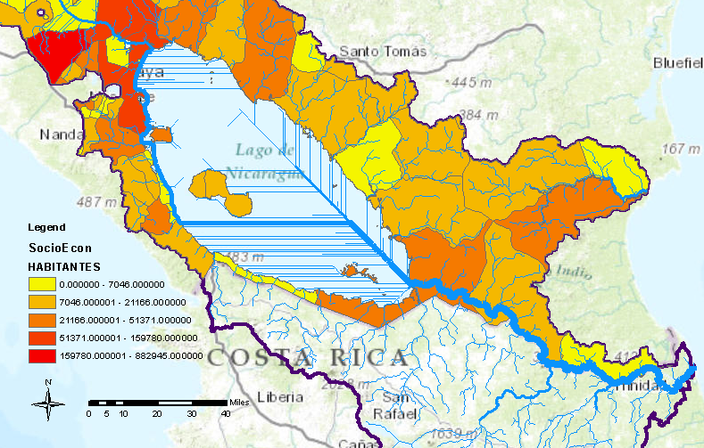
Population area of Nicaragua
Notes:
Population of Nicaragua

Slide 16
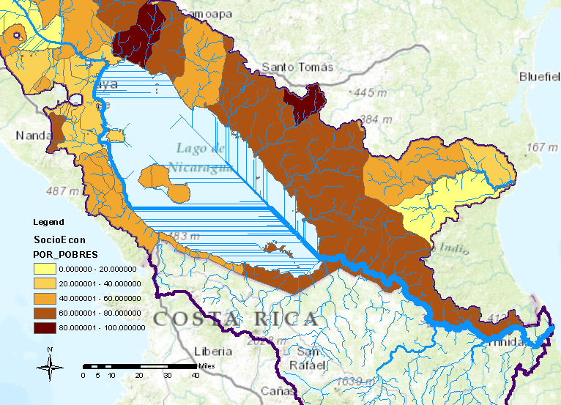
Poverty Scale in Nicaragua
Notes:
Poverty percentage for Nicaragua

Slide 17
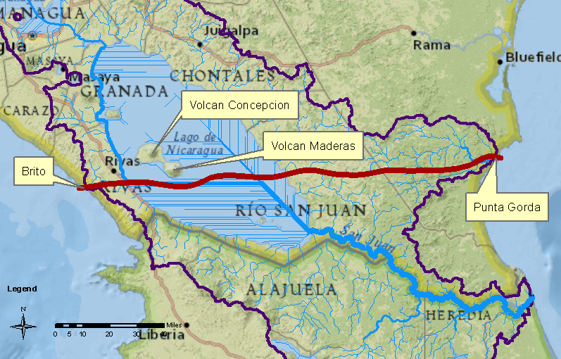
Proposed Canal
Notes:
Proposed canal path

Slide 18
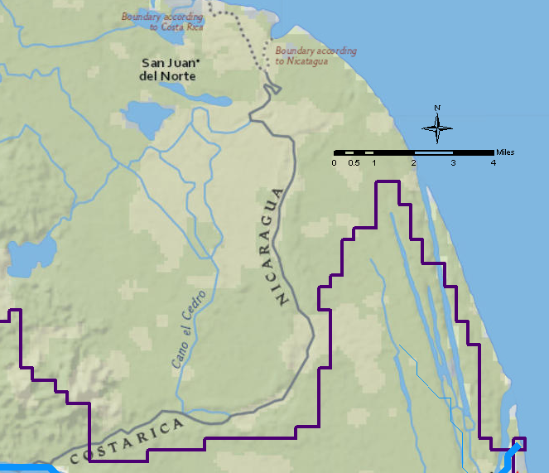
Territory Dispute
Notes:
Boundary dispute

Slide 19
Future Work
Amphibian and fish species populations
Surface water usage
Protected areas
Precipitation data

Slide 20
References
Aguilar, Ilich B. "Si Acaso Hay Canal Será Hasta 2029." La Prensa Nicaragua. N.p., 20 Feb. 2015. Web. 22 Feb. 2015.
"Home Page - HKND Group Nicaragua Canal Global Trade Project." Home Page - HKND Group Nicaragua Canal Global Trade Project. N.p., n.d. Web. 2015.
Nicaragua Canal Project Description. Rep. HKND Group, Dec. 2014. Web. Jan. 2015.
Nicaragua. Legislative Assembly. Ley No. 840. Ley Especial Para El Desarrollo De Infraestructura Y Transporte Nicaragüense Atingente a El Canal, Zonas De Libre Comercio E Infraestructura Asociadas. Managua: n.p., 2013. La Gaceta, 24 June 2013. Web.
Sanchez, W. Alejandro. "Protests against Nicaragua’s Ambitious Canal." Voxxi. N.p., 26 Oct. 2014. Web. Mar. 2015.
Watts, Jonathan. "Land of Opportunity – and Fear – along Route of Nicaragua’s Giant New Canal." The Guardian. N.p., 20 Jan. 2015. Web. 20 Jan. 2015.
www.databasin.org
www.diva-gis.org/gdata
http://hydrosheds.cr.usgs.gov/index.php

Slide 21
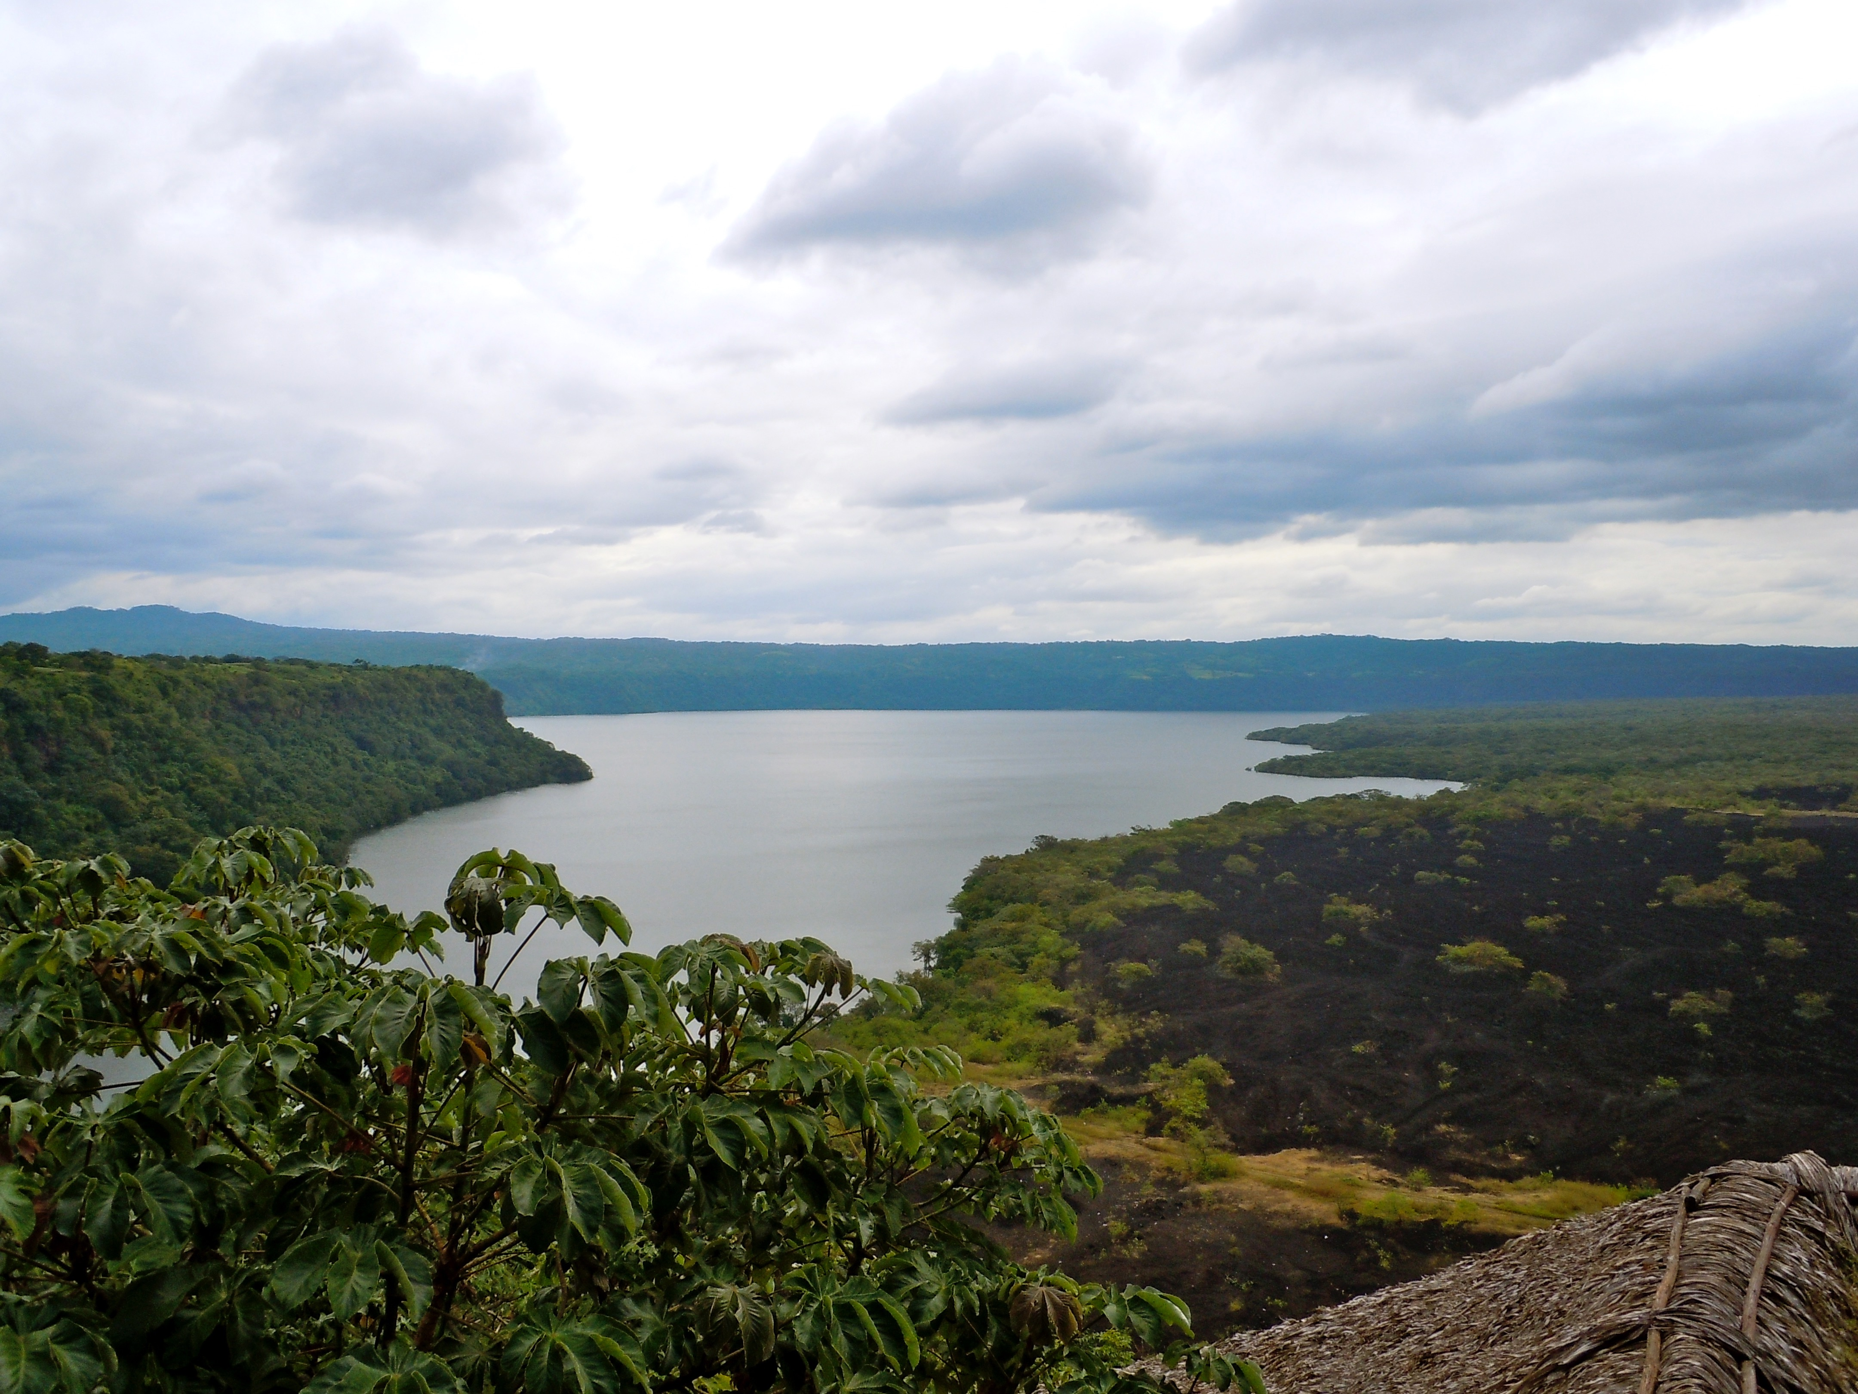
Questions?

