Slide 1
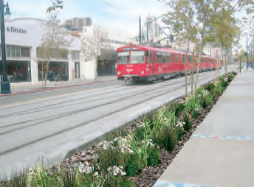
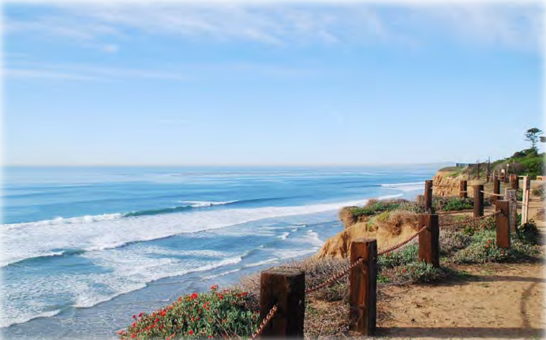
Stormwater and Low-Impact Development in San Diego, CA
Mitchel J. Bartolo
November 24, 2015
Source: City of San Diego

Slide 2
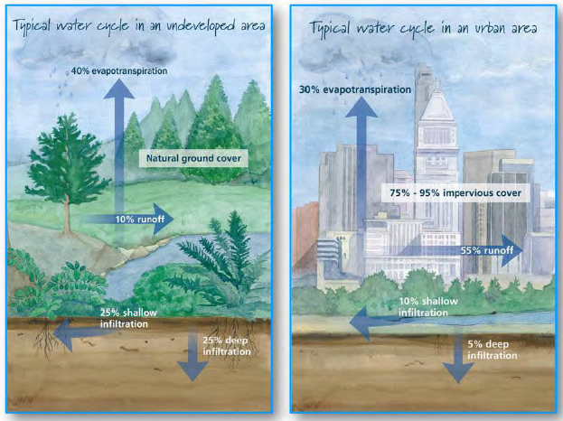
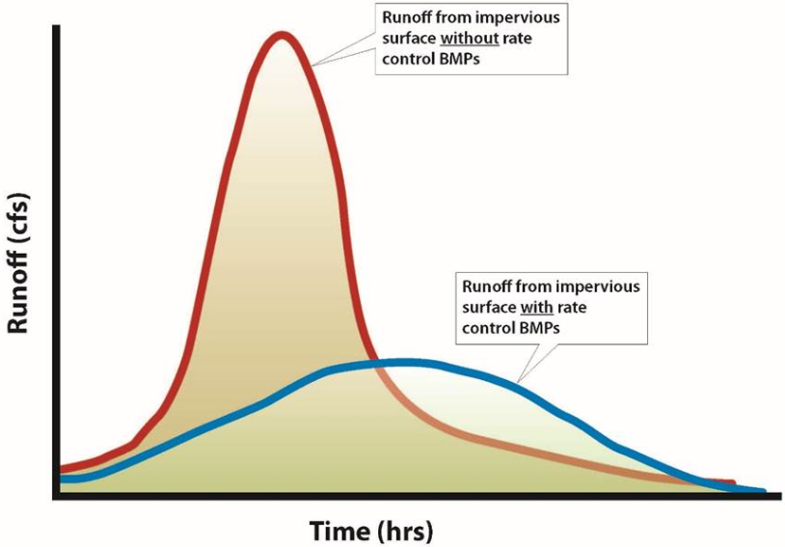
Why We Care #1: Water Cycle
Source: Minnesota Pollution Control Agency
Infiltration Subsurface storage
Overland flow Streamflow
Source: City of San Diego

Slide 3
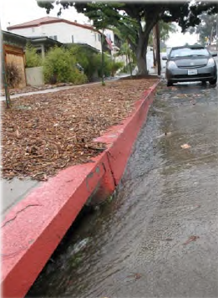
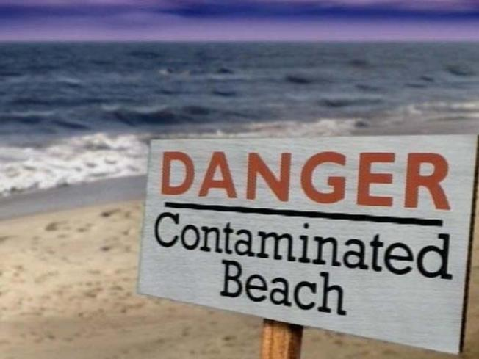
Why We Care #2: Pollution
Bacteria/Viruses
Oil and Grease
Sediment/Turbidity
Metals
Nutrients (N, P)
Organics
Pesticides
Source: City of San Diego, NBC San Diego

Slide 4
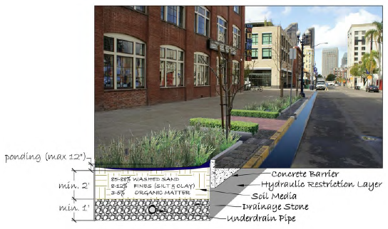
Low-Impact Development (LID)
LID reduces imperviousness by replicating natural hydrology
Addresses both flow and pollution issues
Parking lots, buildings, sidewalks → permeable pavement, green roofs, vegetated swales, bioretention basins

Slide 5
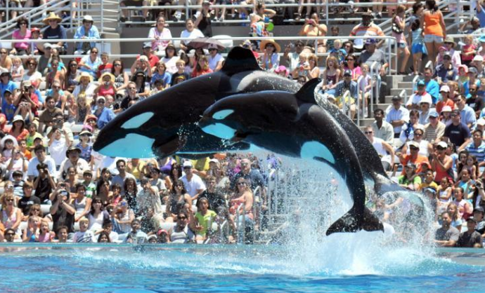
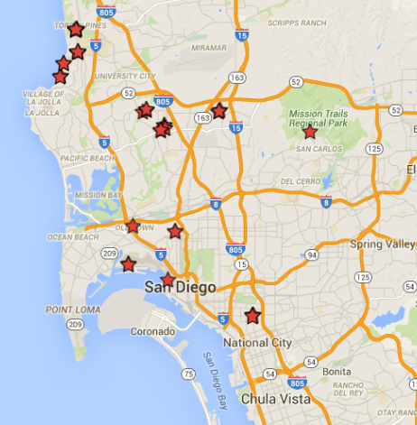
LID in San Diego

Slide 6
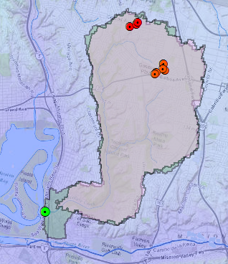
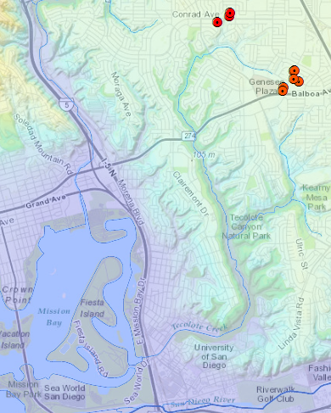
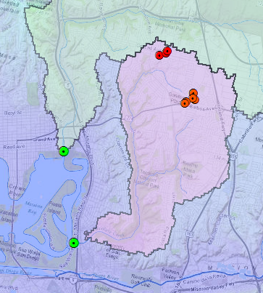
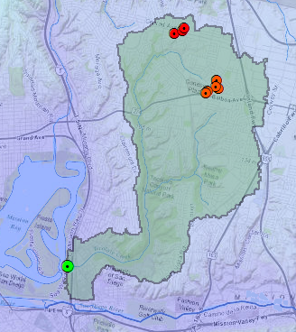
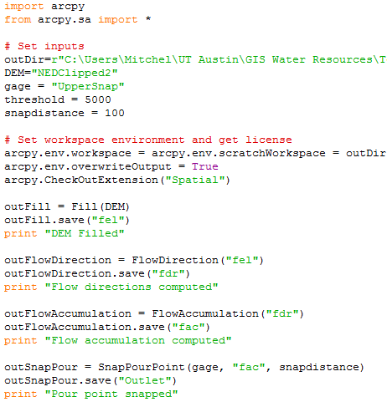
Study Area-Watershed Analysis
Permebale pavement, bioswales, rain barrels
“Green Street” Pilot: bacteria
Vegetated swales and bioretention basins

Slide 7
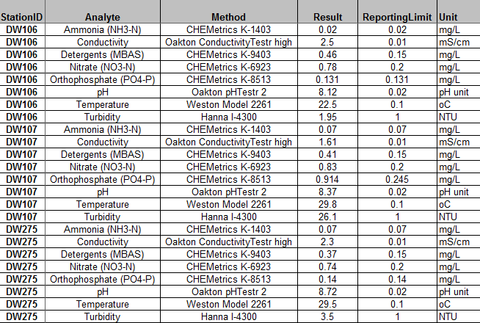
Evaluating LID Effectiveness
Flood Response
No USGS gage in this watershed
Precipitation varies: hard to compare
B) Pollution
San Diego SWPP Program
Yearly Monitoring Data

Slide 8
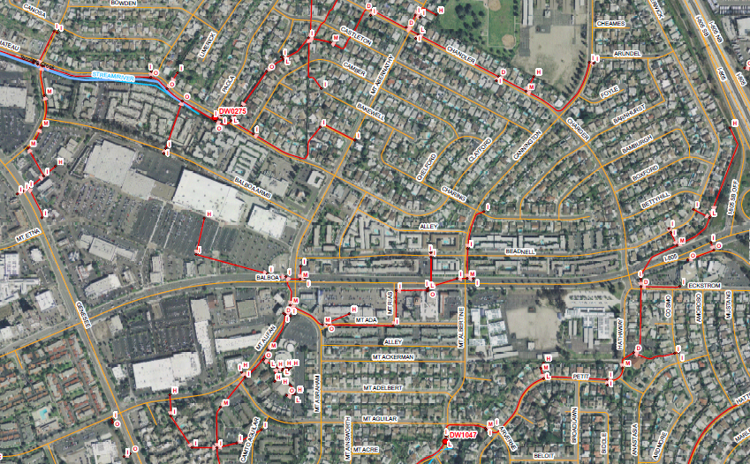
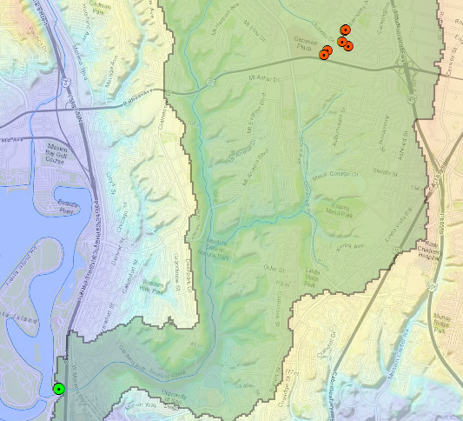
Stormwater Conveyance System
DW0275

Slide 9
Pollution Monitoring Data

Slide 10
To-Do List
Sort out GIS layer acquisition w/ City of SD
Analyze water quality data for each site
Quanitify flow impacts with HEC-HMS model
Impervious values, before and after LID
Compare responses to a fixed storm event

Slide 11
Questions?

