Slide 1
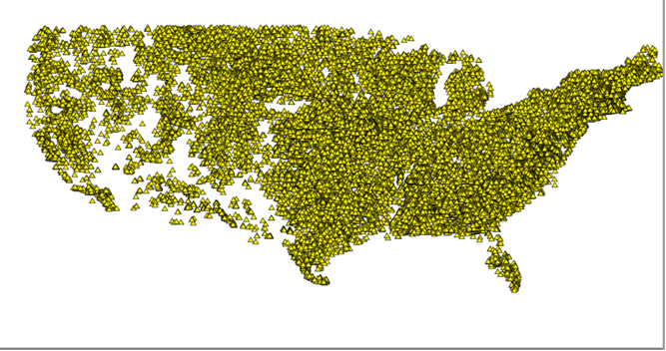
Dams and Their Effect on Fish Throughout the United States
Course: CE394K 11-24-15
By Jonathan A. Batista
~79,000
Notes:
Image from: http://52.6.219.234/dataset/national-anthropogenic-barrier-dataset-nabd-2013-usgs

Slide 2
Project Originally Included Changes in Evaporation due to Reservoirs

Slide 3
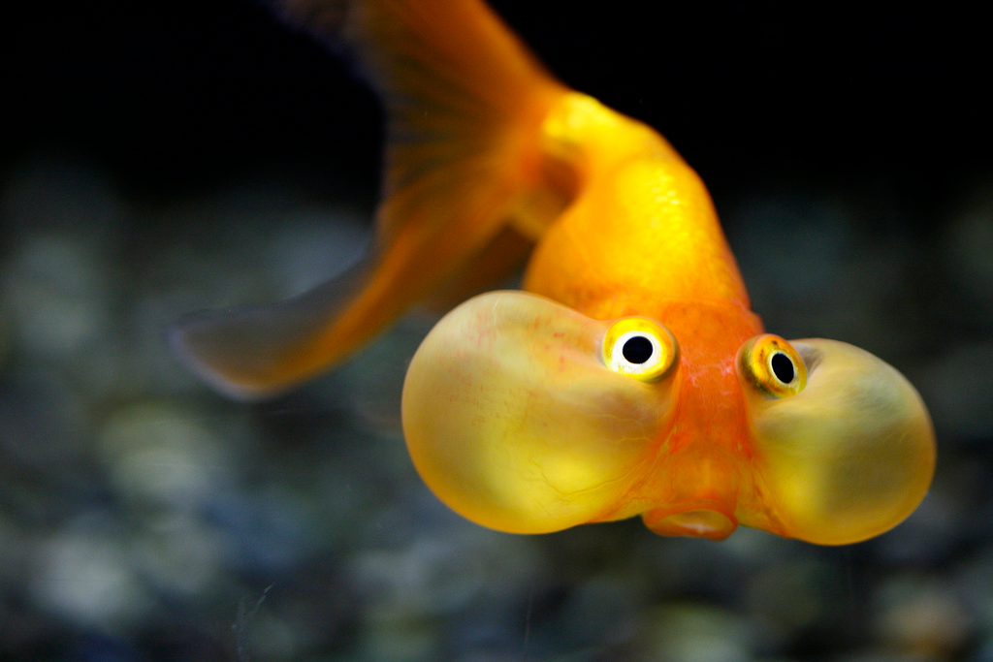
But fish proved to be more attractive.
Notes:
Bubble eye fish, image from imgarcade.com

Slide 4
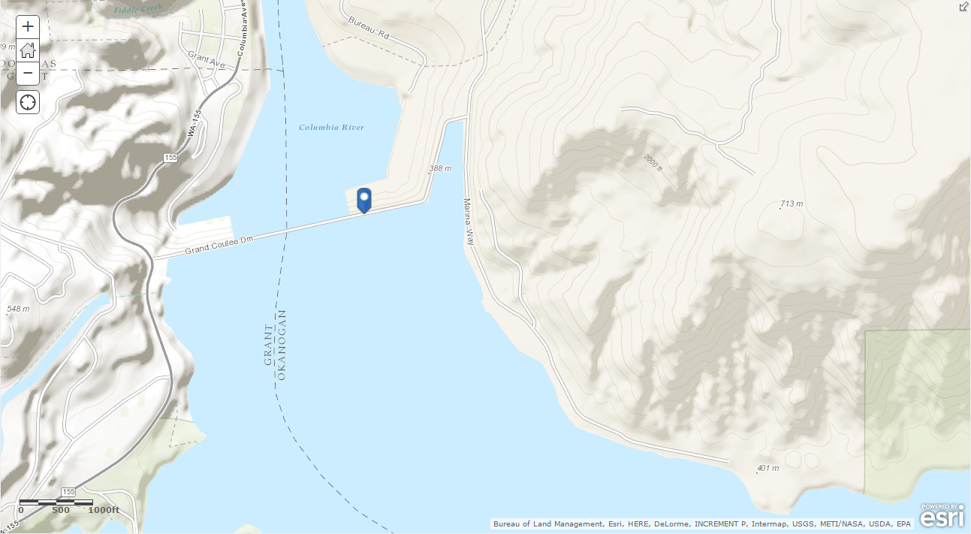
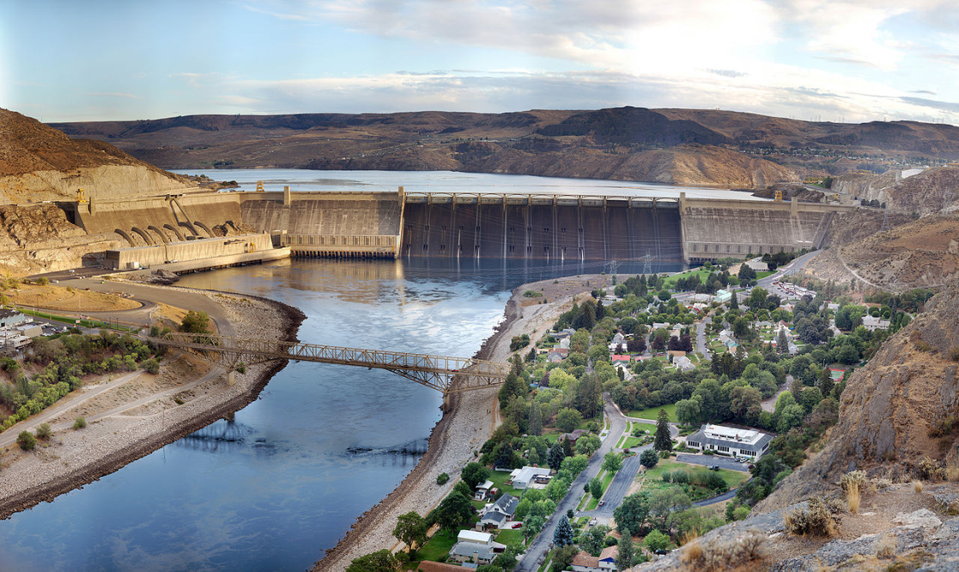
Motivation: Cadillac Desert by Marc Reisner, Published in 1986
The consequences of dams, and the human-environment tradeoff.
Grand Coulee Dam in Washington State: the average catch of over 600,000 salmon per year was eliminated.
Native Americans flooded out on a regular basis.
Notes:
Image from: wikipedia.com

Slide 5
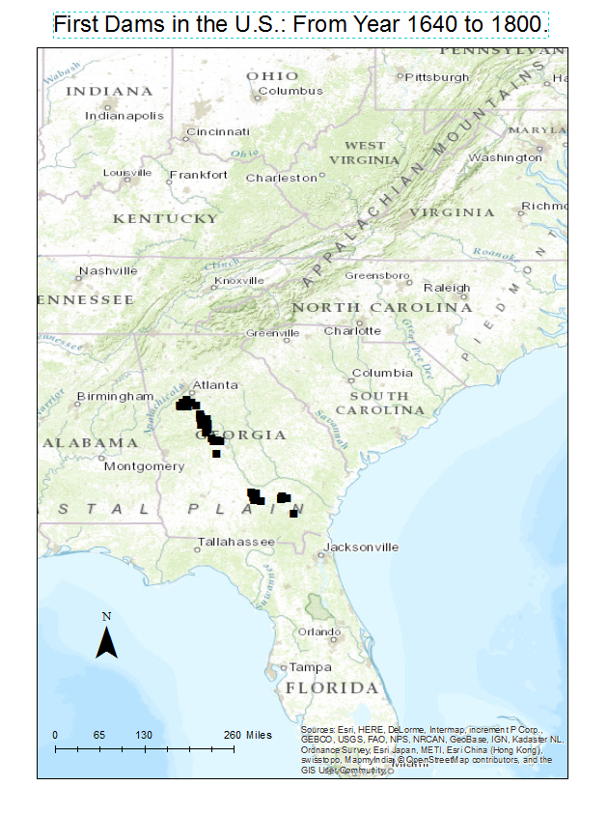
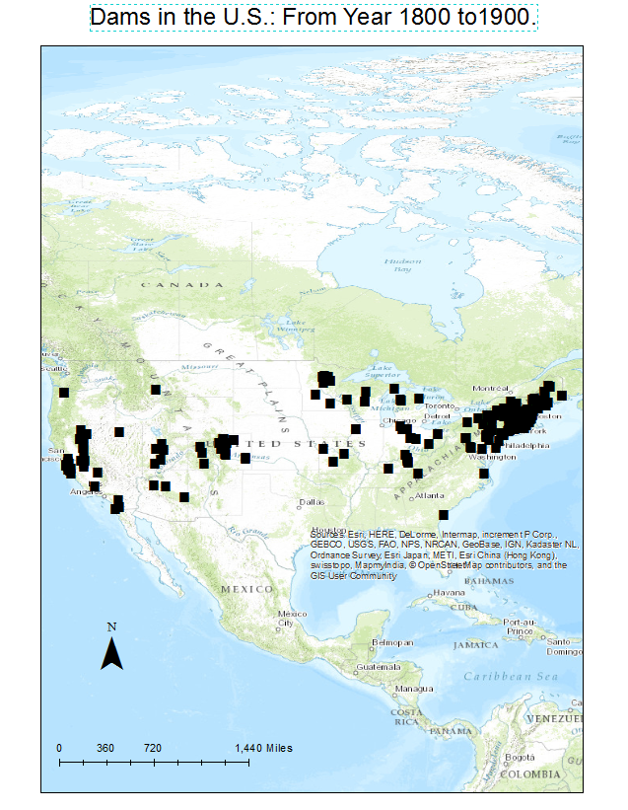
The Start of Dam Nation
Georgia was first settled by the British in 1670.

Slide 6
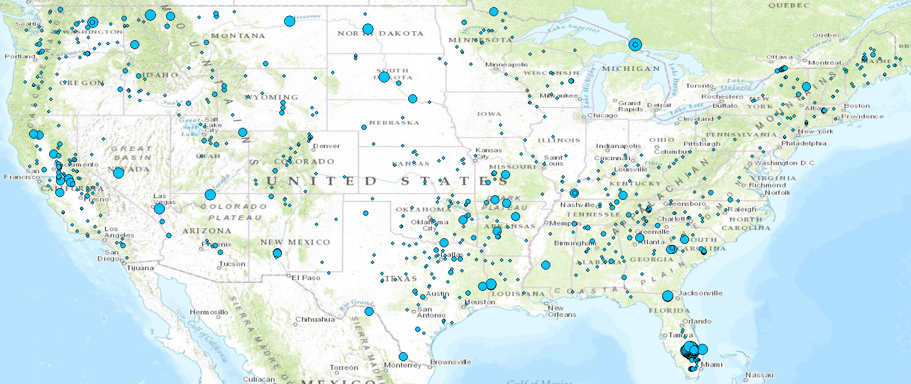
Big Dams: From 100,000 acre-feet of Normal Storage to 9.7 Billion acre-feet.
Natural lakes were practically non-existent before dams were built.

Slide 7
Fish at Risk
National Fish Habitat Partnership, 2010 The Status of Fish Habitats in the U.S.

Slide 8
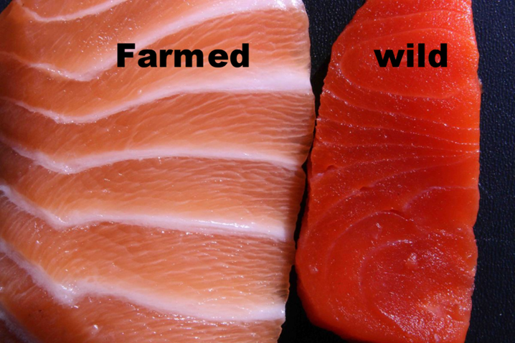
Western Salmon of the Past
Cheap, healthy, wild, and plentiful.
There is a difference between wild and farmed.
Notes:
Image from: https://www.linkedin.com/pulse/wild-caught-salmon-vs-farmed-informed-kevin-gantner

Slide 9
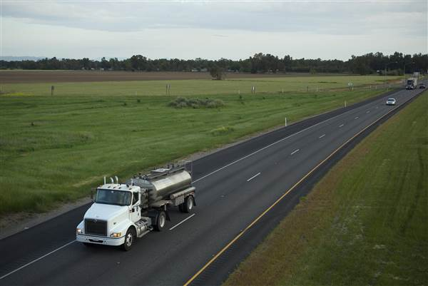
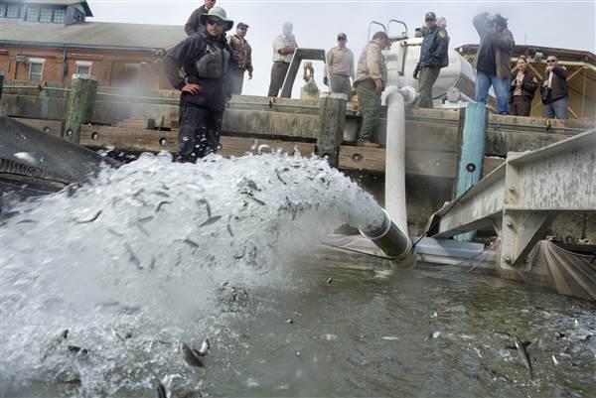
Present Day: Moving Chinook by Truck to San Pablo Bay
Notes:
Image from: http://www.nbcnews.com/storyline/california-drought/25-million-california-salmon-hitch-ride-ocean-due-drought-n88851

Slide 10
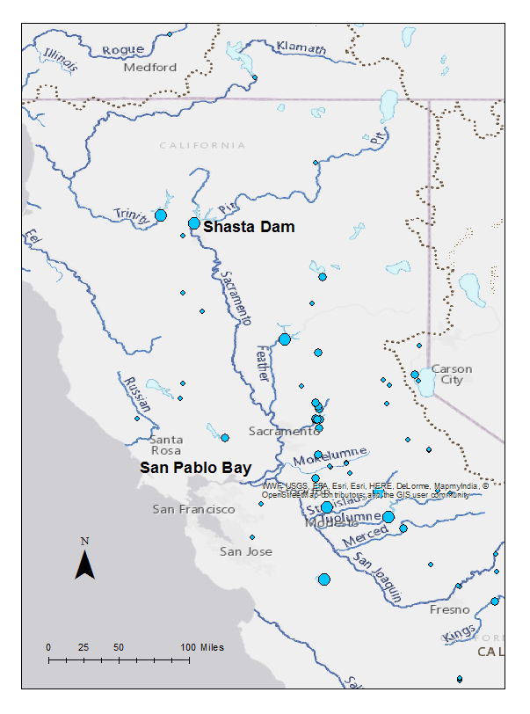

Slide 11
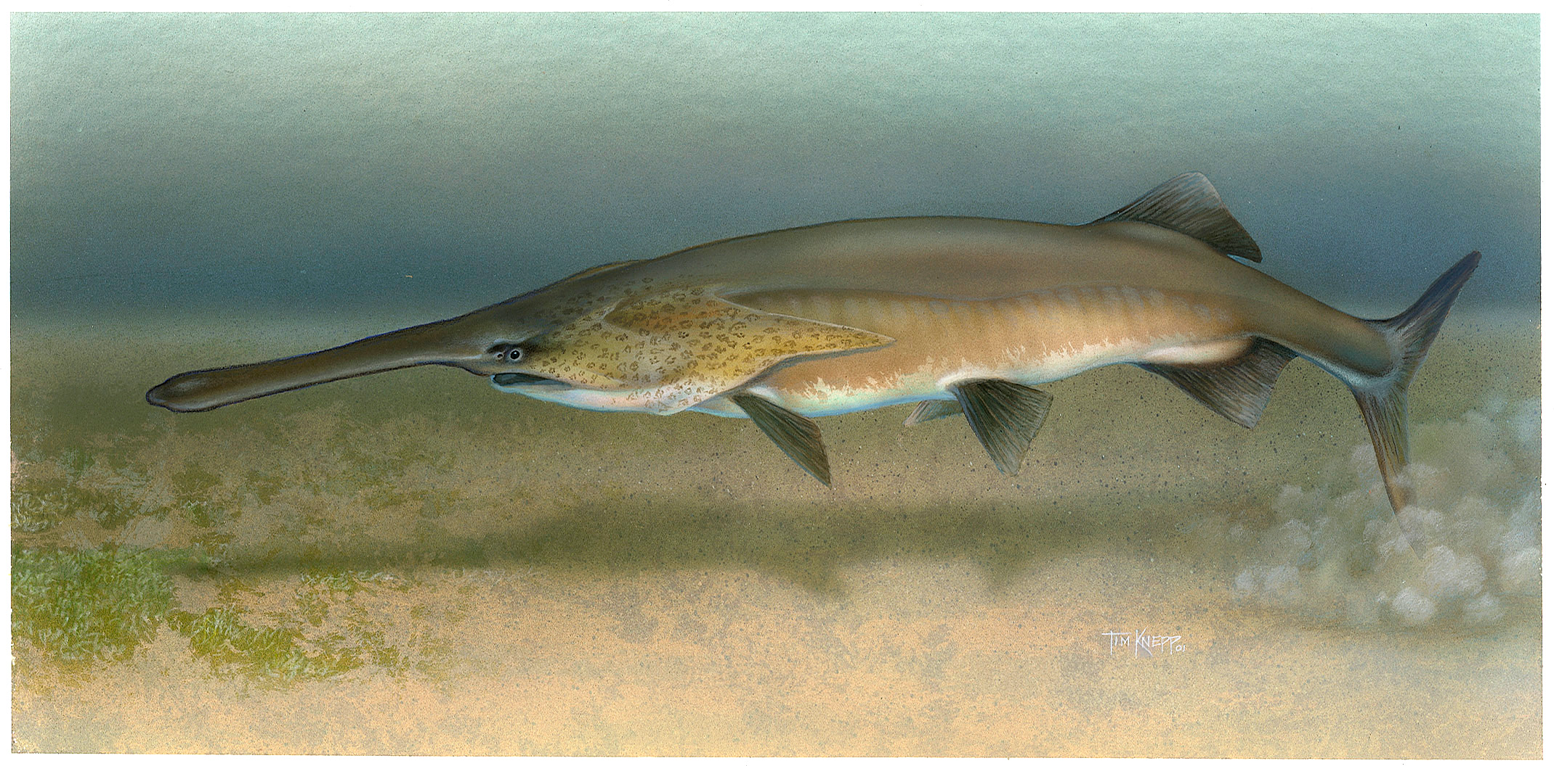
No, I’m not related to Pinocchio.
Notes:
Image from: commons.wikimedia.com

Slide 12
