Slide 1
Surface Water Pollution in Minnesota
Oliver Haugland
CE 394K

Slide 2
Minnesota Lake Life

Slide 3
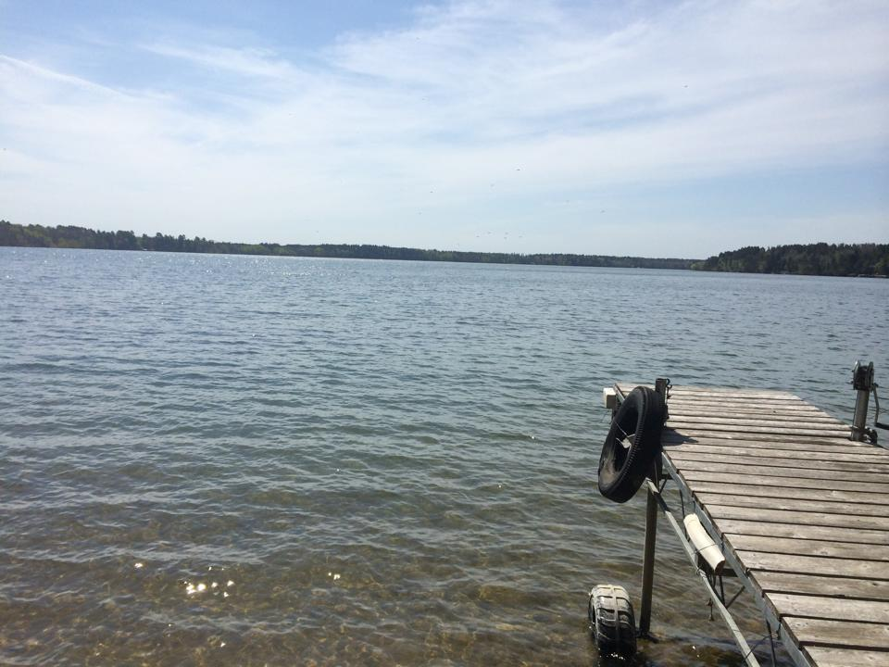
Minnesota Lake Life
11,842 lakes > 10 acres
13,136,357 acres of total surface area
Lake and River Recreation

Slide 4
Project Objective
Land use changes and pollution loading
Agriculture loading on SW pollution
Types of agriculture
Spatial differences

Slide 5
Impaired Waters
Section 303(d) Clean Water Act
4,114 total inventory
515 new impairments since 2012.
Notes:
Mercury in fish tissue and water: 1650, 59 new
Nutrient/Eutrophication biological indicators: 573, 58 new
E. coli and fecal coliform: 533, 125 new
Turbidity: 368, 24 new
Fishes bioassessment: 277, 85 new
Aquatic macroinvertebrate bioassessments: 299, 119 new
PCB in fish tissue and water column: 153, 0 new
Dissolved oxygen: 127, 12 new
Chloride: 47, 28 new
All other: 142, 3 new

Slide 8
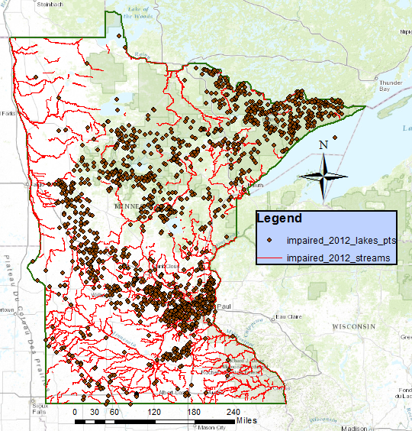
Impaired Water Bodies

Slide 9
Impaired Water Bodies
Notes:
Focus on two areas that have seen a lot of growth in the past 15 years.

Slide 10
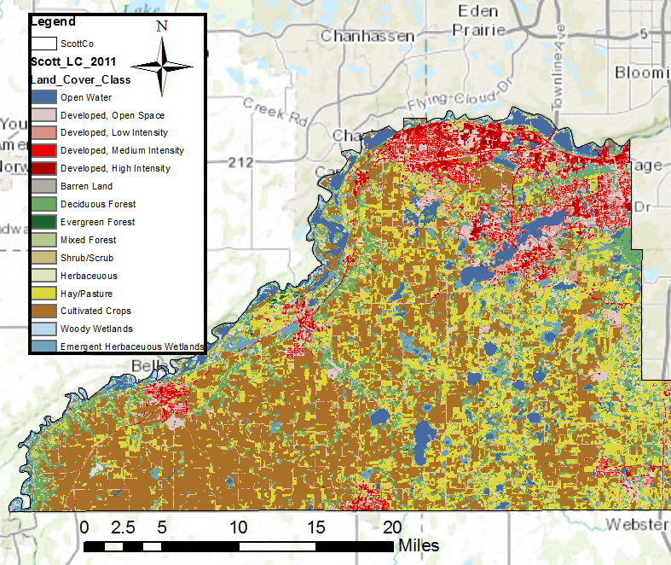
Scott County Growth
2001
2011
35% increase in development, 6% decrease in farmland

Slide 11
Scott County Growth
18 out of the 22 impaired water bodies added during this time.
All were either Mercury or Eutrophication
Measurement and regulations changed in this time period, so this result doesn’t really tell much.

Slide 12
Scott County Growth
EPA Storet water quality data shows little trends.
Inconsistent gages.

Slide 13
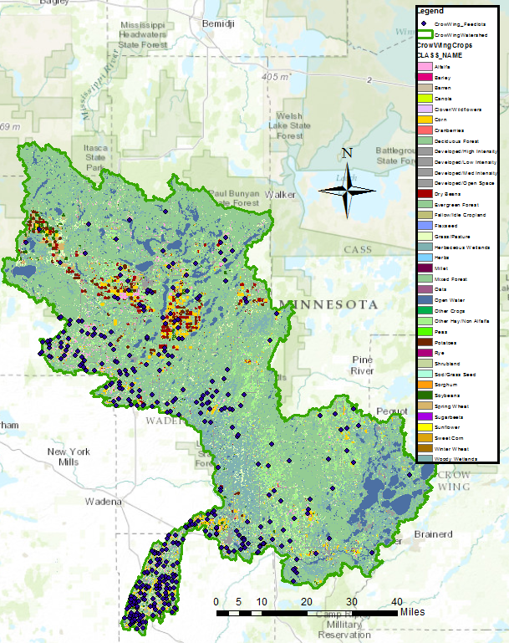
Agriculture in the Crowing Watershed

Slide 14
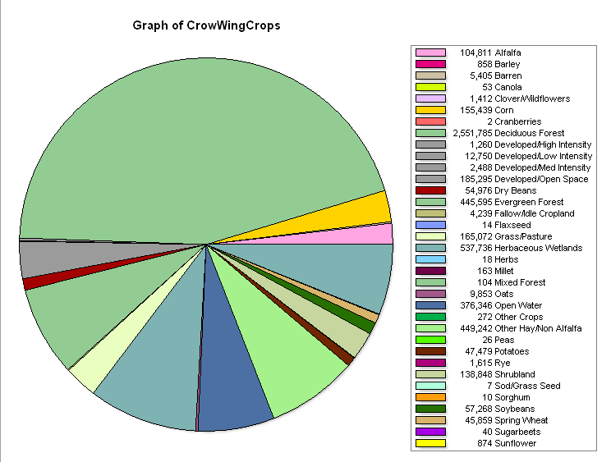
Detailed land use
Total Characterization
Ag Characterization

Slide 15
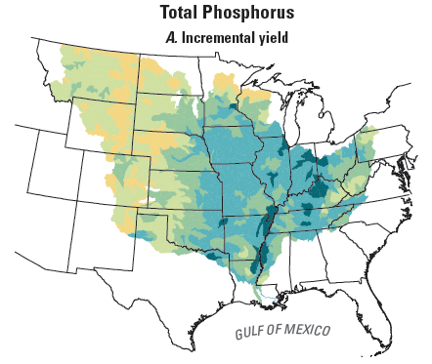
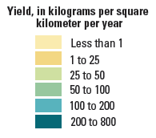
Estimated N, P Losses
Ranges from 0-40 kg/ha/yr depending on various crops (Nielsen et al. 1978)
708,252 kg/yr N
41,549 kg/yr P
Notes:
P is in range with what Sparrow Predicts, N is too high.

Slide 16
N, P Loading
Average Annual Discharge from this watershed is 1576 cfs
Agricultural runoff accounts for an estimated 0.5 mg/l P and 0.03 mg/l N in annual runoff
Do not come close to EPA Storet values
Notes:
P is way to high, N is low, this does not yet account for livestock operations.

Slide 17
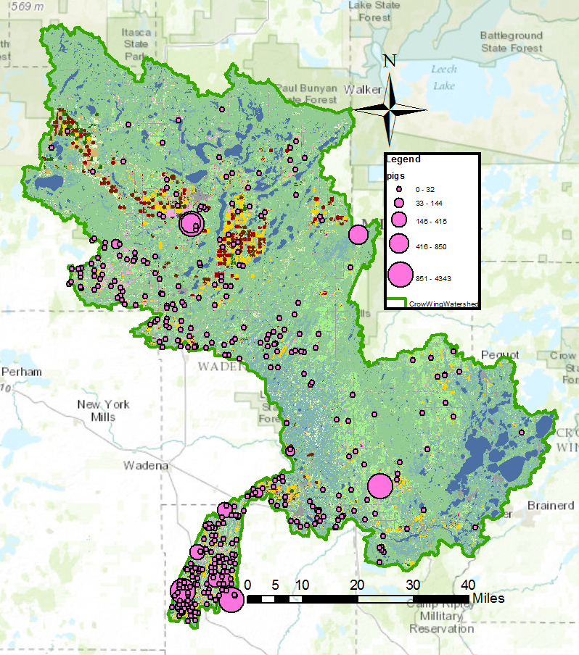
Cattle density
Pig density

Slide 18
Issues thus far
EPA Storet data difficult to work with
Need more accurate pollutant runoff data
USGS Sparrow Model to understand transport

Slide 19
Next steps:
Adding the livestock data to surface water loading
Determine how much additional agriculture activity this watershed can handle without waterbodies becoming impaired
Find a way to better incorporate Storet data accurately

Slide 20
Questions?

