Slide 1
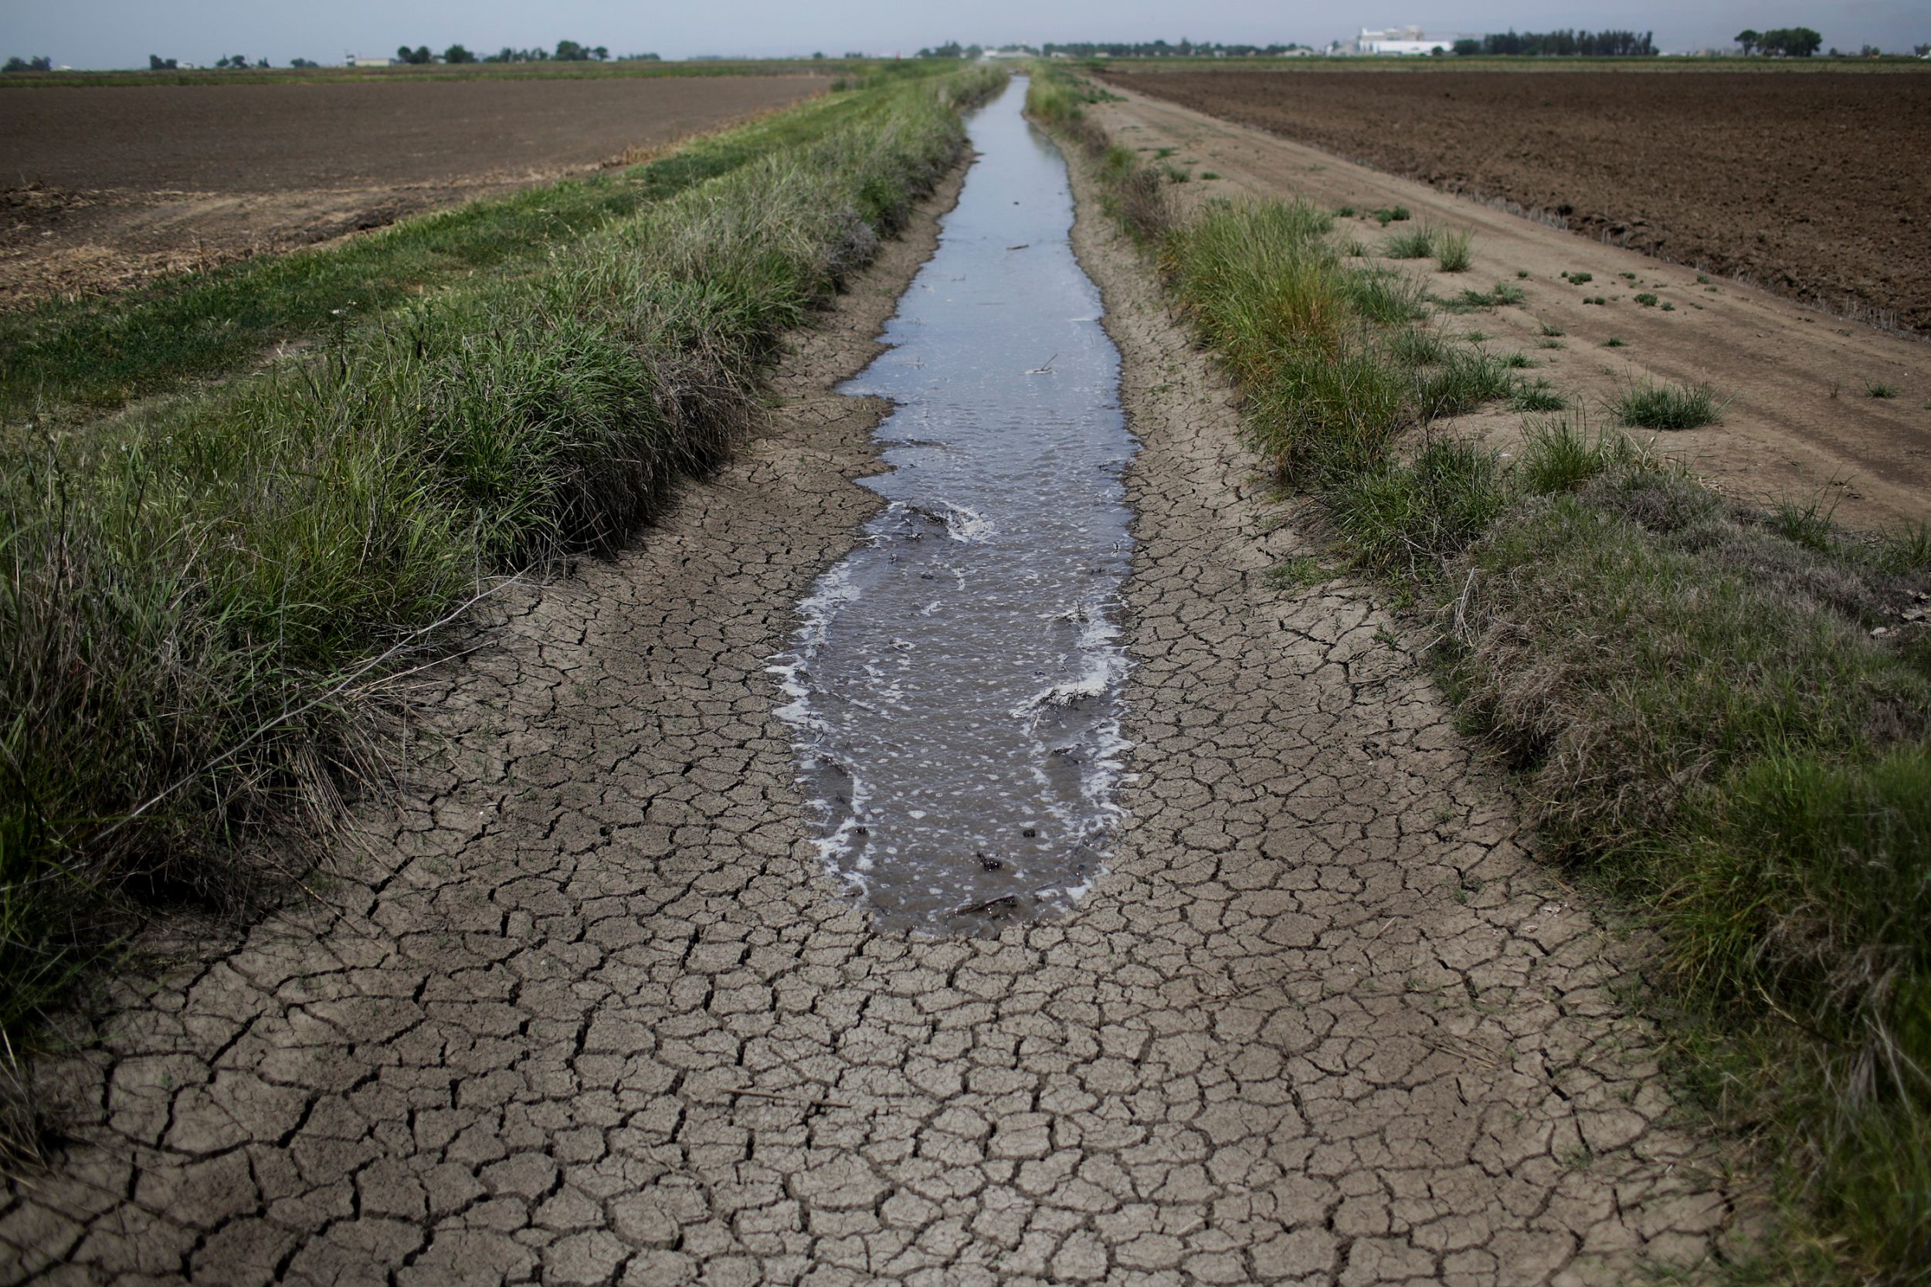
The Brown Effect:
California’s Water Conservation Amidst A Record Drought
Allison Hornstra
GIS in Water Resources Fall 2015
Environmental and Water Resources Engineering

Slide 2
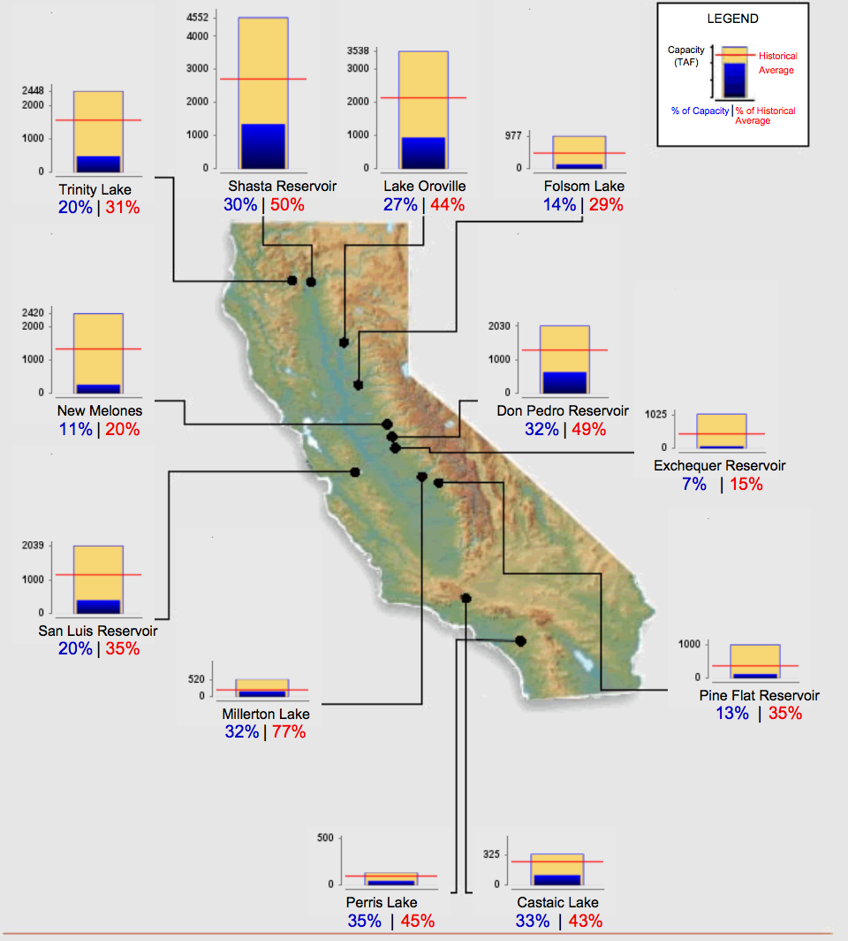
Reservoir Conditions
Source: CA DWR (As of Nov 22, 2015)

Slide 3
Drought in California
April 1, 2014 Governor Brown issued an Executive Order that required all urban water suppliers to submit monthly reports of potable water use to California’s State Water Resources Control Board (State Water Board)
April 1, 2015 Governor Brown issued another Executive Order directing the State Water Board to implement a mandatory 25% reduction in potable water use state-wide
May 18, 2015 Provisions went into effect

Slide 4
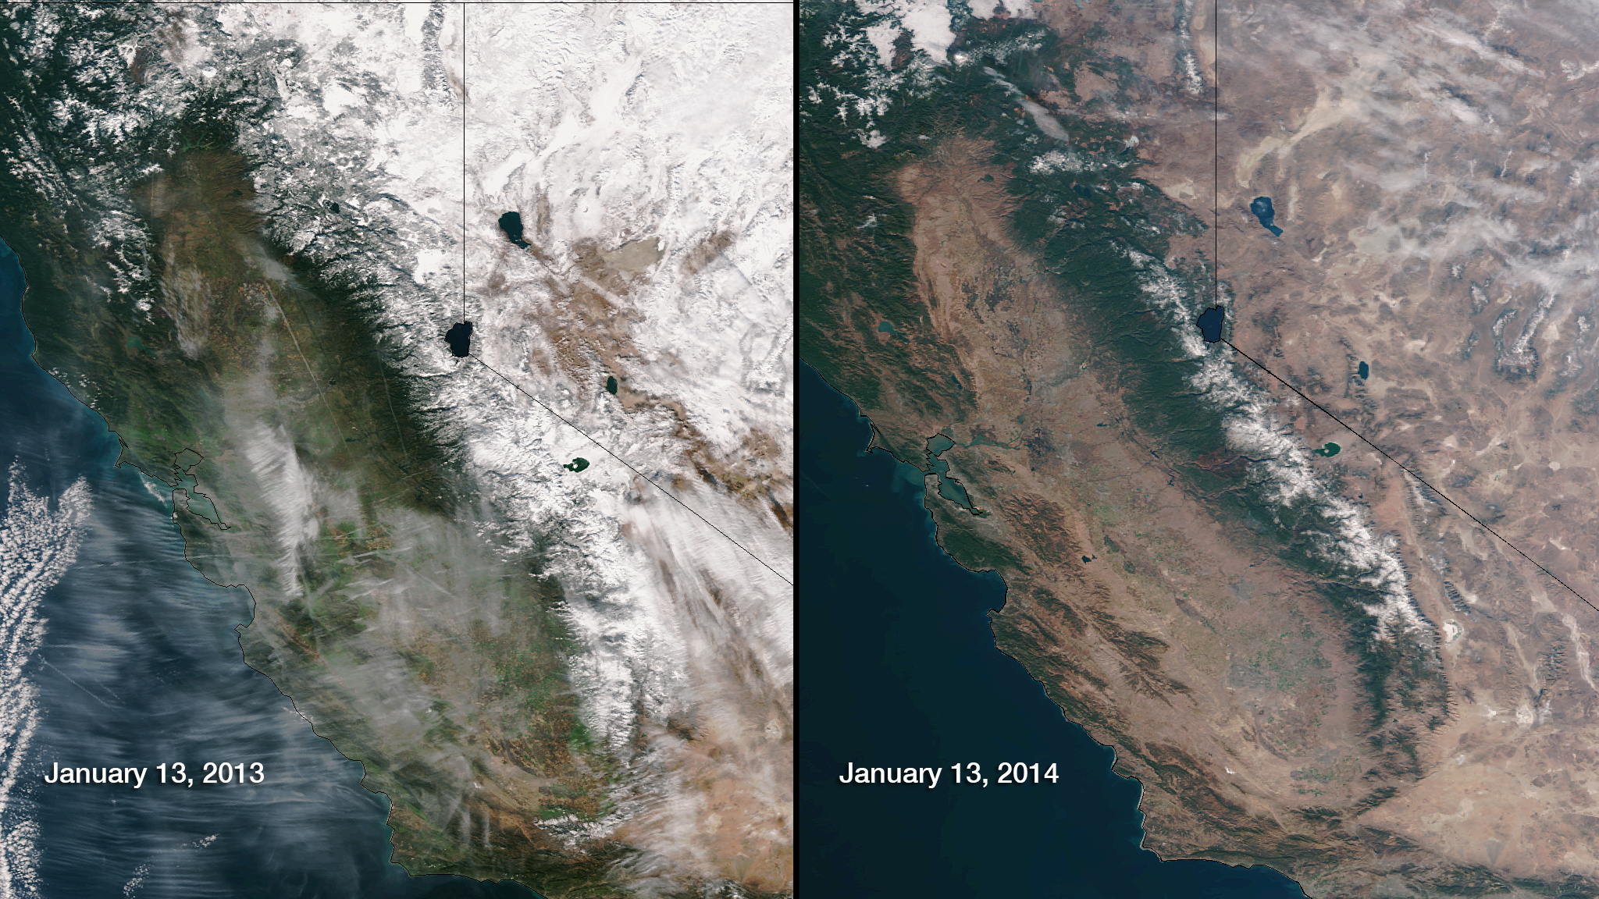

Slide 5
Drought in California
April 1, 2014 Governor Brown issued an Executive Order that required all urban water suppliers to submit monthly reports of potable water use to California’s State Water Resources Control Board (State Water Board)
April 1, 2015 Governor Brown issued another Executive Order directing the State Water Board to implement a mandatory 25% reduction in potable water use state-wide
May 18, 2015 Provisions went into effect

Slide 6
Original Plan
Focus on the service area for West Basin Municipal Water District
Analyze water use in West Basin’s service area for the past 5 years alongside temperature and precipitation records to project what water use would have been in the West Basin service area without conservation efforts
Perform an intervention analysis to determine the extent of the “Brown Effect” since the governor’s mandate
By factoring in additional parameters such as temperature and precipitation, I should be able to generate a more accurate assessment of conservation efforts

Slide 7
Modified Objectives:
(1) To assess the effectiveness of current conservation mandates
My project aims to analyze water conservation successes and failures across the state of California, and use ArcGIS to visually represent trends.
(2) To use findings to better inform future water conservation regulations
What is causing the trends we see? Are current mandates a fair assessment of effort? Is there something we must consider in assigning future conservation mandates?

Slide 8
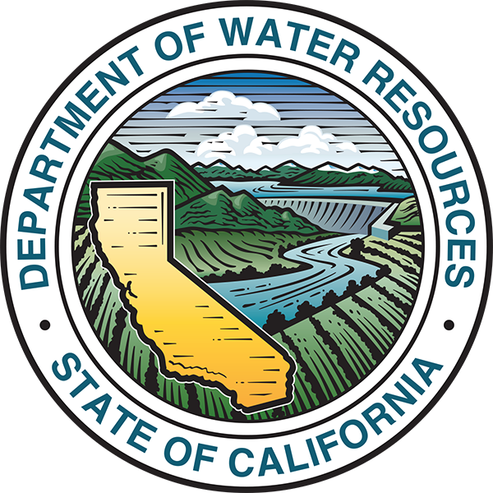
Finding the Data
411 Water Districts
2,600 Small Mutual Water Agencies
No one agency is in charge

Slide 9
Finding the Data
411 Water Districts
2,600 Small Mutual Water Agencies
No one agency is in charge

Slide 10
Data Sources
State Water Resources Control Board
Urban Water Supplier Water Use Reports for June 2014 - September 2015.
411 agencies
Compliance is not always 100% for any given month
CA Department of Public Health
Service Area Boundaries for public water suppliers
3,128 unique ID’s (water agencies, state parks, military bases)

Slide 11
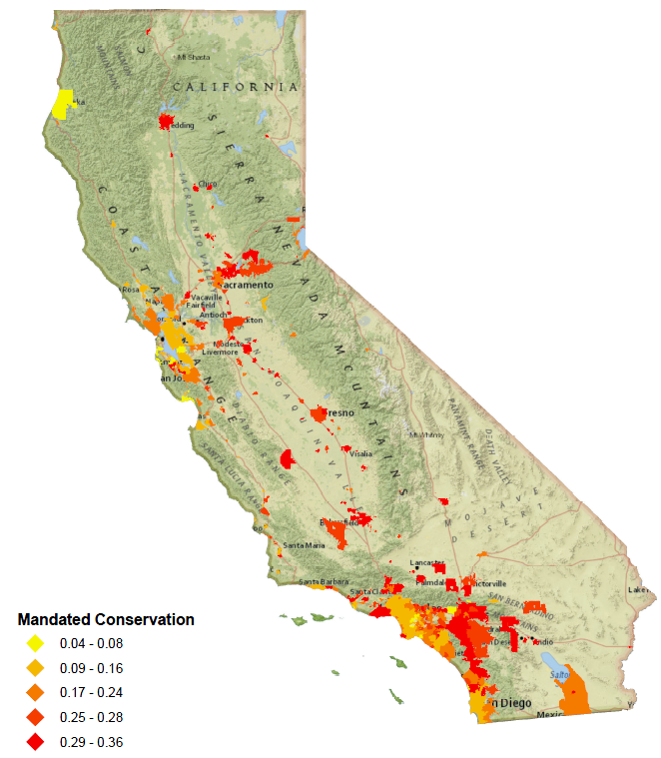
Mandated Conservation
Regulations divide urban water suppliers into nine conservation tiers that range from 4 - 36%
Tiers are based on residential water use in summer 2013
Those with higher residential gallons per capita per day ( R-GPCD) were mandated to cut more

Slide 12
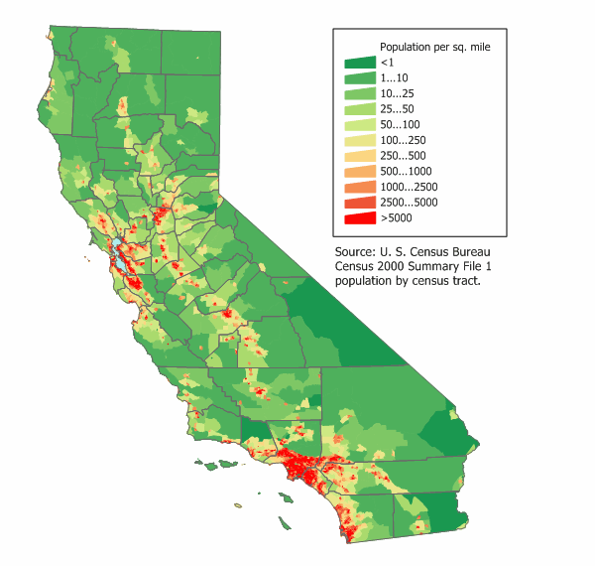
Mandated Conservation

Slide 13
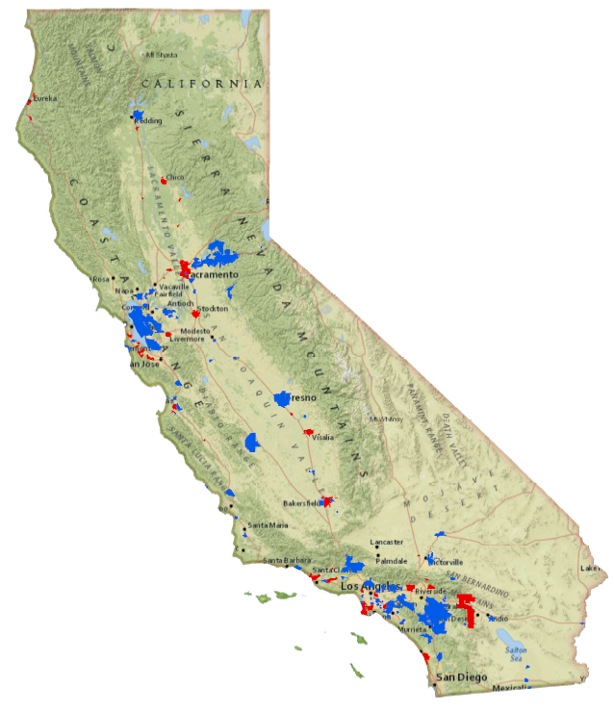
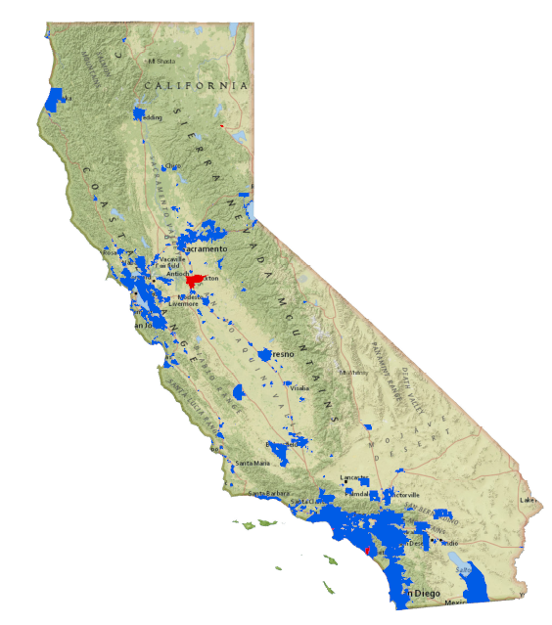
Mandatory Restrictions
July
2014
September 2015
No Mandatory Restrictions
Mandatory Restrictions

Slide 14
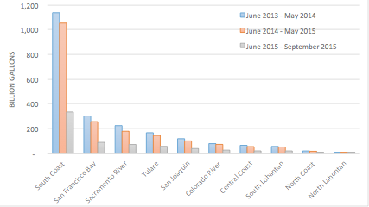
Calculated Potable Water Production
By Hydrologic Region
State-wide water use is concentration in the South Coast
Los Angeles, Orange County, and San Diego
All hydrologic regions reduced water use during the first Executive Order
Production since 25% mandate still in progress

Slide 15
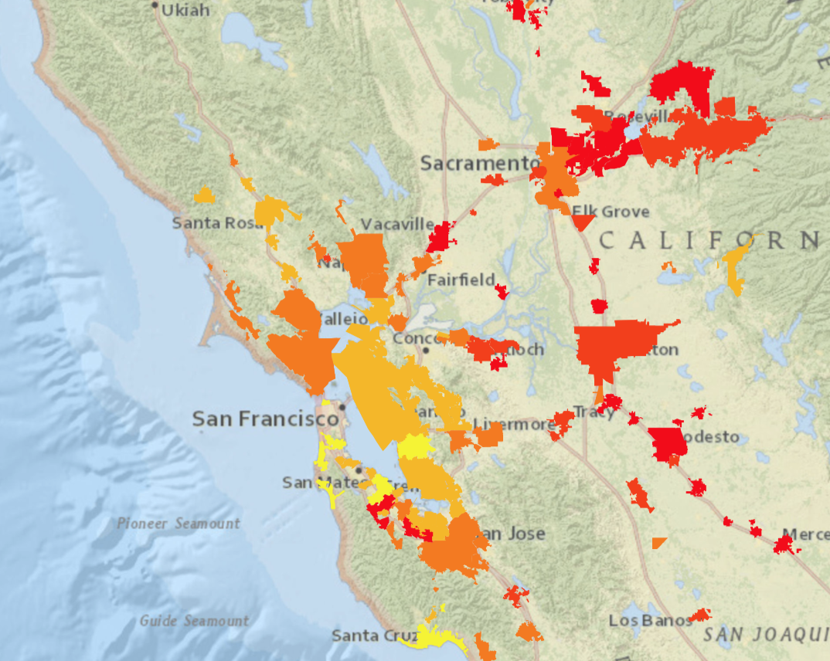
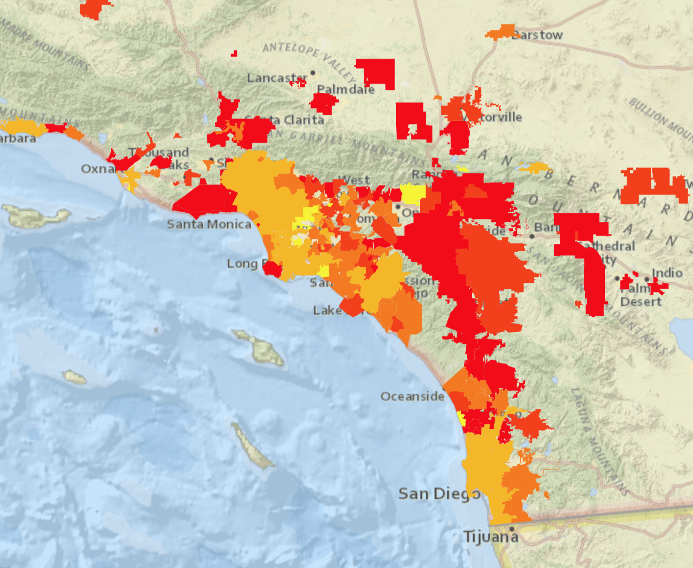
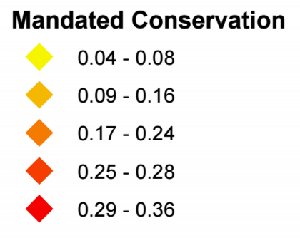

Slide 16
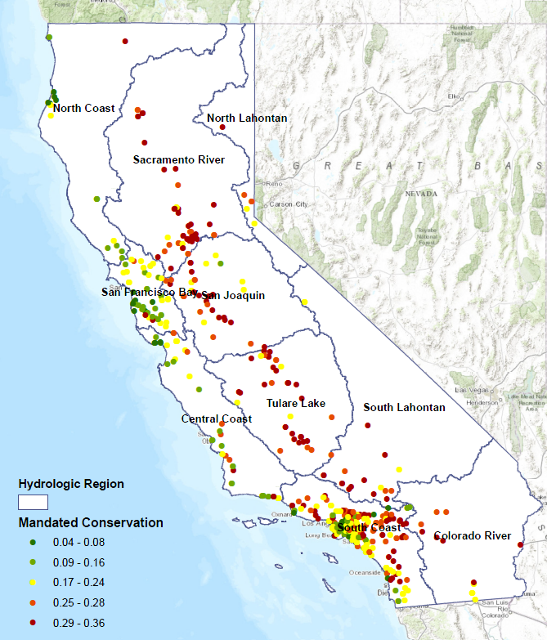
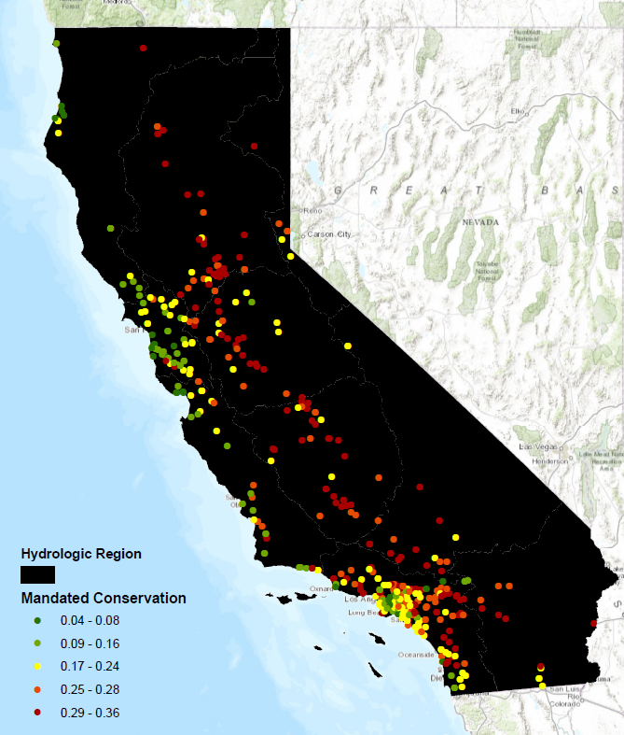

Slide 17
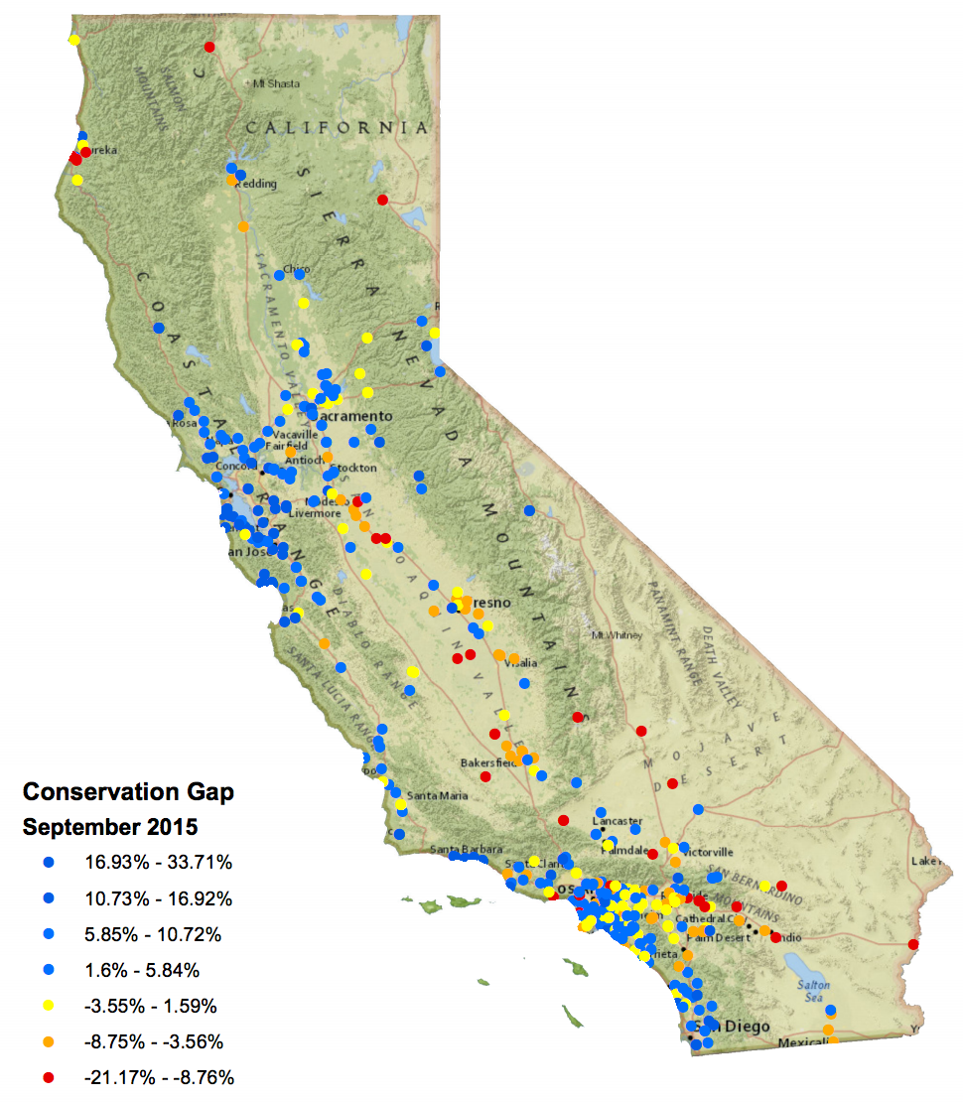
So how are Californians doing?

Slide 18
So how are Californians doing?
Pretty Good!!

Slide 19
So how are Californians doing?
Pretty Good!!
Statewide conservation is currently at 28.2%, well above the 25% target
In September 2015, 282 water agencies (72%) met or exceeded their mandate
Only 6 out of a total of 402 missed their mandate by more than 15%
Geospatial patterns may indicate the need to modify the model for how targets are set

Slide 20
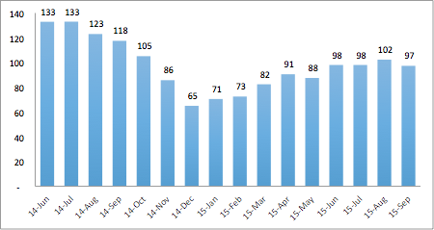
The Brown Effect: Statewide R-GPCD

Slide 21
The Brown Effect: Statewide R-GPCD

Slide 22
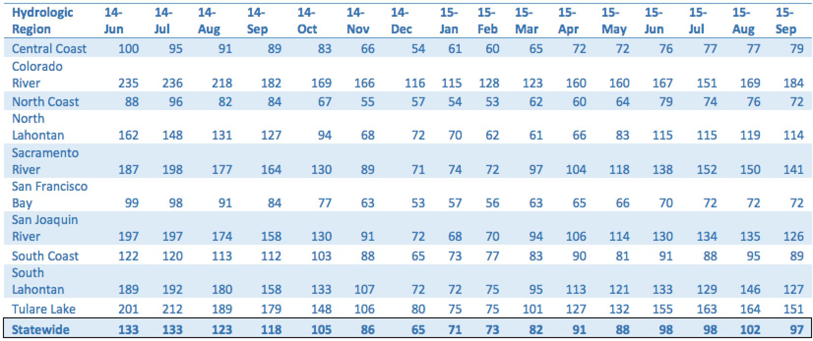
Hydrologic Region R-GPD Trends

Slide 23
(2) To use findings to better inform future water conservation regulations
What is causing the trends we see? Are current mandates a fair assessment of effort? Is there something we must consider in assigning future conservation mandates?

Slide 25
Factors to consider
Many water agencies had been conserving long before summer 2013
Current method ignores the peculiarities of a geographically, hydrologically, and financially diverse state
Regional climate differences
Agency size
Socio-economic factors
Need to find what is fair, doable, but still aggressive enough.

Slide 26
Future Work
Map statewide distributions of:
Population
Socio-economic factors
Precipitation
Temperatures
Regression analysis to see the extent to which these parameters are predictors of water use
These factors may help understand the spatially variable abilities of conservation.

Slide 27
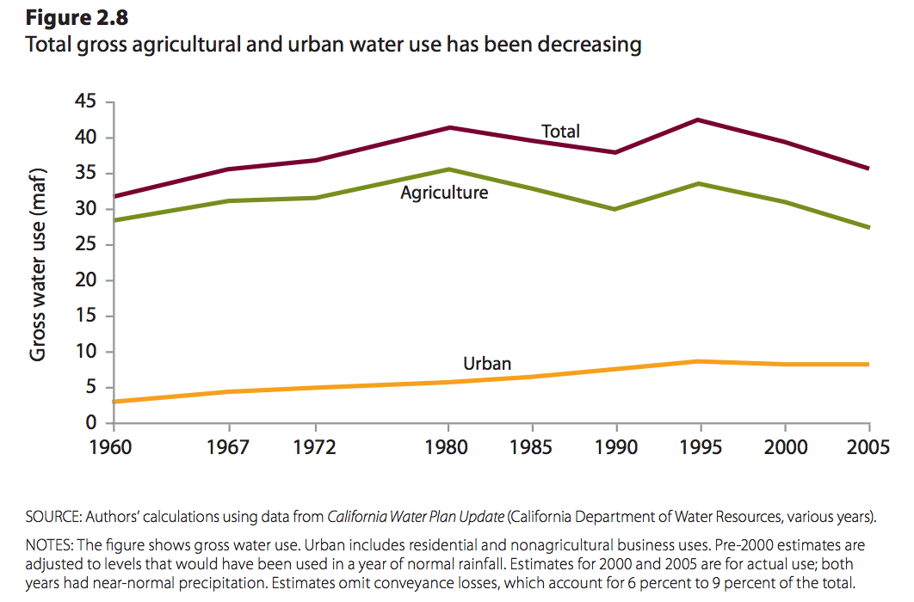
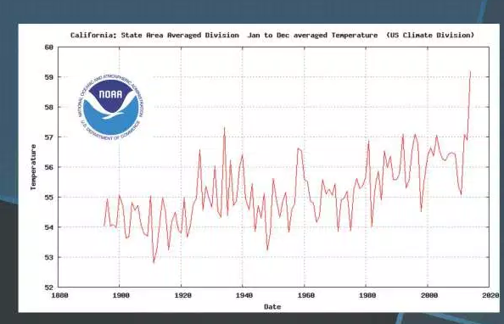
Future Work
Map statewide distributions of:
Population
Socio-economic factors
Precipitation
Temperatures
Regression analysis to see the extent to which these parameters are predictors of water use
These factors may help understand the spatially variable abilities of conservation.

Slide 28
Future Work
Map statewide distributions of:
Population
Socio-economic factors
Precipitation
Temperatures
Regression analysis to see the extent to which these parameters are predictors of water use
These factors may help understand the spatially variable abilities of conservation.

Slide 29
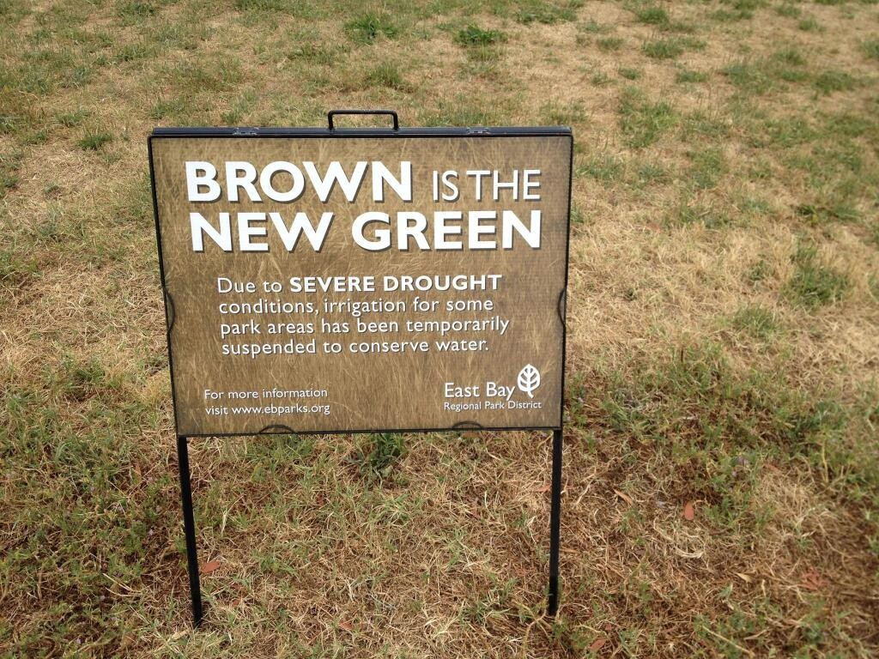
Questions?

