Slide 1
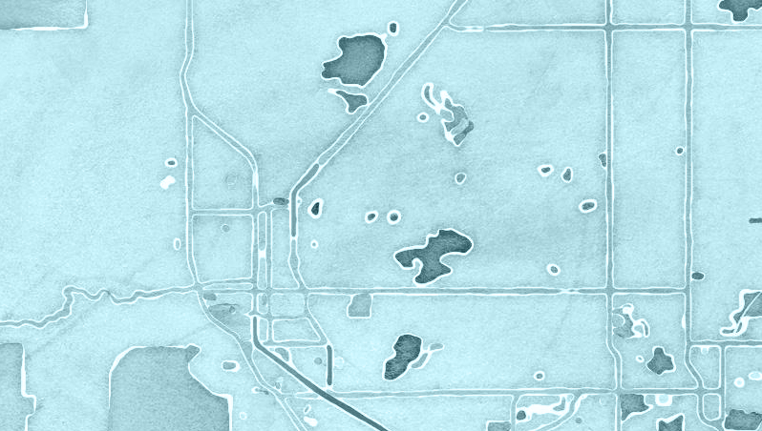
Flood Mapping: Hydrology and Communities
2013 Boulder Floods
Presented by: Sandra Sweat Fall 2015 Professor: Dr. David Maidment

Slide 2
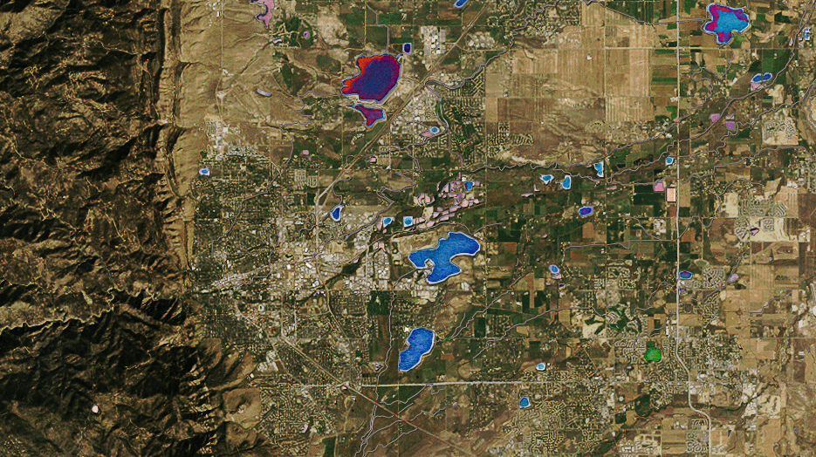
Objectives
Understand the relationship of hydrology and community data sources.
Look at how people interact with flood events.
Visualizations:
What types of visualizations can be made to represent a flooded area – both in GIS and in other representations?

Slide 3
Data
Hydrology
USGS
ArcMap connected data
FEMA
NOAA
Community
CMS
Census 2010
National Weather Service
ESRI
Twitter
Newspapers
Journal and Government Papers
Zip Codes

Slide 4
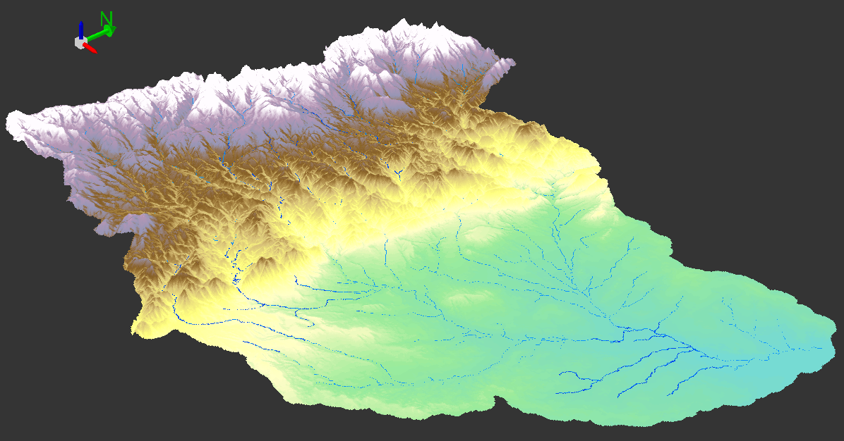
St. Vrain Watershed

Slide 5
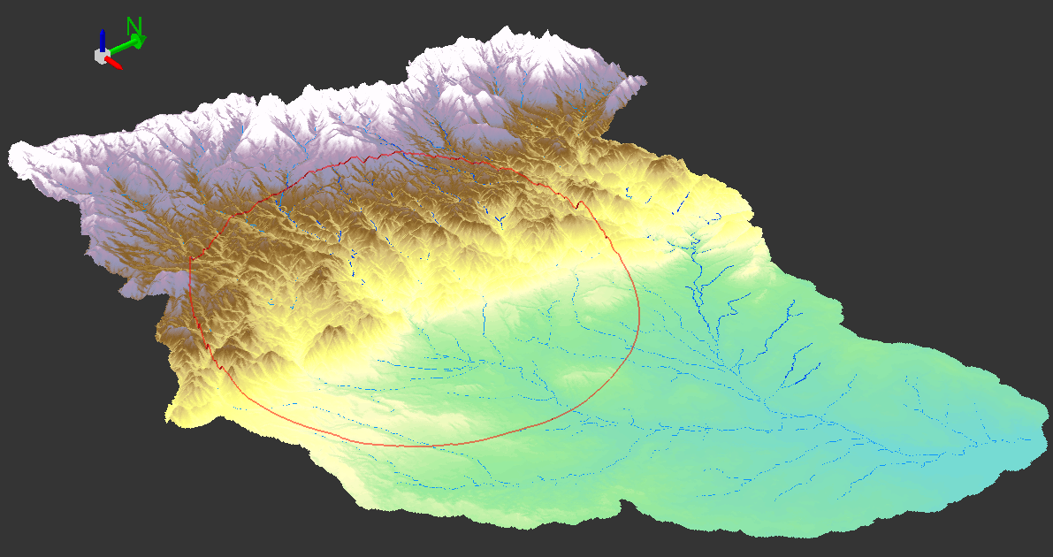
St. Vrain Watershed

Slide 6
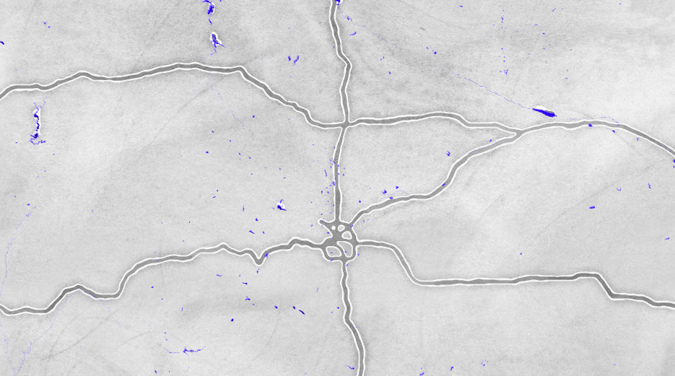
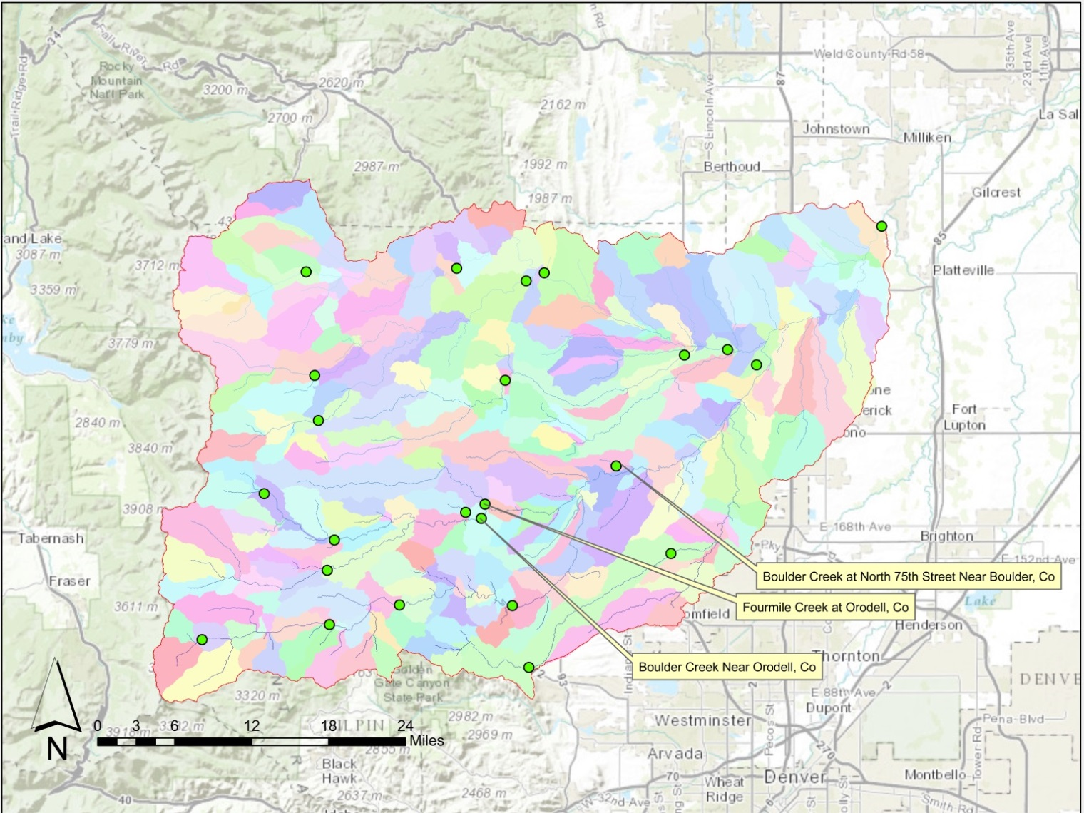
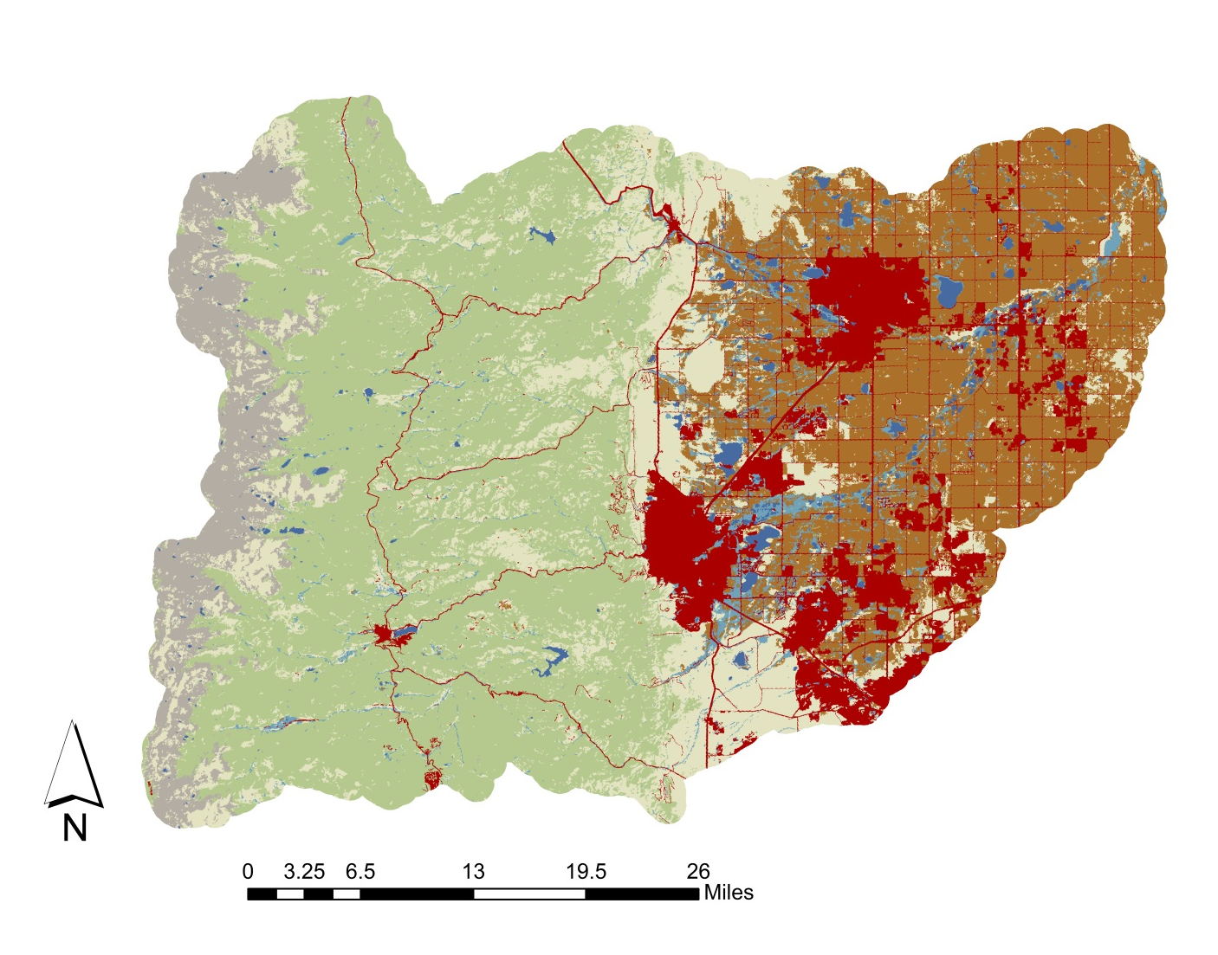
Catchments and Gages
Land Cover

Slide 7
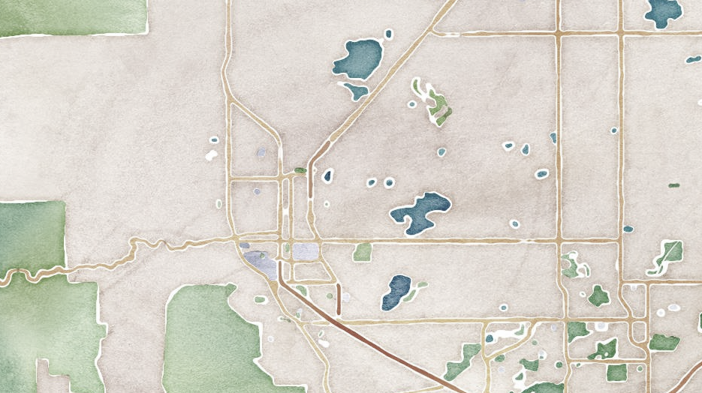
NFHL
There are 12 data layers in the National Flood Hazard Layer.
S_FLD_HAZ_AR
A – 1% annual chance
AE – 1% annual chance
AO - floodway
X – 0.2% annual chance
Hello, FEMA.
Resulting maps

Slide 8
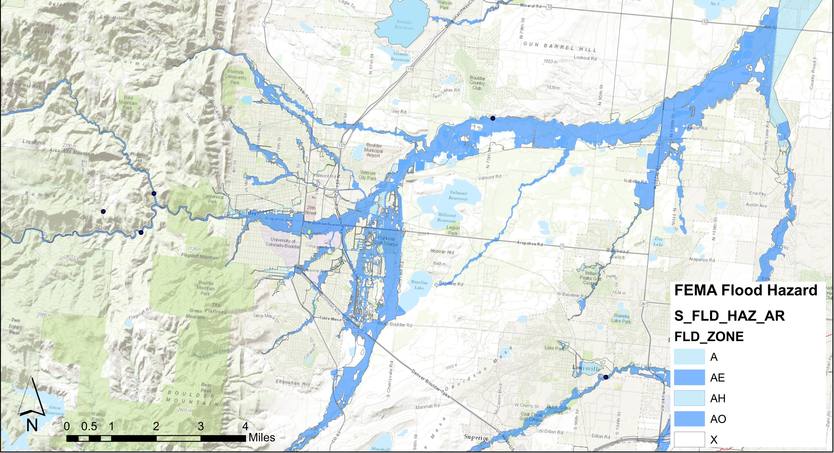

Slide 9
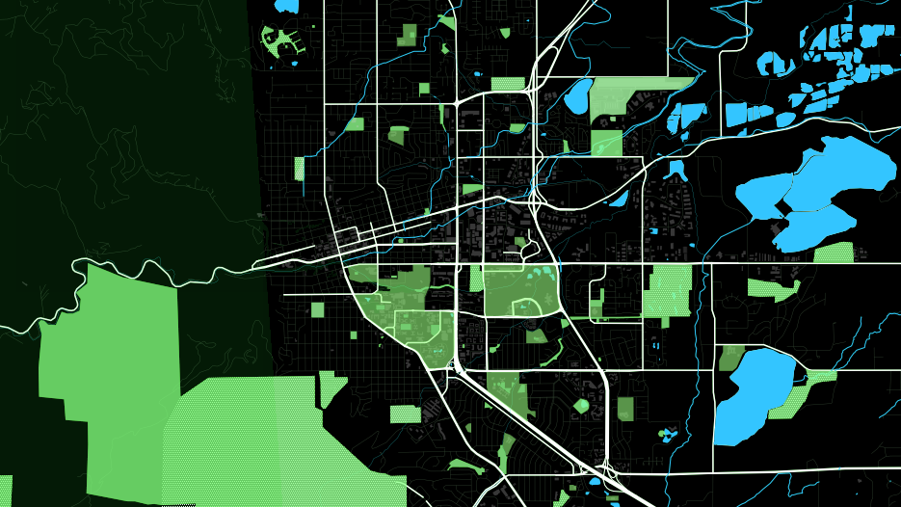
Census
Target groups based on loss of life
Age 15-24
Age 75+
Buildings
Hospitals
Dialysis Centers
Nursing Homes

Slide 10
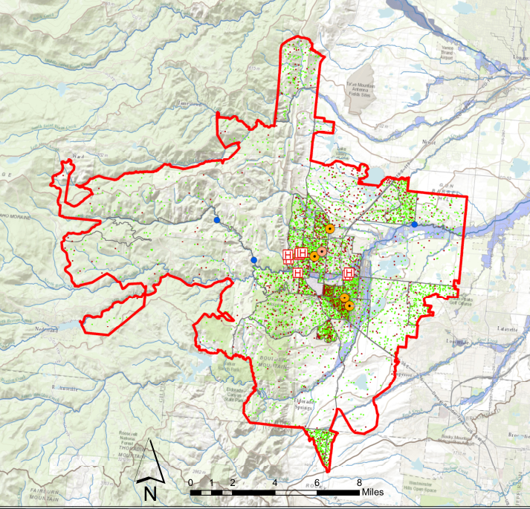
Legend
Age 75-85
Age 85 +

Slide 11
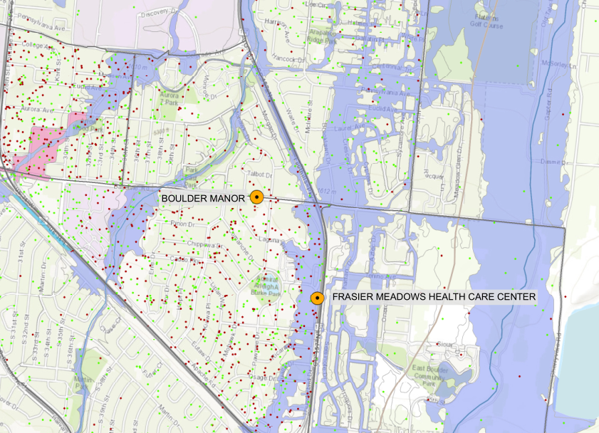
Legend
Age 75-85
Age 85 +

Slide 12
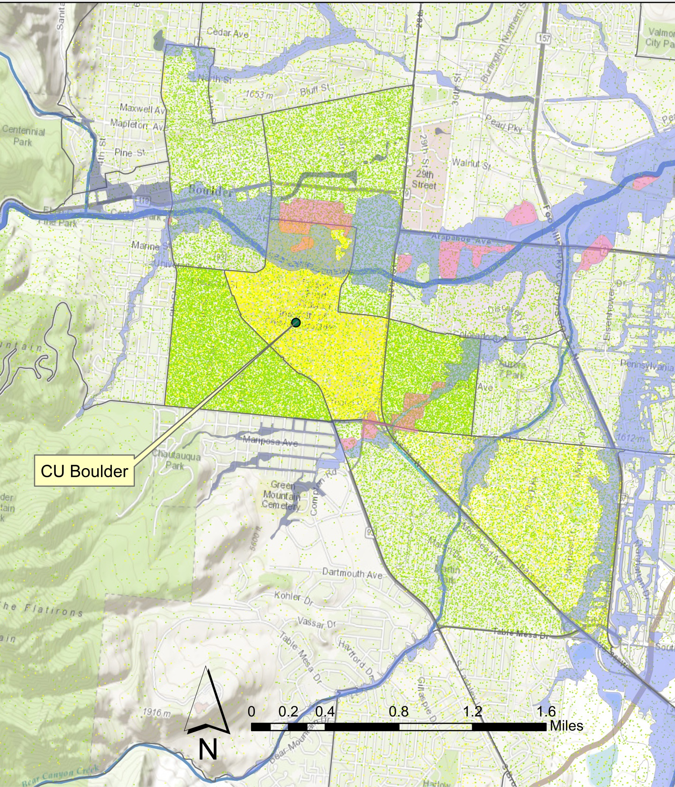
Legend
Age 15-19
Age 20-24

Slide 13
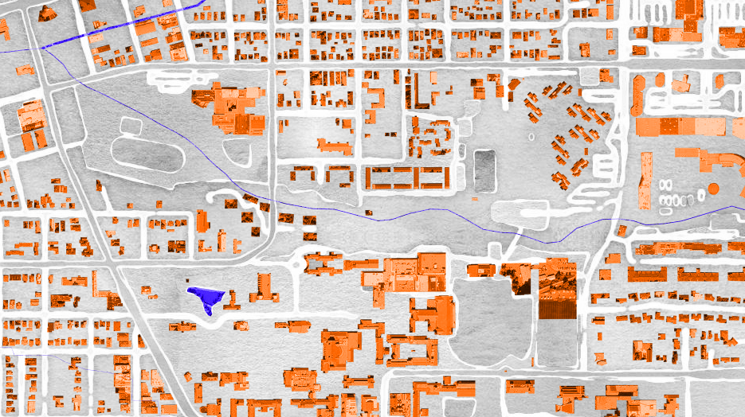
Event Tracking – Creating a Timeline
Streamflow
Rainfall
Daily Camera Article
NWS Storm warnings
Twitter – manual searching

Slide 14
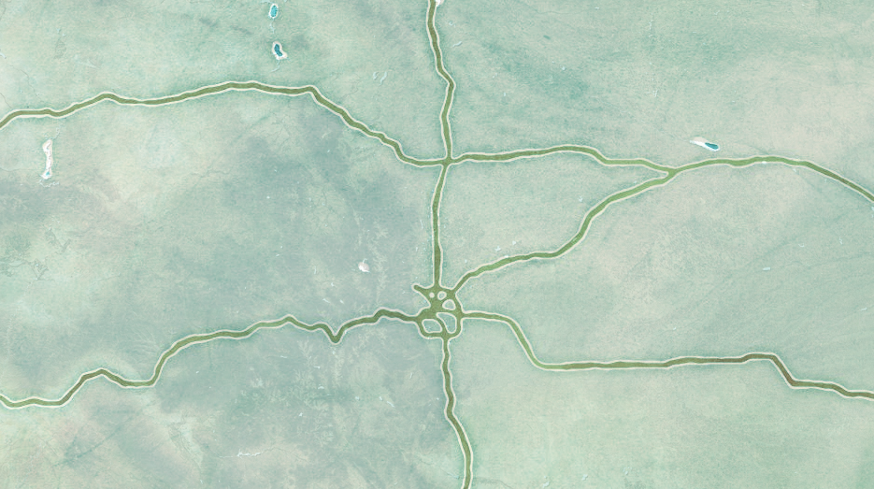
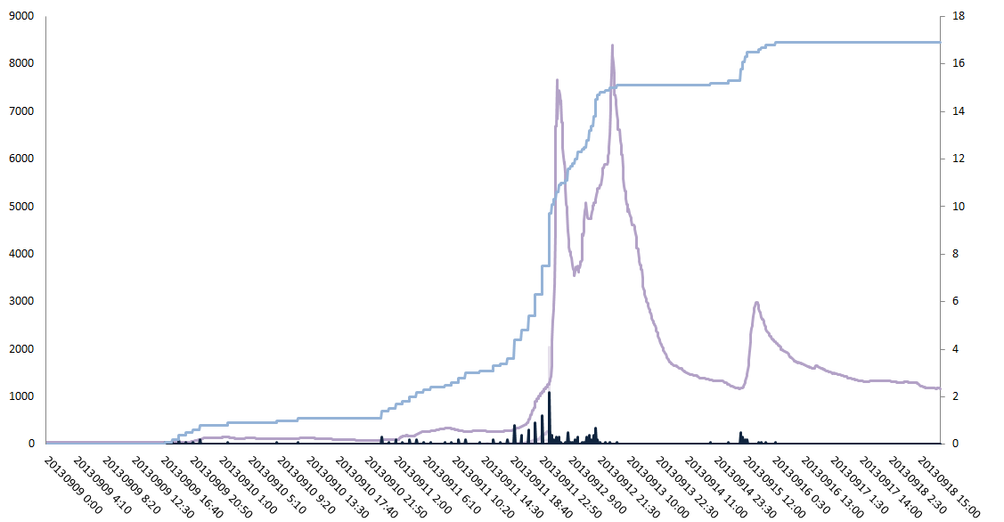
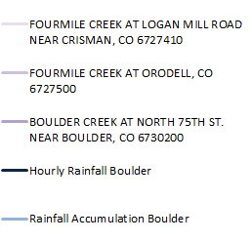
Flow versus Rainfall
September 9th-18th
Boulder Creek at Orodell
Fourmile Creek at Orodell
Flow in cfs
Boulder Creek Near 75th
Rainfall in inches
Hourly Rainfall Boulder
Rainfall Accumulation Boulder
Time (YYYYMMDD hh:mm)

Slide 15
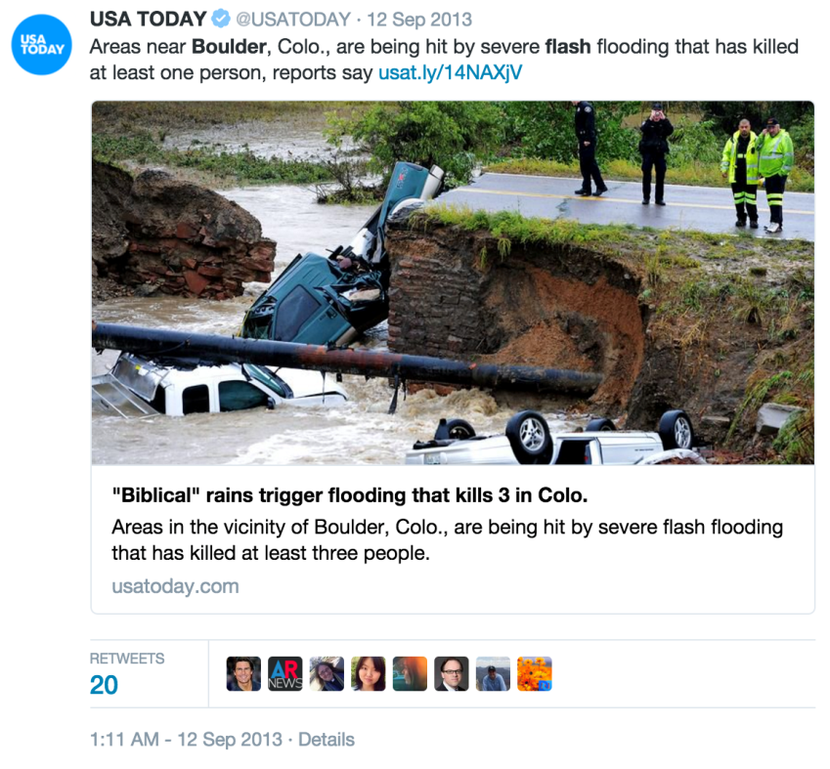
Twitter
Twitter – manual searching
Keyword search: flood, boulder, emergency, storm, precip, rain
Date Range: 9/11 – 9/18
Agency Searches: NOAA, NWS, Boulder Police

Slide 16
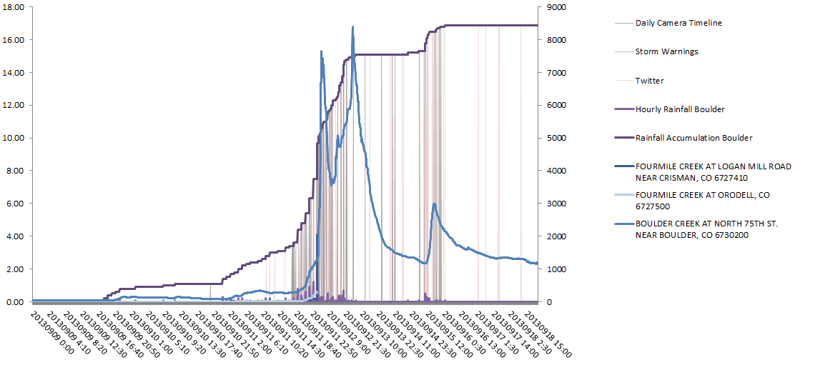
Flow versus Rainfall
Daily Camera
Storm Warnings
Twitter
Hourly Rainfall Boulder
Rainfall in inches
Flow in cfs
Rainfall Accumulation Boulder
Boulder Creek at Orodell
Fourmile Creek at Orodell
Boulder Creek Near 75th
Time (YYYYMMDD hh:mm)

Slide 17
Questions

