Slide 1
Data Sources for GIS in Water Resources by David R. Maidment, and David G. Tarboton
GIS in Water Resources
Fall 2015

Slide 2
Outline
The hierarchical system of watersheds and basins
Where to obtain data and maps
  National/State/Global Data repositories
  Hydrography
  USGS National Water Information System
  Land Cover
  Census
  Elevation
  Soil (Statsgo/Surgo)
  Weather
  Regional data for Texas and Utah

Slide 3


Open Water Data Initiative (OWDI)
Subcommittee on Spatial Water Data leads this effort
Al Rea (USGS) and Ed Clark (NWS) are co-chairs
This reports to both FGDC and ACWI
Sponsoring a series of “experiments” with water information services
NFIE is one of these experiments
Developing a “Geospatial Hydrologic Framework” for the US
Anne Castle, Former Asst Secretary for Water and Science, Dept of Interior
Chair

Slide 4

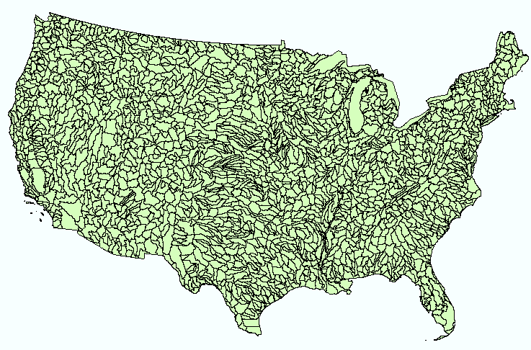
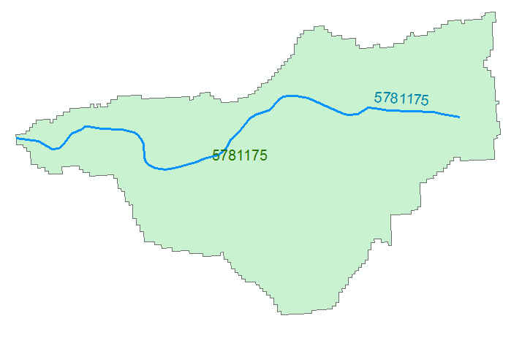
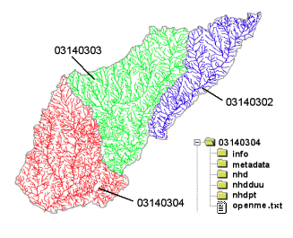
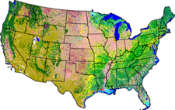
NHDPlus Version 2.1
Foundation for a Geospatial Hydrologic Framework for the United States
NHDPlus
2.7 million reach catchments in US
average area 3 km²
reach length 2 km
Uniquely labelled
National Elevation Dataset
Watershed Boundary Dataset
National Hydrography Dataset
National Land Cover Dataset

Slide 5

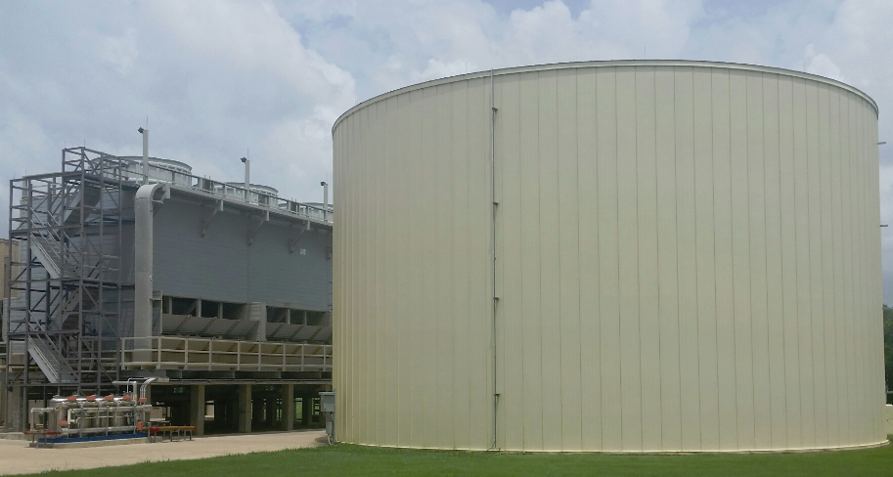
Stampede
1.2 million gallon cooling tank
500,000 processors operating in parallel

Slide 6
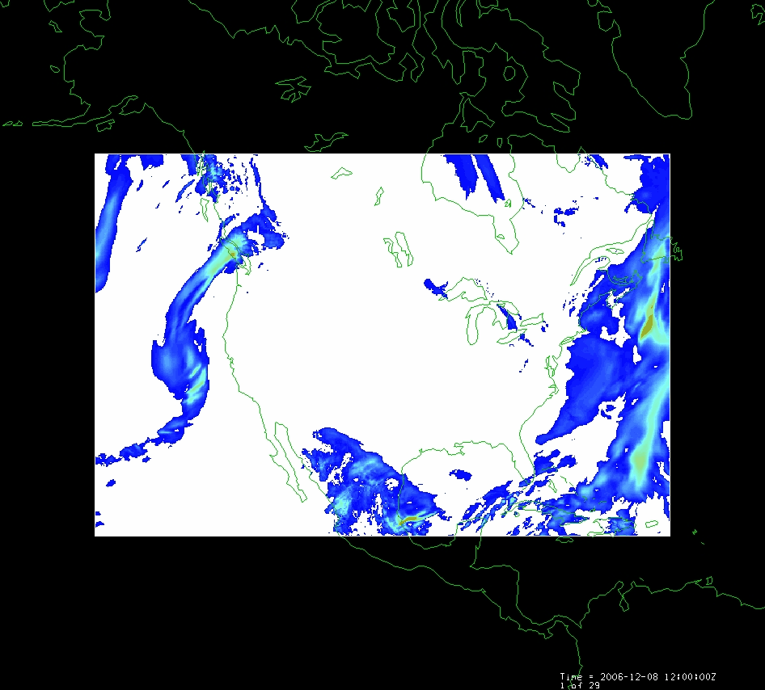
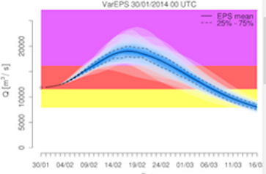
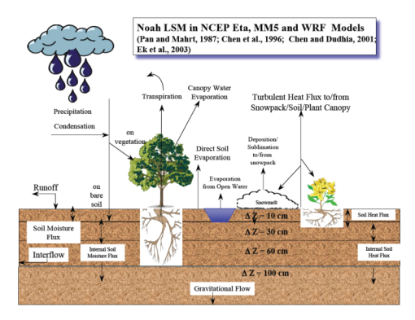
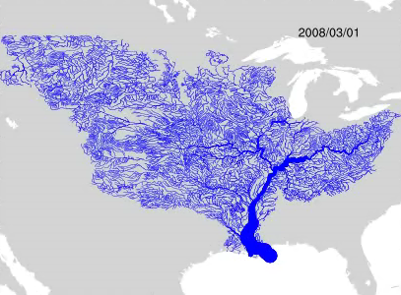
WRF-Hydro Forecasting Model
Computed for the continental US in 10 minutes at Texas Advanced Computing Center
Weather model and forecasts (HRRR)
Probabilistic flood forecasts
Catchment-level forecasts
Weather
Precipitation
Streamflow
Runoff
Land-Atmosphere Model (NOAH-MP)
RAPID flow routing (for continental US)

Slide 7
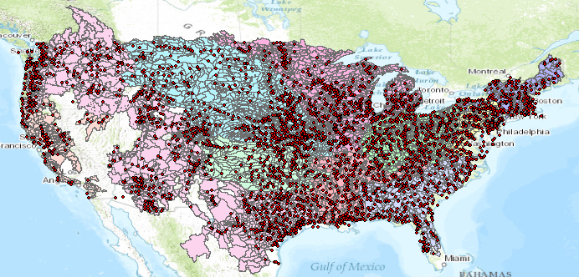
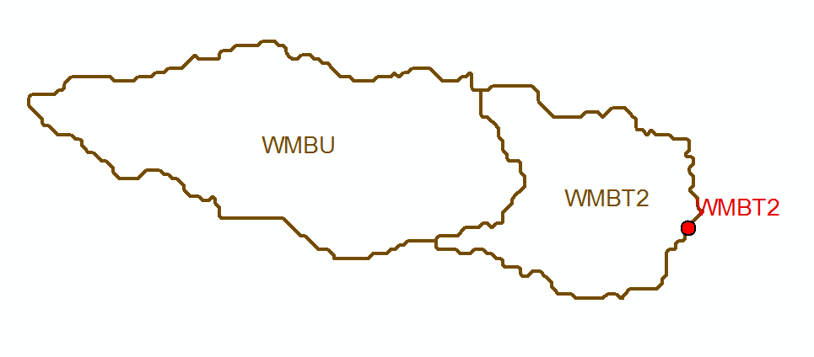
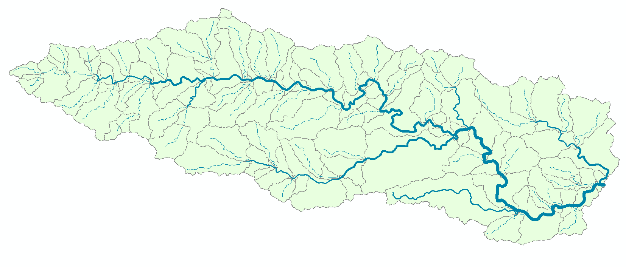
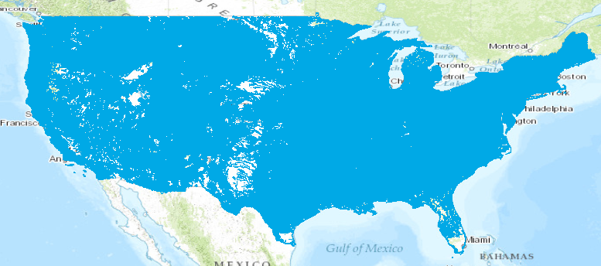
Current and NFIE Forecast Systems
Blanco River at Wimberley
Current: 6600 basins and 3600 forecast points
Two basins and one forecast point
Basin ~ 400 Sq Mile
becomes
NFIE: 2.7 million stream reaches and catchments
Reach Catchment ~ 1 Sq Mile
130 Catchments and Flowlines
uniquely labelled
A national flow network

Slide 8
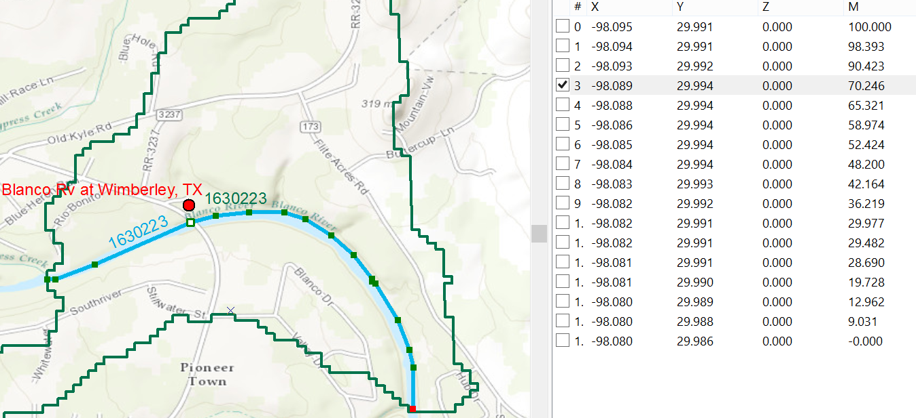
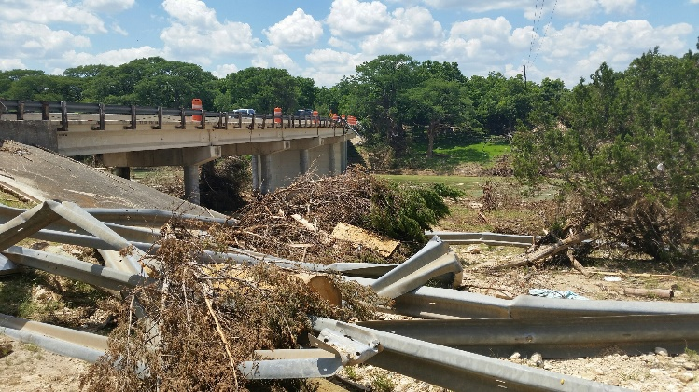
Linear Referencing on Flowlines
Using measures, the flow can be estimated at any point along the line
Bridge and Stream Gage at RR 12 is at Measure 70.246
on Flowline 1630223
Long.
Lat.
Measure
Measure is the % distance upstream from most downstream point on line

Slide 9
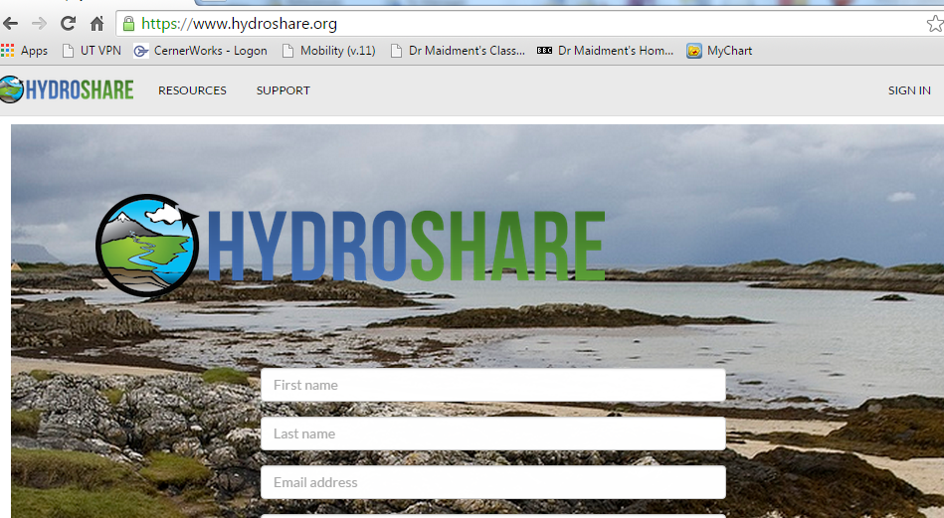
CUAHSI HydroShare
http://www.hydroshare.org

Slide 10
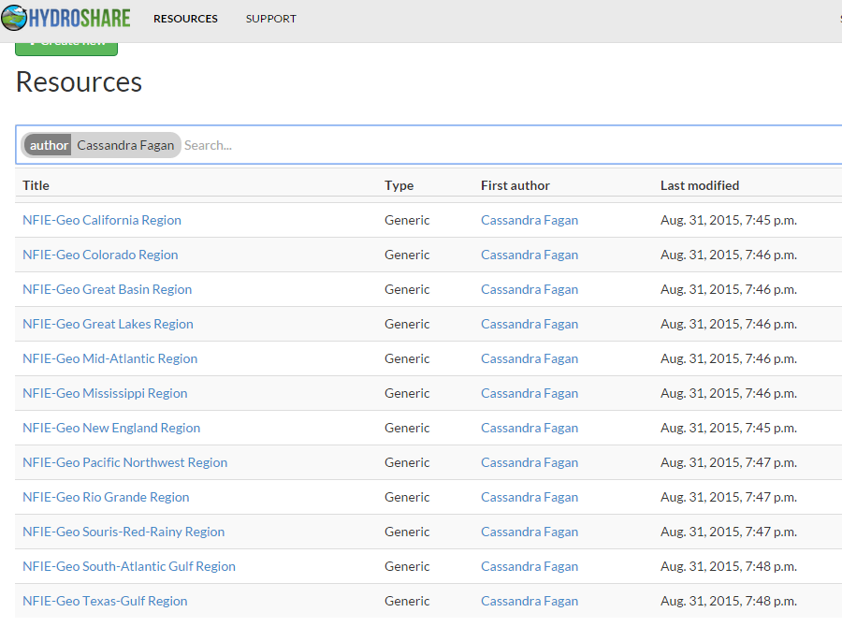
NFIE-Geo in Hydroshare

Slide 11
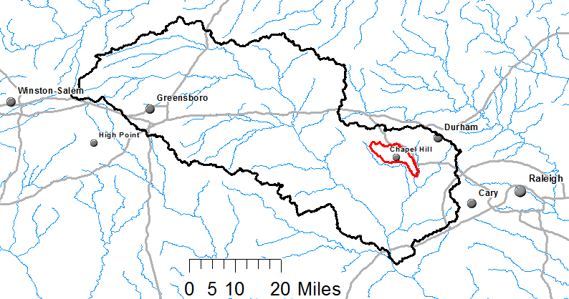
Watershed Hierarchy
Each hydrologic unit is identified by a unique hydrologic unit code (HUC) consisting of two to or more digits based on the levels of classification in the hydrologic unit system.
Digit #
2
4
6
8 HUC
10
12
NHDPlus
HAW HUC 8 03030002
Little Creek HUC 12 030300020603

Slide 12
Hydrologic Unit Code Watersheds
~ 2000 HUC 8 for US, about the size of counties

Slide 13
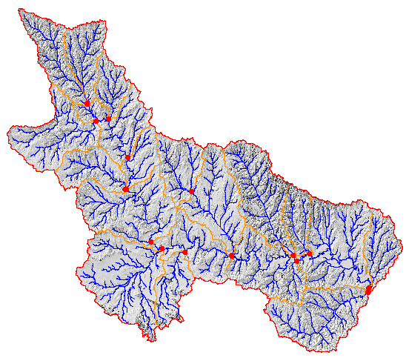
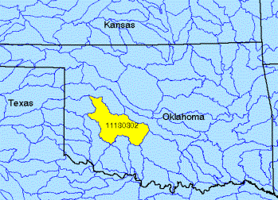
Watershed Boundary Dataset
http://nhd.usgs.gov/wbd.html
National Program by USGS and USDA (NRCS)
Boundaries for 10- and 12- digit watersheds
First cut is by automated delineation from NED
Hand checked and edited
10-digit watersheds

Slide 14
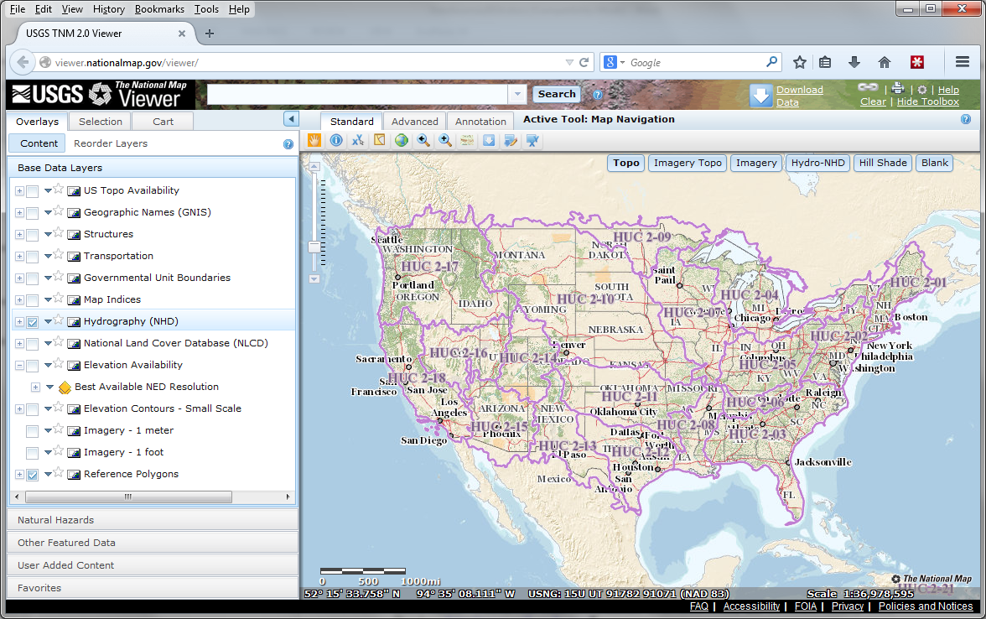
The National Map
http://nationalmap.gov/
A central source for US Government data

Slide 15

River networks
for 8-digit HUC
watersheds
http://nhd.usgs.gov/

Slide 16
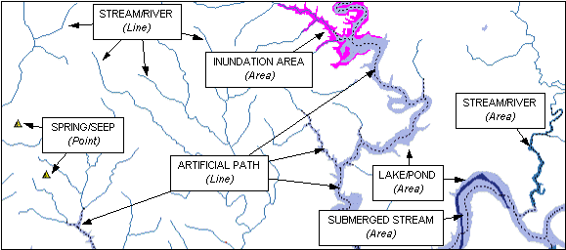

Slide 17

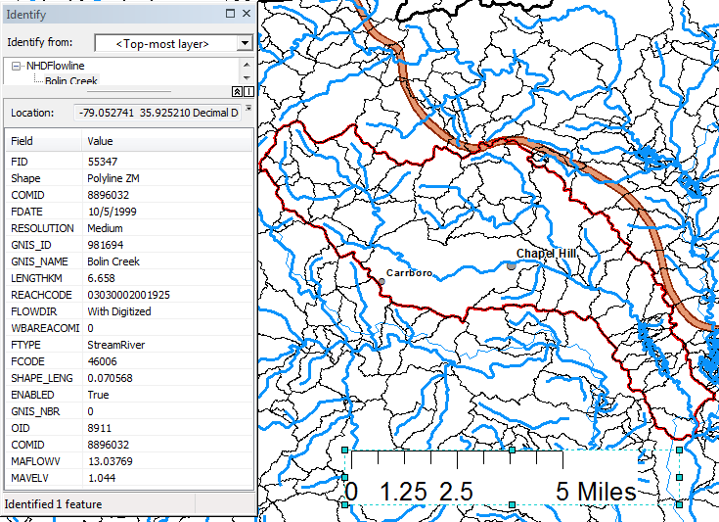
Slope
Elevation
Mean annual flow
  Corresponding velocity
Drainage area
% of upstream drainage area in different land uses
Stream order
http://www.horizon-systems.com/nhdplus/

Slide 18
River Reach Codes
Used for river address locations
ReachCode =
12030102000151
ReachCode = 12030102000005
HUC#
Segment#
Location 0.392
on Reach
12030102000005

Slide 19
National Elevation Dataset
http://ned.usgs.gov/
Digital Elevation Model with 1 arc-second (30m), 1/3 arc-second (10m) and some 1/9 arc second (3m) cells
Distributed as part of the National Map
10 billion data
Derived from USGS 1:24,000 quadrangle sheets and at higher resolution from LIDAR
Get the data:
http://nationalmap.gov/viewer.html

Slide 20
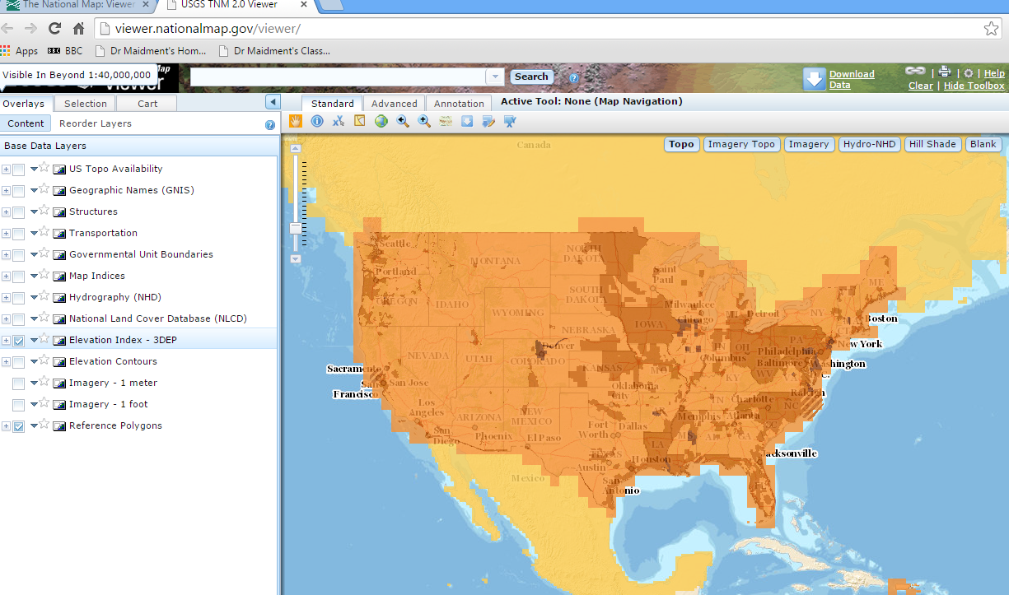
National Elevation Dataset Availability
From http://nationalmap.gov/viewer.html

Slide 21
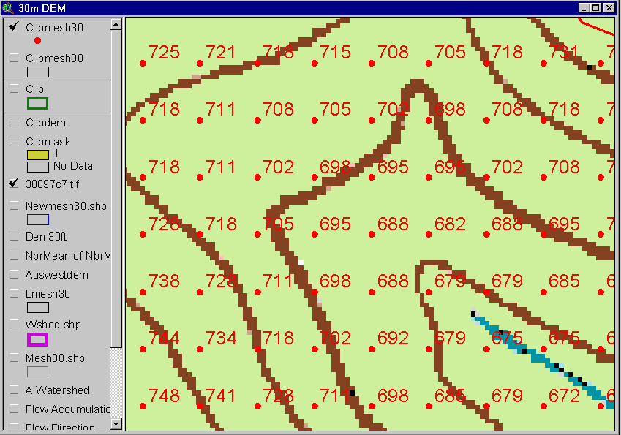
Digital Elevation Model (DEM)
720
720
Contours
740
720
700
680
740
720
700
680

Slide 22
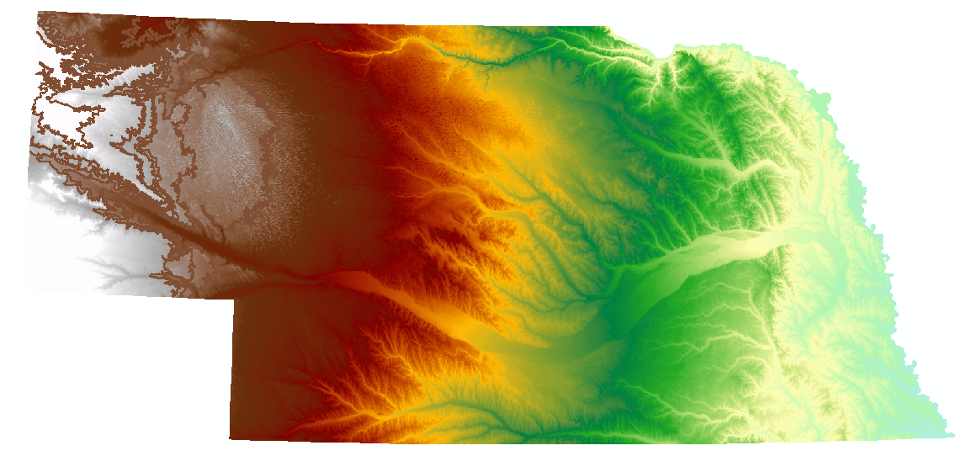
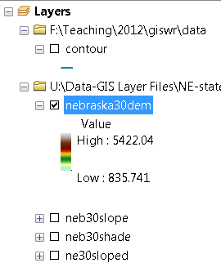
Digital Elevation Model (DEM)-30 meter

Slide 23
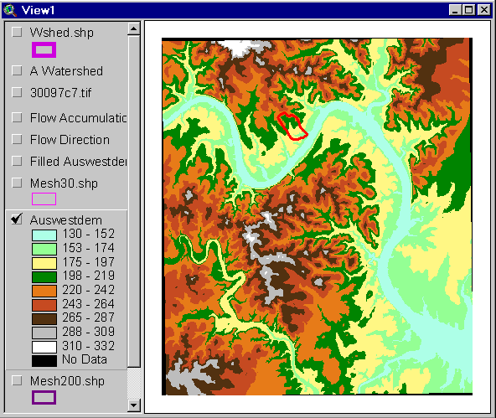
Austin West 30 Meter DEM

Slide 24
Eight Direction Pour Point Model
ArcGIS raster operations involved in watershed delineation are derived from the premise that “water flows downhill, in doing so, will follow the steepest descent
32
64
128
16
1
8
4
2
Water in a given cell flows one or more of eight adjacent cells in the direction of steepest descent (ArcGIS)

Slide 25
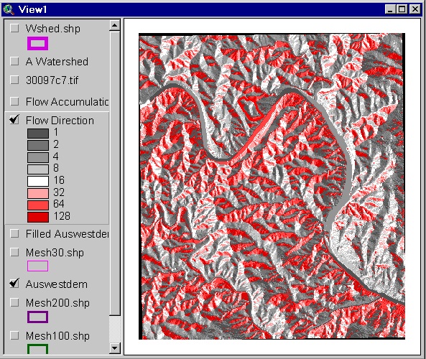
Flow Direction Grid
32
64
128
16
1
8
4
2

Slide 26
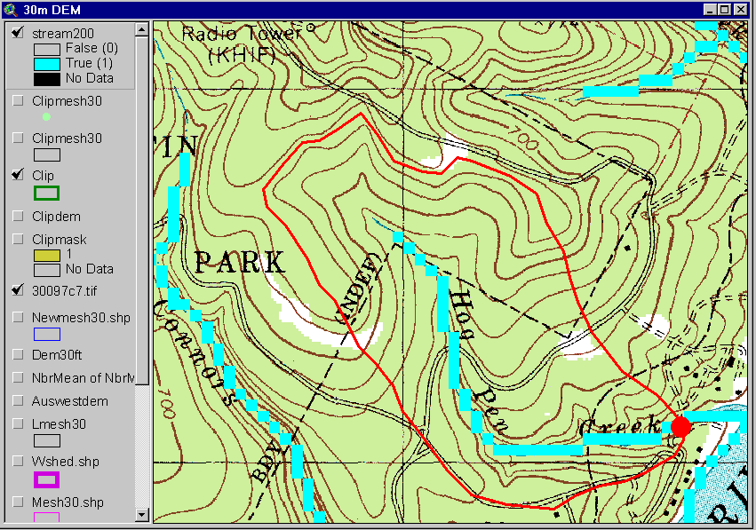
Delineation of Streams and Watersheds on a DEM

Slide 27

http://srtm.usgs.gov/

Slide 28
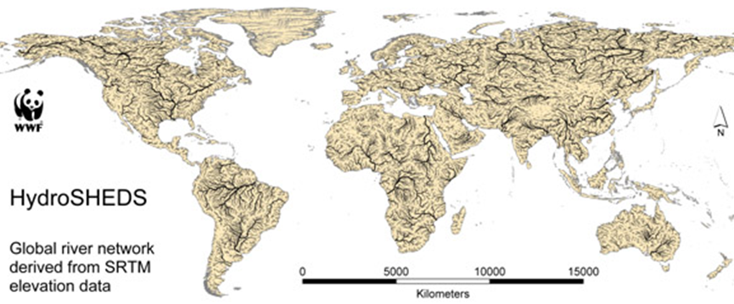
HydroSheds derived from SRTM
http://hydrosheds.cr.usgs.gov/

Slide 29
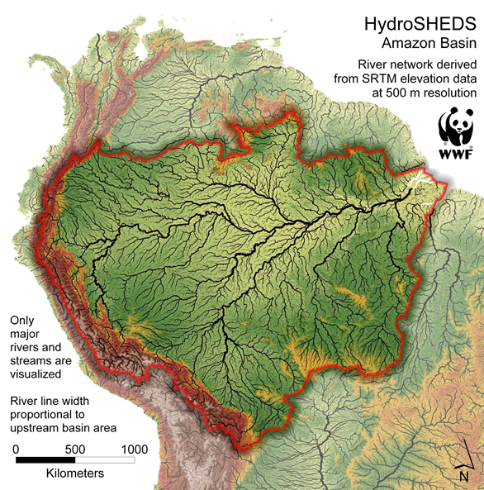

Slide 30
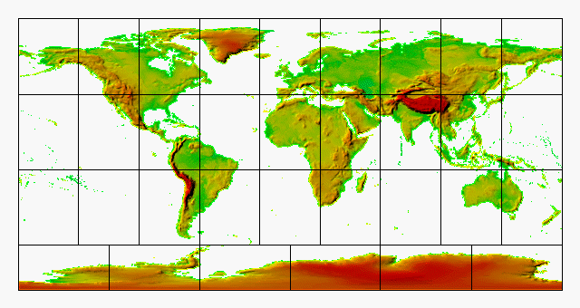
GTOPO30 - 1 km Digital Elevation Model of the Earth
https://lta.cr.usgs.gov/GTOPO30

Slide 31
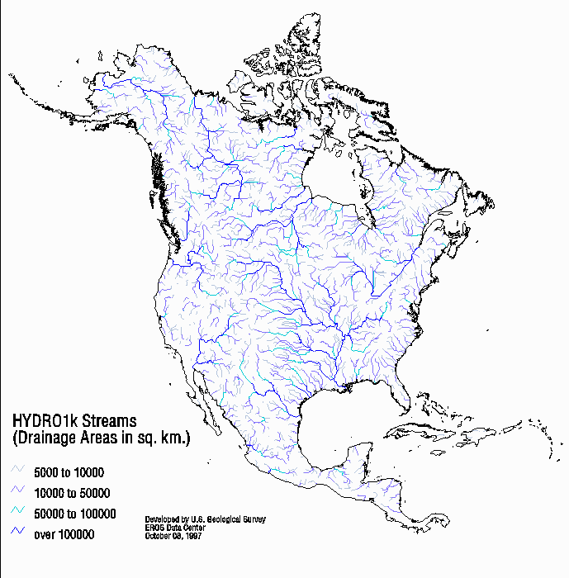
Drainage in North America
Hydro1K is
derived from
GTOPO30
using raster
GIS analysis
https://lta.cr.usgs.gov/HYDRO1K

Slide 32
Soil Data
Natural Resources Conservation Service (NRCS)
State Soil Geographic Database-STATSGO
Soil Survey Geographic Database- SSURGO
http://www.nrcs.usda.gov/wps/portal/nrcs/site/soils/home/
http://websoilsurvey.sc.egov.usda.gov/App/WebSoilSurvey.aspx
https://gdg.sc.egov.usda.gov/

Slide 33

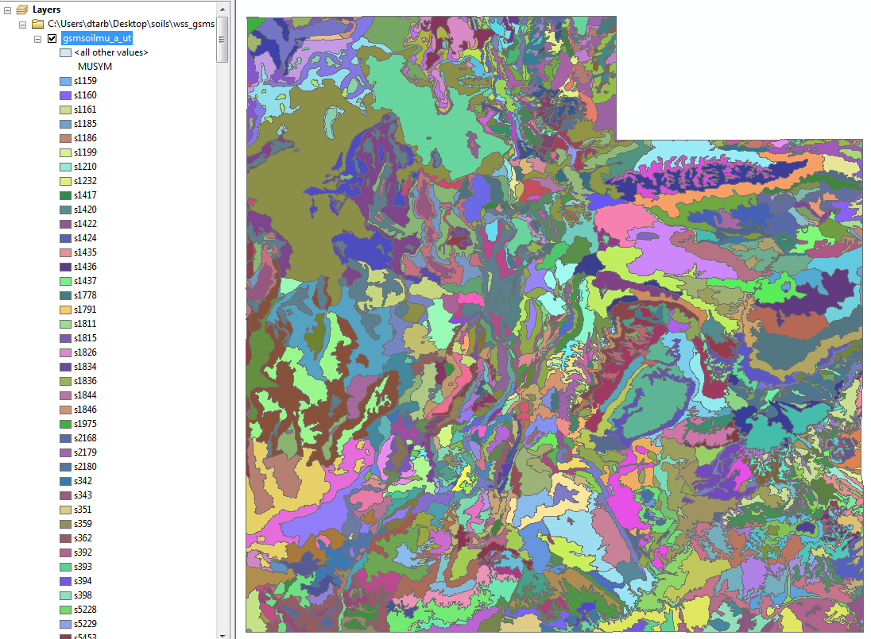
1:250,000 Scale Soil Information
https://gdg.sc.egov.usda.gov/

Slide 34
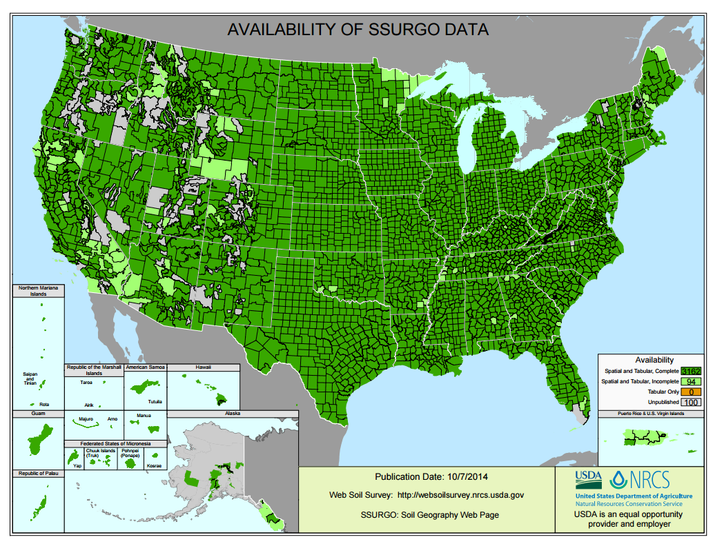
SSURGO:
County Level
Digital Soil Maps
1:24,000 scale
soil information
http://websoilsurvey.nrcs.usda.gov/DataAvailability/SoilDataAvailabilityMap.pdf

Slide 35
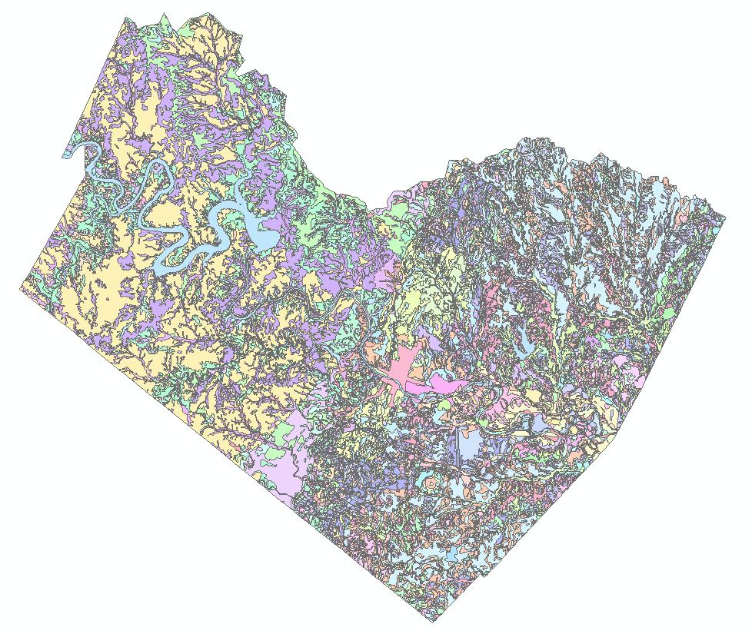
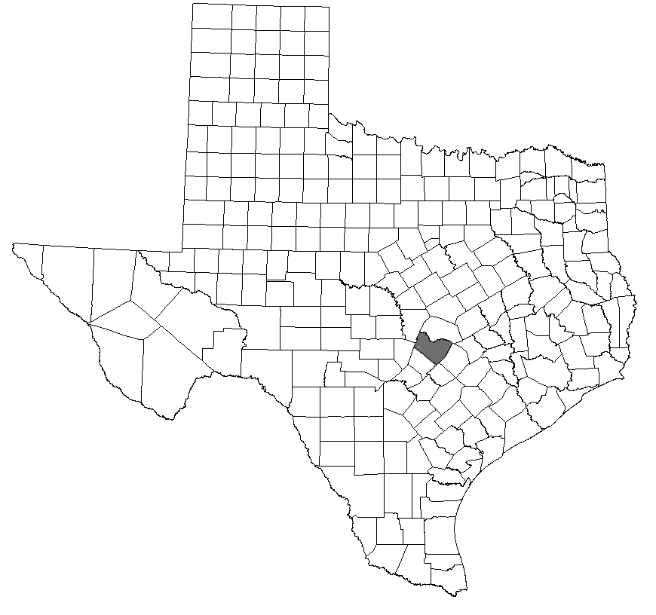
Ssurgo for Travis County
103 soil map units described by 7530 polygons of average area 35.37 ha (87 acres)

Slide 36
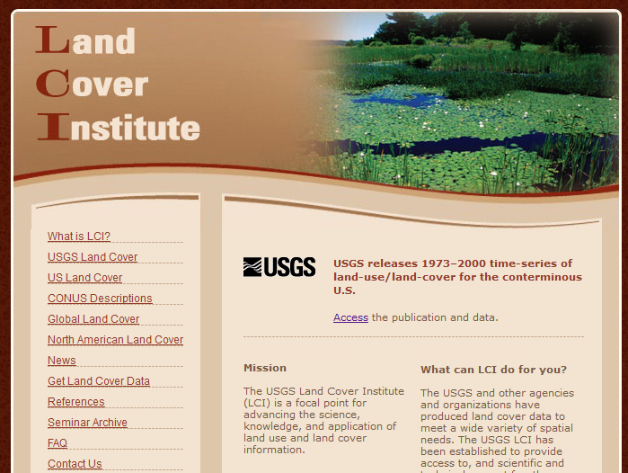
http://landcover.usgs.gov/

Slide 37
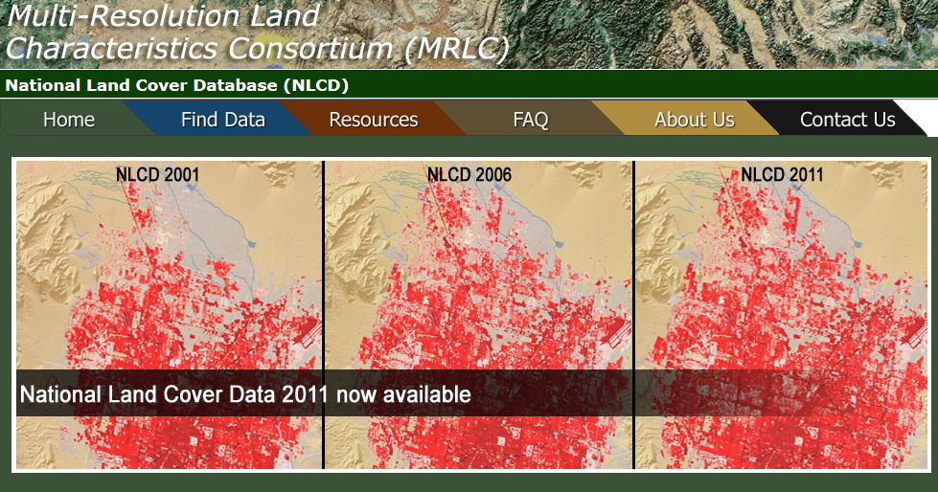
National Land Cover Dataset
1992, 2001, 2006 and 2011
Get the data:
http://www.mrlc.gov/

Slide 38
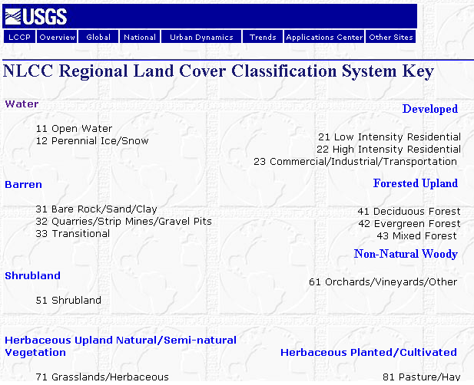

Slide 39
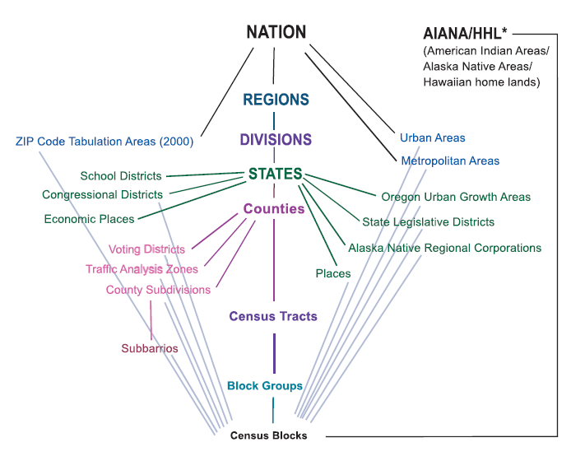
Hierarchy of Census Geographic Entities
http://www.caee.utexas.edu/prof/maidment/giswr2014/Census/AccessingCensusData.pdf
74,000
220,000 (avg 600 households/block grp)
US Population: 316 million
US Households: 133 million
11,000,000
Notes:
This diagram depicts the geographic hierarchy, as a series of nesting relationships, based on the legal, administrative, or areal relationships of the entities. For example, a line joining the lower-level entity “place” and the higher-level entity “state” means that a place cannot cross a state boundary.

Slide 40
American Community Survey
Source of detailed demographic and housing characteristics, including:
  Income
  Language spoken at home
  Educational attainment
  Occupation
  Place of work and journey to work
Data collected annually from approximately 3 million households per year. Approximately 250,000 households per month.
Data collected throughout the year—produces period estimates rather than point estimates.
 | ACS 1-Year Data | ACS 3-Year Data | ACS 5-Year Data
Geographic Areas | 65,000 or more population | 20,000 or more population | All areas, block group or higher

Slide 41
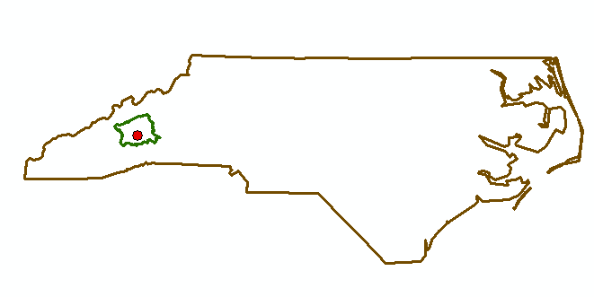
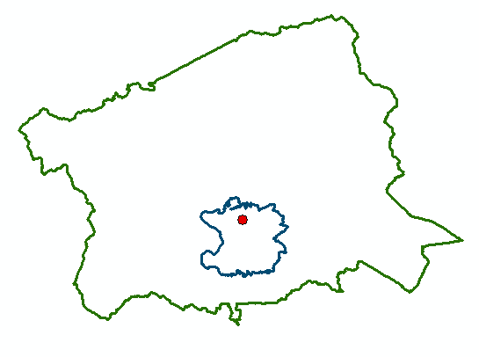
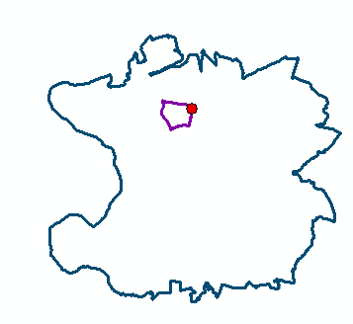
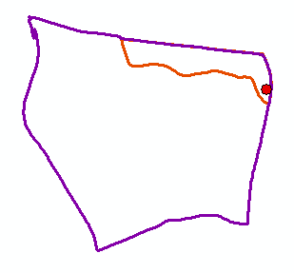
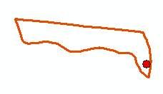
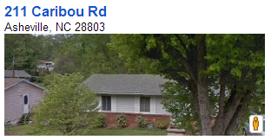
North Carolina
Buncombe County
Zip Code 28803
Census Block Group 370210020004
Scales of
Data Aggregation
Census Block 370210020004000
A single property – 211 Caribou Rd

Slide 42
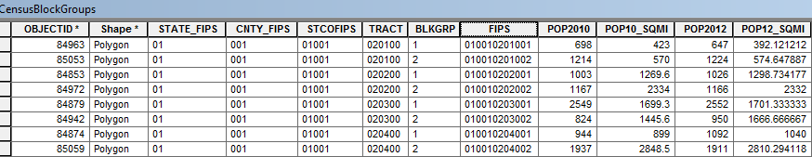
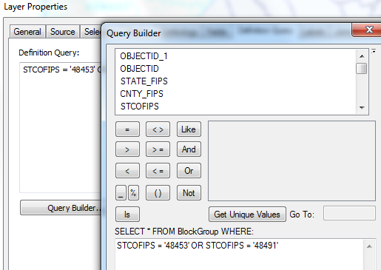
Census Block Groups for the US
http://www.caee.utexas.edu/prof/maidment/giswr2014/census/census.gdb.zip (308MB)
State
County
Tract
Block Group
Definition query to isolate Travis and Williamson Counties

Slide 43


Census Block Groups in Travis and Williamson Counties
Williamson County
Travis County

Slide 44



Demographic Analysis
Williamson
Travis
Two Counties
307 Tracts
823 Block Groups

Slide 45

www.climate.gov

Slide 46

http://www.ncdc.noaa.gov/oa/ncdc.html

Slide 47


PRISM Mean Annual Precipitation (Oregon State U.)
http://www.wcc.nrcs.usda.gov/climate/prism.html

Slide 48

National Water Information System
Web access to USGS water
resources data in real time
http://waterdata.usgs.gov/usa/nwis/

Slide 49


USGS Water Watch
Web access to USGS water resources data in real time
http://waterdata.usgs.gov/nwis/rt

Slide 50


USGS National Water Information System.
http://water.usgs.gov
Real-time and Historic Data
  Streamflow and stage
  Groundwater levels
  Water Quality
  Site information
Tabular or Graphical Format

Slide 51

CUAHSI Water Data Services
http://data.cuahsi.org

Slide 52



ArcGIS Online: Living Atlas
http://doc.arcgis.com/en/living-atlas/
Land Cover
Elevation
Soils

Slide 53


ArcGIS Online Services
http://landscape1.arcgis.com/arcgis/services/
http://landscape2.arcgis.com/arcgis/services/
http://landscape3.arcgis.com/arcgis/services/
http://elevation.arcgis.com/arcgis/services
http://hydro.arcgis.com/arcgis/services

Slide 54

Ready to Use Services in Arc Catalog
You have to sign in to your AGOL account in ArcMap to use these

Slide 55


Elevation Services
http://elevation.arcgis.com/arcgis/services

Slide 56



Other Dynamic Map Services

Slide 57

http://water.weather.gov/ahps/

Slide 58

http://water.weather.gov/ahps/

Slide 59


http://enviroatlas.epa.gov/enviroatlas/

Slide 60


EnviroAtlas
All data is available for download
Some data is available for download as web service

Slide 61


http://www.wcc.nrcs.usda.gov/snotel/

Slide 62

SNOTEL System for Measuring Snow and Supporting Spring Runoff and Water Supply Forecasts

Slide 63

USU Doc Daniels SNOTEL Site

Slide 64


Measuring Snow Water Equivalent

Slide 65

http://www.cbrfc.noaa.gov

Slide 66

CBRFC SNOTEL Ensemble
http://www.cbrfc.noaa.gov/station/sweplot/sweplot.cgi?tglu1

Slide 67


Texas Natural Resource Information System http://www.tnris.org/

Slide 68

TWDB http://www.twdb.texas.gov/mapping/gisdata.asp

Slide 69

http://gis.utah.gov

Slide 70

Utah Terrain Basemap
To use as a basemap in ArcGIS see instructions at
http://gis.utah.gov/map-services/new-utah-terrain-base-map-and-cached-tile-service-available

Slide 71

Utah GIS Portal Download GIS Data
http://gis.utah.gov/data/

Slide 72

http://geology.utah.gov/maps/gis/index.htm

Slide 73

http://www.wrcc.dri.edu/

Slide 74

Bear River Watershed
http://www.bearriverinfo.org/

Slide 75

Great Salt Lake Info System
http://greatsaltlakeinfo.org/

Slide 76


MODIS on NASA Worldview
(Shrinking Great Salt Lake)
2012-05-11
2015-08-31
https://earthdata.nasa.gov/labs/worldview/?p=geographic&l=MODIS_Aqua_CorrectedReflectance_TrueColor,MODIS_Terra_CorrectedReflectance_TrueColor,Reference_Features,Coastlines&t=2012-05-11&v=-114.20487628044651,40.12581729563662,-110.51347003044651,42.16048526438662
https://earthdata.nasa.gov/labs/worldview/?p=geographic&l=MODIS_Aqua_CorrectedReflectance_TrueColor,MODIS_Terra_CorrectedReflectance_TrueColor,Reference_Features,Coastlines&t=2015-08-31&v=-114.20487628044651,40.12581729563662,-110.51347003044651,42.16048526438662

Slide 77

Smoke from Fires over W US
MODIS 2015-08-19
https://earthdata.nasa.gov/labs/worldview/?p=geographic&l=MODIS_Aqua_CorrectedReflectance_TrueColor,MODIS_Terra_CorrectedReflectance_TrueColor,Reference_Features,Coastlines&t=2015-08-19&v=-134.01859698357154,33.61092471751162,-104.48734698357154,49.88826846751162

Slide 78
Summary
There are a plethora of data sources available
Knowing what is available is important to scope GIS analyses and projects
GIS is about creating knowledge, telling stories, making decisions – all involve integrating information from multiple sources
The way that data is organized can enhance or inhibit the analyses that can be done
Data dissemination is increasingly becoming service based

