Slide 1
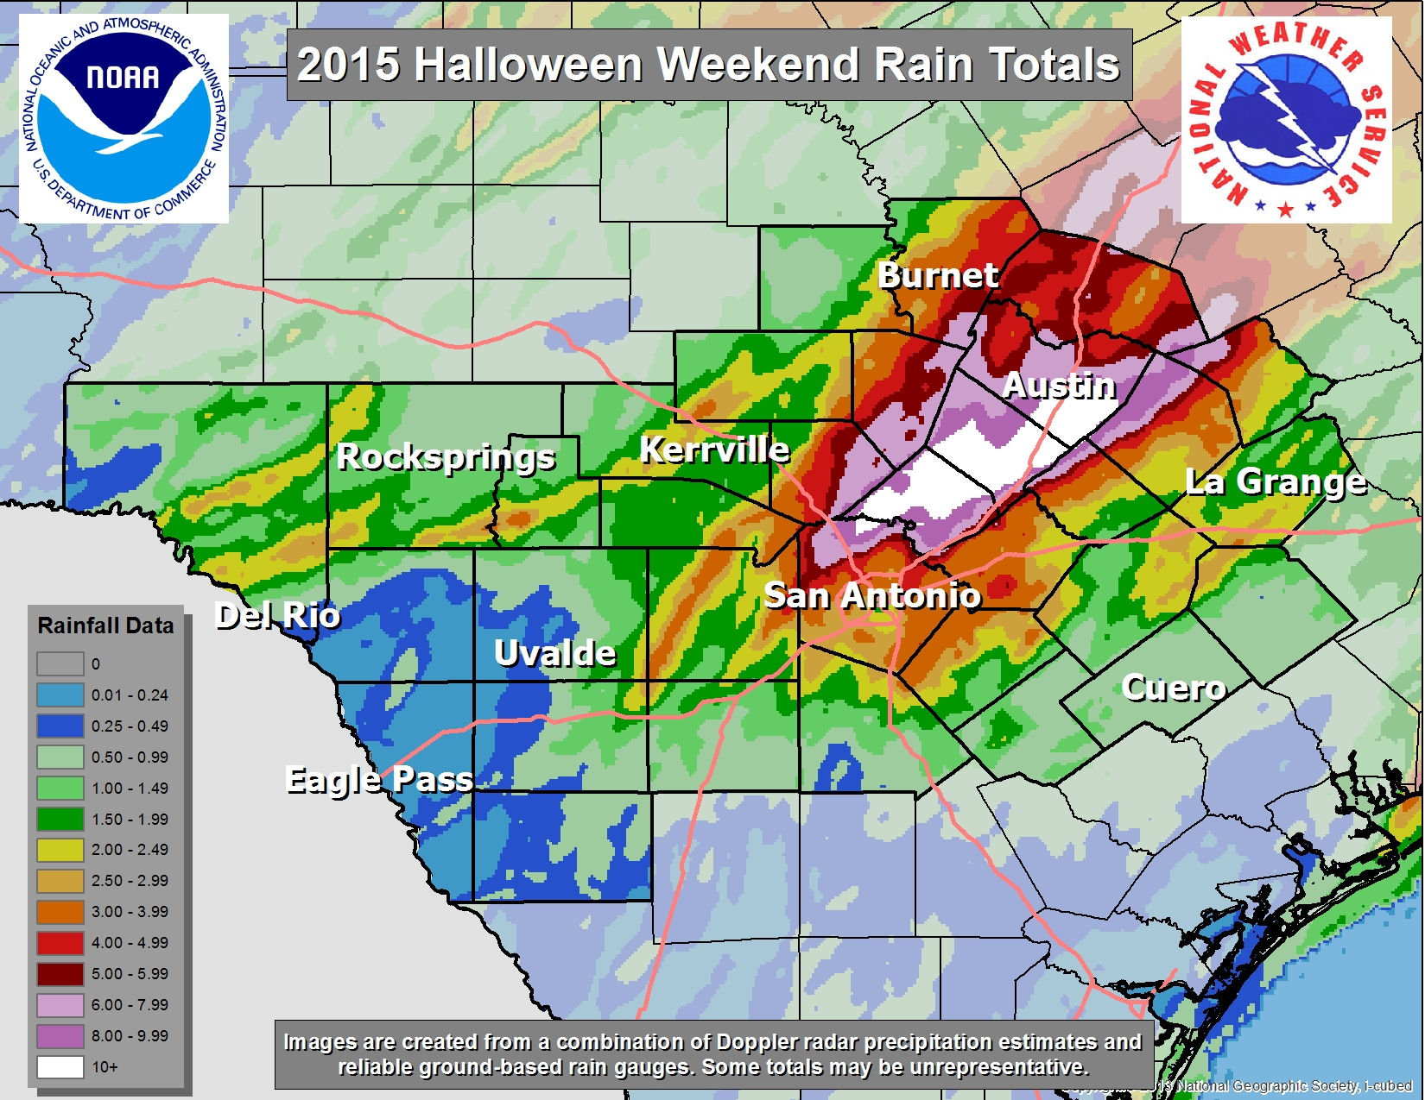
Source: Larry Hopper, NWS

Slide 2
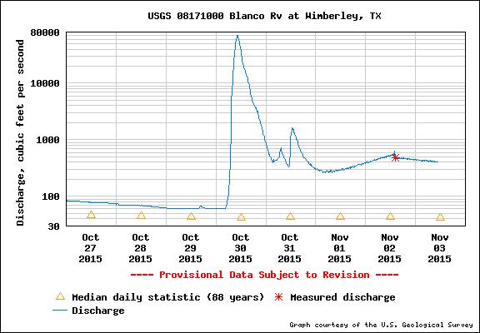
Blanco River at Wimberley (Flow) (Drainage area 355 mile²)
71,000 cfs

Slide 3
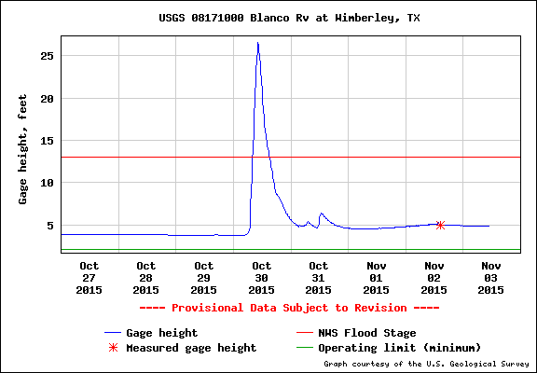
Blanco River at Wimberley (Stage Height)
26.5 ft

Slide 4
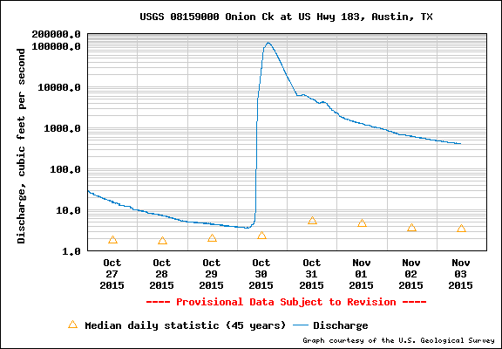
Onion Creek at Highway 183 (Flow) (Drainage area 321 mile²)
120,000 cfs

Slide 5
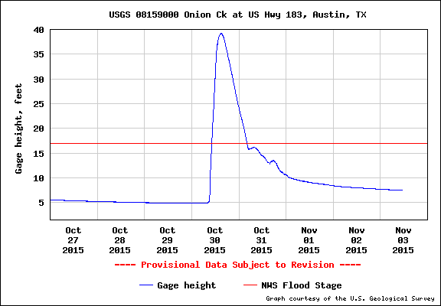
Onion Creek at Highway 183 (Stage Height)
39.22 ft

