Slide 1


HydroShare: Advancing Hydrology through Collaborative Data and Model Sharing
David Tarboton, Ray Idaszak, Jeffery Horsburgh, Dan Ames, Jon Goodall, Larry Band, Venkatesh Merwade, Alva Couch, Rick Hooper, David Maidment, Pabitra Dash, Michael Stealey, Hong Yi, Tian Gan, Tony Castronova, Brian Miles, Cuyler Frisby, Zhiyu Li
USU, RENCI, BYU, UNC, UVA, CUAHSI, Tufts, Texas, Purdue, Caktus
http://www.hydroshare.org
OCI-1148453
OCI-1148090
2012-2017

Slide 2

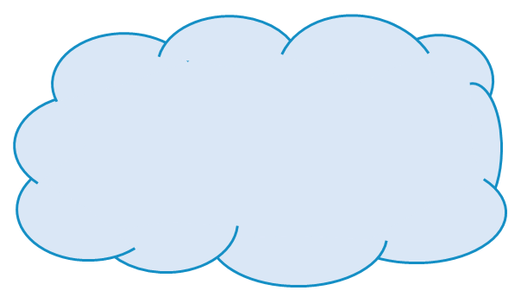
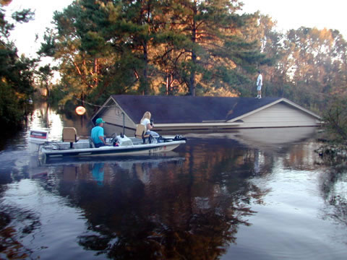
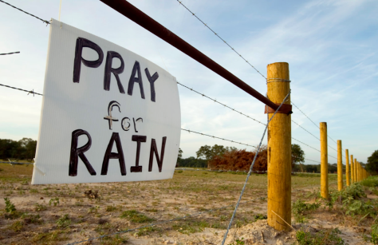
Motivation
Advancing Hydrologic Understanding
  requires integration of information from multiple sources
  is data and computationally intensive
  requires collaboration and working as a team/community
Analysis
Data
Models
Grand challenge (NRC 2001): Better hydrologic forecasting that quantifies effects and consequences of land surface change on hydrologic processes and conditions
Floods and Droughts

Slide 3
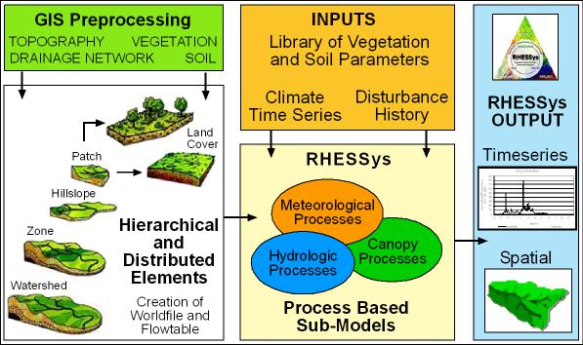
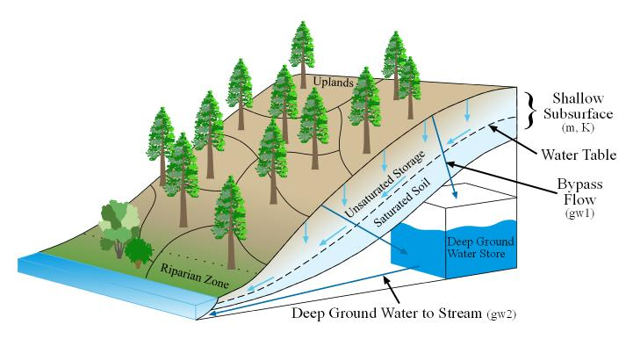
Data intensive models to understand and examine consequences, impacts and effects of land surface and climate changes
From Larry Band
Notes:
Strata can be redefined any time

Slide 4
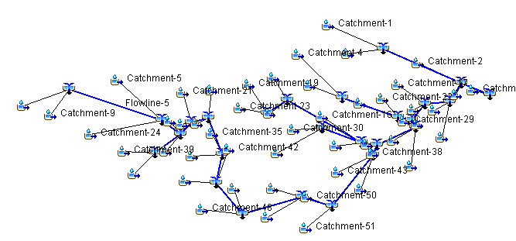
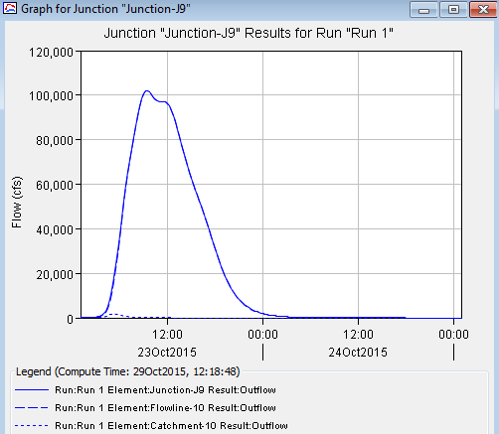
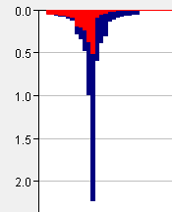
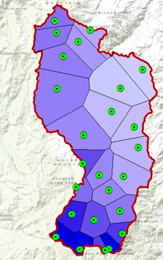
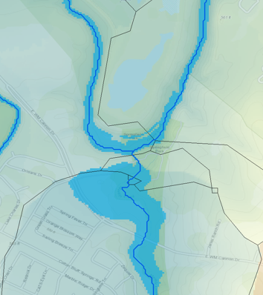
Collaborative modeling of flood risk and protection infrastrucure
GIS Specialist prepares HMS basin model
Hydrologic Engineer runs HMS
Hydraulic Engineer maps flood inundation
Hydrologist calculates precipitation inputs

Slide 5

HydroShare Goals
To provide a cyberinfrastructure platform for hydrologic research to solve problems of size and scope not otherwise solvable using desktop computing through
  Software as a service
  Data as a service
  Models as a service
  Visualization and analysis services
To enable more rapid advances in hydrologic understanding through collaborative data sharing, analysis and modeling
To address community cyberinfrastructure needs

Slide 6
HydroShare is a collaborative environment (being developed) for data sharing, analysis and modeling
Share your data and models with colleagues
Manage who has access to the content that you share
Share, access, visualize and manipulate a broad set of hydrologic data types
Sharing and execution of models
Web services API to facilitate automated and client access to almost all functionality
Access to and use of high performance computing
Publication of data and models with a DOI
Resource exploration
Actions on Resources
Django website
API
HydroShare Apps
iRODS “Network File System”
Resource storage
Our goal is to make sharing of hydrologic data and models as easy as sharing videos on YouTube or shopping on Amazon.

Slide 7
Functionality
Sharing and publication of data
Social discovery and added value
Model sharing
Model input data preparation
Model execution
Visualization and analysis (best of practice tools)
Collaboration
Server/Cloud Computation
Platform independence
Big data
Reproducibility
Software installation and configuration

Slide 8
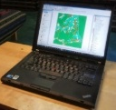

Collaborative data analysis and publication use case
Collaboration
5
3
4
Analysis
6
7
Observers and instruments
Data
Models
Digital Library
1
2
Publication, Archival, Curation
Observe
Store
Discover and access
Analyze
Model
Collaborate
Publish (DOI)

Slide 9
At its heart, HydroShare is a system for sharing Resources and Collaborating
Files and sets of files structured to represent a hydrologic process, model, or element in the hydrologic environment
Standard data models enhance interoperability and support functionality “hydro value added”
Tools that act on resources to visualize, modify and create new resources
  Encode standard/best practices
Access control and sharing model

Slide 10
Tools and Resources
Resources have types (analogous to .docx, .jpg)
HydroShare holds tools that operate on resources
Tools may apply to one or more resource types (like Photoshop for .jpg, .bmp but not .xlsx)
A tool registry to manage access to tools
Tools can be built independently
Like software tools may be embedded on the OS (Django) or may be anywhere on the internet operating over web services
Take advantage of existing tools to the maximum extent possible and to focus on hydro value added tools (hydro models, hydro resource types)
A platform that the community can contribute tools to

Slide 11
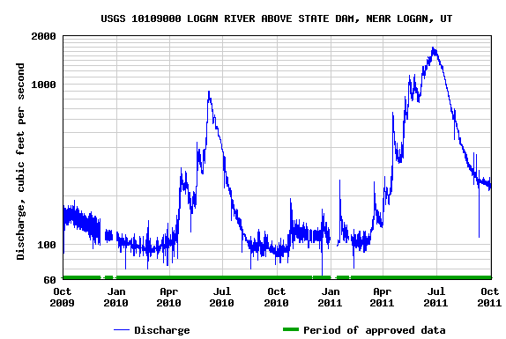
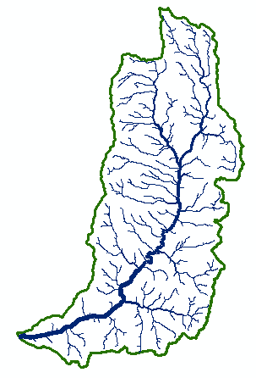
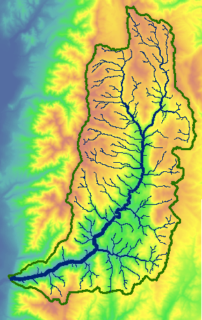

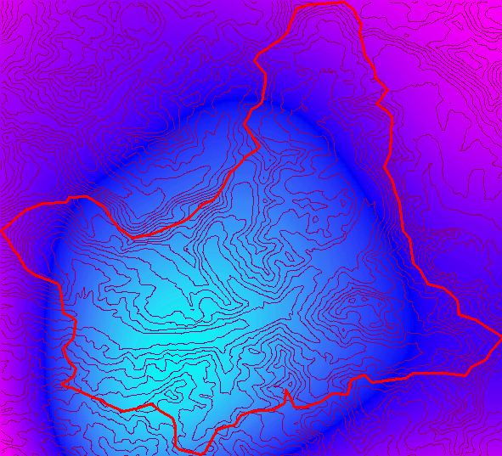
Types of data to support as resources
Resource Types
Generic ✓
Geographic Raster ✓
Time Series ✓
Multidimensional Space Time dataset ✓
Model program ✓
Model instance ✓
Geographic Feature set ✓
Referenced Time Series (CUAHSI HIS web service link)
Application
River Geometry
Sample based observations (ODM2 and CZO)
Model component
Composite resources
t
y
x

Slide 12
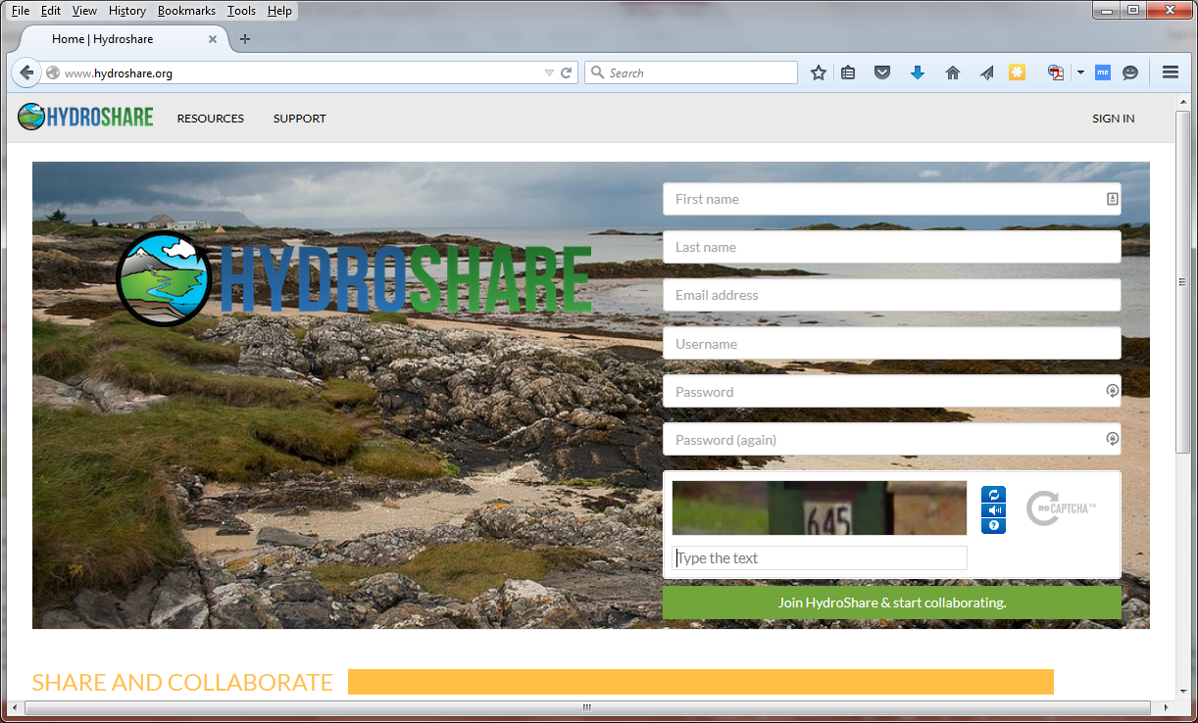
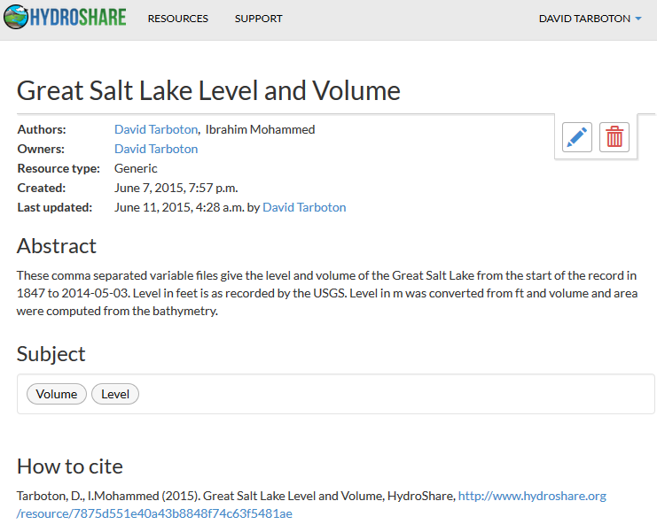
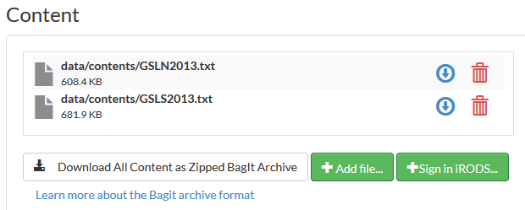
Demo

Slide 13
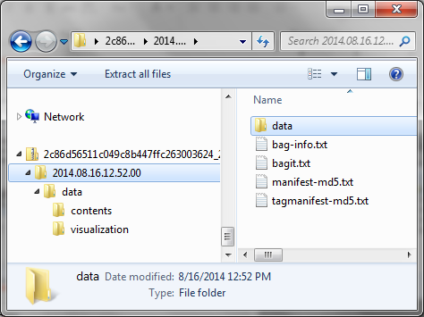
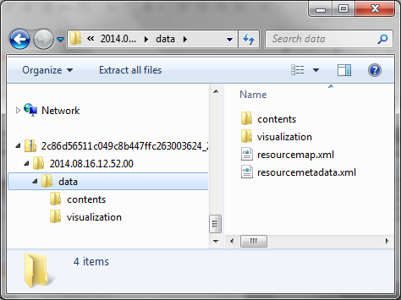
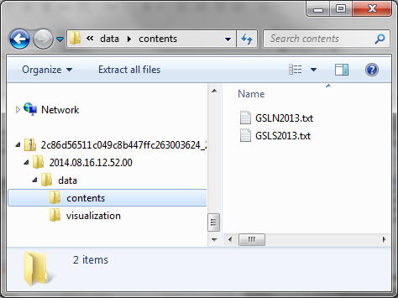
Resource Data Model
Open Archives Initiative – Object Reuse and Exchange (OAI-ORE) - standards for the description and exchange of aggregations of Web resources
BagIt – hierarchical file packaging format designed to support disk-based or network-based storage and transfer of generalized digital content
Compatible with DataOne

Slide 14
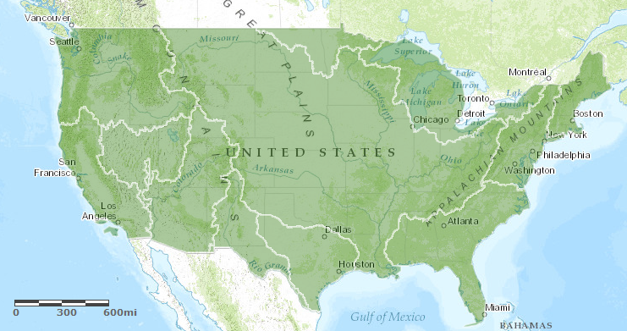
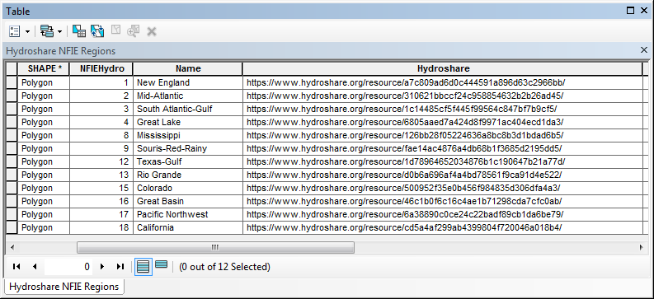
Representing River Geometry in HydroShare
NFIE-GEO
A map resource on ArcGIS.com
URL: http://arcg.is/1JW0DBm
Each polygon links to a resource in HydroShare

Slide 15
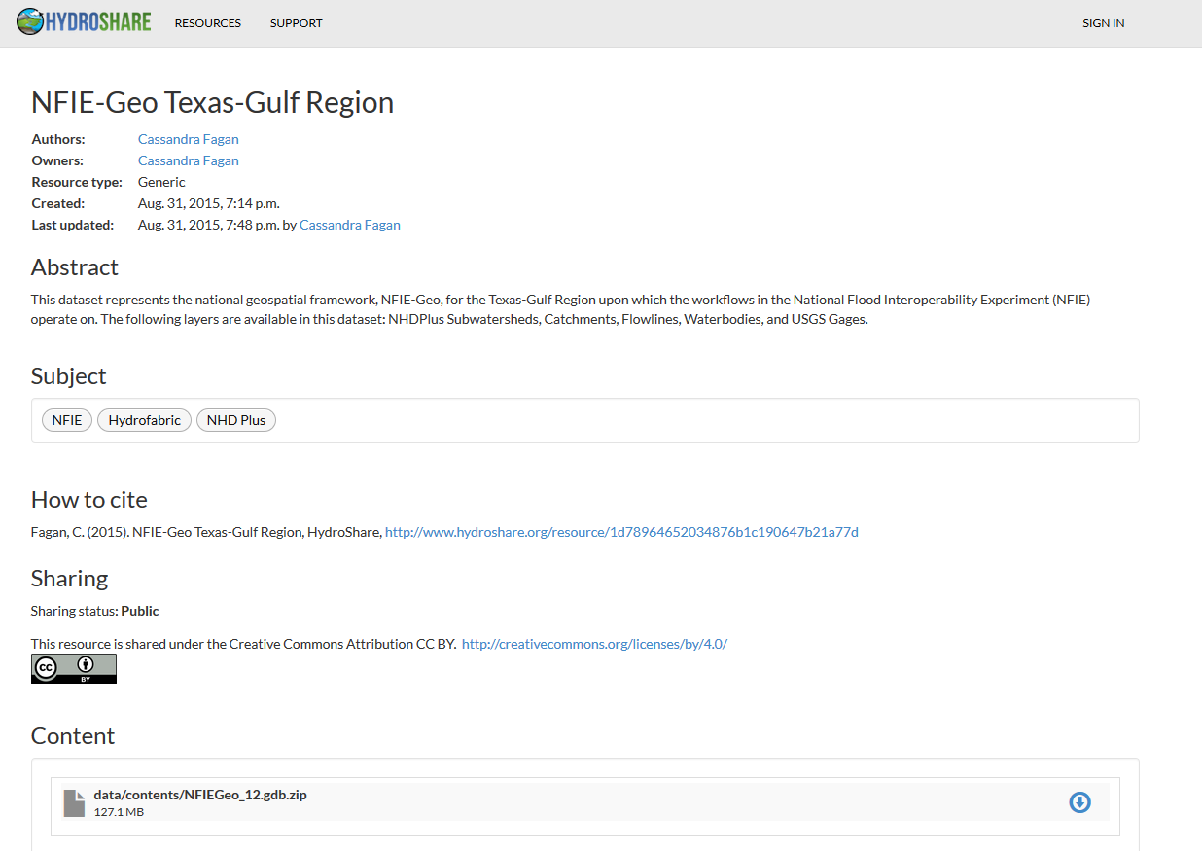
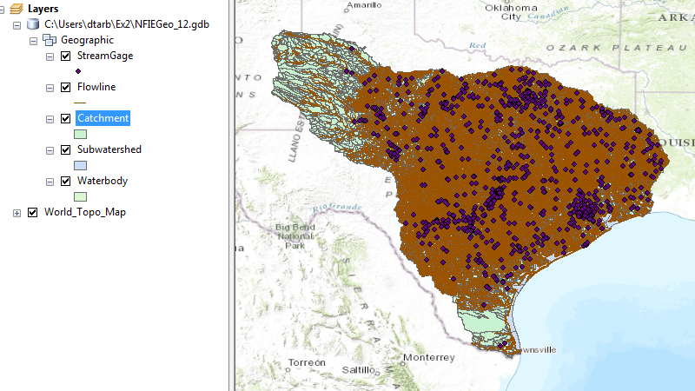
NFIE-GEO Region
A ~130 MB Geodatabase file as a generic resource in HydroShare
5 Feature Classes
Usability limited to users with ArcGIS.
Need to have this become geographic feature resource in HydroShare in open format.
What hydro value added functionality is needed?
  Visualization
  Subsetting
  Web feature services
  Discovery

Slide 16
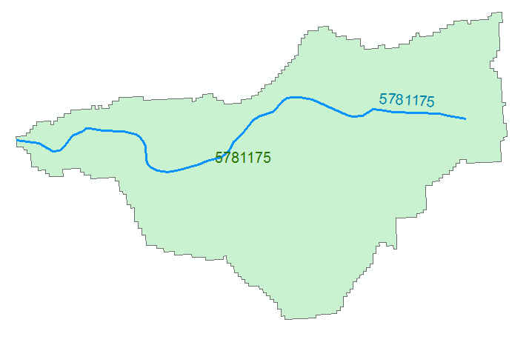

River Hydraulic Properties
Comid | H | A | R | P | T | V | Ab | As
5781175 | 3
5781175 | 4
A table with reach hydraulic parameters as an addition to a geographic feature resource
This may be derived from LIDAR using an automated tool or HEC RAS cross sections
A_{s}
Surface Area
Wetted Bed Area
L
V
Volume
A_{b}
T
$$A=\frac{V}{L}$$
Cross Section Area
Depth
h
A
P
P$=\frac{Ab}{L}$
Wetted Perimeter
T$=\frac{As}{L}$
Top Width
R$=\frac{A}{P}$
Hydraulic Radius

Slide 17
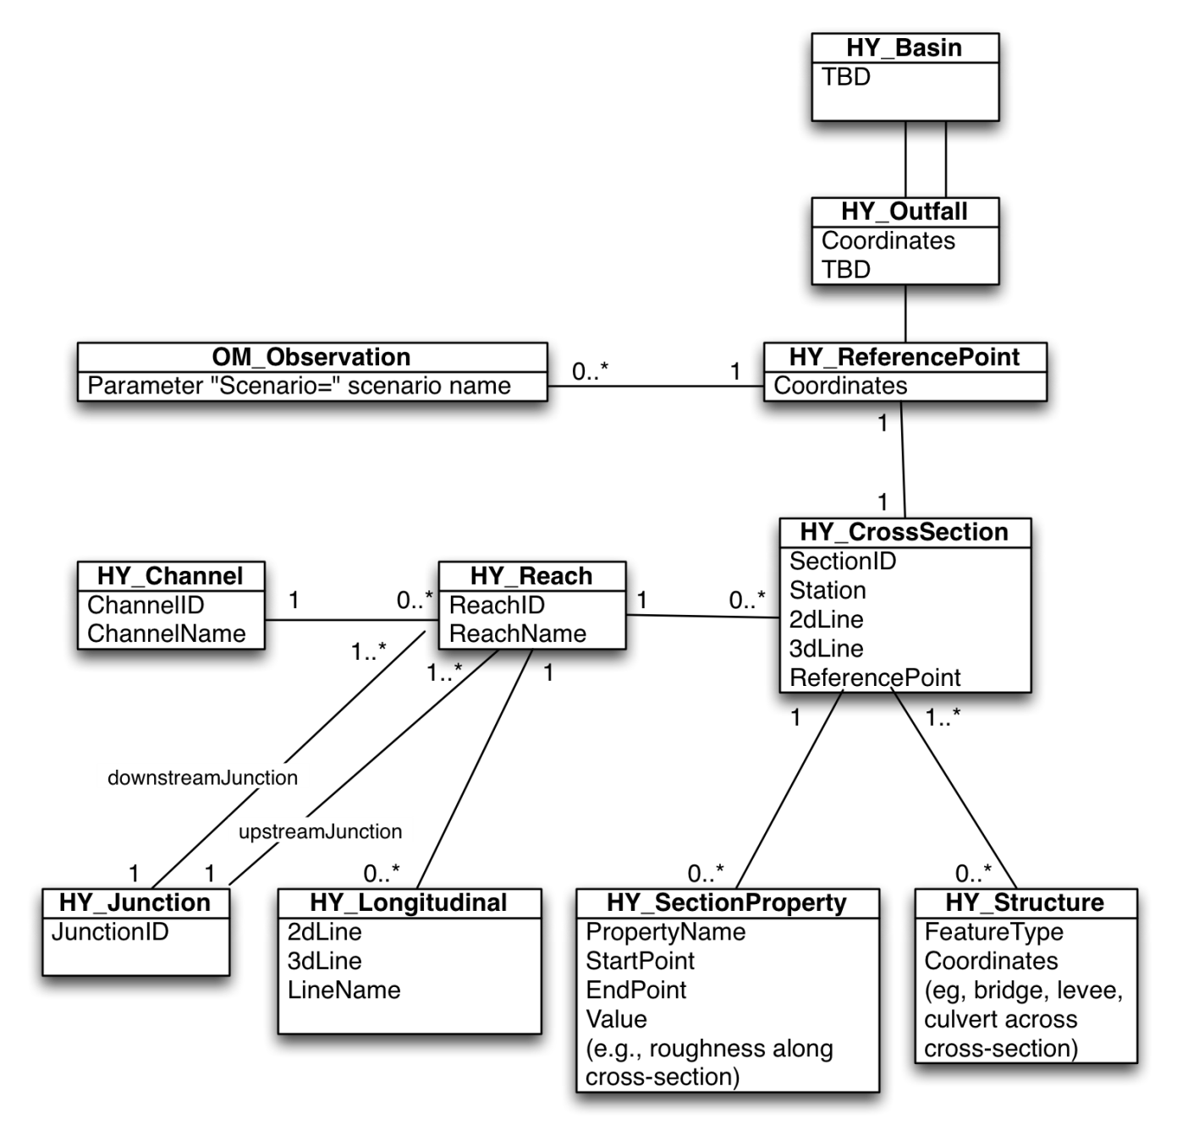
Digital Watershed as a collection of River Geometry Related Resources
Reference point as the key connector between all 4 elements
Observations represented as time series resource
Catchments represented as Geographic Feature Resource
Point Geographic Feature Resource
River Network represented as Geographic Feature Resource
River Cross Section Geometry represented as Cross Sections keyed to point Geographic Feature Resource

Slide 18
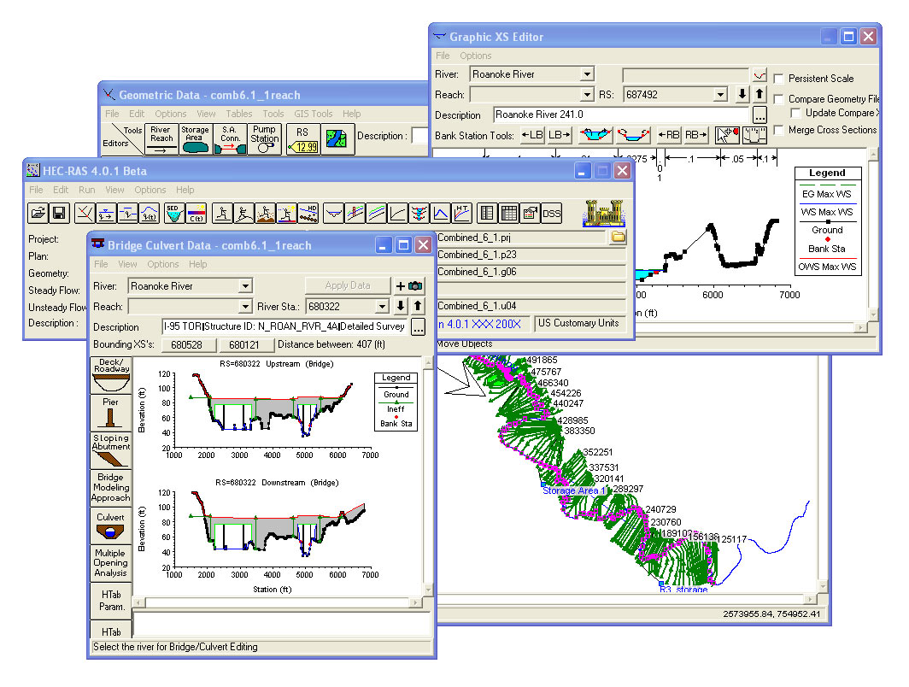
HEC-RAS Model Instance
HEC-RAS model input and output files stored as HydroShare model instance resources

Slide 19
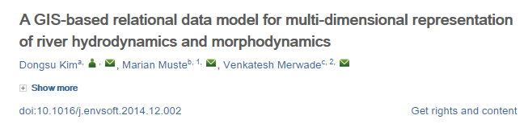
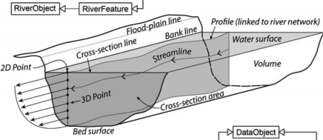
River Channel
http://dx.doi.org/10.1016/j.envsoft.2014.12.002

Slide 20
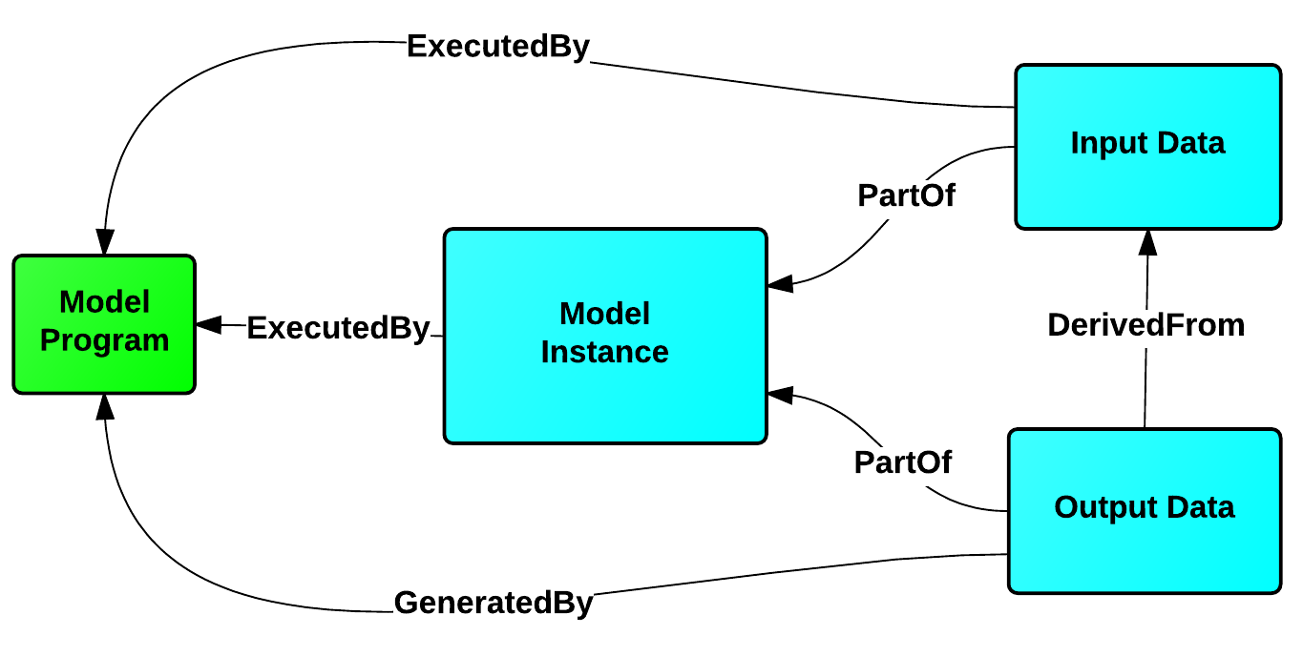
Models
Model Program resource describes the software component of a generic model within the water domain. This resource consists of specific metadata that enables scientists to retrieve all the content and information required to get a model up-and-running. This resource consists of uploaded content such as source code, compiled binaries, and documentation.
Model Instance resource defines the input and output data for a generic hydrological model, for a specific time and place. This resource consists of specific metadata to describe the model content as well as the Model Program resource that is used to execute a simulation.
The Model Program resource can be related to many Model Instance resources to completely describe a simulation and the exact software version used for a particular study, to make data replication possible.
dev.hydroshare.org/terms

Slide 21
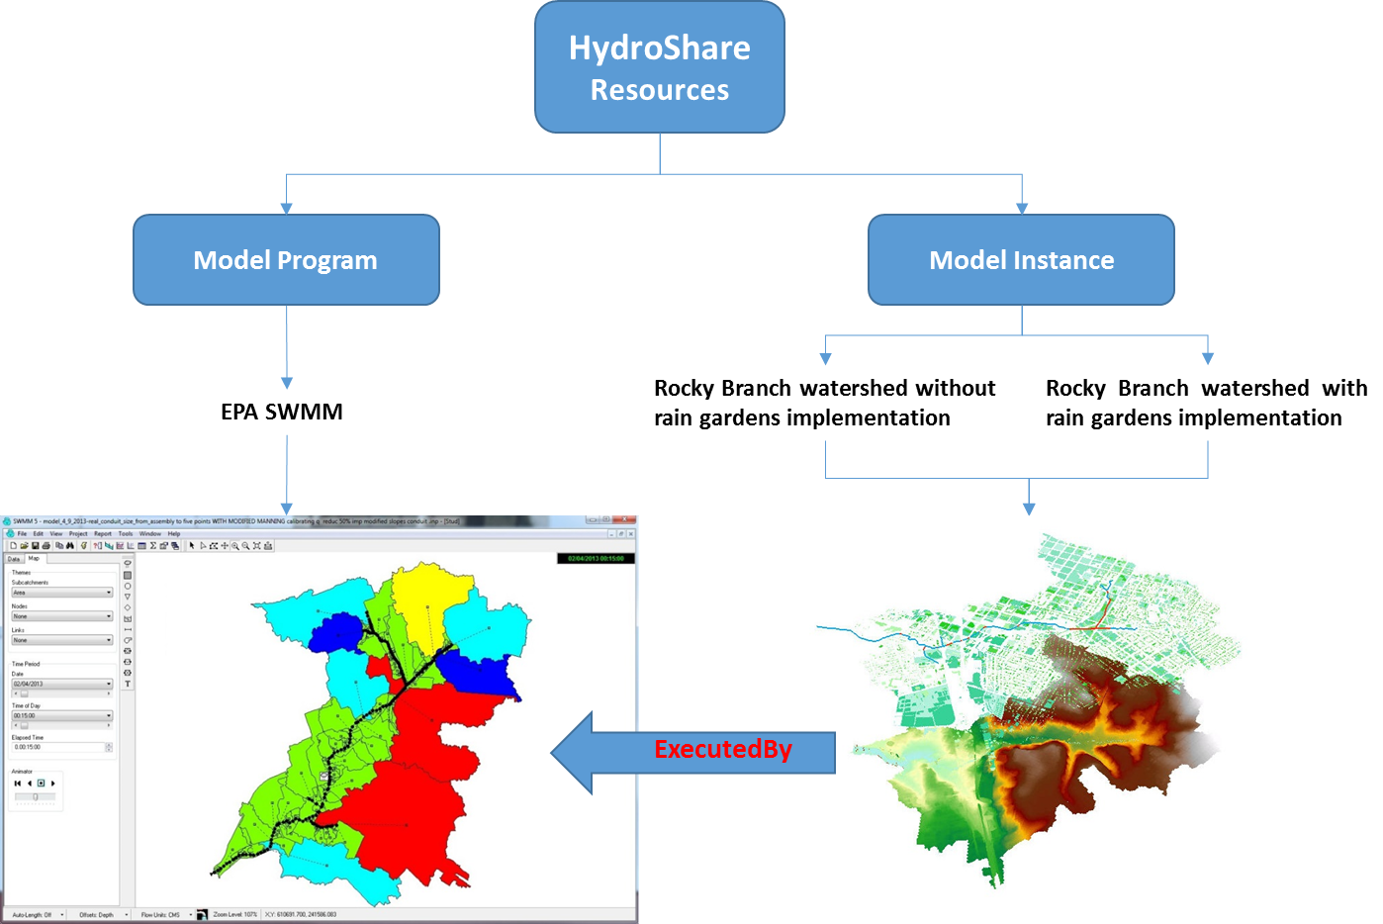
Example: Rocky Branch Stormwater Management

Slide 22
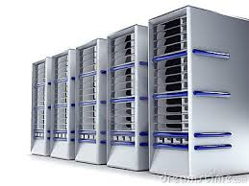
Model Execution in HydroShare
Input and output Hydroshare resources
Link input, output, and program resources to create model packages
Execution of model package within the HydroShare environment to create "new" resources
Output
CREATE OUTPUT
CREATE PACKAGE
Package
EXECUTE
Program
Input
Package
Program
Input
Output

Slide 23
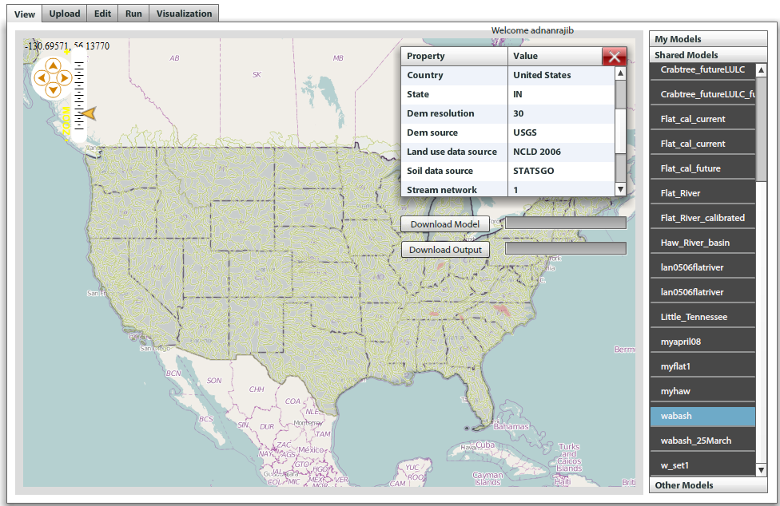
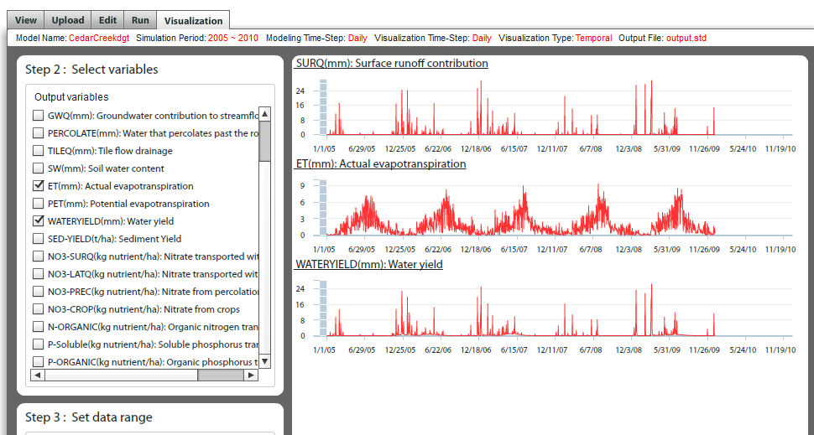
SWATShare
SWAT Models (.zip file)
Metadata
Model and Output (.zip, .xls or .txt file)
Location

Slide 24
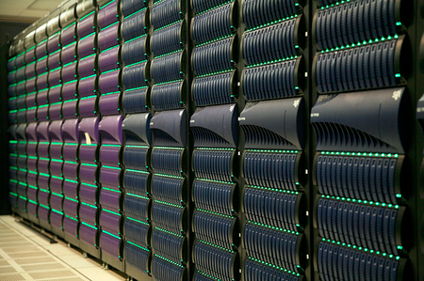
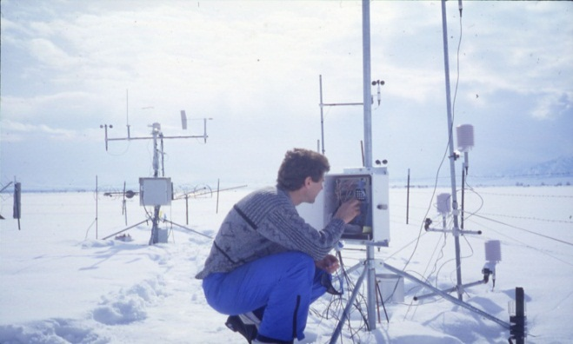
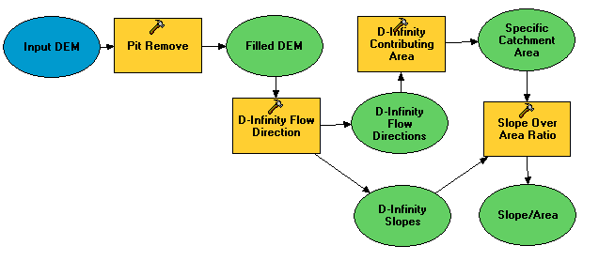

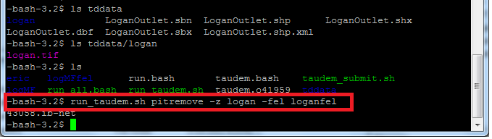
A digital divide
Do you have the access or know how to take advantage of advanced computing capability?
Hydrologic Experimentation and Modeling
Data Intensive High Performance Computing
#!/bin/bash
vi
chmod
#PBS -l nodes=4:ppn=8
grep
awk
mpiexec
Data and Software Services

Slide 25



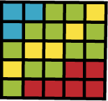





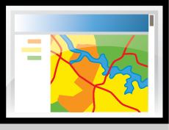


Clearing your desk. The trend towards network (cloud) computing.
Can we deliver Hydrologic Analysis functionality as a service over the web?
Data Sources
Server
Functions and Tools
Software as a Service
Users
Based on slide from Norm Jones

Slide 26
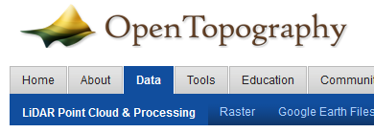
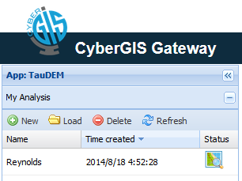
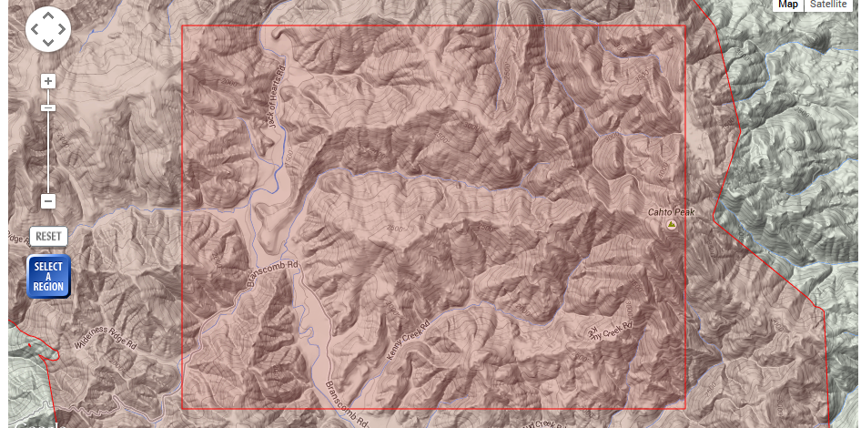
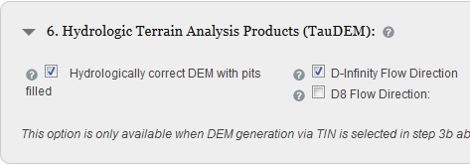
Moving TauDEM to the cloud
CyberGIS
http://gateway.cigi.illinois.edu/
Open Topography
www.opentopography.org

Slide 27
Some Assumptions
Research hydrologic modelers have to learn and become comfortable using a modern scientific programming language (e.g. Python or R)
Hydrologic modeling is data intensive (large datasets from a range of sources) demanding more data and computing resources than is in most PC’s
Reproducibly installing and configuring models on different platforms is a challenge
Research hydrologic modelers should not have to become expert in HPC systems and learning them is a barrier to using HPC and research with big data and computationally intensive models

Slide 28
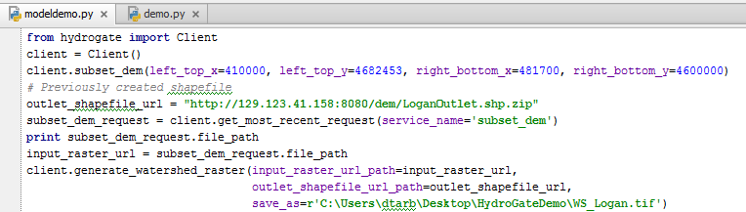
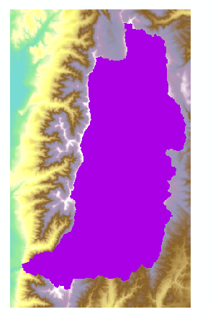
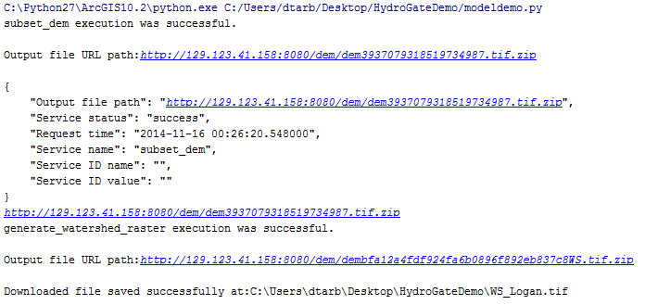
Computation via Python Client calling API
Input
Python session on desktop but data and analysis on server
Result

Slide 29

Hydro Data Services (Hydro-DS)
Python Analysis Environment
Browser
HydroGate
Python Client Library
http
http
HPC Gateway Server
http
HydroDS
Server
http
HydroShare
HydroGate
Django, GDAL, TauDEM, NetCDF, NCO
ssh
HPC Cluster
TauDEM, UEB

Slide 30
HydroDS Data Services
DEM for the western USA
US National Land Cover Dataset 2011
Daymet Climate Data for the whole USA
  Precipitation (mm/day)
  Daily maximum temperature (ºC)
  Daily minimum temperature (ºC)
  Vapor pressure (Pa)
  Solar radiation (W/m²)
NLDAS climate data (accessed through web services not stored locally)
Source code: https://github.com/CI-WATER/Hydro-DS
Documentation: https://github.com/CI-WATER/Hydro-DS/wiki/HydroDS-Web-API-Description
Data Services: http://hydro-ds.uwrl.usu.edu:20199/api/dataservice/capabilities/list

Slide 31
HydroDS Computing Services
Subset DEM (based on bounding box) Subset raster to reference raster Subset NetCDF to reference raster Subset NetCDF by time dimension Delineate watershed Generate outlet shape file Project shape file Project raster Project and clip raster Project and resample raster Project NetCDF Generate aspect raster Generate slope raster Convert raster to NetCDF | Combine two rasters Resample raster Resample NetCDF to reference NetCDF Reverse NetCDF Y-axis (and rename variable) Project, subset and resample NetCDF Project, subset and resample raster Concatenate NetCDF files Generate canopy variable specific data in NetCDF format Convert NetCDF data units Create HydroShare resource List available data sources

Slide 32
HydroDS Supporting Services
List available services
Show information on a specific service
Upload a file
Download a file
Delete a file
Zip a list of user files
List user files

Slide 33
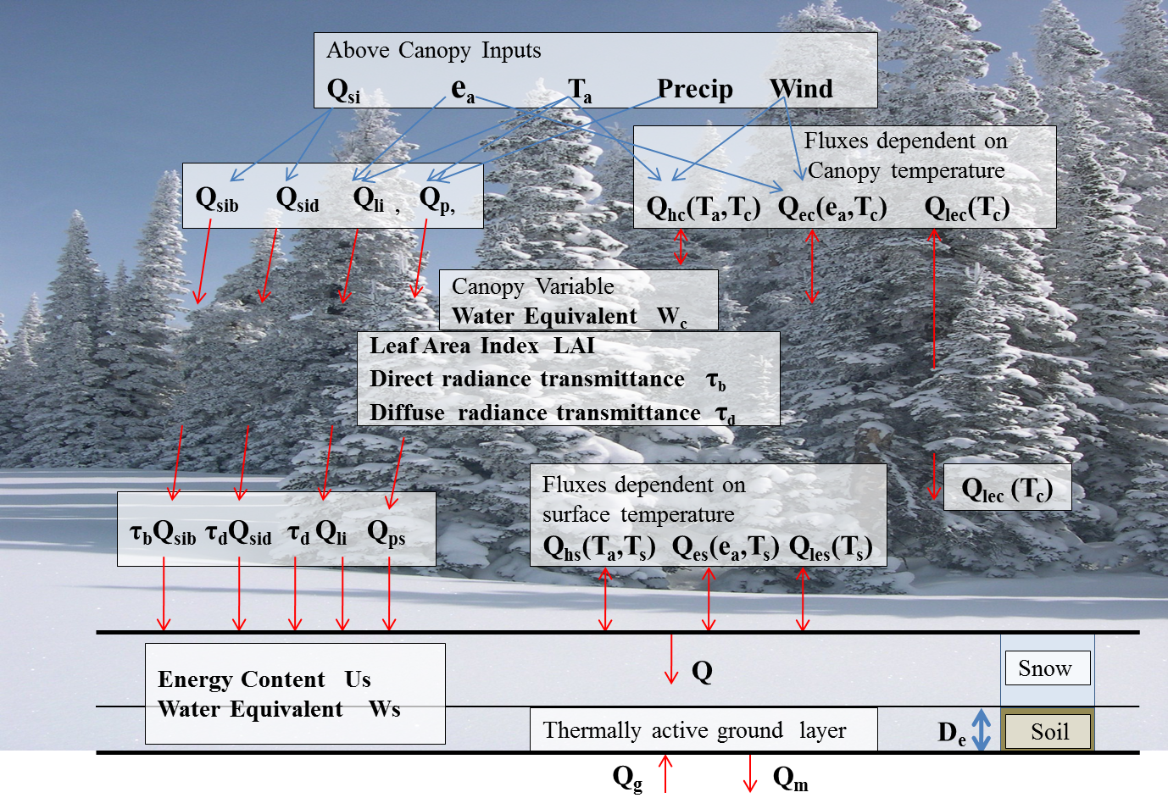
Utah Energy Balance Snowmelt Model
Used in CI-WATER to address what are the impacts of land cover change on watershed snowmelt inputs
Mahat, V. and D. G. Tarboton, (2012), "Canopy radiation transmission for an energy balance snowmelt model," Water Resour. Res., 48: W01534, http://dx.doi.org/10.1029/2011WR010438.

Slide 34
UEB Data Input Preparation Script
Start
NED DEM
Subset DEM to watershed boundaries
Watershed Boundary in lat/lon (Top, Bottom, Left, Right)
Project, resample DEM
Watershed outlet location in WGS84 (Xo, Yo)
Delineate watershed
Create outlet shape file
Compute terrain variables slope and aspect
NLCD 2011 Land Cover classes
Compute Canopy variables
Canopy variable values look up table
Daymet Climate Data
Subset Daymet data prcp, tmin, tmax, vp, srad for watershed domain and model time span, project and resample
Model start and end date time
SNOTEL or nearest weather station
Get wind variable from closest weather station
End

Slide 35
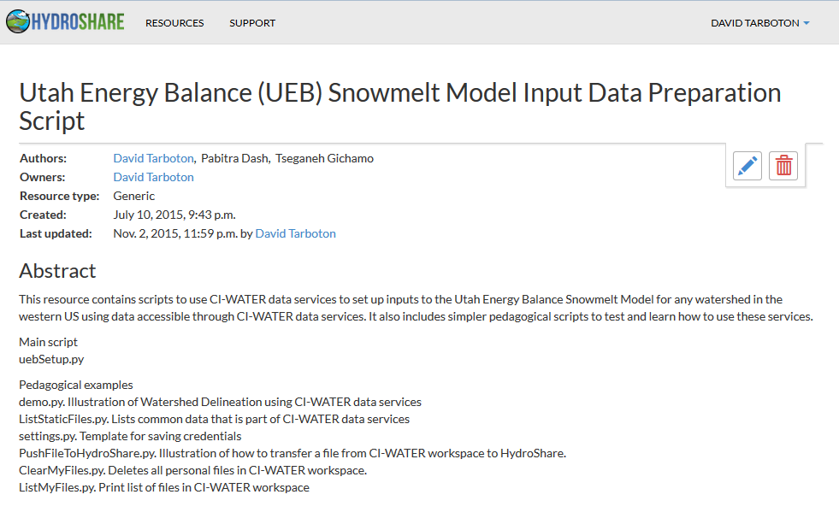
Example preparation of inputs for UEB using CI-Water Data Services

Slide 36
Live Demo
demo.py (use data services to delineate watershed)
PushFileToHydroShare.py
ListMyFiles.py
ClearMyFiles.py
uebSetup.py
uebRun.py

Slide 37



hydrogate.py (HydroGate python client library)
Input
Result

Slide 38



Delineate Watershed
Input
http://www.hydroshare.org/resource/cfb8d71b7f1f4e75a44f5e634f4730d4
Or search for CI-WATER in HydroShare
Result

Slide 39


Use UEB to examine Sensitivity of SWE to Canopy removal

Slide 40
Summary
A new, web-based system for advancing model and data sharing
Access multiple types of hydrologic data using standards compliant data formats and interfaces
Flexible discovery functionality
Model sharing and execution
Facilitate and ease access to use of high performance computing
Social media and collaboration functionality
Links to other data and modeling systems

Slide 41

Thanks to the HydroShare team!
  USU
  RENCI/UNC
  CUAHSI
  BYU
  Tufts
  UVA
  Texas
  Purdue
  SDSC
http://www.hydroshare.org
OCI-1148453
OCI-1148090
2012-2017
Notes:
The HydroShare project is part of a broad effort in CUAHSI in the area of Hydrologic Information Systems. We have a team of developers and domain scientists from eight universities working on HydroShare. This is part of the even broader focus in NSF on data management, Cyberinfrastructure and sustainable software.

