Slide 1
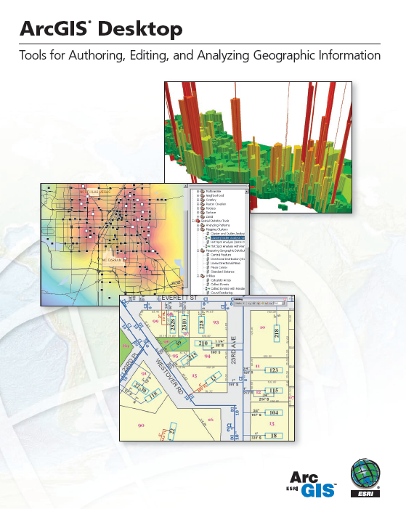
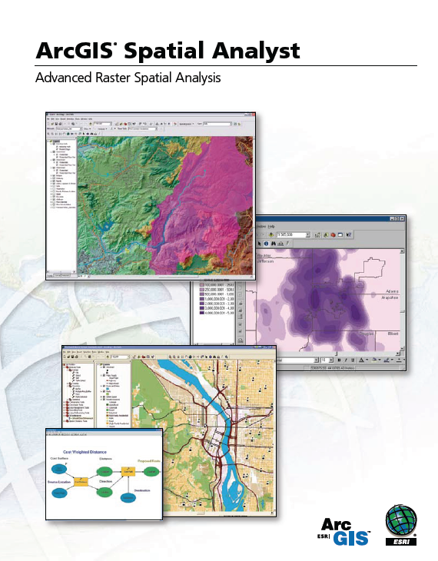
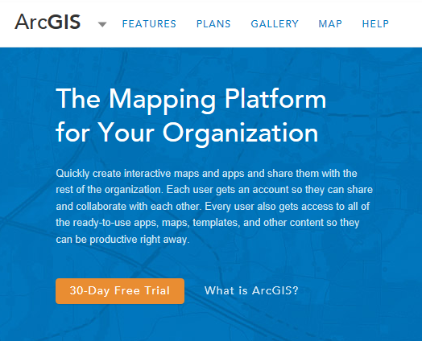
Introduction to ArcGIS Software

Slide 2
Readings
Geodatabase
http://desktop.arcgis.com/en/desktop/latest/manage-data/geodatabases/what-is-a-geodatabase.htm
  “What is a Geodatabase” to “Raster Basics”
ArcMap
http://desktop.arcgis.com/en/desktop/latest/main/map/essential-arcmap-vocabulary.htm
  “Introduction” to “Essential ArcMap Vocabulary”
Videos
GIS around the world
  http://video.esri.com/iframe/4639/ (19 min 50 sec)
GIS Vision: Applying Geography Everywhere
  http://video.esri.com/iframe/4640/ (12 min 42 sec)
GIS at the Southwest Florida Water Management District
  http://video.esri.com/iframe/4650/ (13 min 20 sec)

Slide 3
Introduction to GIS Software
Conceptual framework of ArcGIS
How data are stored in ArcGIS
ArcGIS Desktop
Extensions of ArcGIS – spatial analyst, 3D analyst
ArcGIS Online

Slide 4
Introduction to GIS Software
Conceptual framework of ArcGIS
How data are stored in ArcGIS
ArcGIS Desktop
Extensions of ArcGIS – spatial analyst, 3D analyst
ArcGIS Online

Slide 5

Jack Dangermond, President, ESRI
Article from NY Times:
http://www.nytimes.com/2011/07/10/business/esris-chief-on-tending-his-plants-and-his-company.html?_r=2

Slide 6
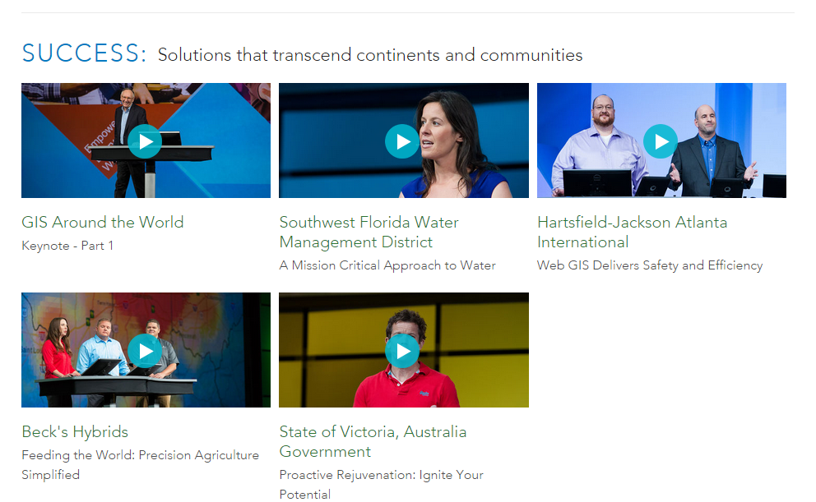
Videos from the Plenary Session of the ESRI User Conference
http://www.esri.com/events/user-conference/plenary-videos

Slide 7

GIS Vision: Applying Geography Everywhere
http://video.esri.com/iframe/4640/
Watch Plenary Session attended by 12,000 people

Slide 8

GIS at the Southwest Florida Water Management District
http://video.esri.com/iframe/4650/

Slide 9





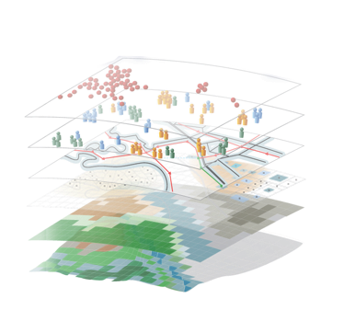


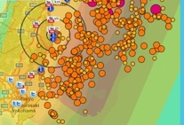

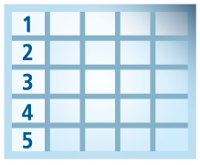
Geospatial Systems Are Helping Us Understand
Understanding
Sharing and Collaboration
Knowledge
Information
Integration
Mapping
Data
. . . Helping Us Make Better Decisions

Slide 10



Good GeoInformation Products Require Good Design
Understanding Issues
Appropriate Data
Analysis & Manipulation
. . . And A Compelling Graphic Design
Good Products Help Us Understand . . .
. . . And Support Action

Slide 11
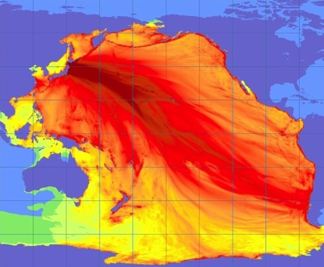
Good Information Products Are Timely
Tsunami Forecast
Help Us Understand . . .
. . . And Support Action

Slide 12
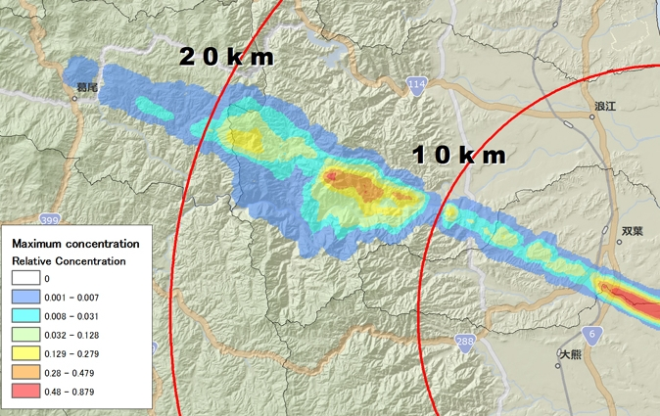
Good Information Products Disseminate Knowledge . . .
Fukushima Radiation Exposure
Help Us Understand . . .
. . . And Support Action

Slide 13
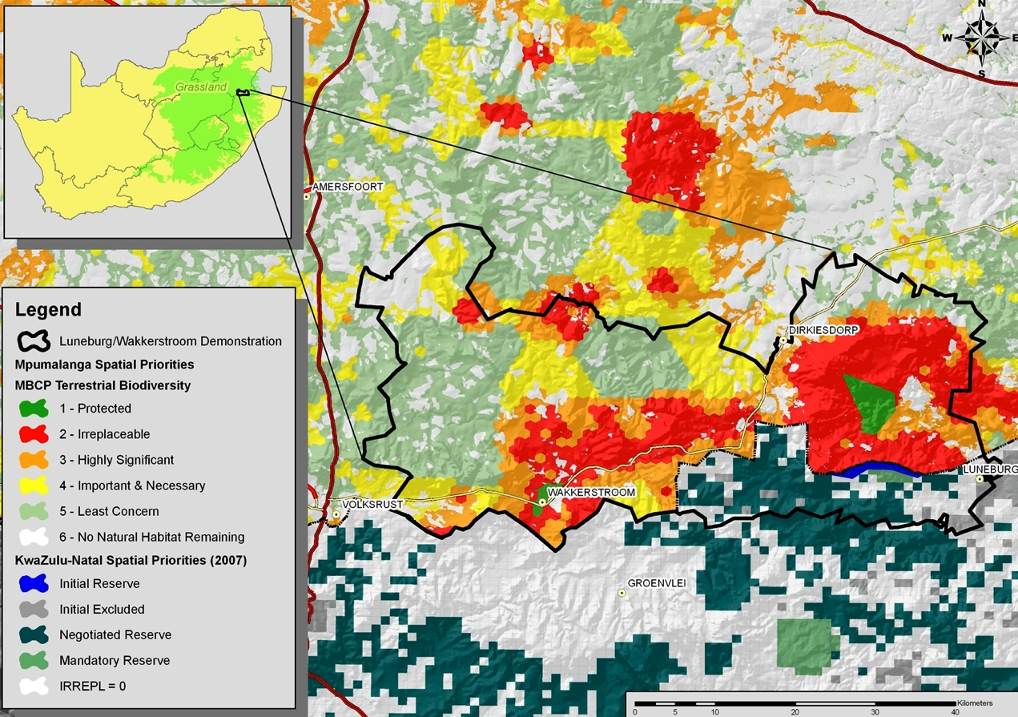
Good Information Products Communicate Importance
Suitability For Conservation
Help Us Understand . . .
. . . And Support Action

Slide 14
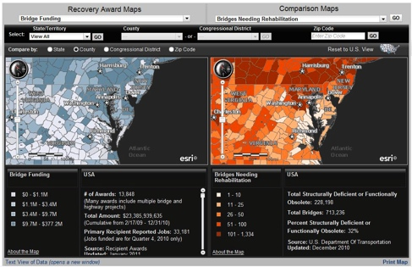
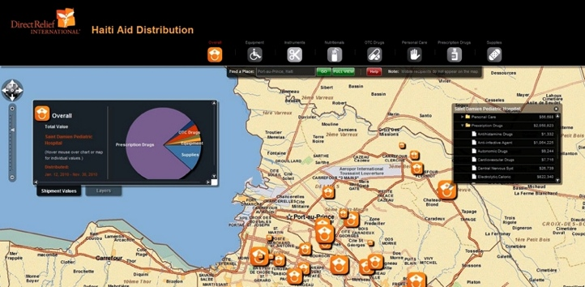
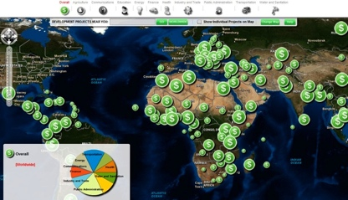
Good Information Products Show Status
Government Expenditures vs. Need
Situation Awareness
Haiti AID Funding
CGI Grants
Help Us Understand . . .
. . . And Support Action

Slide 15
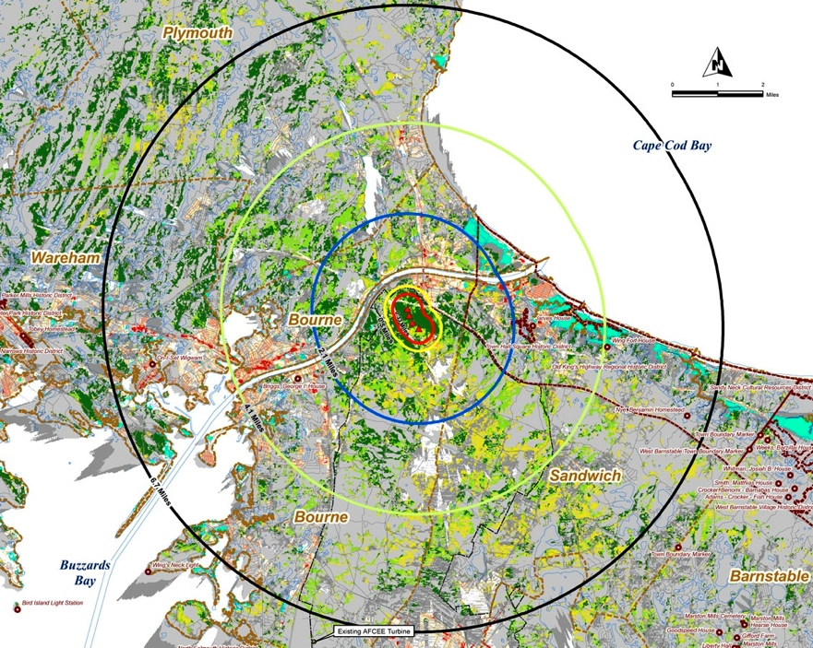
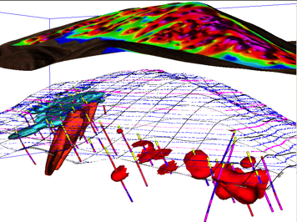
Good Information Products Support Decision Making
Wind Turbine Suitability
Hydrocarbons
Help Us Understand . . .
. . . And Support Action
Leveraging Spatial Analysis

Slide 16
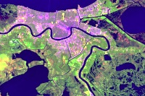
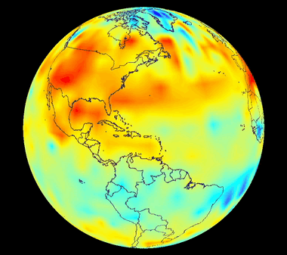
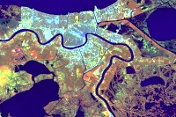
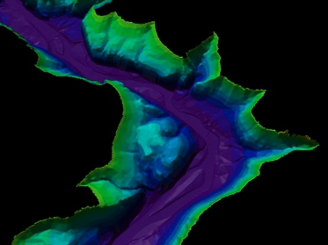
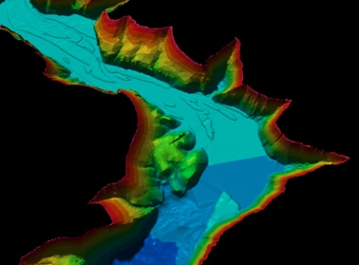
Good Information Products Illustrate Change
Urbanization – Landsat
Temperature
Sedimentation
Help Us Understand . . .
. . . And Support Action

Slide 17
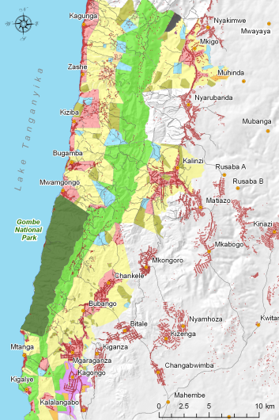
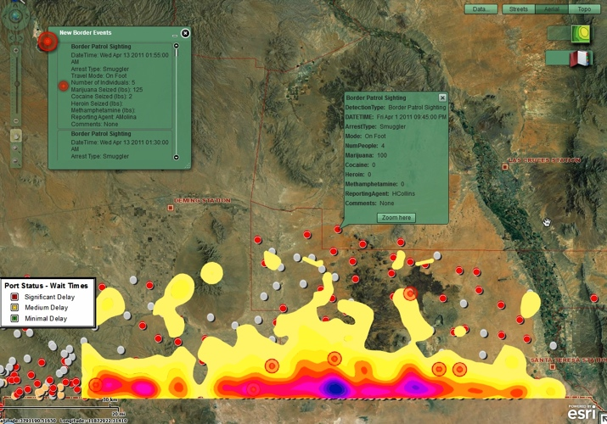
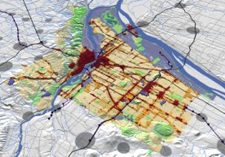
Good Information Products Can Show The Future
Gombe, Tanzania
Texas Border
CGI Grants
Oregon
Help Us Understand . . .
. . . And Support Action

Slide 18

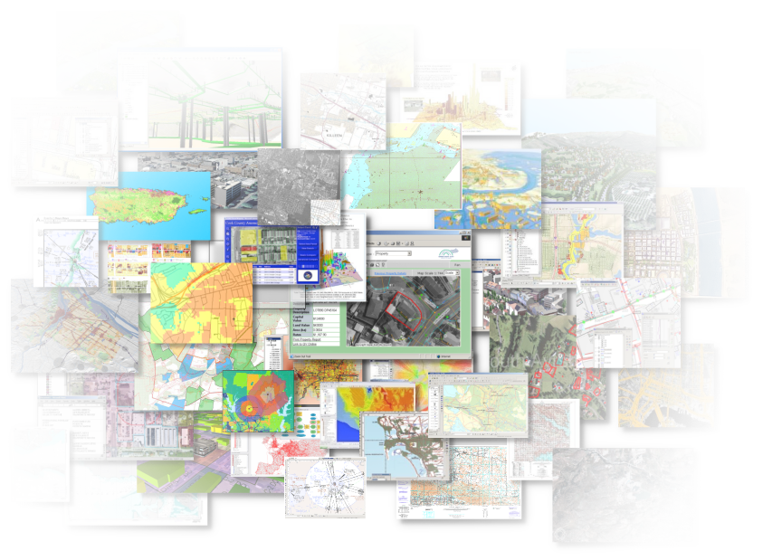

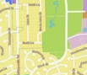

Good GeoInformation Products
Provide Timely Information
Disseminate Knowledge
Communicate Importance
Show Status and Performance
Support Decision Making
Illustrate Change
Show The Future
Effectively Telling a Story . . .
Helping Us Understand . . .
. . . And Make Better Decisions

Slide 19
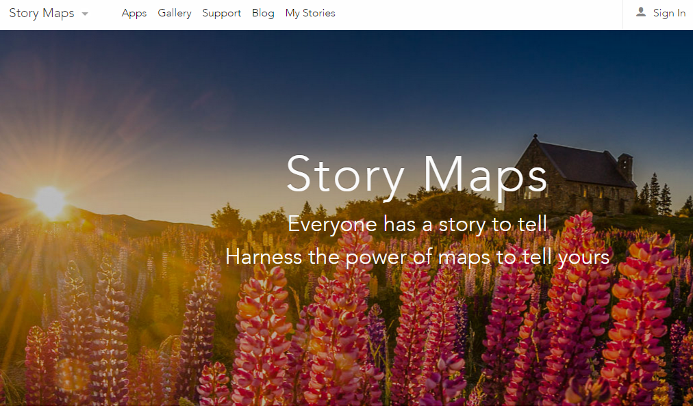
Story Maps
http://storymaps.arcgis.com
“Sound of Music”
http://arcg.is/1FT9CRJ

Slide 20
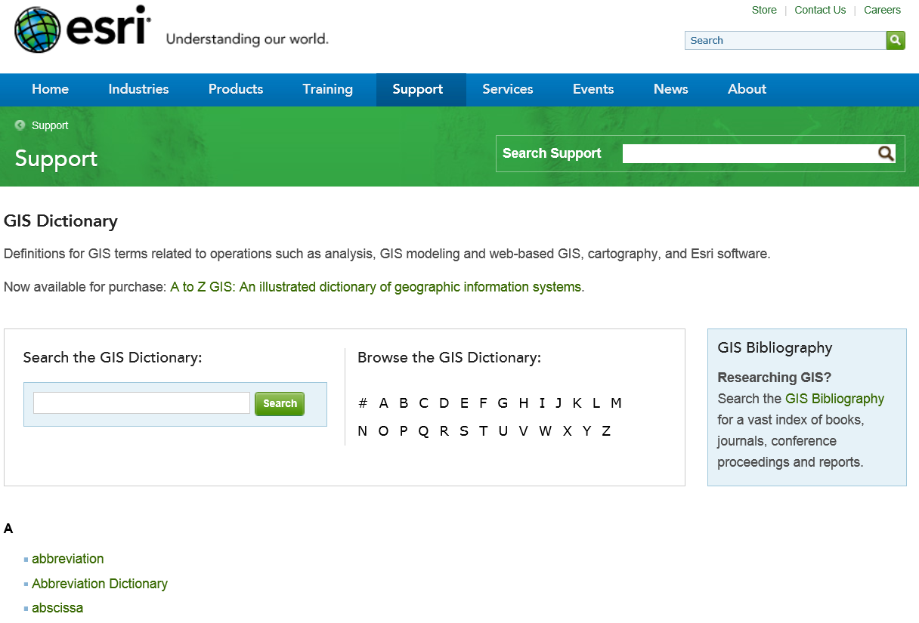
GIS Dictionary
http://support.esri.com/en/knowledgebase/Gisdictionary/browse

Slide 21
Introduction to GIS Software
Conceptual framework of ArcGIS
How data are stored in ArcGIS
ArcGIS Desktop
Extensions of ArcGIS – spatial analyst, 3D analyst
ArcGIS Online

Slide 22
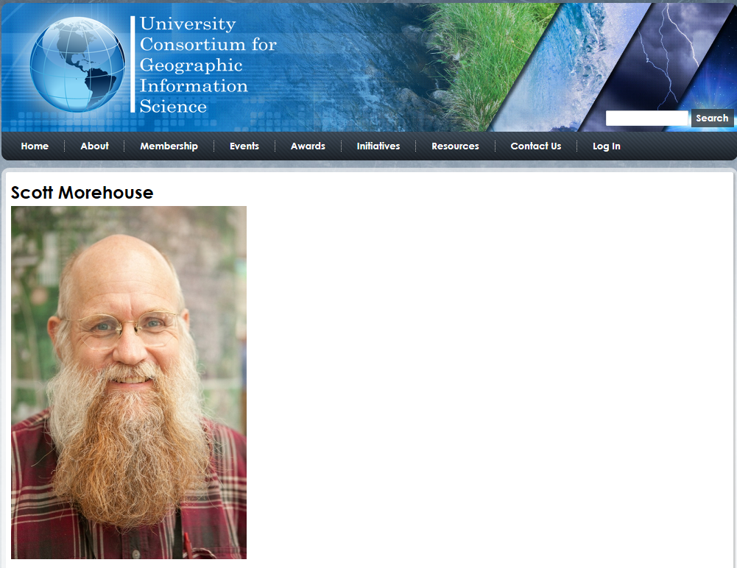
http://ucgis.org/ucgis-fellow/scott-morehouse
Made a Fellow of UCGIS in 2014
“All geographic information systems are built using formal models that describe how things are located in space. A formal model is an abstract and well-defined system of concepts. A geographic data model defines the vocabulary for describing and reasoning about the things that are located on the earth. Geographic data models serve as the foundation on which all geographic information systems are built.”
Scott Morehouse, Preface to “Modeling our World”, First Edition. He is the chief software engineer at ESRI

Slide 23
ESRI GIS Development
Arc/Info (coverage model)
Versions 1-7 from 1980 – 1999
Arc Macro Language (AML)
ArcGIS (geodatabase model)
Version 8.0, …, 10.3.1 from 2000 – Python scripting
ArcView (shapefile model)
Versions 1-3 from 1994 – 1999
Avenue scripting language

Slide 24
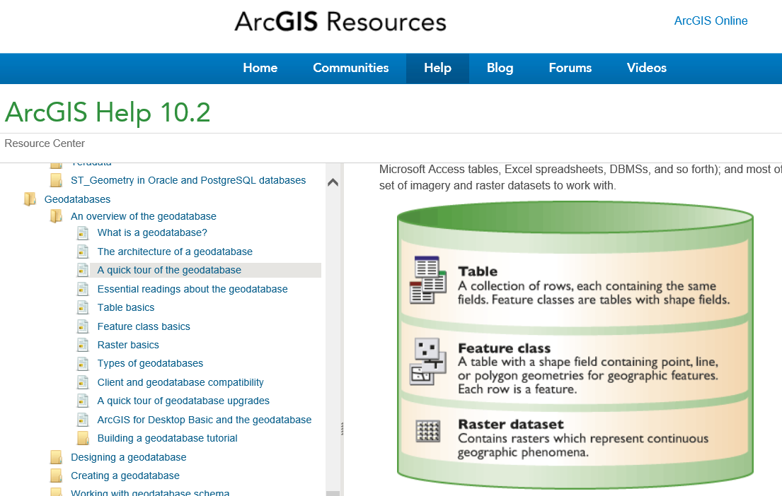
Geodatabase
http://resources.arcgis.com/en/help/main/10.2/#/What_is_a_geodatabase/003n00000001000000/

Slide 25
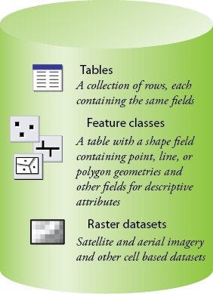
Common Geospatial Information Types
Image: Michael Zeiler, ESRI

Slide 26
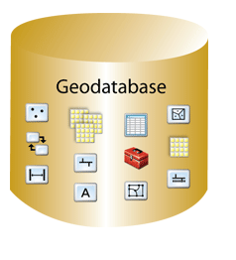
Geodatabase – a store for all types of geospatial information

Slide 27
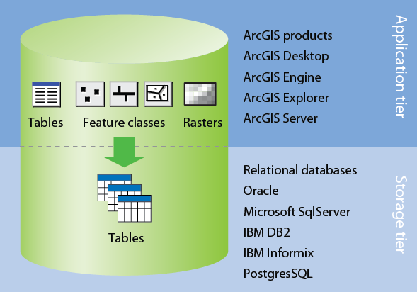
Application and Storage Tiers
Image: Michael Zeiler, ESRI

Slide 28
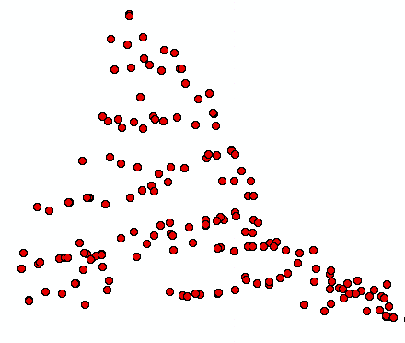
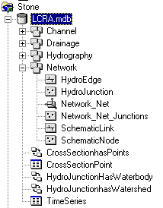
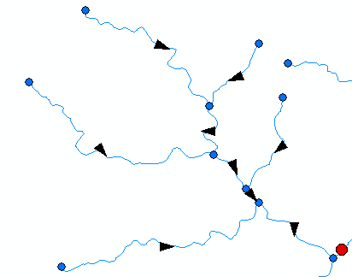
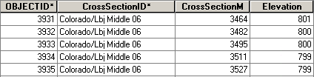
ArcGIS Geodatabase
Workspace
Geodatabase
Feature Dataset
Feature Class
Geometric
Network
Relationship
Object Class

Slide 29
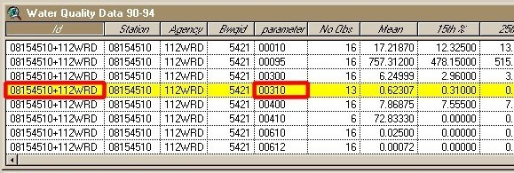
Object Class
An object class is a collection of objects in tabular format that have the same behavior and the same attributes.
An object class is a table that has a unique identifier (ObjectID)
for each record

Slide 30
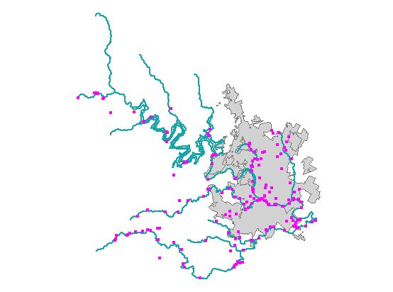
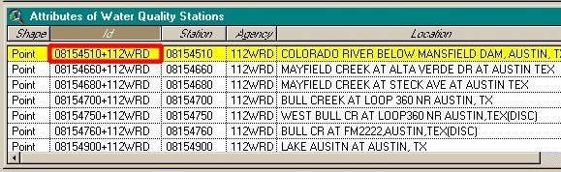
Feature Class
A feature class is a collection of geographic objects in tabular format that have the same behavior and the same attributes.
Feature Class = Object class + spatial coordinates

Slide 31
Relationship
A relationship is an association or link between two objects in a database.
A relationship can exist between spatial objects (features in feature classes), non-spatial objects (objects in object classes), or between spatial and non-spatial objects.

Slide 32
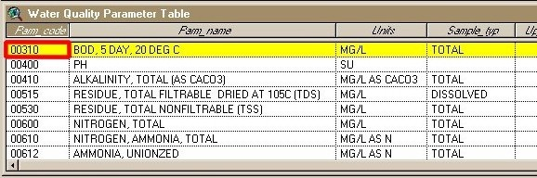
Relationship
Relationship between non-spatial objects
Water
Quality
Data
Water
Quality
Parameters

Slide 33
Relationship
Relationship between spatial and non-spatial objects
Water quality data
(non-spatial)
Measurement station
(spatial)

Slide 34
Introduction to GIS Software
Conceptual framework of ArcGIS
How data are stored in ArcGIS
ArcGIS Desktop
Extensions of ArcGIS – spatial analyst, 3D analyst
ArcGIS Online

Slide 35
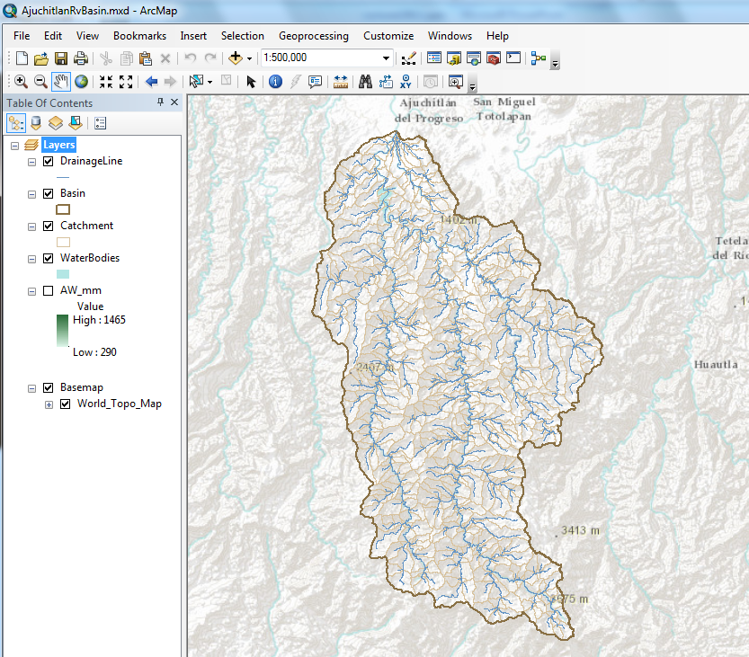
ArcMap – primary work interface
http://resources.arcgis.com/en/help/main/10.2/#/Mapping_and_visualization_in_ArcGIS_for_Desktop/018q00000004000000/

Slide 36
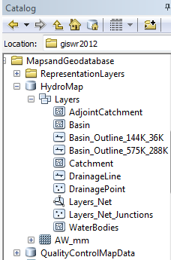
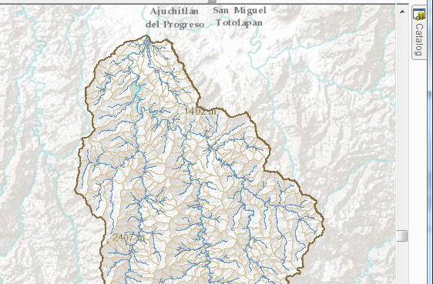
Arc Catalog – view the geodatabase
http://resources.arcgis.com/en/help/main/10.2/#/What_is_the_Catalog_window/006600000449000000/

Slide 37
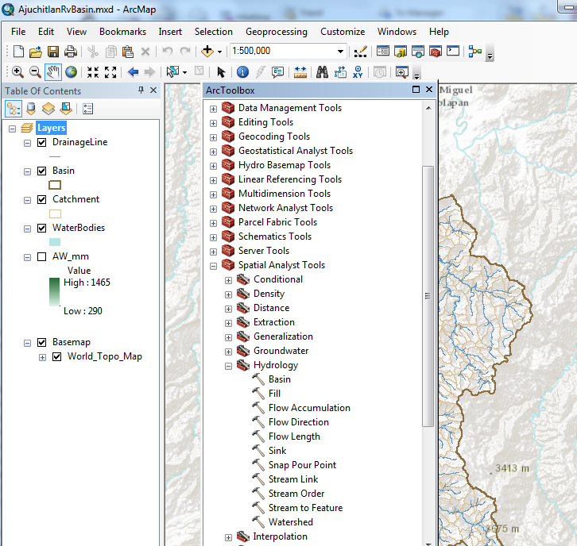
ArcToolbox – processing functions
http://resources.arcgis.com/en/help/main/10.2/index.html#/A_quick_tour_of_geoprocessing_tool_references/002t0000000z000000/

Slide 38
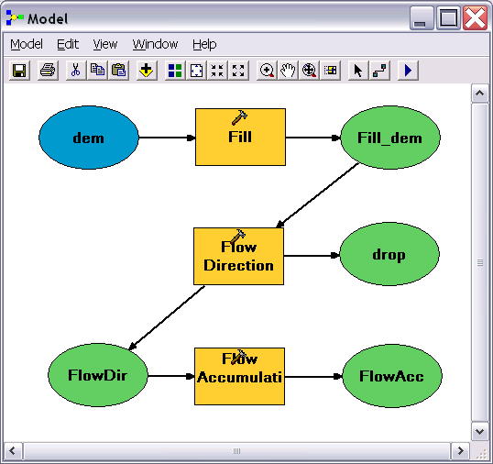
Geo-Processing
Toolbox tools linked together using the model builder to automate data processing

Slide 39
Introduction to GIS Software
Conceptual framework of ArcGIS
How data are stored in ArcGIS
ArcGIS Desktop
Extensions of ArcGIS – spatial analyst, 3D analyst
ArcGIS Online

Slide 40
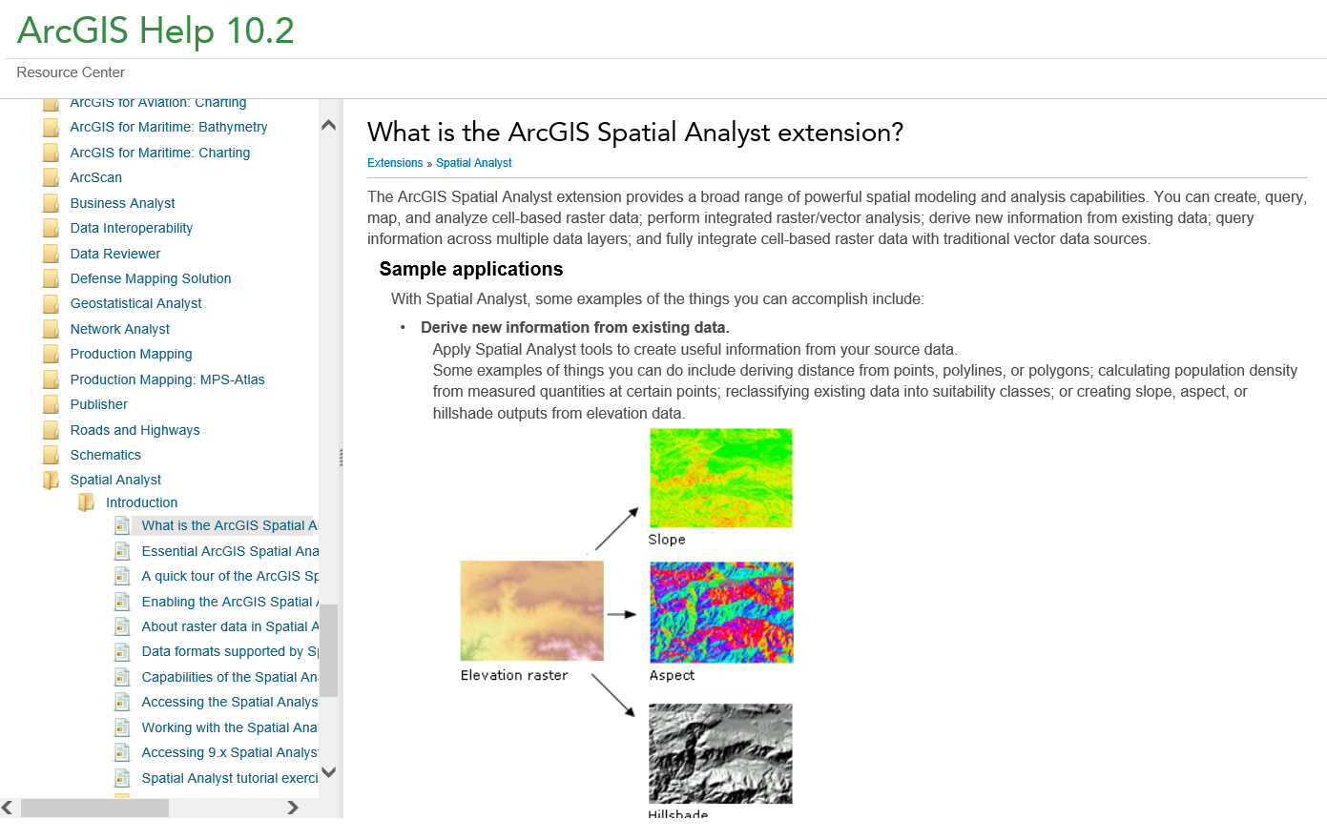
Spatial Analyst
http://resources.arcgis.com/en/help/main/10.2/#/What_is_the_ArcGIS_Spatial_Analyst_extension/005900000001000000/

Slide 41
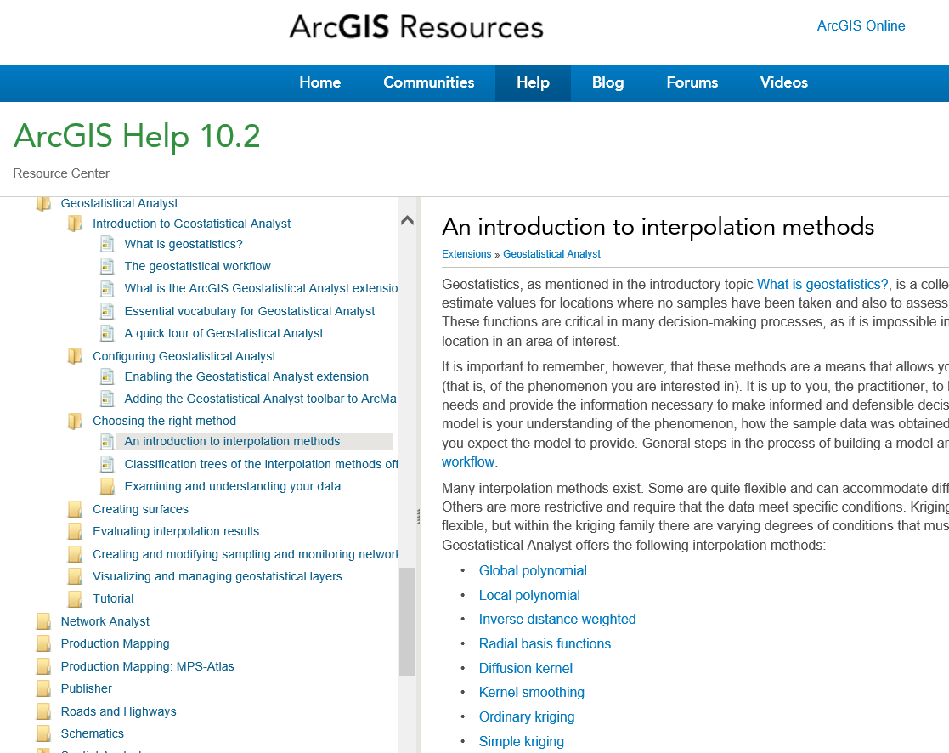
Geostatistical Analyst and Interpolation
http://resources.arcgis.com/en/help/main/10.2/#/An_introduction_to_interpolation_methods/003100000008000000/

Slide 42
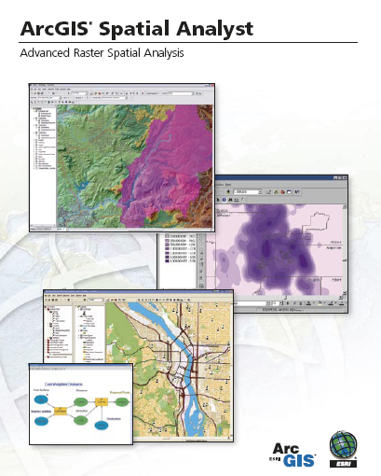
Spatial Analyst
Analysis of land surface terrain as a grid
Key means of defining drainage areas and connectivity to stream network

Slide 43
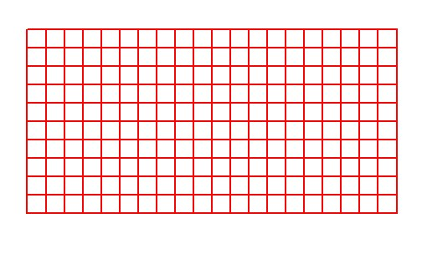
Grid Datasets
Cellular-based data structure composed of square cells of equal size arranged in rows and columns.
The grid cell size and extension (number of rows and columns), as well as the value at each cell have to be stored as part of the grid definition.
Number of columns
Cell size
Number of rows

Slide 44
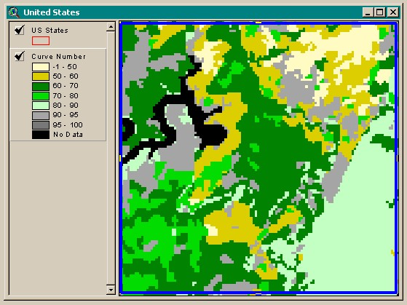

Grid Datasets
Grid datasets

Slide 45

Image Datasets
Digital Orthophotos and satellite imagery
Image datasets

Slide 46

3-D Analyst
Analysis of land surface terrain as triangulated irregular network (TIN)
Visualization in 3-D using Arc Scene
Stream channel of Pecan Bayou, TX

Slide 47


TIN Datasets
TIN datasets
Points and breaklines from which a TIN is constructed.

Slide 48

3D Analyst and ArcScene
http://resources.arcgis.com/en/help/main/10.2/#/3D_Analyst_and_ArcScene/00q8000000p0000000/

Slide 49
Introduction to GIS Software
Conceptual framework of ArcGIS
How data are stored in ArcGIS
ArcGIS Desktop
Extensions of ArcGIS – spatial analyst, 3D analyst
ArcGIS Online

Slide 50

ArcGIS Online
Mapping on the web

Slide 51

Sign In to Organizational Account associated with your institution
Use of services is paid for with “credits”

Slide 52


UT Austin Organizational Account
Resources – my content, groups, organization, public

Slide 53


Make a Map
Select a base map and add things to it

Slide 54

A home in a FEMA flood hazard zone

Slide 55

Using web services to delineate the drainage area above home
Drainage area = 732 km², or 282 miles²

Slide 56

Living Atlas
http://www.arcgis.com/home/gallery.html

Slide 57

Earth Observations

Slide 58


Animated Map of Soil Moisture

