Slide 1
National Flood Interoperability Experiment
David R. Maidment
Center for Research in Water Resources
University of Texas at Austin
Presentation to GIS in Water Resources class
Austin Tx, 6 October 2015
Acknowledgements: Fernando Salas, Marcelo Somos Valenzuela, David Gochis, Ed Clark,
Don Cline, Jack Dangermond, Andy Ernest, Richard Hooper
This research is supported in part by NSF EarthCube grant 1343785

Slide 2
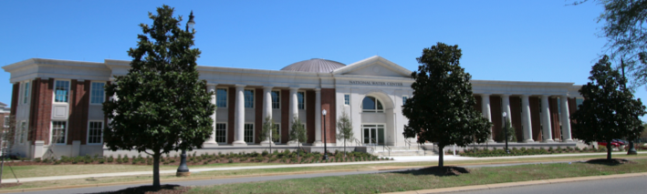
The Opportunity
New National Water Center established on the Tuscaloosa campus of University of Alabama by the National Weather Service and federal agency partners
Has a mission to assess hydrology in a new way at the continental scale for the United States

Slide 3
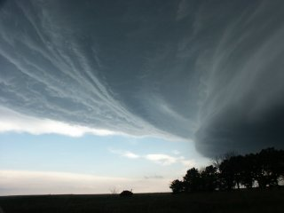
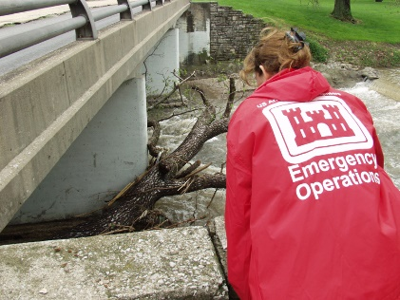
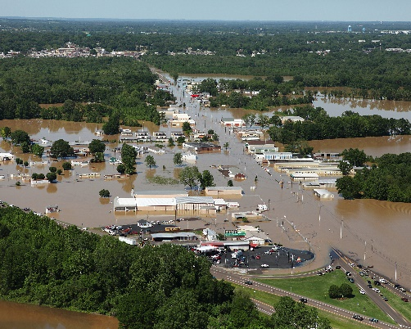
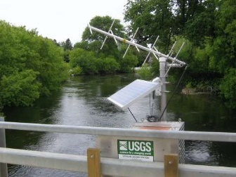
Integrated Water Resources Science and Services (IWRSS)
Formal partnership across these four agencies
Weather
Rivers
Impact
Data

Slide 4
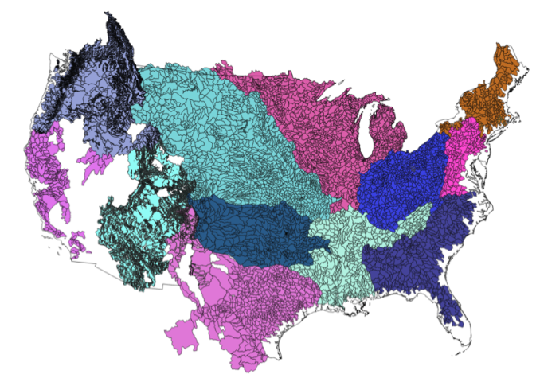
NWS River Forecast Centers (RFCs)
Prepare river and flood forecasts using models based on average basin characteristics
Provide forecast guidance to Weather Forecast Offices (WFOs)
Issue daily stage and streamflow forecasts, rainfall and drought data and information, and flash flood guidance
Work with water managers and other Federal Agencies
6600 sub-basins in continental US
4
Notes:
RFC Summary

Slide 5
100 million people on coast
No River Forecast
Notes:
THERE’S A MAJOR GEOGRAPHIC GAP – WE DON’T FORECAST ALONG THE COAST

Slide 6
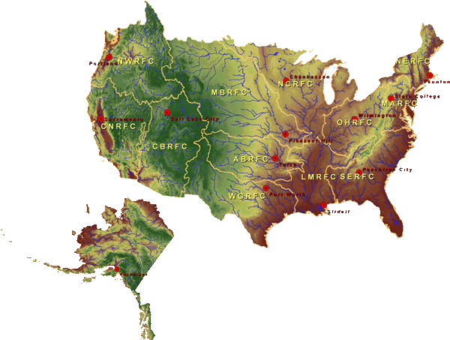
National Water Center
FY15 Centralized Water Forecasting
Centralized Data Archive – all RFC data
Modeling Evaluation Service
RFC and NWC modeling and forecasts
Modeling Testbed – new NWC capabilities
Centralized Water Forecasting Demonstration
Notes:
TRANSITION INTO METHODS
FY15 PROJECT HAS FOUR CORE COMPONENTS
RFC archive
Model evaluation service
Modeling testbed
Centralized modeling demonstration

Slide 7
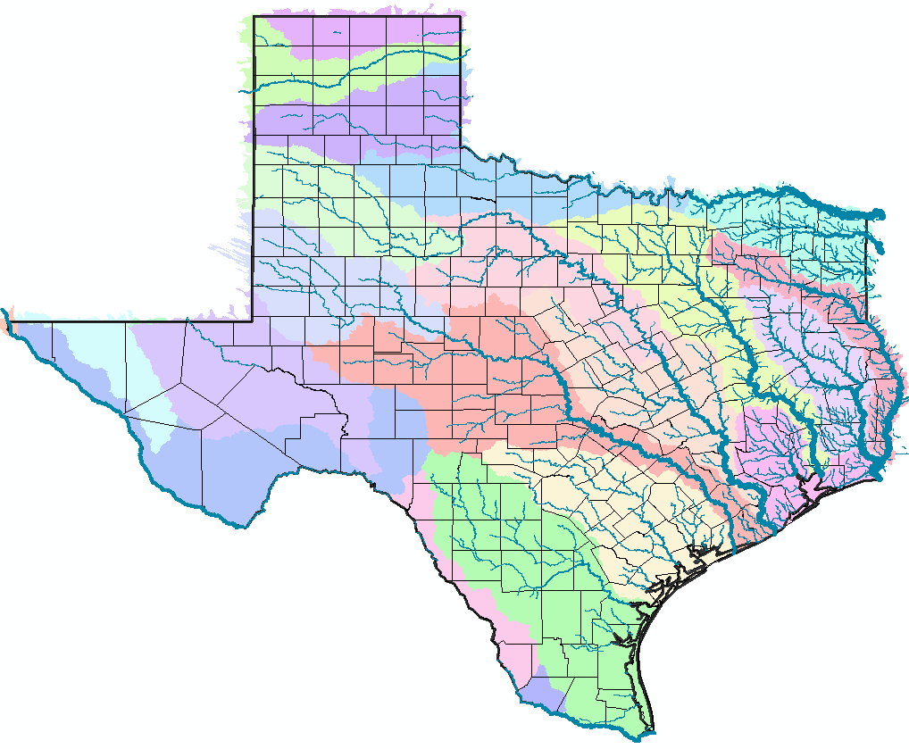
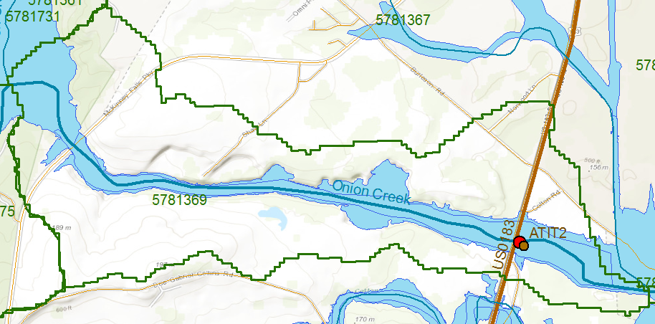
RFC Forecast Point: Onion Creek at Highway 183
National Flood Interoperability Experiment
Geospatial data framework for Texas
NFIE-Geo Texas
USGS Gage 08159000
NHDPlus Catchment 5781369
NWS Forecast Point ATIT2

Slide 8
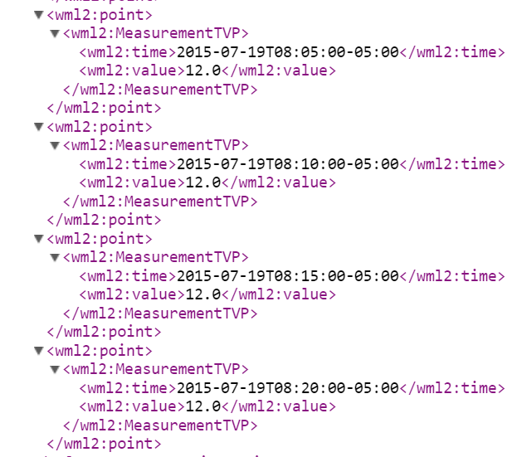
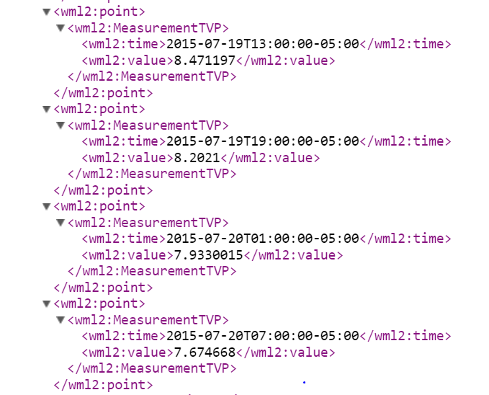
WaterML2 Observations from USGS and Forecasts from NWS for this location
USGS Gage 08159000
NWS Forecast Point ATIT2
USGS Observed Flows, July 19
NWS Forecast Flows, July 19-20

Slide 9
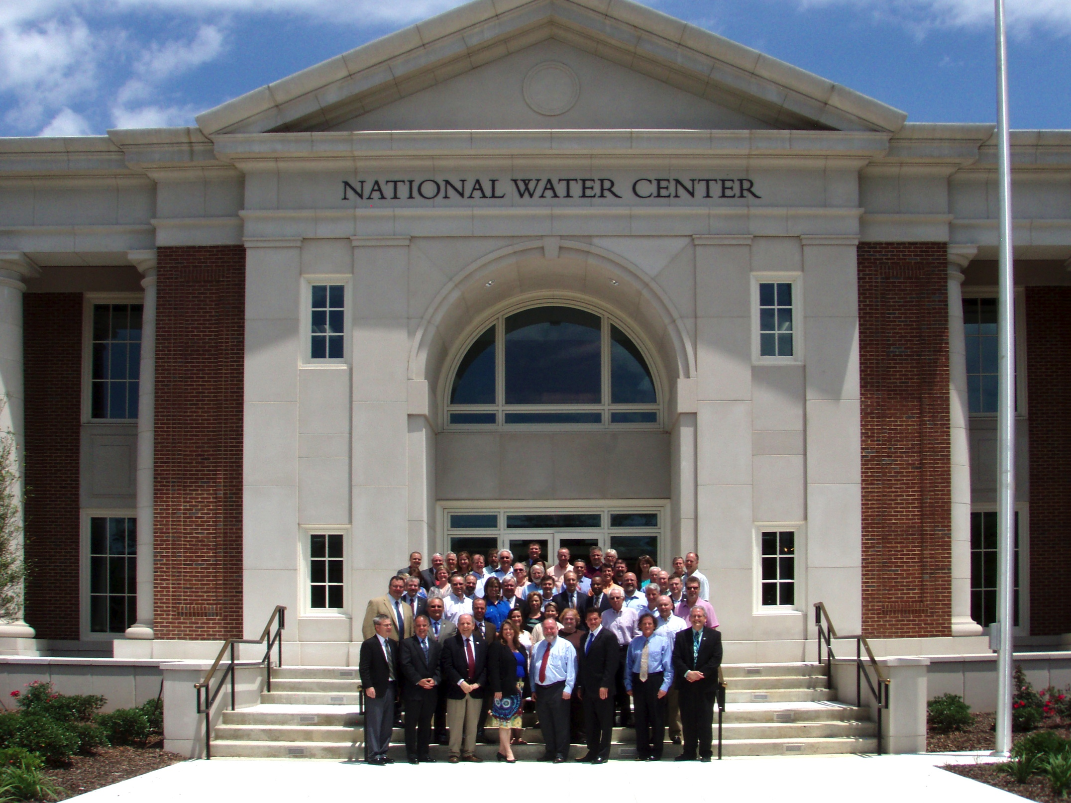
Inaugural Meeting – May, 2014

Slide 10
Transformative Research (NSF)
Transformative research involves ideas, discoveries, or tools that radically change our understanding of an important existing scientific or engineering concept or educational practice or leads to the creation of a new paradigm or field of science, engineering, or education. Such research challenges current understanding or provides pathways to new frontiers.
http://www.nsf.gov/about/transformative_research/definition.jsp
How to move from evolutionary change
to transformative change?

Slide 11
National Flood Interoperability Experiment (NFIE) (Sept 2014 to August 2015)
Partnership between NWS and the academic community (Interagency Agreement between NSF and NOAA)
Included a Summer Institute for 44 graduate students from 19 Universities at the National Water Center, June 1 to July 17, 2015

Slide 12
Goal of the Experiment
Close the gap between National Flood Forecasting and Local Emergency Response
Demonstrate forecasting of flood impacts at “stream and street level”
National
Weather and Hydrology
National Weather Service and federal agencies
National Water Center
River Flooding and Emergency Response
Local, State and Regional Agencies
Citizens
Local

Slide 13
NFIE Conceptual Framework
NFIE-Geo: National geospatial framework for hydrology
NFIE-Response: Community Flood Response System
NFIE-Hydro: National high spatial resolution hydrologic forecasting
NFIE-River: River channel information and real-time flood inundation mapping
NFIE-Services: Web services for flood information

Slide 14
Open Water Data Initiative (OWDI)
Subcommittee on Spatial Water Data leads this effort
Al Rea (USGS) and Ed Clark (NWS) are co-chairs
This reports to both FGDC and ACWI
Sponsoring a series of “experiments” with water information services
NFIE is one of these experiments
Anne Castle, Former Asst Secretary for Water and Science, Dept of Interior
Chair

Slide 15
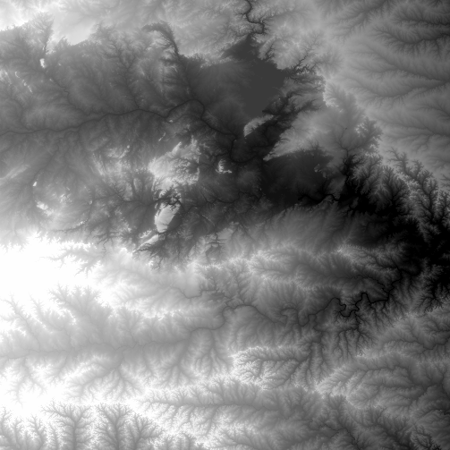
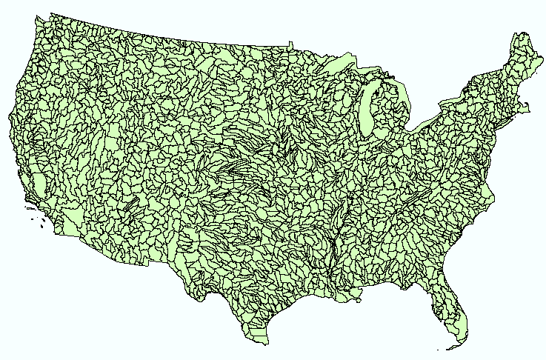
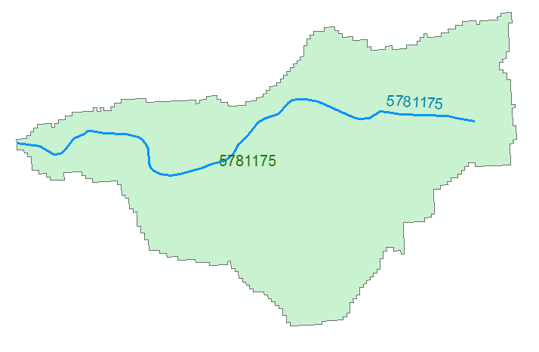
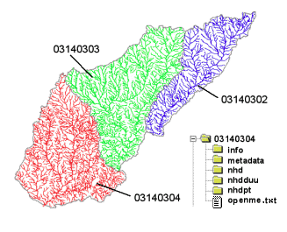
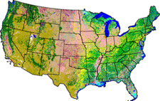
NHDPlus Version 2.1
Foundation for a Geospatial Hydrologic Framework for the United States
NHDPlus
2.7 million reach catchments in US
average area 3 km²
reach length 2 km
Uniquely labelled
National Elevation Dataset
Watershed Boundary Dataset
National Hydrography Dataset
National Land Cover Dataset

Slide 16
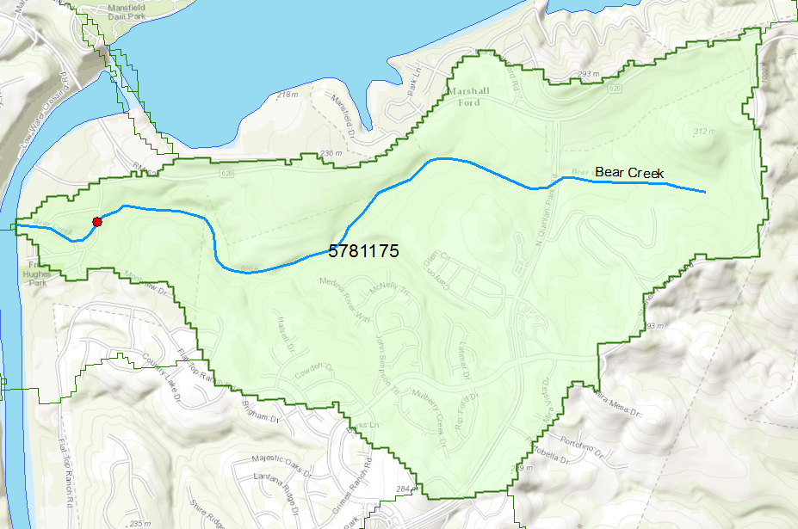
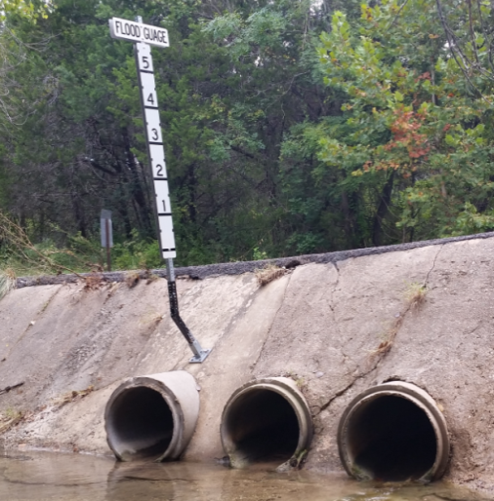
Flood Information for Fritz Hughes Park Rd
National Hydrography Dataset Plus
catchment for Bear Creek
(area = 5.71 km²)
Low water crossing at
3400 Fritz Hughes Park Rd

Slide 17
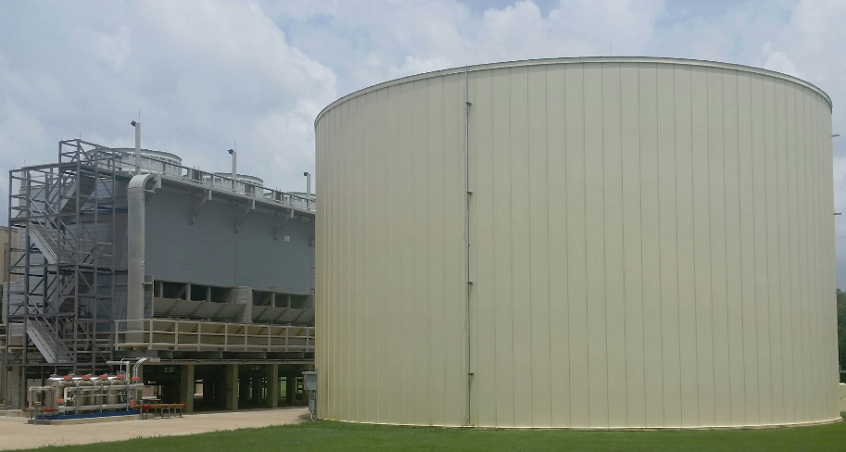
Stampede
1.2 million gallon cooling tank
500,000 processors operating in parallel

Slide 18
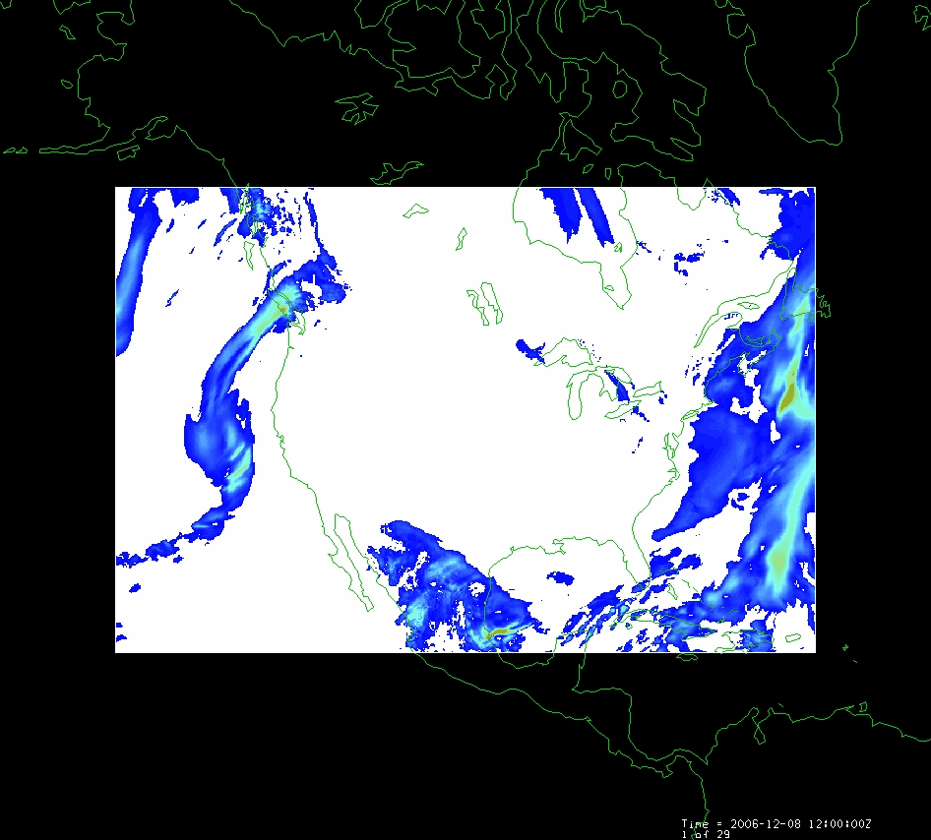
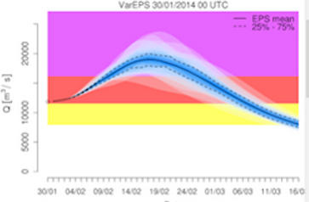
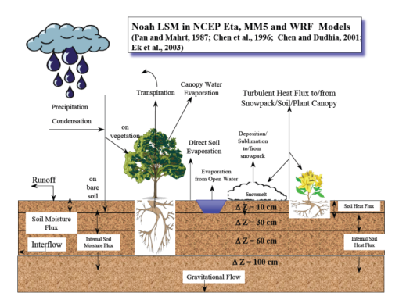
WRF-Hydro Forecasting Model
Computed for the continental US in 10 minutes at Texas Advanced Computing Center
Weather model and forecasts (HRRR)
Probabilistic flood forecasts
Catchment-level forecasts
Weather
Precipitation
Streamflow
Runoff
Land-Atmosphere Model (NOAH-MP)
RAPID flow routing (for continental US)

Slide 19
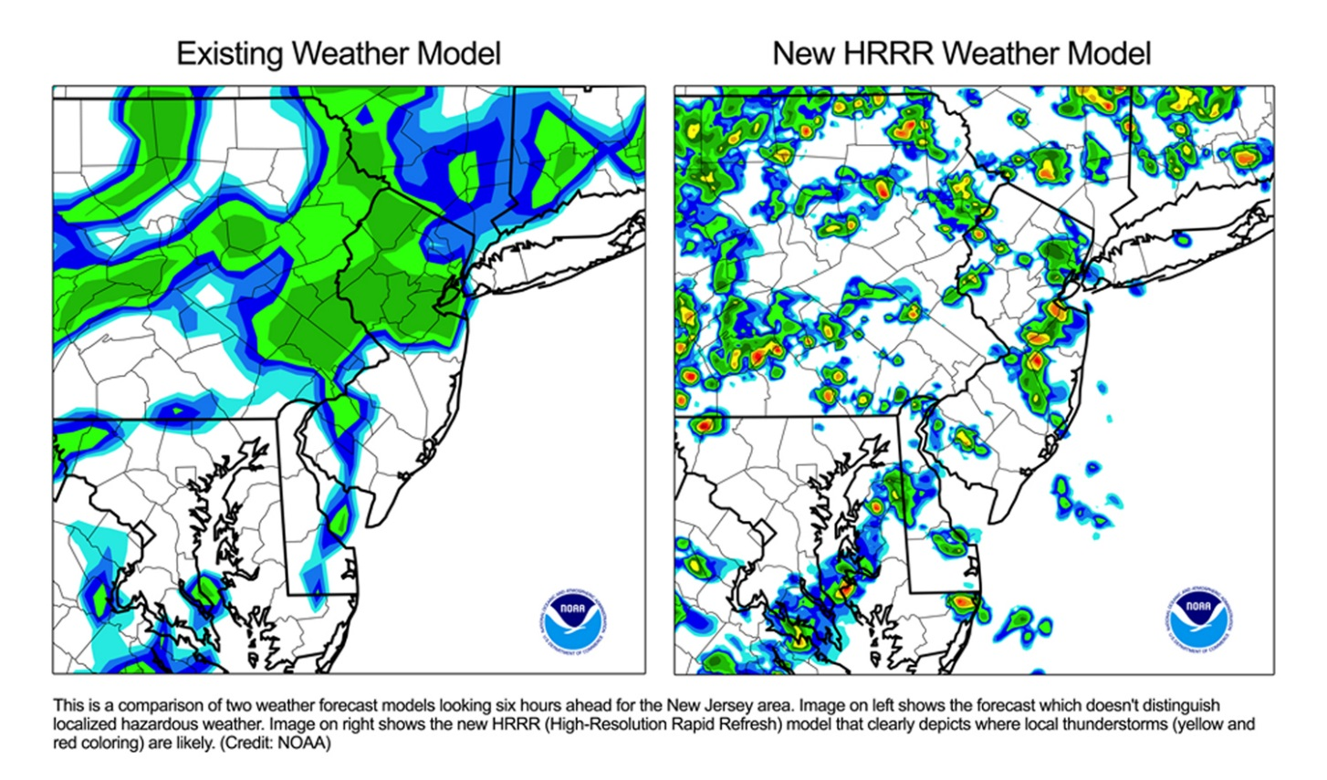
High Resolution Rapid Refresh (HRRR)
Operational HRRR maintained by NCEP
Nested WRF model with cloud resolving physics
15 hour forecast
15 min time step
Updates issued hourly
Preceded by RAP and RUC models
13 km grid spacing
3 km grid spacing
Variables of interest: Temperature at 2 m, u and v-wind at 10 m, relative humidity, specific humidity, precipitation rate, surface pressure, radiation

Slide 20
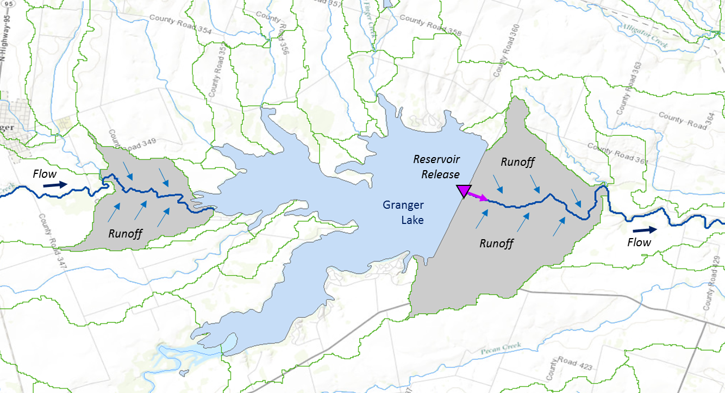
Muskingum
Method
RAPID River Routing Model
River Application for Parallel ComputatIon of Discharge
S_{prism} = KQ
S_{wedge} = KX (I – Q)
Computational Unit for Rivers
Forcing: Runoff and reservoir releases
NHDPlus Catchment
Flow
Legend
Dam
Junction
Catchment
http://rapid-hub.org/

Slide 21
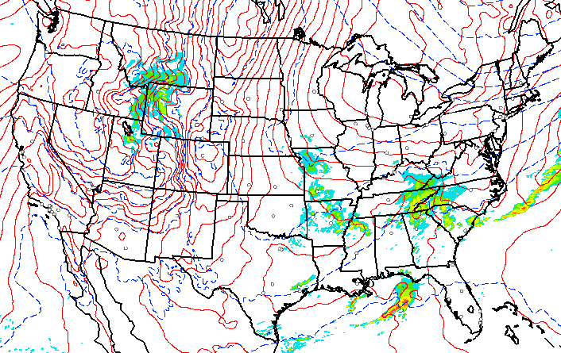
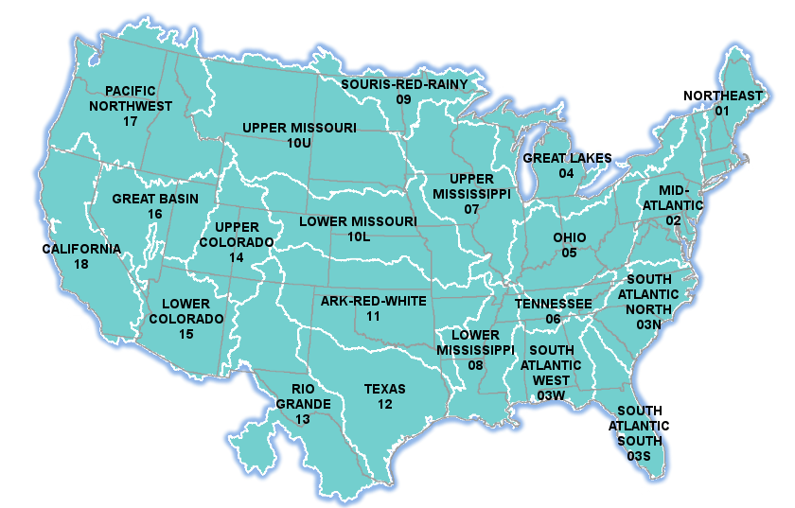
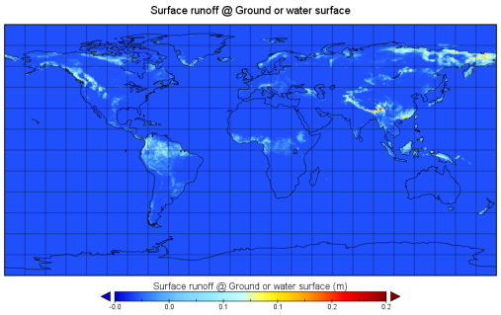
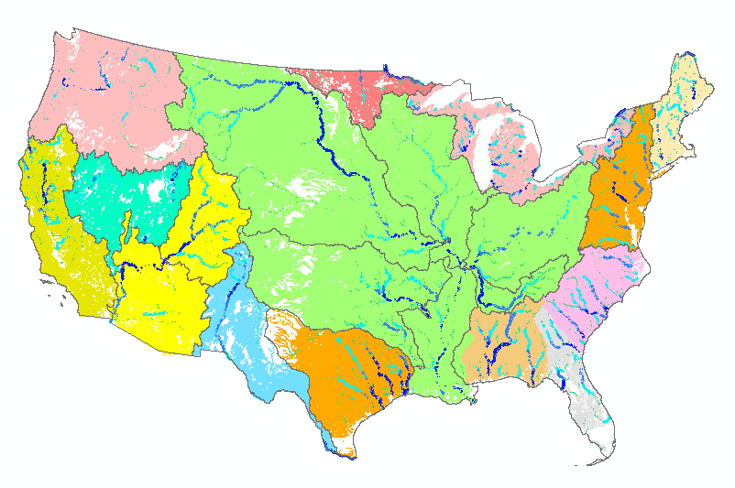
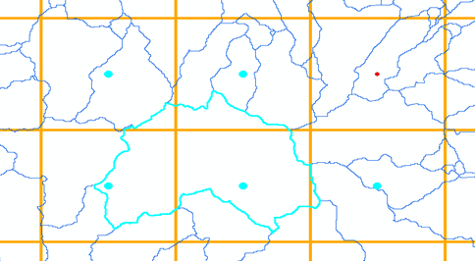
NFIE-Hydro – Flood Forecasting Models
HRRR
Forcing
NHDPlus
to RAPID
WRF-Hydro
ECMWF
TACC
Grid to
catchment

Slide 22
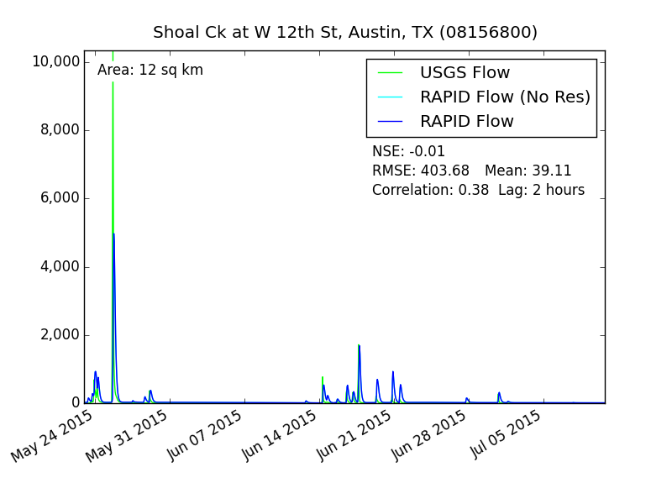
08156800 Shoal Ck at W 12th St Austin TX (12 SQ KM)

Slide 23
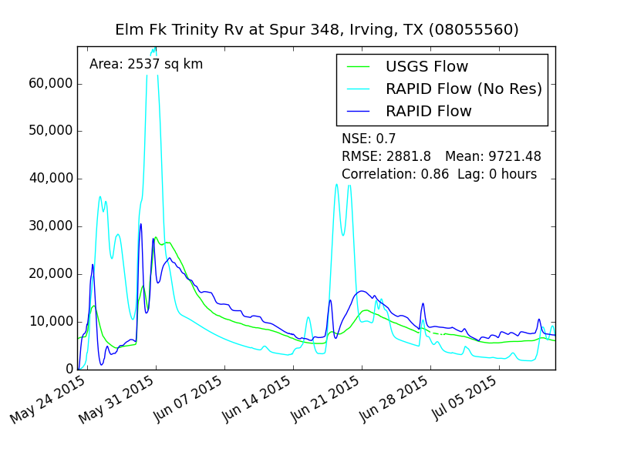
08055560 Elm Fk Trinity Rv at Spur 348, Irving, TX (2,537 SQ KM)

Slide 24
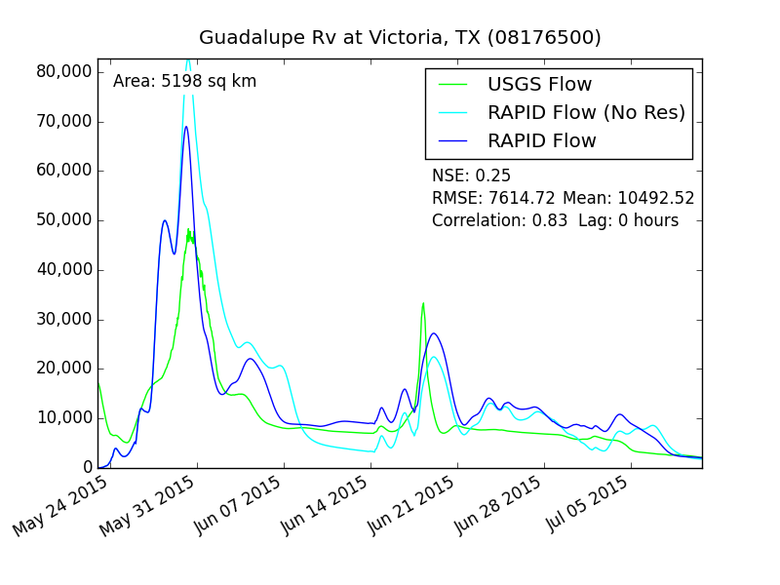
08176500 Guadalupe Rv at Victoria, TX (5,198 SQ KM)

Slide 25
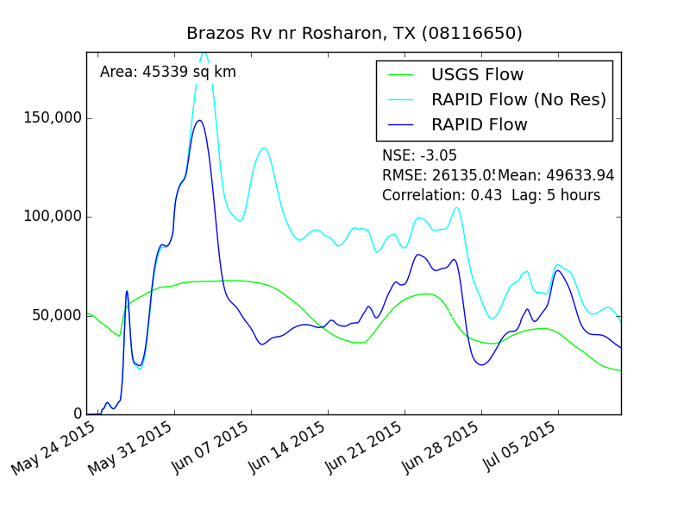
08116650 Brazos Rv nr Rosharon, TX (45,339 SQ KM)

Slide 26
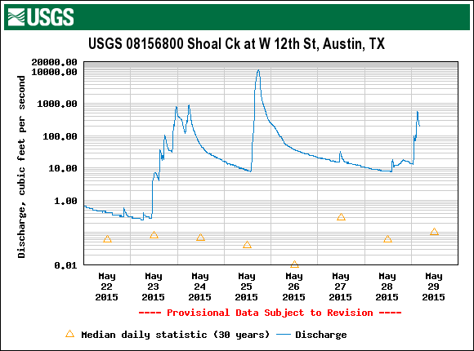
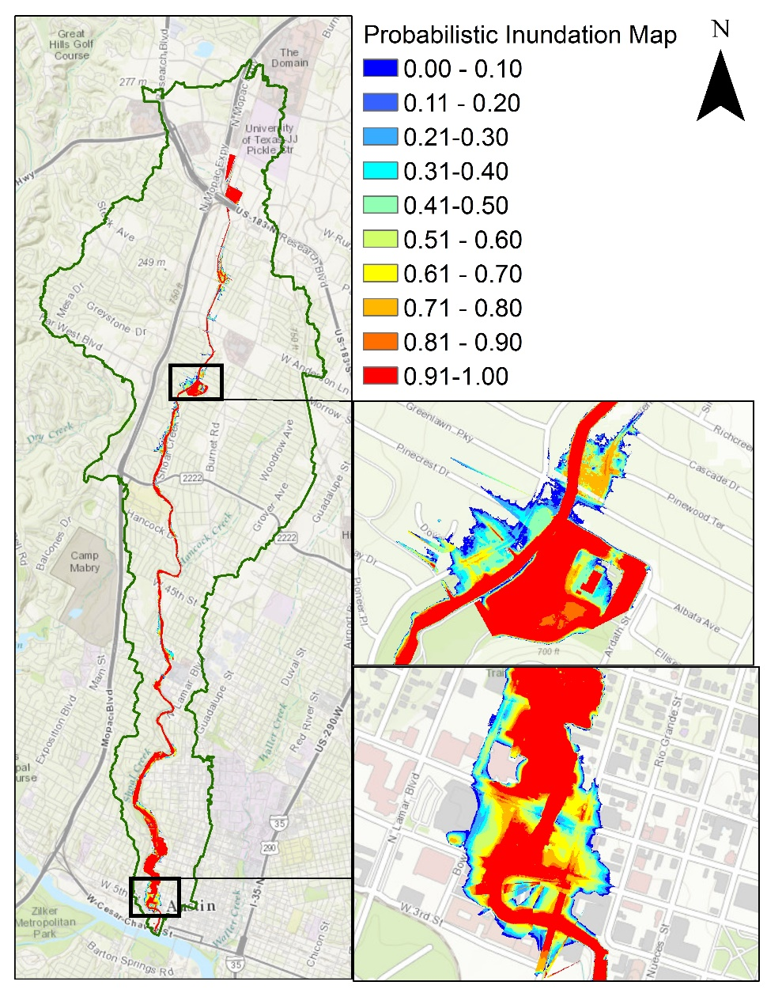
Probability of Flooding on Shoal Ck, Austin, Tx
HEC-RAS model
Rating curves library
ECMWF-RAPID flow forecasts
Deterministic flood maps
Probabilistic flood maps
Ensemble of 50 flood forecasts

Slide 27
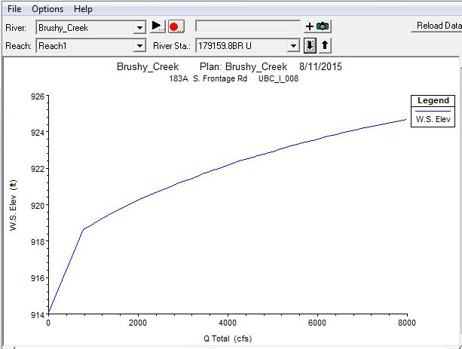
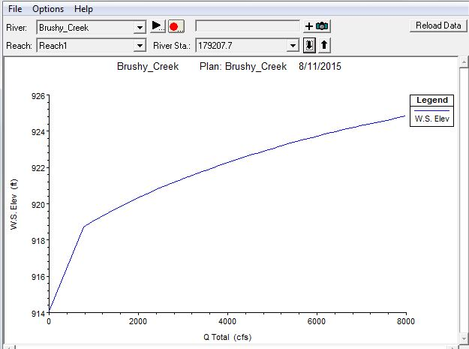
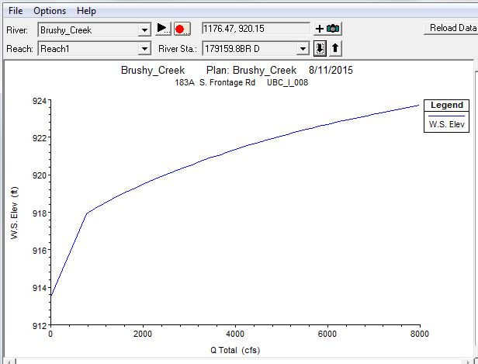
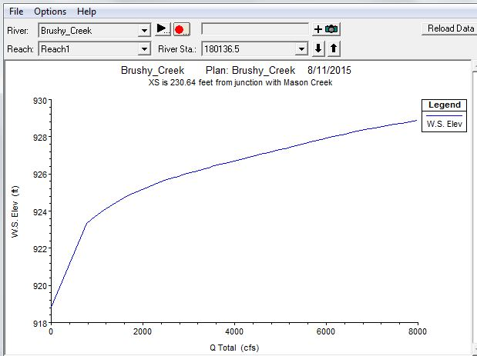
Rating Curve Library
50 profiles with flows ranging from the 2-500 year return period flood were used to create rating curves at each of the cross-sections in the Shoal Creek (299 XS), Onion Creek (266 XS), and Brushy Creek (798 XS) Models.
These are stored in a look up table and used to interpolate
water surface elevations from the ECMWF\RAPID flow forecast
Shoal Creek Plan Shoal Creek 8/17/2015

Slide 28
Inundation depth and probability rasters – Shoal Creek

Slide 29
Progression of Memorial Day Flood on Shoal Creek

Slide 30
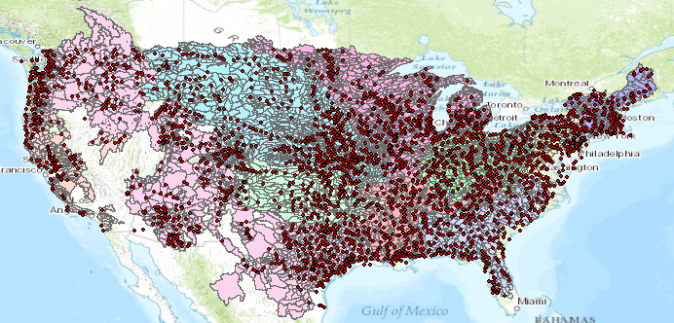
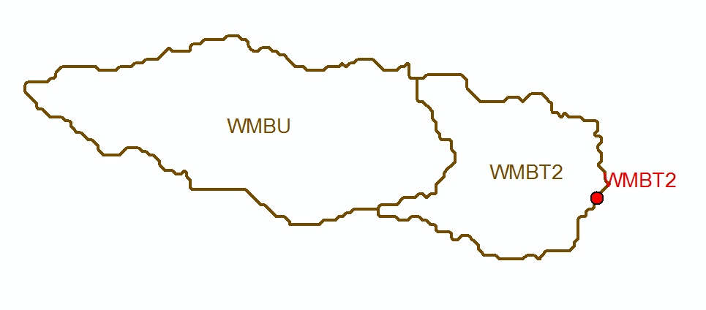
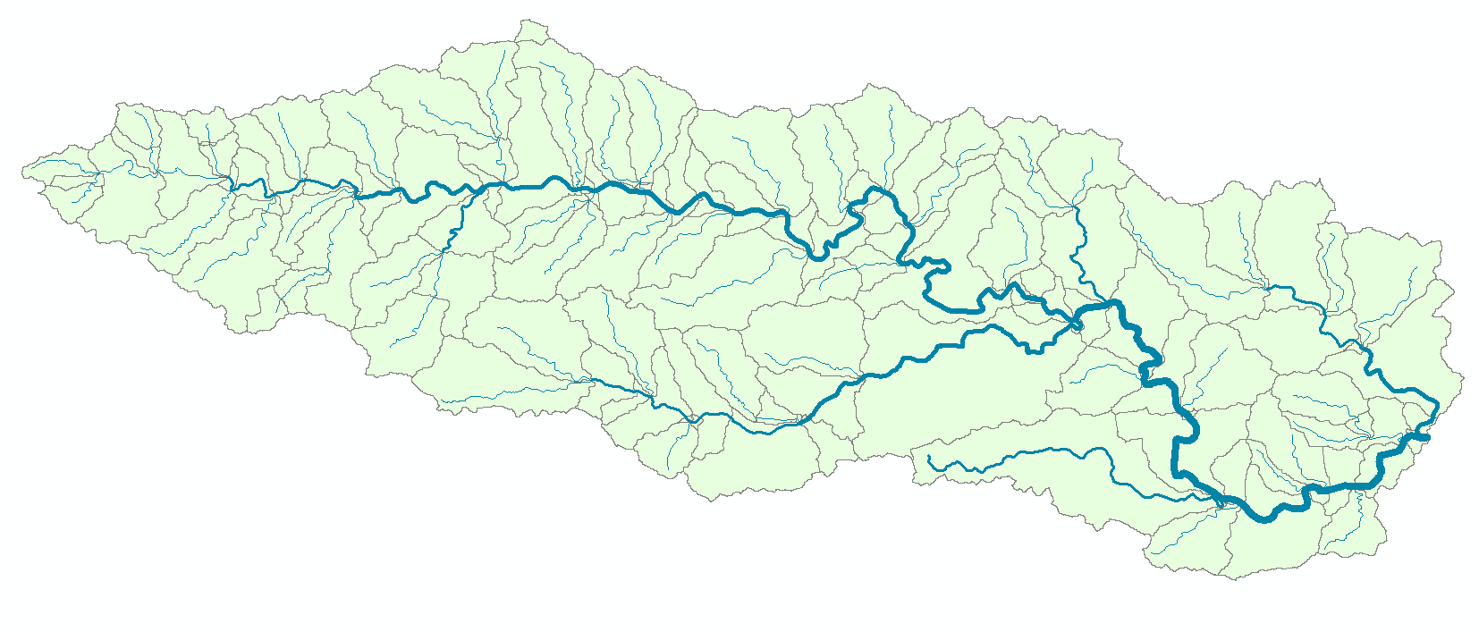
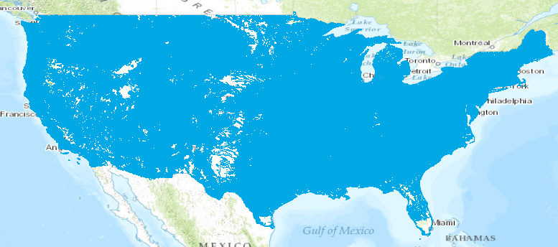
Current and NFIE Forecast Systems
Blanco River at Wimberley
Current: 6600 basins and 3600 forecast points
Two basins and one forecast point
Basin ~ 400 Sq Mile
becomes
NFIE: 2.7 million stream reaches and catchments
Reach Catchment ~ 1 Sq Mile
130 Catchments and Flowlines
uniquely labelled
A national flow network

Slide 31
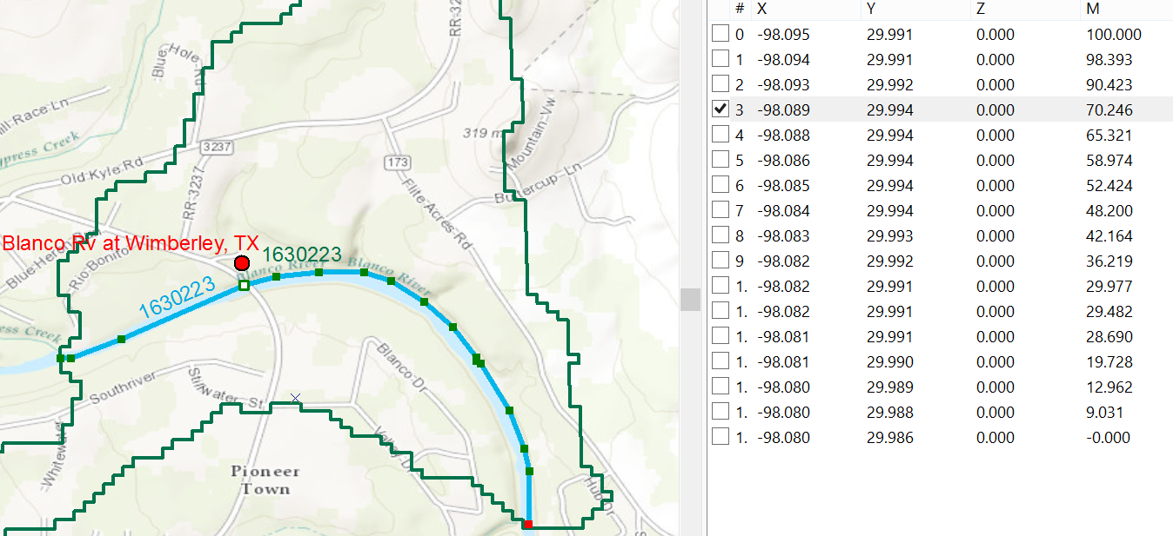
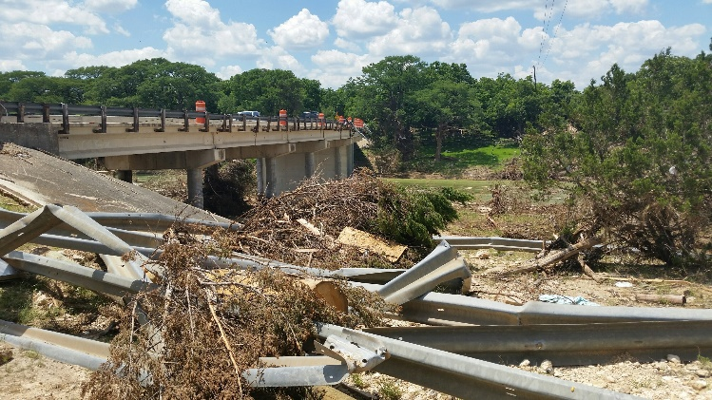
Linear Referencing on Flowlines
Using measures, the flow can be estimated at any point along the line
Bridge and Stream Gage at RR 12 is at Measure 70.246
on Flowline 1630223
Long.
Lat.
Measure
Measure is the % distance upstream from most downstream point on line

Slide 32
Next Step: National Water Prediction Model Configurations
WRF-Hydro IOC Configurations – May 2016
Analysis & Assimilation
Short-Range
‘Flood Prediction’
Medium Range
‘Flow Prediction’
Long Range
‘Water Resources’
Cycling Frequency
Hourly
3-Hourly
Daily
~Daily (x16)
Forecast Duration
- 3 hrs
0-2 days
0-10 days
0-30 days
Spatial Discretization & Routing
1km/250m/NHDPlus Reach
1km/250m/NHDPlus Reach
1km/250m/NHDPlus Reach
1 km/catchment /NHDPlus Reach
Meteorological Forcing
MRMS blend/ HRRR-NAM bkgnd.
Downscaled HRRR /RAP/NAM blend
Short-range + Downscaled GFS
Downscaled & bias-corrected CFS

Slide 33
NFIE Conceptual Framework
Worked Well
Needs Development
NFIE-Geo: National geospatial framework for hydrology
NFIE-Response: Community Flood Response System
NFIE-Hydro: National high spatial resolution hydrologic forecasting
NFIE-River: River channel information and real-time flood inundation mapping
NFIE-Services: Web services for flood information

Slide 34
Improvements in Flood Response Planning
Federal
GIS database and flood discharge forecasts
for 2.67 million stream reaches in
continental US from National Water Center
Conversion to water level forecasts and
inundation maps for 102,000 reaches in Texas
using 10m terrain data. Address points for flood
emergency response planning in each reach
State
Flood impact on transportation system
Flood response planning for stream reaches
and critical infrastructure. Inundation mapping
using LIDAR terrain data, if available.
Local
Flood response portal for citizens (ATXFlood)
Automated flood warnings from cell-phone
towers to phones in flood risk zones
Citizen

Slide 35
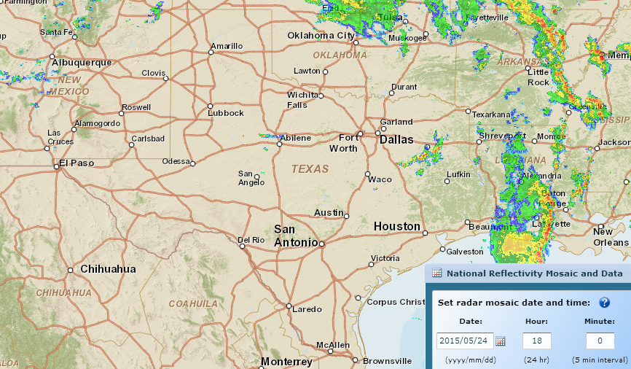
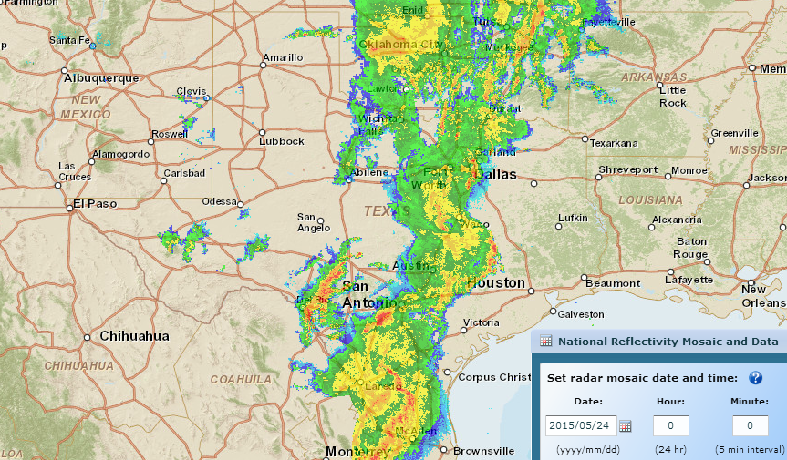
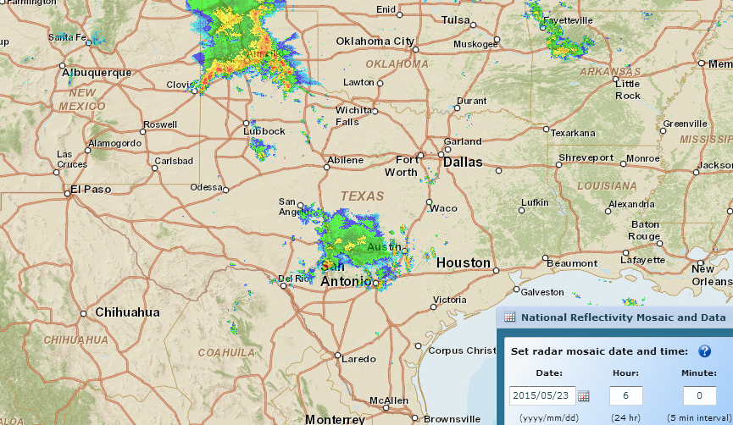
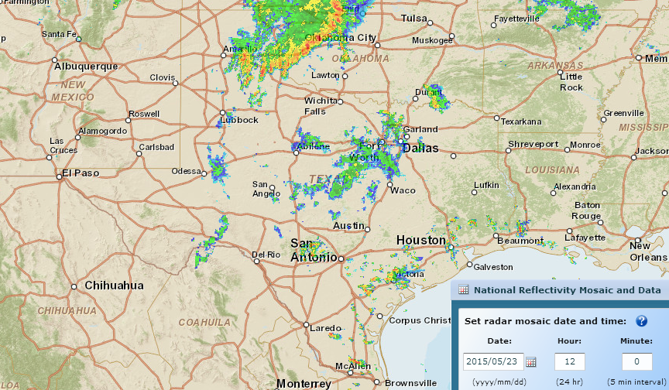
Storm Rainfall during Memorial Day Weekend
http://gis.ncdc.noaa.gov/map/viewer/#app=cdo&cfg=radar&theme=radar&display=nexrad
Where are the corresponding flood maps on the ground?
Sunday, May 24, Midnight
Sunday, May 24, 6 PM
Sunday, May 24, 6 AM
Saturday, May 23, 6 AM
Saturday, May 23, Midnight
Sunday, May 24, noon
Saturday, May 23, noon
Saturday, May 23, 6 PM

Slide 36
Memorial Day Weekend Precipitation
Total Precip.
(inches)

Slide 37
Flow in Blanco River at Wimberley
40 ft wall of water overwhelmed the gage

Slide 38
NFIE-Geo for Texas
NHDPlus reach catchment
Uniquely labeled across nation
102,000 NHDPlus reach catchments for Texas
Average area 7.1 km²
Average reach length 3 km

Slide 39
Flood Information for Fritz Hughes Park Rd
National Hydrography Dataset Plus
catchment for Bear Creek
(area = 5.71 km²)
Low water crossing at
3400 Fritz Hughes Park Rd

Slide 40
FEMA National Flood Hazard Layer in Texas (~ 120 counties)
Blanco County
Hidalgo County, Population 774,000
Cameron County Population 420,000

Slide 41
NWS Flood Inundation Maps for the US (130 in total)
33 maps in Texas (one quarter of total)

Slide 42
NWS Flood Inundation Maps in Texas
33 maps
12079 flood inundation extent polygons
1 ft or 0.5 ft intervals of elevation

Slide 43
Real-Time Flood Inundation Mapping (NWS/AHPS)
http://water.weather.gov/ahps2/inundation/inundation_google.php?gage=atit2

Slide 44
NWS Flood Inundation Map – Onion Creek at Highway 183 (ATIT2)

Slide 45
Flood Extent Map for each 1 ft of geodetic elevation (25 maps in all)

Slide 46
Flood Modeling: Geometry and Flow

Slide 47
Elevation-indexed flood mapping
Center Points of Reaches
Hays County
Map sequence for each point

Slide 48
River Hydraulic Properties
5781175
3
A table with reach hydraulic parameters as an addition to a geographic feature resource
5781175
4
A_{s}
Surface Area
Wetted Bed Area
L
V
Volume
A_{b}
T
$$A=\frac{V}{L}$$
A
Cross Section Area
Depth
h
P
P$=\frac{Ab}{L}$
Wetted Perimeter; Hydraulic Radius, R = A/P
T$=\frac{As}{L}$
Top Width

Slide 49
Solve 100 million equations each night
to check the effects of design changes
made during the day

Slide 50
SPRNT model computes flow and depth in large river networks using VLSI design concepts

Slide 51
CrossSections on Lower Mississippi River
173 cross-sections over 543 km, or 3.1 km between cross-sections, on average
41,479 cross-section points (x,y,z) of bed elevation, or 240 points per cross-section, on average

Slide 52
Elevation-Indexed Flood Response Mapping
Take blue line network, raise it and
flood it out, continue for increments
of elevation
Riverine
Mapping
Elevation-indexed flood
inundation mapping
Treat these
in a common way
Coastal
Mapping
Flood water surface elevation
modeling and forecasting
Inundation map library for each NHDPlus Reach
for coastal and riverine reaches

Slide 53
NFIE-GEO in CUAHSI HydroShare
A map resource on ArcGIS.com
URL: http://arcg.is/1JW0DBm
Each polygon links to a resource in HydroShare

Slide 54
NFIE-GEO for Texas-Gulf Coast Region
A ~130 MB Geodatabase file as a generic resource in HydroShare
5 Feature Classes
Usability limited to users with ArcGIS.
Need to have this become geographic feature resource in HydroShare in open format.
What hydro value added functionality is needed?
Visualization
Subsetting
Web feature services
Discovery

Slide 56
Terrain Analysis in CyberGIS

Slide 57
LIDAR Terrain Data Available from TNRIS

Slide 58
Situational Awareness For Everyone (SAFE)
Source: Jared Allen, NWS Austin-San Antonio Weather Forecast Office
Flood SAFE Viewer: http://arcg.is/1LPOHnE

Slide 59
SAFE Map for Blanco River near Wimberley, Tx
Source: Jared Allen, NWS Austin-San Antonio Weather Forecast Office
Blanco River Proof-of-concept Map: http://arcg.is/1GtObu3

Slide 60
Community Flood Response Map Book
Source: Tomas Rodriguez, City of Austin

Slide 63
Connecting with Local Decision Makers
Work with the first response community to define flood strategy for stream reaches
https://www.youtube.com/watch?v=ympaR6YUxiA&feature=youtube

Slide 64
Conclusions
The National Flood Interoperability Experiment has been a significant success in rapidly prototyping a high spatial resolution flood forecasting system
NHDPlus and Geospatial Hydrologic Framework provide the information foundation for the continental scale modeling
This is a “flow continuum” model on the national stream network, like atmospheric and ocean models
Need to synthesize riverine and coastal flood modeling and mapping
Similar Summer Institutes will be held in 2016 and 2017 at the National Water Center

