Slide 1
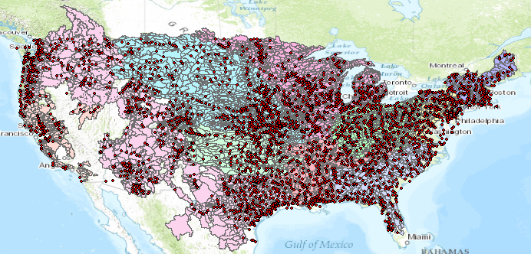
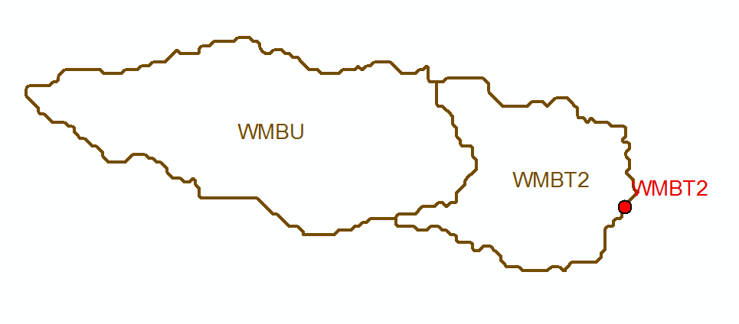
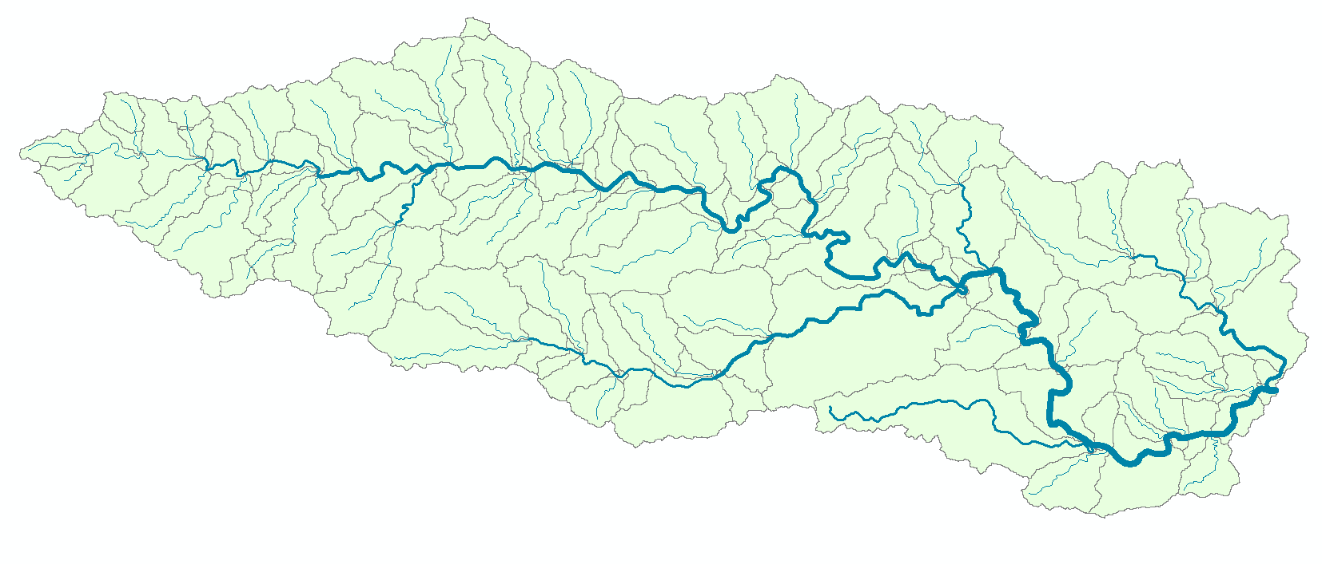
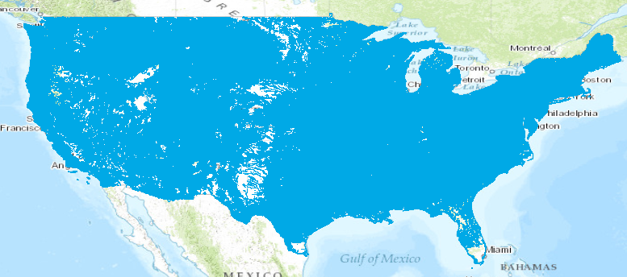
Current and NFIE Forecast Systems
Blanco River at Wimberley
Current: 6600 basins and 3600 forecast points
Two basins and one forecast point
Basin ~ 400 Sq Mile
becomes
NFIE: 2.7 million stream reaches and catchments
Reach Catchment ~ 1 Sq Mile
130 Catchments and Flowlines
uniquely labelled
A national flow network

Slide 2
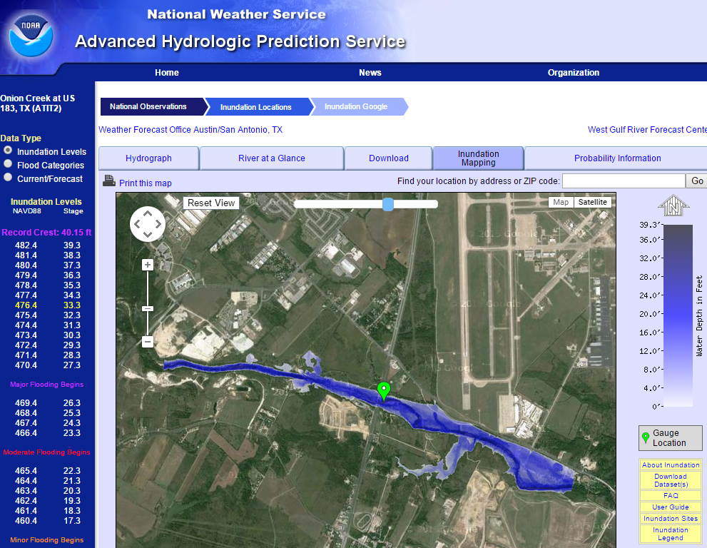
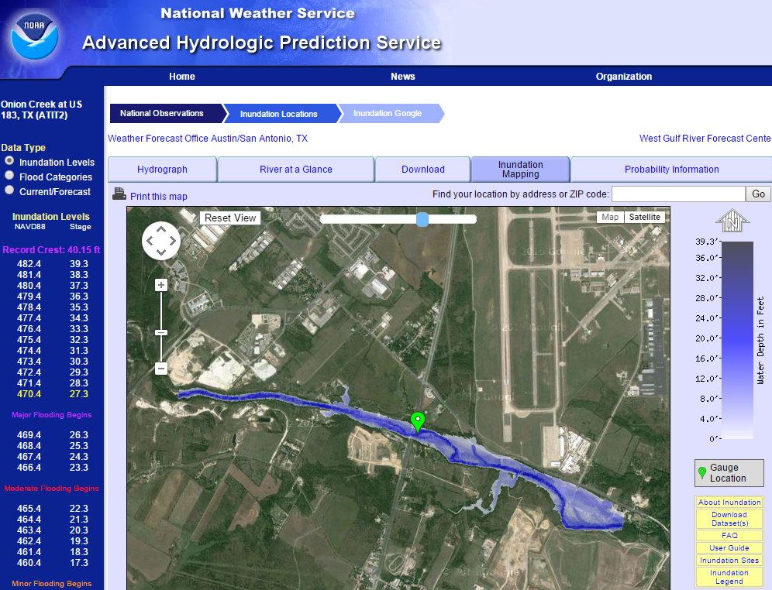
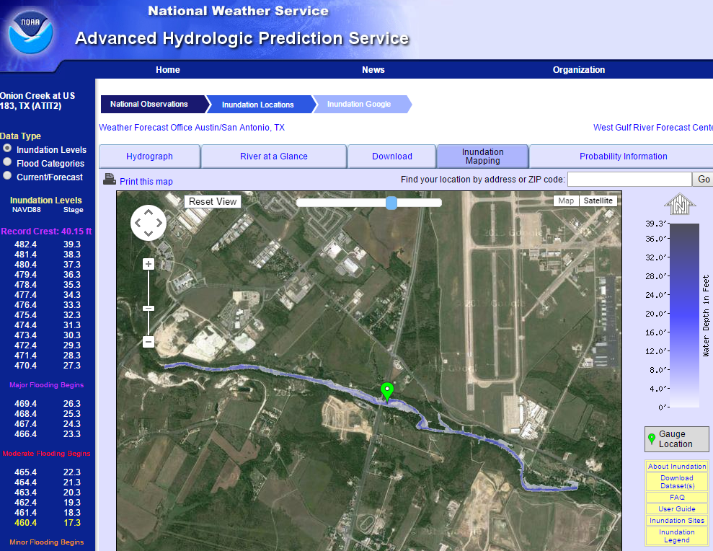
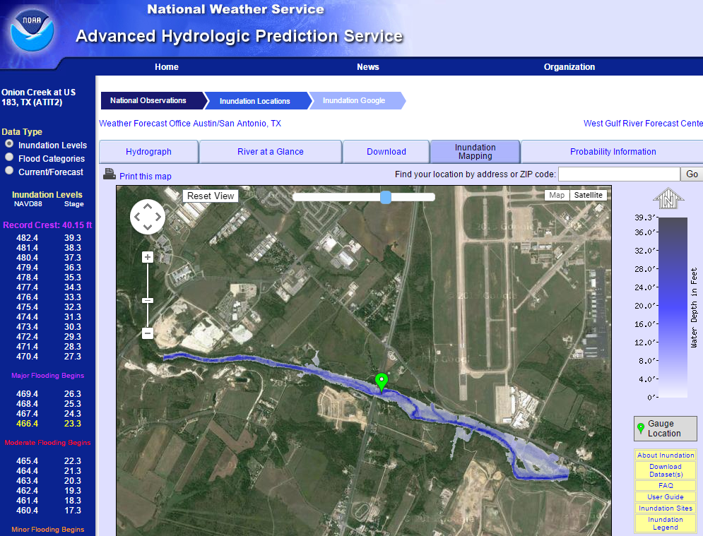

Real-Time Flood Inundation Mapping (NWS/AHPS)
http://water.weather.gov/ahps2/inundation/inundation_google.php?gage=atit2

Slide 3
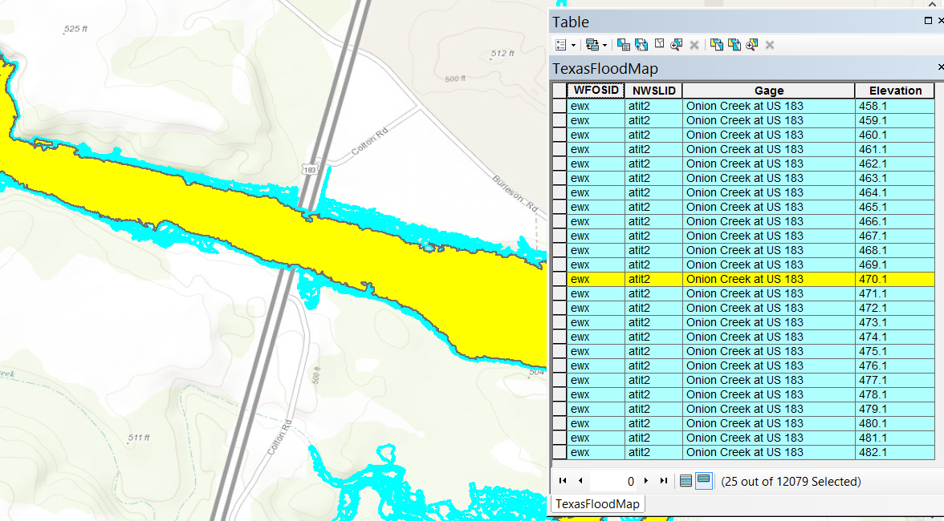
Flood Extent Map for each 1 ft of geodetic elevation

Slide 4
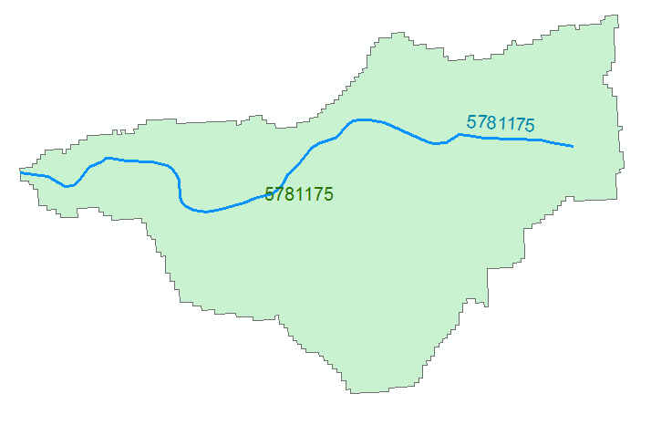




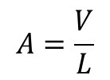
Reach Hydraulic Parameters
Comid | H | A | R | P | T | V | Ab | As
5781175 | 3
5781175 | 4
A_{s}
Surface Area
Wetted Bed Area
L
V
Volume
A_{b}
T
$$A=\frac{V}{L}$$
Cross Section Area
Depth
h
A
P
P$=\frac{Ab}{L}$
Wetted Perimeter
T$=\frac{As}{L}$
Top Width
R$=\frac{A}{P}$
Hydraulic Radius

Slide 5
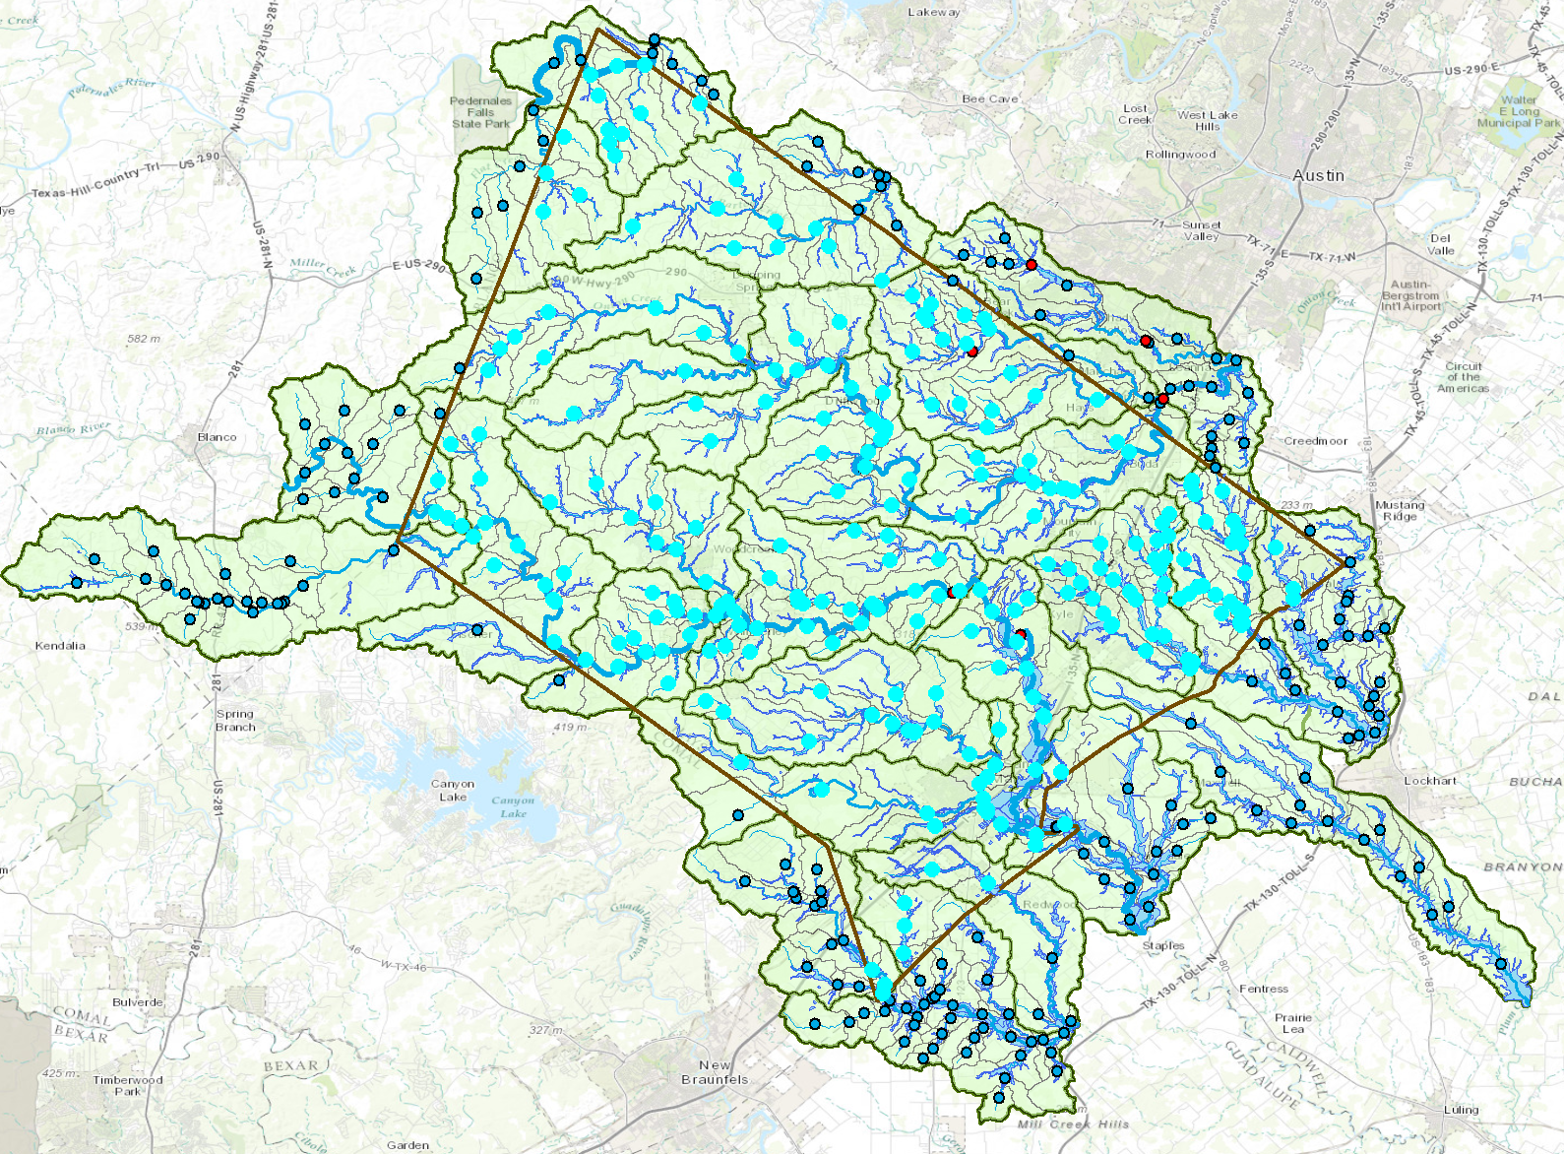
Real-Time Water Surface Elevation: Two Methods
Each reach has a center point and a flow forecast
(1) Establish a rating curve at center point and use this to convert flow, Q, to water depth, h, and water surface elevation
(2) Use the SPRNT model to compute both flow and depth
h
Rating Curve
Depth
h
Q
Forecast, Q

Slide 6
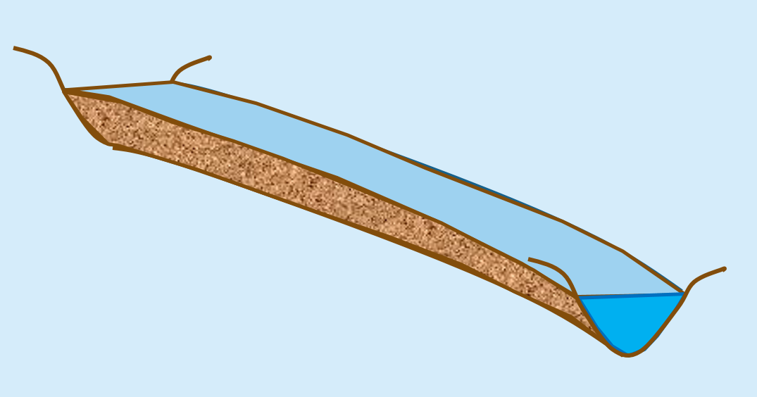
Elevation-Indexed Flood Response Mapping
Take blue line network, raise it and
flood it out, continue for increments
of elevation
Riverine
Mapping
Elevation-indexed flood
inundation mapping
Treat these
in a common way
Coastal
Mapping
Flood water surface elevation
modeling and forecasting
Inundation map library for each NHDPlus Reach
for coastal and riverine reaches

Slide 7
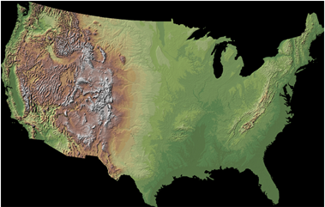
Combining NHD and NED to Define River Channel Geometry and Flood Extent

Slide 8
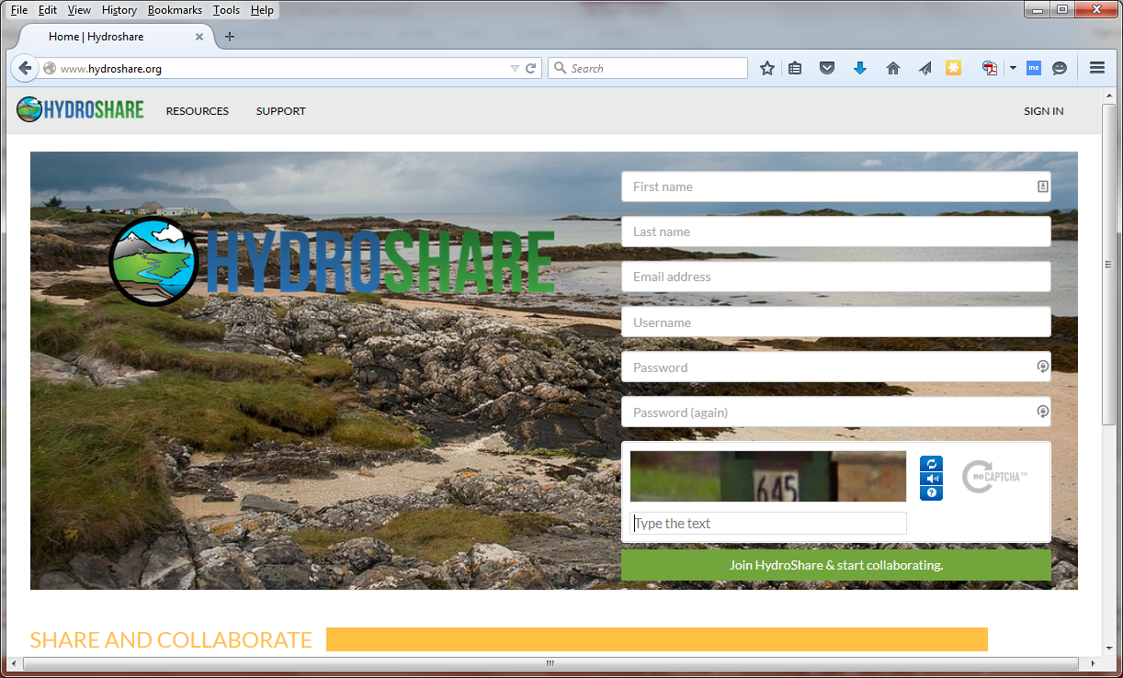


Web based collaboration environment
Being developed by partnership between USU, RENCI, BYU, UNC, UVA, CUAHSI, Tufts, Texas, Purdue, Caktus
OCI-1148453
OCI-1148090
2012-2017

Slide 9
At its heart, HydroShare is a system for sharing Resources and Collaborating
Files and sets of files structured to represent a hydrologic process, model, or element in the hydrologic environment
Standard data models enhance interoperability and support functionality “hydro value added”
Tools that act on resources to visualize, modify and create new resources
  Encode standard/best practices
Access control and sharing model

Slide 10
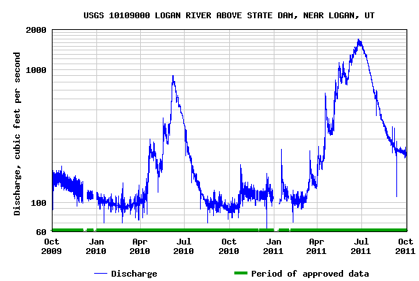
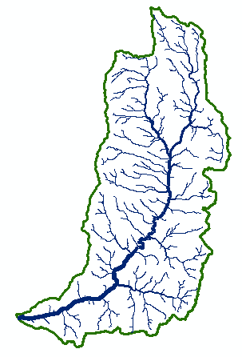
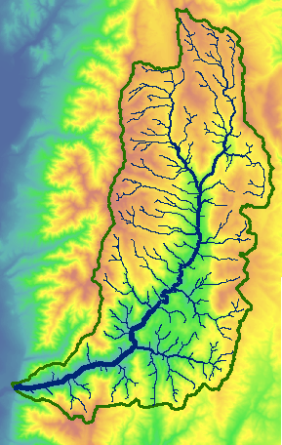

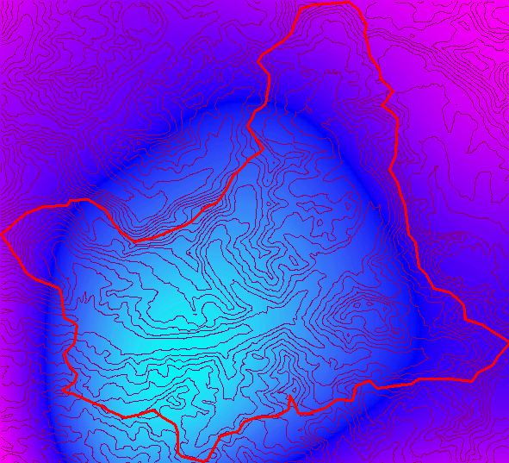
Types of data to support as resources
Resource Types
Generic ✓
Geographic Raster ✓
Time Series ✓
Multidimensional Space Time dataset ✓
Model program ✓
Model instance ✓
Referenced Time Series (CUAHSI HIS web service link)
Application
Geographic Feature set
River Geometry
Sample based observations (ODM2 and CZO)
Model component
Composite resources
t
y
x

Slide 11
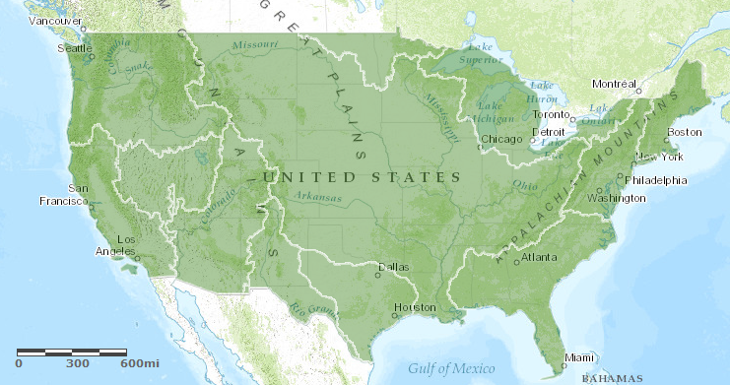
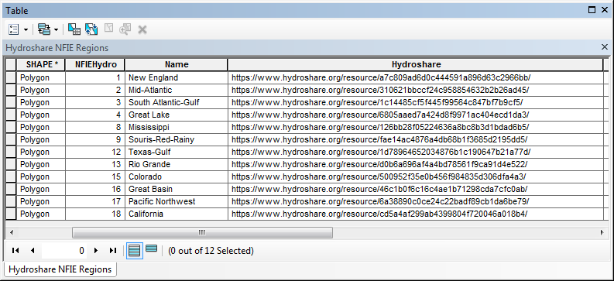
NFIE-GEO
A map resource on ArcGIS.com
URL: http://arcg.is/1JW0DBm
Each polygon links to a resource in HydroShare

Slide 12
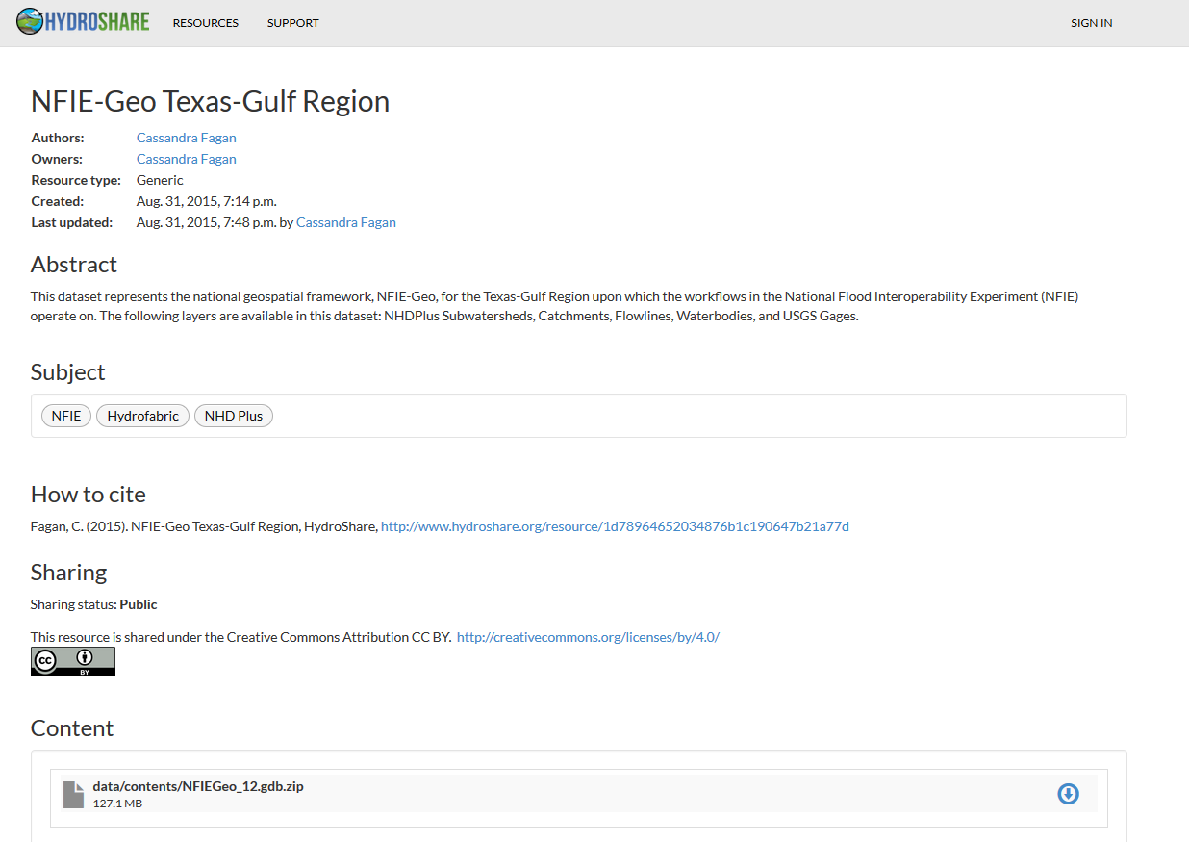
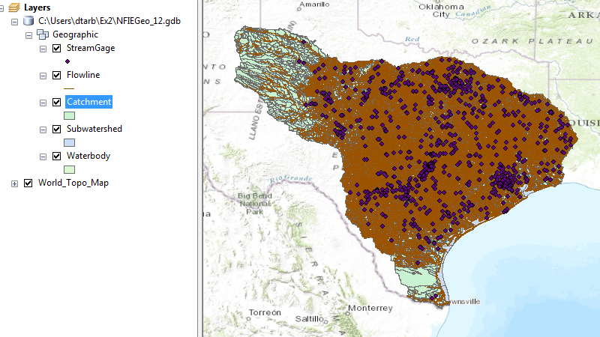
NFIE-GEO Region
A ~130 MB Geodatabase file as a generic resource in HydroShare
5 Feature Classes
Usability limited to users with ArcGIS.
Need to have this become geographic feature resource in HydroShare in open format.
What hydro value added functionality is needed?
  Visualization
  Subsetting
  Web feature services
  Discovery

Slide 13



River Hydraulic Properties
Comid | H | A | R | P | T | V | Ab | As
5781175 | 3
5781175 | 4
A table with reach hydraulic parameters as an addition to a geographic feature resource
This may be derived from LIDAR using an automated tool or HEC RAS cross sections
A_{s}
Surface Area
Wetted Bed Area
L
V
Volume
A_{b}
T
$$A=\frac{V}{L}$$
Cross Section Area
Depth
h
A
P
P$=\frac{Ab}{L}$
Wetted Perimeter
T$=\frac{As}{L}$
Top Width
R$=\frac{A}{P}$
Hydraulic Radius

Slide 14
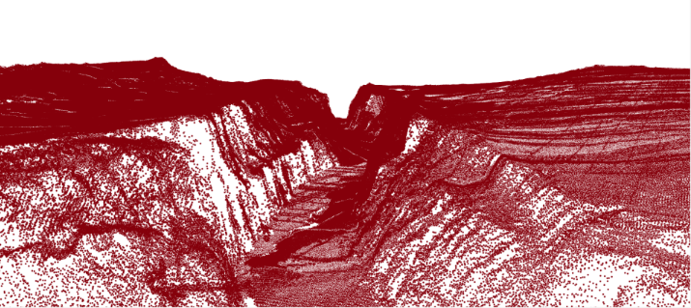
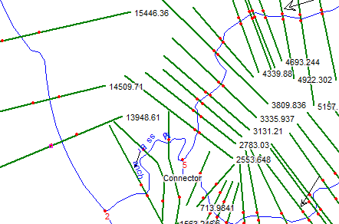
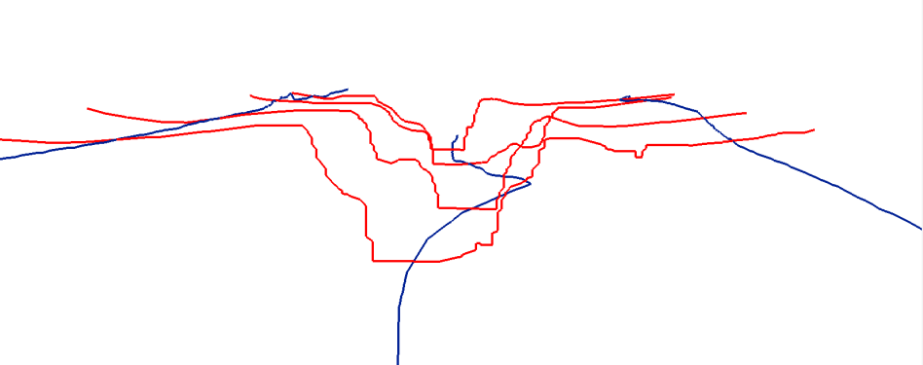
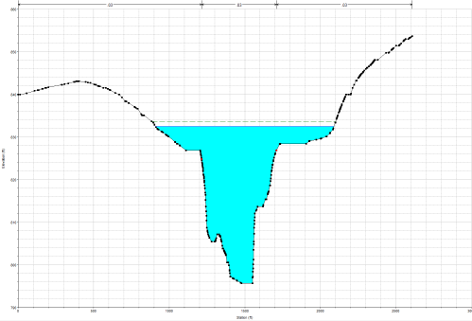
Representing River Geometry in HydroShare
LiDAR
Cross Sections Attached to River Network
Cross Sections
Hydraulic Calculations

Slide 15
DEM Based Flood Plain Mapping
Each reach has a water depth h_{w} from SPRNT
Each reach has an ID
Each grid cell has the ID of the reach it connects to and the height above the stream h_{s}
Flood extent is “rapidly” mapped as
  If(h_{w}(id) > h_{s}(id))
    Inundation depth = h_{w}(id) - h_{s}(id)
  Else
    Inundation depth = 0

Slide 16
Example
Reach and Watershed id
Height above nearest stream raster h_{s}
h_{w}(1) = 1.5
h_{w}(2) = 2.5
h_{w}(3) = 3.5
Notes:
Elevations are filled to that of the pools pour point

Slide 17
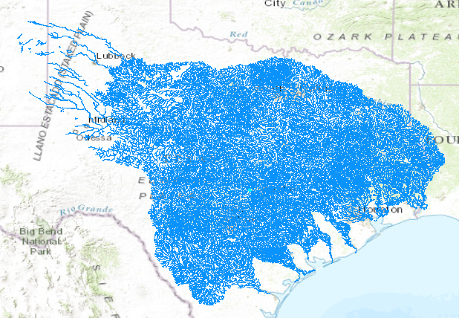
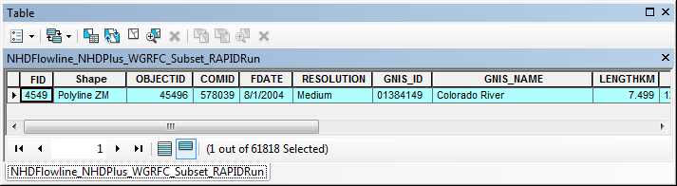

Slide 18
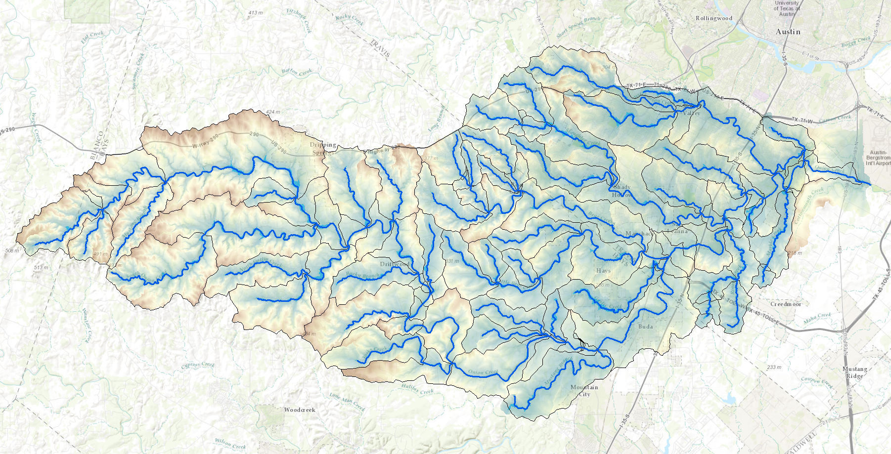
Drop to Stream from TauDEM for Onion Creek

Slide 19
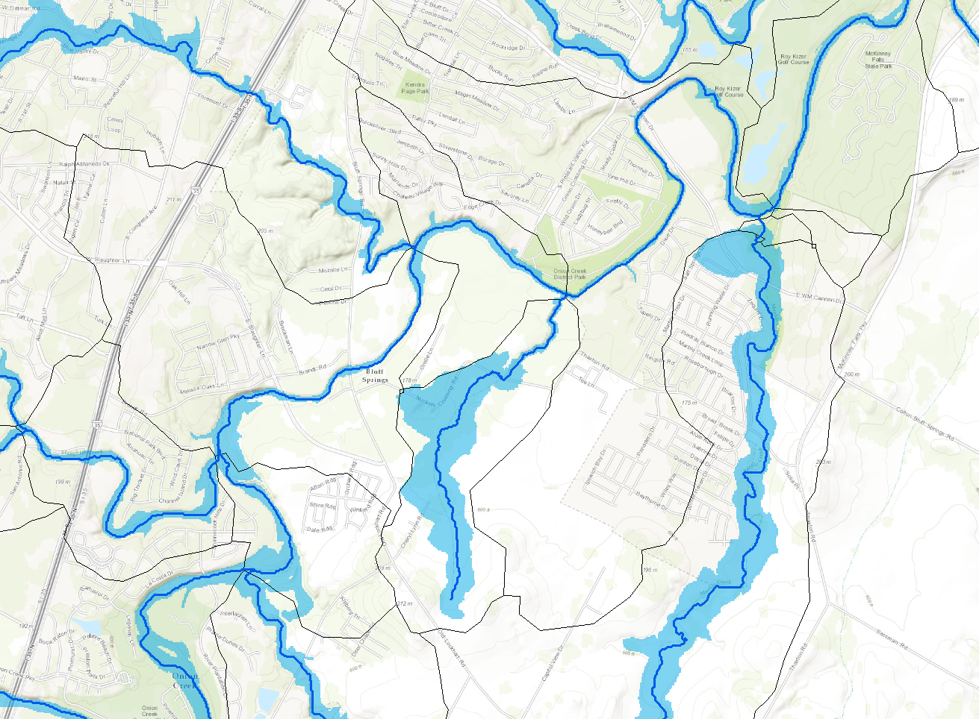
Inundation for DTS < 4m

Slide 20
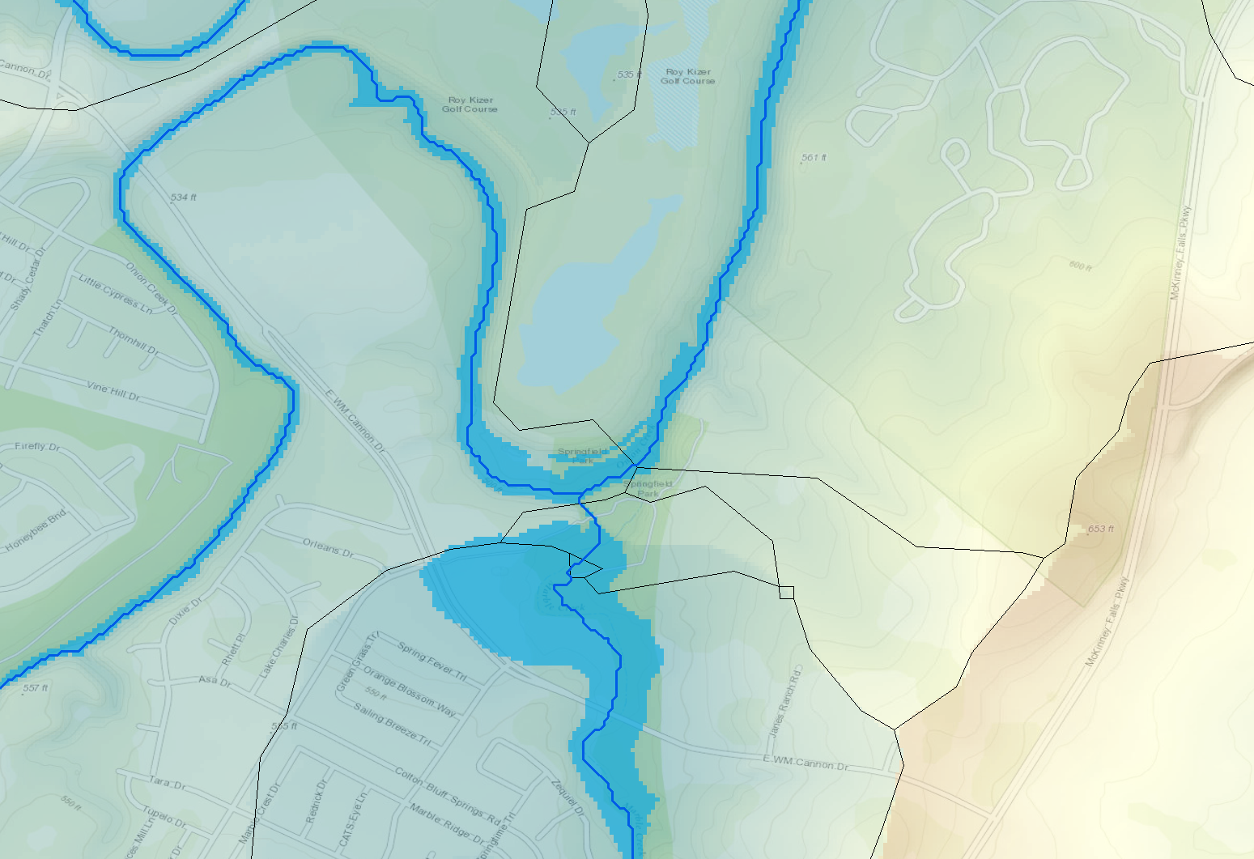
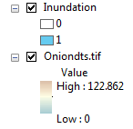
Drop to stream and inundation (DTS < 2 m)

Slide 21
Notes
Based on 1/3 arc sec National Elevation Dataset (pit filled)
Drop to stream used Dinfinity average (could modify to shortest distance)
Thresholding based on catchment not (yet) implemented

