Slide 1
Extending ArcGIS using programming
David Tarboton

Slide 2
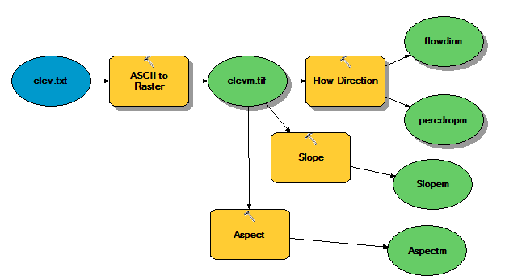
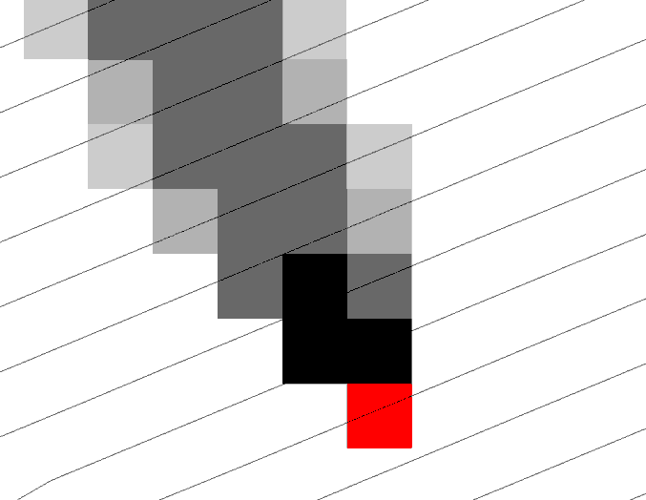
Why Programming
Automation of repetitive tasks (workflows)
Implementation of functionality not available (programming new behavior)

Slide 3
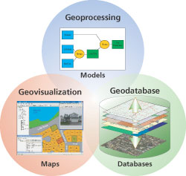
Three Views of GIS
Geodatabase view: Structured data sets that represent geographic information in terms of a generic GIS data model.
Geovisualization view: A GIS is a set of intelligent maps and other views that shows features and feature relationships on the earth's surface. "Windows into the database" to support queries, analysis, and editing of the information.
Geoprocessing view: Information transformation tools that derive new geographic data sets from existing data sets.
adapted from www.esri.com

Slide 4
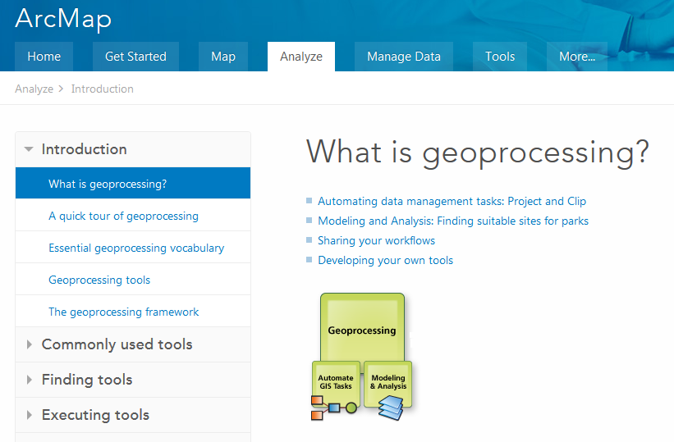
ArcMap Geoprocessing Help
http://desktop.arcgis.com/en/desktop/latest/main/analyze/what-is-geoprocessing.htm

Slide 5
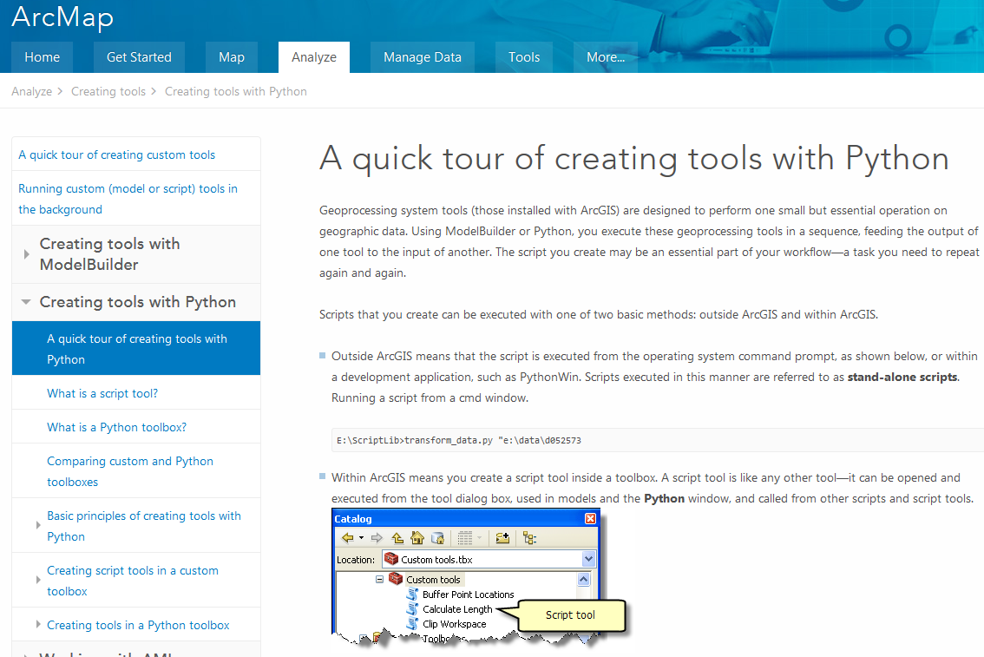
http://desktop.arcgis.com/en/desktop/latest/analyze/creating-tools/a-quick-tour-of-creating-tools-in-python.htm

Slide 6
ArcGIS programming options
Model builder
Python scripting environment
ArcObjects library (for system language like C++, .Net)
AML
Open standard data formats that anyone can use in programs (e.g. shapefiles, geoTIFF, netCDF)

Slide 7
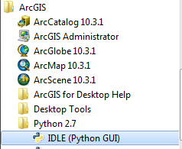
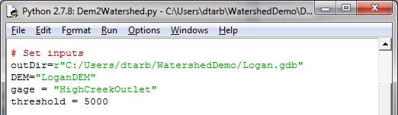
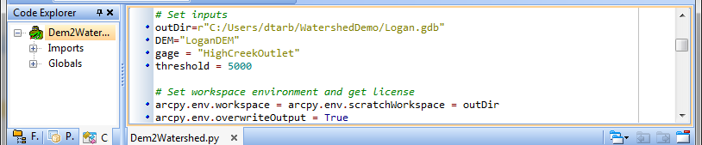
Python Environments
Idle: Simple editor that is part of Python
PyScripter: Suggested by an ESRI programmer http://blogs.esri.com/esri/arcgis/2011/06/17/pyscripter-free-python-ide/
PyCharm: Powerfull professional development environment, https://www.jetbrains.com/pycharm/

Slide 8
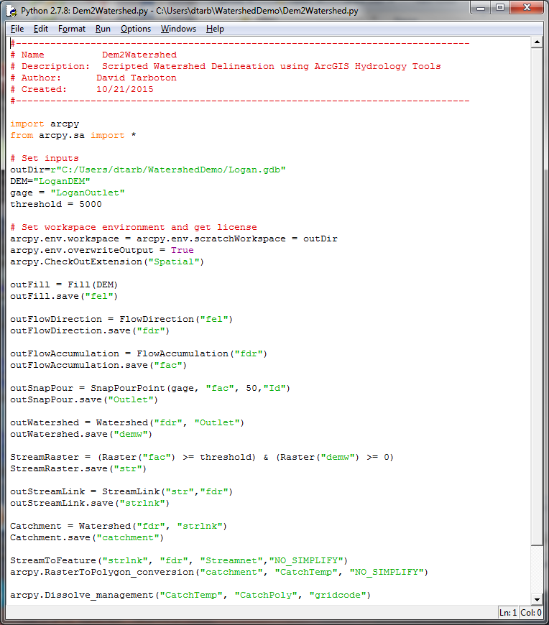
Example – Watershed delineation using Python
(Steps from Exercise 4)
Set Inputs
  DEM
  Outlet
  Threshold
Set workspace
Fill
Flow Direction
Flow Acumulation
Snap Outlet
Watershed
Stream Raster
Stream Link
Catchment
Vector Conversion
1
2
3
4
5
6
7
8
9
10
11

Slide 9
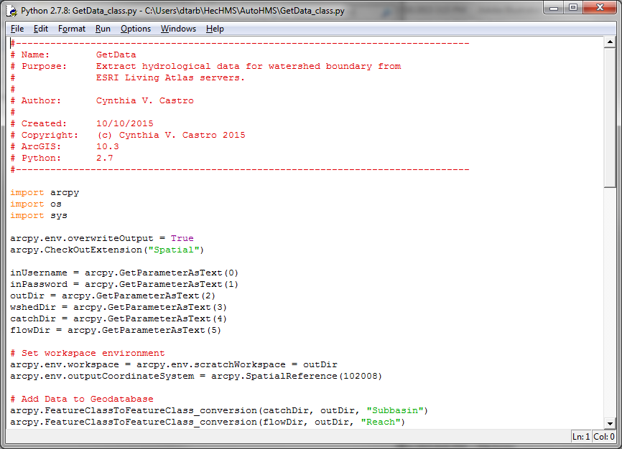
Example – Get Data for HEC HMS from Cyndi Castro

Slide 10
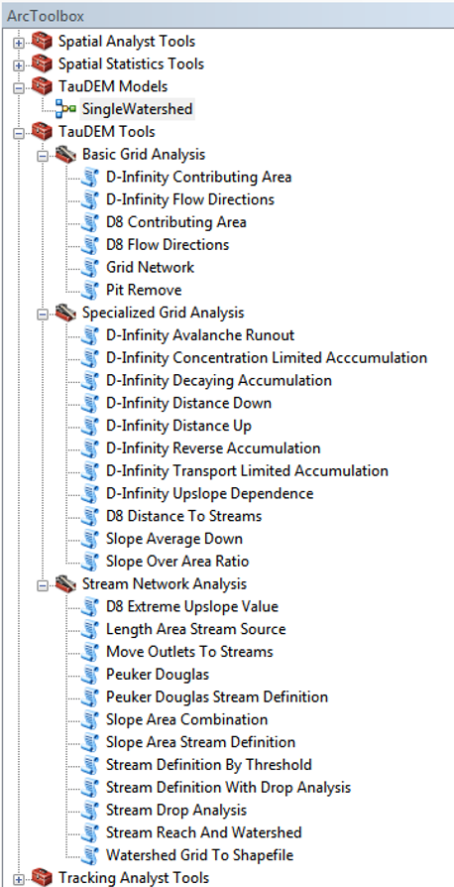
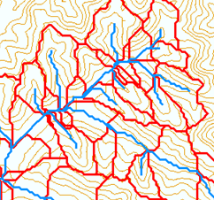
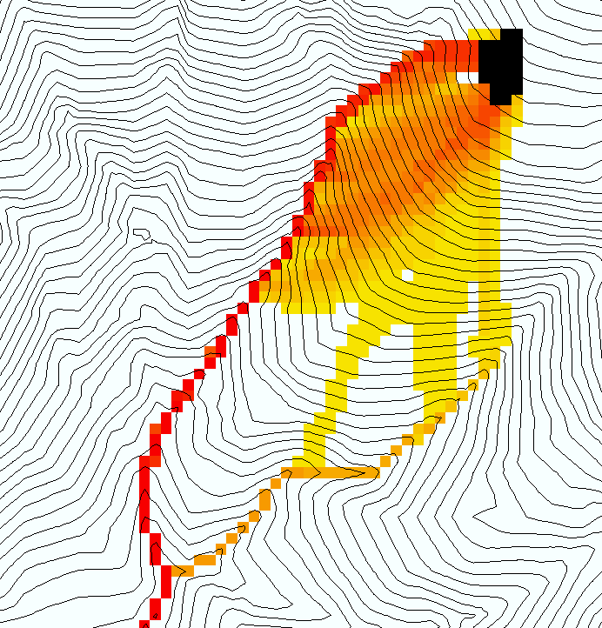
TauDEM
Stream and watershed delineation
Multiple flow direction flow field
Calculation of flow based derivative surfaces
MPI Parallel Implementation for speed up and large problems
Open source platform independent C++ command line executables for each function
Deployed as an ArcGIS Toolbox with python scripts that drive command line executables
http://hydrology.usu.edu/taudem/

Slide 11
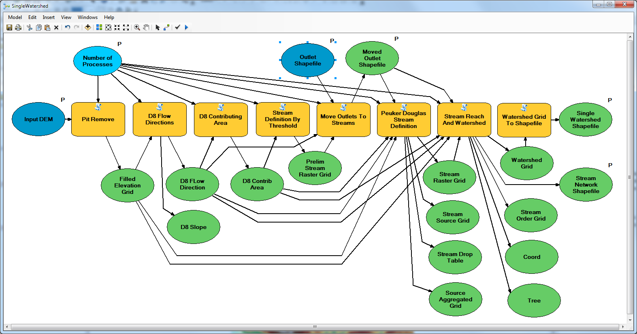
Model Builder Model to Delineate Watershed using TauDEM tools

Slide 12
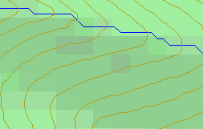
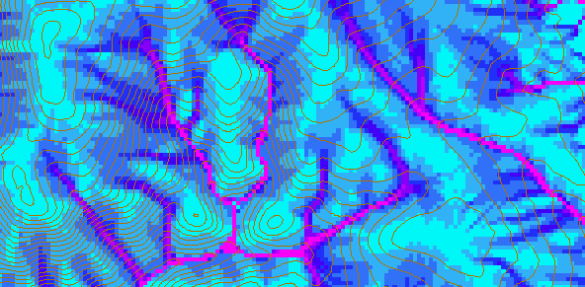
D-Infinity Contributing Area
D8
D∞
Tarboton, D. G., (1997), "A New Method for the Determination of Flow Directions and Contributing Areas in Grid Digital Elevation Models," Water Resources Research, 33(2): 309-319.)
Notes:
This slide shows how the terrain flow field is represented. Early DEM work used a single flow direction model, D8. In 1997 I published the Dinfinity method that proportions flow from each grid cell among downslope neighbors. This, at the expense of some dispersion, allows a better approximation of flow across surfaces.

Slide 13
Pseudocode for Recursive Flow Accumulation
Global P, w, A, Δ FlowAccumulation(i) for all k neighbors of i if P_{ki}>0 FlowAccumulation(k) next k return
P_{ki}

Slide 14
Generalization to Flow Algebra
Replace
P_{ki}
P_{ki}
P_{ki}
i
by general function

Slide 15
Example: Retention limited runoff generation with run-on
Global P, (r,c), q FlowAlgebra(i) for all k neighbors of i if P_{ki}>0 FlowAlgebra(k) next k return
q_{k}
r
q_{i}
c

Slide 16
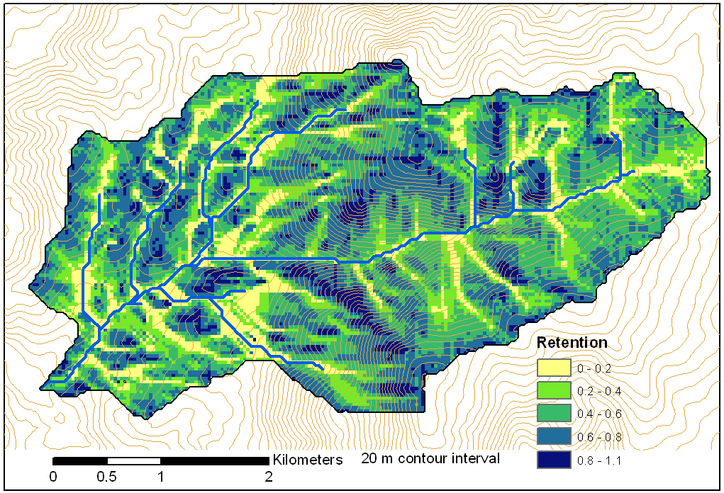
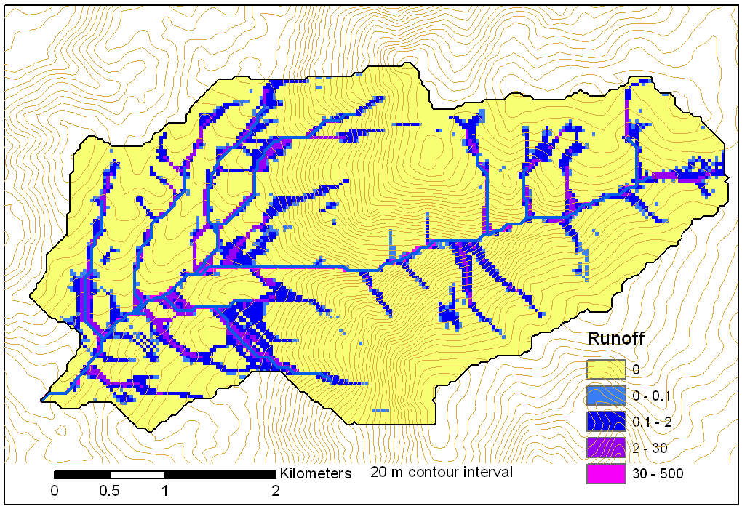
Retention limited runoff with run-on
Retention Capacity
A
C
r=5
c=6
q_{in}=1.8
q=0.8
r=7
c=4
q=3
0.6
1
Runoff from uniform input of 0.25
r=4
c=6
q=0
0.4
r=4
c=5
q_{in}=2
q=1
1
B
D
Notes:
Figure 2 illustrates the evaluation of infiltration capacity limited runoff generation with run on according to (5). Inputs are the r and c values indicated, with the proportional flow directions indicated by the arrows. Grid cells A and B on the left have no dependencies so may be immediately evaluated and using min(r-c,0) result in q=3 and 0 for grid cells A and B respectively. With these evaluated, the unevaluated dependencies of grid cell C become 0, so equation (5) can be evaluated for grid cell C. The inflow is q_{in}=0.6 x 3 = 1.8 from grid cell B. Then q=min(5-6+1.8,0)=0.8. Now all dependencies of D have been evaluated. Inflows from cells A, B, and C, accounting for the proportions are 3 x 0.4 + 0.8 = 2, so the runoff from D is q=min(4-5+2,0)=2.

Slide 17
Useful for a tracking contaminant or compound subject to decay or attenuation

Slide 18
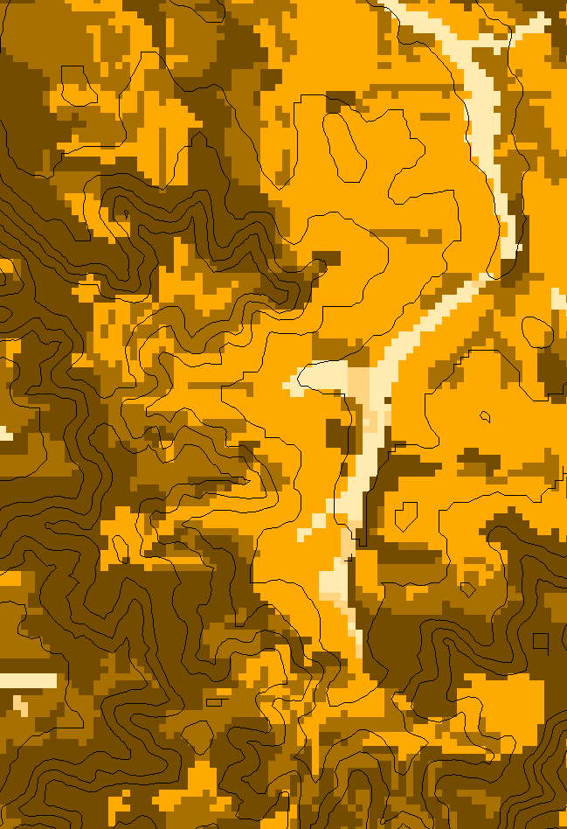
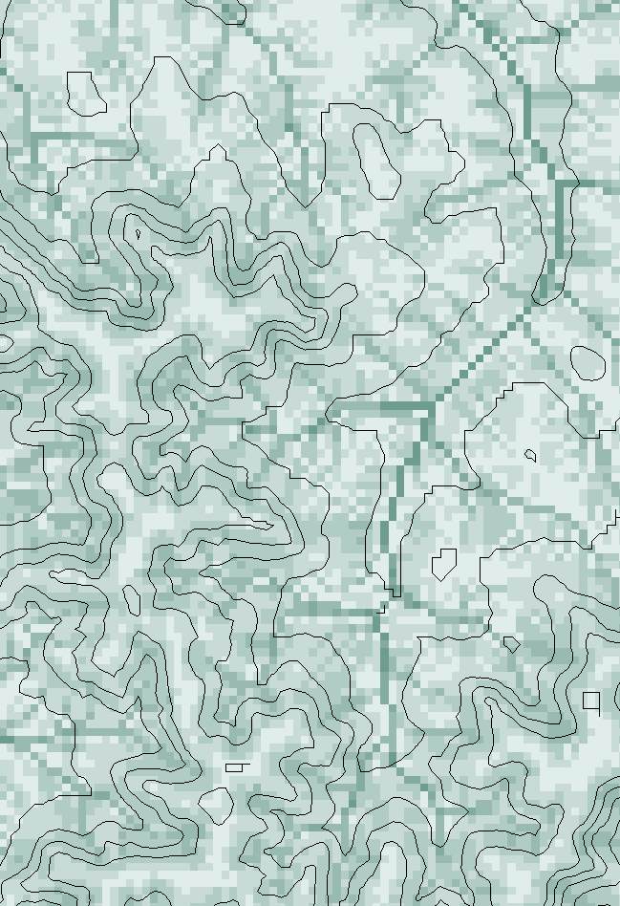
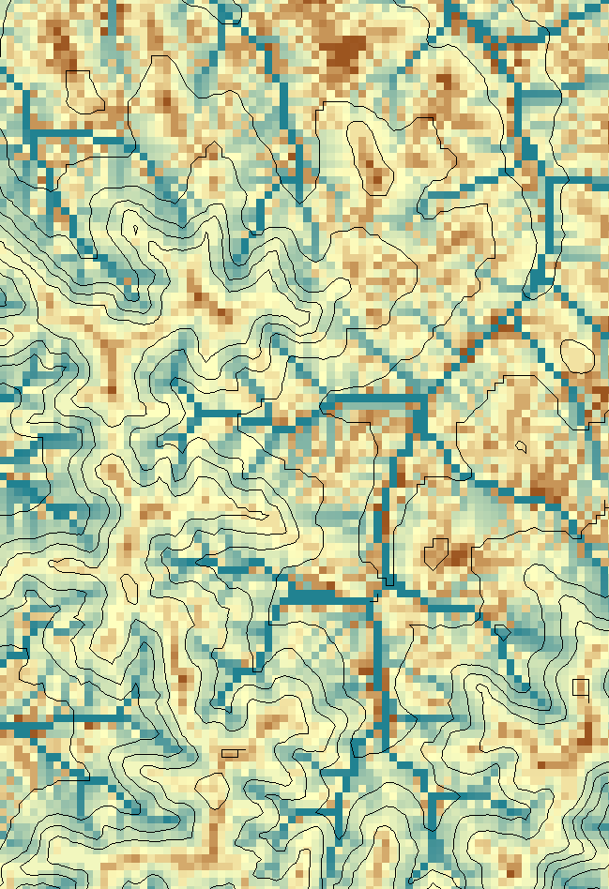
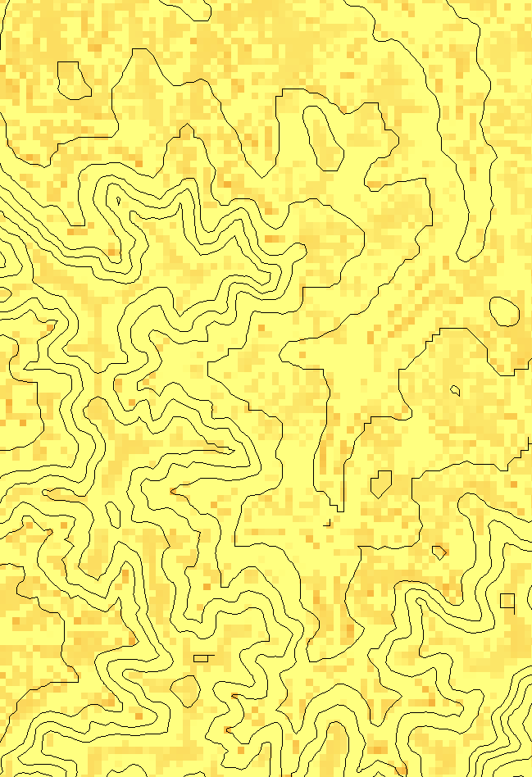
Transport limited accumulation
Supply
Capacity
Transport
Deposition
S
T
=
χa
2
tan(
b
)
2
T
=
min{
S
+
∑
T
,
T
}
D
=
S
+
∑
T
−
T
cap
out
in
cap
in
out
Useful for modeling erosion and sediment delivery, the spatial dependence of sediment delivery ratio and contaminant that adheres to sediment
Flow Algebra provides a general modeling framework for static flow field based geospatial concepts

Slide 19
General Pseudocode Downstream Flow Algebra Evaluation
Global P, γ, θ FlowAlgebra(i) for all k neighbors of i if P_{ik}>0 FlowAlgebra(k) next k θ_{i} = FA(γ_{i}, P_{ik}, θ_{k}, γ_{k}) return
P_{ki}

Slide 20
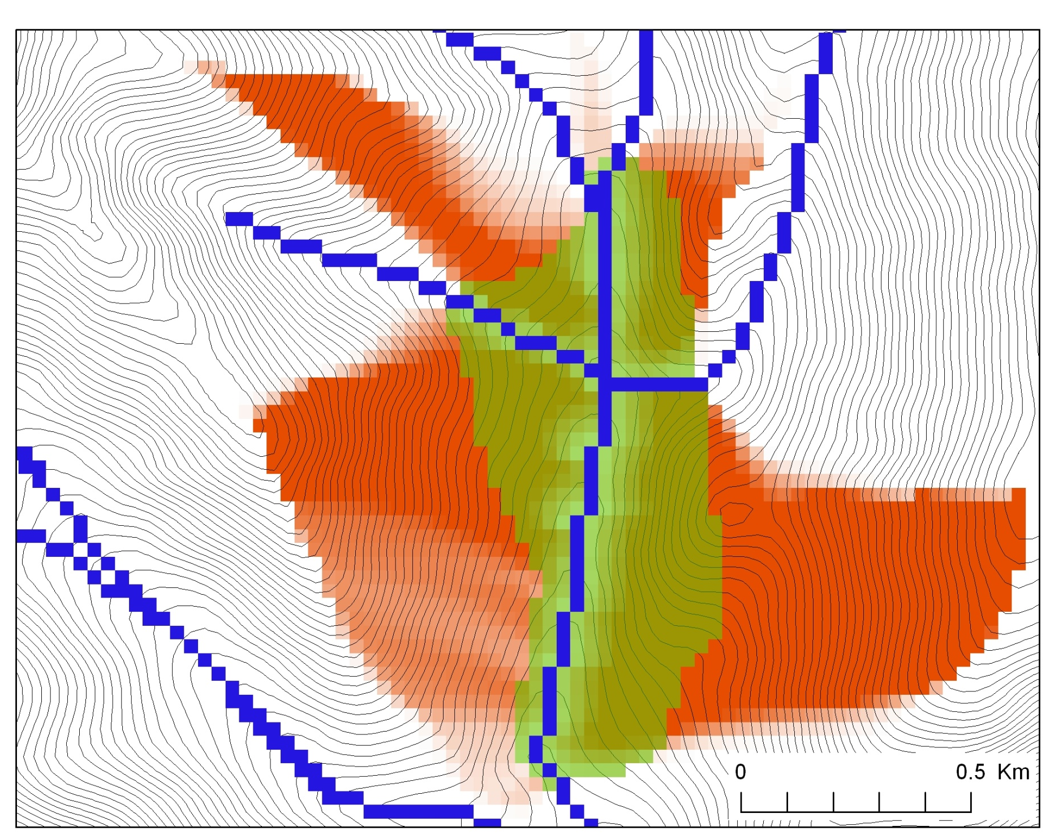
Buffer potential weighted distance to stream

Slide 21
Distance Down and Distance Up
Ridge
Ridge
sr
sr
pr
pr
vr
Point of interest
vr
Point of interest
Stream
Stream
ps
ps
vs
ss
vs
ss
hr
hs
hr
hs
Types of distance measurements possible in distance down and distance up functions.

Slide 22
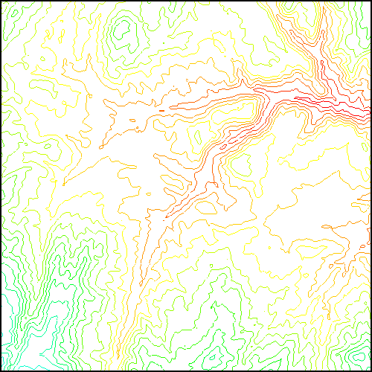
TauDEM Parallel Approach
MPI, distributed memory paradigm
Row oriented slices
Each process includes one buffer row on either side
Each process does not change buffer row

Slide 23
Parallelization of Flow Algebra
1. Dependency grid
2. Flow algebra function
Executed by every process with grid flow field P, grid dependencies D initialized to 0 and an empty queue Q. FindDependencies(P,Q,D) for all i for all k neighbors of i if P_{ki}>0 D(i)=D(i)+1 if D(i)=0 add i to Q next
Executed by every process with D and Q initialized from FindDependencies. FlowAlgebra(P,Q,D,θ,γ) while Q isn’t empty get i from Q θ_{i} = FA(γ_{i}, P_{ki}, θ_{k}, γ_{k}) for each downslope neighbor n of i if P_{in}>0 D(n)=D(n)-1 if D(n)=0 add n to Q next n end while swap process buffers and repeat

Slide 24
Parallelization of Contributing Area/Flow Algebra
1. Dependency grid
and so on until completion
resulting in new D=0 cells on queue
Queue’s empty so exchange border info.
Decrease cross partition dependency
Executed by every process with grid flow field P, grid dependencies D initialized to 0 and an empty queue Q. FindDependencies(P,Q,D) for all i for all k neighbors of i if P_{ki}>0 D(i)=D(i)+1 if D(i)=0 add i to Q next
A=1
A=1
A=1
A=1
A=1
A=1
A=1
A=1
D=0
A=1
A=1
A=1
A=1
D=0
D=0
A=1
A=1
A=1
D=0
D=0
A=1
D=0
A=1
A=1
A=1
A=1
A=1
A=1.5
A=1.5
A=3
D=0
A=1.5
A=1.5
D=1
D=0
D=1
D=0
D=0
A=3
D=0
D=3
D=2
D=1
D=0
D=0
D=1
D=1
A=1.5
D=1
A=1.5
A=3
A=3
A=1.5
A=1.5
2. Flow algebra function
B=-2
B=-1
Executed by every process with D and Q initialized from FindDependencies. FlowAlgebra(P,Q,D,θ,γ) while Q isn’t empty get i from Q θ_{i} = FA(γ_{i}, P_{ki}, θ_{k}, γ_{k}) for each downslope neighbor n of i if P_{in}>0 D(n)=D(n)-1 if D(n)=0 add n to Q next n end while swap process buffers and repeat
B=-2
B=-1
A=1
A=1
D=2
D=2
D=1
A=1
D=1
A=1
D=0
A=1
A=1
D=2
D=2
D=2
D=2
D=2
D=1
D=1
D=1
D=1
A=1
D=1
A=1
A=5.5
D=0
A=2.5
D=0
A=1
A=1
D=1
D=1
D=1
A=1
D=1
A=1
D=0
D=0
A=1
D=1
D=1
D=3
D=2
D=1
D=1
D=1
D=1
D=1
A=1
D=1
A=1
D=1
A=6
A=3.5
D=1

Slide 25
Programming
C++ Command Line Executables that use MPI
ArcGIS Python Script Tools
Python validation code to provide file name defaults
Shared as ArcGIS Toolbox

Slide 26
Q based block of code to evaluate any “flow algebra expression”
while(!que.empty())
{
//Takes next node with no contributing neighbors
temp = que.front(); que.pop();
i = temp.x; j = temp.y;
// FLOW ALGEBRA EXPRESSION EVALUATION
if(flowData->isInPartition(i,j)){
float areares=0.; // initialize the result
for(k=1; k<=8; k++) { // For each neighbor
in = i+d1[k]; jn = j+d2[k]; flowData->getData(in,jn, angle);
p = prop(angle, (k+4)%8);
if(p>0.){
if(areadinf->isNodata(in,jn))con=true;
else{
areares=areares+p*areadinf->getData(in,jn,tempFloat);
}
}
}
}
// Local inputs
areares=areares+dx;
if(con && contcheck==1)
areadinf->setToNodata(i,j);
else
areadinf->setData(i,j,areares);
// END FLOW ALGEBRA EXPRESSION EVALUATION
}
C++

Slide 27
Maintaining to do Q and partition sharing
C++
while(!finished) { //Loop within partition
while(!que.empty())
{ .... // FLOW ALGEBRA EXPRESSION EVALUATION
}
// Decrement neighbor dependence of downslope cell
flowData->getData(i, j, angle);
for(k=1; k<=8; k++) {
p = prop(angle, k);
if(p>0.0) {
in = i+d1[k]; jn = j+d2[k];
//Decrement the number of contributing neighbors in neighbor
neighbor->addToData(in,jn,(short)-1);
//Check if neighbor needs to be added to que
if(flowData->isInPartition(in,jn) && neighbor->getData(in, jn, tempShort) == 0 ){
temp.x=in; temp.y=jn;
que.push(temp);
}
}
}
}
//Pass information across partitions
areadinf->share();
neighbor->addBorders();

Slide 28
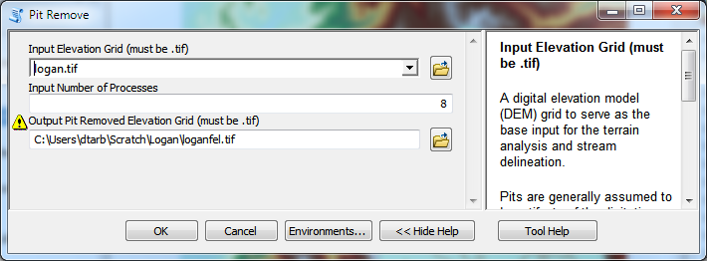
Python Script to Call Command Line
mpiexec –n 8 pitremove –z Logan.tif –fel Loganfel.tif

Slide 29
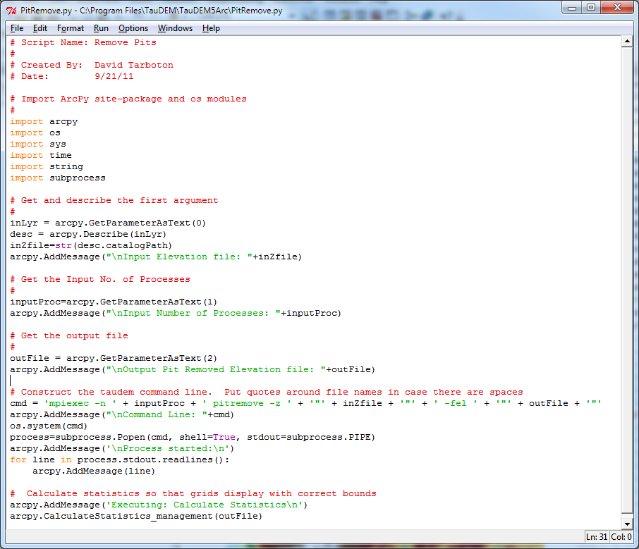
PitRemove
Python

Slide 30
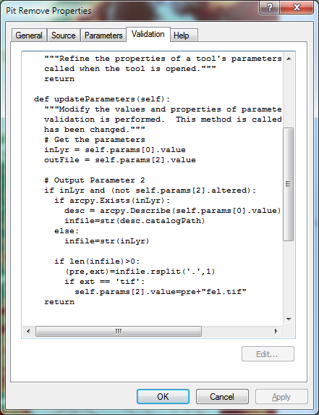
Validation code to add default file names
Python

Slide 31
Summary
GIS and Water Resources analysis capabilities are readily extensible with programming
to do something new
to repeat something needed frequently
Model builder provides visual programming and helps learn ArcGIS python commands
Python – cross platform, powerful and easy to use is a good programming language to start with (when your time is valuable)
Compiled language programming for developers (C++) to achieve optimal efficiency (when the computers time is valuable)

