Slide 1
River Reach Codes
Used for river address locations
ReachCode =
12030102000151
ReachCode = 12030102000005
HUC#
Segment#
Location 0.392
on Reach
12030102000005

Slide 2

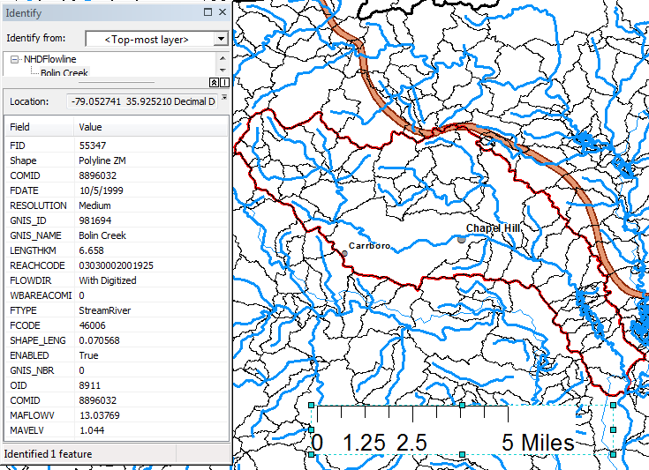
Slope
Elevation
Mean annual flow
  Corresponding velocity
Drainage area
% of upstream drainage area in different land uses
Stream order
http://www.horizon-systems.com/nhdplus/

Slide 3
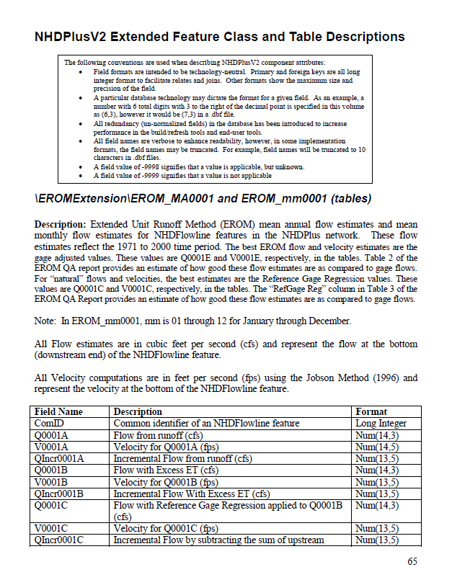
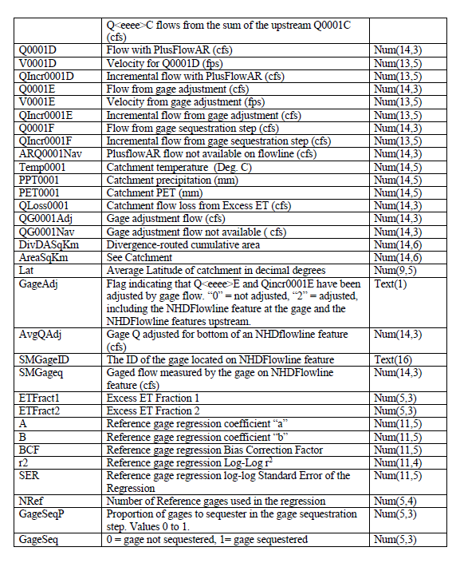
NHDPlus User Guide
ftp://ec2-54-227-241-43.compute-1.amazonaws.com/NHDplus/NHDPlusV21/Documentation/NHDPlusV2_User_Guide.pdf
http://www.caee.utexas.edu/prof/maidment/giswr2015/Docs/NHDPlusV2_User_Guide.pdf
Extended Unit Runoff Method, p.65-66

