Slide 1
GIS In Water Resources
Information on Term Projects
Due this week: A one page statement that describes the goals of your project and the GIS datasets that you anticipate using.
The purposes of the term project are:
To enable you to explore in-depth some aspect of the subject of personal interest to you and to develop experience in the use of GIS technology to solve that problem.
To provide experience in the formulation, execution and presentation of original research, including the proper documentation of a GIS project.
To make an oral presentation and produce a report in PDF on the world wide web that will be informative to you and to your classmates.
Schedule
Sept 24. 1 page proposal. In HydroShare (Utah), Canvas (Texas)
Oct 27. 2 page progress report.
Nov 10-Dec 3. Student presentations
Dec 4. Term project.

Slide 2
Today
Homework assigned – due Sept 29 (1 week)
Exercise assigned – Due Oct 1 (9 days)
Homework 1 guidance (Utah State Plane System Spatial Reference)
Complete presentation on slope
Work high points of Exercise 3

Slide 3
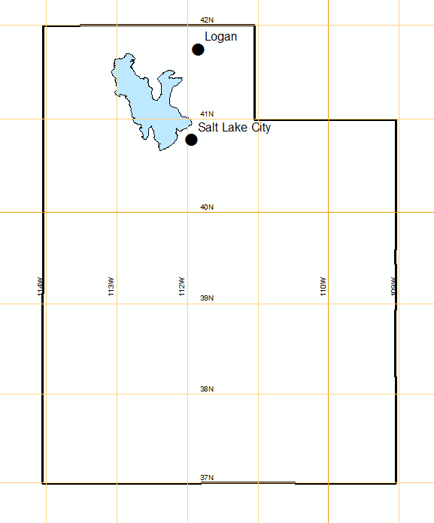
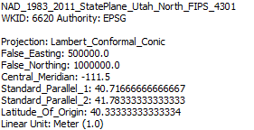
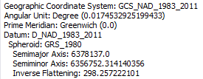
Utah State Plane System (North)
Central Meridian
Std Parallel 2
Origin
$$\left(φ_{0},λ_{0}\right)=\left(40.33° N, −111.5 W\right)$$
$$\left(x_{0},y_{0}\right)=\left(500000, 1000000\right)$$
Std Parallel 1
Latitude of Origin

Slide 4
Utah State Plane System (North)
Central Meridian
-111.5
$$\left(φ_{0},λ_{0}\right)=\left(41.754, −111.846\right)$$
$$∆y=\left(41.754−40.333\right)∗\frac{π}{180}∗6371 \\ =158.008 km$$
$$∆y$$
Latitude of Origin 40.333
$$∆x=\left(−111.846−(−111.5)\right)∗\frac{π}{180}$$
$∗6371∗\cos\left(41.754\right)$
$$=−28.702 km$$
$$∆x$$
Projected coordinates (approx.)
$$\left(x,y\right)=(500000−28702,$$
$1000000+158008)$
$=\left(471298, 1158008\right) meters$
Origin
$$\left(φ_{0},λ_{0}\right)=\left(40.33° N, −111.5 W\right)$$
$$\left(x_{0},y_{0}\right)=\left(500000, 1000000\right)$$

Slide 5
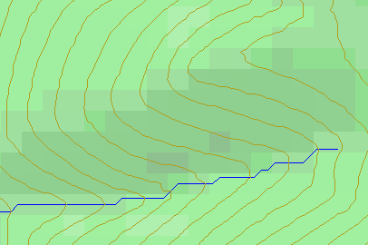
Topographic Slope
Defined or represented by one of the following
Surface derivative ∇z (dz/dx, dz/dy)
Vector with x and y components (S_{x}, S_{y})
Vector with magnitude (slope) and direction (aspect) (S, α)
See http://www.neng.usu.edu/cee/faculty/dtarb/giswr/2015/Slope.pdf

Slide 6
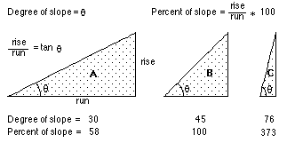
Slope and Aspect
$$y$$
$$Δx$$
$α$ = aspect clockwise from North
$$Δy$$
$$α$$
$$x$$

Slide 7
ArcGIS “Slope” tool
y
a
b
c
$$\frac{\frac{\frac{a−c}{2∆}+\frac{d−f}{2∆}}{2}+\frac{\frac{d−f}{2∆}+\frac{g−i}{2∆}}{2}}{2}$$
$$\frac{dz}{dx}=\frac{\left(a+2d+g\right)−\left(c+2f+i\right)}{8∆}$$
Similarly
$$\frac{dz}{dy}=\frac{\left(g+2h+i\right)−\left(a+2b+c\right)}{8∆}$$
Slope magnitude =
$$\sqrt{{\left(\frac{dz}{dx}\right)}^{2}+{\left(\frac{dz}{dy}\right)}^{2}}$$
d
e
f
g
h
i
x
$$\frac{a−c}{2∆}$$
$$\frac{d−f}{2∆}$$
c
$$\frac{g−i}{2∆}$$
$$∆$$
b
f
a
e
i
d
h
g
$$2∆$$
x
y

Slide 8
ArcGIS Aspect – the steepest downslope direction
$$Δy=$$
$$Δx=$$
$$Δx$$
Use atan2 to resolve ambiguity in atan direction
$$Δy$$
$$α$$
$$−Δx$$
$$−Δy$$
$$α+{180}^{o}$$

Slide 9
Example
30
a
b
c
80
74
63
d
e
f
145.2º
69
67
56
g
h
i
60
52
48

Slide 10
Hydrologic (D8) Slope (Flow Direction Tool)
- Direction of Steepest Descent
30
30
80
74
63
80
74
63
69
67
56
69
67
56
60
52
48
60
52
48
Slope:

Slide 11
Eight Direction (D8) Pour Point Model
32
64
128
16
1
8
4
2
ESRI Direction encoding

Slide 12
Limitation due to 8 grid directions.
?

Slide 13
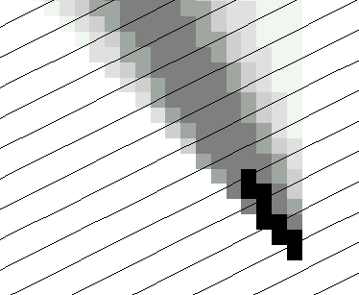
The D∞ Algorithm
Tarboton, D. G., (1997), "A New Method for the Determination of Flow Directions and Contributing Areas in Grid Digital Elevation Models," Water Resources Research, 33(2): 309-319.) (http://www.engineering.usu.edu/cee/faculty/dtarb/dinf.pdf)

Slide 14
The D∞ Algorithm
z₀
Elevations at each vertex z_{i}
z₂
z₁
Δ
If α₁ does not fit within the triangle the angle is chosen along the steepest edge or diagonal resulting in a slope and direction equivalent to D8

Slide 15
D∞ Example
30
80
74
63
69
e_{o}
67
56
60
e₇
e₈
52
48
284.9º
14.9º

Slide 16
Summary Concepts
Grid (raster) data structures represent surfaces as an array of grid cells
Raster calculation involves algebraic like operations on grids
Interpolation and Generalization is an inherent part of the raster data representation
Watershed average precipitation may be computed by interpolation from point gages

Slide 17
Summary Concepts (2)
The elevation surface represented by a grid digital elevation model is used to derive slope important for surface flow
The eight direction pour point model approximates the surface flow using eight discrete grid directions.
The D∞ vector surface flow model approximates the surface flow as a flow vector from each grid cell apportioned between down slope grid cells.

