Slide 1
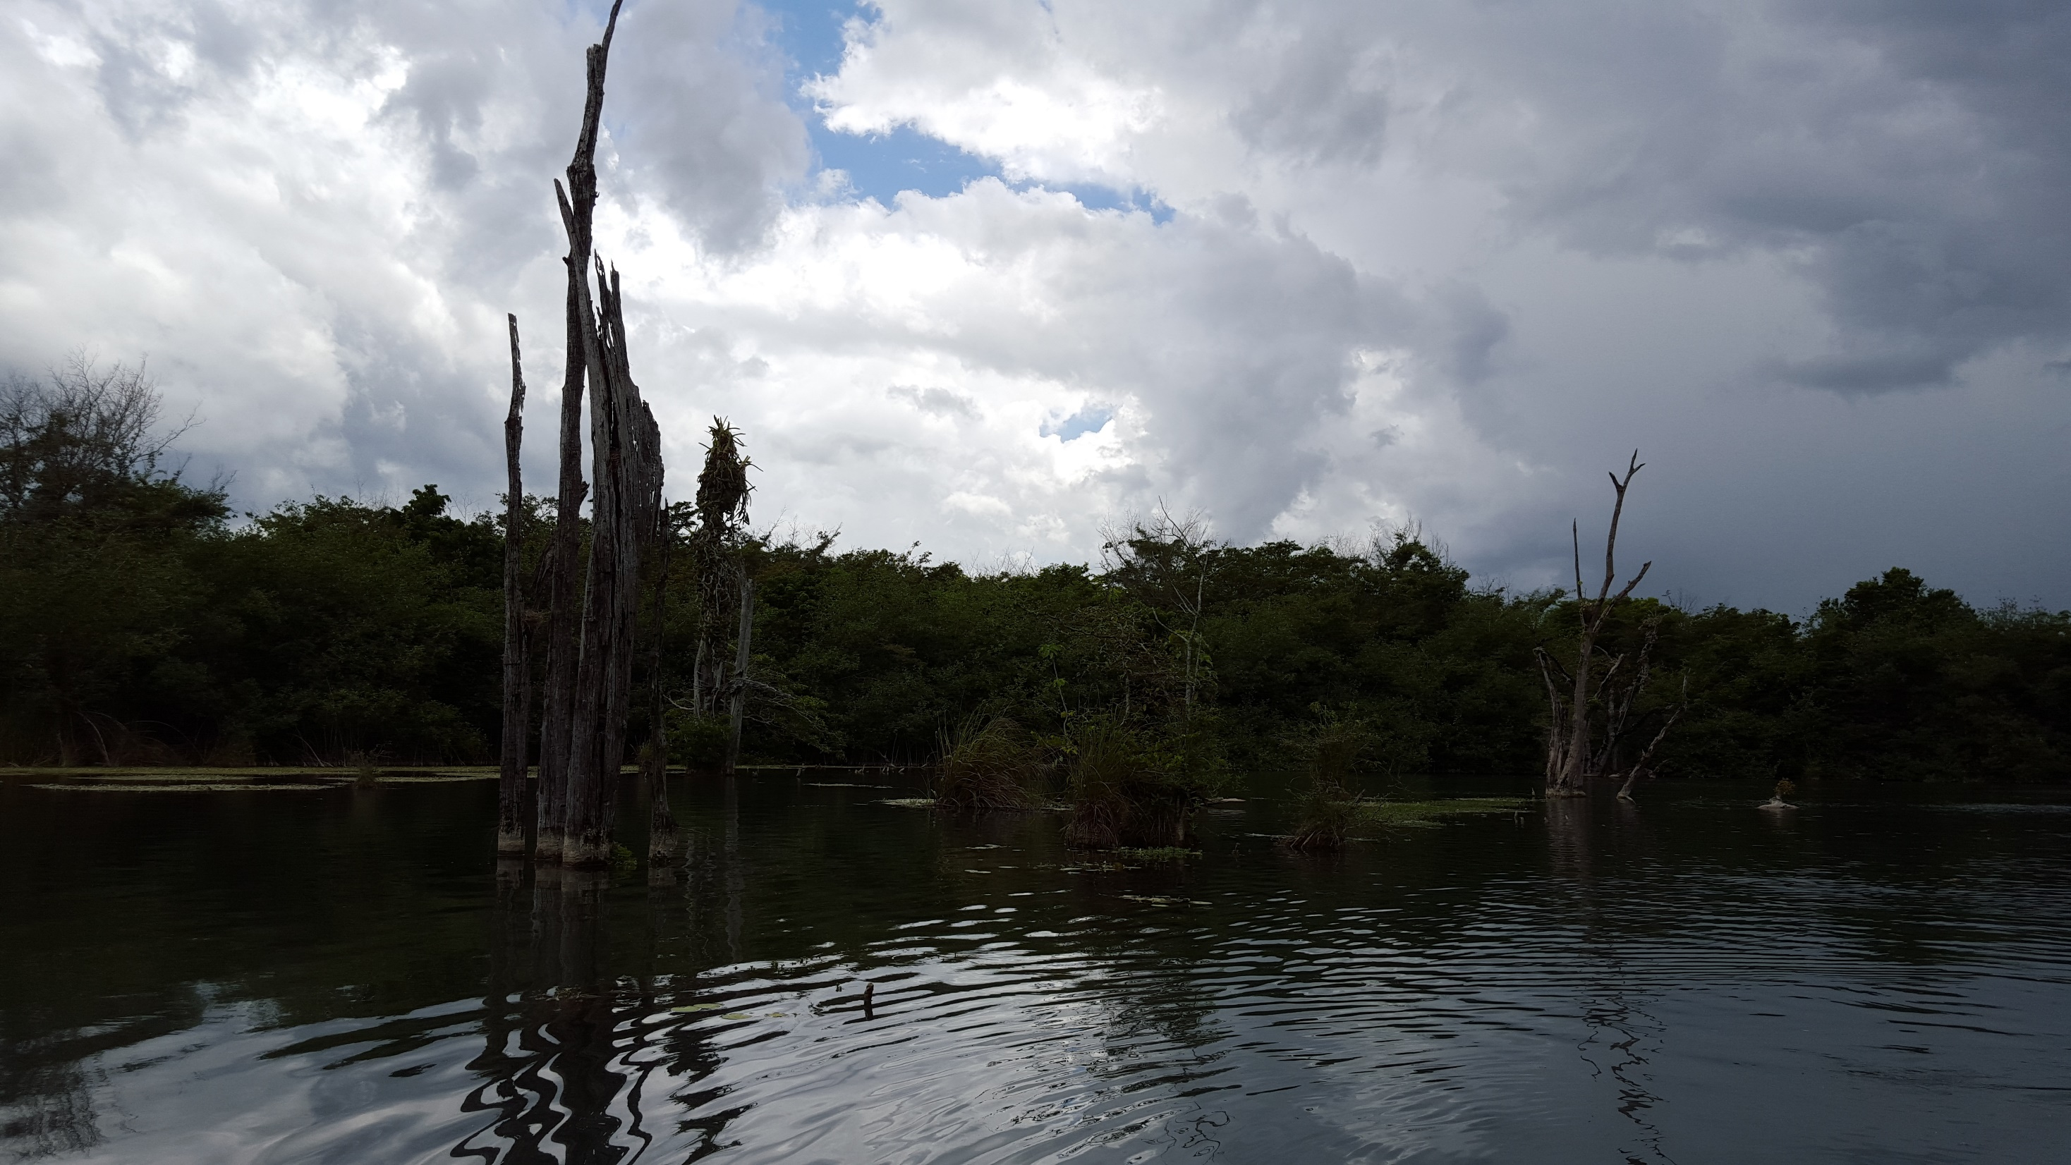
The Watershed of the
Rio Bravo, Belize
Sara Eshleman
1 December 2016

Slide 2
Background: Belize
Population = 368,000
(2015 Statistical Institute of Belize, estimate)
Land Area = 22,800 km² (8,800 mi²)
16 people/ km²
~ 61% forest cover in 2012
(Cherrington et al. 2012)
Notes:
Belize is a small nation in Central America. With an average of 16 people per square kilometer which is about half the density of the United States. Also, it is still fairly forested, with 61% forest cover, but declining somewhat quickly. Which is part of my reason for working there. It is a rare situation where we have the opportunity to study and preserve crucial environments before they are destroyed. It’s also in an ideal location to increase environmental connectivity through central America, with “wild” borders between Mexico and Guatemala still in place – meaning the borderlands are largely still forested and could be crucial aspects of the broader “Maya Forest” a proposed connection of forests throughout central america

Slide 3
Study Location: Northwestern Belize
Notes:
I work at the cusp of the three countries, in northwestern Belize. I am particularly interested in the ecosystem functioning of this region. Partially for the conservation goals I just mentioned. Belize is largely forested, but this part of the country has been recently subject to industrialized farming, so I find it particularly important to research before the forest destruction extends. You can see there is a protected area, the Rio Bravo Conservation Management Area, but north of that area is intensive farming. I pursued a study of the Rio Bravo – which runs through the Rio Bravo Conservation Management Area. This is the current map of the Rio Bravo that almost any source will show you – it was created by land surveys and then updated by remote imaging recently, I believe. Yet, this is an incredibly dense environment, that few people or images can penetrate the forest, and this feature is often thought to be incorrect. And I know this because whenever I and others have had a chance to take a gps point on the river it does not match the feature.

Slide 4
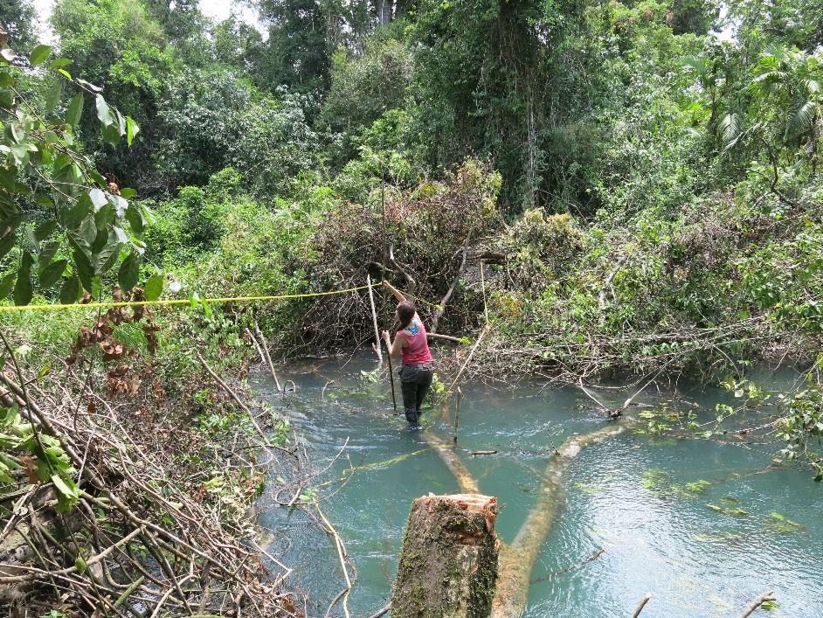
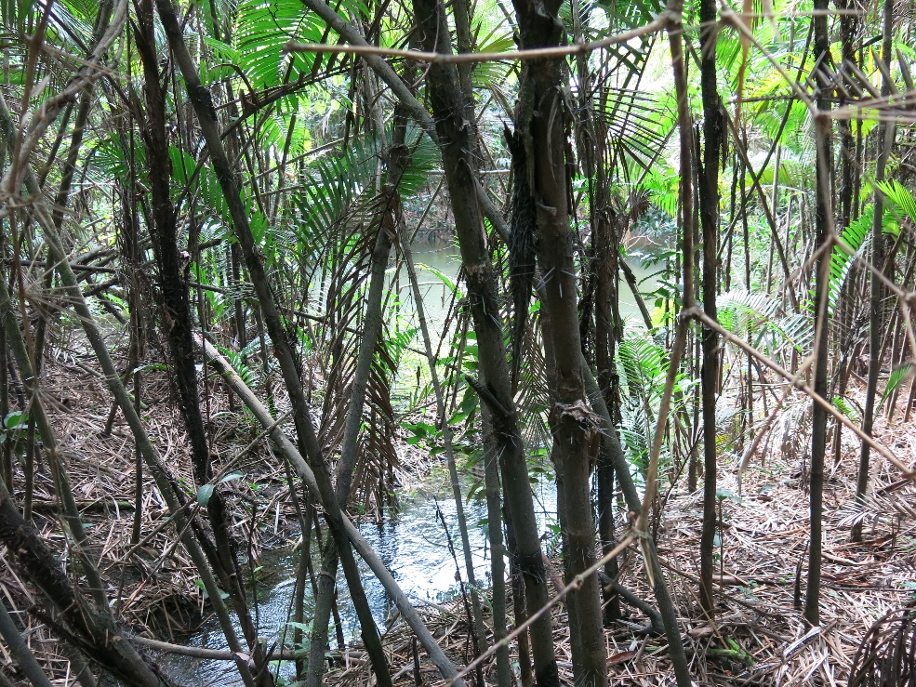
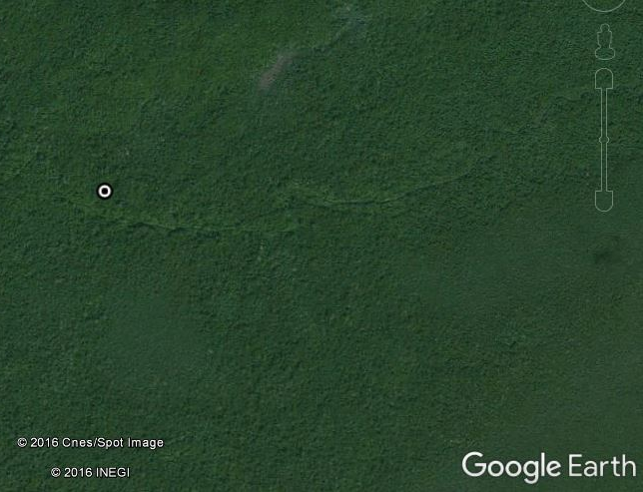
Study Location: Rio Bravo
Notes:
To show the density of the forest, this is me taking water measurements on the river – this spot took us multiple hours to get to through dense jungle and you can see the vegetation near me – that is the “typical” vegetation of this river – dense and gnarly. It is clear that a land survey would be difficult of this river, and most remote imaging surveys are not much better because of the dense canopy. We did recently fly LiDAR over most of the river, but we just received the full dataset yesterday, so it has yet to be analyzed for river characteristics. Regardless, this river does not have an accurate vector because of the difficulty of surveying it.

Slide 5
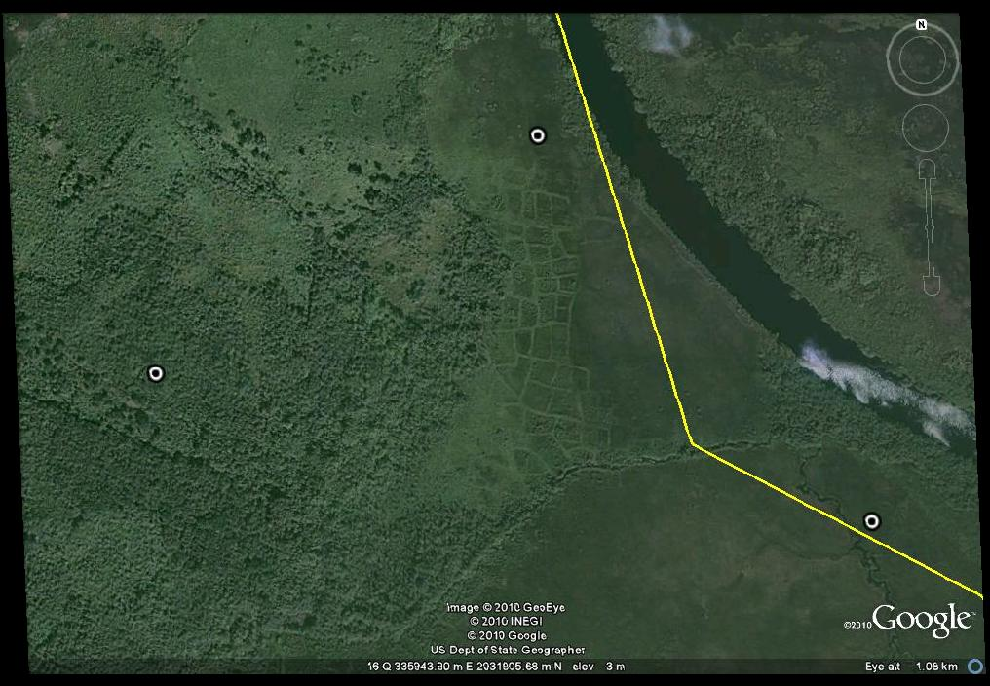
Rio Bravo History
Notes:
In fact, it is assumed that no one has traversed the Rio Bravo since ancient Maya times. There are ancient Maya settlements and features scattered throughout the region, as you can see from the map on the left. The Rio Bravo in particular has evidence of ancient agriculture along its extent. The second image is an example of the wetland agricultural fields, where canals were ditched in a rectilinear pattern. Clearly, the Rio Bravo is an interesting and understudied river.

Slide 6
Purpose of Study
More accurate map
Help inform future ecological and archaeological studies
Assess downstream impacts
Notes:
Thus, my purposes for this study are multifold. Foremost is to create a more accurate map of this river, because of the issues with maps in the past. This will help inform future ecological and archaeological studies, which I find pressing as this area undergoes increased industrialized farming. And then to assist with the assessment of flow patterns in this region. The Rio Bravo floods, but it doesn’t generally affect people because there aren’t people living along it, and the wetlands absorb any flood impact. Yet, this river does flow into the Rio Hondo which has a few populations living along it, and it does flood and affect these people every few years. So I hoped to determine the extent of the Rio Bravo’s watershed to help determine which weather patterns will result in this flooding. It’s generally understood that rain in northern Guatemala causes flooding in Belize, but the actual delineation of these patterns has not occurred.

Slide 7
(Changing) Methods
LiDAR
SRTM
HydroSHED
Notes:
I initially hoped to approach these questions with LiDAR imagery which was flown this summer, but unfortunately did not arrive in total until yesterday. This is a small piece that we received this past summer, but you can see the Maya site of Xnoha. I then attempted to use SRTM imagery, which I’ll discuss in a moment. And ended up delineating the watershed with the help of HydroSHED data.

Slide 8
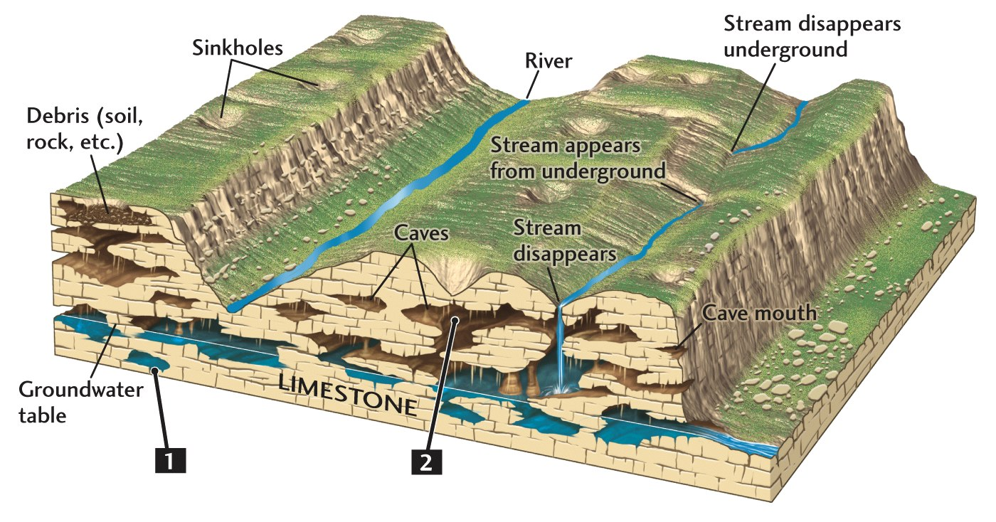
Geology
Notes:
Before I describe the issues that arose in my processing, I need to describe the geology of this region. The Rio Bravo occurs between a series of escarpments and the coastal plain. Much of the bedrock is limestone, and it is thus a karstic environment. I’m not sure how much you all know about karst but when you have an underlying bedrock that dissolves easily, you get an interesting geomorphology. And this varies greatly between karstic environments, but generally there will be caves and sinkholes, and disappearing streams. We have a bunch of streams that appear out of nowhere along the Rio Bravo. And also a good deal of sinkholes, some which fill with water and are called cenotes.

Slide 9
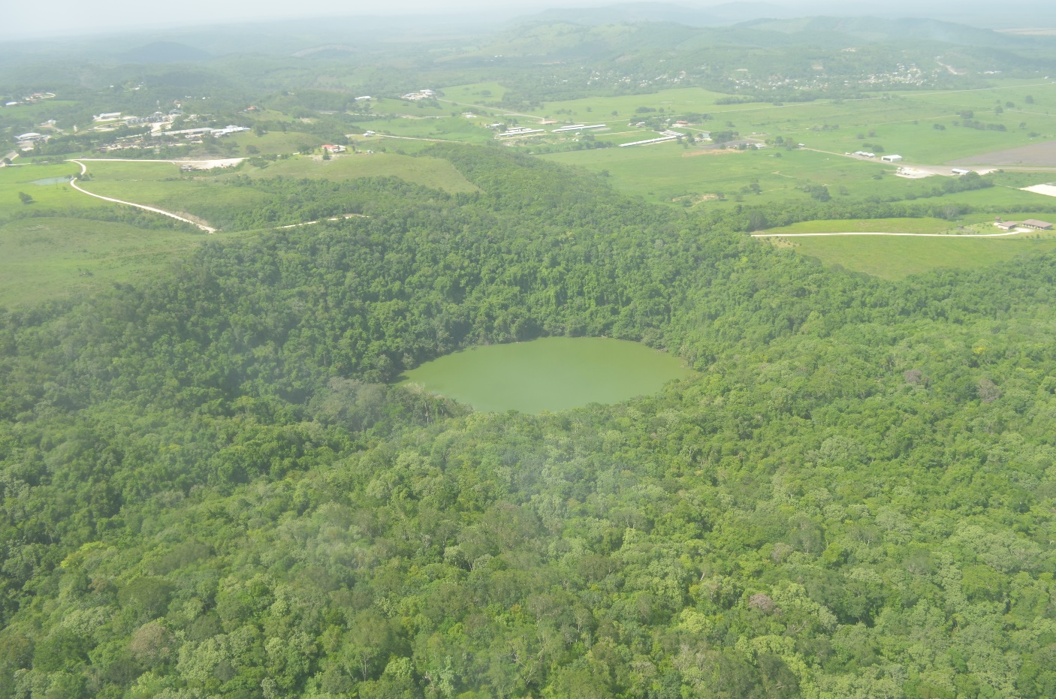
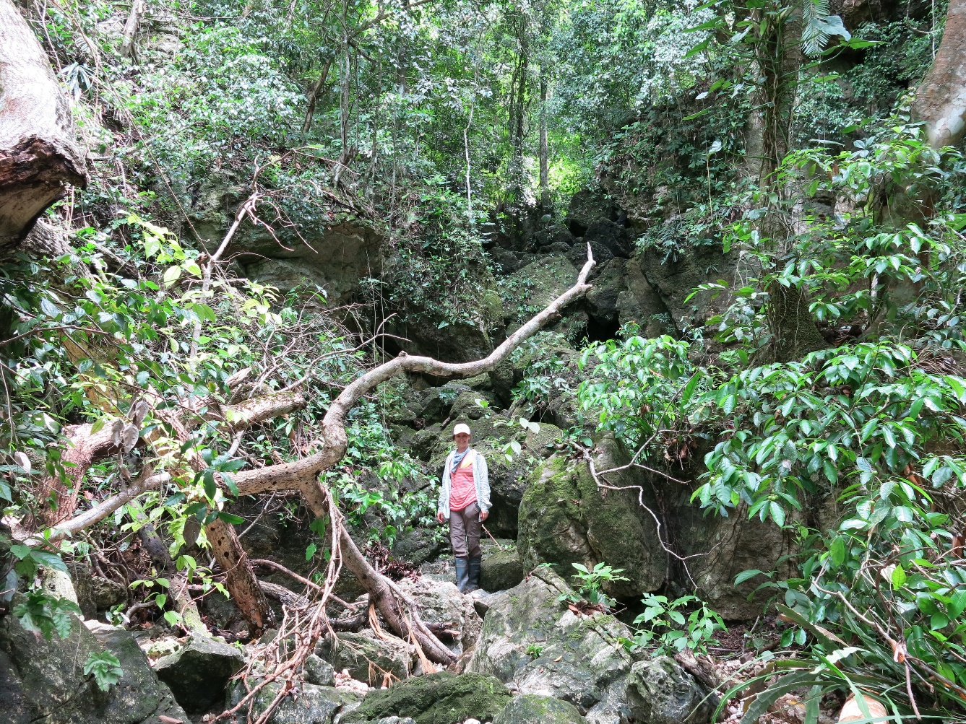
Notes:
Here’s one example of a cenote, so one of those filled sinkholes. This is Crocodile Lake. And the second image is me in the ravine that connects with crocodile lake. You see all these large boulders because there is some sort of underground water source that dissolved a lower layer of rock and then the upper layers of rock collapsed. Clearly normal fluvial hydrology tools will look different in a region such as this one.

Slide 10
Karst Hydrology Issues
Notes:
To talk about my attempts at using SRTM imagery briefly. As I said, this is a karst environment, so there’s frequent sinkholes. Thus, when you fill the pits in an SRTM image and subtract the new version from the SRTM you get this result, which is not ideal. I tried to group some of these and extract them from the dataset in order to run the tools, but was not especially successful. So I decided to run the tools through HydroSHED, which as you may remember, essentially conditions the data for you. After digging into their literature, I found that they deal with natural sinks in a combination of automatic and manual ways, which are not explicitly detailed. HydroSHED is derived from SRTM so I subtracted the HydroSHED dataset from one of the SRTM images and came up with the second result, so I could get an idea of what I was working with. They also burn in streams, clearly, which I forsaw as being an issue because of the problems with every vector feature of the river I have seen, but worth a shot nonetheless.

Slide 11
Rio Bravo and its Catchments
Notes:
Eventually yielding a map of the Rio Bravo and its catchments. This map is interesting for a few reasons. The Rio Bravo’s watershed goes farther into Guatemala than anticipated. And this image does not completely match with the existing lines depicting the river.

Slide 12
Notes:
Here’s a comparison of the most widely used shapefile for the river– it is the one that originated from the land survey. You can see that, at places the rivers match well, but the derived river continues farther into Guatemala than the previous version, and has a different path towards the mouth, notably. This was particularly interesting to me because that is where I have points to verify accuracy, and clearly the previously feature fits those points better than the HydroSHED derived river. I realized that HydroSHED was using an older vector that has the junction of the Rio Bravo and Rio Hondo wrong – I’ve seen this before, some basemaps for Belize uses this representation, and has the Rio Hondo, and thus the border of Belize and Mexico in the wrong place.

Slide 13
Notes:
Sure enough – this raises an issue with burned in streams. The first image is the one I showed earlier, but the second shows the overlay of these river features. You can see that the burned in lines do not follow the correct path. This is really interesting, but I don’t think it completely negates the rest of the watershed derived from HydroSHED, it just shows the flaws inherent in this system.

Slide 14
Rio Bravo and its Catchments
Notes:
Thus, this isn’t a perfect map or system, but it gives a more detailed view of the Rio Bravo than previously accessible. Which may sound like I’m compromising in some way, but given how difficult assessing river patterns is in this area, any advancement is noteworthy.

Slide 15
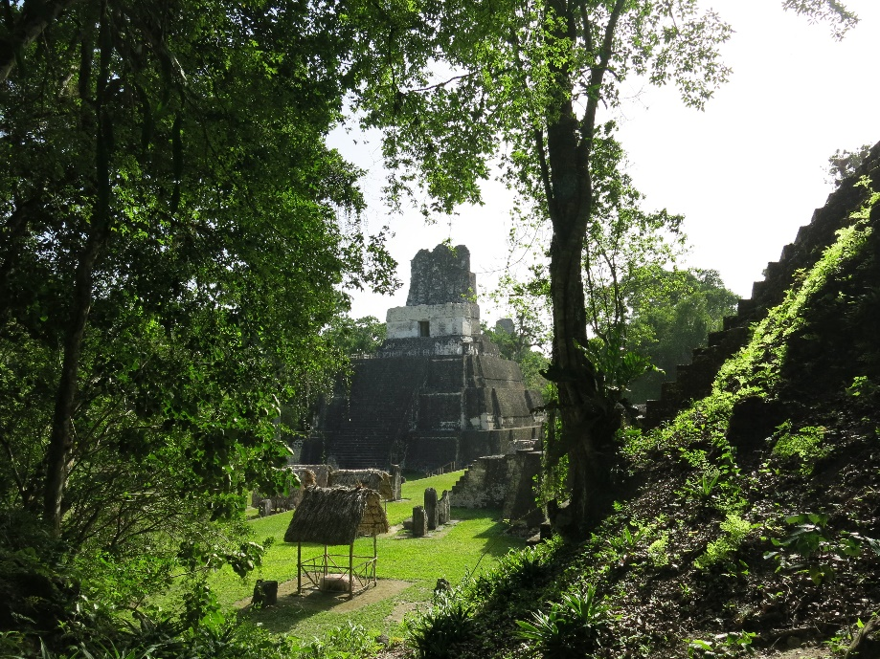
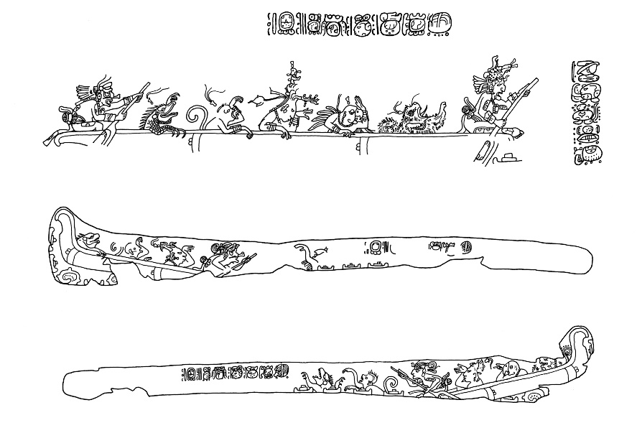
Possible ancient Maya trade route
Schele and Miller 1986
Notes:
Particularly interesting is the distance its watershed extends into Guatemala. I have never heard of an account of these two areas being linked, and I’ve done a lot of research on trade routes. This has pretty astounding implications. Tikal is in its watershed. Which is a very major site. Also a site that has depictions of dugout canoes – as seen in this bottom image, this is actually a bone carving found in a burial – but no one is fully sure why, since it is so far inland. This is still in its beginning stages of my conception, but is certainly interesting. I’ve intensely studied the Rio Hondo, which is the river it connects to, and the Rio Hondo is almost certainly a trade route. The Rio Bravo has always been a more difficult puzzle because it has a much stronger current, which would make it not ideal for trade, but I’m not discounting some sort of mechanism to be able to trade along this river. The Maya did not have the wheel or pack animals, and yet were moving a large amount of goods, so how this trade is fully occurring to some of these inland sites is still a little baffling. And I just digressed…

Slide 16
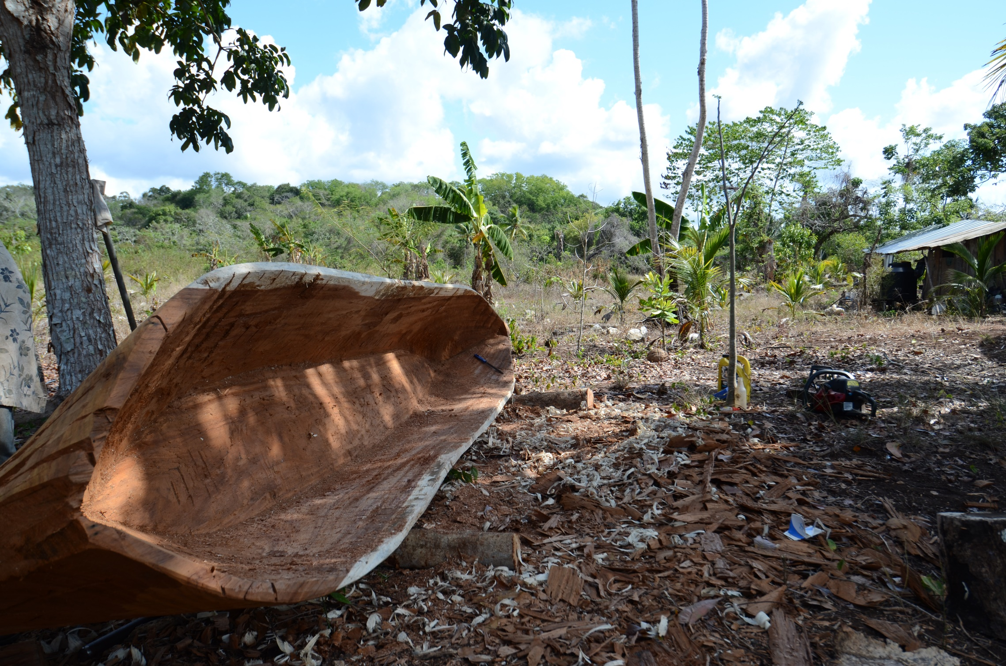
Future Work
Incorporate LiDAR
Groundtruth River Course
Notes:
Future work, beyond this project, clearly, is to incorporate the LiDAR to make a better, more representative map of this region and this river system. And then also groundtruth the river’s course to try and determine it’s actual location. I also happen to be the owner of a dugout canoe because of my work on the Rio Hondo, so there’s the potential to recreate the trade route, although it would be different and much more difficult today.

Slide 17
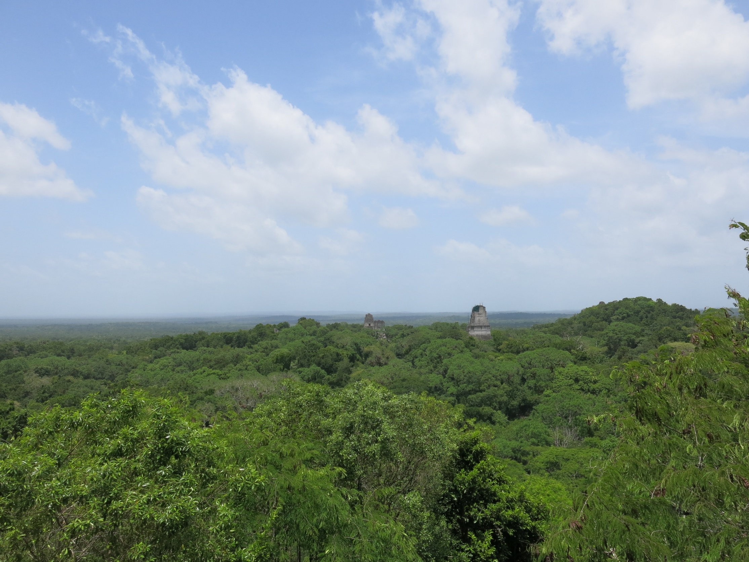
Questions?

Slide 19
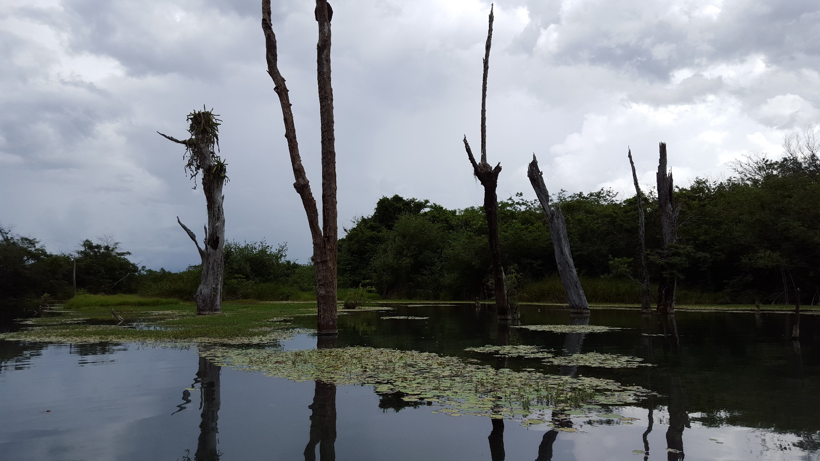
Notes:
Before I show my results I want to briefly mention the issues in running some of the tools in a less-researched environment than the United States. Here is an image of what was returned when I tried to run the watershed tool from arcgis server on a point which I took on the river. The watershed crosses another river, the Rio Hondo, which I know very well, to say the least. The blue line along that river is my gps track from this summer as I was boating along it, so clearly this watershed is not correct.

Slide 20
Notes:
Thus I had to work from a broader region and then narrow the catchments down to just the Rio Bravo ones once they were created. This is the region I worked with and the drainage lines and catchments that were derived.

Slide 21
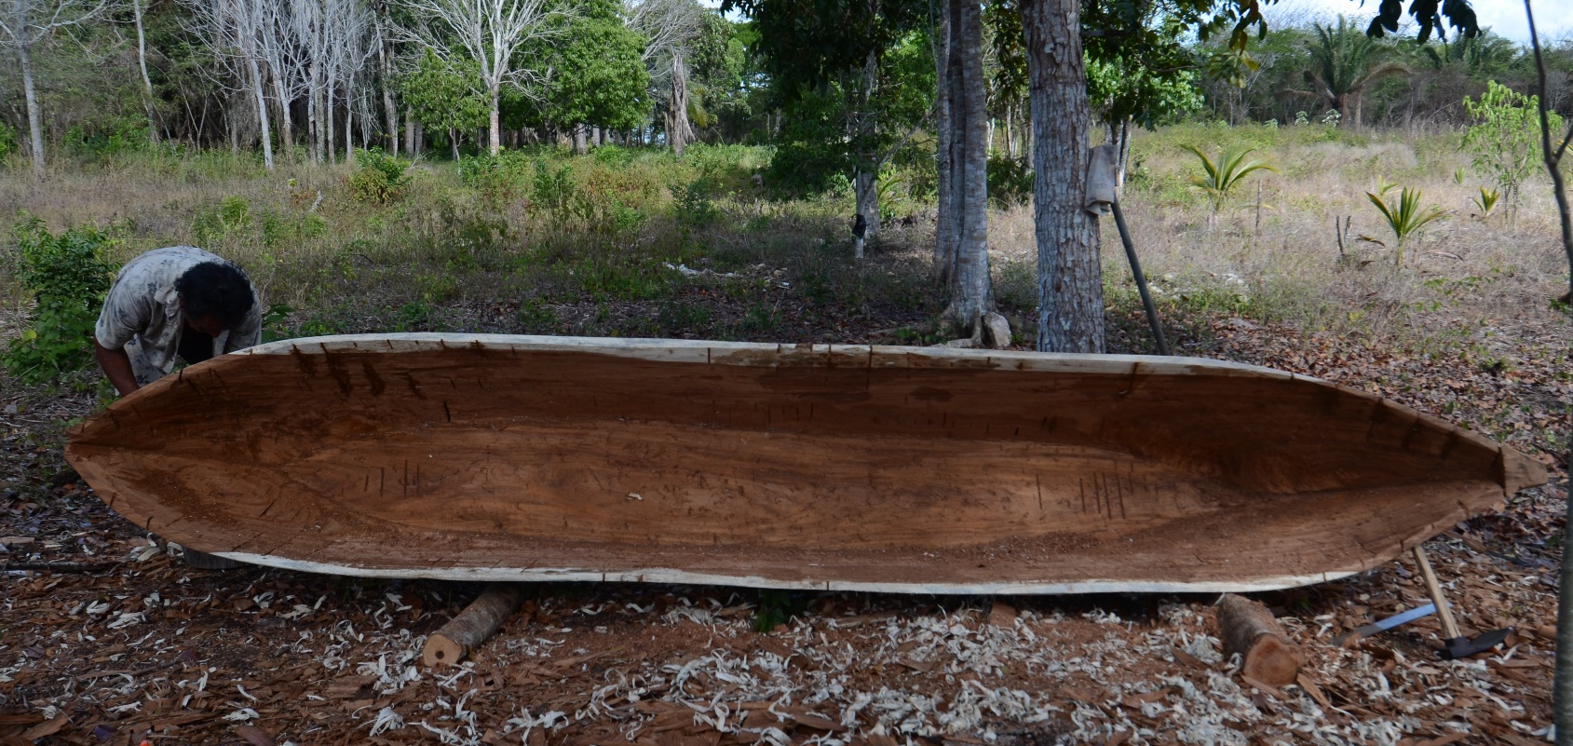
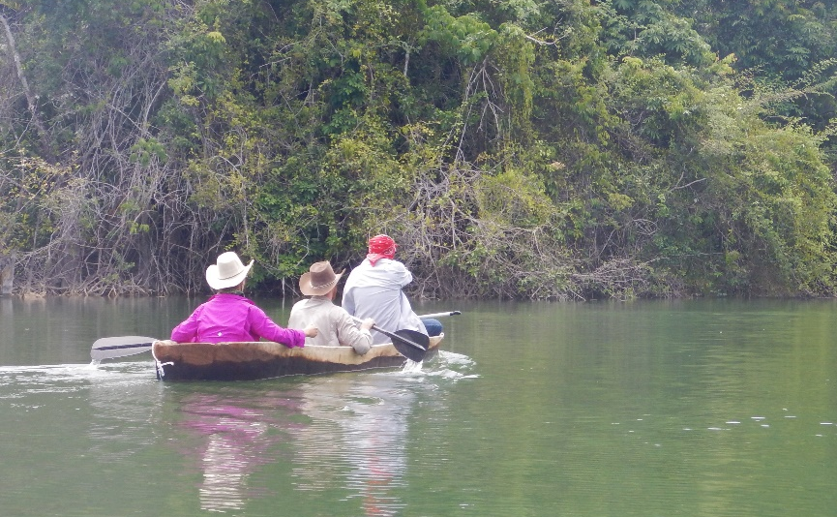
Modern Dugout Canoe Use
Notes:
Dugout canoes are present in the Maya world today. One can find them in use in Chiapas, and certain places in Guatemala and El Salvador. The method to make them is thus still around, but a bit of a fading artform as new technologies and infrastructure comes to all of these areas. The creation of canoes in this way seems to be present for at least a millennium, the evidence for which is multifold.

Slide 22
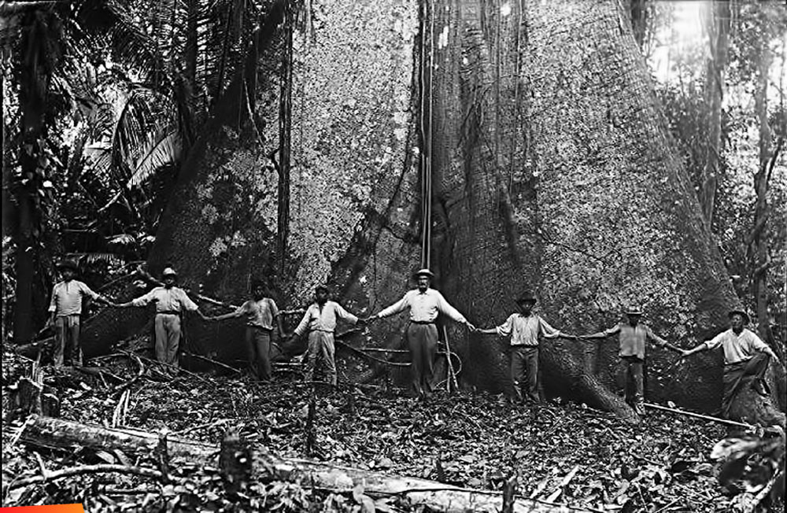
Columbus and a Maya canoe
“There arrived a canoe full of Indians, as long as a galley and eight feet wide. It was loaded with merchandise from the west, almost certainly from the land of Yucatan, for that was near there [the Bay Islands], a matter of thirty leagues or a little more… Inside … were their women and children, possessions, and merchandise... There were in the canoe up to twenty-five men"
Notes:
First, we have historical evidence, with a record of Columbus and his crew engaging with a canoe near the Bay Islands in 1502 during Columbus’ 4th voyage. This quote was from Ferdinand Columbus. This canoe was clearly very large at eight feet wide and holding an estimated 40 people – 25 men rowing and then women and children. It also had a large number of goods, including textiles, copper axes, swords with flint knives embedded in them, which was probably obsidian, grains, and cacao beans.
There are a few additional historical accounts like this one showing maritime trade in canoes by the Maya occurred at least in the 16th century, but we need to go earlier to prove that previous Maya had this same trade.

Slide 23

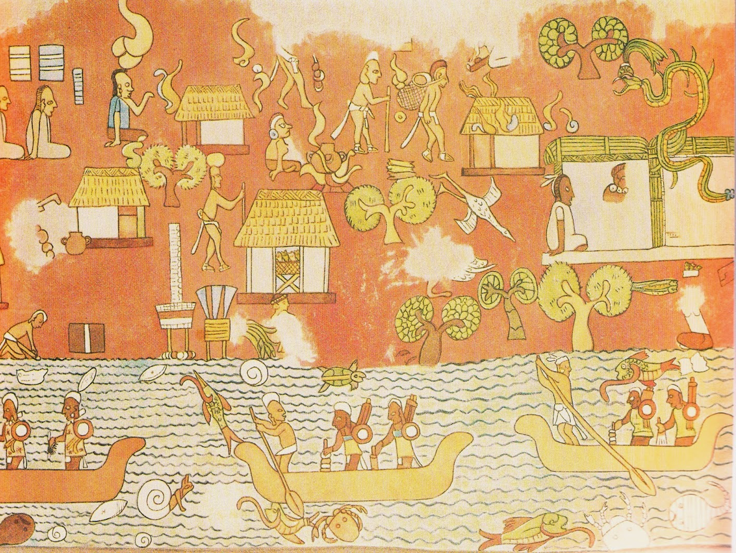
Canoe Iconography
Schele and Miller 1986
Carnegie Institute of Washington; Leshikar 1988
Notes:
This is where archaeological evidence comes in.
There is iconography of canoe travel and trade at multiple sites. Including this one at Tikal, which is a bone carving found in a Late Classic Burial. And this depiction at Chichen Itza, created around 1000 CE.

Slide 24
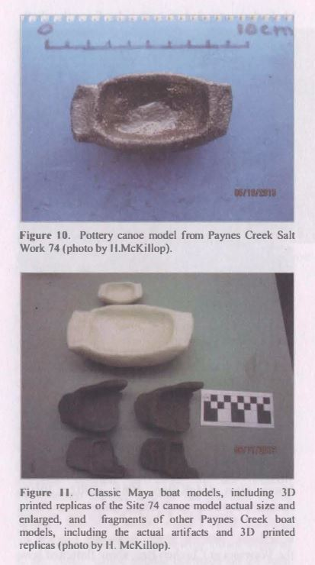
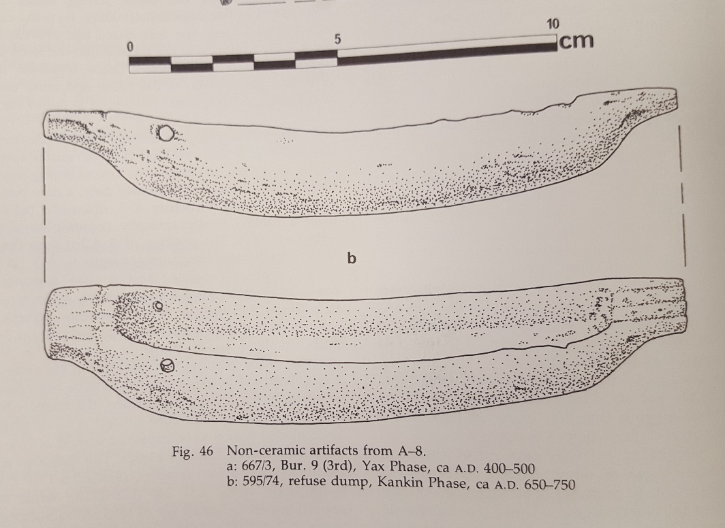
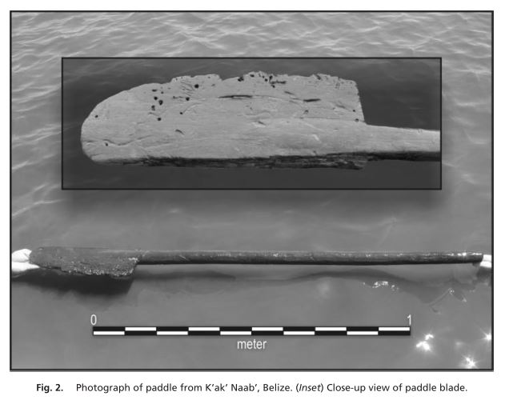
Models, Paddle, and Canoe
Pendergast 1979
McKillop 2005
McKillop et al. 2014
Notes:
There are also models and the direct evidence of ancient Maya canoes. The first is a carved bone, which is likely a manatee found at Altun Ha, and the rest was found by Dr. Heather McKillop and her team in the Paynes Creek Salt Works area of Belize. The K’ak’ Naab’ paddle is a Late Classic artifact and the canoe’s radiocarbon dates were in the Early Classic, giving evidence that canoe travel certainly occurred and trade was probable for the Classic Maya. Combined with evidence from this same site and others of large scale production of goods for trade during this time.

Slide 25
Extensive and Intensive Agriculture
Samantha Krause
Notes:
Our research group at UT Austin along with the Maya Research Program and other collaborators have been investigating these fields for many years now, and we’ve come to know a lot about them. We know that these rectilinear patterns were made by the ancient Maya at times varying from the Preclassic to the Postclassic, and that they were likely productive agricultural systems. They are in a much broader region than initially anticipated. There are similar fields in Campeche and elsewhere in the Maya world, but focusing on just the Rio Hondo, plane surveys indicated these patches of wetland fields in the map above, but Google earth and investigation on the ground have shown us that these fields extend farther north along the river, and that fields are present under tree cover, which can’t be seen from plane or most remote imaging surveys. This will further be debunked by LiDAR imagery which was flown in early July and will likely show even more about the extent and presence of these fields. Even with the data we currently have, this agricultural system would have required a large workforce and produced large quantities of products, which indicate a good to be traded along this river.

Slide 26
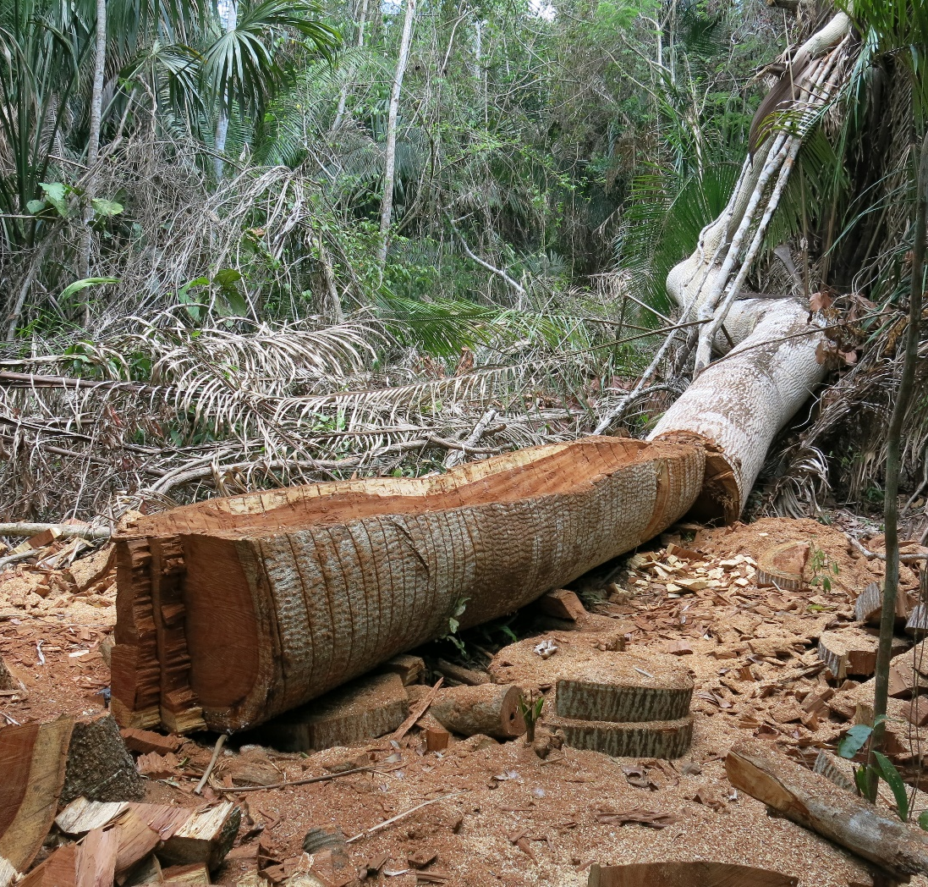
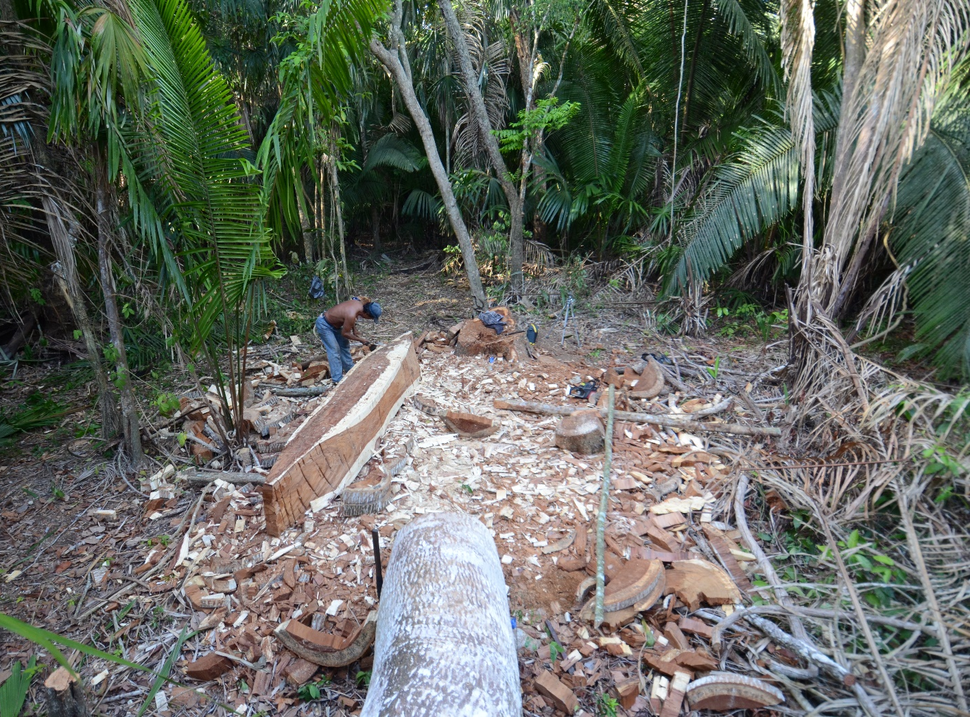
Creation of a modern Dugout Canoe
Notes:
We had a lot of difficulty finding someone to make a dugout canoe in northern Belize, it is not an area where dugout canoes are frequently made or even seen. Fortunately, one of my colleagues, Justin Telepak, heard word that one of his neighbors near Indian Church was currently making a canoe for his own use. Sure enough, this was the state of the canoe when I first saw it, and after a conversation with Domingo Aguilar it seemed highly likely that he would let me rent or buy it. It turned out he let me buy it, and also graciously allowed me to record his process.
Here you can see the Guanacaste tree he’s making the canoe out of. It’s a slow process of chipping away excess wood to carve the log into a usable boat. This was aided by a few modern tools such as a chainsaw and metal adzes, but still a time-intensive and precise process. I am going to spare you the details of this process now, but I’ll happily answer any questions about it after the presentation.

Slide 27
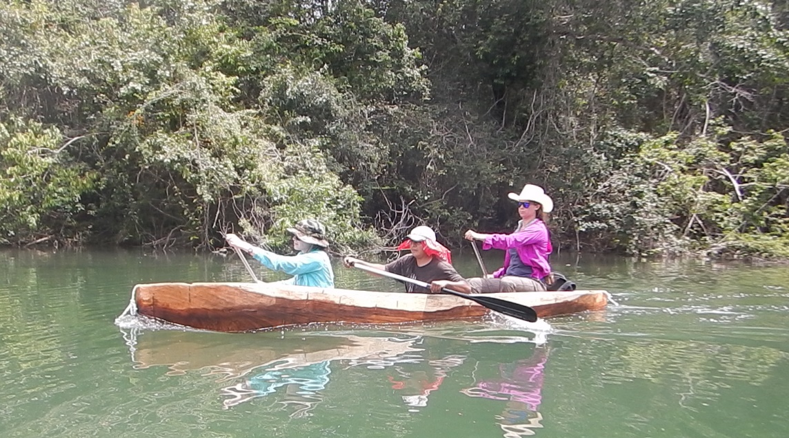
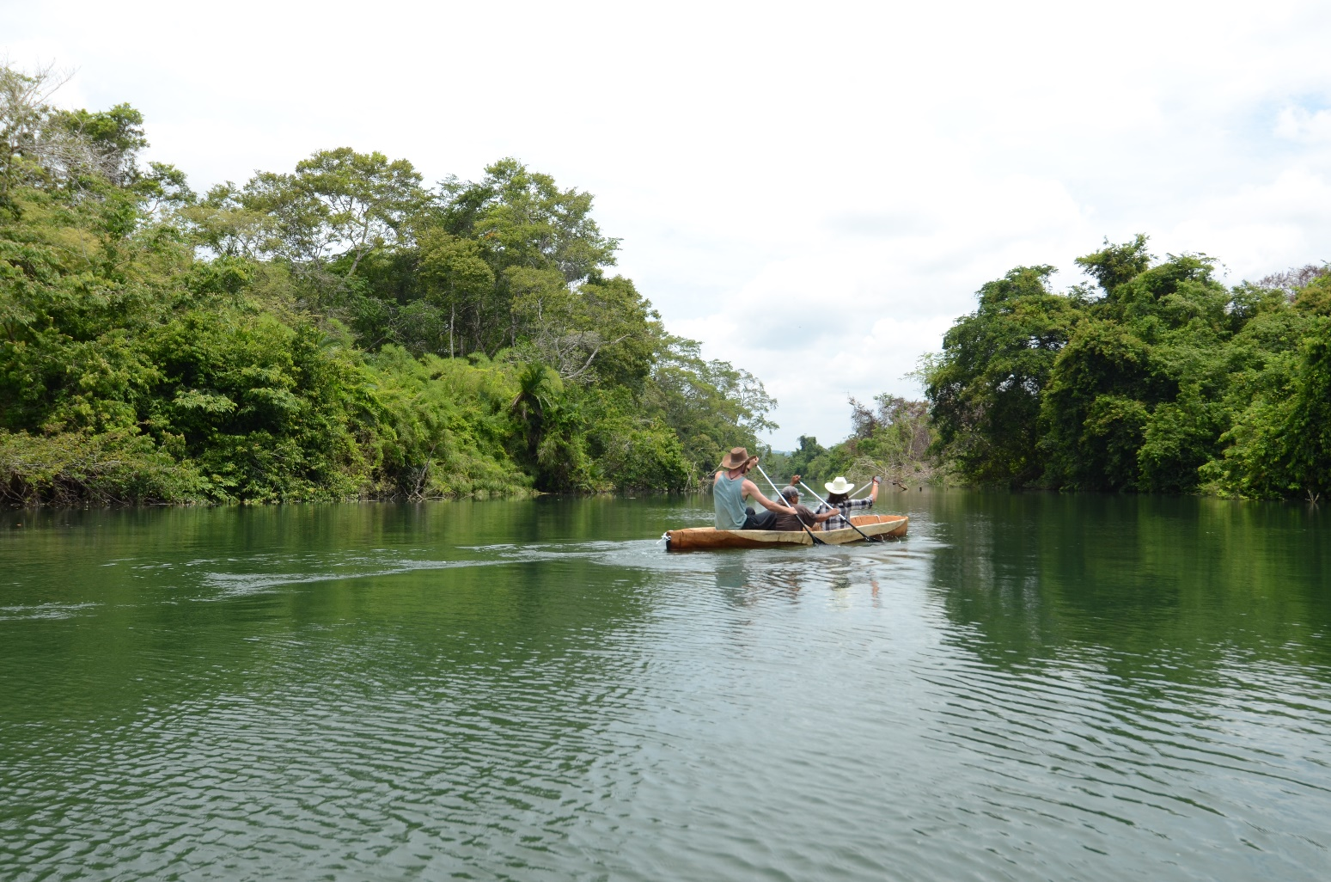
Trip along the Rio Hondo
Notes:
Me and a team of 4 others embarked on a trip down the Rio Hondo with the canoe Don Aguilar made on June 8th
We quickly found that the Rio Hondo is an incredibly navigable river, it is wide, slow-moving, and without many junctions
The only obstacles were trees near our starting point, but those had already been opened up by local fishermen, as I imagine they would have been in ancient Maya times
The Rio Hondo is fairly unique in that it has such a slow current that sometimes the wind makes it seem like it is moving backwards, but this also means it would be incredibly easy to travel in both directions – making it a great river for man-powered boats and trade

Slide 28
Trip along the Rio Hondo
Notes:
We were able to navigate about 100 kilometers of this river in 4 days, travelling at about 4 kilometers per hour.
There are a few distinctions to make with these numbers- The team, while physically fit, is untrained and travelling this river for the first time, and in a boat that was just created and not fully finish and dry. So we were in a “green” boat, it will get lighter and faster with time.

Slide 29
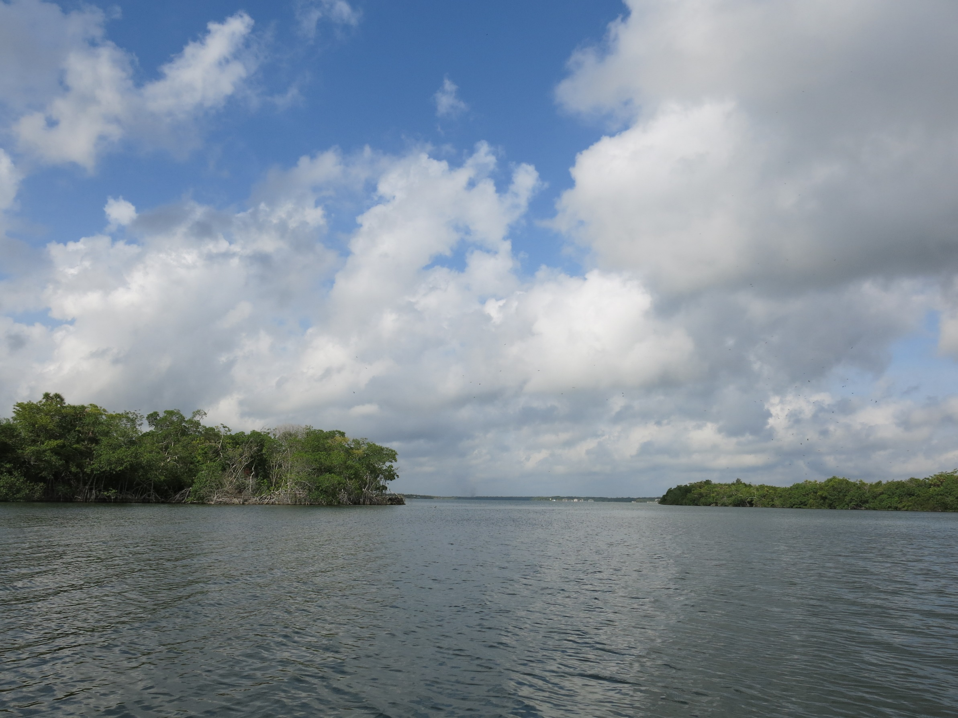
Feasibility for ancient Maya canoe trade on the Rio Hondo
Notes:
Thus, I believe that the ancient Maya could traverse this river considerably faster – after conversing with my team, we think almost twice as fast, and thus the entire length of the river in 3 days. They would know this land and where they can camp, but also be physically prepared to trade along this river regularly, and have boats that would be fully finished and even created especially for this river - the right weight, length, and shape, which we can not possibly know. This speed of travelling the river along with the relative ease of canoeing over other methods, and the presence of sites and goods along the Rio Hondo’s extent, all make the Rio Hondo a probable trade route in ancient times

