Slide 1
Land Mass Change Along the Bangladesh Coastline
Manar Hasan
GIS in Water Resources, University of Texas at Austin
December 1, 2016

Slide 2
Background
The National Geographic Society finds that Bangladesh is in an area that is most vulnerable to the impacts of climate change.
The reasons for this are complex.
Low-lying coastal region.
Surrounded by boundary rivers.
Deadly floods are a common yearly occurrence.
How much is the land
mass actually changing?

Slide 3
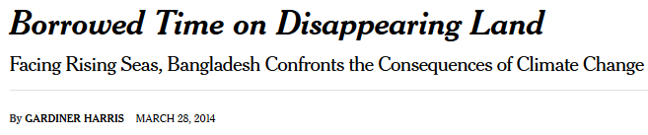
Background
The National Geographic Society finds that Bangladesh is in an area that is most vulnerable to the impacts of climate change.
The reasons for this are complex.
Low-lying coastal region.
Surrounded by boundary rivers.
Deadly floods are a common yearly occurrence.
How much is the land
mass actually changing?

Slide 4
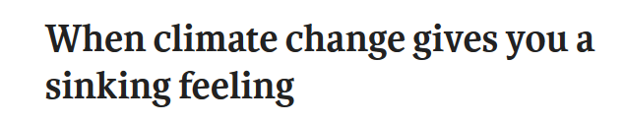
Background
The National Geographic Society finds that Bangladesh is in an area that is most vulnerable to the impacts of climate change.
The reasons for this are complex.
Low-lying coastal region.
Surrounded by boundary rivers.
Deadly floods are a common yearly occurrence.
How much is the land
mass actually changing?

Slide 5
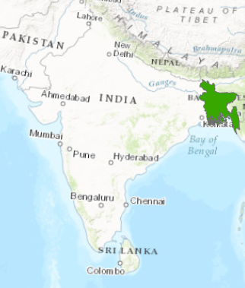
Methodology
Erosion-Accretion data obtained from the Center for Environmental and Geographic Information Services
1973 to 2015
Data tabulated and ArcGIS used to calculated net rates
ArcGIS map shape subtractions/additions to show overall land mass change

Slide 6
For 1973 to 1984
Accretion - Erosion
Net Accretion/Time
For all districts over time

Slide 7
Between 1973 and 1984
Between 2006 and 2015

Slide 8
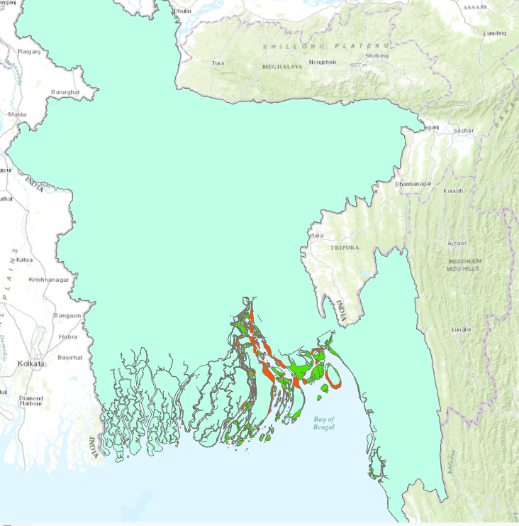

Slide 12
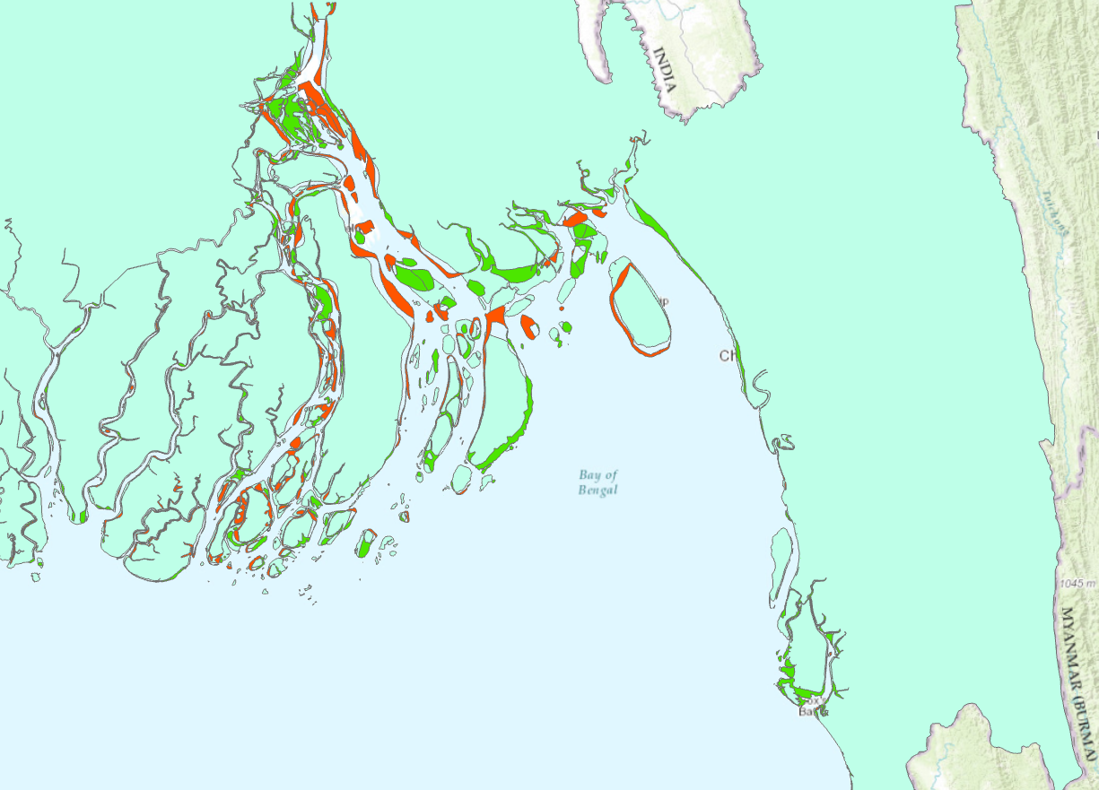
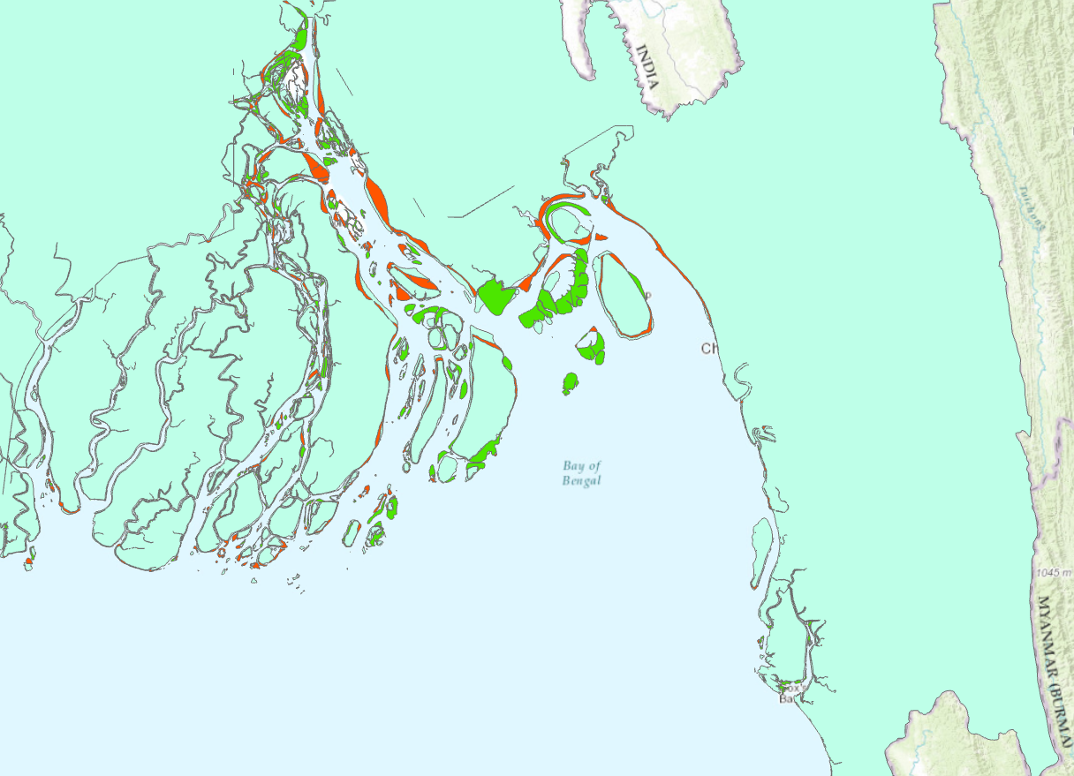
Between 1973 and 1984
Between 2006 and 2015

Slide 13
Preliminary Findings
Land increasing overall
Accretion towards Eastern side of the coast.
Erosion mostly on Western coast.

Slide 14
Further Investigation
Instead of just looking at where mass increased or decreased, postulate why it happened?
Compare data available with major weather events in the area (floods, hurricanes, Himalayan ice melts) to see if patterns exist.
Look at population/land cover in net erosion areas to determine negative impacts on food/population security.

Slide 15
Questions and/or Ideas?

